Slide 1
Lecture 19
Constraint based verification meets synthesis
Armando Solar-Lezama

Slide 2
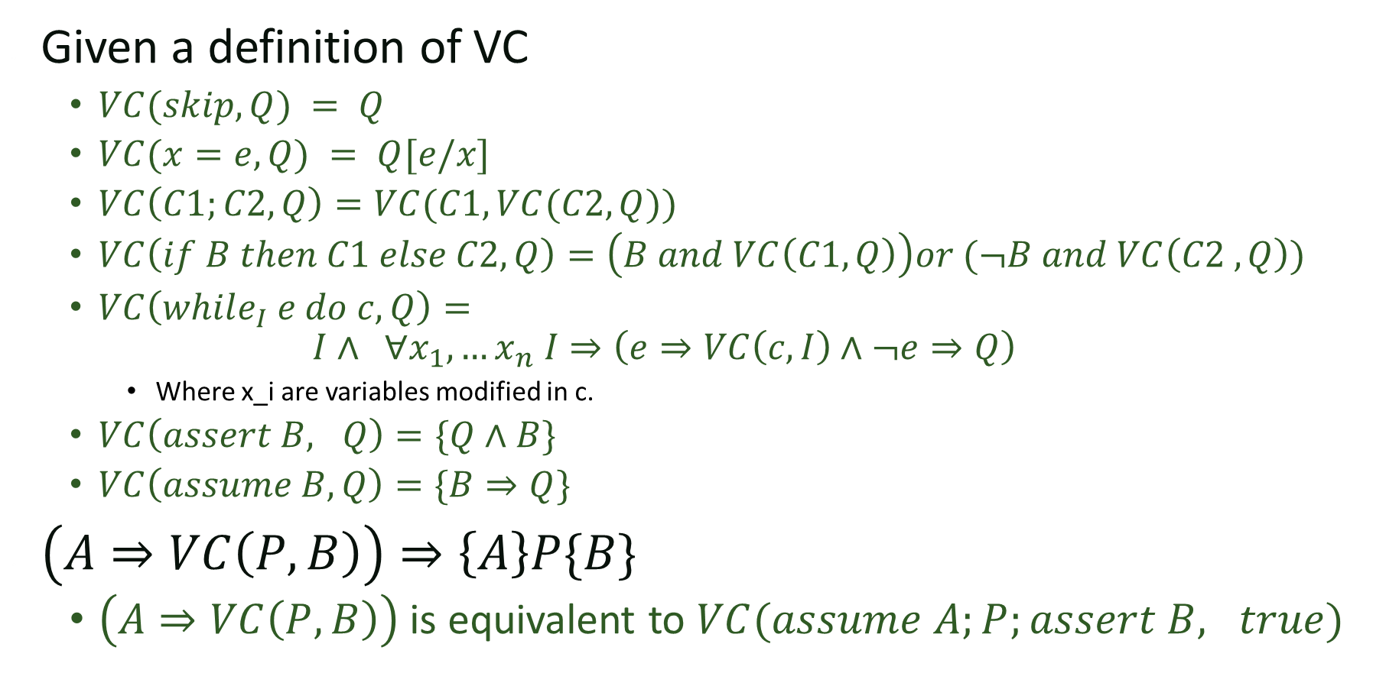
Recap
Given a definition of VC
  $VC(skip, Q) = Q$
  $VC(x=e,Q) = Q[e/x]$
  $VC\left(C1;C2, Q\right)=VC(C1,VC(C2, Q))$
  $VC\left(if B then C1 else C2, Q\right)=\left(B and VC\left(C1, Q\right)\right)or (¬B and VC\left(C2 ,Q\right))$
  $VC\left(while_{I} e do c, Q\right)=$
  $$I∧ ∀x_{1}, …x_{n} I⇒\left(e⇒VC\left(c,I\right)∧¬e⇒Q\right)$$
    Where x_i are variables modified in c.
  $VC\left(assert B, Q\right)=\{Q∧B\}$
  $VC\left(assume B, Q\right)=\{B⇒Q\}$
$\left(A⇒VC\left(P, B\right)\right)⇒\left\{A\right\}P\{B\}$
  $\left(A⇒VC\left(P, B\right)\right)$ is equivalent to $VC(assume A;P;assert B, true)$

Slide 3

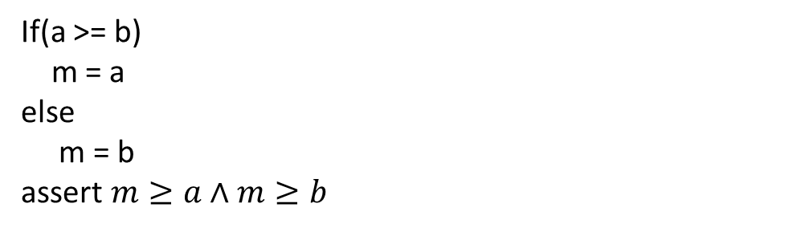
VC Generation
If(a >= b)
m = a
else
m = b
assert $m≥a∧m≥b$

Slide 4
VC Generation
If(a >= b)
m = a
else
m = b
x = 2*m – a;
x = x – b;
assert x > 0

Slide 5
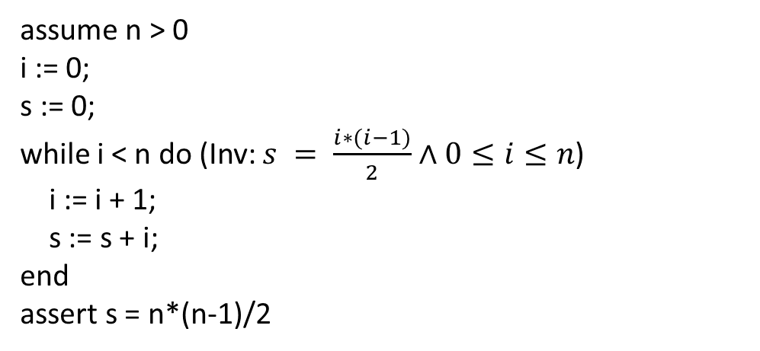
VC Generation
assume n > 0
i := 0;
s := 0;
while i < n do (Inv: $s = \frac{i∗(i−1)}{2}∧0≤i≤n$)
i := i + 1;
s := s + i;
end
assert s = n*(n-1)/2

Slide 6
Synthesizing invariants
Given a program with pre/post conditions, the only obstacle to making verification automatic is finding the invariants
  (and checking the resulting formula if it happens
  to be in a complicated logic)

Slide 7
Example
{y=y_0, k=k_0, t=y_0-k_0}
while(t>0){
y = y-1;
t = t-1;
}
Assert y <= k_0;
Notes:
Work out the verification condition in text.

Slide 8


VC as a sketch harness
$$∀y,y_{0},k,k_{0},t, y^{′}, t^{′}, y^{′′}, \left(y=y_{0}∧k=k_{0}∧t=y_{0}−k_{0}\right)⇒$$
$$inv\left(y, y_{0},k,k_{0},t\right)$$
$$inv\left(y^{′}, y_{0},k,k_{0},t^{′}\right)∧\left(t^{′}>0\right)⇒inv\left(y^{′}−1, y_{0},k,k_{0},t^{′}−1\right)$$
$inv\left(y^{′′}, y_{0},k, k_{0}, t^{′′}\right)∧¬\left(t^{′′}>0\right)⇒y^{′′}≤k_{0}$,
harness void main(int y, int y_0, int k, int k_0, int t,
int yp, int tp, int ypp, int tpp ){
if(y==y_0 && k==k_0 && t==y_0-k_0){
assert inv(y, y_0, k, k_0, t);
  if(inv(yp, y_0, k, k_0, tp) && tp>0){
  assert inv(yp-1, y_0, k, k_0, tp-1);
  }
  if(inv(ypp, y_0, k, k_0, tpp) && tpp<=0){
  assert ypp <= k_0;
  }
} }
Notes:
/*
This sketch is designed to find an invariant for the following problem:
{y=y_0, k=k_0, t=y_0-k_0}
while(t>0){
y = y-1;
t = t-1;
}
Assert y <= k_0;
*/
include "generators.skh";
pragma options "--bnd-inline-amnt 3";
bit inv(int y, int y_0, int k, int k_0, int t){
return exprBool({y, y_0, k, k_0, t}, {PLUS});
}
harness void main(int y, int y_0, int k, int k_0, int t,
int yp, int tp, int ypp, int tpp
){
if(y==y_0 && k==k_0 && t==y_0-k_0){
assert inv(y, y_0, k, k_0, t);
if(inv(yp, y_0, k, k_0, tp) && tp>0){
assert inv(yp-1, y_0, k, k_0, tp-1);
}
if(inv(ypp, y_0, k, k_0, tpp) && tpp<=0){
assert ypp <= k_0;
}
}
}

Slide 9
VC as a sketch invariant
include "generators.skh";
pragma options "--bnd-inline-amnt 3";
bit inv(int y, int y_0, int k, int k_0, int t){
return exprBool({y, y_0, k, k_0, t}, {PLUS});
}

Slide 10
Summary
If we find a solution that works for all inputs, we know the program verifies
Sketch has no loops so bounded execution is not a problem
Sketch is only considering small inputs
  To get full guarantees we need to check that the resulting invariant works for *all* inputs
  We can check that with an SMT solver
Notes:
Next week we’ll have a lecture on how SMT solvers work.

Slide 11
From program verification to program synthesis
Srivastava, Gulwani, Foster

Slide 12
Key ideas
Structured program statements to reduce symmetries

Slide 13
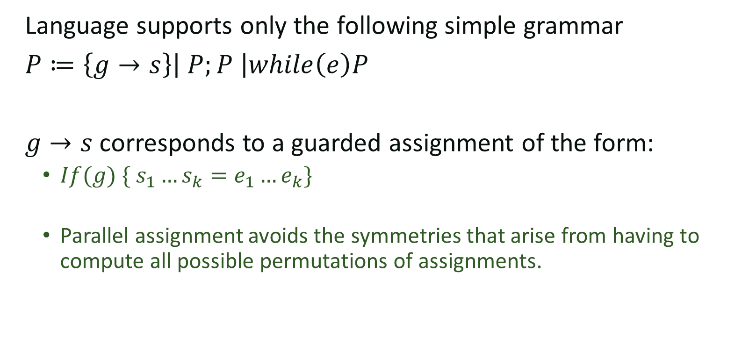
Stylized program fragments
Language supports only the following simple grammar
$P≔\left\{g→s\right\}\left| P;P \right|while\left(e\right)P$
$g→s$ corresponds to a guarded assignment of the form:
  $If(g) \{ s_{1}…s_{k}=e_{1}…e_{k}\}$
  Parallel assignment avoids the symmetries that arise from having to compute all possible permutations of assignments.

Slide 14
Proof-Theoretic Synthesis
Input: Program Scaffold
  Flowgraph template (a nested loop structure)
  Function spec (pre-/post-conditions)
  Other constraints (temp variables, size limit, etc. )
Output:
  Synthesized code fragments
  Associated loop invariants and ranking functions
Synthesis Condition:
  Generalization of verification conditions
  A valid program exists iff. the SC has a satisfying solution

Slide 15
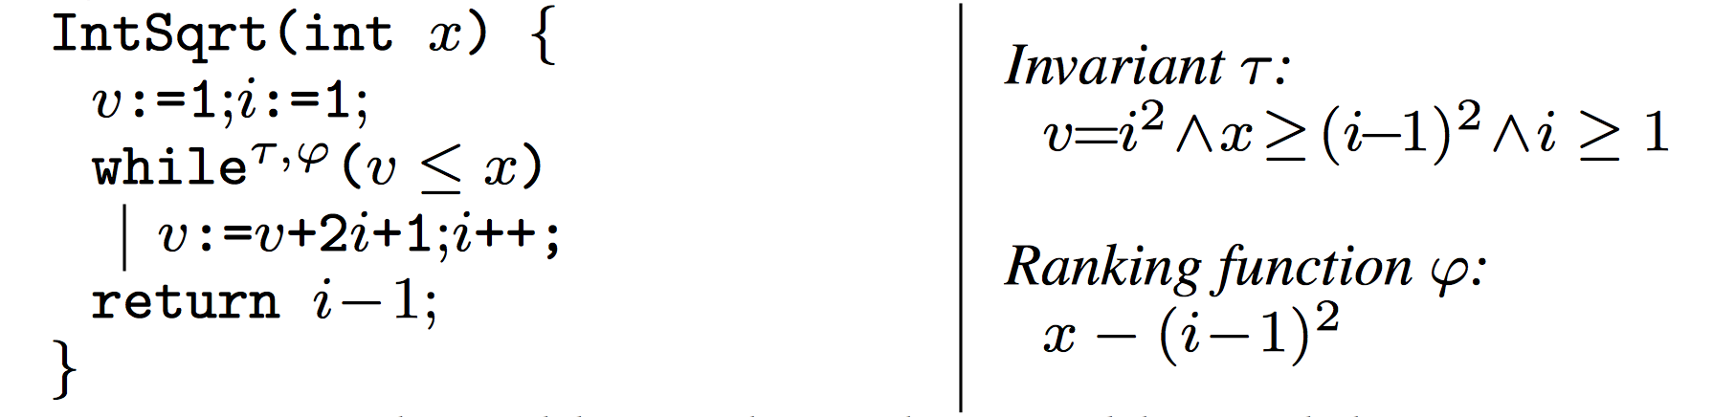
Example: Square Root

Slide 16

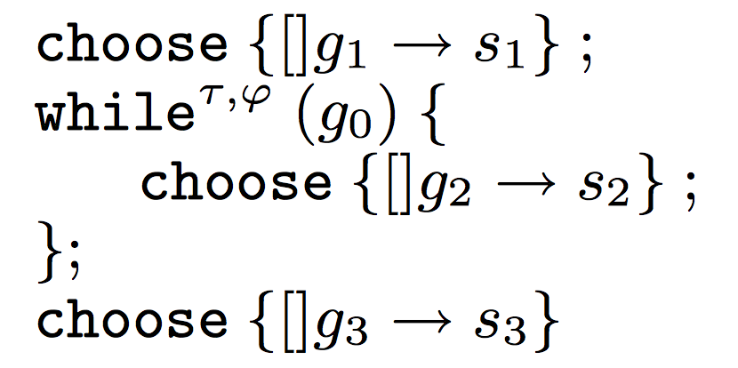

Program Scaffold
Pre:
Post:
(Assume only one branch in each fragment)

Slide 17
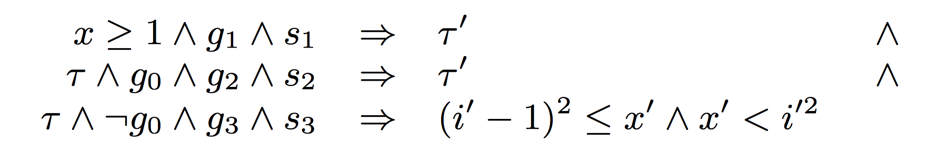
Verification Condition

Slide 18
Well-formedness Condition

Slide 19
Ranking Function

Slide 20
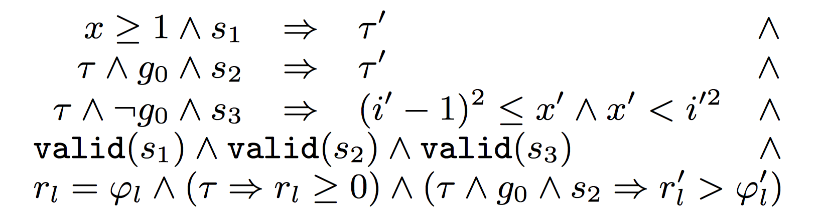
Synthesis Conditions
Theorem (soundness and completeness)
  The synthesis conditions are satisfiable iff. there exists a program that is valid w.r.t. the scaffold.

