Slide 1
Lecture 20
SMT and Theorem Proving
Armando Solar-Lezama partially based on slides by
Isil Dillig
http://www.cs.utexas.edu/~isil/cs780-02/lecture16.pdf

Slide 2
What is a theory
A language of expressions and predicates over those expressions where we have a satisfiability procedure for conjunctions over predicates

Slide 3
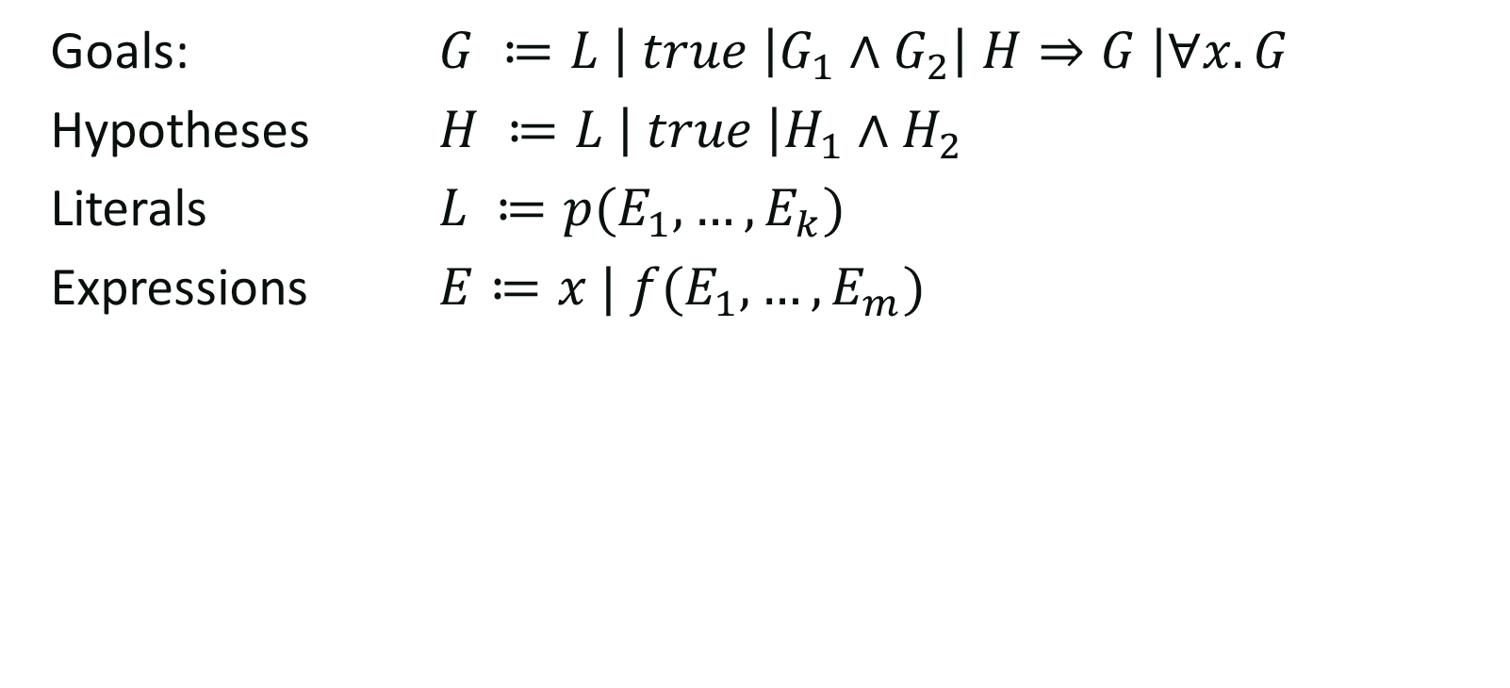
Candidate Logic
Goals: $G ≔L \left| true \right|G_{1}∧G_{2}\left| H⇒G \right|∀x. G$
Hypotheses $H ≔L \left| true \right|H_{1}∧H_{2}$
Literals $L ≔p(E_{1},…,E_{k})$
Expressions $E≔x | f(E_{1},…,E_{m})$
Background theory
Gives meaning to these

Slide 4
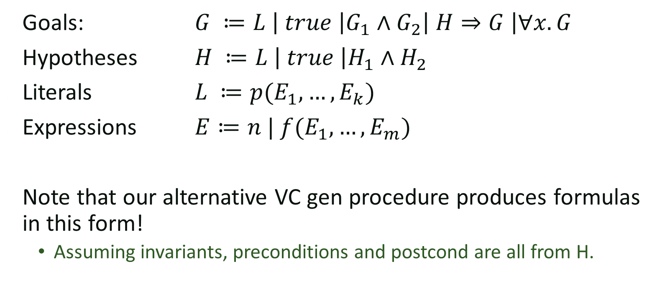
Candidate Logic
Goals: $G ≔L \left| true \right|G_{1}∧G_{2}\left| H⇒G \right|∀x. G$
Hypotheses $H ≔L \left| true \right|H_{1}∧H_{2}$
Literals $L ≔p(E_{1},…,E_{k})$
Expressions $E≔n | f(E_{1},…,E_{m})$
Note that our alternative VC gen procedure produces formulas in this form!
  Assuming invariants, preconditions and postcond are all from H.

Slide 5
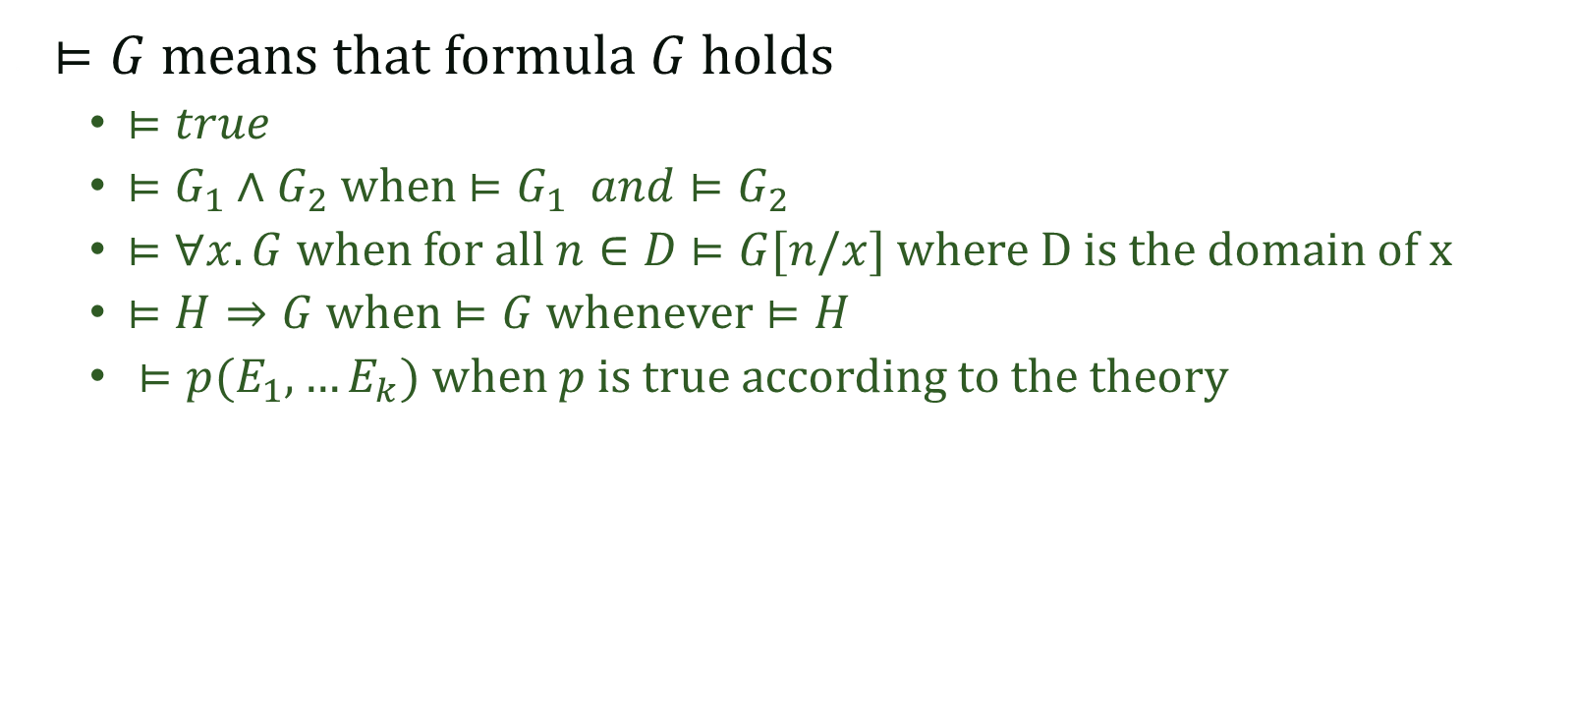
Meaning of a formula
$⊨G$ means that formula $G$ holds
  $⊨true$
  $⊨G_{1}∧G_{2}$ when $⊨G_{1} and⊨G_{2}$
  $⊨∀x.G$ when for all $n∈D$ $⊨G[n/x]$ where D is the domain of x
  $⊨H⇒G$ when $⊨G$ whenever $⊨H$
  $⊨p(E_{1},…E_{k})$ when $p$ is true according to the theory

Slide 6
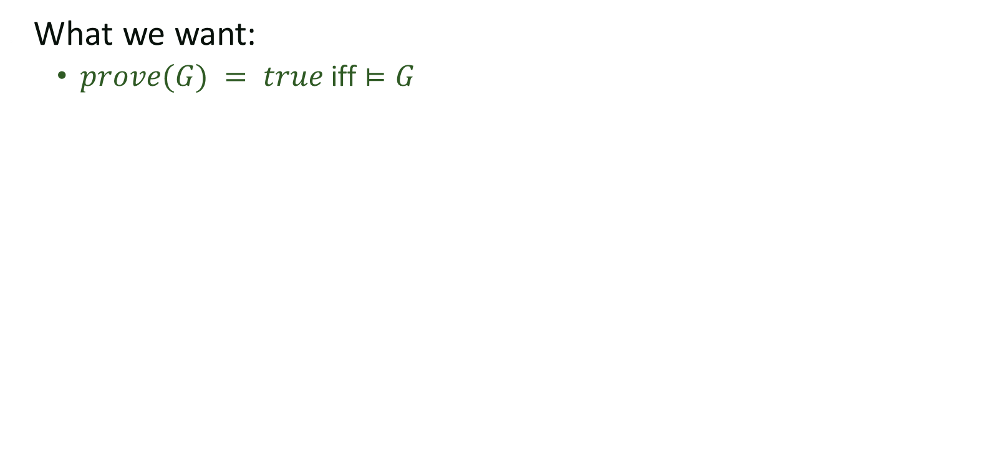
A simple prove procedure
What we want:
  $prove(G) = true$ iff $⊨G$

Slide 7
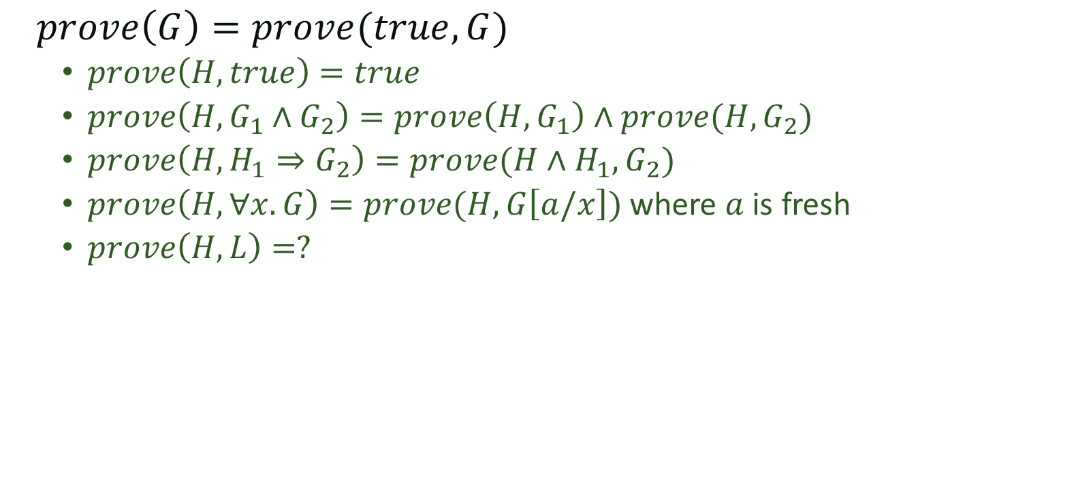
A simple algorithm
$prove\left(G\right)=prove(true,G)$
  $prove\left(H,true\right)=true$
  $prove\left(H,G_{1}∧G_{2}\right)=prove\left(H,G_{1}\right)∧prove(H, G_{2})$
  $prove\left(H, H_{1}⇒G_{2}\right)=prove(H∧H_{1},G_{2})$
  $prove\left(H, ∀x. G\right)=prove(H, G\left[a/x\right])$ where $a$ is fresh
  $prove\left(H,L\right)=?$

Slide 8
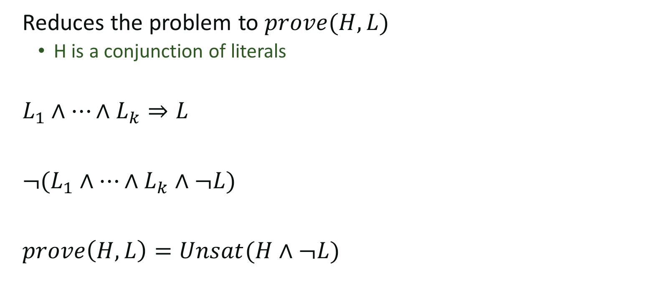
Theorem prover for literals
Reduces the problem to $prove(H,L)$
  H is a conjunction of literals
$L_{1}∧…∧L_{k}⇒L$
$¬(L_{1}∧…∧L_{k}∧¬L)$
$prove\left(H,L\right)=Unsat(H∧¬L)$

Slide 9
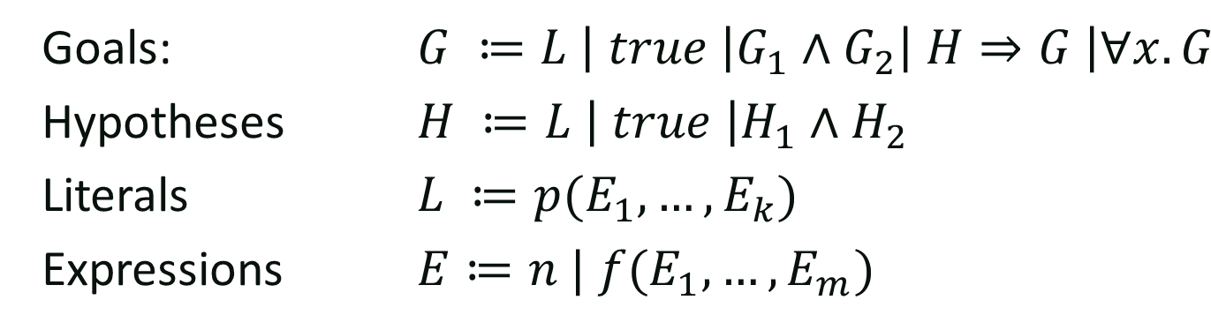


Example: Linear Inequalities
Expressions: ${c∗x}_{i} | E+E$
Literals: $E≥0 | E=0$
$$∀y,y_{0},k,k_{0},t, y^{′}, t^{′}, \left(y=y_{0}∧k=k_{0}∧t=y_{0}−k_{0}\right) ⇒$$
$$y=k_{0}+t$$
$$∧ { y}^{′}=k_{0}+t^{′}∧ \left(t^{′}>0\right)⇒y^{′}−1=k_{0}+(t^{′}−1)$$
$∧ y^{′}=k_{0}+t^{′}∧¬\left(t^{′}>0\right)⇒y^{′}≤k_{0}$

Slide 10

Example: Linear Inequalities
$$not (∃y,y_{0},k,k_{0},t, y^{′}, t^{′}, not\left(y=y_{0}∧k=k_{0}∧t=y_{0}−k_{0}\right) ⇒$$
$$y=k_{0}+t$$
$$∧ { y}^{′}=k_{0}+t^{′}∧ \left(t^{′}>0\right)⇒y^{′}−1=k_{0}+(t^{′}−1)$$
$∧ y^{′}=k_{0}+t^{′}∧¬\left(t^{′}>0\right)⇒y^{′}≤k_{0}$

Slide 11
Linear Inequalities
$$Prove(true, \left(\begin{matrix}\left(y=y_{0}∧k=k_{0}∧t=y_{0}−k_{0}\right) ⇒ & \begin{matrix}y=k_{0}+t \\ ∧ { y}^{′}=k_{0}+t^{′}∧ \left(t^{′}>0\right)⇒y^{′}−1=k_{0}+(t^{′}−1) \\ ∧ y^{′}=k_{0}+t^{′}∧\left(t^{′}≤0\right)⇒y^{′}≤k_{0} \end{matrix}\end{matrix}\right))$$
$$Prove(y=y_{0}∧k=k_{0}∧t=y_{0}−k_{0}, \left(\begin{matrix} & \begin{matrix}y=k_{0}+t \\ ∧ { y}^{′}=k_{0}+t^{′}∧ \left(t^{′}>0\right)⇒y^{′}−1=k_{0}+(t^{′}−1) \\ ∧ y^{′}=k_{0}+t^{′}∧\left(t^{′}≤0\right)⇒y^{′}≤k_{0} \end{matrix}\end{matrix}\right))$$

Slide 12
Linear Inequalities
$$Prove(y=y_{0}∧k=k_{0}∧t=y_{0}−k_{0}, \left(\begin{matrix} & \begin{matrix}y=k_{0}+t \\ ∧ { y}^{′}=k_{0}+t^{′}∧ \left(t^{′}>0\right)⇒y^{′}−1=k_{0}+(t^{′}−1) \\ ∧ y^{′}=k_{0}+t^{′}∧\left(t^{′}≤0\right)⇒y^{′}≤k_{0} \end{matrix}\end{matrix}\right))$$
$$Prove(y=y_{0}∧k=k_{0}∧t=y_{0}−k_{0},y=k_{0}+t)$$
$$Prove(y=y_{0}∧k=k_{0}∧t=y_{0}−k_{0},{ y}^{′}=k_{0}+t^{′}∧ \left(t^{′}>0\right)⇒y^{′}−1=k_{0}+(t^{′}−1))$$
$$Prove(y=y_{0}∧k=k_{0}∧t=y_{0}−k_{0},y^{′}=k_{0}+t^{′}∧\left(t^{′}≤0\right)⇒y^{′}≤k_{0})$$

Slide 13
Linear Inequalities
$$Prove(y=y_{0}∧k=k_{0}∧t=y_{0}−k_{0}, \left(\begin{matrix} & \begin{matrix}y=k_{0}+t \\ ∧ { y}^{′}=k_{0}+t^{′}∧ \left(t^{′}>0\right)⇒y^{′}−1=k_{0}+(t^{′}−1) \\ ∧ y^{′}=k_{0}+t^{′}∧\left(t^{′}≤0\right)⇒y^{′}≤k_{0} \end{matrix}\end{matrix}\right))$$
$$Prove(y=y_{0}∧k=k_{0}∧t=y_{0}−k_{0},y=k_{0}+t)$$
$$Prove(y=y_{0}∧k=k_{0}∧t=y_{0}−k_{0}∧{ y}^{′}=k_{0}+t^{′}∧ \left(t^{′}>0\right), y^{′}−1=k_{0}+(t^{′}−1))$$
$$Prove(y=y_{0}∧k=k_{0}∧t=y_{0}−k_{0}∧y^{′}=k_{0}+t^{′}∧\left(t^{′}≤0\right), y^{′}≤k_{0})$$

Slide 14
Linear Inequalities
$$Prove(y=y_{0}∧k=k_{0}∧t=y_{0}−k_{0}, \left(\begin{matrix} & \begin{matrix}y=k_{0}+t \\ ∧ { y}^{′}=k_{0}+t^{′}∧ \left(t^{′}>0\right)⇒y^{′}−1=k_{0}+(t^{′}−1) \\ ∧ y^{′}=k_{0}+t^{′}∧\left(t^{′}≤0\right)⇒y^{′}≤k_{0} \end{matrix}\end{matrix}\right))$$
$$Unsat(y=y_{0}∧k=k_{0}∧t=y_{0}−k_{0}∧y≠k_{0}+t)$$
$$Unsat(y=y_{0}∧k=k_{0}∧t=y_{0}−k_{0}∧{ y}^{′}=k_{0}+t^{′} ∧ t^{′}>0∧y^{′}−1≠k_{0}+(t^{′}−1))$$
$$Unsat(y=y_{0}∧k=k_{0}∧t=y_{0}−k_{0}∧y^{′}=k_{0}+t^{′}∧t^{′}≤0∧y^{′}>k_{0})$$

Slide 15
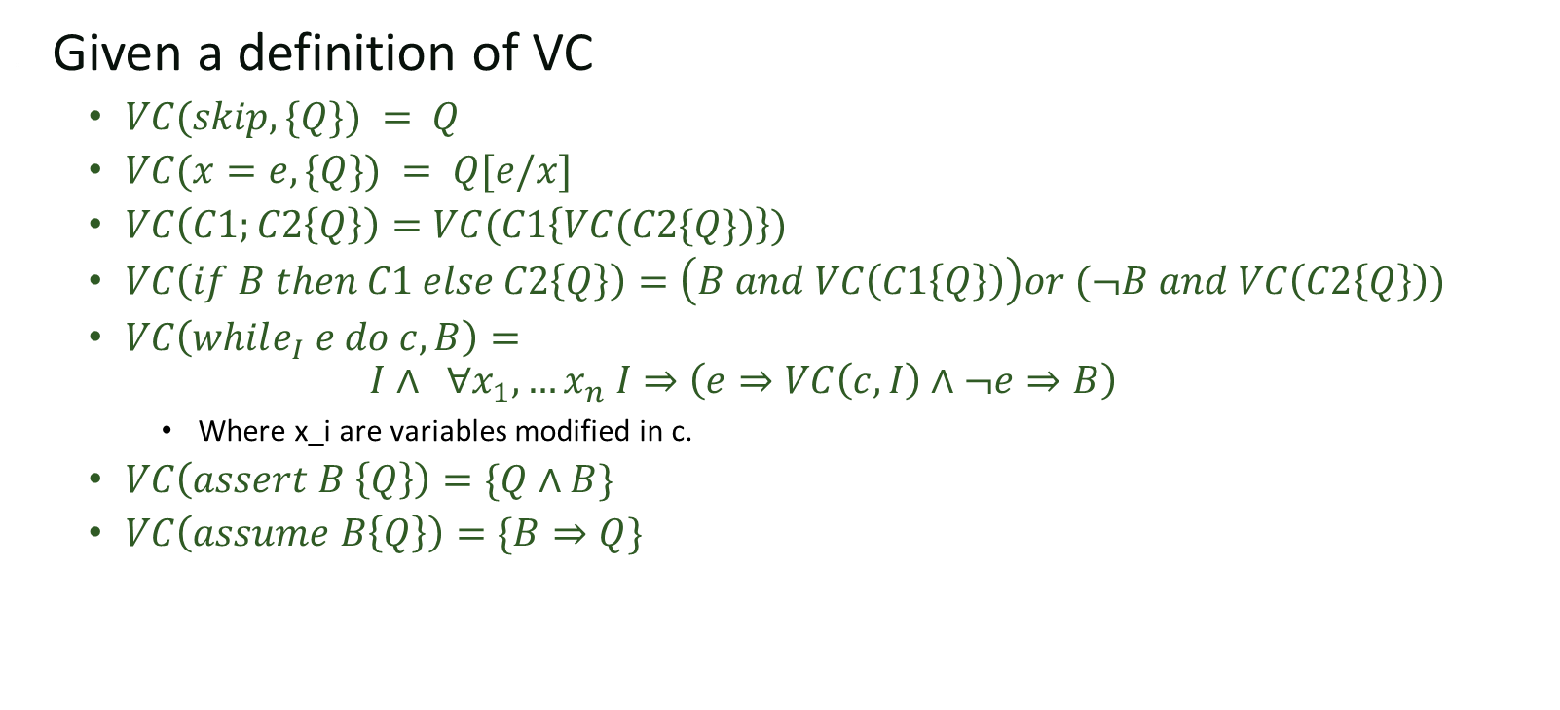
Is this enough to check VCs?
Given a definition of VC
  $VC(skip, \{Q\}) = Q$
  $VC(x=e,\{Q\}) = Q[e/x]$
  $VC\left(C1;C2\left\{Q\right\}\right)=VC(C1\left\{VC(C2\{Q\})\right\})$
  $VC\left(if B then C1 else C2\left\{Q\right\}\right)=\left(B and VC\left(C1\left\{Q\right\}\right)\right)or (¬B and VC\left(C2\left\{Q\right\}\right))$
  $VC\left(while_{I} e do c, B\right)=$
  $$I∧ ∀x_{1}, …x_{n} I⇒\left(e⇒VC\left(c,I\right)∧¬e⇒B\right)$$
    Where x_i are variables modified in c.
  $VC\left(assert B \left\{Q\right\}\right)=\{Q∧B\}$
  $VC\left(assume B\left\{Q\right\}\right)=\{B⇒Q\}$

Slide 16
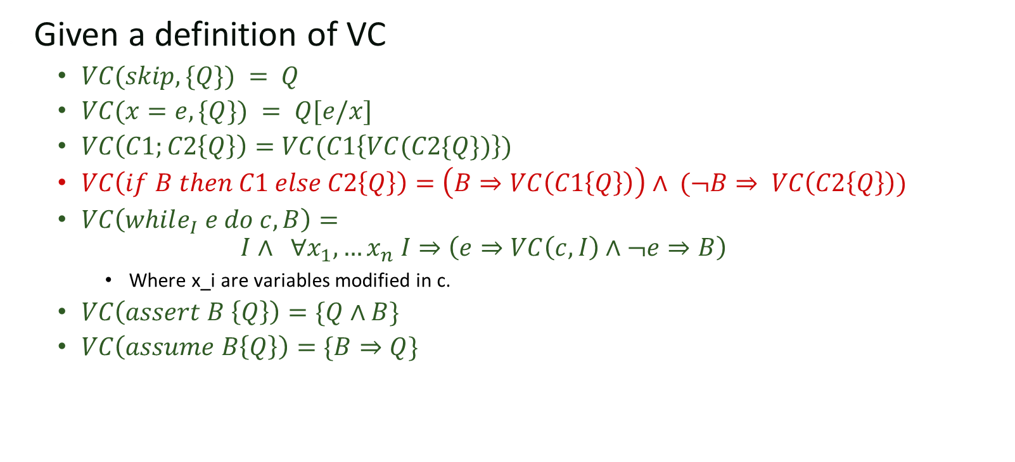
Is this enough to check VCs?
Given a definition of VC
  $VC(skip, \{Q\}) = Q$
  $VC(x=e,\{Q\}) = Q[e/x]$
  $VC\left(C1;C2\left\{Q\right\}\right)=VC(C1\left\{VC(C2\{Q\})\right\})$
  $VC\left(if B then C1 else C2\left\{Q\right\}\right)=\left(B⇒VC\left(C1\left\{Q\right\}\right)\right)∧ (¬B⇒ VC\left(C2\left\{Q\right\}\right))$
  $VC\left(while_{I} e do c, B\right)=$
  $$I∧ ∀x_{1}, …x_{n} I⇒\left(e⇒VC\left(c,I\right)∧¬e⇒B\right)$$
    Where x_i are variables modified in c.
  $VC\left(assert B \left\{Q\right\}\right)=\{Q∧B\}$
  $VC\left(assume B\left\{Q\right\}\right)=\{B⇒Q\}$

Slide 17
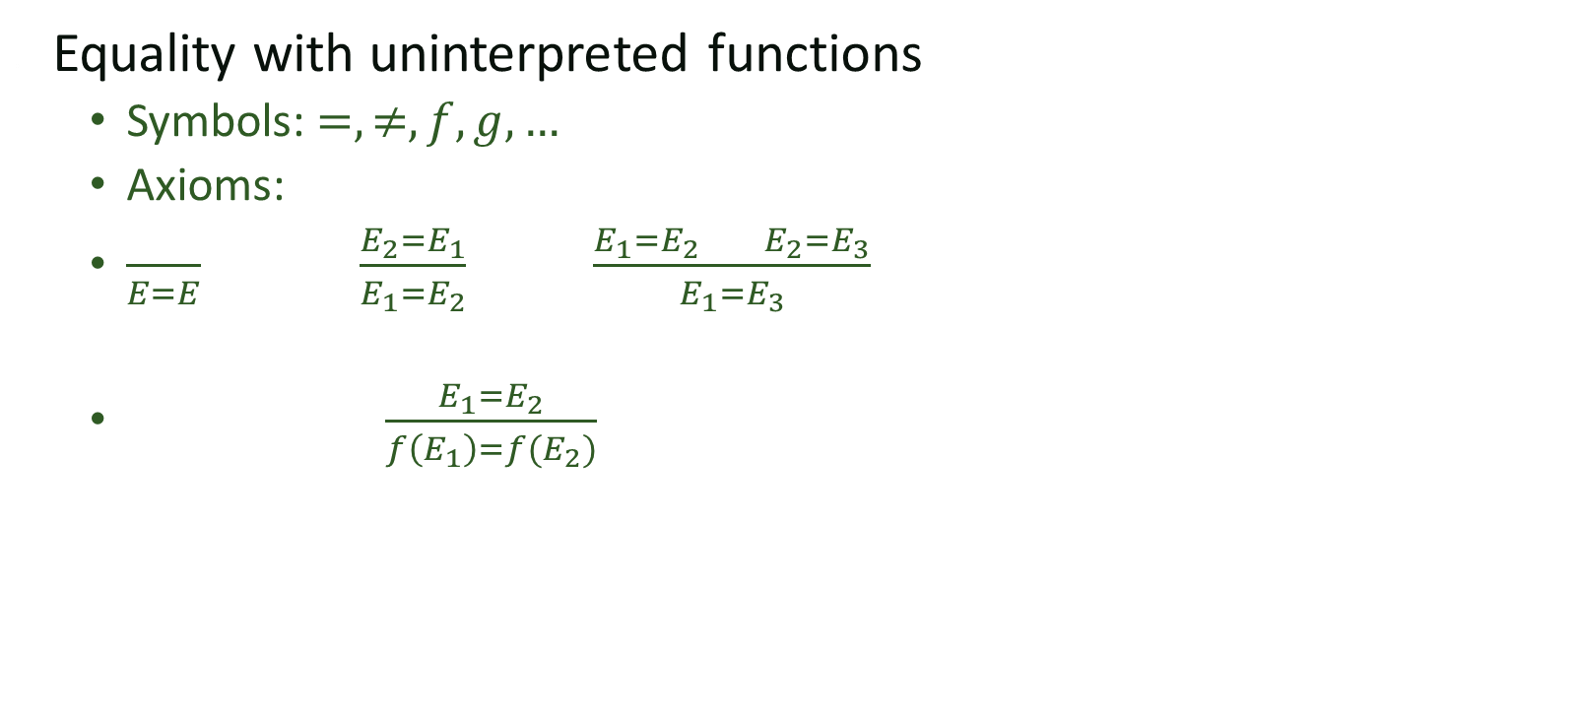
Equality with uninterpreted functions
Equality with uninterpreted functions
  Symbols: $=, ≠, f,g,…$
  Axioms:
  $\frac{}{E=E} \frac{E_{2}=E_{1}}{E_{1}=E_{2}} \frac{E_{1}=E_{2} E_{2}=E_{3}}{E_{1}=E_{3}}$
  $\frac{E_{1}=E_{2}}{f\left(E_{1}\right)=f(E_{2})}$

Slide 18
Equality with UF (Congruence closure algorithm)
x
y
z
t
x=y
y=z
f(x)=f(z)
g(t)=z
f(y) = g(t)
f(x) != f(f(f(x)))
f(x)
f(y)
f(z)
g(t)
f(f(x))
f(g(t))
f(f(f(x)))

Slide 19
Equality with UF
x
y
z
t
x=y
y=z
f(x)=f(z)
g(t)=z
f(y) = g(t)
f(x) != f(f(f(x)))
f(x)
f(y)
f(z)
g(t)
f(f(x))
f(g(t))
f(f(f(x)))

Slide 20
Equality with UF
x
y
z
t
x=y
y=z
f(x)=f(z)
g(t)=z
f(y) = g(t)
f(x) != f(f(f(x)))
f(x)
f(y)
f(z)
g(t)
f(f(x))
f(g(t))
f(f(f(x)))

Slide 21
Equality with UF
x
y
z
t
x=y
y=z
f(x)=f(z)
g(t)=z
f(y) = g(t)
f(x) != f(f(f(x)))
f(x)
f(y)
f(z)
g(t)
f(f(x))
f(g(t))
f(f(f(x)))

Slide 22
Equality with UF
x
y
z
t
x=y
y=z
f(x)=f(z)
g(t)=z
f(y) = g(t)
f(x) != f(f(f(x)))
f(x)
f(y)
f(z)
g(t)
f(f(x))
f(g(t))
f(f(f(x)))

Slide 23
Equality with UF
x
y
z
t
x=y
y=z
f(x)=f(z)
g(t)=z
f(y) = g(t)
f(x) != f(f(f(x)))
f(x)
f(y)
f(z)
g(t)
f(f(x))
f(g(t))
f(f(f(x)))
Contradiction!

Slide 24
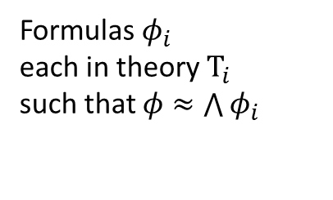
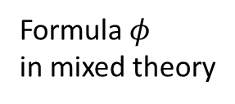
Nelson-Oppen
Two step process
Purification
Equality
Propagation
Formulas $φ_{i}$
each in theory $T_{i}$
such that $φ≈\bigwedge{φ_{i}}$
Formula $φ$
in mixed theory
Solution

Slide 25
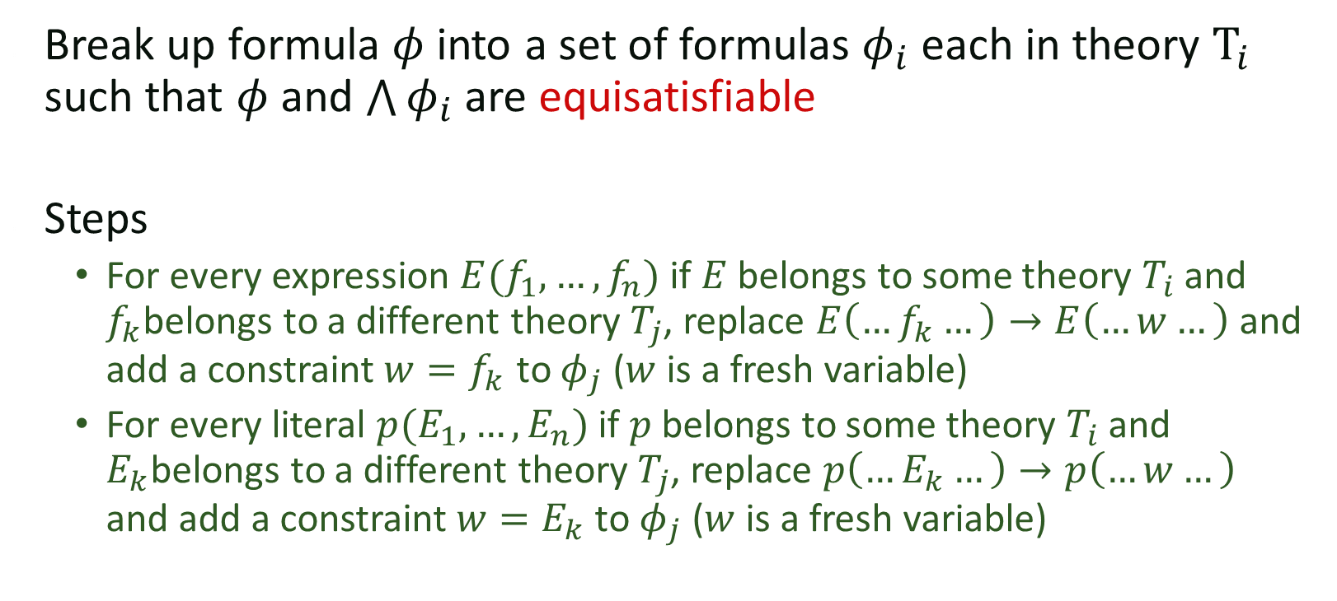
Purification
Break up formula $φ$ into a set of formulas $φ_{i}$ each in theory $T_{i}$
such that $φ$ and $\bigwedge{φ_{i}}$ are equisatisfiable
Steps
  For every expression $E(f_{1},…,f_{n})$ if $E$ belongs to some theory $T_{i}$ and $f_{k}$belongs to a different theory $T_{j}$, replace $E\left(…f_{k}…\right)→E\left(…w…\right)$ and add a constraint $w=f_{k}$ to $φ_{j}$ ($w$ is a fresh variable)
  For every literal $p(E_{1},…,E_{n})$ if $p$ belongs to some theory $T_{i}$ and $E_{k}$belongs to a different theory $T_{j}$, replace $p\left(…E_{k}…\right)→p\left(…w…\right)$ and add a constraint $w=E_{k}$ to $φ_{j}$ ($w$ is a fresh variable)

Slide 26
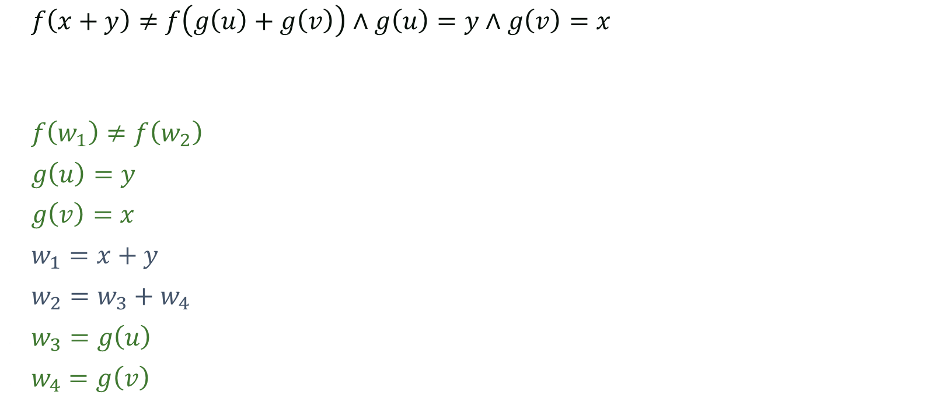
Example
$f\left(x+y\right)≠f\left(g\left(u\right)+g\left(v\right)\right)∧g\left(u\right)=y∧g\left(v\right)=x$
$f\left(w_{1}\right)≠f\left(w_{2}\right)$
$g\left(u\right)=y$
$g\left(v\right)=x$
$w_{1}=x+y$
$w_{2}=w_{3}+w_{4}$
$w_{3}=g\left(u\right)$
$w_{4}=g\left(v\right)$

Slide 27





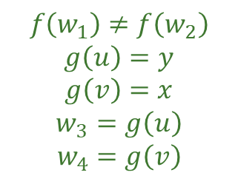






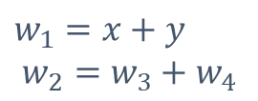
Equality Propagation
1) Run each UNSAT procedure independently
  If any returns UNSAT we are done
2) Broadcast any equalities that were discovered
  If no new equalities were discovered, return SAT
=
Uninterpreted Fun.
Linear Integer Arithmetic
=
$$f\left(w_{1}\right)≠f\left(w_{2}\right)$$
$$g\left(u\right)=y$$
$$g\left(v\right)=x$$
$$w_{3}=g\left(u\right)$$
$$w_{4}=g\left(v\right)$$
$$w_{1}=x+y$$
$$w_{2}=w_{3}+w_{4}$$
=
$$g$$
$$g$$
$$f$$
$$≠$$
$$f$$
=
x
y
$$w_{1}$$
$$w_{2}$$
$$w_{3}$$
$$w_{4}$$
$$u$$
$$v$$
+
+
=
=

Slide 28
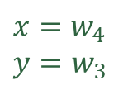
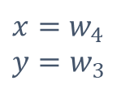
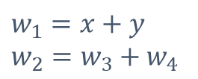
Equality Propagation
1) Run each UNSAT procedure independently
  If any returns UNSAT we are done
2) Broadcast any equalities that were discovered
  If no new equalities were discovered, return SAT
=
Uninterpreted Fun.
Linear Integer Arithmetic
=
$$f\left(w_{1}\right)≠f\left(w_{2}\right)$$
$$g\left(u\right)=y$$
$$g\left(v\right)=x$$
$$w_{3}=g\left(u\right)$$
$$w_{4}=g\left(v\right)$$
$$w_{1}=x+y \\ w_{2}=w_{3}+w_{4}$$
=
$$g$$
$$g$$
$$f$$
$$≠$$
$$f$$
=
$$x=w_{4}$$
$$y=w_{3}$$
x
y
$$w_{1}$$
$$w_{2}$$
$$w_{3}$$
$$w_{4}$$
$$u$$
$$v$$
$$x=w_{4}$$
$$y=w_{3}$$
+
+
=
=

Slide 29


Equality Propagation
1) Run each UNSAT procedure independently
  If any returns UNSAT we are done
2) Broadcast any equalities that were discovered
  If no new equalities were discovered, return SAT
=
Uninterpreted Fun.
Linear Integer Arithmetic
=
$$f\left(w_{1}\right)≠f\left(w_{2}\right)$$
$$g\left(u\right)=y$$
$$g\left(v\right)=x$$
$$w_{3}=g\left(u\right)$$
$$w_{4}=g\left(v\right)$$
$$w_{1}=x+y \\ w_{2}=w_{3}+w_{4}$$
=
$$g$$
$$g$$
$$f$$
$$≠$$
$$f$$
=
$$x=w_{4}$$
$$y=w_{3}$$
$$w_{1}=w_{2}$$
x
y
$$w_{1}$$
$$w_{2}$$
$$w_{3}$$
$$w_{4}$$
$$u$$
$$v$$
$$x=w_{4}$$
$$y=w_{3}$$
$$w_{1}=w_{2}$$
+
+
=
=

Slide 30

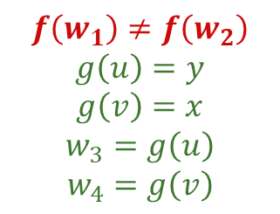
Equality Propagation
1) Run each UNSAT procedure independently
  If any returns UNSAT we are done
2) Broadcast any equalities that were discovered
  If no new equalities were discovered, return SAT
=
Uninterpreted Fun.
Linear Integer Arithmetic
=
$$f\left(w_{1}\right)≠f\left(w_{2}\right)$$
$$g\left(u\right)=y$$
$$g\left(v\right)=x$$
$$w_{3}=g\left(u\right)$$
$$w_{4}=g\left(v\right)$$
$$w_{1}=x+y \\ w_{2}=w_{3}+w_{4}$$
=
$$g$$
$$g$$
$$f$$
$$≠$$
$$f$$
=
$$x=w_{4}$$
$$y=w_{3}$$
$$w_{1}=w_{2}$$
x
y
$$w_{1}$$
$$w_{2}$$
$$w_{3}$$
$$w_{4}$$
$$u$$
$$v$$
$$x=w_{4}$$
$$y=w_{3}$$
$$w_{1}=w_{2}$$
+
+
=
=

Slide 31
Soundness and Completeness
Soundness (when it says unsat, it is true)
  Yes assuming theory solvers don’t lie
Completeness (will it always say unsat when required?)
  Yes under certain conditions
  Argument not as obvious

Slide 32
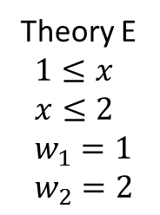
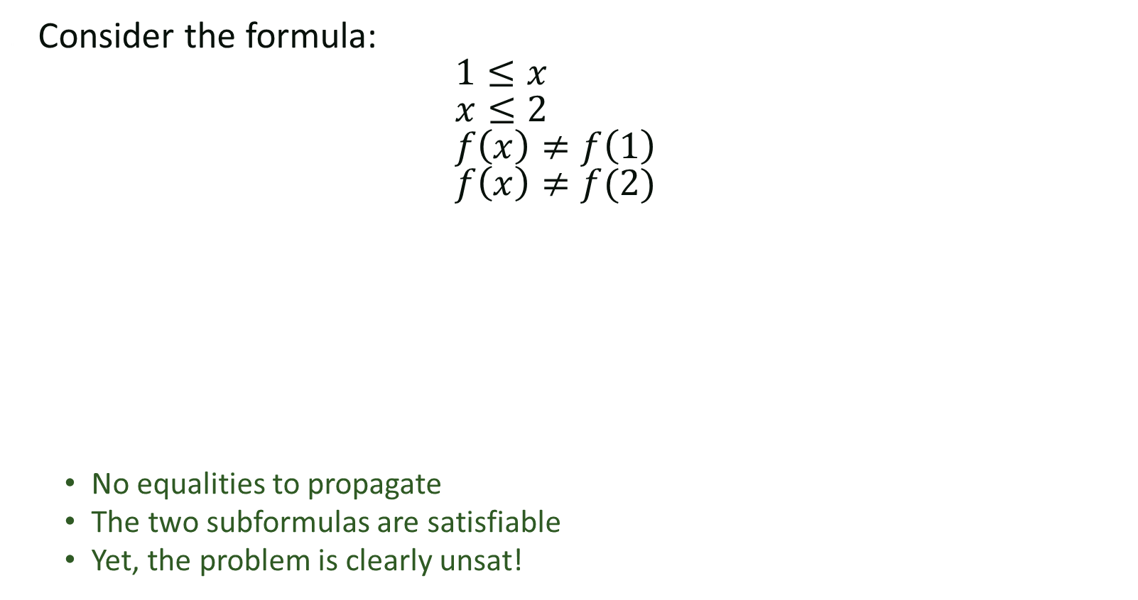
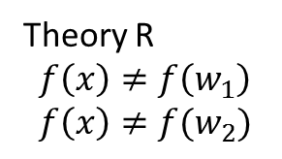
Convex theories
Consider the formula:
$1≤x$
$x≤2$
$f\left(x\right)≠f\left(1\right)$
$f\left(x\right)≠f(2)$
  No equalities to propagate
  The two subformulas are satisfiable
  Yet, the problem is clearly unsat!
Theory E
$$1≤x \\ x≤2 \\ w_{1}=1 \\ w_{2}=2$$
Theory R
$$f\left(x\right)≠f\left(w_{1}\right) \\ f\left(x\right)≠f(w_{2})$$

Slide 33
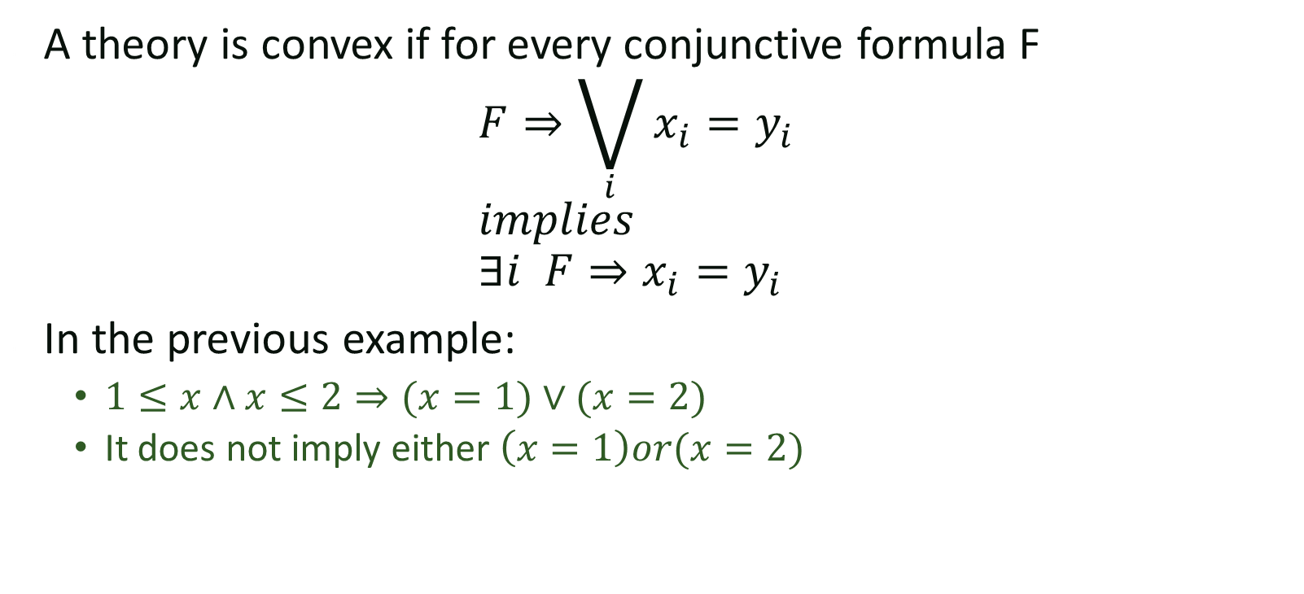
Convex theories
A theory is convex if for every conjunctive formula F
$F⇒\bigvee_{i}{x_{i}=y_{i}}$
$implies$
$∃i F⇒x_{i}{=y}_{i}$
In the previous example:
  $1≤x∧x≤2⇒(x=1)∨(x=2)$
  It does not imply either $\left(x=1\right)or(x=2)$

Slide 34
Completeness
Nelson-Oppen is complete for Convex theories
What to do for non-convex ones?

Slide 35
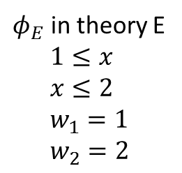
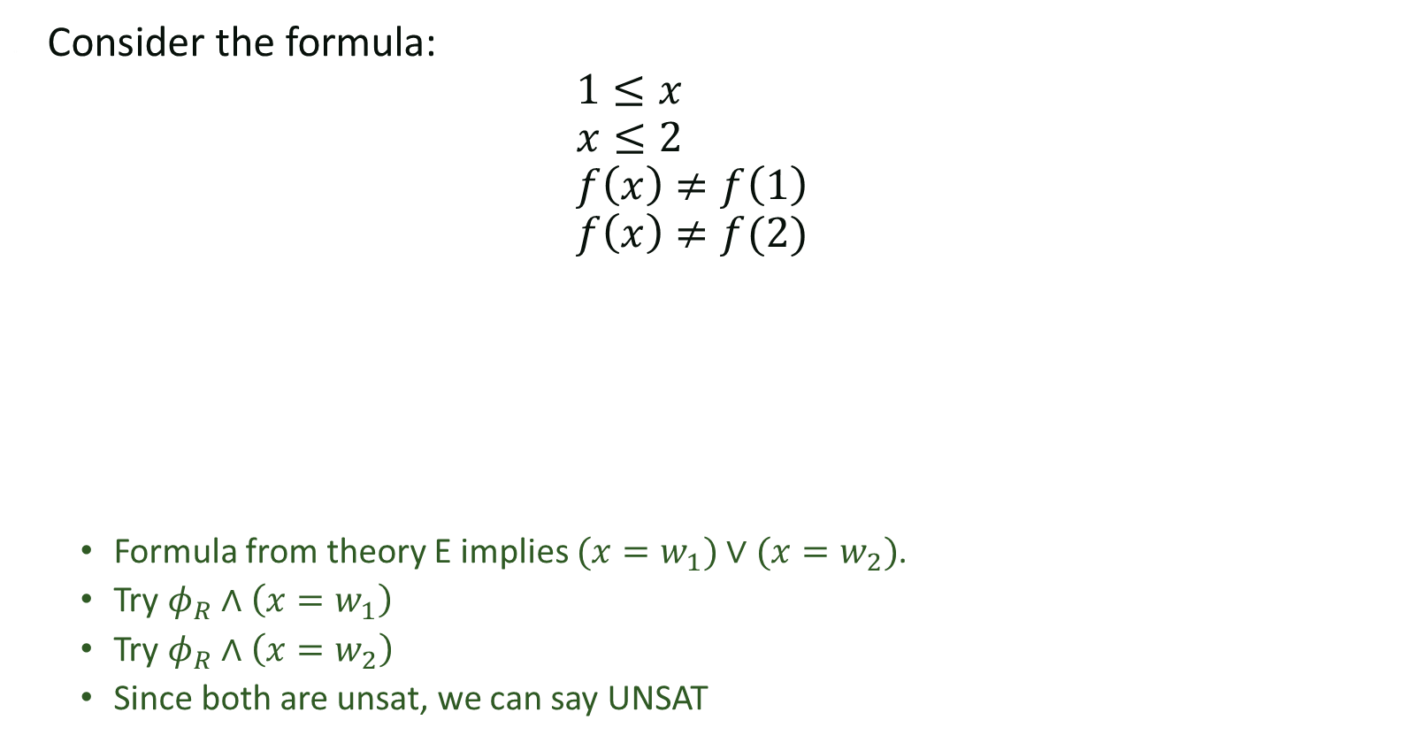
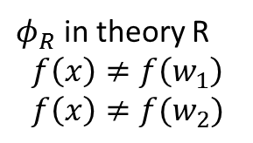
Backtracking
Consider the formula:
$1≤x$
$x≤2$
$f\left(x\right)≠f\left(1\right)$
$f\left(x\right)≠f(2)$
  Formula from theory E implies $(x=w_{1})∨(x=w_{2})$.
  Try $φ_{R}∧\left(x=w_{1}\right)$
  Try $φ_{R}∧\left(x=w_{2}\right)$
  Since both are unsat, we can say UNSAT
$φ_{E}$ in theory E
$$1≤x \\ x≤2 \\ w_{1}=1 \\ w_{2}=2$$
$φ_{R}$ in theory R
$$f\left(x\right)≠f\left(w_{1}\right) \\ f\left(x\right)≠f(w_{2})$$

Slide 36
Backtracking
Key issues
  How do we decide which disjunctive equalities to branch on?
  How to perform backtracking efficiently?

Slide 37
DPLL(T) Key idea
Theory Solver Handles Theories
SAT Solver Handles Boolean Structure
Theory Solver 1
Theory Solver 2

Slide 38
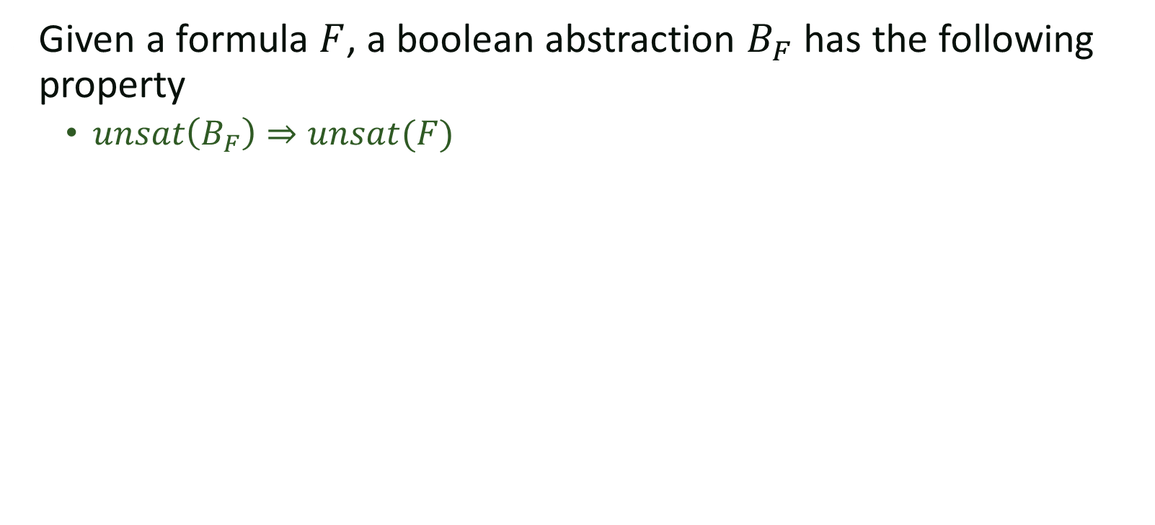
Boolean Abstraction
Given a formula $F$, a boolean abstraction $B_{F}$ has the following property
  $unsat\left(B_{F}\right)⇒unsat(F)$

Slide 39
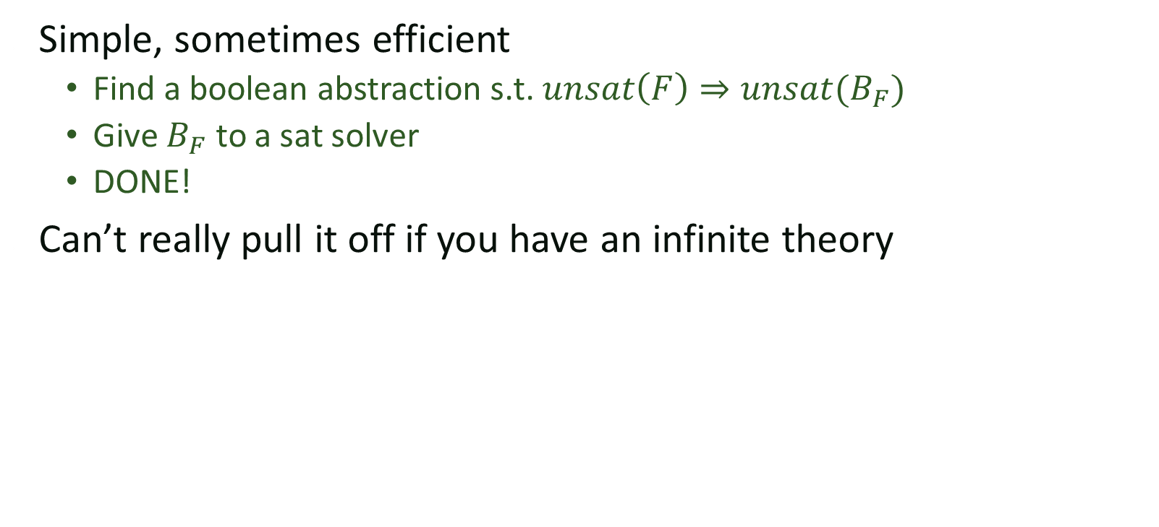
Eager approach
Simple, sometimes efficient
  Find a boolean abstraction s.t. $unsat\left(F\right)⇒unsat(B_{F})$
  Give $B_{F}$ to a sat solver
  DONE!
Can’t really pull it off if you have an infinite theory

Slide 40
Lazy approach
Start with a simple boolean abstraction
Check solutions against theory solver
If theory solver determines unsat improve your boolean abstraction
Repeat until either theory solver agrees or boolean abstraction becomes unsat
Theory Solver Handles Theories
SAT Solver Handles Boolean Structure
Theory Solver 1
Theory Solver 2

Slide 41
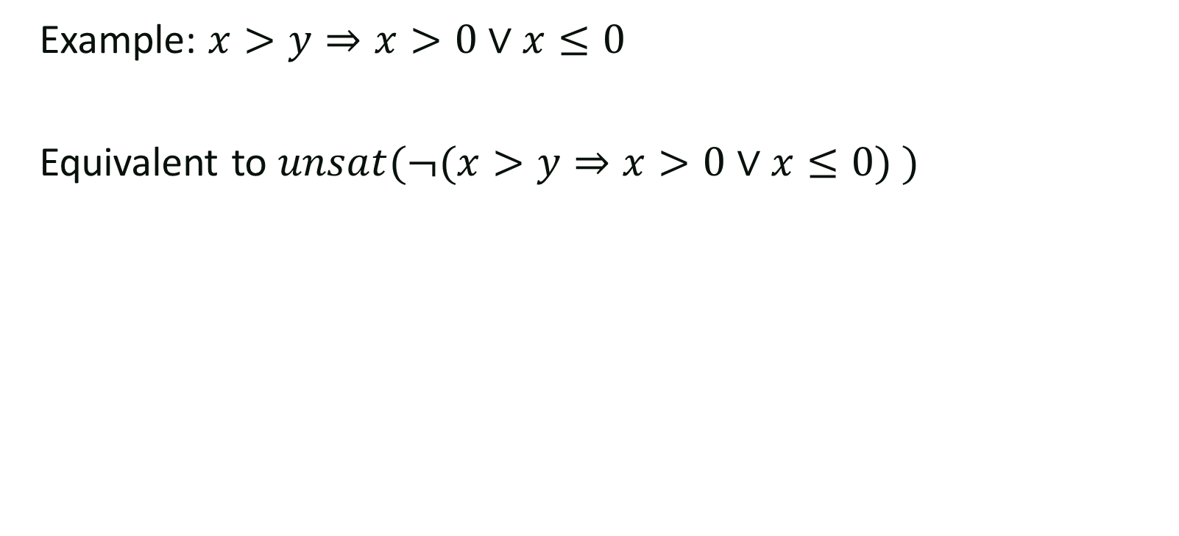
Complex boolean structure
Example: $x>y⇒x>0∨x≤0$
Equivalent to $unsat(¬(x>y⇒x>0∨x≤0) )$

Slide 42
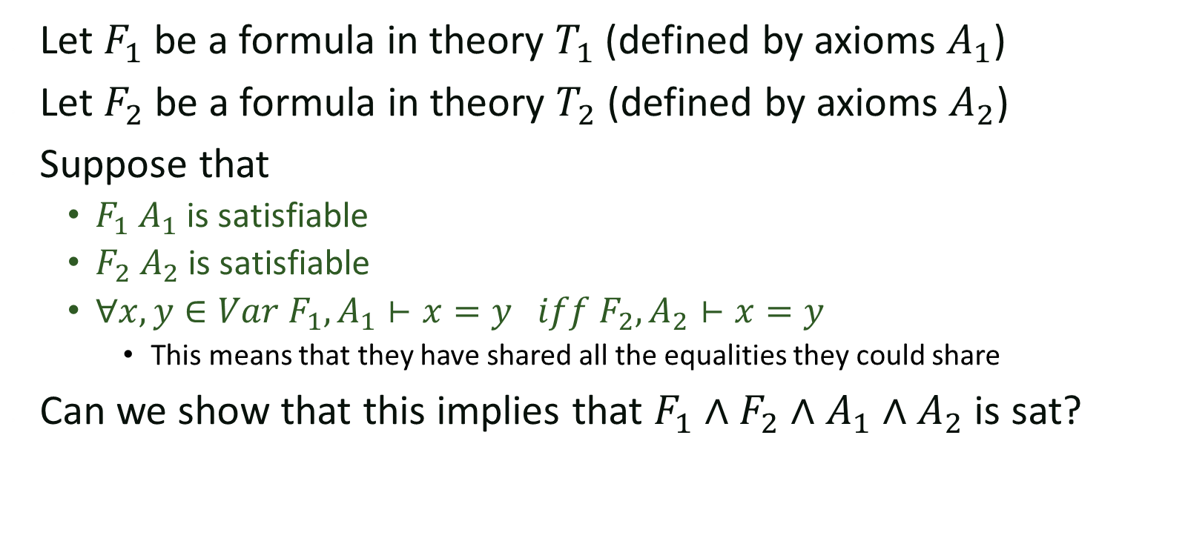
Completeness
Let $F_{1}$ be a formula in theory $T_{1}$ (defined by axioms $A_{1}$)
Let $F_{2}$ be a formula in theory $T_{2}$ (defined by axioms $A_{2}$)
Suppose that
  $F_{1} A_{1}$ is satisfiable
  $F_{2} A_{2}$ is satisfiable
  $∀x,y∈Var F_{1},A_{1}⊢x=y iff$ $F_{2},A_{2}⊢x=y$
    This means that they have shared all the equalities they could share
Can we show that this implies that $F_{1}∧F_{2}∧A_{1}∧A_{2}$ is sat?

Slide 43

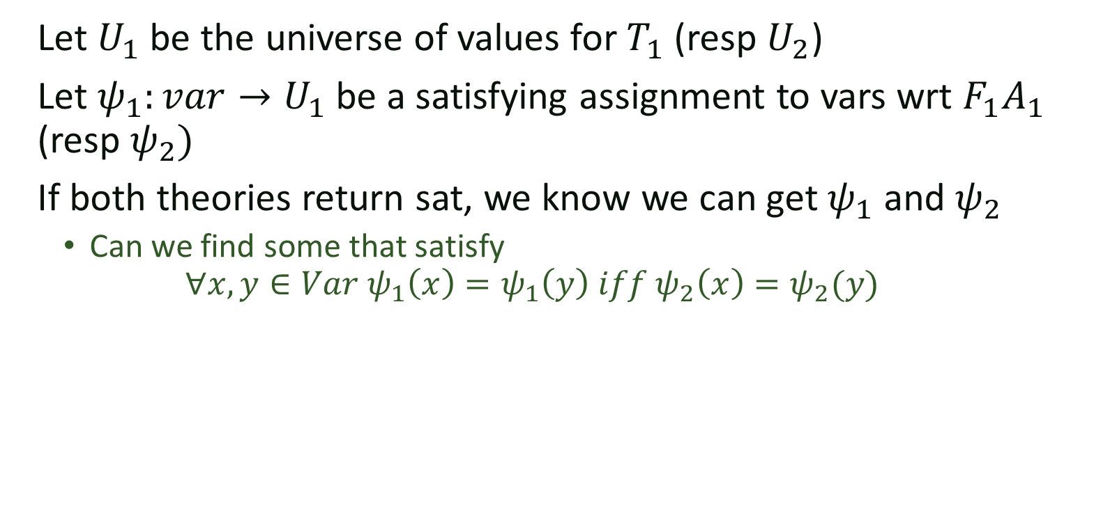
Argument
Let $U_{1}$ be the universe of values for $T_{1}$ (resp $U_{2}$)
Let $ψ_{1}:var→U_{1}$ be a satisfying assignment to vars wrt $F_{1}A_{1}$
(resp $ψ_{2})$
If both theories return sat, we know we can get $ψ_{1}$ and $ψ_{2}$
  Can we find some that satisfy
  $∀x,y∈Var ψ_{1}\left(x\right)=ψ_{1}\left(y\right) iff ψ_{2}\left(x\right)=ψ_{2}(y)$

