Slide 1
Lecture 20
Quantitative Reasoning and a Bayesian View of Synthesis
Armando Solar-Lezama

Slide 2
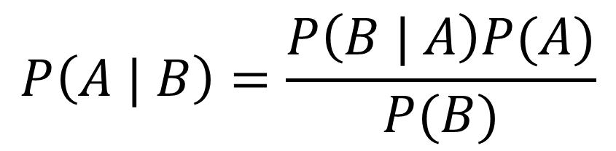
Bayes Theorem
$$P\left(A | B\right)=\frac{P\left(B | A\right)P(A)}{P(B)}$$
$P\left(A∩B\right)=P\left(B | A\right)P\left(A\right)=P\left(A | B\right)P(B)$

Slide 3




Programming by Example
[$(in_{0},out_{0}),(in_{1},out_{1}), …(in_{k},out_{k})$]
$f$
$$in_{i}$$
$$out_{i}$$
Problem is hopelessly underspecified
  Many semantically distinct programs can satisfy the examples

Slide 4
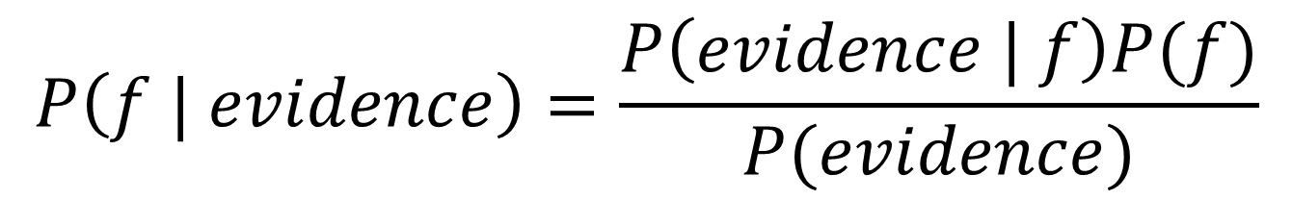
Bayesian View of PBE
$$P\left(f | evidence\right)=\frac{P\left(evidence | f\right)P(f)}{P(evidence)}$$
I/O Examples

Slide 5
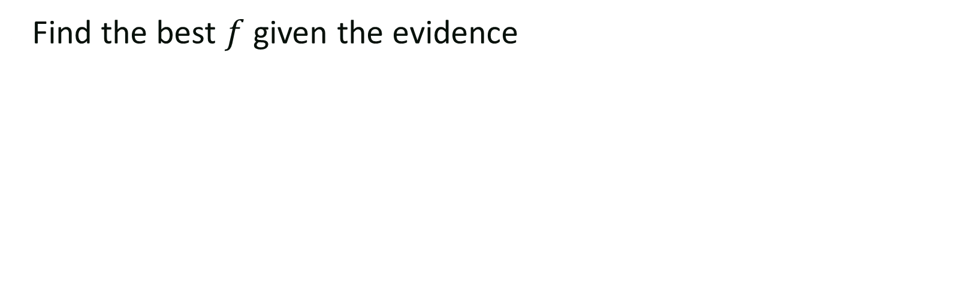

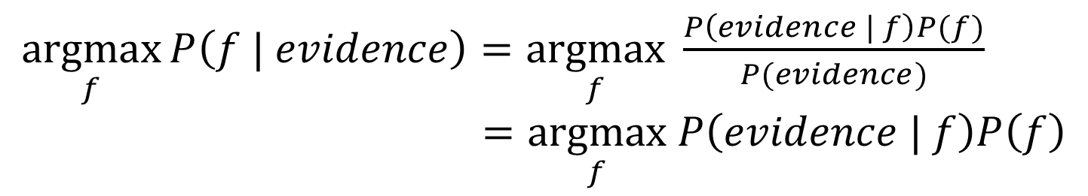
Bayesian View of PBE
$$P\left(f | evidence\right)=\frac{P\left(evidence | f\right)P(f)}{P(evidence)}$$
Find the best $f$ given the evidence
$\underset{f}{argmax}{P\left(f | evidence\right)}=\underset{f}{argmax} \frac{P\left(evidence | f\right)P(f)}{P(evidence)}$
$=\underset{f}{argmax} P\left(evidence | f\right)P\left(f\right)$
WARNING: $P\left(evidence\right)$ better not be zero!

Slide 6
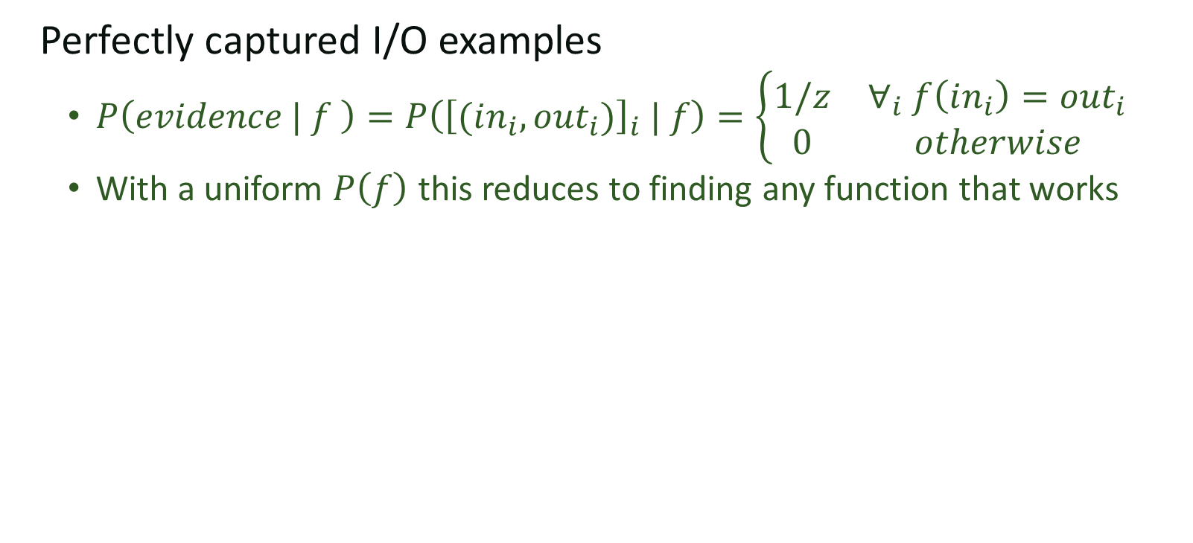
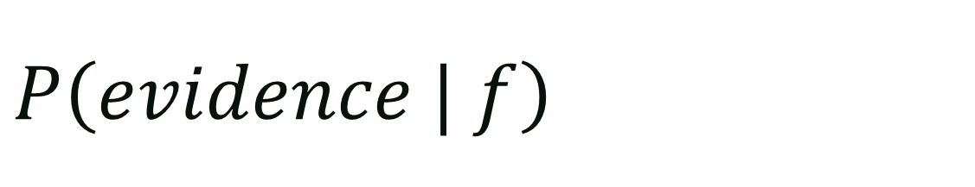
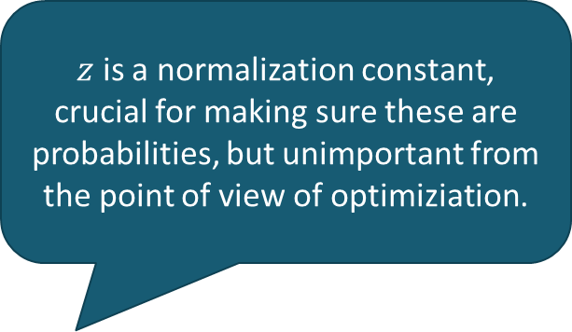
$$P\left(evidence | f\right)$$
$z$ is a normalization constant, crucial for making sure these are probabilities, but unimportant from the point of view of optimiziation.
Perfectly captured I/O examples
  $P\left(evidence | f \right)=P\left({\left[(in_{i},out_{i})\right]}_{i} | f\right)=\left\{\begin{matrix}1/z & ∀_{i} f\left(in_{i}\right)=out_{i} \\ 0 & otherwise\end{matrix}\right.$
  With a uniform $P\left(f\right)$ this reduces to finding any function that works

Slide 7
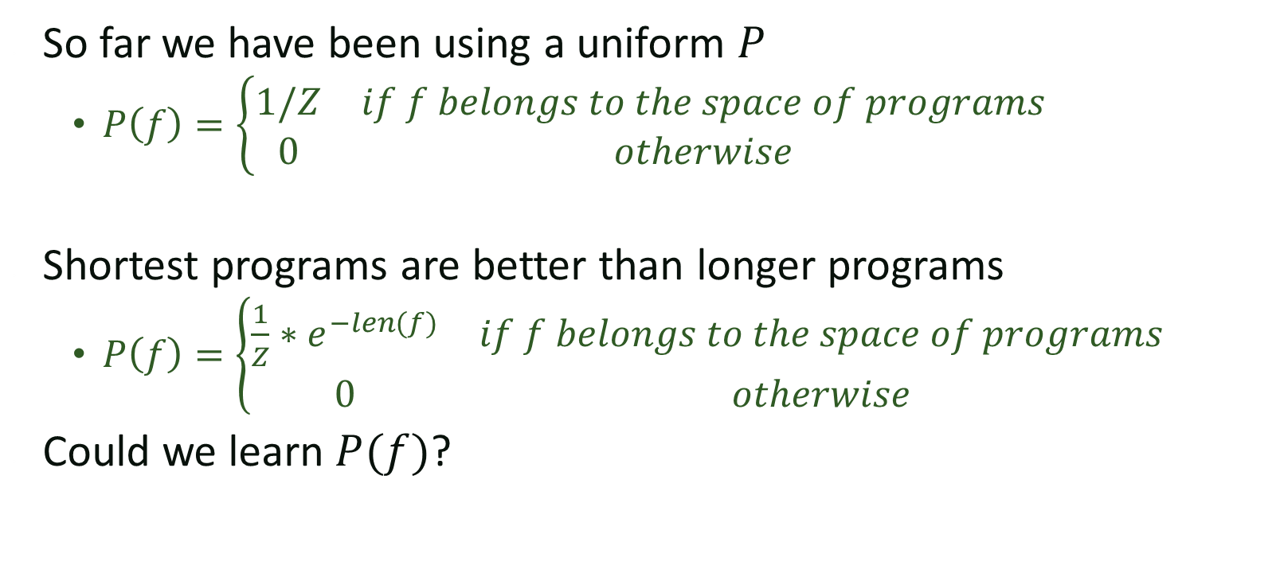
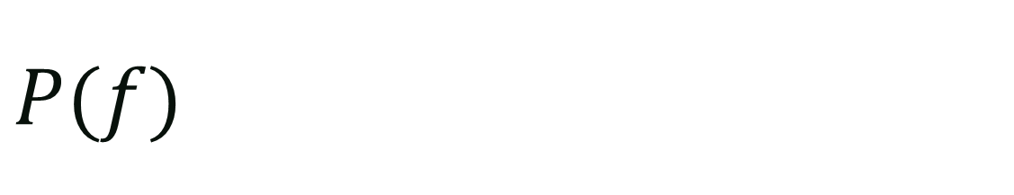
$$P(f)$$
So far we have been using a uniform $P$
  $P\left(f\right)=\left\{\begin{matrix}1/Z & if f belongs to the space of programs \\ 0 & otherwise\end{matrix}\right.$
Shortest programs are better than longer programs
  $P\left(f\right)=\left\{\begin{matrix}\frac{1}{Z}∗e^{−len(f)} & if f belongs to the space of programs \\ 0 & otherwise\end{matrix}\right.$
Could we learn $P(f)$?

Slide 8
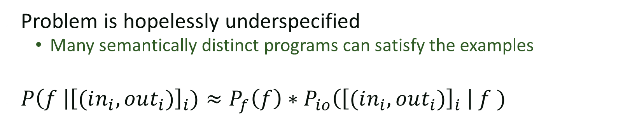
Programming by Example
[$(in_{0},out_{0}),(in_{1},out_{1}), …(in_{k},out_{k})$]
$f$
$$in_{i}$$
$$out_{i}$$
Problem is hopelessly underspecified
  Many semantically distinct programs can satisfy the examples
$P\left(f \right|{\left[(in_{i},out_{i})\right]}_{i})≈P_{f}\left(f\right)∗P_{io}\left({\left[(in_{i},out_{i})\right]}_{i} \right| f )$

Slide 9
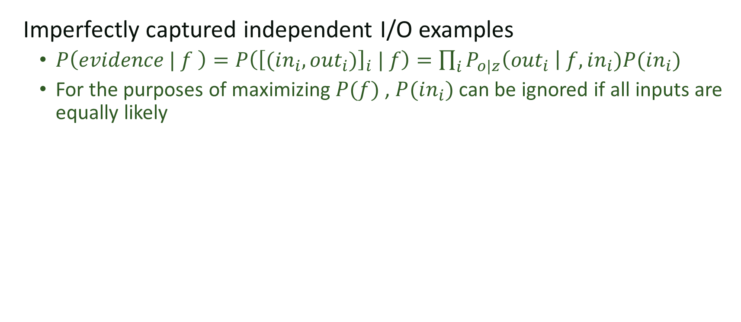
$$P\left(evidence | f\right)$$
Imperfectly captured independent I/O examples
  $P\left(evidence | f \right)=P\left({\left[(in_{i},out_{i})\right]}_{i} | f\right)=\prod_{i}{P_{o|z}\left(out_{i} \right| f, in_{i})P(in_{i})}$
  For the purposes of maximizing $P(f)$ , $P(in_{i})$ can be ignored if all inputs are equally likely

Slide 10
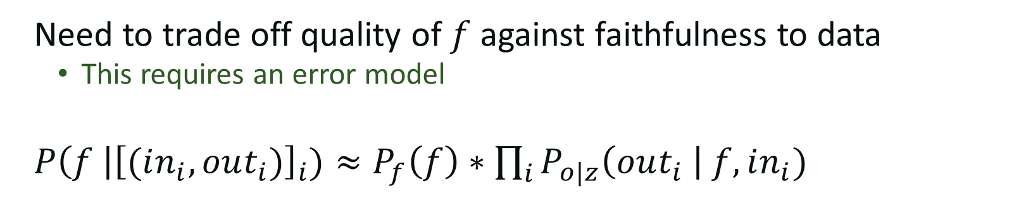


Learning from noisy data
[$(in_{0},out_{0}),(in_{1},out_{1}), …(in_{k},out_{k})$]
$f$
$$in_{i}$$
$$z_{i}$$
Need to trade off quality of $f$ against faithfulness to data
  This requires an error model
$P\left(f \right|{\left[(in_{i},out_{i})\right]}_{i})≈P_{f}\left(f\right)∗\prod_{i}{P_{o|z}\left(out_{i} \right| f, in_{i})}$

Slide 11
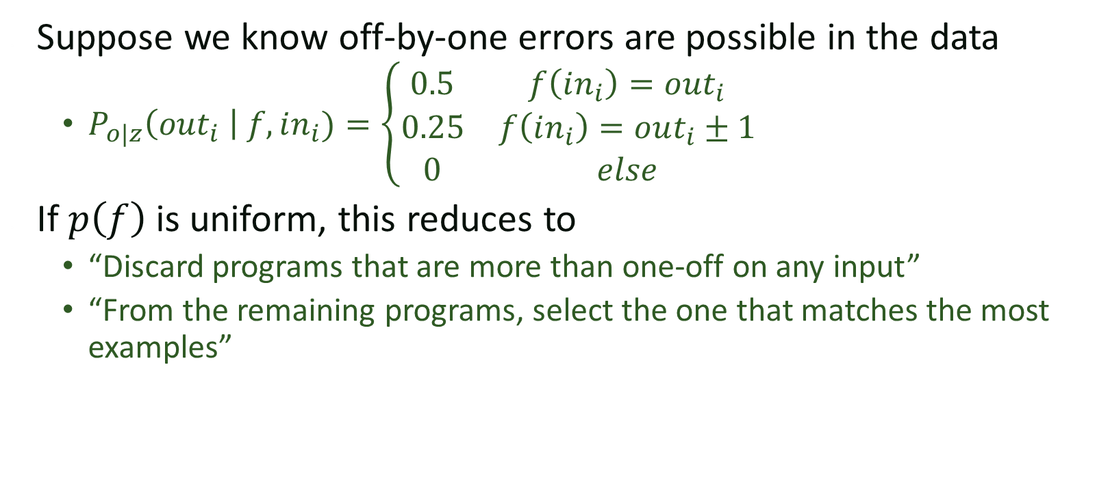
Off-by-one Errors
Suppose we know off-by-one errors are possible in the data
  $P_{o|z}\left(out_{i} \right| f, in_{i})=\left\{\begin{matrix}0.5 & f\left(in_{i}\right)=out_{i} \\ 0.25 & f\left(in_{i}\right)=out_{i}±1 \\ 0 & else\end{matrix}\right.$
If $p\left(f\right)$ is uniform, this reduces to
  “Discard programs that are more than one-off on any input”
  “From the remaining programs, select the one that matches the most examples”

Slide 12
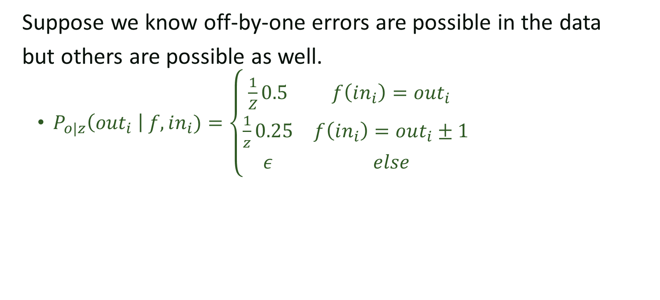
Off-by-one Errors
Suppose we know off-by-one errors are possible in the data
but others are possible as well.
  $P_{o|z}\left(out_{i} \right| f, in_{i})=\left\{\begin{matrix}\frac{1}{Z}0.5 & f\left(in_{i}\right)=out_{i} \\ \frac{1}{z}0.25 & f\left(in_{i}\right)=out_{i}±1 \\ ε & else\end{matrix}\right.$

Slide 13
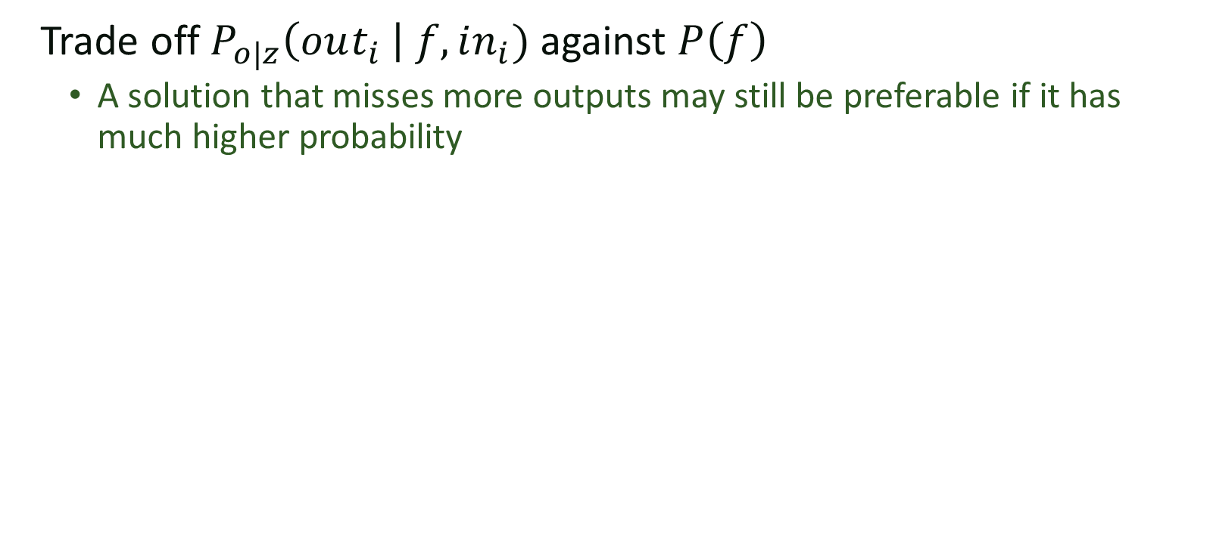

Non-uniform $P(f)$
Trade off $P_{o|z}\left(out_{i} \right| f, in_{i})$ against $P\left(f\right)$
  A solution that misses more outputs may still be preferable if it has much higher probability

Slide 14
Learning to Infer Graphics Programs from Hand-Drawn Images
with Kevin Ellis, Daniel Ritchie, Josh Tenenbaum

Slide 15
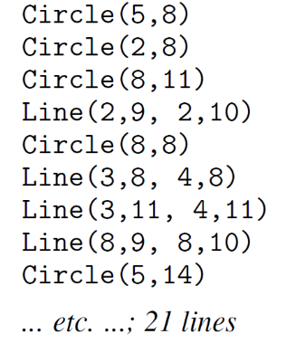
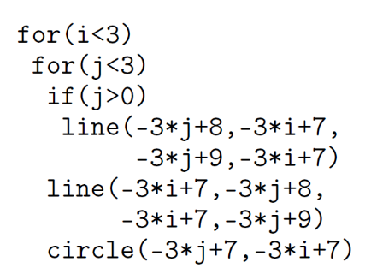
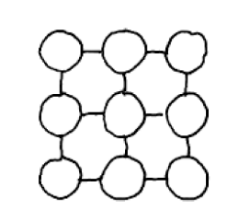
From images to programs
NN + Search
Synthesis
Hand Drawn Figure
Description of
elements in the drawing
Program representation
of drawing

Slide 16
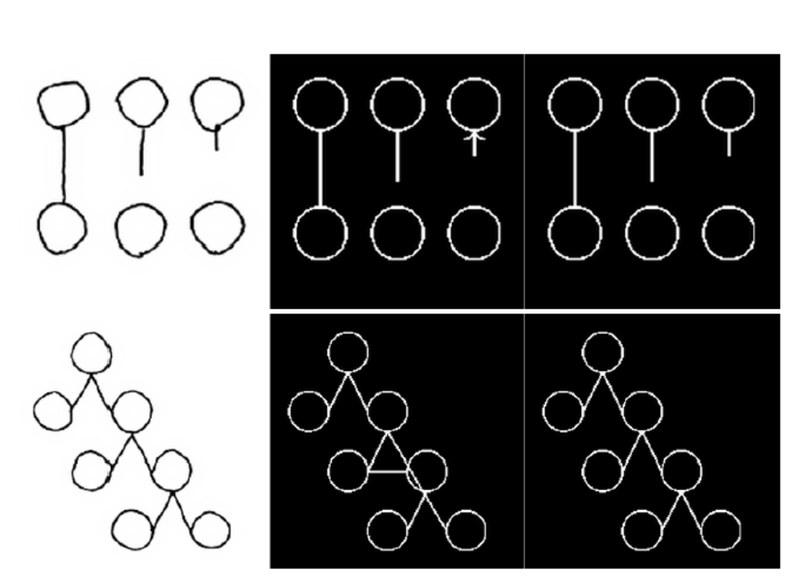
Why? Correcting errors in perception

Slide 17


Unsupervised learning
[$out_{0}, out_{1}, …,out_{k}$]
$f$
$$in_{i}$$
$${out}_{i}$$
This is hopelessly underspecified
  Can we identify the process that generated the sequence?

Slide 18

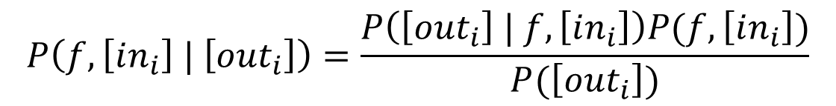

Unsupervized learning
$$P\left(f, \left[in_{i}\right] | \left[out_{i}\right]\right)=\frac{P\left(\left[out_{i}\right] | f,\left[in_{i}\right]\right)P(f,\left[in_{i}\right])}{P(\left[out_{i}\right])}$$
Assuming independence:
$P\left(\left[out_{i}\right] | f,\left[in_{i}\right]\right)=Π_{i} P\left(out_{i} | f, in_{i}\right)$
$$P\left(f,\left[in_{i}\right]\right)=P\left(f\right)∗Π_{i} P\left(in_{i}\right)$$

Slide 19
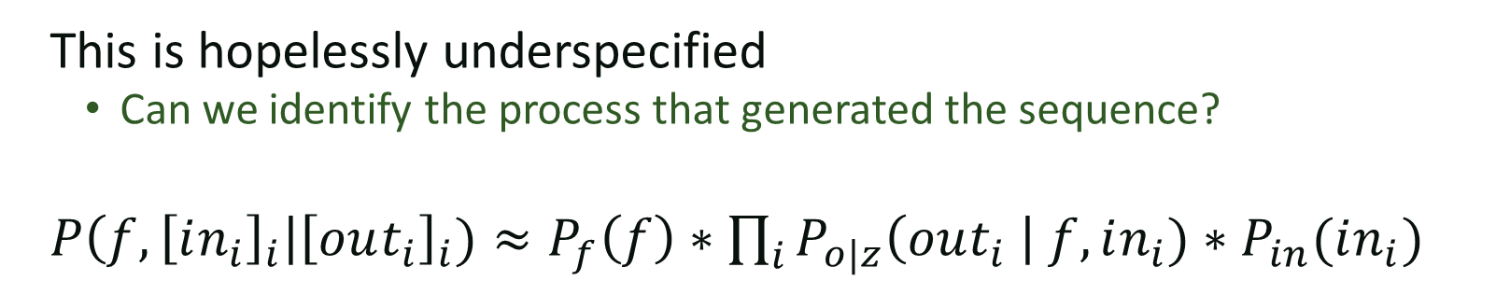
Unsupervised learning
[$out_{0}, out_{1}, …,out_{k}$]
$f$
$$in_{i}$$
$${out}_{i}$$
This is hopelessly underspecified
  Can we identify the process that generated the sequence?
$P\left(f, {\left[in_{i}\right]}_{i}\right|{\left[out_{i}\right]}_{i})≈P_{f}\left(f\right)∗\prod_{i}{P_{o|z}\left(out_{i} \right| f,in_{i})∗P_{in}(in_{i})}$

Slide 20
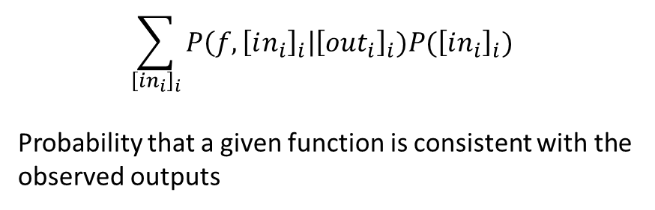
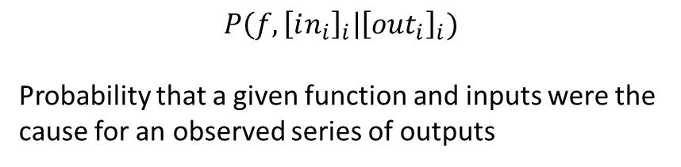
To marginalize or not to Marginalize
$$\sum_{{\left[in_{i}\right]}_{i}}{P\left(f, {\left[in_{i}\right]}_{i}\right|{\left[out_{i}\right]}_{i})P({\left[in_{i}\right]}_{i})}$$
Probability that a given function is consistent with the observed outputs
$$P\left(f, {\left[in_{i}\right]}_{i}\right|{\left[out_{i}\right]}_{i})$$
Probability that a given function and inputs were the cause for an observed series of outputs
Which of the two functions above should you be optimizing?
  Formulation on the left is easier to solve for
    especially with symbolic methods

Slide 21
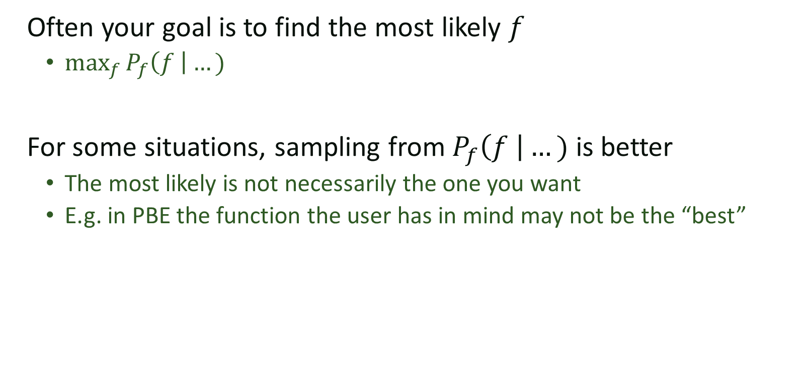
Maximum Likelihood vs Sampling
Often your goal is to find the most likely $f$
  $\max_{f}{P_{f}\left(f \right|…)}$
For some situations, sampling from $P_{f}\left(f \right|…)$ is better
  The most likely is not necessarily the one you want
  E.g. in PBE the function the user has in mind may not be the “best”

Slide 22
Isn’t there a whole field looking into this?
Machine learning has been studying these problems for a while
What we bring to the table:
  Flexible spaces of functions
  Complex distributions
  Powerful symbolic search techniques

Slide 23
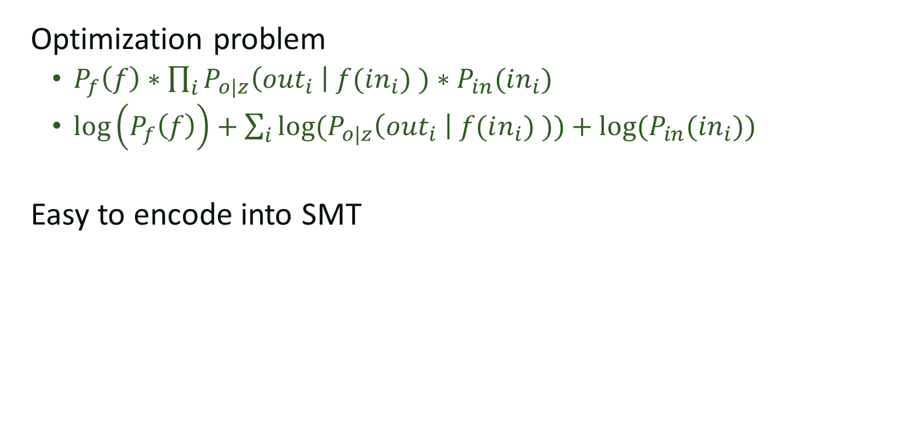
Maximum Likelihood
Optimization problem
  $P_{f}\left(f\right)∗\prod_{i}{P_{o|z}\left(out_{i} \right| f(in_{i}) )∗P_{in}(in_{i})}$
  $\log\left(P_{f}\left(f\right)\right)+\sum_{i}{log⁡(P_{o|z}\left(out_{i} \right| f(in_{i}) ))+log⁡(P_{in}(in_{i}))}$
Easy to encode into SMT

Slide 24
Visual Concept Learning
?

Slide 25
Visual Concept Learning
?
teleport(position[0], 0)
draw(shape[0], scale=1.0)
draw(shape[0], scale=0.5)

Slide 26
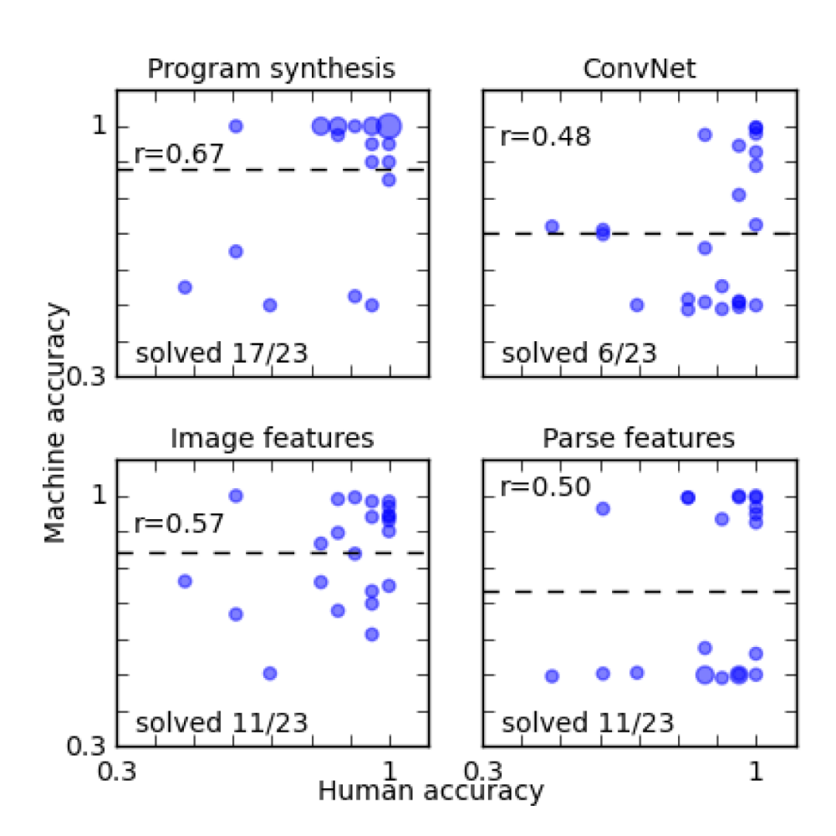
Does it work?
6 positive
6 negative
2000 Image examples
23 Challenge problems
For each problem we have large numbers of positive and negative examples.
6 Symbolic examples
10000 Image examples

Slide 27
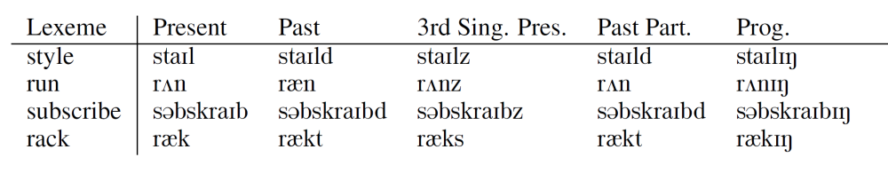

Morphological Rule Learning
Learn rules for constructing different tenses of a word
$$f:\left\langle stem , tense\right\rangle →word$$

Slide 28
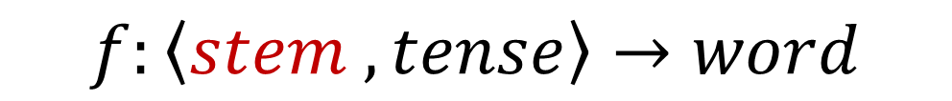
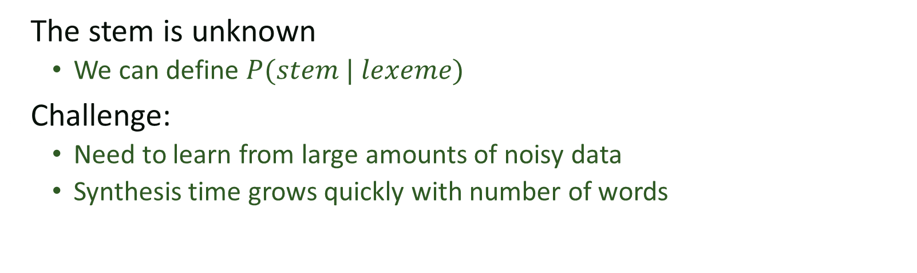
Unsupervised learning
$$f:\left\langle stem , tense\right\rangle →word$$
The stem is unknown
  We can define $P(stem | lexeme)$
Challenge:
  Need to learn from large amounts of noisy data
  Synthesis time grows quickly with number of words

Slide 29
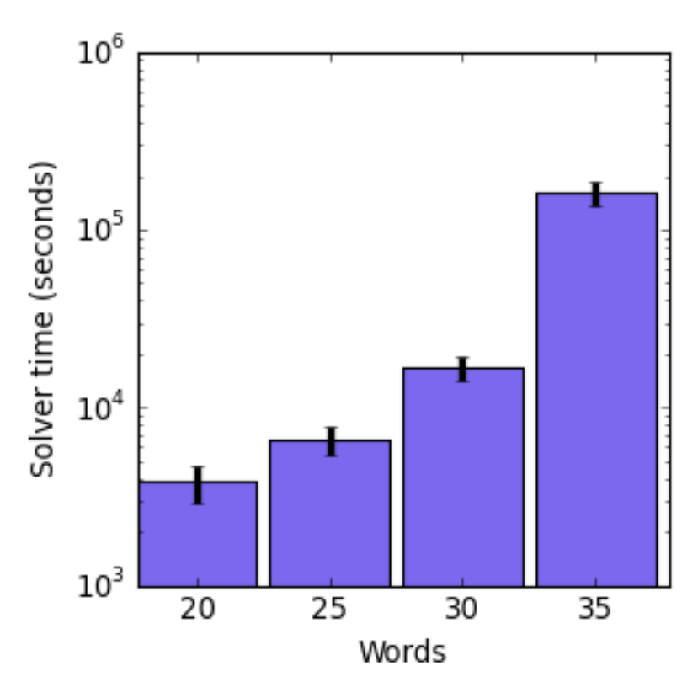
Synthesis time

Slide 30
RANSAC
Random Sample Consensus
Developed by Martin Fischler and Robert Bolles in 1980
Designed to cope with gross errors in data

Slide 31
RANSAC
Key ideas:
  Pick small random samples from the noisy data
  Learn from the samples
  Incorporate other samples consistent with the learned model
  Repeat

Slide 32
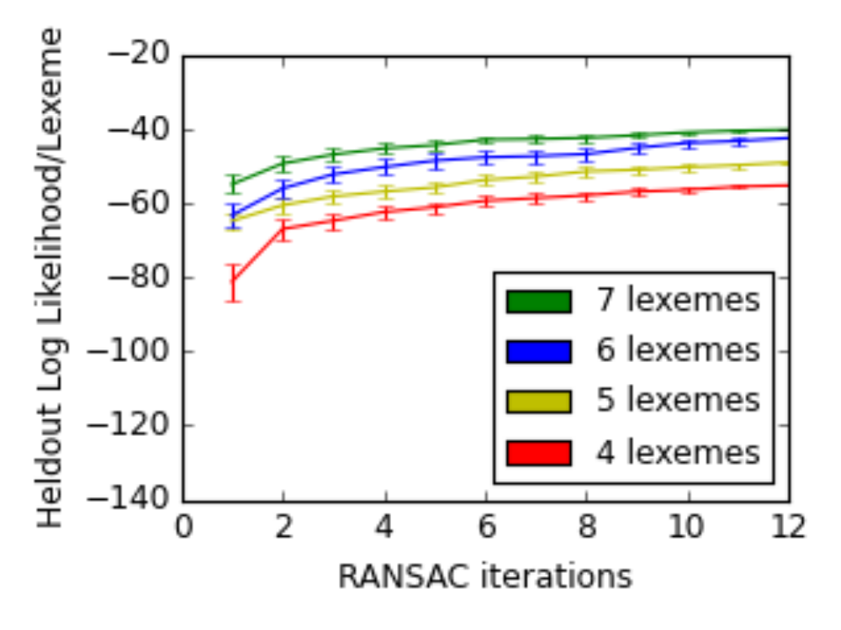
Precision with # of iterations

Slide 33
State of the art
Synthesis
Morfessor
Error Rate
3.16%
16.43%
Caveats: This is not a fair comparison
  Synthesis based solution has much more domain knowledge
  But, that’s part of the point

Slide 34
Learning program distributions

Slide 35
Program Correction
def evaluatePoly ( x0 , x1 ) :
x2 = 0
for x3 in range ( len ( x0 ) - 1) :
x2 = x2 + x0 [ x3 ] * ( x1 ** x3 )
return x2
def evaluatePoly ( x0 , x1 ) :
x2 = 0
for x3 in range ( len ( x0 ) ) :
x2 = x2 + x0 [ x3 ] * ( x1 ** x3 )
return x2

Slide 36
Skipgrams
A skipgram is a natural language structure consisting of a sequence of words with a gap in the middle
Example:
I am going to the store

Slide 37
Program statements as skipgrams
def evaluatePoly ( x0 , x1 ) :
x2 = 0
for x3 in range ( len ( x0 ) ) :
x2 = x2 + x0 [ x3 ] * ( x1 ** x3 )
return x2
Notes:
Think of skipgram as a context

Slide 38
Correction as a regeneration proccess
def evaluatePoly ( x0 , x1 ) :
x2 = 0
for x3 in range ( len ( x0 ) - 1) :
x2 = x2 + x0 [ x3 ] * ( x1 ** x3 )
return x2
def evaluatePoly ( x0 , x1 ) :
x2 = 0
for x3 in range ( len ( x0 ) ) :
x2 = x2 + x0 [ x3 ] * ( x1 ** x3 )
return x2
def evaluatePoly ( x0 , x1 ) :
x2 = 0
for x3 in range ( len ( x0 ) ) :
x2 = x2 + x0 [ x3 ] * ( x1 ** x3 )
return x2
Notes:
Delete the statement and regenreate it fron context

Slide 39
Replacement Insertion Deletion
Our simple correction scheme is flexible:
Replacement Insertion Deletion

Slide 40
Space of edits
We consider all possible replacement, insertions, and deletions given our skipgram context taken in 1 step simultaneously:
Original Program Possible Edits Candidates for each Edit

Slide 41
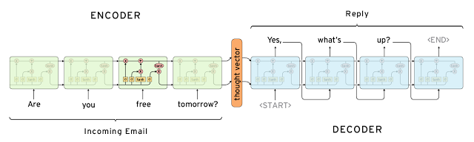
Seq2seq modeling

Slide 42
Modifying Seq2Seq for candidate generation
ENCODING
X: x2 = 0 …. \n
DECODING
v_{x}
<s> for x3 in ... :
….
v_{x}
v_{y}
….
v_{x’}
….
v_{x’}
v_{x’}
Y: for x3 in range …. \n
X’: x2 = x2 …... \n

Slide 43
Probability of Candidate
ENCODING
X: x2 = 0 …. \n
DECODING
v_{x}
<s> for x3 in ... :
….
v_{x}
v_{y}
….
v_{x’}
….
v_{x’}
v_{x’}
Y: for x3 in range …. \n
X’: x2 = x2 …... \n
Pr(for x3 in … \n | X, X’) = Pr(for x3 in … \n | v_y) = Pr(for | v_y, <s>) * Pr(x3 | v_y, <s>, for) * ...

Slide 44
Experiments
Benchmarks | training_raw_n | trianing_filtered_n | testing_n | filterd_score | raw_score
computeDeriv | 1256 | 912 (0.726) | 295 | 23/142 = 0.162 | 23/295 = 0.078
computeRoot | 1611 | 1185 (0.735) | 101 | 12/58 = 0.207 | 12/101 = 0.119
evaluatePoly | 2304 | 1881 (0.816) | 117 | 38/54 = 0.703 | 38/117 = 0.324
oddTuples | 8720 | 6903 (0.791) | 2009 | 491/957 = 0.513 | 491/2009 = 0.244

Slide 45
RANSAC

