Slide 1
Lecture 22
Synthesis with Optimization
Armando Solar-Lezama with slides from Swarat Chaudhuri

Slide 2
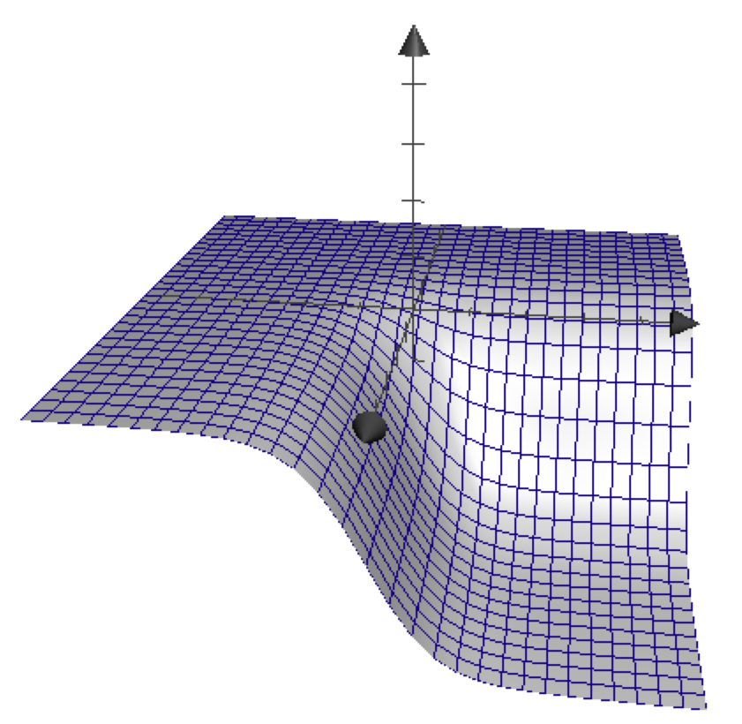

Numerical Optimization
Goal: Find a (hopefully global) minima of a function
  Sample the function on a small set of values
  Based on the result sample in a new set of locations
Gradient descent
Newton iteration
…

Slide 3
Numerical Optimization for Synthesis
Many synthesis problems are best framed as optimization problems
  Especially true for problems involving hybrid systems or probabilities

Slide 4




The Parameter Synthesis Problem
tOff := ??; tOn := ??; h := ??
forever{
temp := readTemp();
if (isOn() && temp > tOff)
switchHeaterOff();
elseif ( !isOn() && temp < tOn)
switchHeaterOn(h);
}
Warming:
Cooling:
Notes:
To motivate the problem, consider the following simple exercise. You want to develop a thermostat to control the temperature of a house.
The house is a physical system that behaves according to a set of equations that determine how the temperature evolves when the heater is on or off.
The thermostat, in turn, is a simple piece of code that keeps two thresholds; one to determine when to turn the heater on, and one to determine when to turn it off.
The code is very simple, but determining the correct constants is far from trivial; for example, if tOn is too close to the target temperature, then by the time the next reading comes in, you will have overshot the target by too much.
So the challenge is to find the most effective parameters to keep the house comfortable.

Slide 5

The Parameter Synthesis Problem
75·
temp
time
Can we find values of (tOff, tOn, h) to minimize Err?
Notes:
A simple approach to this problem is to write a program that takes tOn, tOff and h as parameters and simulates the behavior of the house and the thermostat.
The output of this program is a series of temperature readings.
Our goal is to keep the house at a pleasant 75deg, we can write an error function that gives us a measure of how close our temperature readings are to the desired temperature.
This error function is also our program, and our goal, is to find values that minimize its output.
At this point, the problem is no longer a parameter synthesis problem; it’s a problem of how to find values that minimize the output of a complicated program.

Slide 6
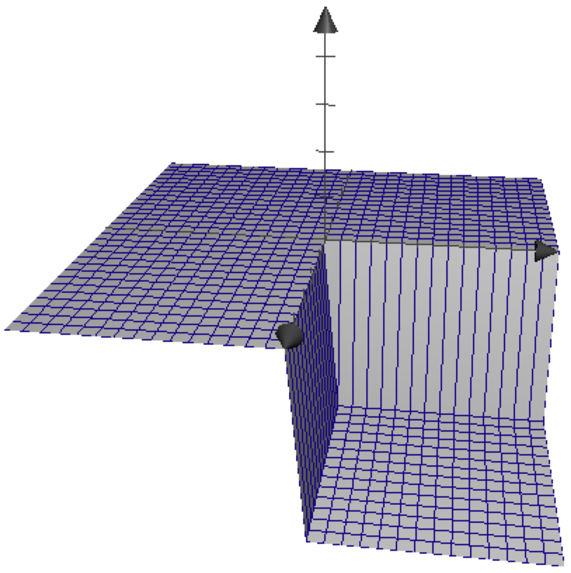
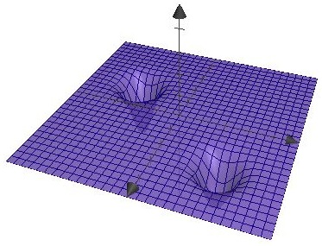
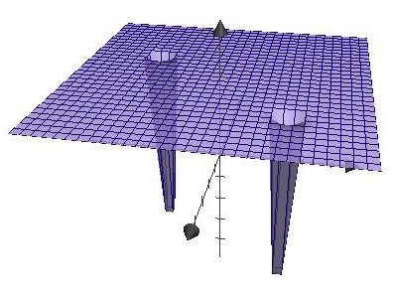
The challenge of optimizing programs
Plateaus and discontinuities thwart search

Slide 7


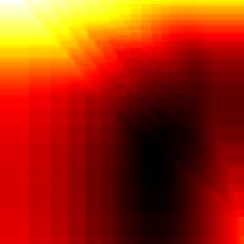
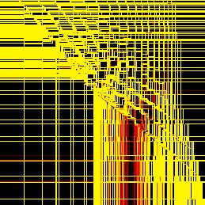


Branches introduce discontinuities
For the thermostat example
Notes:
Function minimization has long been a problem of interest for numerical analysis, so one intriguing idea is to use a standard numerical minimization technique to minimize the Error function.
For example, could we use simple gradient descent algorithm to find a minimum for our function. The problem is that our Error function is not a particularly well behaved function; specifically, the function is full of plateaus and discountinuities as a result of the discrete control flow inside the function.
This is a problem for gradient descent, because for all practical purposes, there is no gradient. In fact, it is a problem for many of the most effective minimization algorithms because they all rely on some kind of continuity and even differentiability assumption.

Slide 8
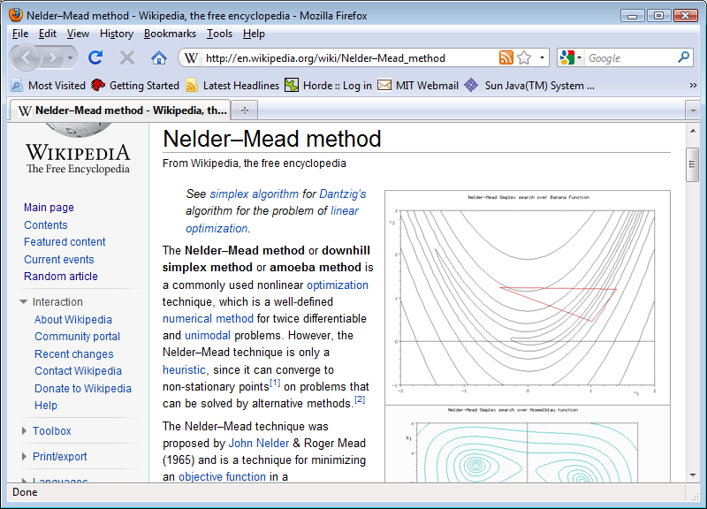
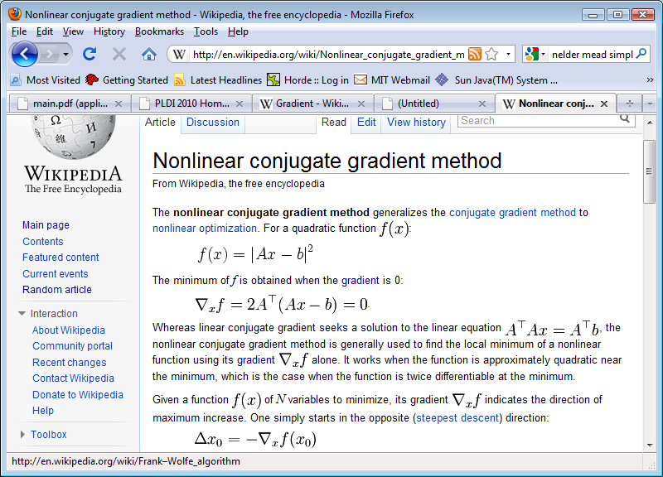
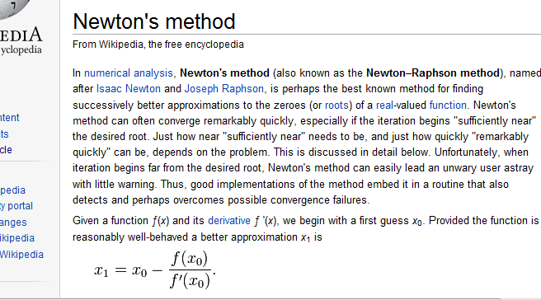
Minimization by numerical Search
Discontinuities affect even the best methods
Notes:
So this approach seems like a dead end, but it raises the question: is it possible to approximate the program with a continuous function, one that works well with these numerical methods?
Because if we can do that, we could use these optimization methods for a whole range of program analysis problems, not just parameter synthesis, but potentially even bug finding.
This is really the big idea of this paper.

Slide 9
Key Idea: Smooth the Function
Approximate the problem by a smooth function

Slide 10
Example: Gaussian Smoothing
Execute on a distribution instead of a value
Program
Output value
Input x

Slide 11
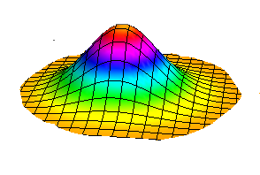
Example: Gaussian Smoothing
Execute on a distribution instead of a value
Expected value smooths discontinuities
Output distribution
Input x
Program
Distribution centered at x
Expected value

Slide 12
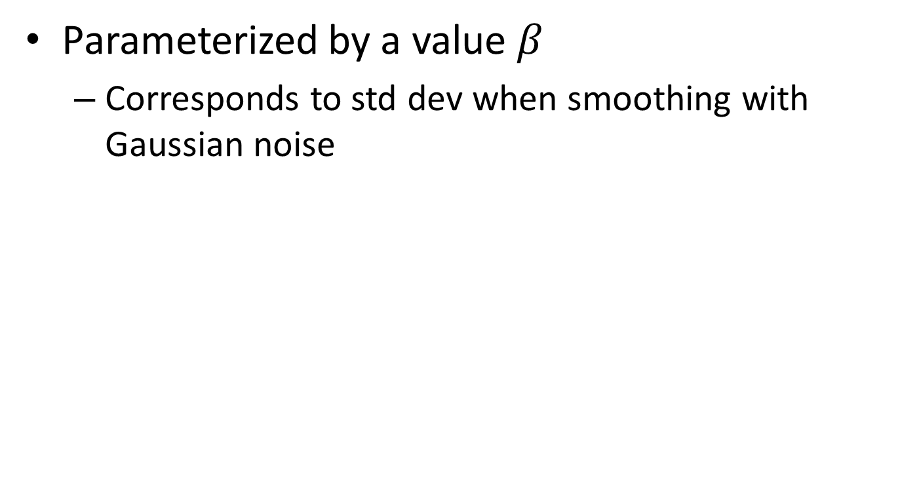
Parameterized Smoothing
Parameterized by a value $β$
  Corresponds to std dev when smoothing with Gaussian noise

Slide 13
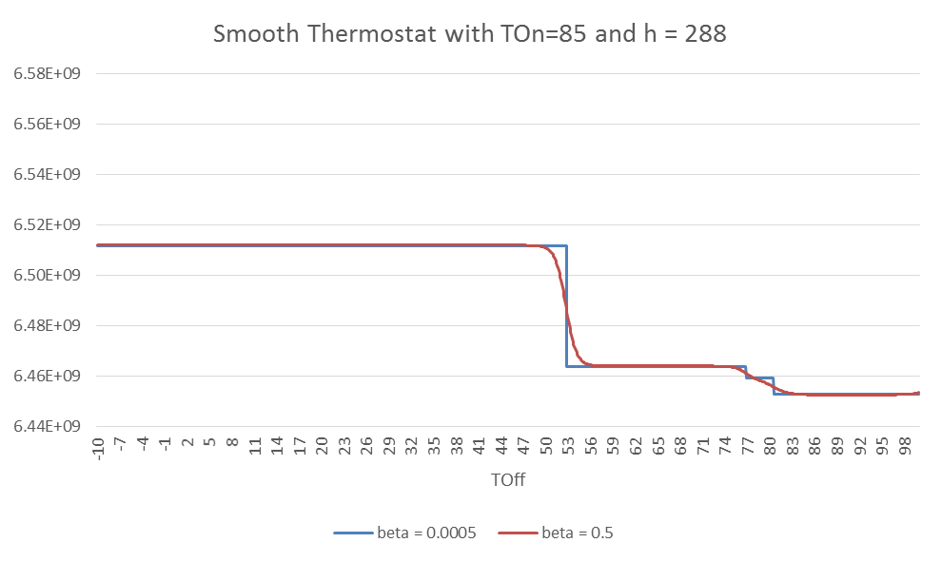
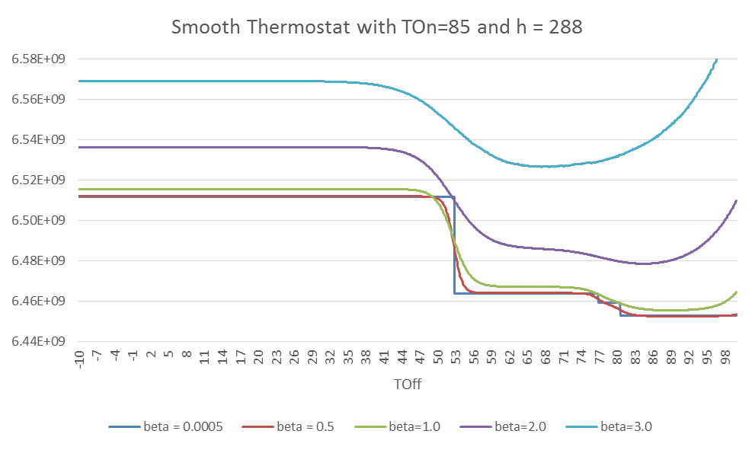
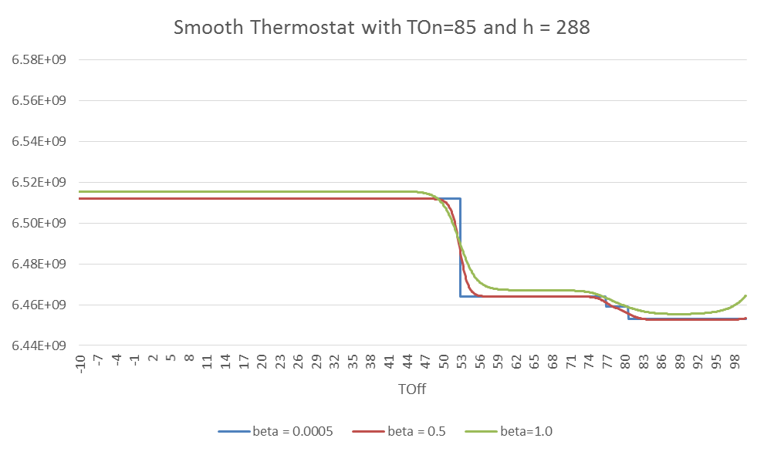
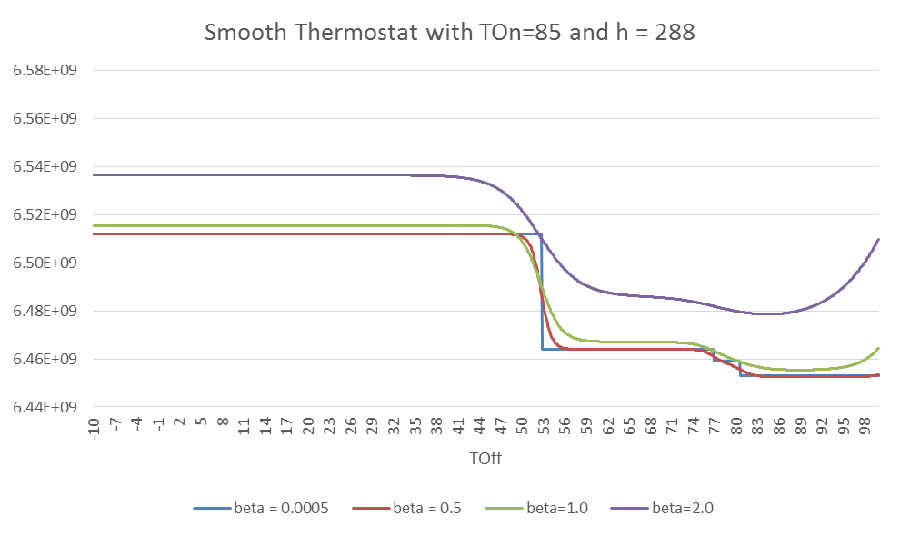
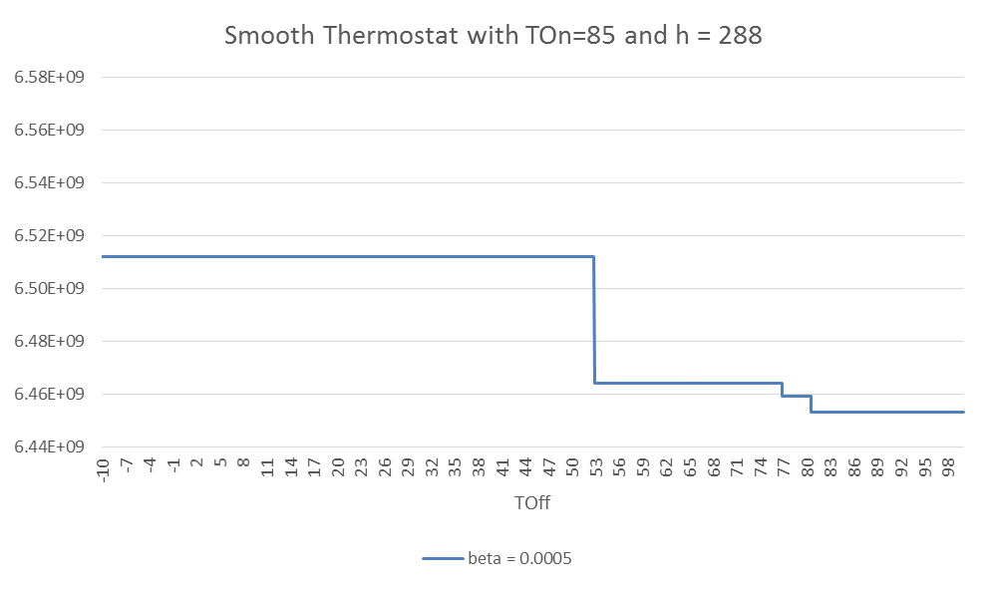
Parameterized Smoothing
Parameterized by a value $β$
  Corresponds to std dev when smoothing with Gaussian noise

Slide 14
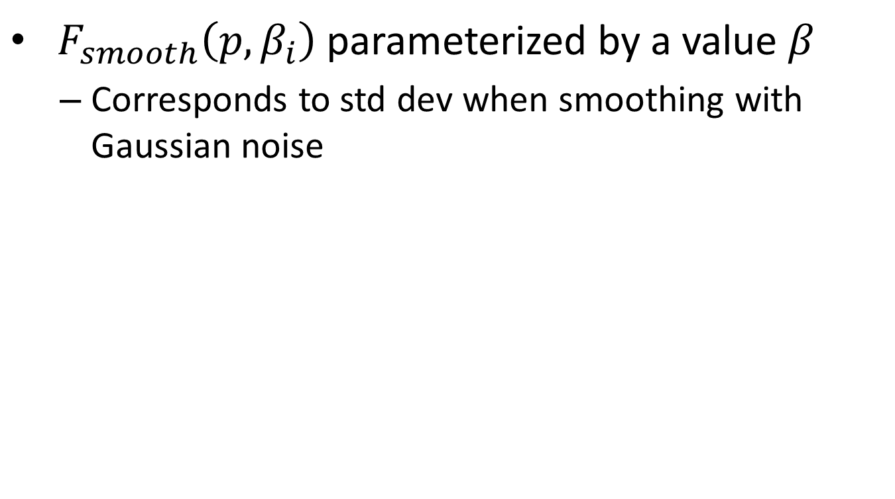
Parameterized Smoothing
${ F}_{smooth}\left(p, β_{i}\right)$ parameterized by a value $β$
  Corresponds to std dev when smoothing with Gaussian noise
Minima of smooth function is different from minima of the original

Slide 15
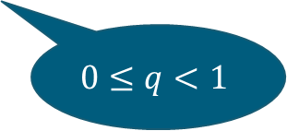
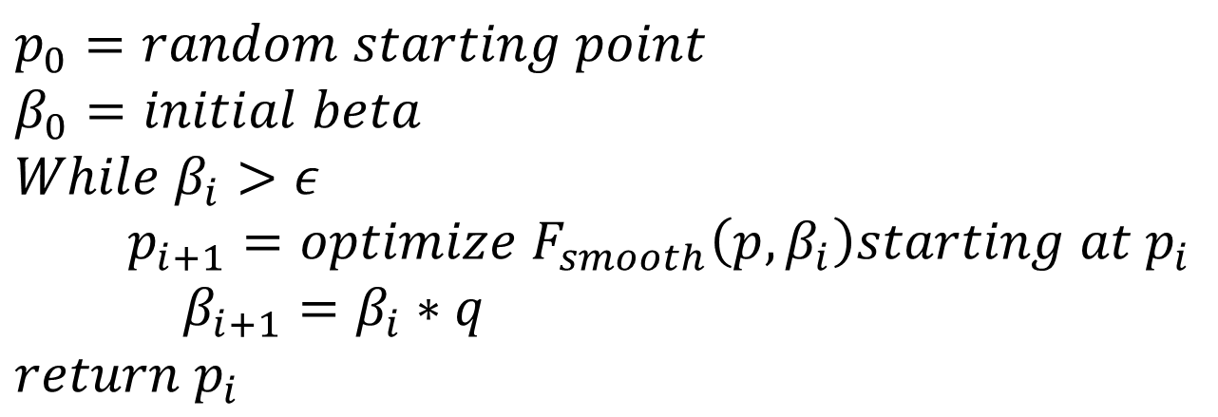
Smoothed Numerical Search
$$p_{0}=random starting point$$
$$β_{0}=initial beta$$
$$While β_{i}>ε$$
$p_{i+1}=optimize{ F}_{smooth}\left(p, β_{i}\right)starting at p_{i}$
$β_{i+1}=β_{i}∗q$
$return p_{i}$
$$0≤q<1$$

Slide 16
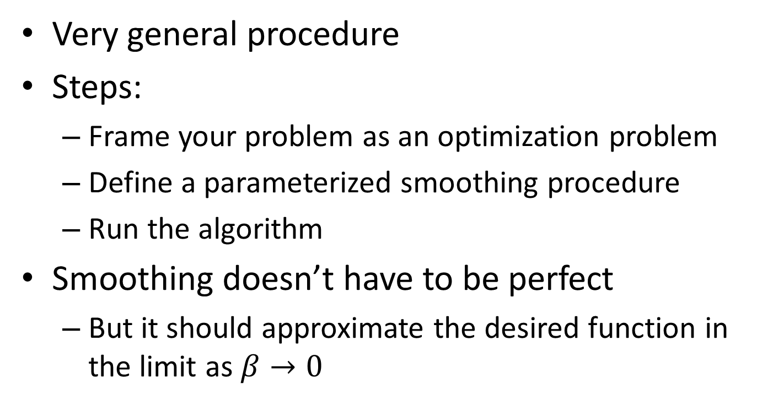
Smoothed Numerical Search
Very general procedure
Steps:
  Frame your problem as an optimization problem
  Define a parameterized smoothing procedure
  Run the algorithm
Smoothing doesn’t have to be perfect
  But it should approximate the desired function in the limit as $β→0$

Slide 17
Euler:
SNS for programs

Slide 18
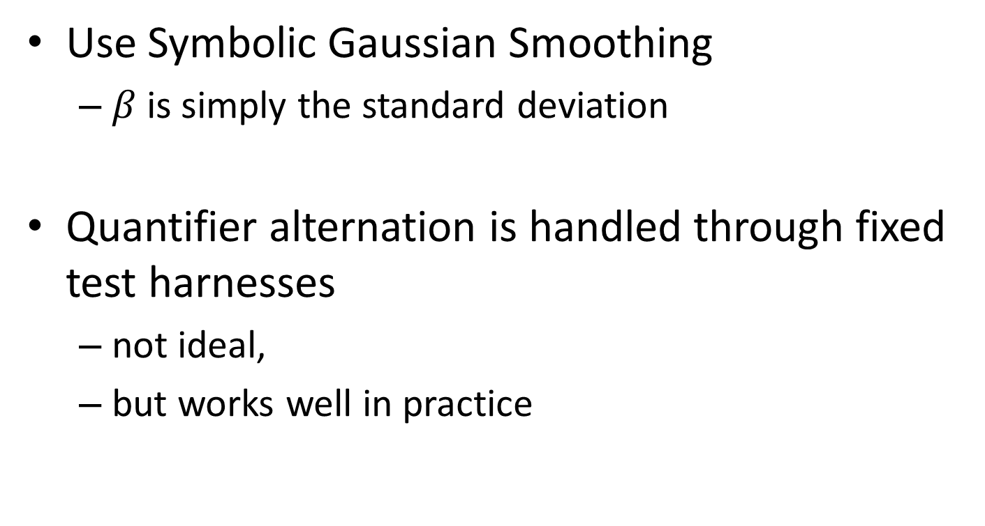
SNS in Euler
Use Symbolic Gaussian Smoothing
  $β$is simply the standard deviation
Quantifier alternation is handled through fixed test harnesses
  not ideal,
  but works well in practice

Slide 19


Smoothed Numerical Search in Euler
Euler Search Procedure
Sketch
(.sk file)
Executable
(.out file)
Optimization
backend (GSL)
Euler
compiler
main () { … }
program() {
… ?? ...
}
Nelder-mead
simplex search
smoothParallel
(β, x) {
… x ..
}
$$x_{N}$$

Slide 20
Smooth Interpretation
How do we execute a program on a distribution of inputs?
  Not by sampling
    we would miss essential features of the search landscape.
  Symbolic execution:
    propagate symbolic representations of distributions.
Input x
Program
Approximation of expected
output
Notes:
Not numerically, as it would require us to discretize. This would miss important features.

Slide 21
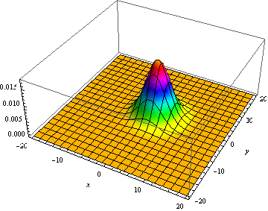
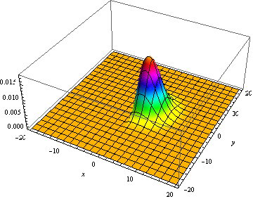
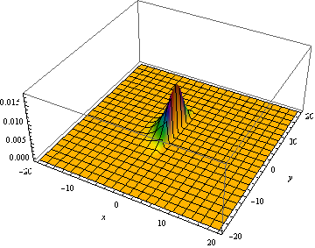
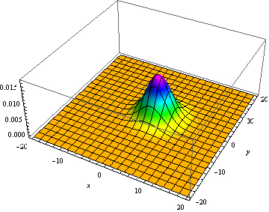
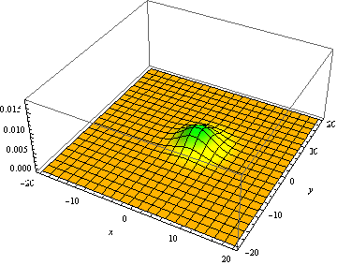
Smooth Interpretation: Branch
if( x > 0 )
true
false

Slide 22
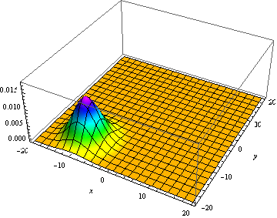
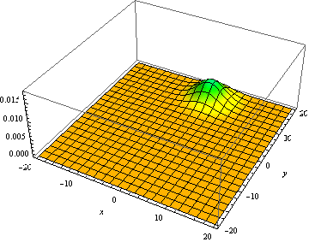
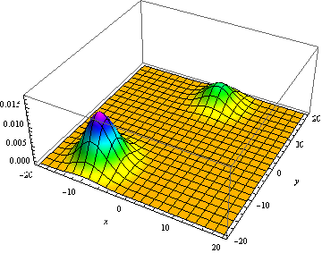
Smooth Interpretation: Join
if( x > 0 )
true
false

Slide 23
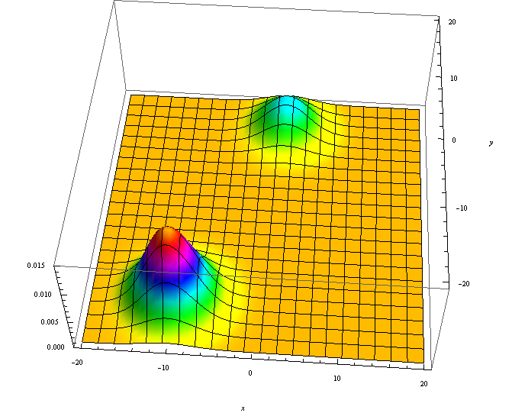
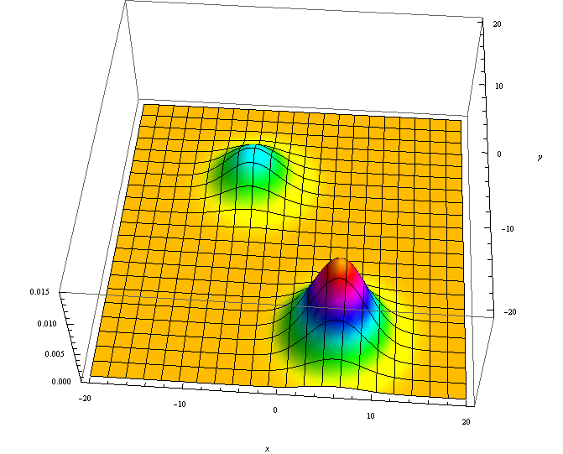
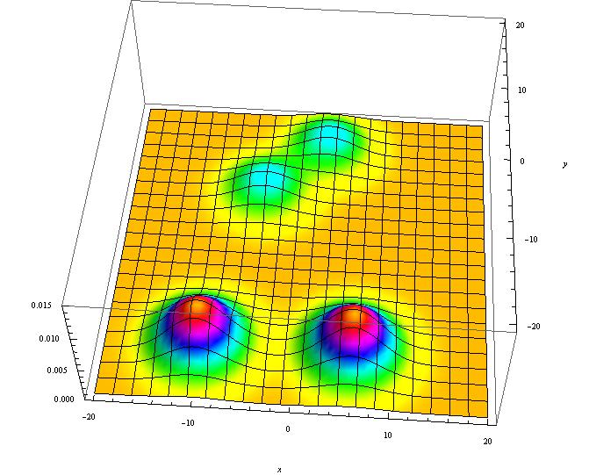
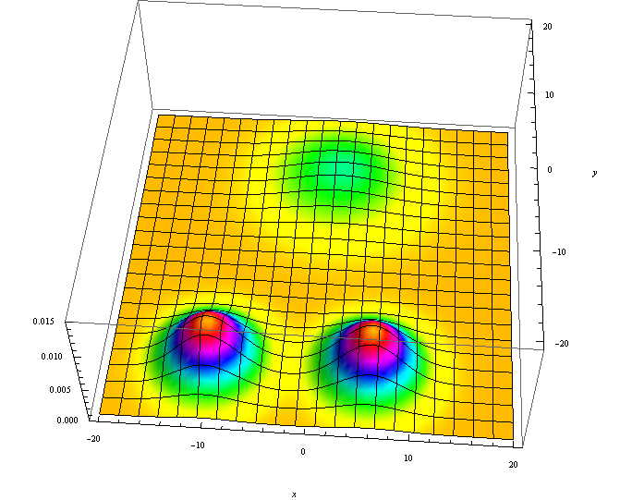
Smooth Interpretation: Join
if( x > 0 )
true
false

Slide 24
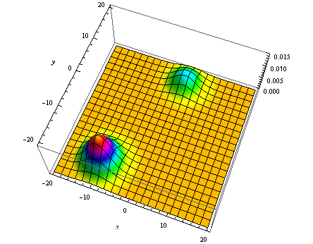
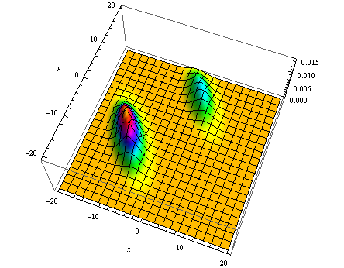
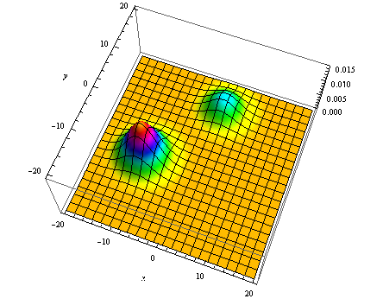
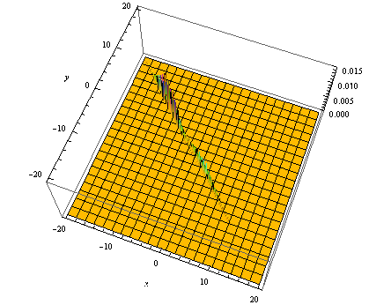
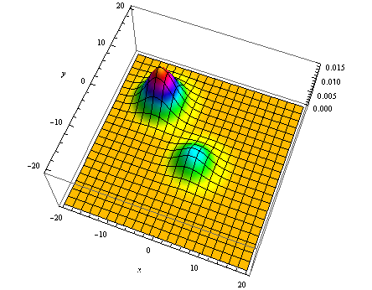
Smooth Interpretation: Assignment
x = x - y;
x = -y;

Slide 25
Approximations
Trick Question:
  Which of the previous approximations is problematic?

Slide 26
Approximations
Trick Question:
  Which of the previous approximations is problematic?
Merging can introduce discontinuities!

Slide 27
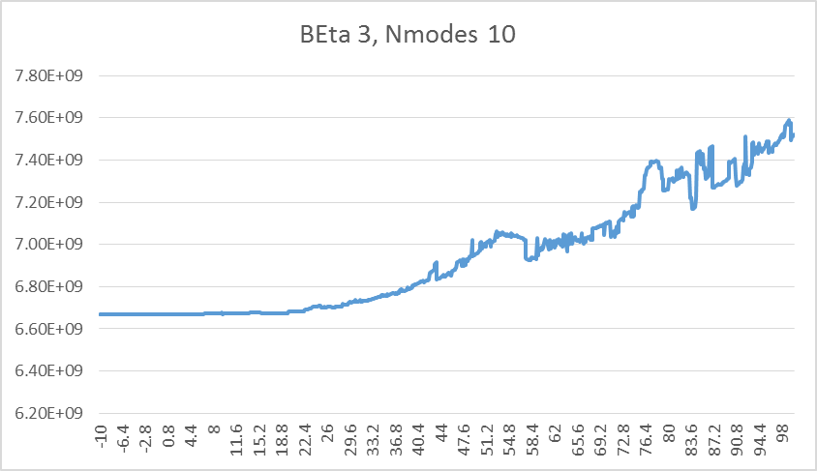
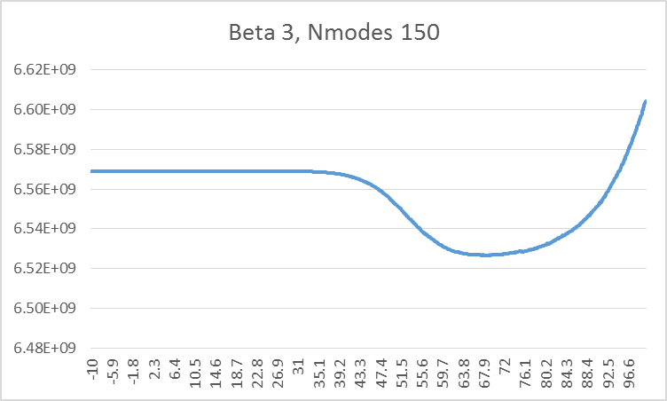
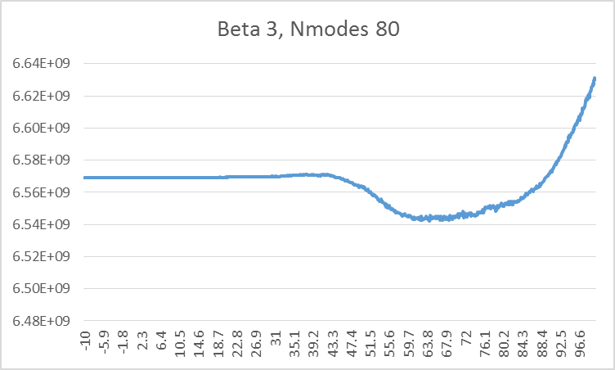
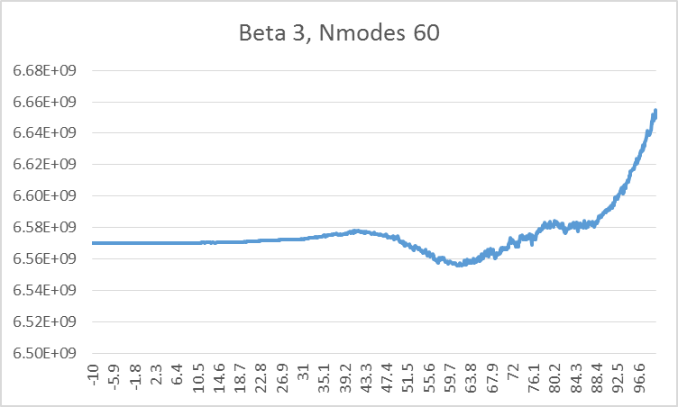
Excessive merging can cause problems

Slide 28
Examples

Slide 29

Parameter synthesis
t₁ := ??; t₂ := ??; A₁ := ??;
A₂ := ??;
repeat (every ΔT) {
if (stage = BACK && time > t₁)
stage = INTURN;
if (stage = INTURN) {
if (time > t₂) then stage = OUTTURN;
angle = angle – A₁; }
if (stage = OUTTURN)
angle = angle + A₂;
moveCar();
}
Notes:
We were motivated by a class of optimal control problems. Parameter synthesis

Slide 30
Parameter synthesis
t₁ := ??; t₂ := ??; A₁ := ??;
A₂ := ??;
repeat (every ΔT) {
if (stage = BACK && time > t₁)
stage = INTURN;
if (stage = INTURN) {
if (time > t₂) then stage = OUTTURN;
angle = angle – A₁; }
if (stage = OUTTURN)
angle = angle + A₂;
moveCar();
}
Notes:
We were motivated by a class of optimal control problems. Parameter synthesis

Slide 31
Parameter synthesis
t₁ := ??; t₂ := ??; A₁ := ??;
A₂ := ??;
repeat (every ΔT) {
if (stage = BACK && time > t₁)
stage = INTURN;
if (stage = INTURN) {
if (time > t₂) then stage = OUTTURN;
angle = angle – A₁; }
if (stage = OUTTURN)
angle = angle + A₂;
moveCar();
}
Notes:
We were motivated by a class of optimal control problems. Parameter synthesis

Slide 32
Application : Parameter synthesis
Error = distance between
ideal and actual final position
t₁ := ??; t₂ := ??; A₁ := ??;
A₂ := ??;
repeat (every ΔT) {
if (stage = BACK && time > t₁)
stage = INTURN;
if (stage = INTURN) {
if (time > t₂) then stage = OUTTURN;
angle = angle – A₁; }
if (stage = OUTTURN)
angle = angle + A₂;
moveCar();
}
Goal: minimize Error.
Notes:
We were motivated by a class of optimal control problems. Parameter synthesis

Slide 33
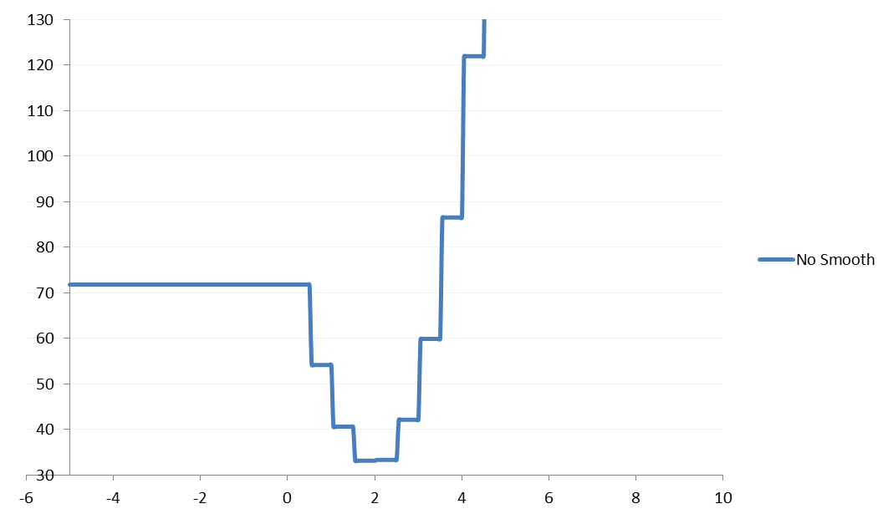
Slice of Error function WRT T2

Slide 34
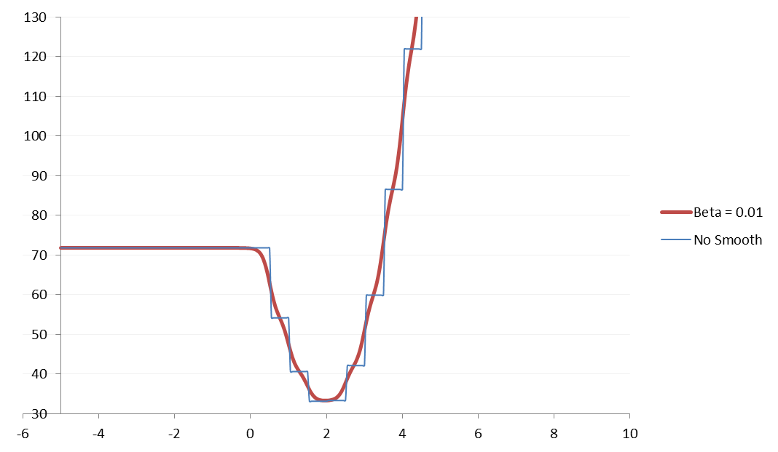
Slice of Error function WRT T2

Slide 35
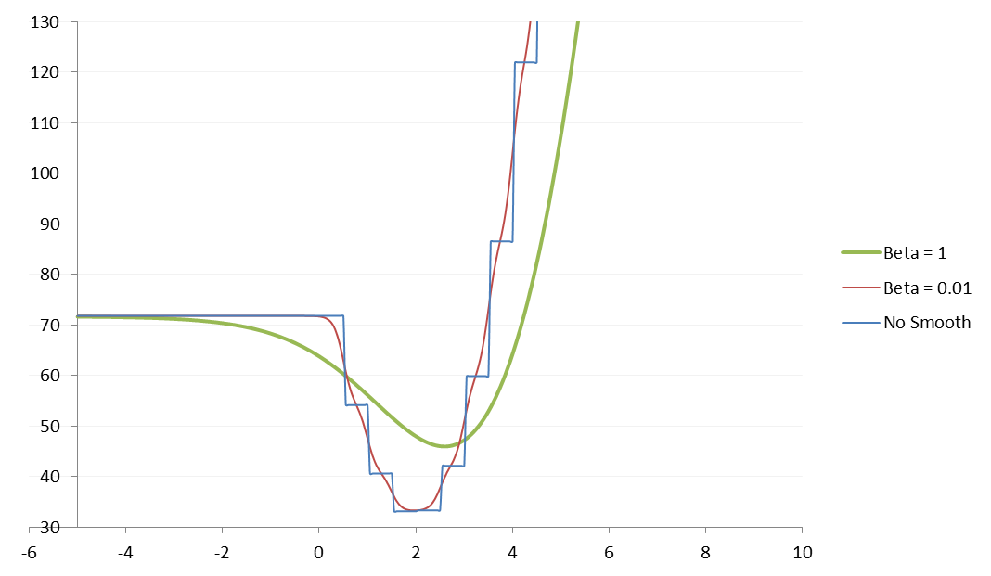
Slice of Error function WRT T2

Slide 36
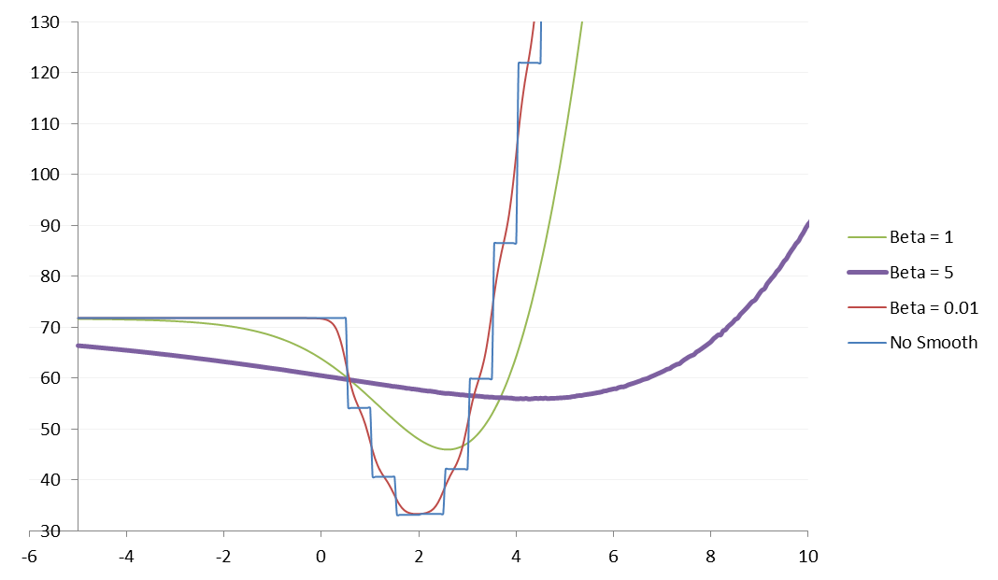
Slice of Error function WRT T2

Slide 37
Numerical Search with Smoothing

Slide 38
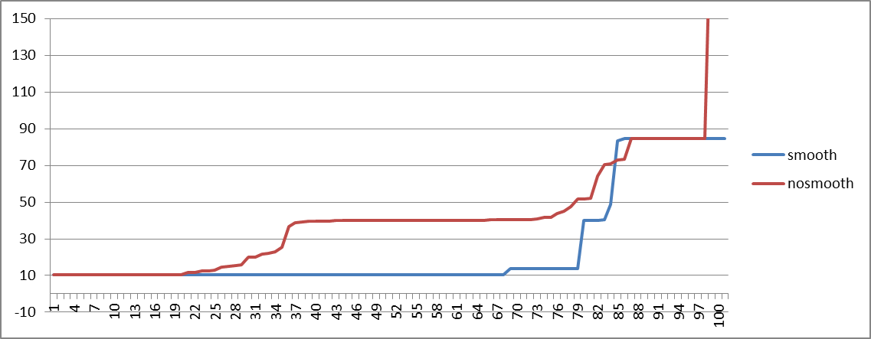
Errors from different starting points
Both are quite good
Both are quite bad
Result of smoothing is much better

Slide 39
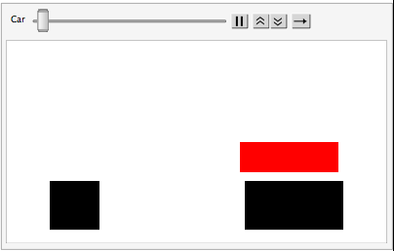
What the difference means
How an error of 40 look like
How an error of 10 looks like

Slide 40
Limitations
Smooth function converges to original function according to L2 norm.
  That’s not enough for optimization.
  The function below converges to the original function, but the local minima is in the worst possible point

Slide 41
Limitations
Programs tend to be difficult to optimize
  Even with smoothing, there are too many local minima
Can be useful in combination with other search techniques
  e.g. Hamiltonian Monte Carlo

Slide 43
Smoothing + Abstract Interpretation

Slide 44
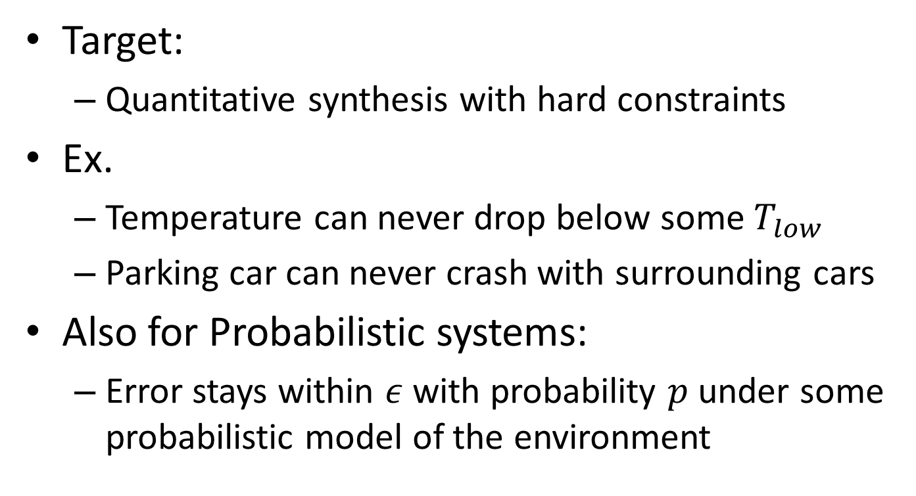
Smooth Verified Synthesis
Target:
  Quantitative synthesis with hard constraints
Ex.
  Temperature can never drop below some $T_{low}$
  Parking car can never crash with surrounding cars
Also for Probabilistic systems:
  Error stays within $ε$ with probability $p$ under some probabilistic model of the environment

Slide 45
Straw-man Approach
Use Euler to create a candidate program
Use Abstract Interpretation to verify program
  If it doesn’t work, repeat
Problems:
  Abstract Interpretation is brittle
  Euler works on concrete test harnesses
    No quantifier alternation

Slide 46
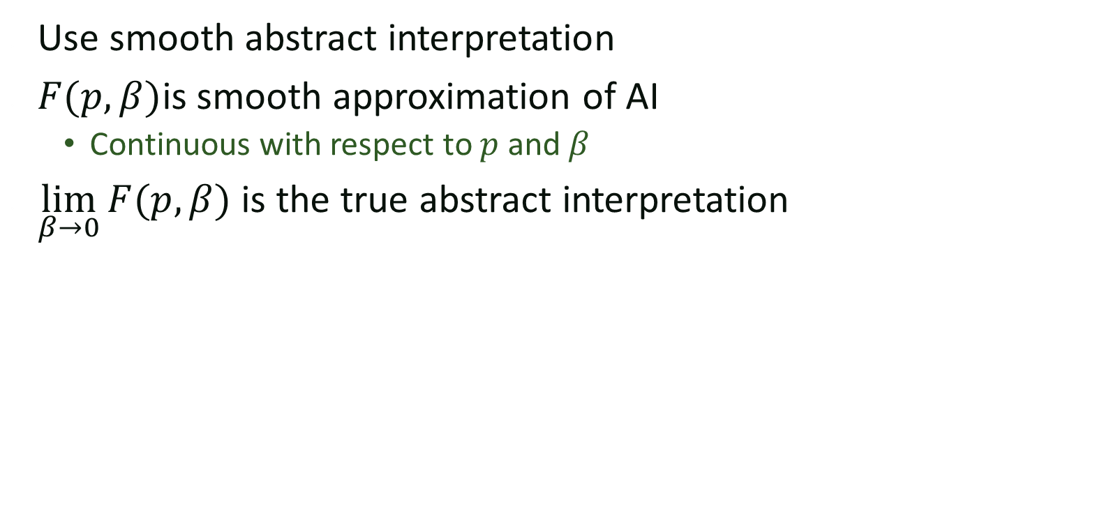
Smooth Verified Synthesis
Use smooth abstract interpretation
$F(p, β)$is smooth approximation of AI
  Continuous with respect to $p$ and $β$
$\lim_{β→0}{F(p, β)}$ is the true abstract interpretation

Slide 47



The Parameter Synthesis Problem
tOff := ??; tOn := ??; h := ??
forever {
temp := readTemp();
if (isOn() && temp-$T_{goal}$ > tOff)
switchHeaterOff();
elseif ( !isOn() && temp-$T_{goal}$ < tOn)
switchHeaterOn(h);
}
Heater On:
$$\frac{d}{dt}temp=h −k⋅(temp−T_{env})$$
Heater Off:
$$\frac{d}{dt}temp= −k⋅(temp−T_{env})$$
assert temp > 60;
Notes:
To motivate the problem, consider the following simple exercise. You want to develop a thermostat to control the temperature of a house.
The house is a physical system that behaves according to a set of equations that determine how the temperature evolves when the heater is on or off.
The thermostat, in turn, is a simple piece of code that keeps two thresholds; one to determine when to turn the heater on, and one to determine when to turn it off.
The code is very simple, but determining the correct constants is far from trivial; for example, if tOn is too close to the target temperature, then by the time the next reading comes in, you will have overshot the target by too much.
So the challenge is to find the most effective parameters to keep the house comfortable.

Slide 48


The Parameter Synthesis Problem
$$F(tOff, tOn, h, T_{goal}, T_{env})$$
$F\left(tOff, tOn, h, T_{goal}, T_{env}\right)=[t_{0}, t_{1}, …, t_{k}]$
$$Err\left(tOff, tOn, h, T_{goal}, T_{env}\right)=\sum{\left|t_{i}−T_{goal}\right|}$$
What to do about $T_{goal}$ and $T_{env}?$
Notes:
A simple approach to this problem is to write a program that takes tOn, tOff and h as parameters and simulates the behavior of the house and the thermostat.
The output of this program is a series of temperature readings.
Our goal is to keep the house at a pleasant 75deg, we can write an error function that gives us a measure of how close our temperature readings are to the desired temperature.
This error function is also our program, and our goal, is to find values that minimize its output.
At this point, the problem is no longer a parameter synthesis problem; it’s a problem of how to find values that minimize the output of a complicated program.

Slide 49


Probabilistic Parameter Synthesis
$goal$ and $T_{env}$ are out of our control
  they behave according to a known distribution
Goal: Find values of $tOff, tOn, h$ to optimize the expected error of the system
$$F(tOff, tOn, h, T_{goal}, T_{env})$$

Slide 50
Adding Probabilistic Assertions
tOff := ??; tOn := ??; h := ??
forever {
temp := readTemp();
if (isOn() && temp-goal > tOff)
switchHeaterOff();
elseif ( !isOn() && temp-goal < tOn)
switchHeaterOn(h);
passert temp > 60 : .95;
}
Assertion only has to be true 95% of the time

Slide 51



Background: Probabilistic Semantics
$$P_{C}(x):$$
$P_{C}\left(x\right)${
if(x > C){
x = x + 1;
}else{
x = 5.5;
}
}
$P\left(x\right)${
if(x > ??){
x = x + 1;
}else{
x = 5.5;
}
}
2.5
x > C
x = x + 1
x = 5.5
return x

Slide 52









Background: Probabilistic Semantics
$$μ_{x}=$$
$$P_{C}(x):$$
2.5
x > C
x = x + 1
x = 5.5
return x
Probabilistic Semantics
$$⟦P_{(2.5)}⟧(μ_{x})$$

Slide 53







Background [Monniaux 2000]
A histogram is a natural abstraction for a distribution
$α$({ })
$γ$( )
…

Slide 54


Background:
Verifying Probabilistic Programs [cite]
$$𝒜_{x}=$$
-7.5
-5
-2.5
0
2.5
5
7.5
$$P_{C}(x):$$
2.5
x > C
-7.5
-5
-2.5
0
2.5
5
7.5
x = x + 1
x = 5.5
-7.5
-5
-2.5
0
2.5
5
7.5
-7.5
-5
-2.5
0
2.5
5
7.5
-7.5
-5
-2.5
0
2.5
5
7.5
return x
Abstract Semantics
$$⟦P_{\left(2.5\right)}⟧\left(𝒜_{x}\right)=$$
-7.5
-5
-2.5
0
2.5
5
7.5

Slide 55




Strawman Synthesis Algorithm
$$Objective(H)$$
$$𝒜_{out}=⟦P_{H}⟧\left(𝒜_{x}\right)$$
return $E_{𝒜_{out}}\left[goal\right]+$
$$Penalty(P_{𝒜_{out}}\left[failure\right])$$
Numerical Optimizer
(Nelder-Mead)
Locally optimal parameter $H$
Problem: Objective(H) is highly discontinuous!

Slide 56
Discontinuity of Abstract Interp.
x=
2.49
x > C
x = x + 1
x = 5.5
return x

Slide 57
Discontinuity of Abstract Interp.
$$𝒜_{x}=$$
-7.5
-5
-2.5
0
2.5
5
7.5
x > C
2.49
-7.5
-5
-2.5
0
2.5
5
7.5
x = x + 1
x= 5.5
-7.5
-5
-2.5
0
2.5
5
7.5
-7.5
-5
-2.5
0
2.5
5
7.5
-7.5
-5
-2.5
0
2.5
5
7.5
return x
-7.5
-5
-2.5
0
2.5
5
7.5

Slide 58






Discontinuity of Abstract Interp.
$$⟦P_{\left(2.5\right)}⟧\left(𝒜_{x}\right)$$
$$⟦P_{\left(2.49\right)}⟧\left(𝒜_{x}\right)$$
$$𝒜_{out}^{2.5}$$
$$𝒜_{out}^{2.49}$$
-7.5
-5
-2.5
0
2.5
5
7.5
-7.5
-5
-2.5
0
2.5
5
7.5
$P_{𝒜_{out}^{2.5}}\left[x<2.5\right]≤0$
$$P_{𝒜_{out}^{2.49}}\left[x<2.5\right]≤0.39$$

Slide 59
Smoothed Proof Search

Slide 60


Smooth Abstract Semantics
$${⟦P⟧}_{β}(𝒜)$$
Properties
  $\lim_{β→0}{{⟦P⟧}_{β}\left(𝒜\right)}= ⟦P⟧(𝒜)$
  ${⟦P⟧}_{β}\left(𝒜\right)$ is continuous over $𝒜$ and $β$

Slide 61









Smoothed Proof Search
$$β_{0}=initial β \\ H_{0}=initial random guess$$
$$Search$$
$$Objective(H)$$
$$𝒜_{out}={⟦P⟧}_{β_{i}}\left(𝒜_{x}×dist(H, β\right))$$
$$β_{i}$$
$$β_{i}∗α→ β_{i+1}$$
return $E_{𝒜_{out}}\left[goal\right]+$
$$Penalty(P_{𝒜_{out}}\left[failure\right])$$
Numerical Optimizer
(Nelder-Mead)
$$H_{i}$$
$$H_{i+1}$$

Slide 62


Smoothed Proof Search
$$β_{0}=initial β \\ H_{0}=initial random guess$$
$$β_{0} \\ H_{0}$$
…
$$ε \\ H_{final}$$
Search
Search
Search
Search

Slide 63
Smooth abstract semantics
The details

Slide 64




















Histograms in Higher Dimensions
$$w_{5}$$
$$w_{4}$$
$$w_{2}$$
Weight
$$w_{3}$$
$$w_{1}$$
$$w_{0}$$
-7.5
-5
-2.5
0
2.5
5
7.5
$$E_{0}$$
$$E_{1}$$
$$E_{2}$$
$$E_{3}$$
$$E_{4}$$
$$E_{5}$$
Subsets of $ℝ^{n}$
$$P_{μ}\left[x∈E_{i}\right]≤w_{i}$$
Ellipsoid Domain: Use Ellipsoids to Represent Buckets
$$E_{0}$$
$$w_{0}$$
$$E_{2}$$
$$w_{1}$$
$$w_{2}$$
$$E_{1}$$

Slide 65


Discontinuity
0.5
0.2
0.3
x
y
if( B )
true
false
0.3
0.5
0.2
0.5
y=y-10
y=y+10
x
x
y
y
0.2
0.3
0.5
0.5
x
y

Slide 66
Discontinuity
0.5
0.2
0.3
x
y
if( B )
true
false
0.3
0.5
0.2
y=y-10
y=y+10
x
x
y
y
0.2
0.3
0.5
x
y

Slide 67

Smooth Abstract Semantics
Track “Distance from disappearance”
High α
Low α
Additional information $0 ≤ α_{i} ≤ 1$for each ellipsoid
  $α_{i}=ρ_{β}(Vol)$ a smooth, monotone function of ellipsoid volume
  When vol=0, $α_{i}=0$
  $\lim_{β→0} ρ_{β}\left(V\right)= \left\{\begin{aligned}0 if V=∅ \\ 1 otherwise\end{aligned}\right.⁡$

Slide 68











Smooth Abstract Semantics
0.5
0.2
0.3
$$α_{0}=1$$
$$α_{1}=1$$
$$α_{2}=1$$
x
y
if( B )
true
false
0.3
0.5
0.2
0.5
y=y-10
y=y+10
x
$$α_{0}=1$$
$$α_{1}=0.2$$
y
x
$$α_{1}=1$$
$$α_{2}=1$$
y
0.2
0.3
$$α_{0}=1$$
0.5
x
$$α_{1}=0.2$$
$$α_{1}=1$$
$$α_{2}=1$$
y

Slide 69
















Discontinuity
0.5
0.2
0.3
$$α_{0}=1$$
$$α_{1}=1$$
$$α_{2}=1$$
x
y
if( B )
true
false
0.5
0.5
0.3
y=y-10
y=y+10
0.2
$$α_{0}=1$$
$$α_{1}=1.0$$
$$α_{1}=0.1$$
$$α_{1}=0.5$$
$$α_{1}=1.0$$
$$α_{2}=1$$
$$α_{1}=1.0$$
$$α_{1}=0.8$$
0.5
0.2
0.3
$$α_{0}=1$$
$$α_{2}=1$$
$$α_{1}=1.0$$
$$α_{1}=0.5$$
$$α_{1}=0.1$$
$$α_{1}=0.8$$
$$α_{1}=1.0$$

Slide 70
More Smooth Abstract Semantics
We also need smooth approximations of
  Expected value computation
  Probability bound computation

Slide 71
Some Empirical Results

Slide 72
Experimental Setup
Vary execution setup across two axis:
  What we measure
    Bound we can prove for the synthesized program
    Empirically observed bound on the behavior of the real program
  What we optimize
    Objective function returns the result of standard AI
    Objective function returns the result of running the implementation on a few samples
    Objective function returns the result of smooth AI

Slide 73
Thermostat Expectation
Proved Bounds
    Nelder-Mead on Smooth Interpretation (SNS)
    Nelder-Mead on standard (non-smooth) AI
    Nelder-Mead on samples

Slide 74
Thermostat Expectation
Measured Bounds
    Nelder-Mead on samples
    Nelder-Mead on Smooth Interpretation (SNS)
    Nelder-Mead on standard (non-smooth) AI

Slide 75
Thermostat Probability Bounds
    Nelder-Mead on Smooth Interpretation (SNS)
    Nelder-Mead on standard (non-smooth) AI
    Nelder-Mead on samples

