Slide 1
Lecture 24
Neurosymbolic Synthesis
Armando Solar-Lezama with slides from Swarat Chaudhuri

Slide 2

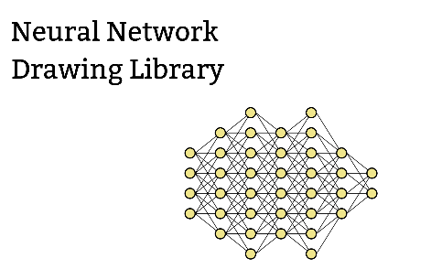

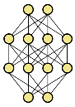


























Neurosymbolic program synthesis
Neural Guided Search
Symbolic Guided DL
Distillation
Relaxation
Goal
$$□$$
Goal
Goal
$$λ$$
$$in$$
$$out$$
$$⇓$$
$$⇓$$
$$in$$
$$out$$
$$in$$
$$out$$
$$⇓$$
$$λ$$
map $□$ $□$
$$⇓$$
$$in$$
$$out$$
$$in$$
$$λ$$
$$out$$
$$λ$$
$$in$$
$$out$$
Component Discovery
Goals
Components
map $in$ $λ □$
$$λ$$

Slide 3
Neural Guided Search
Goal
$$□$$
Leverage the ability of NN to learn complex conditional distributions
Network guides the search for programs that satisfy the goals
map $□$ $□$
map $in$ $λ □$

Slide 4





Symbolic Guided Deep Learning
Symbolic knowledge can be used to guide the training of neural networks
  When you want a network that is consistent with prior knowledge
  When you want to improve data efficiency and better generalization
Goal
$$⇓$$
$$in$$
$$out$$
$$⇓$$
$$in$$
$$λ$$
$$out$$

Slide 5





Distillation
Goal
Use the neural network as a starting point for program synthesis
Replace neural components with symbolic ones
  To improve interpretability and analyzability
  To better generalize out of distribution
  To ensure more predictable behavior
$$⇓$$
$$in$$
$$out$$
$$⇓$$
$$in$$
$$λ$$
$$out$$

Slide 6
Relaxation
Replace symbolic components with neural proxies
  Can help leverage the information in the symbolic component into a larger DL pipeline
  Can help guide the search for symbolic components
$$in$$
$$λ$$
$$out$$
$$λ$$
$$in$$
$$out$$

Slide 7
Relaxation:
Supporting numerical optimization over discrete programs

Slide 8
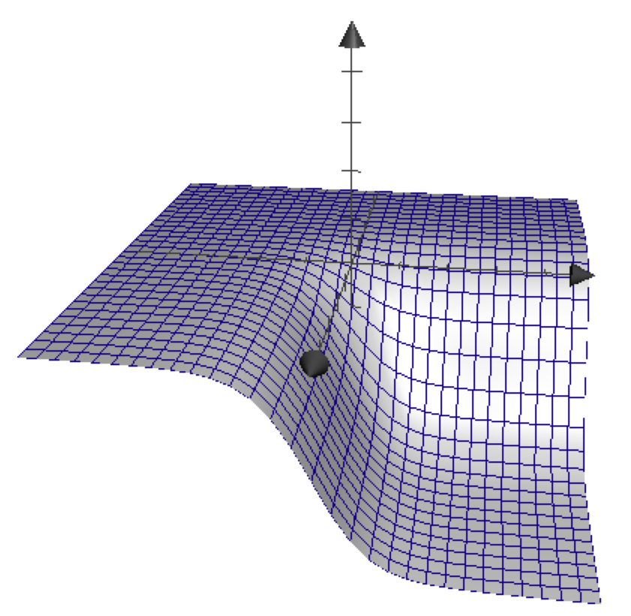

Numerical Optimization
Goal: Find a (hopefully global) minima of a function
  Sample the function on a small set of values
  Based on the result sample in a new set of locations
Gradient descent
Newton iteration
…

Slide 9
Numerical Optimization for Synthesis
Many synthesis problems are best framed as optimization problems
  Especially true for problems involving hybrid systems or probabilities

Slide 10




The Parameter Synthesis Problem
tOff := ??; tOn := ??; h := ??
forever{
temp := readTemp();
if (isOn() && temp > tOff)
switchHeaterOff();
elseif ( !isOn() && temp < tOn)
switchHeaterOn(h);
}
Warming:
Cooling:
Notes:
To motivate the problem, consider the following simple exercise. You want to develop a thermostat to control the temperature of a house.
The house is a physical system that behaves according to a set of equations that determine how the temperature evolves when the heater is on or off.
The thermostat, in turn, is a simple piece of code that keeps two thresholds; one to determine when to turn the heater on, and one to determine when to turn it off.
The code is very simple, but determining the correct constants is far from trivial; for example, if tOn is too close to the target temperature, then by the time the next reading comes in, you will have overshot the target by too much.
So the challenge is to find the most effective parameters to keep the house comfortable.

Slide 11

The Parameter Synthesis Problem
75·
temp
time
Can we find values of (tOff, tOn, h) to minimize Err?
Notes:
A simple approach to this problem is to write a program that takes tOn, tOff and h as parameters and simulates the behavior of the house and the thermostat.
The output of this program is a series of temperature readings.
Our goal is to keep the house at a pleasant 75deg, we can write an error function that gives us a measure of how close our temperature readings are to the desired temperature.
This error function is also our program, and our goal, is to find values that minimize its output.
At this point, the problem is no longer a parameter synthesis problem; it’s a problem of how to find values that minimize the output of a complicated program.

Slide 12
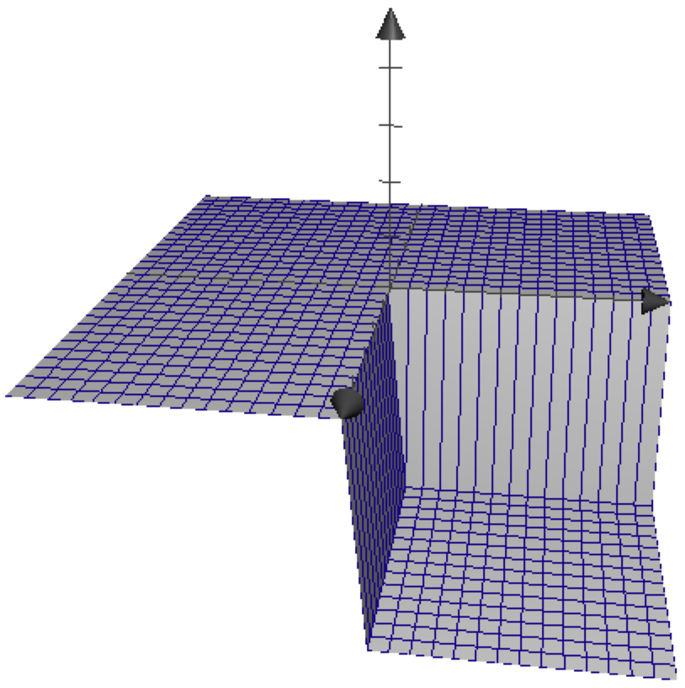
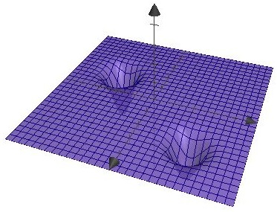
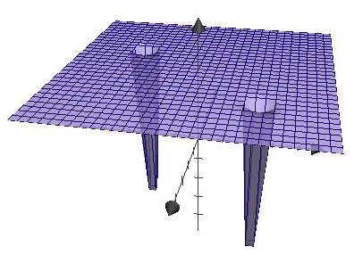
The challenge of optimizing programs
Plateaus and discontinuities thwart search

Slide 13


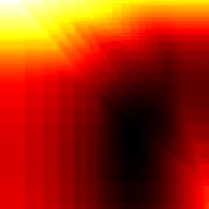
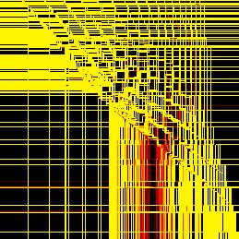


Branches introduce discontinuities
For the thermostat example
Notes:
Function minimization has long been a problem of interest for numerical analysis, so one intriguing idea is to use a standard numerical minimization technique to minimize the Error function.
For example, could we use simple gradient descent algorithm to find a minimum for our function. The problem is that our Error function is not a particularly well behaved function; specifically, the function is full of plateaus and discountinuities as a result of the discrete control flow inside the function.
This is a problem for gradient descent, because for all practical purposes, there is no gradient. In fact, it is a problem for many of the most effective minimization algorithms because they all rely on some kind of continuity and even differentiability assumption.

Slide 14
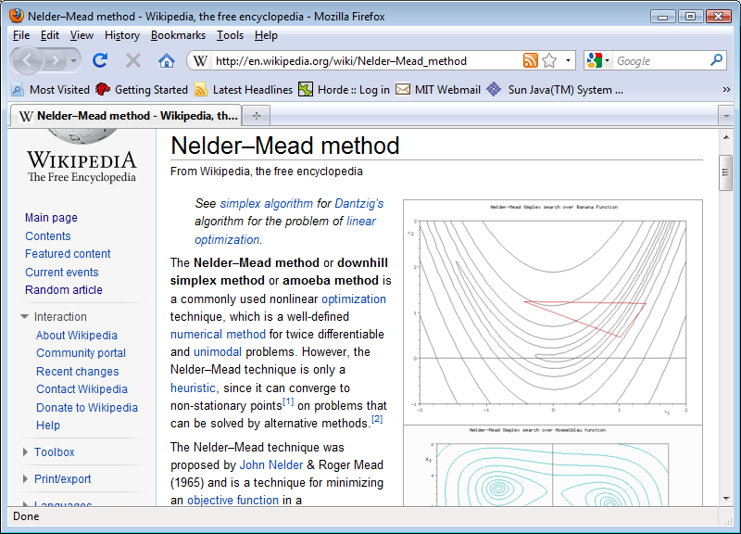
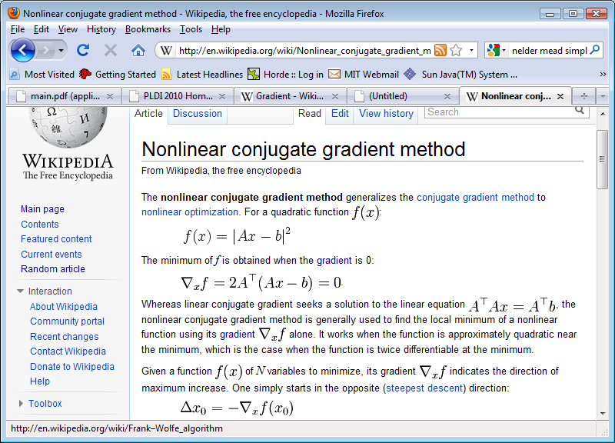
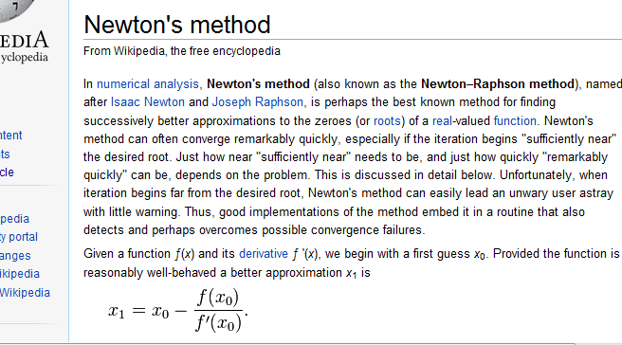
Minimization by numerical Search
Discontinuities affect even the best methods
Notes:
So this approach seems like a dead end, but it raises the question: is it possible to approximate the program with a continuous function, one that works well with these numerical methods?
Because if we can do that, we could use these optimization methods for a whole range of program analysis problems, not just parameter synthesis, but potentially even bug finding.
This is really the big idea of this paper.

Slide 15
Key Idea: Smooth the Function
Approximate the problem by a smooth function

Slide 16
Example: Gaussian Smoothing
Execute on a distribution instead of a value
Program
Output value
Input x

Slide 17
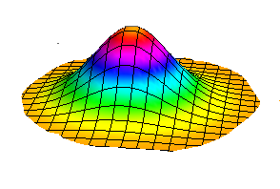
Example: Gaussian Smoothing
Execute on a distribution instead of a value
Expected value smooths discontinuities
Output distribution
Input x
Program
Distribution centered at x
Expected value

Slide 18
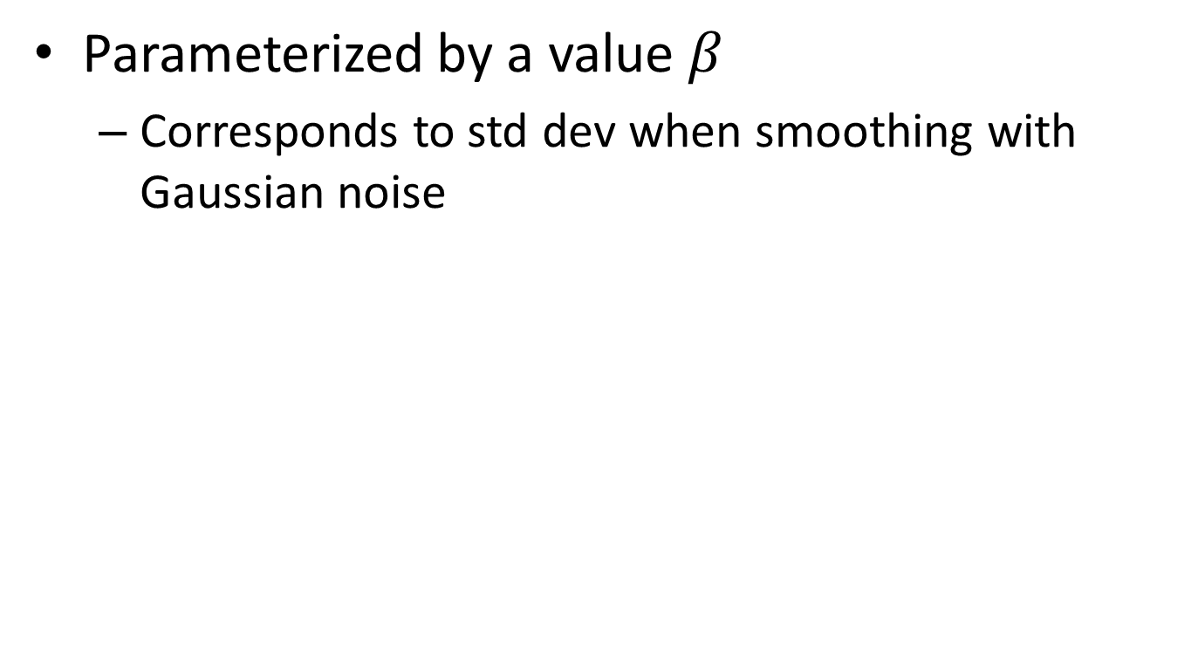
Parameterized Smoothing
Parameterized by a value $β$
  Corresponds to std dev when smoothing with Gaussian noise

Slide 19
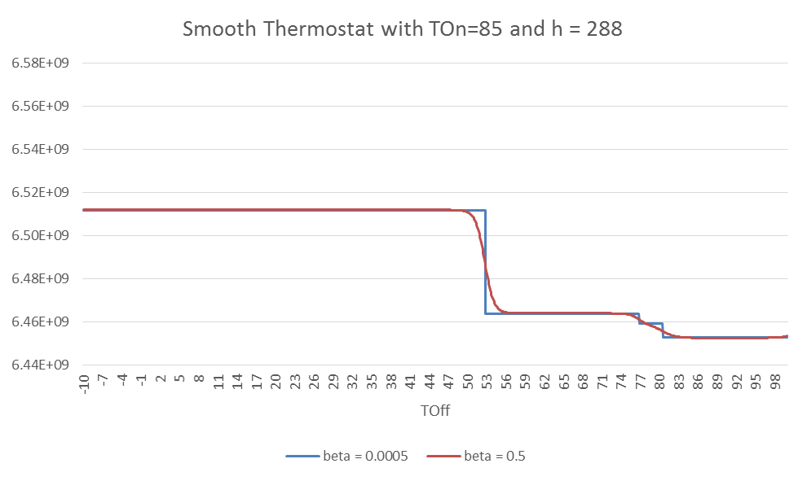
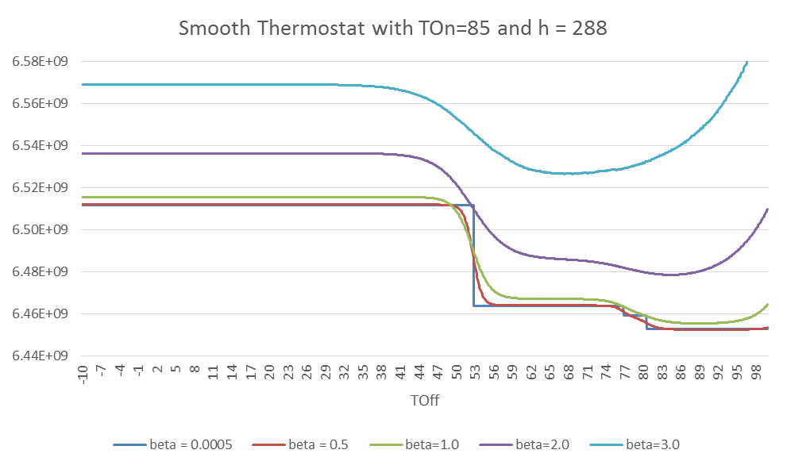
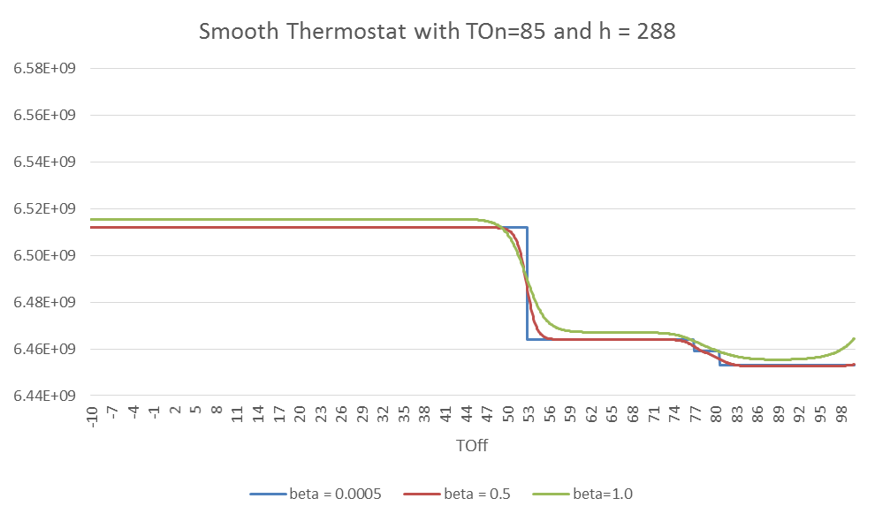
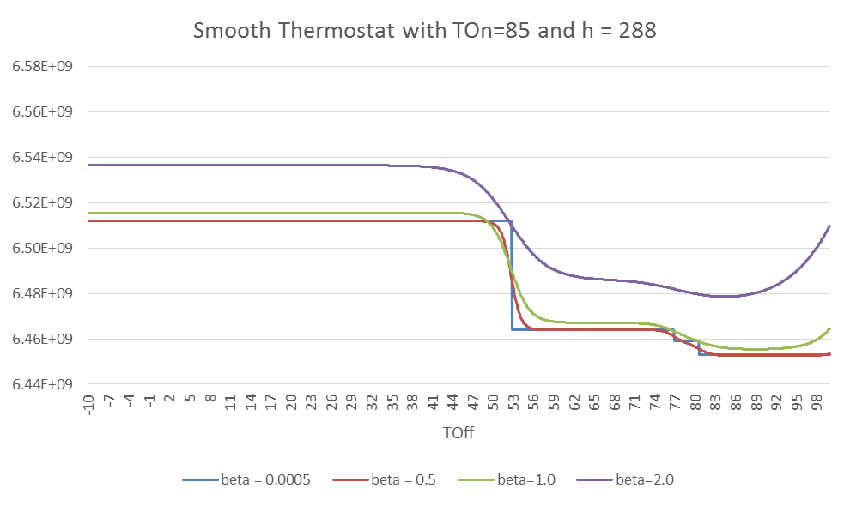
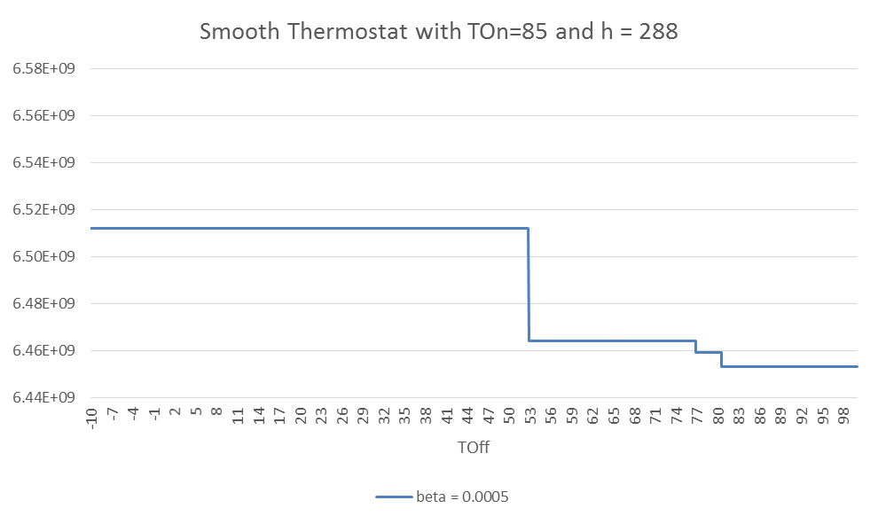
Parameterized Smoothing
Parameterized by a value $β$
  Corresponds to std dev when smoothing with Gaussian noise

Slide 20
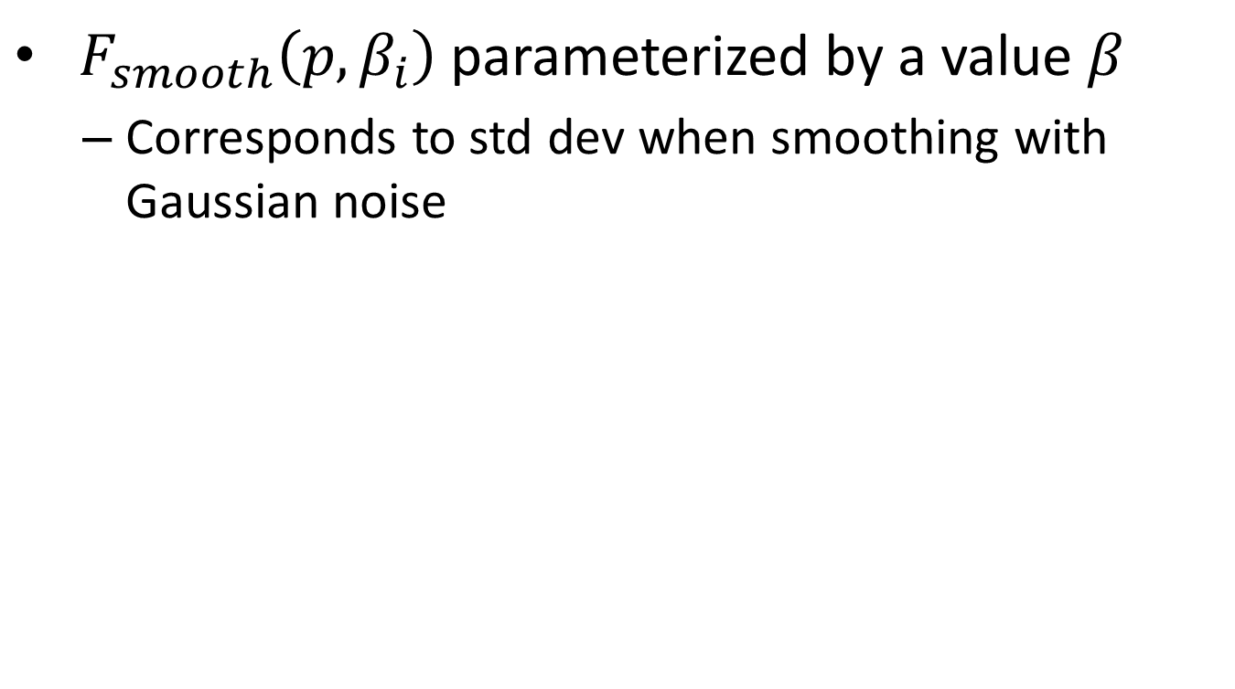
Parameterized Smoothing
${ F}_{smooth}\left(p, β_{i}\right)$ parameterized by a value $β$
  Corresponds to std dev when smoothing with Gaussian noise
Minima of smooth function is different from minima of the original

Slide 21
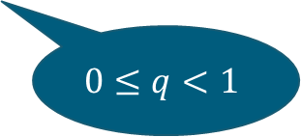
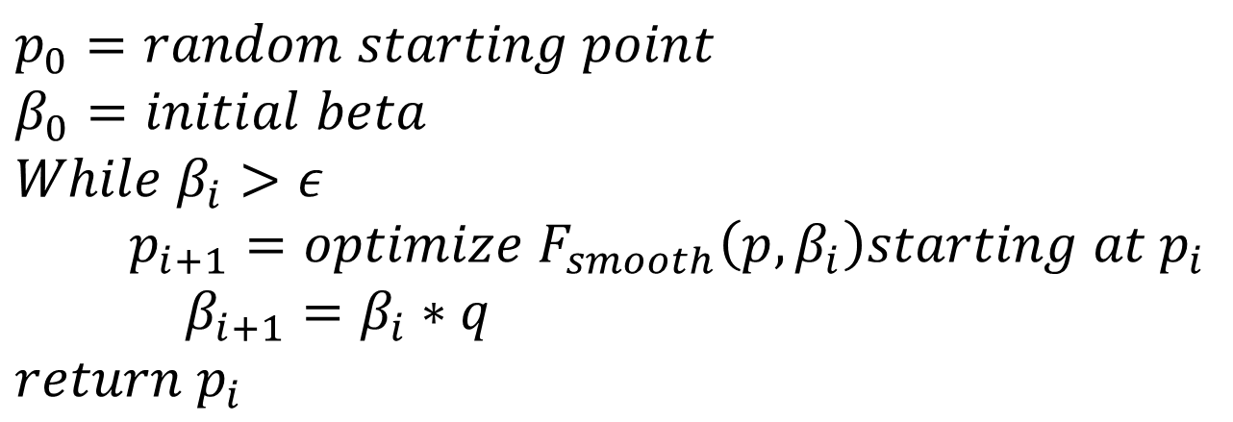
Smoothed Numerical Search
$$p_{0}=random starting point$$
$$β_{0}=initial beta$$
$$While β_{i}>ε$$
$p_{i+1}=optimize{ F}_{smooth}\left(p, β_{i}\right)starting at p_{i}$
$β_{i+1}=β_{i}∗q$
$return p_{i}$
$$0≤q<1$$

Slide 22
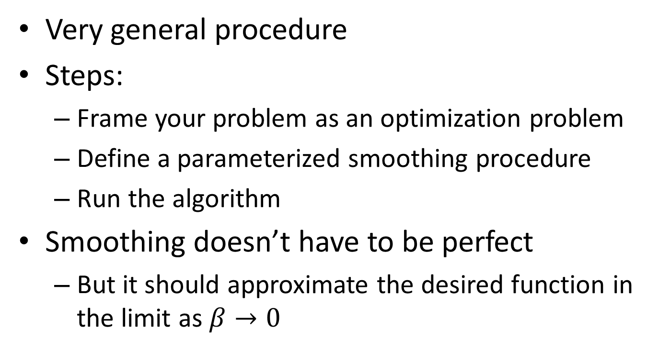
Smoothed Numerical Search
Very general procedure
Steps:
  Frame your problem as an optimization problem
  Define a parameterized smoothing procedure
  Run the algorithm
Smoothing doesn’t have to be perfect
  But it should approximate the desired function in the limit as $β→0$

Slide 23
Euler:
SNS for programs

Slide 24
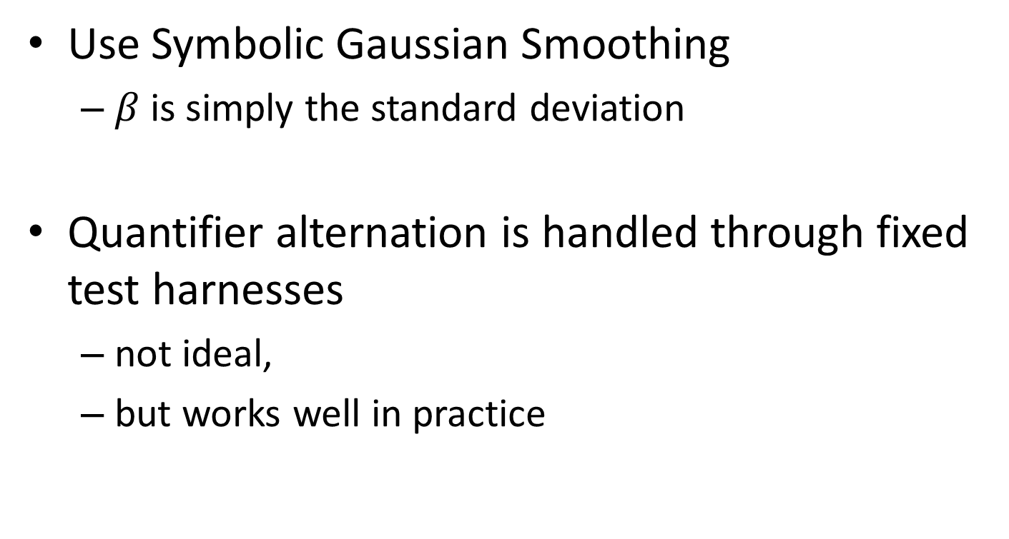
SNS in Euler
Use Symbolic Gaussian Smoothing
  $β$is simply the standard deviation
Quantifier alternation is handled through fixed test harnesses
  not ideal,
  but works well in practice

Slide 25


Smoothed Numerical Search in Euler
Euler Search Procedure
Sketch
(.sk file)
Executable
(.out file)
Optimization
backend (GSL)
Euler
compiler
main () { … }
program() {
… ?? ...
}
Nelder-mead
simplex search
smoothParallel
(β, x) {
… x ..
}
$$x_{N}$$

Slide 26
Smooth Interpretation
How do we execute a program on a distribution of inputs?
  Not by sampling
    we would miss essential features of the search landscape.
  Symbolic execution:
    propagate symbolic representations of distributions.
Input x
Program
Approximation of expected
output
Notes:
Not numerically, as it would require us to discretize. This would miss important features.

Slide 27
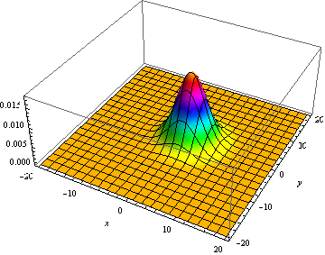
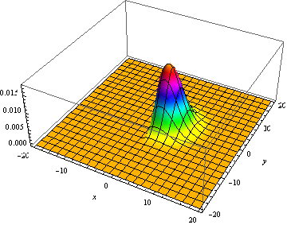
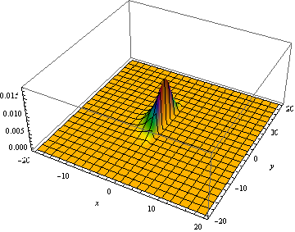
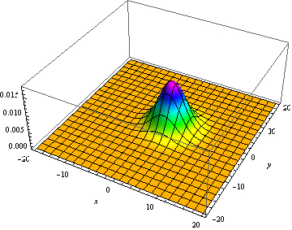
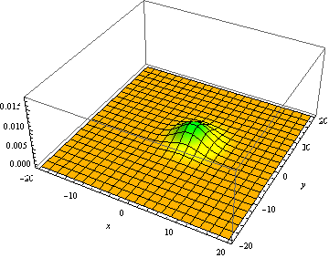
Smooth Interpretation: Branch
if( x > 0 )
true
false

Slide 28
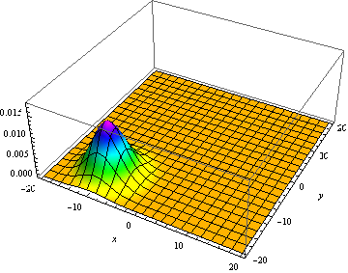
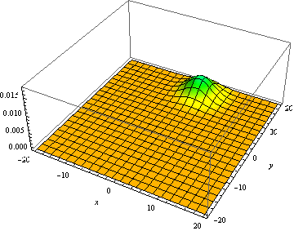
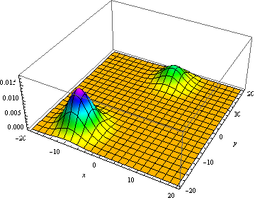
Smooth Interpretation: Join
if( x > 0 )
true
false

Slide 29
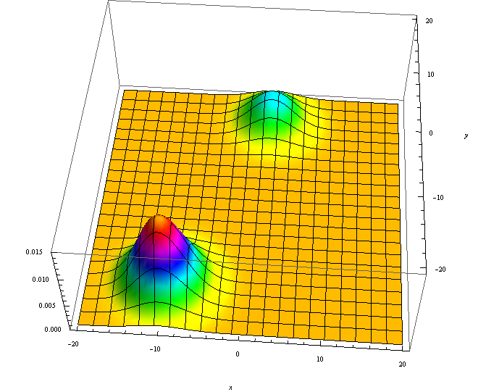
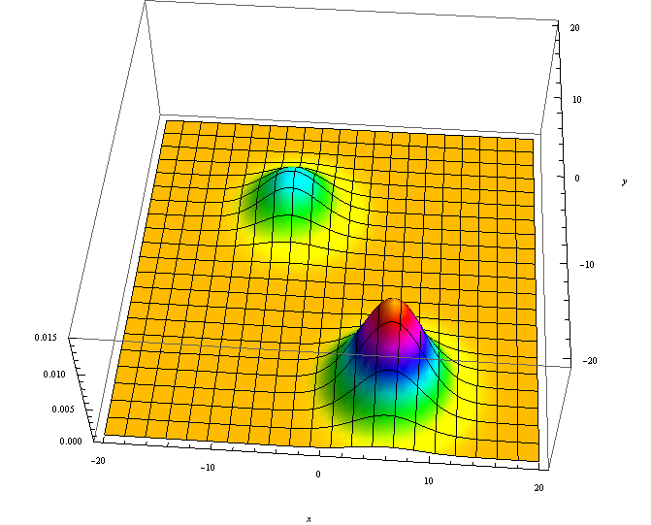
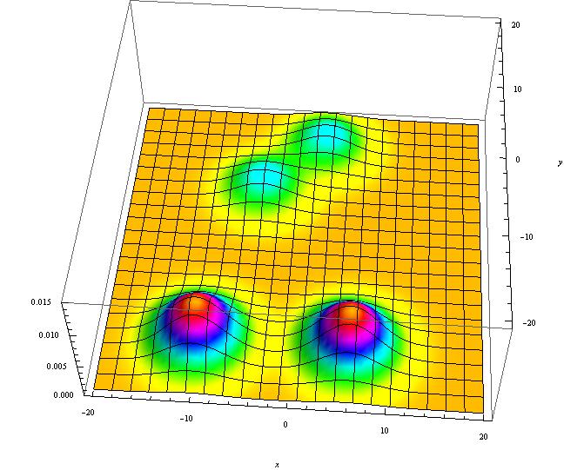
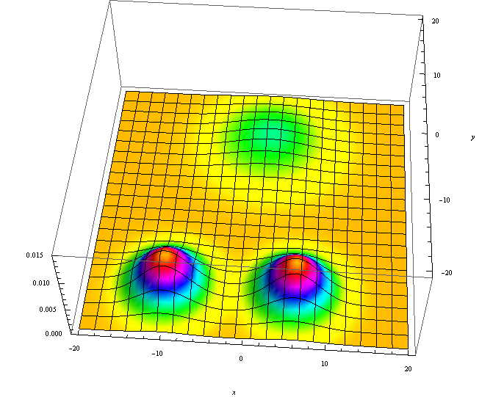
Smooth Interpretation: Join
if( x > 0 )
true
false

Slide 30
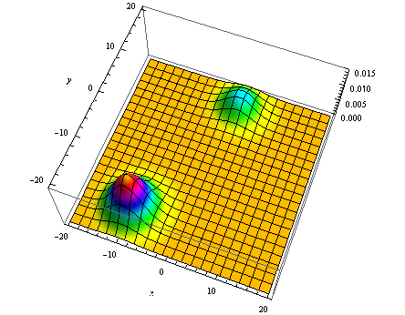
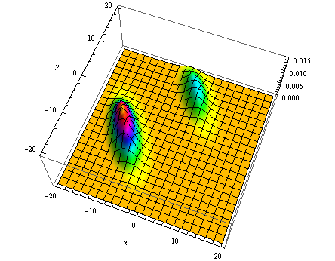
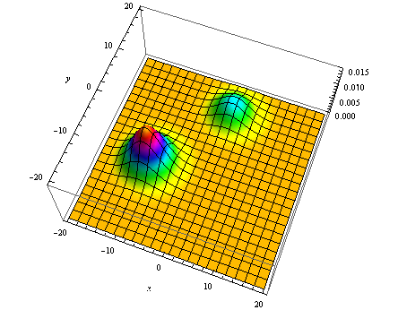
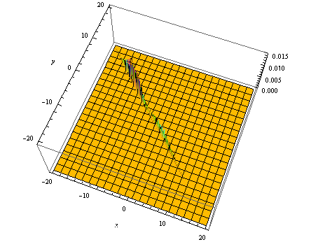
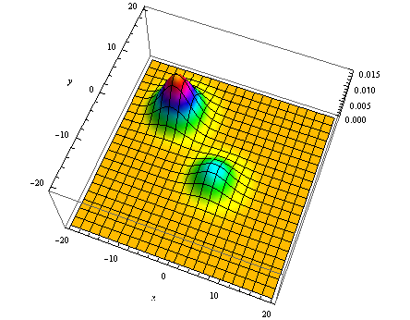
Smooth Interpretation: Assignment
x = x - y;
x = -y;

Slide 31
Approximations
Trick Question:
  Which of the previous approximations is problematic?

Slide 32
Approximations
Trick Question:
  Which of the previous approximations is problematic?
Merging can introduce discontinuities!

Slide 33
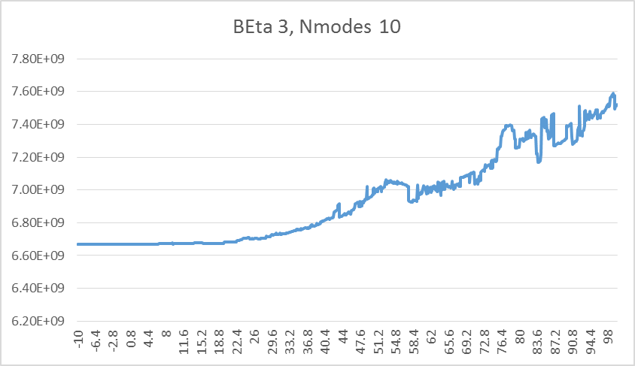
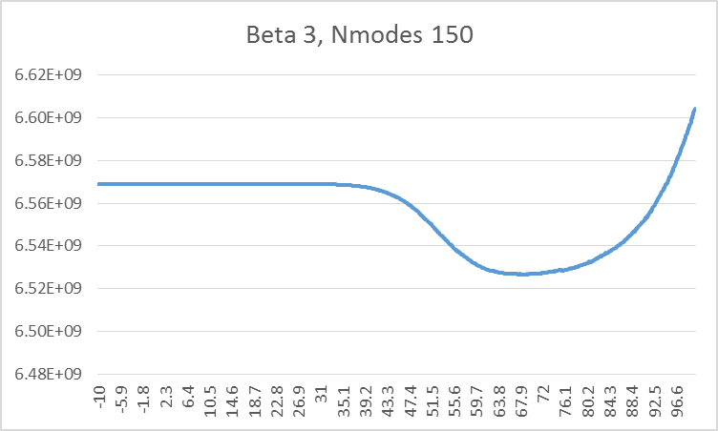
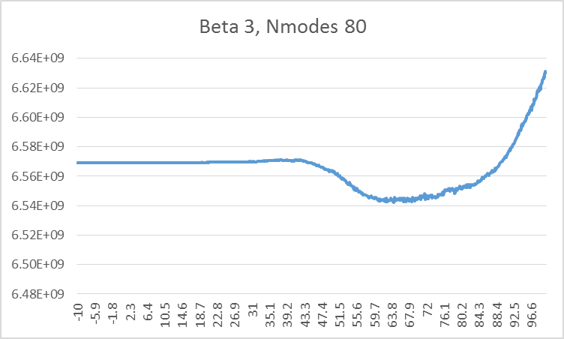
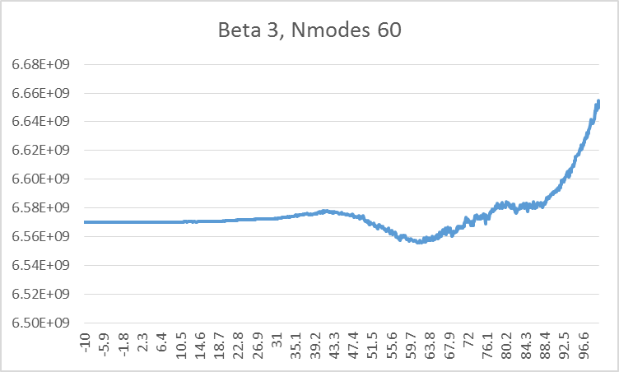
Excessive merging can cause problems

Slide 34
Examples

Slide 35

Parameter synthesis
t₁ := ??; t₂ := ??; A₁ := ??;
A₂ := ??;
repeat (every ΔT) {
if (stage = BACK && time > t₁)
stage = INTURN;
if (stage = INTURN) {
if (time > t₂) then stage = OUTTURN;
angle = angle – A₁; }
if (stage = OUTTURN)
angle = angle + A₂;
moveCar();
}
Notes:
We were motivated by a class of optimal control problems. Parameter synthesis

Slide 36
Parameter synthesis
t₁ := ??; t₂ := ??; A₁ := ??;
A₂ := ??;
repeat (every ΔT) {
if (stage = BACK && time > t₁)
stage = INTURN;
if (stage = INTURN) {
if (time > t₂) then stage = OUTTURN;
angle = angle – A₁; }
if (stage = OUTTURN)
angle = angle + A₂;
moveCar();
}
Notes:
We were motivated by a class of optimal control problems. Parameter synthesis

Slide 37
Parameter synthesis
t₁ := ??; t₂ := ??; A₁ := ??;
A₂ := ??;
repeat (every ΔT) {
if (stage = BACK && time > t₁)
stage = INTURN;
if (stage = INTURN) {
if (time > t₂) then stage = OUTTURN;
angle = angle – A₁; }
if (stage = OUTTURN)
angle = angle + A₂;
moveCar();
}
Notes:
We were motivated by a class of optimal control problems. Parameter synthesis

Slide 38
Application : Parameter synthesis
Error = distance between
ideal and actual final position
t₁ := ??; t₂ := ??; A₁ := ??;
A₂ := ??;
repeat (every ΔT) {
if (stage = BACK && time > t₁)
stage = INTURN;
if (stage = INTURN) {
if (time > t₂) then stage = OUTTURN;
angle = angle – A₁; }
if (stage = OUTTURN)
angle = angle + A₂;
moveCar();
}
Goal: minimize Error.
Notes:
We were motivated by a class of optimal control problems. Parameter synthesis

Slide 39
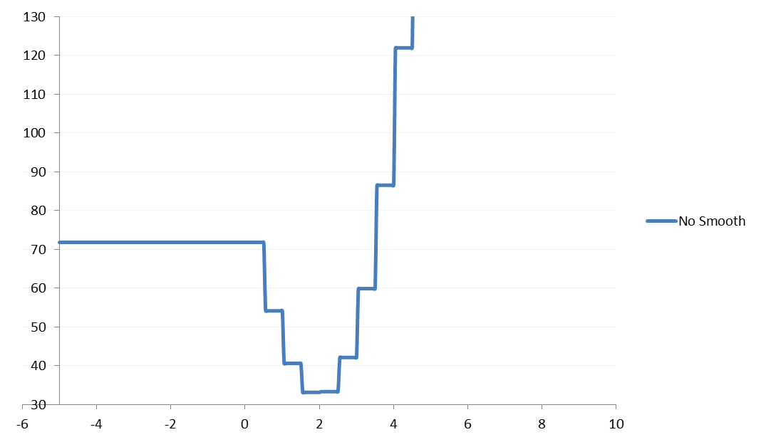
Slice of Error function WRT T2

Slide 40
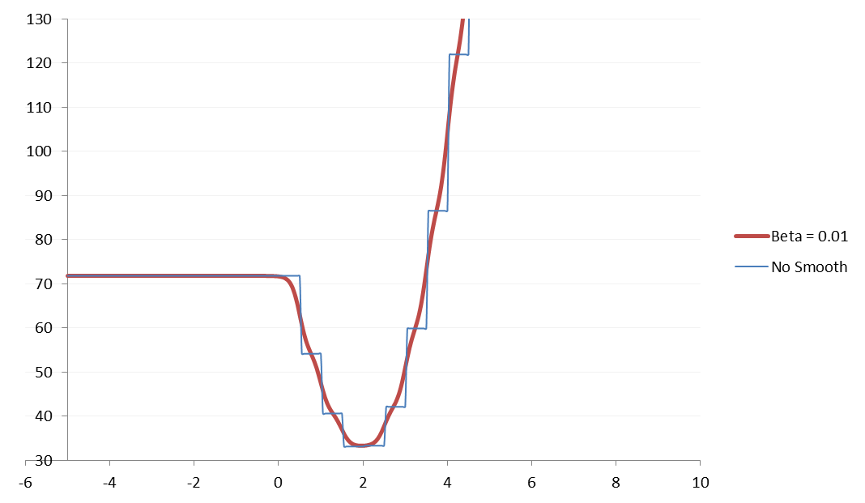
Slice of Error function WRT T2

Slide 41
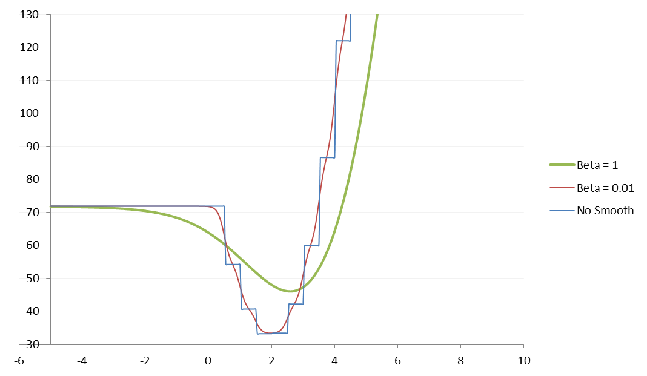
Slice of Error function WRT T2

Slide 42
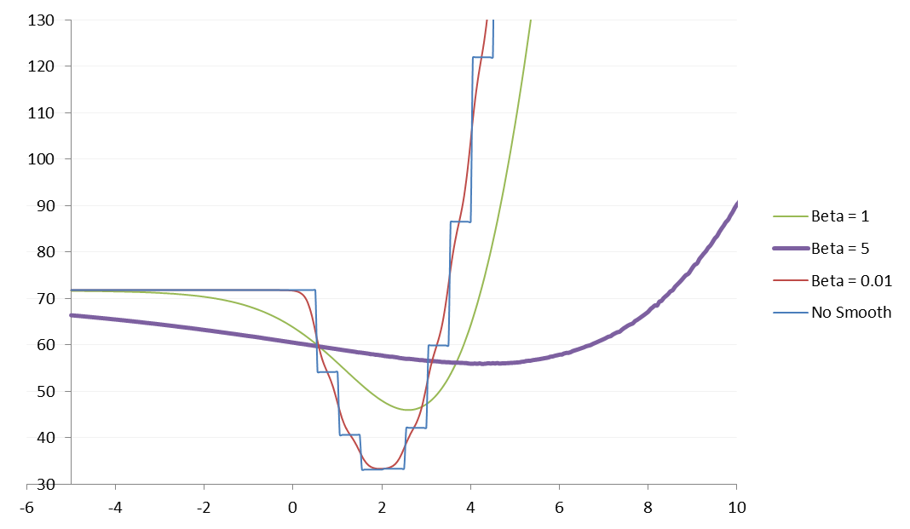
Slice of Error function WRT T2

Slide 43
Numerical Search with Smoothing

Slide 44
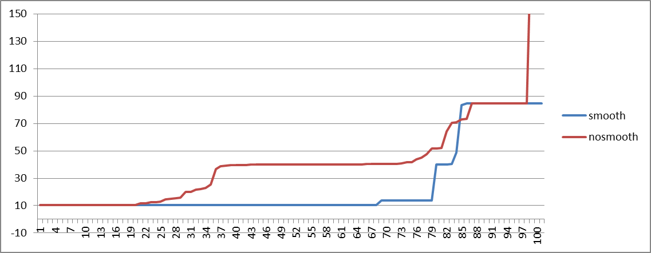
Errors from different starting points
Both are quite good
Both are quite bad
Result of smoothing is much better

Slide 45
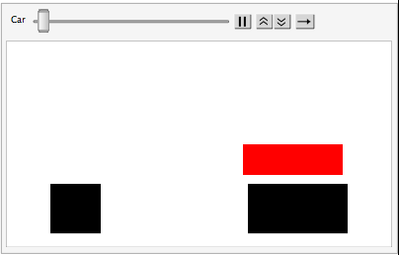
What the difference means
How an error of 40 look like
How an error of 10 looks like

Slide 46
Limitations
Smooth function converges to original function according to L2 norm.
  That’s not enough for optimization.
  The function below converges to the original function, but the local minima is in the worst possible point

Slide 47
Limitations
Programs tend to be difficult to optimize
  Even with smoothing, there are too many local minima
Can be useful in combination with other search techniques
  e.g. Hamiltonian Monte Carlo

Slide 48
Relaxation + Top-Down = Near

Slide 49


Learning to synthesize incrementally 2
value function
policy
Notes:
Introduce Cost-to-go and notation.
The second idea is that instead of generating a single instruction, to generate a set of possible next instructions. This leads to a search tree that now needs to be explored to find the correct program. In order to do this, we borrow an idea from AlphaGo (the system that learned to play go) and train a separate neural network to score the states to decide which one is most promising and use that to guide the search.

Slide 50
Guiding program search
So far
  Neural network policy to guide search
  Value function scores individual states

Slide 51


Guiding program search
Problem: You only get ground truth on the leaves of the search tree
  Value for an intermediate node is only an estimate
$$P$$
$$s\left(P\right)+ \min_{θ} Loss(α_{P}, θ_{P})$$

Slide 52



Guiding program search
Problem: You only get ground truth on the leaves of the search tree
  Value for an intermediate node is only an estimate
Can we get a better estimate with DL?
$$P_{1}^{∗}$$
$$P_{2}^{∗}$$
$$P_{3}^{∗}$$
$$P$$
$$s\left(P\right)+ \min_{θ} Loss(α_{P}, θ_{P})$$

Slide 53

Estimating the “Cost to Go”
$P^{∗}$ = partial program (non-terminal nodes)
$P^{∗}[?→e]$ = completions of $P^{∗}$ (reachable terminal nodes)
  Heuristic Estimate: d$\left(P^{∗}\right)≈\min_{P∈ℂ\left(P^{∗}\right)}\left[Δs\left(P,P^{∗} \right)+\min_{θ} Loss(α_{P}, θ_{P})\right]$
If $d\left(P^{∗}\right)$ is a lower bound it becomes an “admissible heuristic”
“Cost to Go”
Additional Structure Cost
Training Loss

Slide 54
Learning with Neural Heuristics
Shah et al. Learning Differentiable Programs with Neural Admissible Heuristics. NeurIPS 2020.

Slide 55





Guiding Search with Neural Relaxations
$$λx. map x g^{∗}$$
$$g^{∗}$$
Fill hole with NN
If a large neural network cannot fit this hole, then a neurosymbolic completion also cannot
Train parameters
Use training loss to guide search
Learning Differentiable Programs with Admissible Neural Heuristics, Ameesh Shah*, Eric Zhan*, et al., NeurIPS 2020

Slide 56
Motivating Observation/Assumption:
Functional Representational Power
Neurosymbolic Models
“Large” Neural Models
“Neural Relaxation”
Every neurosymbolic model can be (approximately) represented by some “large” neural model.

Slide 57




Implication
(abstract form)
$$P$$
$$f∈F$$
Slack due to approximation error or training ability
Large Neural
$∀P, ∃f∈F$ s.t. $d\left(f\right)≤d\left(P\right)+ε$
Neurosymbolic
Any Cost Function
We can train an admissible heuristic!
“Neural Relaxation”
Every neurosymbolic model can be (approximately) represented by some “large” neural model.

Slide 58




Informed Search (e.g., A*)
Use $d\left(P^{∗}\right)$ to prune the search
$$λx. map x g^{∗}$$
Can Prune This Branch!
Suppose:
Structural Cost
Training Loss
$$s\left(. \right)+d\left(. \right)$$
>
$$s\left(. \right)+Loss( . )$$
$$λx. map x g^{∗}$$
$$λx. map x g^{∗}$$
“Cost to Go” Heuristic

Slide 59

A* Search
Priority queue of current leaf nodes:
  Sorted by $s\left(P^{∗}\right)+d(P^{∗})$
Pop off top program $P^{∗}$
  If $P^{∗}$ is complete, terminate
  Else, expand $P^{∗}$, add child nodes to priority queue
Guarantee: if $d(P^{∗})$ is admissible, A* will return optimal $P$
  Tighter $d(P^{∗})$ prunes more aggressively
  Uninformed $d\left(P^{∗}\right)$ (e.g., always 0) => uninformed search
Lower bounds “Cost to Go”

Slide 60

Implementing Admissible Heuristic
Implementing $d(P^{∗})$ requires knowing the future?
Historically, hand crafted using domain knowledge
Today: Neural Relaxations
Session 3: learning approaches that learn from many tasks

Slide 61

NEAR: Results
Order of magnitude speedup!
B E T T E R
NEAR
Learning Differentiable Programs with Admissible Neural Heuristics, Ameesh Shah*, Eric Zhan*, et al., NeurIPS 2020

Slide 62
NEAR: Neural Admissible Relaxations
$$λx. map x g^{∗}$$
$$g^{∗}$$
Fill hole with NN
If a large neural network cannot fit this hole, then a neurosymbolic completion also cannot
Train parameters
Use training loss as admissible heuristic
Learning Differentiable Programs with Admissible Neural Heuristics, Ameesh Shah*, Eric Zhan*, et al., NeurIPS 2020

