Slide 1
Lecture 4
Top-Down Explicit Search
Armando Solar-Lezama
with content from Jack Feser

Slide 2
Quick Intro to Functional Idioms
map f lst = case lst of
[] -> []
head:rest -> f(head) : (map f rest)
  Applies f to every element in the list
filter p lst = case lst of
[] -> []
head:rest -> if p(head) then head: (filter p rest)
else (filter p rest)
  Removes any element x for which p(x) is false

Slide 3
foldl definition
foldl binop start lst = case lst of
[] -> start
head:rest -> (foldl binop (binop start head) rest)
  Apply the binary operation binop from left to right to the list

Slide 4
foldl definition
foldl binop start lst = case lst of
[] -> start
head:rest -> (foldl binop (binop start head) rest)
  Apply the binary operation binop from left to right to the list
foldl (+) 1:2:3:4:[]
0

Slide 5
foldl definition
foldl binop start lst = case lst of
[] -> start
head:rest -> (foldl binop (binop start head) rest)
  Apply the binary operation binop from left to right to the list
foldl (+) 2:3:4:[]
+
0
1

Slide 6
foldl definition
foldl binop start lst = case lst of
[] -> start
head:rest -> (foldl binop (binop start head) rest)
  Apply the binary operation binop from left to right to the list
foldl (+) 3:4:[]
+
+
2
0
1

Slide 7
foldl definition
foldl binop start lst = case lst of
[] -> start
head:rest -> (foldl binop (binop start head) rest)
  Apply the binary operation binop from left to right to the list
foldl (+) 4:[]
+
+
3
+
2
0
1

Slide 8
foldl definition
foldl binop start lst = case lst of
[] -> start
head:rest -> (foldl binop (binop start head) rest)
  Apply the binary operation binop from left to right to the list
foldl (+) []
+
+
4
+
3
+
2
0
1

Slide 9
foldl definition
foldl binop start lst = case lst of
[] -> start
head:rest -> (foldl binop (binop start head) rest)
  Apply the binary operation binop from left to right to the list
+
+
4
+
3
+
2
0
1

Slide 10
Example
 | Midterm 1 | Midterm 2 | Final
Student A | 71 | 75 | 83
Student B | 90 | 87 | 95
Student C | 68 | 77 | 80
Teacher has a gradebook
Wants to drop the lowest score for each student
Needs a program to do this operation

Slide 11
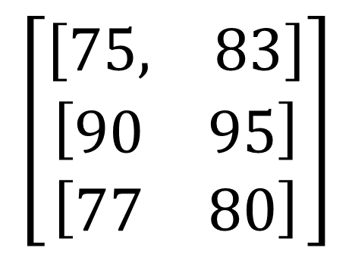
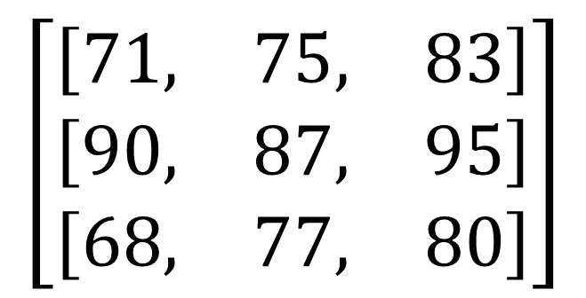
Example
Drop the smallest element from each list
$$\left[\begin{matrix}\left[\begin{matrix}71, & 75, & 83\end{matrix}\right] \\ \left[\begin{matrix}90, & 87, & 95\end{matrix}\right] \\ \left[\begin{matrix}68, & 77, & 80\end{matrix}\right]\end{matrix}\right]$$
$$\left[\begin{matrix}\left[\begin{matrix}75, & 83\end{matrix}\right] \\ \left[\begin{matrix}90 & 95\end{matrix}\right] \\ \left[\begin{matrix}77 & 80\end{matrix}\right]\end{matrix}\right]$$

Slide 12
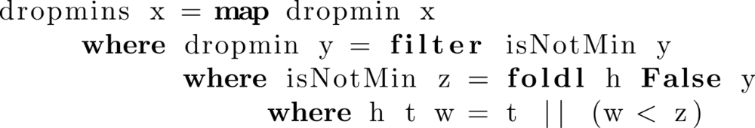
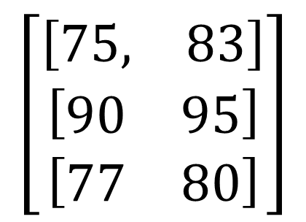
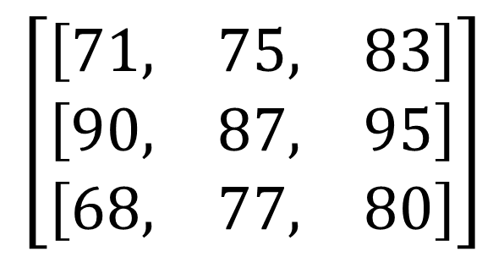
Example
$$\left[\begin{matrix}\left[\begin{matrix}71, & 75, & 83\end{matrix}\right] \\ \left[\begin{matrix}90, & 87, & 95\end{matrix}\right] \\ \left[\begin{matrix}68, & 77, & 80\end{matrix}\right]\end{matrix}\right]$$
$$\left[\begin{matrix}\left[\begin{matrix}75, & 83\end{matrix}\right] \\ \left[\begin{matrix}90 & 95\end{matrix}\right] \\ \left[\begin{matrix}77 & 80\end{matrix}\right]\end{matrix}\right]$$
How can we discover this program?

Slide 13
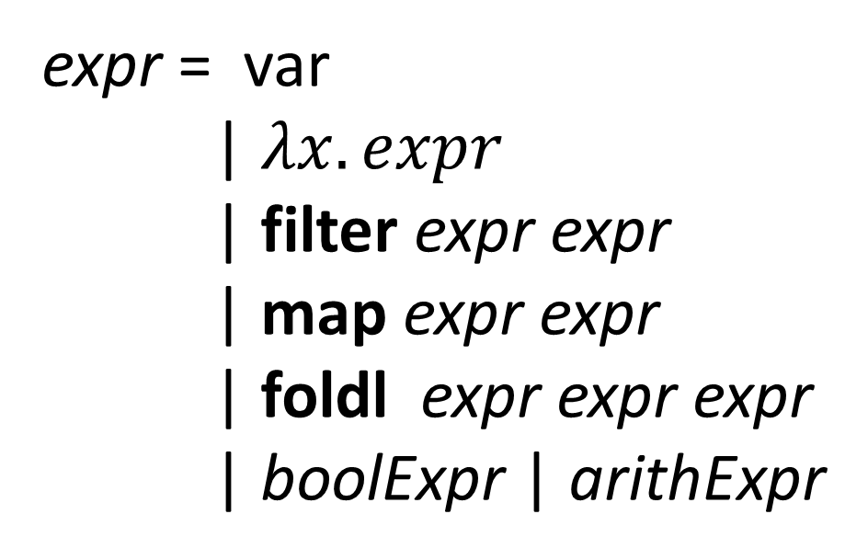
Defining the language
expr = var
| $λx. expr$
| filter expr expr
| map expr expr
| foldl expr expr expr
| boolExpr | arithExpr

Slide 14

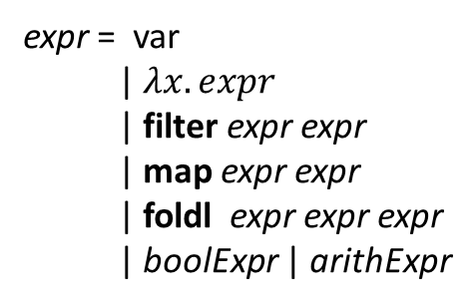
Top-down search
expr = var
| $λx. expr$
| filter expr expr
| map expr expr
| foldl expr expr expr
| boolExpr | arithExpr
dropmins in = expr
in
$λ x.$expr
filter expr expr
map expr expr expr
fold expr expr expr
boolExpr
arithExpr
Many of these programs can be eliminated before
having to complete them!
How?

Slide 15
Top-down search
expr = var
| $λx. expr$
| filter expr expr
| map expr expr
| foldl expr expr expr
| boolExpr | arithExpr
dropmins in = expr
in
$λ x.$expr
filter expr expr
map expr expr
fold expr expr expr
boolExpr
arithExpr
This is a fully concrete program, and
it clearly doesn’t match the examples

Slide 16
Top-down search
expr = var
| $λx. expr$
| filter expr expr
| map expr expr
| foldl expr expr expr
| boolExpr | arithExpr
dropmins in = expr
in
$λ x.$expr
filter expr expr
map expr expr
fold expr expr expr
boolExpr
arithExpr
This program has a missing expression, but we can already tell
it will not work. Why not?

Slide 17
Types
Our simple language supports an infinite set of types of 3 basic kinds
$$τ ≔ Int | Bool \left| \left[τ\right] \right| τ→τ$$
Integer
Boolean
List of some type
Function from some type
to some other type

Slide 18
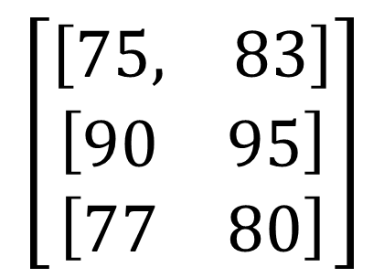
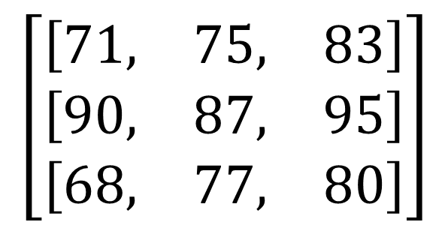
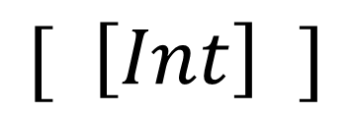
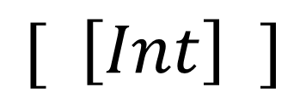
Types
$$\left[\begin{matrix}\left[\begin{matrix}71, & 75, & 83\end{matrix}\right] \\ \left[\begin{matrix}90, & 87, & 95\end{matrix}\right] \\ \left[\begin{matrix}68, & 77, & 80\end{matrix}\right]\end{matrix}\right]$$
$$\left[\begin{matrix}\left[\begin{matrix}75, & 83\end{matrix}\right] \\ \left[\begin{matrix}90 & 95\end{matrix}\right] \\ \left[\begin{matrix}77 & 80\end{matrix}\right]\end{matrix}\right]$$
$$[ \left[Int\right] ]$$
$$[ \left[Int\right] ]$$
Input and output types are lists of lists of integers

Slide 19
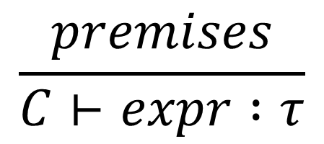
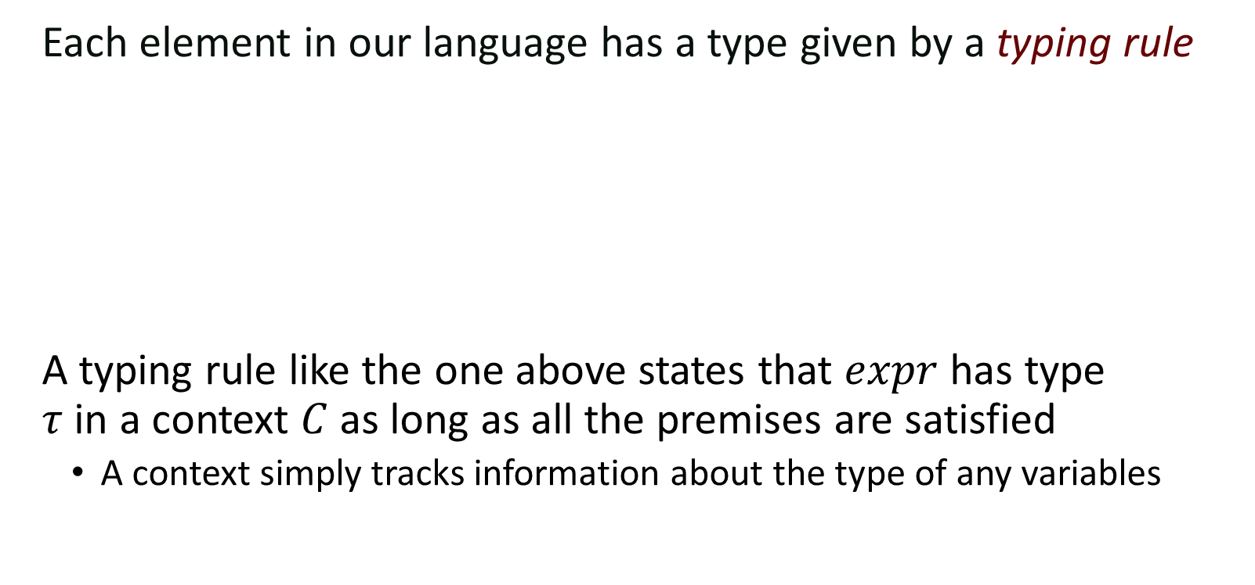
Types
Each element in our language has a type given by a typing rule
A typing rule like the one above states that $expr$ has type
$τ$ in a context $C$ as long as all the premises are satisfied
  A context simply tracks information about the type of any variables
$$\frac{premises}{C⊢expr :τ}$$

Slide 20
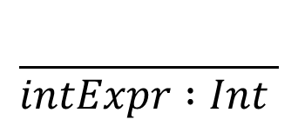
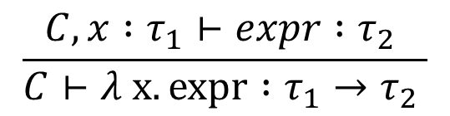
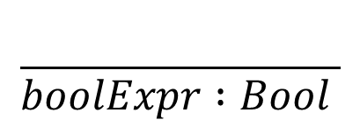
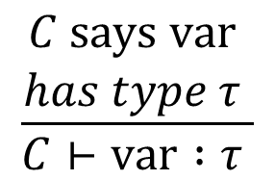
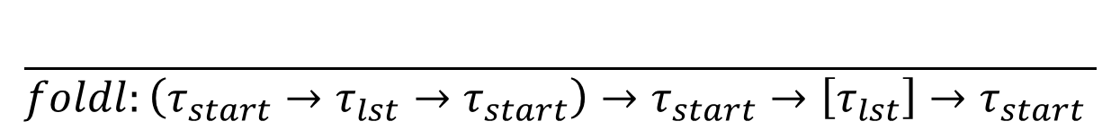
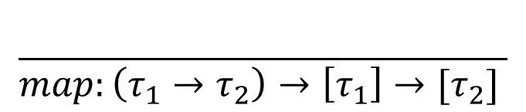
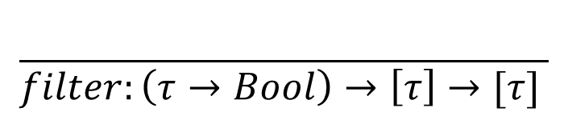
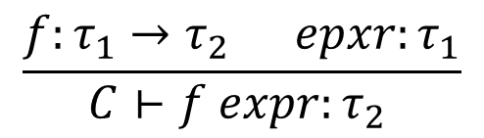
Types
Each element in our language has a type given by a typing rule
$$\frac{\begin{aligned}C says var \\ has type τ \end{aligned}}{C⊢var :τ }$$
$$\frac{f:τ_{1}→τ_{2} epxr:τ_{1}}{C⊢f expr:τ_{2} }$$
$$\frac{C,x :τ_{1}⊢expr :τ_{2} }{C⊢λ x. expr :τ_{1}→τ_{2} }$$
$$\frac{}{map:\left(τ_{1}→τ_{2}\right)→\left[τ_{1}\right]→[τ_{2}] }$$
$$\frac{}{foldl:\left(τ_{start}→τ_{lst}→τ_{start}\right)→τ_{start}→\left[τ_{lst}\right]→τ_{start} }$$
$$\frac{}{boolExpr :Bool }$$
$$\frac{}{filter:\left(τ→Bool\right)→\left[τ\right]→[τ] }$$
$$\frac{}{intExpr :Int }$$

Slide 21
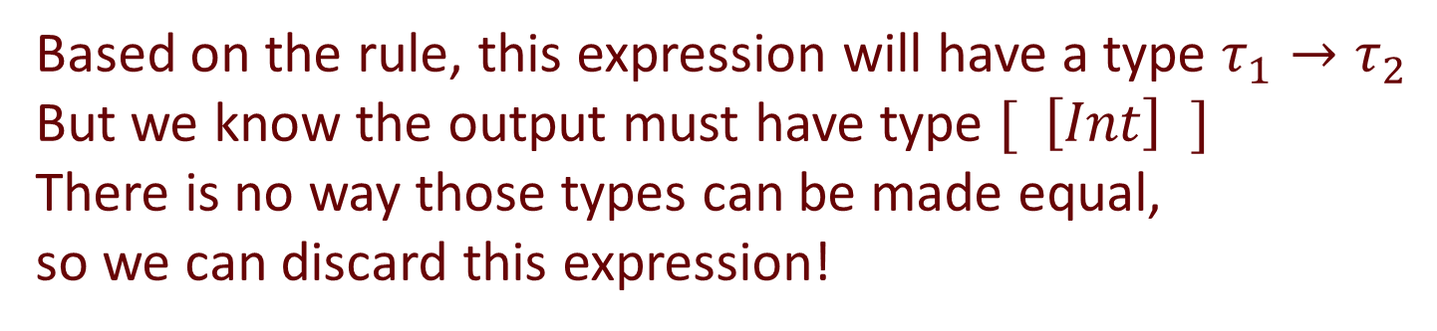
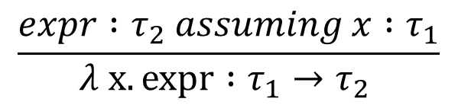
Type-based pruning
expr = var
| $λx. expr$
| filter expr expr
| map expr expr
| foldl expr expr expr
| boolExpr | arithExpr
dropmins in = expr
in
$λ x.$expr
filter expr expr
map expr expr
fold expr expr expr
boolExpr
arithExpr
$$\frac{expr :τ_{2} assuming x :τ_{1}}{λ x. expr :τ_{1}→τ_{2} }$$
Based on the rule, this expression will have a type $τ_{1}→τ_{2}$
But we know the output must have type $[ \left[Int\right] ]$
There is no way those types can be made equal,
so we can discard this expression!

Slide 22
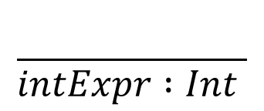
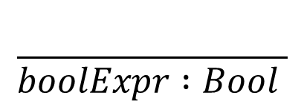
Type-based pruning
expr = var
| $λx. expr$
| filter expr expr
| map expr expr
| foldl expr expr expr
| boolExpr | arithExpr
dropmins in = expr
in
$λ x.$expr
filter expr expr
map expr expr
fold expr expr expr
boolExpr
arithExpr
$$\frac{}{boolExpr :Bool }$$
With the same reasoning we can discard both of
these expressions
They cannot possibly have the correct type
$$\frac{}{intExpr :Int }$$

Slide 23
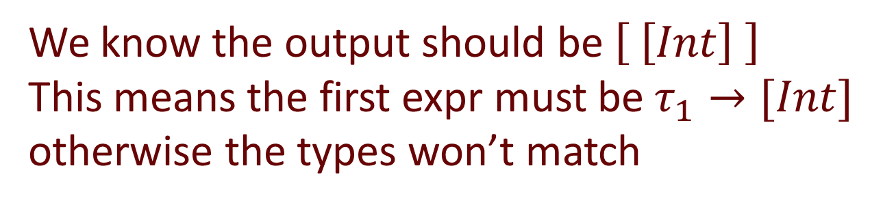
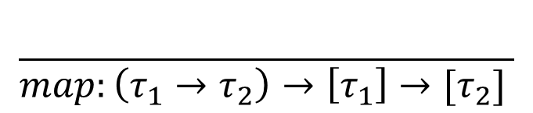
Type-based pruning
expr = var
| $λx. expr$
| filter expr expr
| map expr expr
| foldl expr expr expr
| boolExpr | arithExpr
dropmins in = expr
in
$λ x.$expr
filter expr expr
map expr expr
fold expr expr expr
boolExpr
arithExpr
$$\frac{}{map:\left(τ_{1}→τ_{2}\right)→\left[τ_{1}\right]→[τ_{2}] }$$
We know the output should be $\left[ \left[Int\right] \right]$
This means the first expr must be $τ_{1}→[Int]$
otherwise the types won’t match

Slide 24
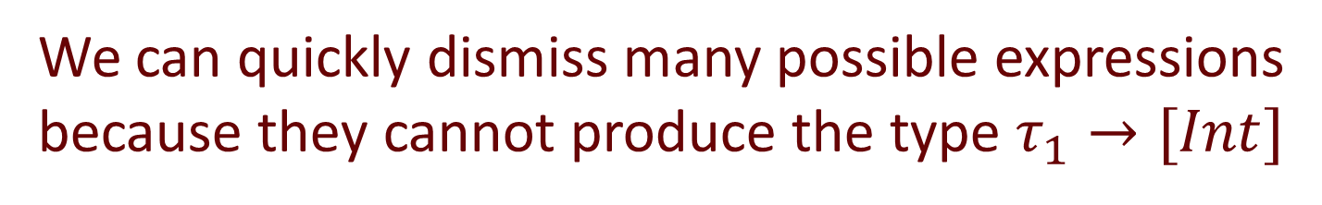

Type-based pruning
expr = var
| $λx. expr$
| filter expr expr
| map expr expr
| foldl expr expr expr
| boolExpr | arithExpr
dropmins in = expr
in
$λ x.$expr
filter expr expr
map expr expr
fold expr expr expr
boolExpr
arithExpr
in
$λ x.$expr
filter expr expr
map expr expr
fold expr expr expr
boolExpr
arithExpr
We can quickly dismiss many possible expressions
because they cannot produce the type $τ_{1}→[Int]$

Slide 25
We can do better
Key observation: in some cases we can propagate examples to the sub-components

Slide 26
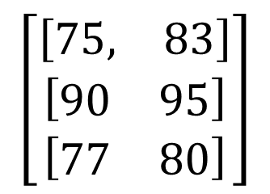
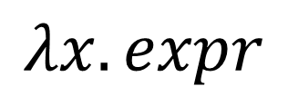
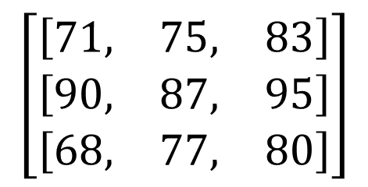
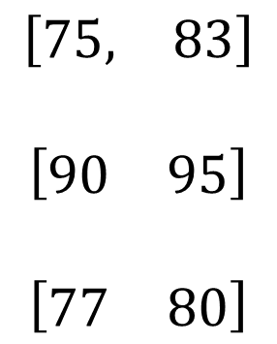
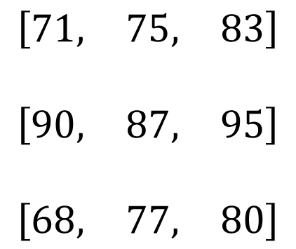
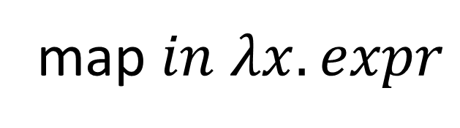
Example
$$\left[\begin{matrix}\left[\begin{matrix}71, & 75, & 83\end{matrix}\right] \\ \left[\begin{matrix}90, & 87, & 95\end{matrix}\right] \\ \left[\begin{matrix}68, & 77, & 80\end{matrix}\right]\end{matrix}\right]$$
$$\left[\begin{matrix}\left[\begin{matrix}75, & 83\end{matrix}\right] \\ \left[\begin{matrix}90 & 95\end{matrix}\right] \\ \left[\begin{matrix}77 & 80\end{matrix}\right]\end{matrix}\right]$$
map $in$ $λx. expr$
$$\begin{matrix}\begin{aligned}\left[\begin{matrix}71, & 75, & 83\end{matrix}\right] \\ \end{aligned} \\ \begin{aligned}\left[\begin{matrix}90, & 87, & 95\end{matrix}\right] \\ \end{aligned} \\ \left[\begin{matrix}68, & 77, & 80\end{matrix}\right]\end{matrix}$$
$$\begin{matrix}\begin{aligned}\left[\begin{matrix}75, & 83\end{matrix}\right] \\ \end{aligned} \\ \begin{aligned}\left[\begin{matrix}90 & 95\end{matrix}\right] \\ \end{aligned} \\ \left[\begin{matrix}77 & 80\end{matrix}\right]\end{matrix}$$
$$λx. expr$$

Slide 27
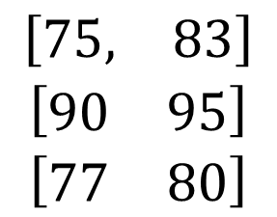
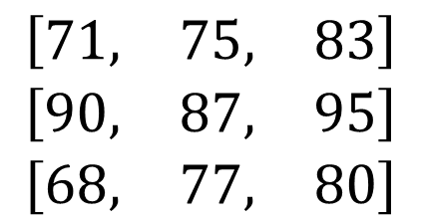

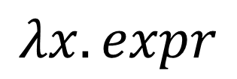
Continuing the search
$$\begin{matrix}\left[\begin{matrix}71, & 75, & 83\end{matrix}\right] \\ \left[\begin{matrix}90, & 87, & 95\end{matrix}\right] \\ \left[\begin{matrix}68, & 77, & 80\end{matrix}\right]\end{matrix}$$
$$\begin{matrix}\left[\begin{matrix}75, & 83\end{matrix}\right] \\ \left[\begin{matrix}90 & 95\end{matrix}\right] \\ \left[\begin{matrix}77 & 80\end{matrix}\right]\end{matrix}$$
$$λx. expr$$
in
$λ x.$expr
filter expr expr
map expr expr
fold expr expr expr
boolExpr
arithExpr
This is a fully concrete program, and
it clearly doesn’t match the examples

Slide 28
Continuing the search
$$\begin{matrix}\left[\begin{matrix}71, & 75, & 83\end{matrix}\right] \\ \left[\begin{matrix}90, & 87, & 95\end{matrix}\right] \\ \left[\begin{matrix}68, & 77, & 80\end{matrix}\right]\end{matrix}$$
$$\begin{matrix}\left[\begin{matrix}75, & 83\end{matrix}\right] \\ \left[\begin{matrix}90 & 95\end{matrix}\right] \\ \left[\begin{matrix}77 & 80\end{matrix}\right]\end{matrix}$$
$$λx. expr$$
in
$λ x.$expr
filter expr expr
map expr expr
fold expr expr expr
boolExpr
arithExpr
Again, these are all of the wrong type

Slide 29
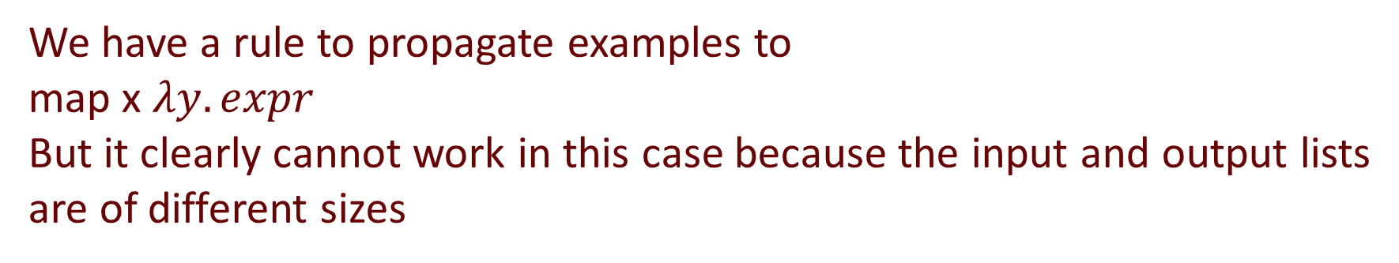
Continuing the search
$$\begin{matrix}\left[\begin{matrix}71, & 75, & 83\end{matrix}\right] \\ \left[\begin{matrix}90, & 87, & 95\end{matrix}\right] \\ \left[\begin{matrix}68, & 77, & 80\end{matrix}\right]\end{matrix}$$
$$\begin{matrix}\left[\begin{matrix}75, & 83\end{matrix}\right] \\ \left[\begin{matrix}90 & 95\end{matrix}\right] \\ \left[\begin{matrix}77 & 80\end{matrix}\right]\end{matrix}$$
$$λx. expr$$
in
$λ x.$expr
filter expr expr
map expr expr
fold expr expr expr
boolExpr
arithExpr
We have a rule to propagate examples to
map x $λy. expr$
But it clearly cannot work in this case because the input and output lists
are of different sizes

Slide 30
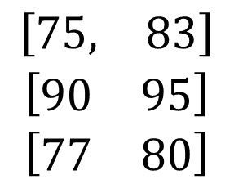
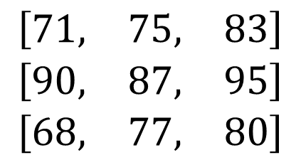
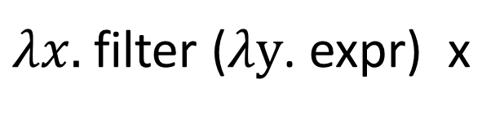
Works for filter as well
$$\begin{matrix}\left[\begin{matrix}71, & 75, & 83\end{matrix}\right] \\ \left[\begin{matrix}90, & 87, & 95\end{matrix}\right] \\ \left[\begin{matrix}68, & 77, & 80\end{matrix}\right]\end{matrix}$$
$$\begin{matrix}\left[\begin{matrix}75, & 83\end{matrix}\right] \\ \left[\begin{matrix}90 & 95\end{matrix}\right] \\ \left[\begin{matrix}77 & 80\end{matrix}\right]\end{matrix}$$
$λx.$filter ($λy$. expr) x
x= [71, 75, 83] , y=71
x= [71, 75, 83] , y=75
x= [71, 75, 83] , y=83
x= [90, 87, 95] , y=90
x= [90, 87, 95] , y=87
x= [90, 87, 95] , y=95
x= [68, 77, 80] , y=68
x= [68, 77, 80] , y=77
x= [68, 77, 80] , y=80
false
true
true
true
false
true
false
true
true
expr

Slide 31
Deduction rules
All of these tricks are codified into deduction rules
Two kinds of rules
  Rules that tell you that a candidate is not going to work
    for example if input list has different length from output list, map f in will not work
  Rules that tell you how to propagate input/outputs to new expressions

Slide 32
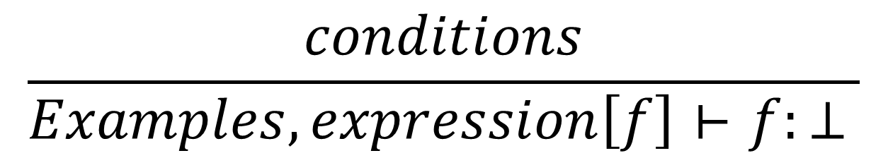
Rule format: when it won’t work
$$\frac{conditions}{Examples, expression\left[f\right]⊢f:⊥ }$$
Expression involving a function f

Slide 33
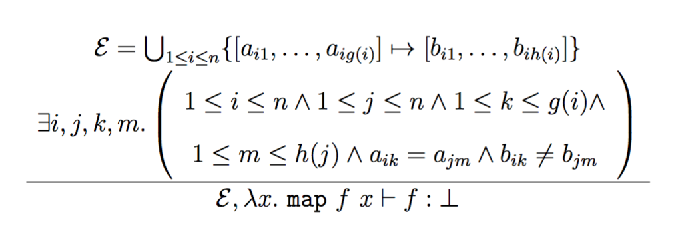
Example: rule for map
If the same input value is mapped to multiple output values, then there is no possible function f.

Slide 34
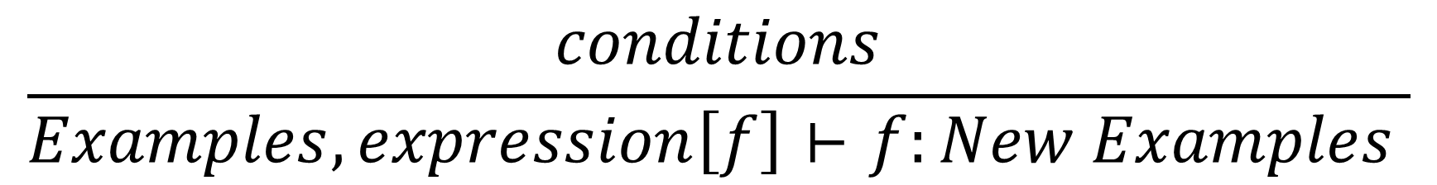
Rule format: when we can propagate
$$\frac{conditions}{Examples, expression\left[f\right]⊢f:New Examples }$$

Slide 35
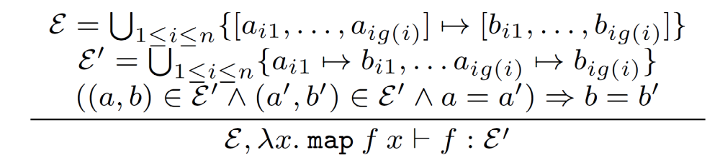
Example rules for map

