Slide 1
Lecture 5
Symbolic Representations: Version Spaces
Armando Solar-Lezama

Slide 2
Symbolic representations
So far we have been generating ASTs 1-by-1 and evaluating them
  Our representations have been either complete or partial ASTs
We want ‘symbols’ that concisely represent large sets of ASTs
  by manipulating those symbols, we can eliminate large sets of ASTs
Key challenges:
  Define the symbols
  Define operations over symbols to efficiently incorporate new evidence
  Query the symbols to extract concrete programs

Slide 3
Symbolic vs Enumerative
The boundary between them is not crisp
Basic bottom-up
Stochastic
Enumerative
Symbolic

Slide 4
Symbolic vs Enumerative
The boundary between them is not crisp
Basic bottom-up
Hierarchical Bottom-up
Stochastic
Top-down
Enumerative
Symbolic

Slide 5
Symbolic vs Enumerative
The boundary between them is not crisp
Basic bottom-up
Hierarchical Bottom-up
Stochastic
Top-down
They work by constructing sets of ASTs
Enumerative
Symbolic

Slide 6
Symbolic vs Enumerative
The boundary between them is not crisp
Basic bottom-up
Hierarchical Bottom-up
Stochastic
Top-down
They work by constructing sets of ASTs
ASTs have holes, so each AST represents a set of actual programs
Enumerative
Symbolic

Slide 7
Symbolic vs Enumerative
The boundary between them is not crisp
Basic bottom-up
2001-Version Spaces
Hierarchical Bottom-up
Stochastic
Top-down
Enumerative
Symbolic

Slide 8
Version spaces
Programming by demonstration using version space algebra
Lau, Wolfman, Domingos, Weld, 2001

Slide 9
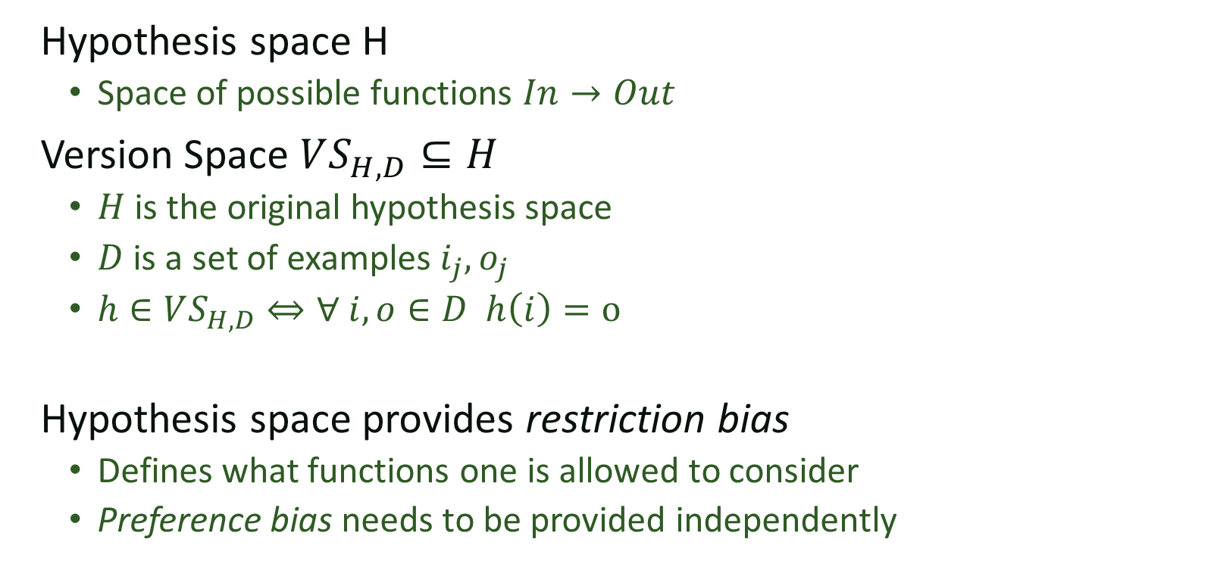
Version Space Formulation
Hypothesis space H
  Space of possible functions $In→Out$
Version Space $VS_{H,D}⊆H$
  $H$ is the original hypothesis space
  $D$ is a set of examples $i_{j},o_{j}$
  $h∈VS_{H,D}⇔∀ i,o∈D h\left(i\right)=o$
Hypothesis space provides restriction bias
  Defines what functions one is allowed to consider
  Preference bias needs to be provided independently

Slide 10
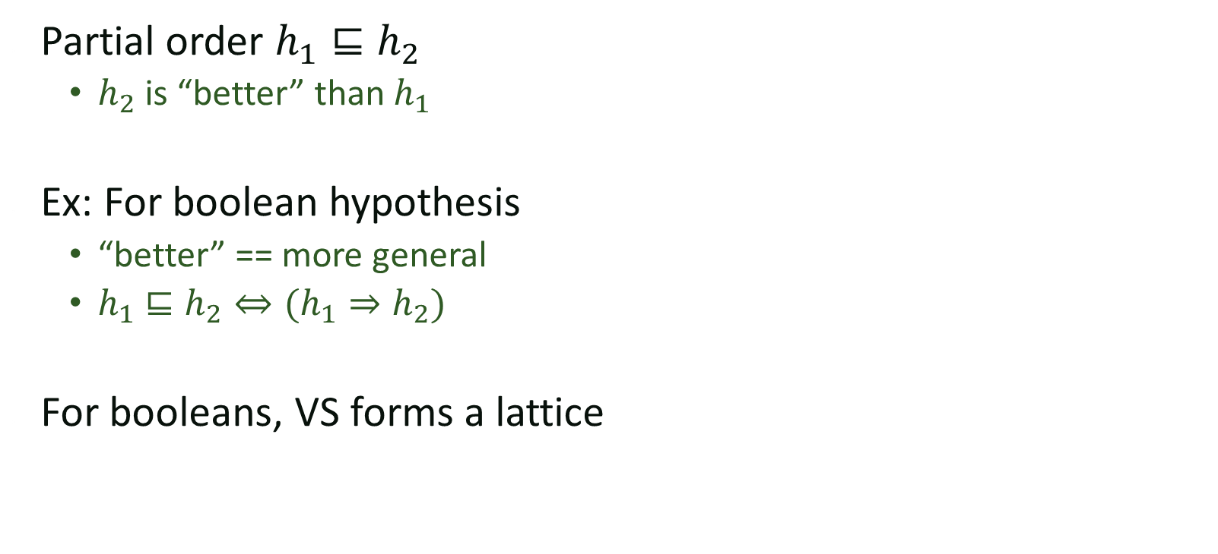
Partial Ordering of hypothesis
Partial order $h_{1}⊑h_{2}$
  $h_{2}$ is “better” than $h_{1}$
Ex: For boolean hypothesis
  “better” == more general
  $h_{1}⊑h_{2}⇔(h_{1}⇒h_{2})$
For booleans, VS forms a lattice

Slide 11
Partial Orders
Set P
Partial order ≤ such that ∀x,y,z∈P
  x ≤ x (reflexive)
  x ≤ y and y ≤ x implies x = y (asymmetric)
  x ≤ y and y ≤ z implies x ≤ z (transitive)
Can use partial order to define
  Upper and lower bounds
  Least upper bound
  Greatest lower bound

Slide 12
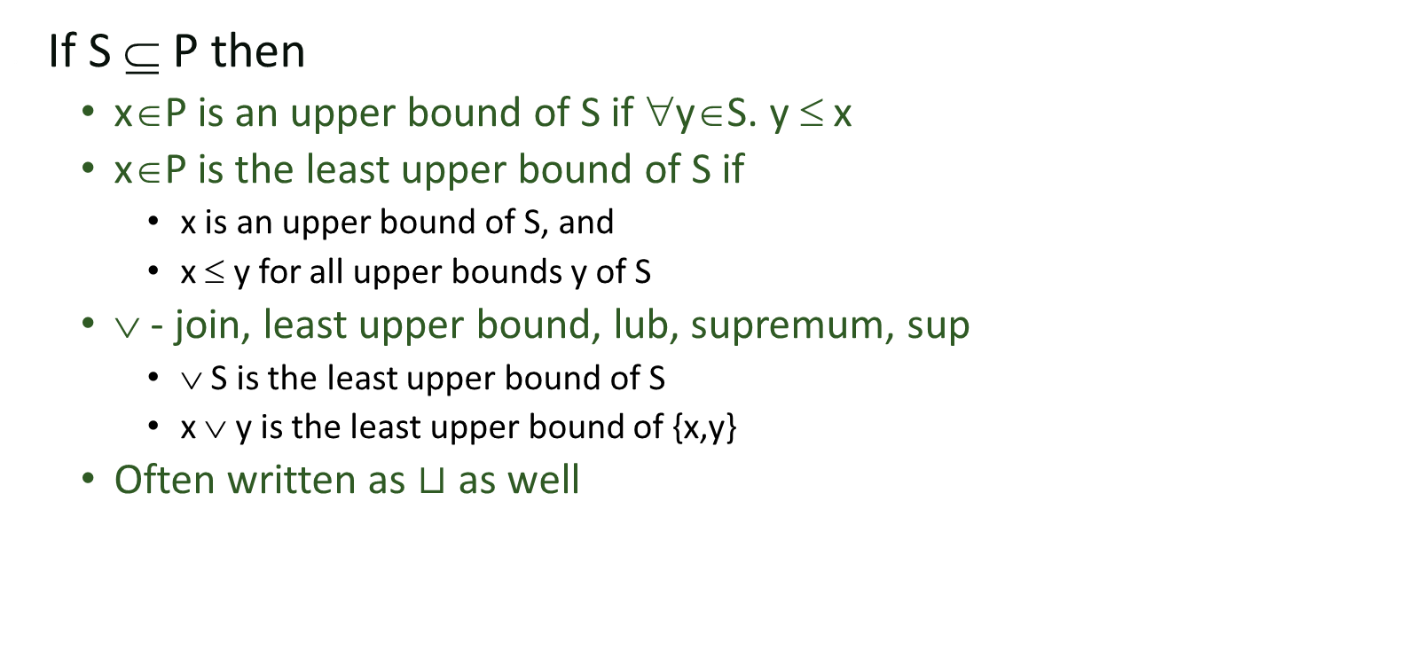
Upper Bounds
If S ⊆ P then
  x∈P is an upper bound of S if ∀y∈S. y ≤ x
  x∈P is the least upper bound of S if
    x is an upper bound of S, and
    x ≤ y for all upper bounds y of S
  ∨ - join, least upper bound, lub, supremum, sup
    ∨ S is the least upper bound of S
    x ∨ y is the least upper bound of {x,y}
  Often written as $⊔$ as well

Slide 13
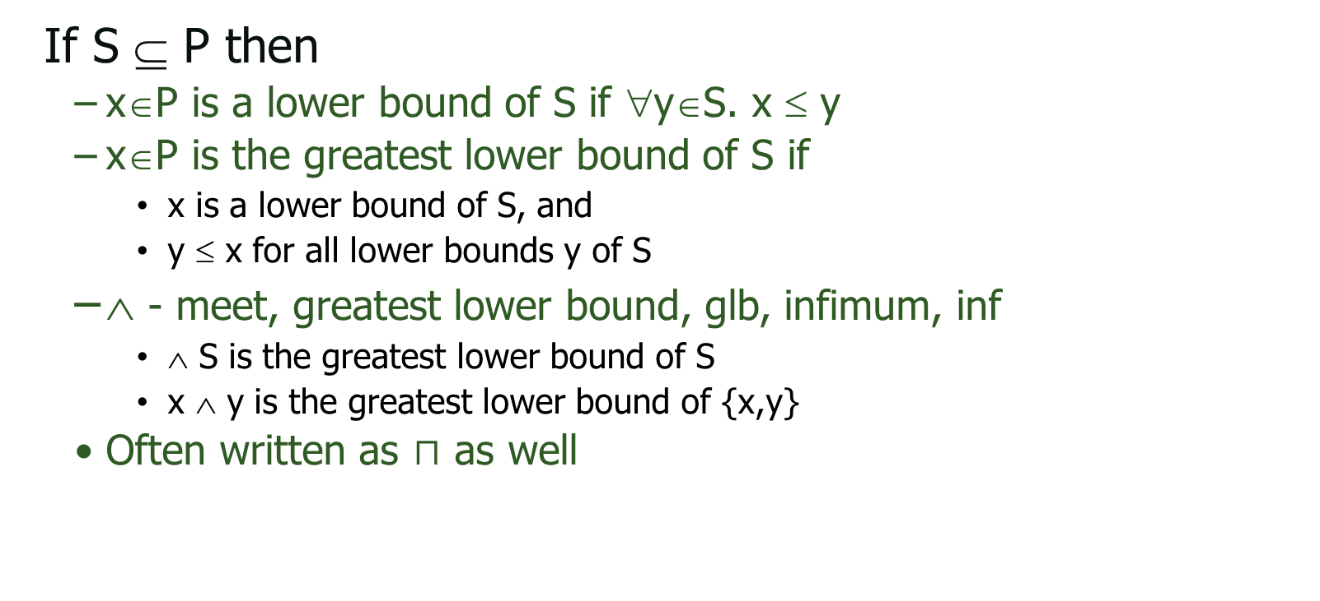
Lower Bounds
If S ⊆ P then
  x∈P is a lower bound of S if ∀y∈S. x ≤ y
  x∈P is the greatest lower bound of S if
    x is a lower bound of S, and
    y ≤ x for all lower bounds y of S
  ∧ - meet, greatest lower bound, glb, infimum, inf
    ∧ S is the greatest lower bound of S
    x ∧ y is the greatest lower bound of {x,y}
  Often written as $⊓$ as well

Slide 14
Lattices
If x ∧ y and x ∨ y exist for all x,y∈P
then P is a lattice
If ∧S and ∨S exist for all S ⊆ P
then P is a complete lattice
All finite lattices are complete
Example of a lattice that is not complete
  Integers I
  For any x, y∈I, x ∨ y = max(x,y), x ∧ y = min(x,y)
  But ∨ I and ∧ I do not exist
  I ∪ {+∞,−∞ } is a complete lattice

Slide 15
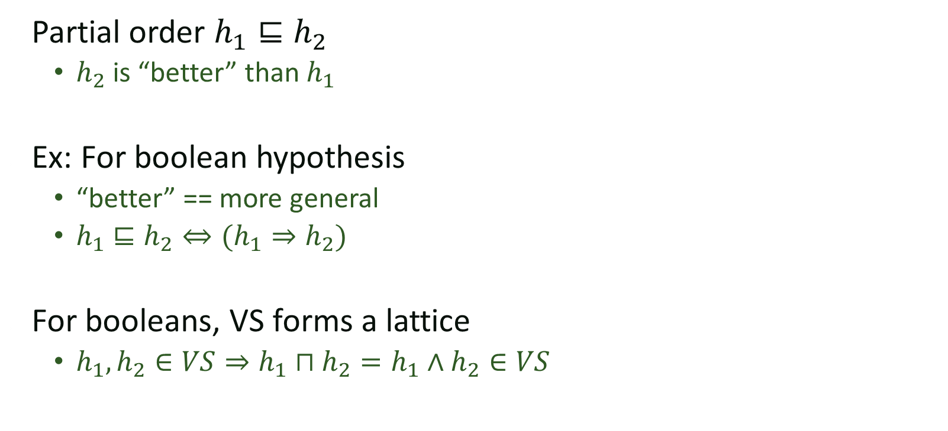
Partial Ordering of hypothesis
Partial order $h_{1}⊑h_{2}$
  $h_{2}$ is “better” than $h_{1}$
Ex: For boolean hypothesis
  “better” == more general
  $h_{1}⊑h_{2}⇔(h_{1}⇒h_{2})$
For booleans, VS forms a lattice
  $h_{1},h_{2}∈VS⇒h_{1}⊓h_{2}=h_{1}∧h_{2}∈VS$
Most specific hypothesis that
satisfies the observations

Slide 16
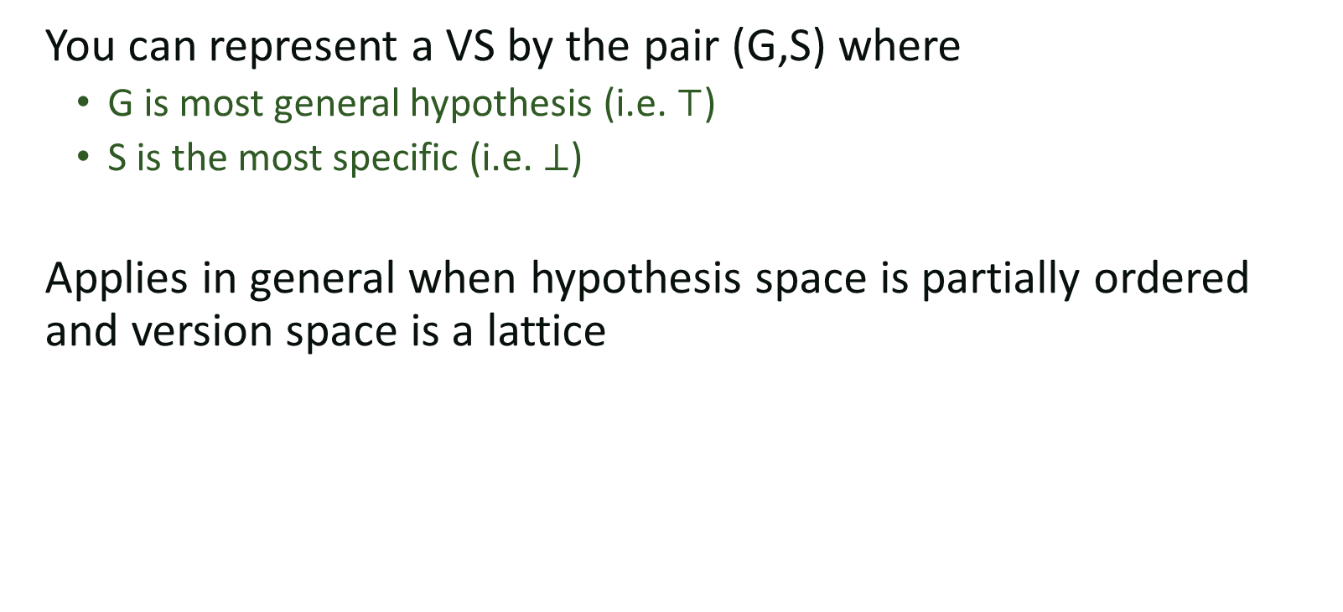
Boundary set representable
You can represent a VS by the pair (G,S) where
  G is most general hypothesis (i.e. $⊤$)
  S is the most specific (i.e. $⊥$)
Applies in general when hypothesis space is partially ordered and version space is a lattice

Slide 17
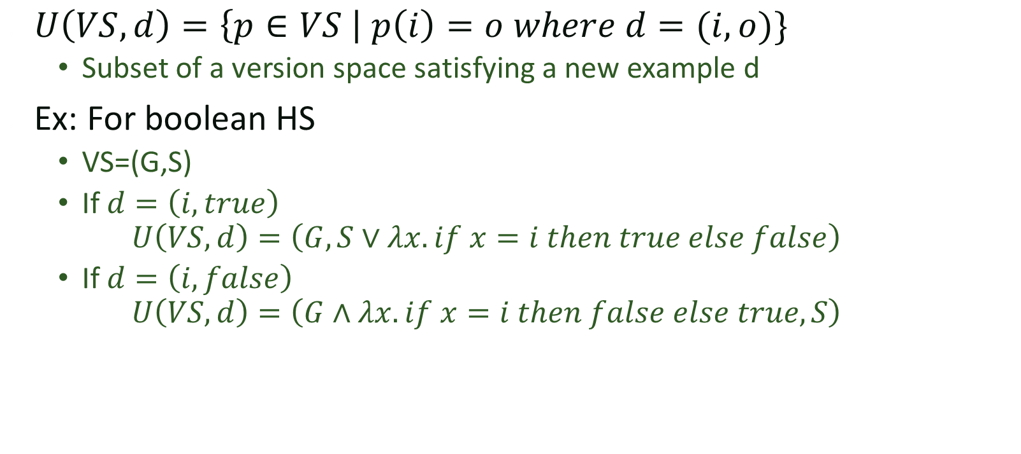
Update
$U\left(VS, d\right)=\left\{p∈VS \right| p\left(i\right)=o where d=(i,o)\}$
  Subset of a version space satisfying a new example d
Ex: For boolean HS
  VS=(G,S)
  If $d=\left(i,true\right)$
  $$U\left(VS,d\right)=\left(G,S∨λx. if x=i then true else false\right)$$
  If $d=\left(i,false\right)$
  $$U\left(VS,d\right)=\left(G∧λx. if x=i then false else true,S\right)$$

Slide 18






Example: FindSuffix
$FS_{T}:$ move to the position right before the next occurrence of $T$.
$$FS_{""}$$
$$FS_{"s"}$$
We shall go on to the end. We |shall fight in France, we |shall fight on the seas and oceans, we shall fight with growing confidence and growing strength in the air,…
$$FS_{"sha"}$$
$$FS_{"shall"}$$
$$FS_{"shall fight"}$$
$$FS_{"shall fight on"}$$
$$FS_{"shall fight on the seas and oceans, we shall fight…"}$$

Slide 19
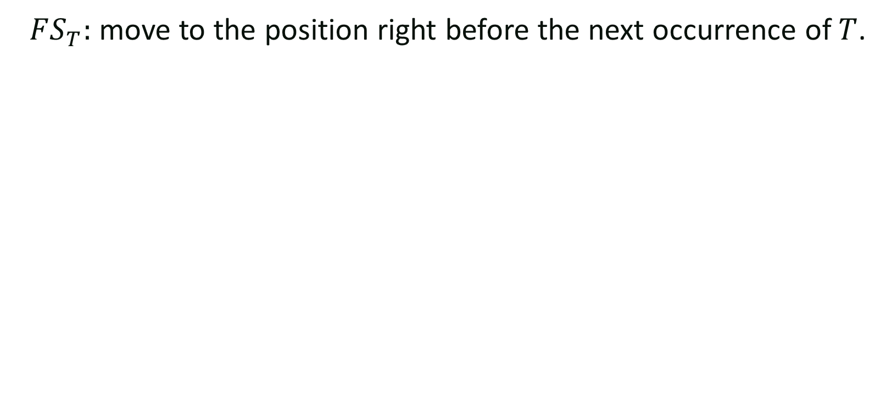
Example: FindSuffix
$FS_{T}:$ move to the position right before the next occurrence of $T$.
$$FS_{""}$$
$$FS_{"s"}$$
We shall go on to the end. We |shall fight in France, we |shall fight on the seas and oceans, we |shall fight with growing confidence and growing strength in the air,…
$$FS_{"sha"}$$
$$FS_{"shall"}$$
$$FS_{"shall fight"}$$
$$FS_{"shall fight on"}$$
$$FS_{"shall fight on the seas and oceans, we shall fight…"}$$

Slide 20

Example: FindSuffix
$FS_{T}:$ move to the position right before the next occurrence of $T$.
$$FS_{""}$$
$$FS_{"s"}$$
We shall go on to the end. We |shall fight in France, we |shall fight on the seas and oceans, we |shall fight with growing confidence and growing strength in the air,…
$$FS_{"sha"}$$
$$FS_{"shall"}$$
$$FS_{"shall fight"}$$
$$FS_{"shall fight on"}$$
$$FS_{"shall fight on the seas and oceans, we shall fight…"}$$

Slide 21

Example: FindSuffix
$FS_{T}:$ move to the position right before the next occurrence of $T$.
$$FS_{""}$$
$$FS_{"s"}$$
We shall go on to the end. We |shall fight in France, we |shall fight on the seas and oceans, we |shall fight with growing confidence and growing strength in the air,…
$$FS_{"sha"}$$
$$FS_{"shall"}$$
$$FS_{"shall fight"}$$
$$FS_{"shall fight on"}$$
$$FS_{"shall fight on the seas and oceans, we shall fight…"}$$

Slide 22
Idea
If your hypothesis space is partially ordered and your VS are boundary set representable, you can represent and search very efficiently
If they are not?
Break them down into simpler hypothesis spaces!

Slide 23
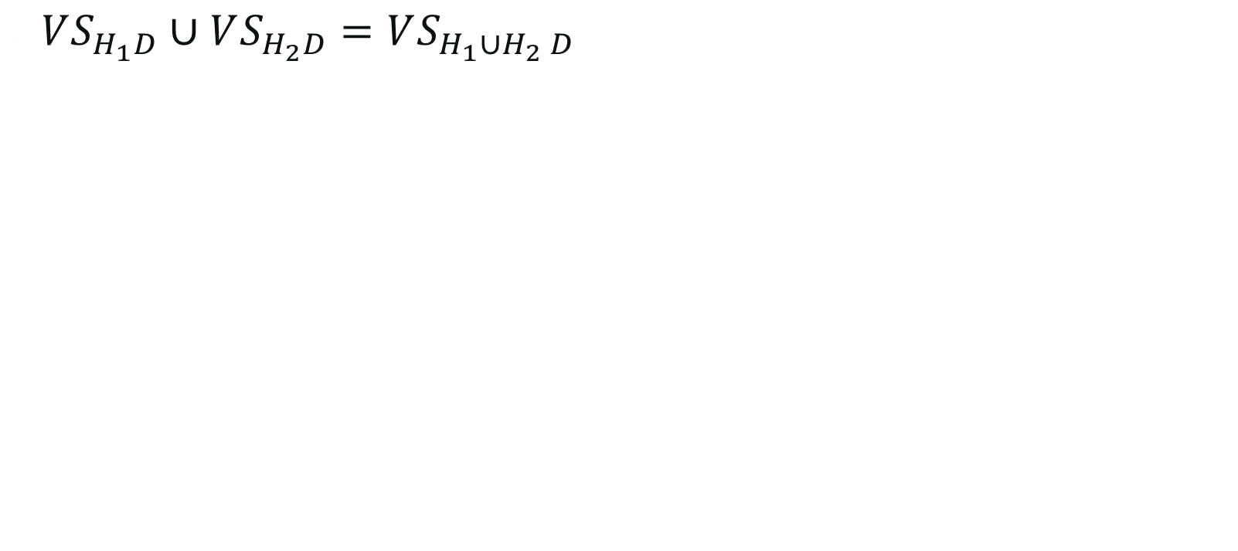
Union
$VS_{H_{1}D}∪VS_{H_{2}D}=VS_{H_{1}∪H_{2} D}$

Slide 24
FindSuffix U FindPrefix
We shall go on to the end. We |shall fight in France, we |shall fight on the seas and oceans, we |shall fight with growing confidence and growing strength in the air,…
FS(“sh”-”shall fight ”)
U
FP(“we “ – “, we”)

Slide 25

FindSuffix U FindPrefix
We shall go on to the end. We |shall fight in France, we |shall fight on the seas and oceans, we |shall fight with growing confidence and growing strength in the air,…
FS(“sh”-”shall fight ”)
U
$$∅$$

Slide 26
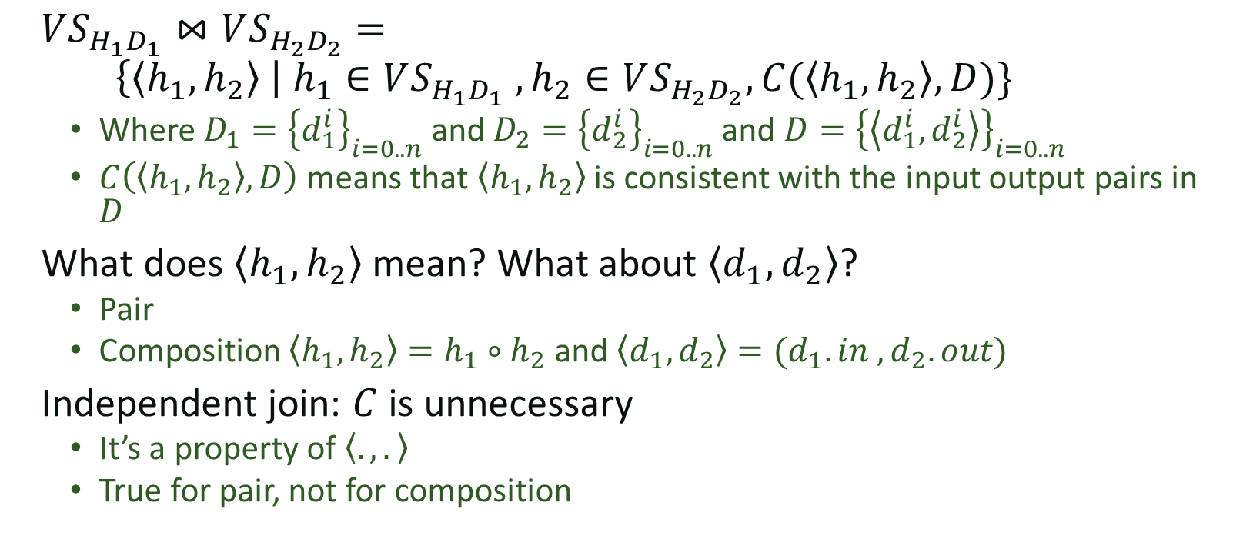
Join
$VS_{H_{1}D_{1}}⋈VS_{H_{2}D_{2}}=$
$\left\{\left\langle h_{1},h_{2}\right\rangle \right| h_{1}∈VS_{H_{1}D_{1}} , h_{2}∈VS_{H_{2}D_{2}}, C(\left\langle h_{1},h_{2}\right\rangle , D)\}$
  Where $D_{1}={\left\{d_{1}^{i}\right\}}_{i=0..n}$ and $D_{2}={\left\{d_{2}^{i}\right\}}_{i=0..n}$ and $D={\left\{\left\langle d_{1}^{i},d_{2}^{i}\right\rangle \right\}}_{i=0..n}$
  $C\left(\left\langle h_{1},h_{2}\right\rangle , D\right)$ means that $\left\langle h_{1},h_{2}\right\rangle$ is consistent with the input output pairs in $D$
What does $\left\langle h_{1},h_{2}\right\rangle$ mean? What about $\left\langle d_{1},d_{2}\right\rangle$?
  Pair
  Composition $\left\langle h_{1},h_{2}\right\rangle =h_{1}∘h_{2}$ and $\left\langle d_{1},d_{2}\right\rangle =(d_{1}.in , d_{2}.out)$
Independent join: $C$ is unnecessary
  It’s a property of $\left\langle ., .\right\rangle$
  True for pair, not for composition
Notes:
What does this mean? I have some pairs of samples $\left\langle d_{1}^{i},d_{2}^{i}\right\rangle$. I want something that works for all of them. Instead of searching the entire $H_{1}⋈H_{2}$ product, I search H_1 for things that work for D_1, I search H_2 for things that work for D_2, and then I join
1->a
2->b
3->c
(char) ‘a’ + i
1->a, 2->b, 3->c, n->c
-1->x
-2->y
-3->z
(char) ‘w’ - i
(1,-1) -> (a,x)
(2,-2) -> (b,y)
(3,-3) -> (c,z)
D-> x
E-> y
F-> z

Slide 27
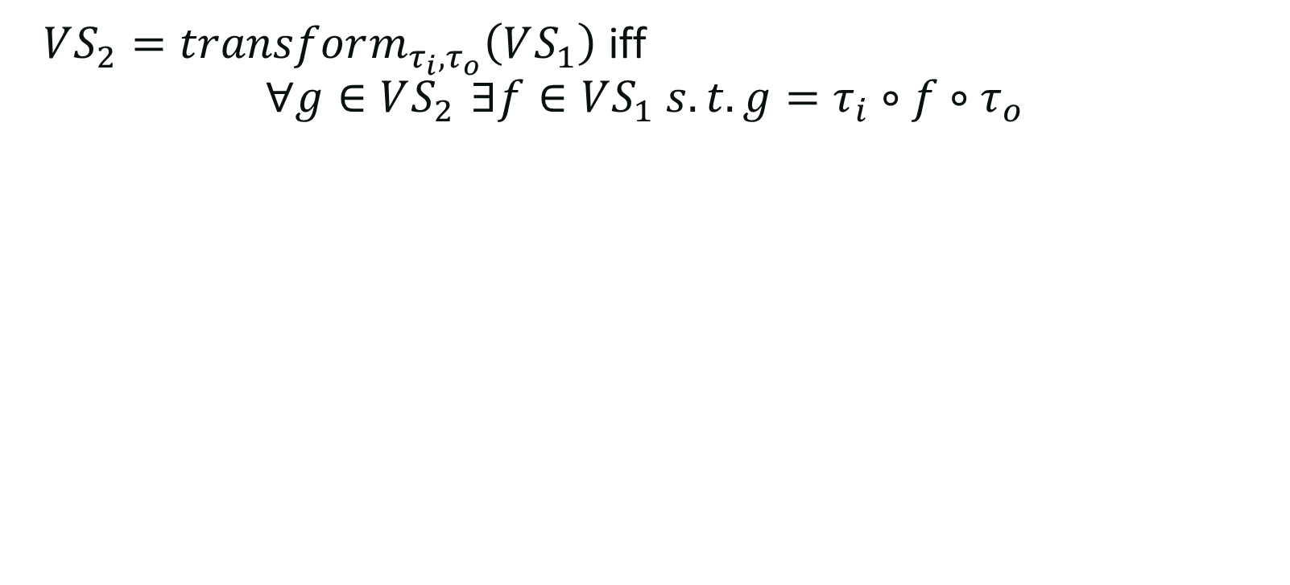
Transform
$VS_{2}=transform_{τ_{i}, τ_{o}}\left(VS_{1}\right)$ iff
$∀g∈VS_{2 }∃f∈VS_{1} s.t. g=τ_{i}∘f∘τ_{o}$

Slide 28
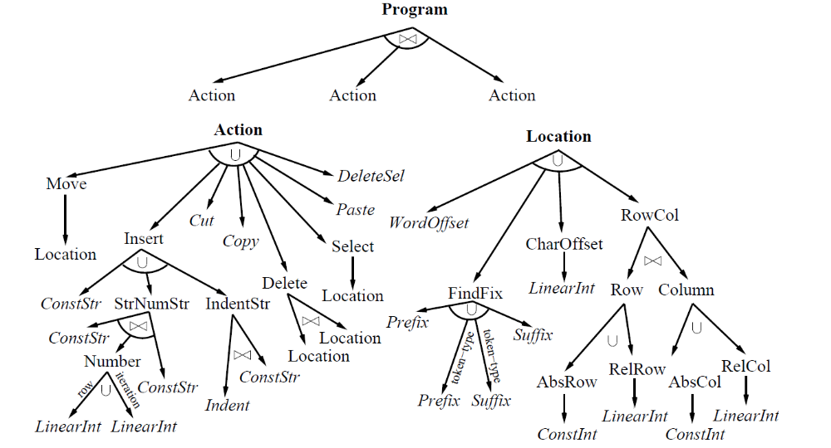
SMARTedit version space
Notes:
ConstInt:
F(x) = C
LinearInt:
F(x) = x + C

Slide 29
Flashfill
Spreadsheet Data Manipulations Using Examples
Gulwani, Harris, Singh, CACM August 2012
With slides from Sumit Gulwani and Rishabh Singh

Slide 30
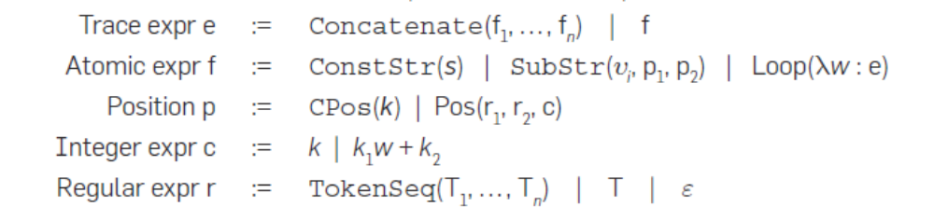
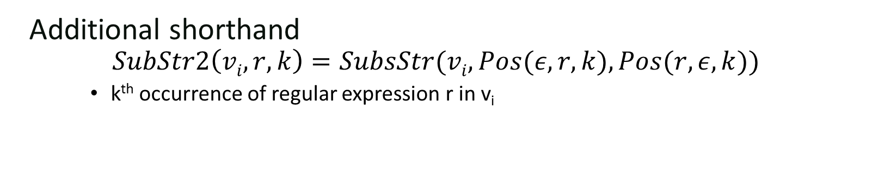
Core language
Additional shorthand
$$SubStr2\left(vi,r,k\right)=SubsStr(vi,Pos(ε,r,k),Pos(r,ε,k))$$
    k^{th} occurrence of regular expression r in v_{i}
Notes:
Pos(r1,r2,c) c^th occurrence the position right after r1 and before r2.
Loop(\w:e) try w=1,2,3… until it fails.

Slide 31
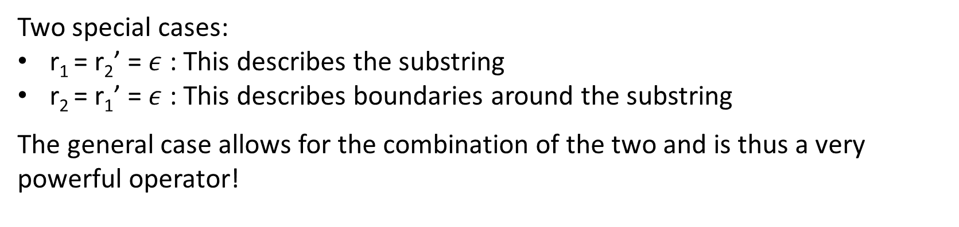
Substring Operator
Let w = SubString(s, p, p’)
where p = Pos(r_{1,} r₂, k) and p’ = Pos(r₁’, r₂’, k’)
w₁
w₂
w₁’
w₂’
r₁ matches w₁
r₂ matches w₂
r₁’ matches w₁’
r₂’ matches w₂’
p
p’
w
s
Two special cases:
r₁ = r₂’ = $ε$ : This describes the substring
r₂ = r₁’ = $ε$ : This describes boundaries around the substring
The general case allows for the combination of the two and is thus a very powerful operator!
Slide by Sumit Gulwani

Slide 32
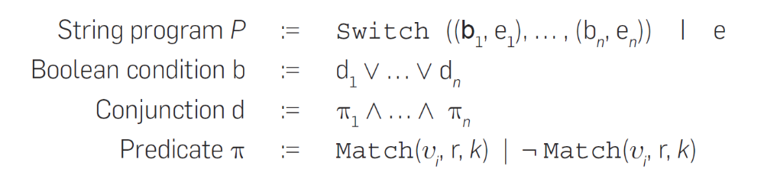
Additional Control Structure

Slide 33
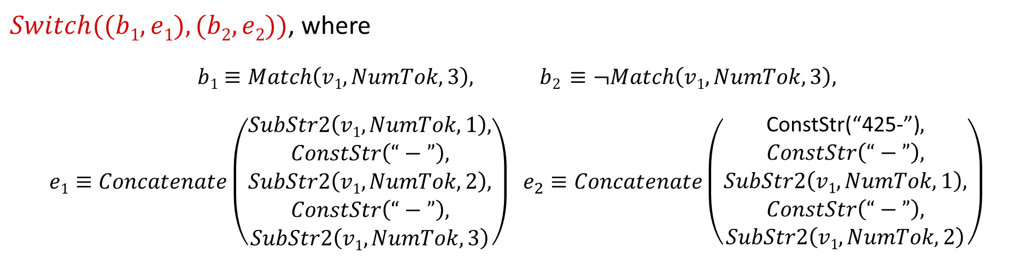
Syntactic String Transformations: Example
Input v₁ | Output
(425)-706-7709 | 425-706-7709
510.220.5586 | 510-220-5586
235 7654 | 425-235-7654
745-8139 | 425-745-8139
$Switch((b1, e1), (b2, e2))$, where
$$b1≡Match\left(v1,NumTok,3\right), b2 ≡¬Match\left(v1,NumTok,3\right),$$
$$e1≡Concatenate\left(\begin{matrix}\begin{matrix}SubStr2\left(v1,NumTok,1\right), \\ ConstStr\left(“−”\right),\end{matrix} \\ SubStr2\left(v1,NumTok,2\right), \\ \begin{matrix}ConstStr\left(“−”\right), \\ SubStr2\left(v1,NumTok,3\right)\end{matrix}\end{matrix}\right) e_{2}≡Concatenate\left(\begin{matrix}\begin{matrix}\text{ConstStr}\text{(“425−”)}, \\ ConstStr\left(“−”\right),\end{matrix} \\ SubStr2\left(v1,NumTok,1\right), \\ \begin{matrix}ConstStr\left(“−”\right), \\ SubStr2\left(v1,NumTok,2\right)\end{matrix}\end{matrix}\right)$$
Slide by Sumit Gulwani

Slide 34
How does it work
Reuse ideas from version space algebra
  Start with simple version spaces
  Define combinators to construct complex version spaces from simple ones
New twist:
  Move beyond simple lattice representations

Slide 35
E-Graph
(x+2*y)+4*y
x
2
y
4
*
*
+
+

Slide 36
E-Graph
(x+2*y)+4*y
x
2
y
4
*
+
*
+
+

Slide 37
E-Graph
(x+2*y)+4*y
x
2
y
4
*
+
*
+
+
+

Slide 38
E-Graph
(x+2*y)+4*y
x
2
y
4
3
*
+
*
*
+
+
+
+

Slide 39
E-Graph
(x+2*y)+4*y
x
2
y
4
3
*
+
*
*
+
+
+
+
+
+

Slide 40
E-Graph
(x+2*y)+4*y
x
2
y
4
3
*
+
*
*
+
+
+
6
+
*
+
+

Slide 41
E-Graph
(x+2*y)+4*y
x
2
y
4
3
*
+
*
*
+
+
6
+
+
+
*
+
+

Slide 42
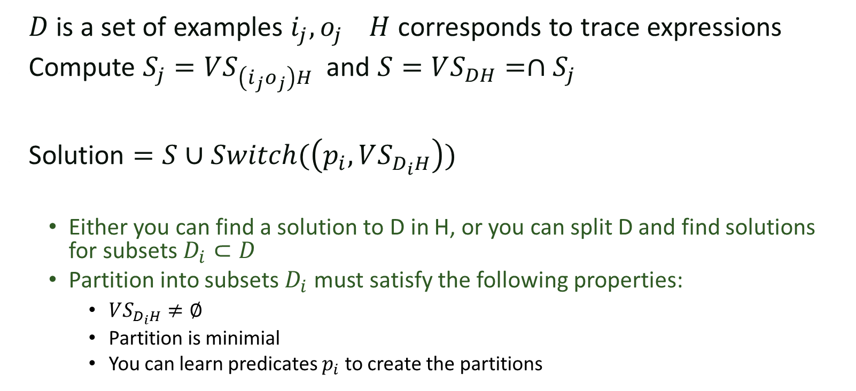
Guarded Expressions
$D$ is a set of examples $i_{j},o_{j}$ $H$ corresponds to trace expressions
Compute $S_{j}=VS_{\left(i_{j}o_{j}\right)H}$ and $S=VS_{DH}=∩S_{j}$
Solution $=S∪Switch(\left(p_{i}, VS_{D_{i}H}\right))$
  Either you can find a solution to D in H, or you can split D and find solutions for subsets $D_{i}⊂D$
  Partition into subsets $D_{i}$ must satisfy the following properties:
    $VS_{D_{i}H}≠∅$
    Partition is minimial
    You can learn predicates $p_{i}$ to create the partitions

Slide 43
Learning Trace Expressions
Full Name | Title Name
Rob Miller | Dr. Rob
Saman Amarasinghe
Sumit Gulwani
Armando Solar-Lezama
Martin Rinard
Slide by Rishabh Singh

Slide 44
Learning Trace Expressions
Top level is always concatenation

Slide 45
Concat Expression (Associative)
Rob Miller → Dr. Rob
Slide by Rishabh Singh

Slide 46
Concat Expression (Associative)
0
1
2
3
4
5
6
7
Dr. Rob
0 1 2 3 4 5 6 7
Slide by Rishabh Singh

Slide 47

Concat Expression (Associative)
0
1
2
3
4
5
6
7
$$γ_{1}$$
Dr. Rob
0 1 2 3 4 5 6 7
Slide by Rishabh Singh

Slide 48

Concat Expression (Associative)
$$γ_{50}$$
0
1
2
3
4
5
6
7
$$γ_{1}$$
Dr. Rob
0 1 2 3 4 5 6 7
Slide by Rishabh Singh

Slide 49










Concat Expression (Associative)
$$γ_{50}$$
$$γ_{8}$$
$$γ_{9}$$
$$γ_{11}$$
$$γ_{10}$$
0
1
2
3
4
5
6
7
$$γ_{1}$$
$$γ_{2}$$
$$γ_{3}$$
$$γ_{4}$$
$$γ_{5}$$
$$γ_{6}$$
$$γ_{7}$$
Dr. Rob
0 1 2 3 4 5 6 7
Slide by Rishabh Singh

Slide 50

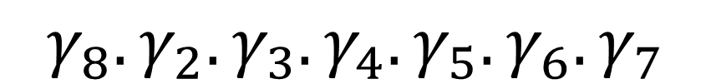
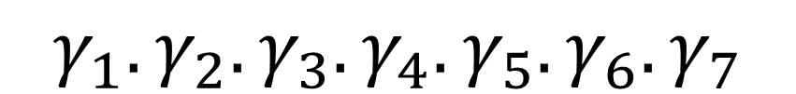
DAG-based Sharing
$$γ_{50}$$
$$γ_{8}$$
$$γ_{9}$$
$$γ_{11}$$
$$γ_{10}$$
0
1
2
3
4
5
6
7
$$γ_{1}$$
$$γ_{2}$$
$$γ_{3}$$
$$γ_{4}$$
$$γ_{5}$$
$$γ_{6}$$
$$γ_{7}$$
Any Path is a valid program
$$γ_{1}.γ_{2}.γ_{3}.γ_{4}.γ_{5}.γ_{6}.γ_{7}$$
$$γ_{8}.γ_{2}.γ_{3}.γ_{4}.γ_{50}$$
$$γ_{8}.γ_{2}.γ_{3}.γ_{4}.γ_{5}.γ_{6}.γ_{7}$$
Exponential Number of paths
Slide by Rishabh Singh

Slide 51
Learning atomic expressions
Can only be constants, substring or loop expressions
Constants are trivial to learn
Substring can be factored!

Slide 52
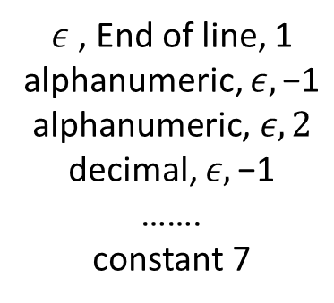
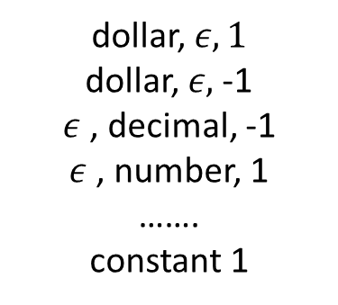
Substring Expression
$145.67 → 145.67
1
7
Substr(left, right)
1
7
{
}
{
}
dollar, $ε, 1$
dollar, $ε,$-1
$ε$, decimal, -1
$ε$ , number, 1
…….
constant 1
$ε$ , End of line, 1
alphanumeric, $ε,\text{−1}$
$$\text{alphanumeric}\text{, }ε, 2$$
decimal, $ε,\text{−1}$
…….
constant 7
Slide by Rishabh Singh
Notes:
Show single tuple program
Relational functions → short example (substring matches)
How expressive is it relative to relational algebra (nested query vs joins)

Slide 53
Intersection
A. Solar
Armando Solar
Rishabh Singh
R. Singh

Slide 54
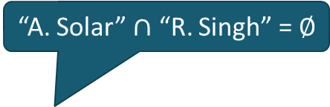
Intersection
“A. Solar”
A. Solar
Armando Solar
Rishabh Singh
“R. Singh”
“A. Solar” $∩$ “R. Singh” = $∅$
R. Singh

Slide 55
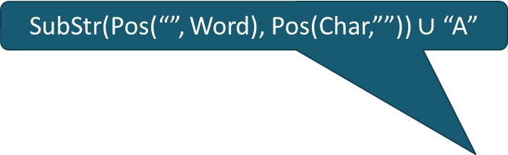
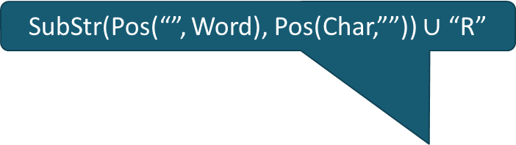
Intersection
SubStr(Pos(“”, Word), Pos(Char,””)) $∪$ “A”
A. Solar
Armando Solar
SubStr(Pos(“”, Word), Pos(Char,””)) $∪$ “R”
SubStr(Pos(“”, Word), Pos(Char,””))
Rishabh Singh
R. Singh

Slide 56
Intersection
“.”
A. Solar
Armando Solar
Rishabh Singh
“.”
“.”
R. Singh

Slide 57
Ranking
Prefer shorter programs.
  Fewer number of conditionals.
  Shorter string expression, regular expressions.
Prefer programs with fewer constants.
Strategies
Baseline: Pick any minimal sized program using minimal number of constants.
Manual: Break conflicts using a weighted score of program features.
Machine Learning: Weights are learned from training data.
Adapted from slide by Sumit Gulwani

