Slide 1
Lecture 22
Learning
Complex Distributions
Armando Solar-Lezama

Slide 2

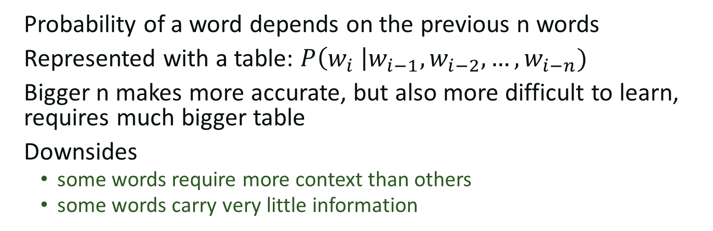
n-gram models
The big brown bear scares the children with its roar
$$P\left(scares \right|bear, brown)$$
Probability of a word depends on the previous n words
Represented with a table: $P\left(w_{i} \right|w_{i−1}, w_{i−2}, …, w_{i−n})$
Bigger n makes more accurate, but also more difficult to learn, requires much bigger table
Downsides
  some words require more context than others
  some words carry very little information

Slide 3





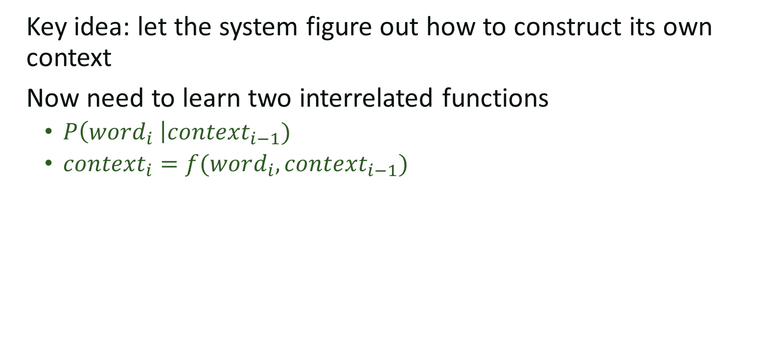






Recurrent models
Key idea: let the system figure out how to construct its own context
Now need to learn two interrelated functions
  $P\left(word_{i} \right|context_{i−1})$
  $context_{i}=f(word_{i}, context_{i−1})$
P
P
P
P
P
P
P
P
P
P
$$C_{0}$$
$$f$$
$$f$$
$$f$$
$$f$$
$$f$$
$$f$$
$$f$$
$$f$$
$$f$$
$$f$$
The big brown bear scares the children with its roar

Slide 4
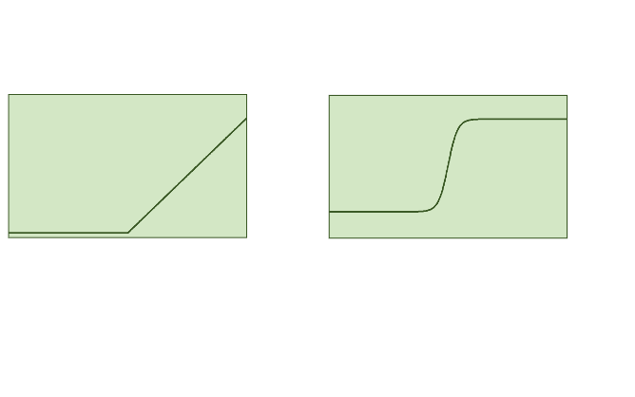











Neural Networks
Most popular way of representing recurrent models
Standard neural network model:
or
$$in$$
$$t_{1}$$
$$t_{n}$$
$$out$$
$$M_{0}$$
$$M_{n}$$
$$×$$
$$rect$$
$$…$$
$$×$$
$$rect$$
Constant 1
Matrices of parameters to be discovered

Slide 5












Simple recurrent neural network
P
$$p_{i}$$
$$C_{i−1}$$
$$f$$
$$C_{i}$$
$$in_{i}$$
$$C_{i−1}$$
$$M_{0}$$
$$C_{i}$$
$$×$$
$$tanh$$
$$in_{i}$$
$$p_{i}$$
Constant 1

Slide 6



























LSTM
$$p_{i}$$
P
$$C_{i−1}$$
$$f$$
$$C_{i}$$
$$in_{i}$$
$$×$$
$$+$$
$$C_{i−1}$$
$$C_{i}$$
$$p_{i−1}$$
$$M_{0}$$
$$p_{i}$$
$$×$$
$$σ$$
$$tanh$$
$$×$$
$$M_{1}$$
$$σ$$
$$×$$
$$in_{i}$$
$$×$$
$$×$$
$$M_{2}$$
$$tanh$$
$$×$$
$$M_{3}$$
$$σ$$

Slide 7
LSTM
$$p_{i}$$
P
$$C_{i−1}$$
$$f$$
$$C_{i}$$
$$in_{i}$$
$$×$$
$$+$$
$$C_{i−1}$$
Forget Gate Layer
$$C_{i}$$
$$p_{i−1}$$
$$M_{0}$$
$$p_{i}$$
$$×$$
$$σ$$
$$tanh$$
$$×$$
$$M_{1}$$
$$σ$$
$$×$$
$$in_{i}$$
$$×$$
$$×$$
$$M_{2}$$
$$tanh$$
$$×$$
$$M_{3}$$
$$σ$$

Slide 8
LSTM
$$p_{i}$$
P
$$C_{i−1}$$
$$f$$
$$C_{i}$$
$$in_{i}$$
$$×$$
$$+$$
$$C_{i−1}$$
$$C_{i}$$
$$p_{i−1}$$
$$M_{0}$$
$$p_{i}$$
$$×$$
$$σ$$
Input Gate Layer
$$tanh$$
$$×$$
$$M_{1}$$
$$σ$$
$$×$$
$$in_{i}$$
$$×$$
$$×$$
$$M_{2}$$
$$tanh$$
$$×$$
$$M_{3}$$
$$σ$$

Slide 9
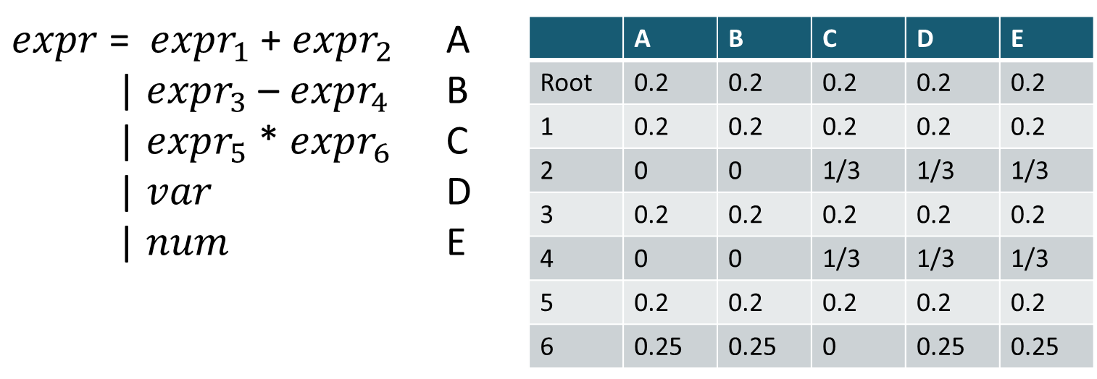

Context sensitive P G
Generalizes n-gram for n = 1
Can be extended to bigger contexts
+
*
+
x
2
x
3
$$P\left(production | site_{i}, site_{i−1}\right)$$
Can also be generalized to a recurrent model

Slide 10



Context sensitive P G
P
$$C_{0}$$
$$f$$
P
+
$$f$$
P
*
+
x
2
x
3
Can also be generalized to a recurrent model

Slide 11





















Encoder-decoder model
Encoder:
Generates latent representation of the evidence
Why do children hate the big brown bear?
$$C_{0}$$
$$f$$
$$f$$
$$f$$
$$f$$
$$f$$
$$f$$
$$f$$
$$f$$
$$C_{e}$$
P
P
P
P
P
P
P
P
P
P
$$C_{e}$$
$$f$$
$$f$$
$$f$$
$$f$$
$$f$$
$$f$$
$$f$$
$$f$$
$$f$$
$$f$$
Decoder:
Produces a distribution based on the evidence
The big brown bear scares the children with its roar

Slide 12
Multilayer and bidirectional models
Bidirectional networks propagate information back-to-front as well as
front-to-back. They can also have more than one layer.
The big brown bear scares the children with its roar
encoding

Slide 13
Attention
Key idea: Summarizing into a single vector is a big bottleneck. Every output should have direct access to the whole input

Slide 14













Attention
$$C_{0}$$
$$f$$
$$f$$
$$f$$
$$f$$
$$f$$
$$f$$
$$f$$
$$f$$
$$C_{e}$$
$$h_{0}$$
$$h_{0}$$
A
…
A
+
P
P
P
P
P
P
P
P
P
P
$$C_{e}$$
$$f$$
$$f$$
$$f$$
$$f$$
$$f$$
$$f$$
$$f$$
$$f$$
$$f$$
$$f$$

Slide 15
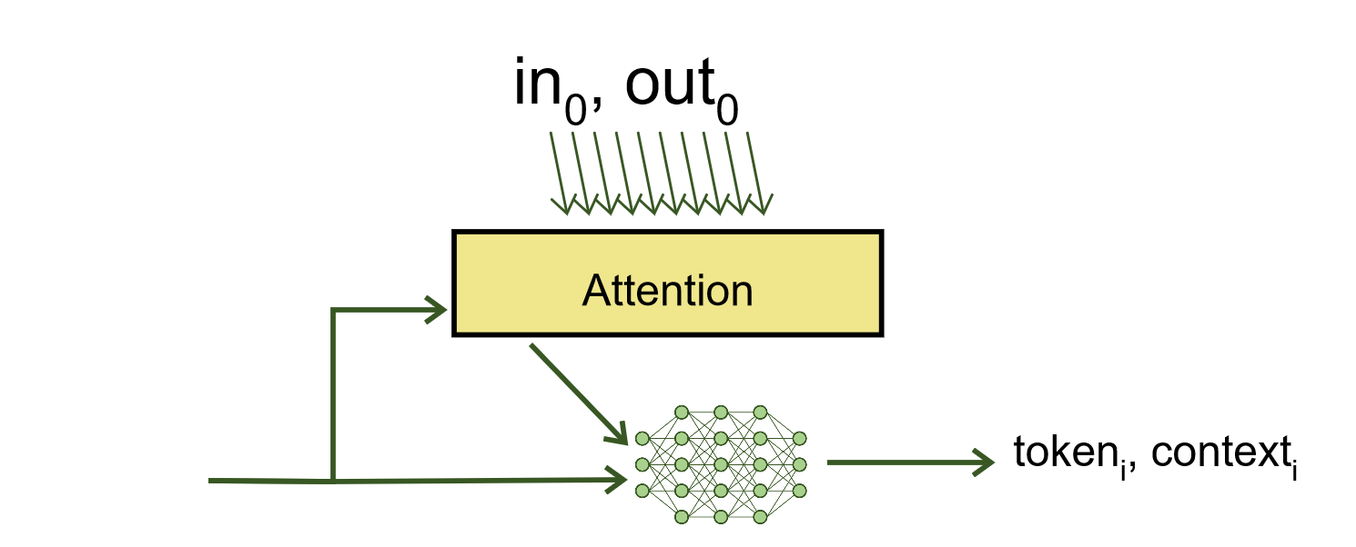
RobustFill
Single example case
  Attend over the input/output to produce each token

Slide 16


RobustFill
Multiple example case
  Compute each example independently
  pool over the result to decide which token to output
…
max_pool
token_{i}

Slide 17




Beam Search
bear 0.1
lion 0.05
fox 0.01
cat 0.001
P
P
P
$$C_{0}$$
$$f$$
$$f$$
$$f$$
The big brown
At each step pick the K most likely successors

Slide 18


Beam Search
runs 0.05
scares 0.03
eats 0.01
sleeps 0.007
P
P
P
P
$$f$$
$$C_{0}$$
$$f$$
$$f$$
$$f$$
bear (0.1)
The big brown
P
hunts 0.1
hides 0.07
eats 0.01
sleeps 0.001
$$f$$
lion (0.05)

Slide 19
Beam Search
runs 0.05
scares 0.03
eats 0.01
sleeps 0.007
P
P
P
P
$$f$$
$$C_{0}$$
$$f$$
$$f$$
$$f$$
bear (0.1)
The big brown
P
hunts 0.1
hides 0.07
eats 0.01
sleeps 0.001
$$f$$
lion (0.05)

Slide 20
Beam Search
fast 0.07
after 0.03
towards 0.01
into 0.007
P
P
$$f$$
P
P
P
$$f$$
runs (0.005)
$$C_{0}$$
$$f$$
$$f$$
$$f$$
bear (0.1)
P
gazelles 0.05
its 0.03
prey 0.01
into 0.007
The big brown
P
$$f$$
$$f$$
lion (0.02)
hunts (0.005)

Slide 21
Beam Search
fast 0.07
after 0.06
towards 0.01
into 0.007
P
P
$$f$$
P
P
P
$$f$$
runs (0.005)
$$C_{0}$$
$$f$$
$$f$$
$$f$$
bear (0.1)
P
gazelles 0.05
its 0.03
prey 0.01
into 0.007
The big brown
P
$$f$$
$$f$$
lion (0.02)
hunts (0.005)

Slide 22
Beam search for programs
Similar to top-down search
  Same strategies for pruning the search space apply

Slide 23
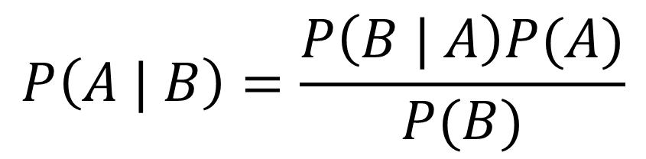
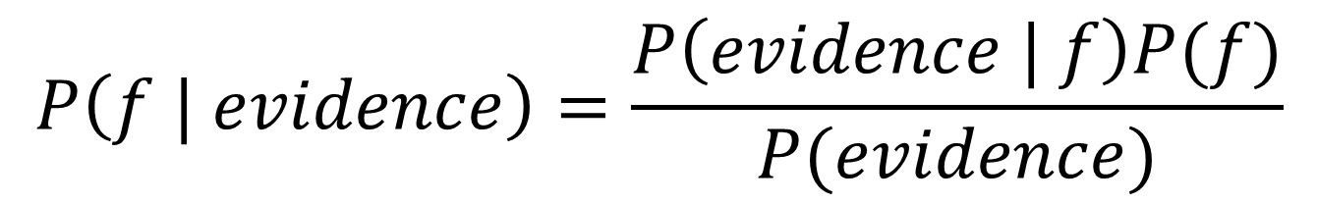

Bayesian View of PBE
$$P\left(f | evidence\right)=\frac{P\left(evidence | f\right)P(f)}{P(evidence)}$$
Can we learn $P\left(f | evidence\right)$ directly?

Slide 24

Synthesis from ambiguous evidence
Statistical model learned from corpus of code
An idealized program
Ambiguous, syntactic “evidence” about what the
program does
Synthesizer
Type-safe, compilable candidate
implementations (Prog)
Search guided by
statistical model
Neural Sketch Learning for Conditional Program Generation. Murali, Qi, Chaudhuri, and Jermaine. ICLR 2018 (oral presentation).
Notes:
These two ideas come together in a recent piece of work.

Slide 25
The Bayou system: Example
Input
Output
void read(String file) {
String s;
BufferedReader br;
FileReader fr;
try {
fr = new FileReader(file);
br = new BufferedReader(fr);
while ((s = br.readLine())!=null){
}
br.close();
}
catch (FileNotFoundException _e) {}
catch (IOException _e) {}
}
void read(String file) {
/// call:readline
/// type:BufferedReader
}

Slide 26
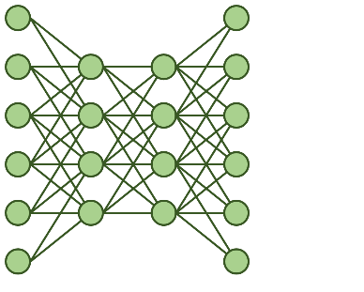
Learning to Sketch
Soft Constraints
encoder
Hard Constraints
Spec Vector
Code

Slide 27



Learning to Sketch
“Drop some elements”
encoder
[1,3,5,8,9]$→$[1,5,8]
Spec Vector
Search
filter input $λx.$HOLE
filter input $λx.$x%3==0

Slide 28
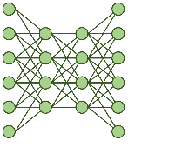
Beam Search + Synthesis
filter in
filter map
filter
filter fold
fold
fold in
fold filter

Slide 29




Training
Penalize heavily for incorrect token
Key idea
Penalty for hole depends on cost
of completing it
“Drop some elements”
filter input $λx.$x%3==0
[1,3,5,8,9]$→$[1,5,8]
fold input $λx.$x%3==0
x
filter input $λx.$HOLE
HOLE

Slide 30
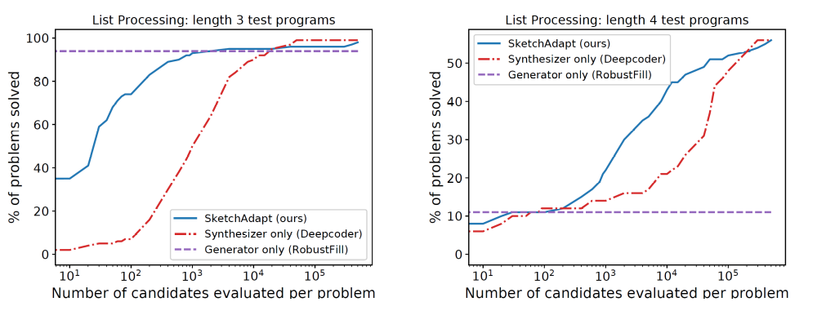
Results

Slide 31
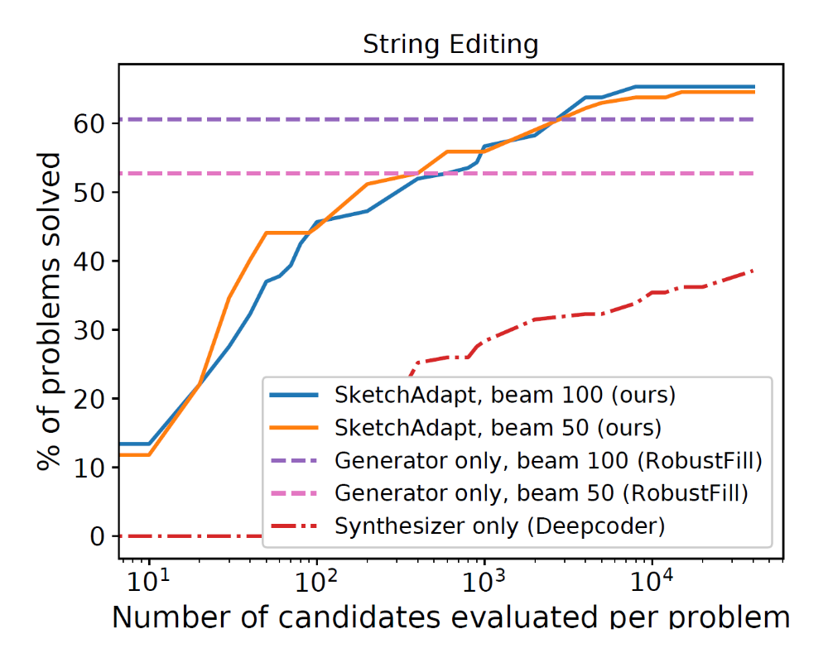
Results

Slide 32
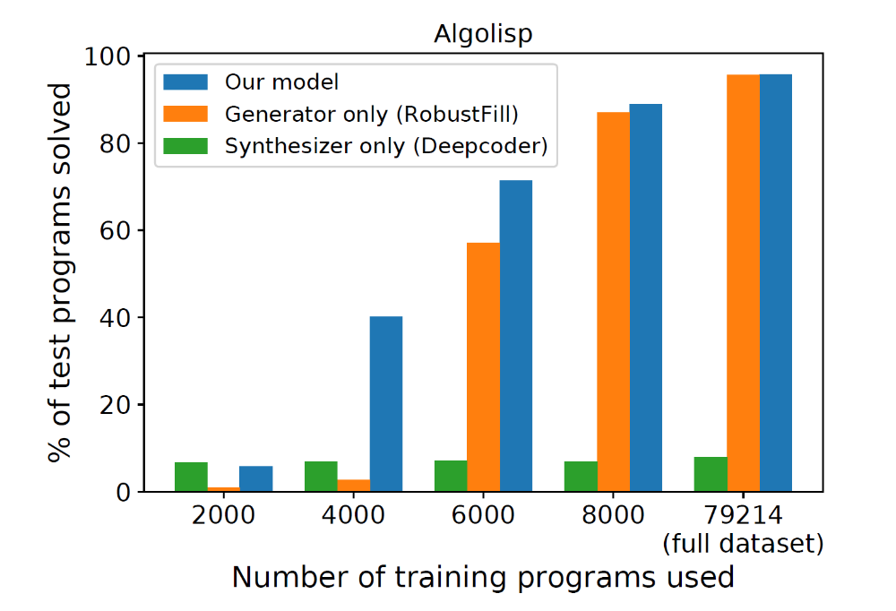
Algolisp Results

Slide 33
Generating programs
Specification
Recurrent state
Recurrent state
Next command

Slide 34

Generating programs
Specification
Program so far
Next command
Program state

Slide 35
Spec
Spec
Next Instruction:
Subtract($3, $1) .5
Subtract($3, $2) .4
Rectangle(….) .1
Next Instruction:
Subtract($1, $2) .5
Rectangle(….) .4
Circle(…) .1
canvas 1
canvas 1
canvas 2
canvas 2
canvas 3

Slide 36
Spec
Spec
Next Instruction:
Subtract($3, $1) .5
Subtract($3, $2) .4
Rectangle(….) .1
Next Instruction:
Subtract($1, $2) .5
Rectangle(….) .4
Circle(…) .1
canvas 1
canvas 1
canvas 2
canvas 1
canvas 2
canvas 1
canvas 3
canvas 2
canvas 1
canvas 1
canvas 1
canvas 3

Slide 37
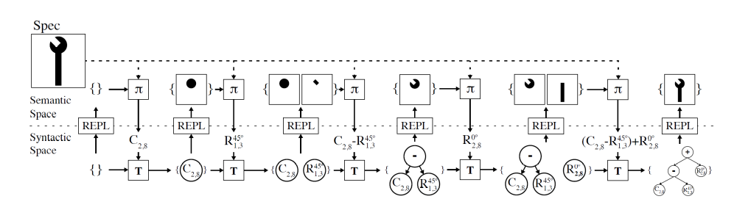
REPL

Slide 38




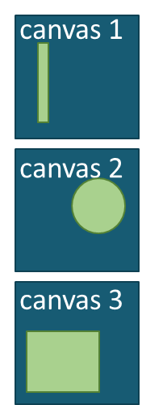
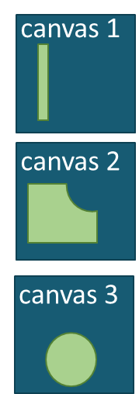


Value function over program states

Slide 39
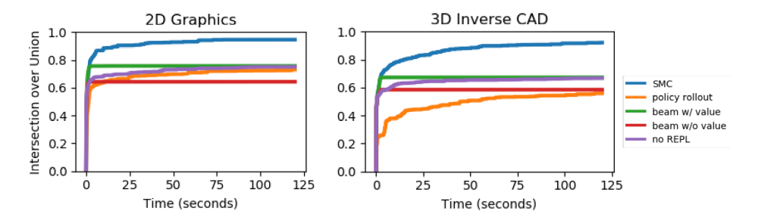
CSG domain

Slide 40
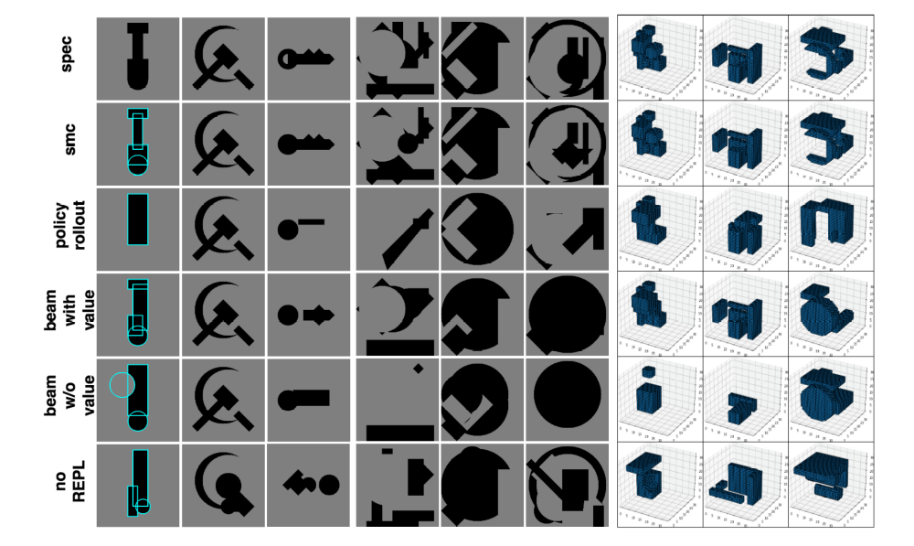

Slide 41
