Slide 1


M.Tech/MCA Program
Advanced Industry Integrated Programs
Jointly offered by University and LTIMindTree
Review II | Project 1
Intelligent Examination Trend Analysis Using Semantic Representation and Temporal Forecasting
Team Member
Sanjay Karthick S
251011013
Knowledge partner | Implementation partner

Slide 2

Intelligent Examination Trend Analysis
Introduction
Examination papers contain valuable historical information about topic recurrence and evolution.
Limits of conventional analysis
Relies mainly on manual inspection and frequency-based counting
Frequency alone may miss questions with similar meaning but different wording
Does not adequately capture recency, recurrence and temporal trends
Proposed framework
Combines semantic representations with temporal modeling
Semantic embeddings
+
Temporal modeling
Forecasts topics, not exact future questions

Slide 3
Intelligent Examination Trend Analysis
Objective
Extract & structure
Extract and structure questions from multi-year examination papers.
Semantic representation
Represent questions using semantic embeddings to identify conceptually related questions.
1
2
Topic behaviour
Model topic behaviour using frequency, recurrence, recency and temporal trends.
Top-K forecasting
Forecast and rank Top-K likely future examination topics.
3
4
Explainability
Provide evidence-based explanations for topic predictions.
Evaluation
Evaluate using chronological back-testing against baseline methods.
5
6

Slide 4






Intelligent Examination Trend Analysis
Modules to Cover
Data Ingestion & OCR
Semantic Representation
Temporal Topic Analysis
PDF text extraction with OCR fallback
Question segmentation and year metadata
Sentence-BERT embeddings
Cosine-similarity topic mapping
Topic-year matrix
Frequency, recurrence, recency, trend
Forecasting & Ranking
Explainability & Evaluation
Research Dashboard
Frequency and recency baselines
Top-K topics; RF / XGBoost planned
Evidence-based topic explanations
Chronological back-testing, P/R/F1/NDCG@K
Flask + React (Vite) + Recharts
Timeline, heatmap and Top-K charts

Slide 5
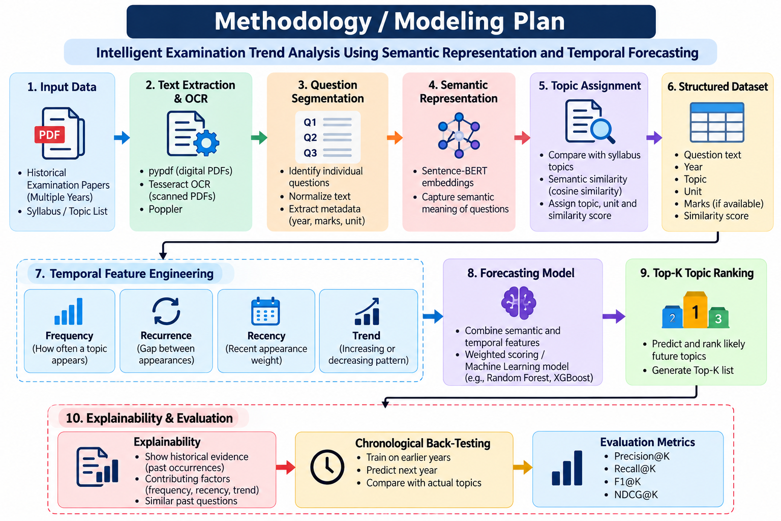
Intelligent Examination Trend Analysis
Methodology / Modeling Plan
Semantic layer
Sentence-BERT embeddings and cosine similarity map questions to syllabus topics
Temporal layer
Frequency, recurrence, recency and trend features for every topic
Forecast & rank
Weighted scoring / ML model produces the Top-K likely topics
Explain & validate
Historical evidence and chronological back-testing, scored with P/R/F1/NDCG@K

Slide 6
Intelligent Examination Trend Analysis
Data Preprocessing & EDA
Data preprocessing
Exploratory data analysis
Topic frequency by year
Unit-wise topic distribution
1
Extract text using pypdf; Tesseract + Poppler when OCR is required
Topic recurrence across years
Recent vs historical frequency
2
Segment individual questions and normalize extracted text
Temporal trend progression
Semantic similarity distribution
3
Preserve examination-year metadata
Planned visualizations
4
Generate Sentence-BERT embeddings
Topic-frequency timeline
Topic-year heatmap
5
Flag questions that cannot be reliably mapped to a topic
Topic evolution graph
Top-K forecast chart

Slide 7
Intelligent Examination Trend Analysis
Approach, Algorithms & Tools
Algorithms
Tools
Sentence-BERT
Semantic embeddings
DATA
Python
Pandas
NumPy
Cosine similarity
Semantic topic matching
ML & NLP
Sentence Transformers
Scikit-learn
Temporal feature engineering
Recurrence, recency and trend
OCR
Random Forest / XGBoost
Planned learned forecasting
Tesseract OCR
Poppler
WEB APP
Frequency and recency
Baseline models
Flask
React + Vite
Recharts
REPORTS
Precision@K, Recall@K, F1@K, NDCG@K
Evaluation metrics
ReportLab

Slide 8



Intelligent Examination Trend Analysis
Project Plan & Milestones
9
Completed / in progress
7
Phase 2
Literature review and research-gap formulation
Expand historical examination corpus
Multi-year paper ingestion pipeline
Improve semantic topic discovery
PDF text extraction and OCR fallback
Question segmentation
Introduce learned forecasting model
Sentence-BERT semantic matching
Add semantic topic evolution
Temporal topic analysis
Add marks / question-type / Bloom's taxonomy analysis
Forecast dashboard
Add uncertainty and stronger explainability
Frequency and recency baselines
Chronological back-testing framework
Complete rigorous baseline comparison
Note: Actual forecasting metrics will be reported after the full multi-year corpus is processed successfully.

Slide 9
Intelligent Examination Trend Analysis
Pipeline Structure
1
2
3
4
5
6
7
Historical Examination Papers
PDF Text Extraction
OCR if Required
Question Segmentation
Metadata Extraction
Sentence-BERT Embeddings
Semantic Topic Mapping
14
13
12
11
10
9
8
Research Dashboard
Chronological Back-Testing
Explainable Evidence
Top-K Topics
Forecasting Model
Temporal Features
Frequency • Recurrence • Recency • Trend
Topic-Year Matrix
Data ingestion
Semantic mapping
Temporal analysis
Forecasting
Explain, evaluate & present

Slide 10
M.Tech/MCA Program
Advanced Industry Integrated Programs
Jointly offered by University and LTIMindTree
Review II | Project 2
Agentic AI Framework for Autonomous Data Analysis and Insight Generation
Team Member
Sanjay Karthick S
251011013
Knowledge partner | Implementation partner

Slide 11
Agentic AI for Autonomous Data Analysis
Introduction
Data analysis requires profiling, preprocessing, EDA, modeling and validation.
Profiling
Preprocessing
EDA
Modeling
Validation
Conventional automation
Often follows predefined workflows
Fixed workflows may not adapt effectively to different datasets and analytical objectives
Agentic AI framework
Understands datasets and plans suitable workflows
Specialized agents execute Data Science tasks using deterministic Python tools
Adds autonomous preprocessing and a downloadable processed dataset
PHASE 2

Slide 12
Agentic AI for Autonomous Data Analysis
Objective
1
Profile
2
Detect the task
3
Plan
4
Preprocess & EDA
Automatically profile uploaded structured / tabular datasets.
Identify classification, regression or clustering from dataset characteristics and user intent.
Dynamically plan an appropriate Data Science workflow.
Autonomously perform preprocessing and EDA.
5
Model
6
Validate
7
Insights
8
Deliver
Select and execute suitable ML algorithms and metrics.
Validate results and support iterative refinement.
Generate interpretable insights and reports.
Provide a downloadable preprocessed dataset as an output artifact.

Slide 13






Agentic AI for Autonomous Data Analysis
Modules to Cover
Profiling & Task Detection
Workflow Planning
Autonomous Preprocessing
Profile Agent analyses the dataset
Classification, regression or clustering
Planner Agent builds the plan
Dataset-specific, dynamic workflow
Preprocessing Agent + validation
Phase 2: downloadable processed CSV
Exploratory Data Analysis
Modeling & Validation
Insights & Reporting
EDA Agent runs the analysis
Matplotlib / Plotly visualizations
Model Agent: LR, RF, K-Means
Validation and iterative refinement
Insight Agent: interpretable insights
Analysis report + preprocessed CSV

Slide 14


Agentic AI for Autonomous Data Analysis
Methodology / Modeling Plan
1
2
3
4
5
6
Dataset + User Goal
Dataset Profiling Agent
Task Understanding
Workflow Planning
Autonomous Preprocessing
Preprocessing Validation
12
11
10
9
8
7
Report + Preprocessed Dataset
Insight Generation
Iterative Refinement
Model Validation
Model Selection & Execution
EDA
LLM responsibility
Reasoning, planning, tool selection and explanations
Python responsibility
Data transformation, statistics, ML and file generation
This separation keeps execution deterministic and reproducible.

Slide 15

Agentic AI for Autonomous Data Analysis
Data Preprocessing & EDA
Autonomous preprocessing
Output
Missing values
Choose suitable numerical / categorical imputation
Original dataset
Duplicates
Detect and remove exact duplicates where appropriate
Data types
Detect and correct inconsistent representations
Processed dataset
Categorical data
Choose one-hot / ordinal encoding based on characteristics
Numerical data
Scale when required by the downstream model
Outliers
Detect using statistical methods; retain, transform or flag based on context
Downloadable CSV + preprocessing report
Identifier columns
Detect high-cardinality ID-like features; exclude from modeling when justified

Slide 16
Agentic AI for Autonomous Data Analysis
Approach, Algorithms & Tools
Agentic approach
Models & metrics
LangGraph / LangChain
Workflow orchestration, conditional transitions
Classification
Local LLM
Ollama + Phi-4-mini
Models: Logistic Regression, Random Forest
Metrics: Accuracy, Precision, Recall, F1
Pandas / NumPy
Deterministic data processing
Regression
Scikit-learn
ML and evaluation
Models: Linear Regression, Random Forest
Metrics: MAE, RMSE, R²
Matplotlib / Plotly
Visualization
Streamlit
User interface
Clustering
SQLite
Execution metadata and logging
Models: K-Means
Metrics: Silhouette Score

Slide 17
Agentic AI for Autonomous Data Analysis
Project Plan & Milestones
PHASE 1
PHASE 2
RESEARCH EVALUATION
Implemented / in progress
Current enhancements
Fixed Data Science pipeline
Agentic Data Science pipeline
VS
Dataset profiling
Autonomous preprocessing agent
Dynamic task detection
Dataset-specific preprocessing plan
Measures
Preprocessing validation
Task completion rate
Manual intervention count
Execution time
Analytical / model performance
Workflow failures and recovery
Dynamic model selection
Downloadable processed CSV
Profile, Planner, EDA, Model, Validation and Insight agents
Preprocessing decision log / report
Model and workflow validation
Local-first Ollama + Phi-4-mini to avoid paid API quotas

Slide 18
Agentic AI for Autonomous Data Analysis
Pipeline Structure
1
2
3
4
5
Dataset + Analysis Goal
USER input
Profile Agent
profiles the dataset
Planner Agent
plans the workflow
Preprocessing Agent
autonomous preprocessing
Validation Agent
validates preprocessing
9
PARALLEL BRANCHES
Analysis Report
8
7
6
6
Insight Agent
interpretable insights
Validation Agent
validates model results
EDA Agent
exploratory analysis
Model Agent
selects and runs ML models
9
Preprocessed CSV
The LLM plans, selects tools and explains; deterministic Python tools execute every step.

