Slide 1
MINI PROJECT REVIEW - 1
Word level Auto-Complete
Context-Aware Next Word Prediction
Team
Prabakaran K – 23bad111
Sanjay K N – 23bad115
Sukil Raj M S – 23bad121

Slide 2

Problem Statement
Typing Efficiency Challenge
• Typing large amounts of text is time-consuming
• Traditional autocomplete ignores contextual meaning
• Many systems only use dictionary matching
• No intelligent next-word prediction in simple editors
Critical Need:
An intelligent NLP-based system that predicts the most probable next word based on the previous word using statistical language models.

Slide 3





Project Objectives
NLP-Based System
Dual Approach
Develop a context-aware word auto-complete system
Implement n-gram based prediction models
Preprocessing
Evaluation
Clean and normalize textual data
Calculate next-word probabilities using frequency distribution
User Interface
Create a simple interface for real-time word suggestions

Slide 4
Word Prediction Approaches
Statistical Language Model
Rule-Based Enhancement
• n-Gram Model
• Probability-based prediction
• Frequency-based ranking
Algorithms:
• Unigram
• Bigram
• Trigram
• POS-based filtering
• Morphological analysis
• Grammar-aware filtering

Slide 5
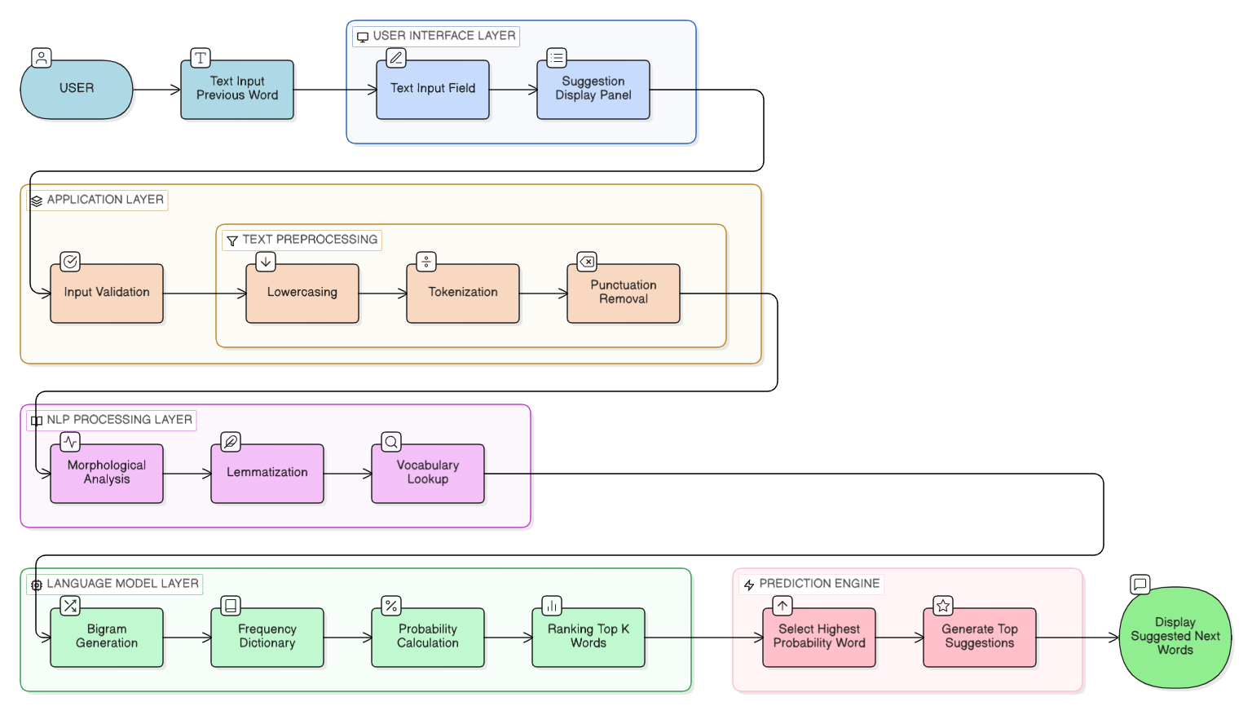
System Architecture

Slide 6
Project Modules
1
Data Input
2
Text Preprocessing
3
Feature Extraction
• Word frequency count
• Bigram generation
• Trigram generation
• Probability calculation
• Text corpus loading
• Tokenization
• Lowercase conversion
• StopWord removal
• Lemmatization
• Special character removal
• Dataset validation
• Vocabulary creation
4
Language Modeling
5
Prediction Engine
6
User Interface
• Takes previous word as input
• Finds matching bigrams
• Computes probability
• Suggests top-k next words
• Text input box
• Real-time suggestion display
• Top 2/Top 3 suggestions
• Morphological Analysis
• n-Gram Model implementation
• POS Tagging
• Context-based next word prediction

Slide 7
Tools & Technologies
Category | Tools/Technologies
Programming Language | Python 3.10
NLP Libraries | NLTK
Data Processing | Pandas, NumPy
Language Modelling | N – Gram(Unigram, Bigram, Trigram)
Development IDE | Jupyter Notebook, VS Code
Dataset | Shakespeare Dataset (Kaggle)

Slide 8

Dataset Information
Dataset Sources
Dataset Used
• Shakespeare Corpus: Dramatic plays containing dialogues, character speeches, and stage directions.
Domain
Literary / Classical English
Dataset | Documents | Avg Length | Domain
Shakespeare Plays | 37 plays | ~25,000 words per play | Literary Drama
Shakespeare Dialogues (processed lines) | 111396 lines | ~5–20 words per line | Dialogue

Slide 9
Module 1
Basic Text Processing operation on text document
Text Pre-processing -I

Slide 10
Module Description
Module 1 focuses on cleaning and preparing the Shakespeare dataset for building a statistical language model from scratch.
Since we are not using any pre-trained models, preprocessing plays a critical role in ensuring accurate probability calculations for next-word prediction.

Slide 11
Preprocessing Pipeline
Sample Input:
"Betwixt my love and your high majesty"
1. Tokenization
[‘Betwixt ‘,‘love’, ‘high’, ‘majesty’]
2. Lowercase & Cleaning
[‘betwixt ‘,‘love’, ‘high’, ‘majesty’]
3. Lemmatization
[‘betwixt’, ‘love’, ‘high', ‘majest’]

Slide 12
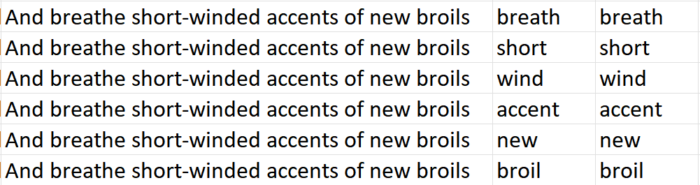
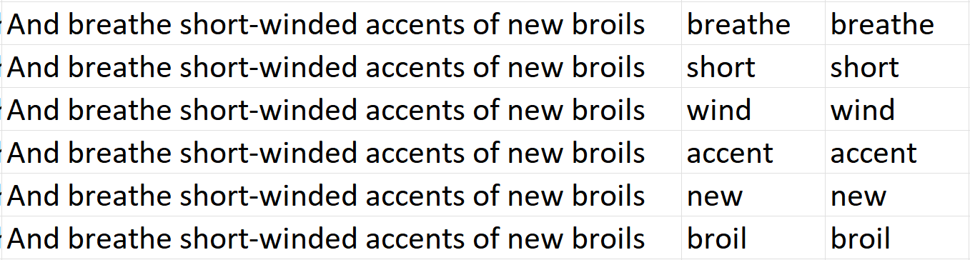
Screenshots
Stemmed
Lemmatized

Slide 13
Module 2
Morphological Analysis
Explore Language Models - n-Gram model
POS tagging

Slide 14
Module Description
Module 2 focuses on understanding the structure of words and building a statistical language model to predict the next word based on the previous word.
This module improves prediction accuracy by analyzing word forms and contextual probabilities using n-gram techniques.

Slide 15
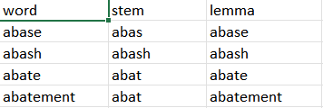
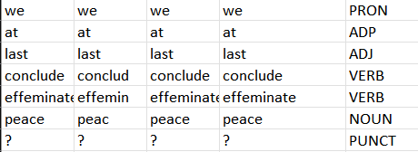
Screenshots
Comparision
POS tagging

Slide 16
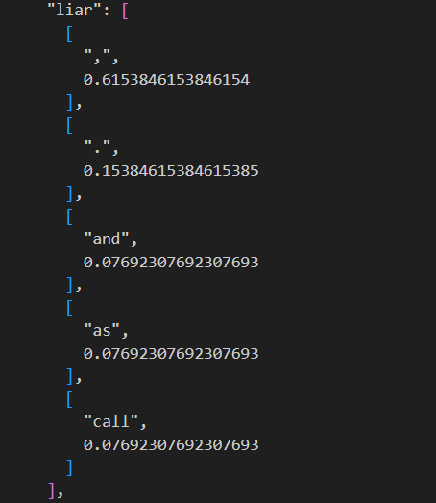
Screenshots
Prediction

Slide 17

Expected Outcomes
Functional next-word prediction system
Bigram accuracy > 60% (depending on dataset)
Reduced typing effort
Real-time suggestions
Clean and modular code

Slide 18

Future Enhancements
Technical Improvements
Model Improvements
Features Improvements
Implement higher-order n-gram models (4-gram / 5-gram)
Apply smoothing techniques (Laplace smoothing)
Use Trie data structure for faster word lookup
Optimize real-time prediction speed
Upgrade to LSTM / GRU-based language models
Implement transformer-based models such as GPT
Combine statistical and neural approaches (Hybrid model)
Improve contextual prediction accuracy
Add user-personalized learning
Develop web-based interface for real-time use
Support multi-language prediction
Integrate voice-based auto-completion

Slide 19

Conclusion
This project implements a statistical NLP-based word auto-completion system built from scratch using preprocessing and n-gram language modeling. In Review 1, the core prediction engine and text processing modules have been successfully developed, forming the foundation for future enhancements.

Slide 20
Thank You
Word Auto Completion

