Slide 1
Deep Q Learning
ML Project

Slide 2
Modules Used
Torch
Stable baselines
Gymnasium
Ale python

Slide 3
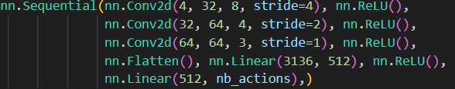
Neural Network

Slide 4
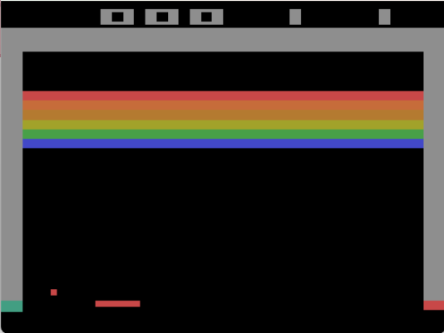
Atari - Breaker

Slide 5
Activations
Input Tensor : 4 x 84 x 84
Hidden 1 + ReLu : 32 x 20 x 20
Hidden 2 + ReLu : 64 x 9 x 9
Hidden 3 + ReLu : 64 x 7 x 7

Slide 6
Parameters
Hidden 1 + ReLu : 32 x 8 x 4 x 4
Hidden 2 + ReLu : 64 x 32 x 4 x 4
Hidden 3 + ReLu : 64 x 64 x 3 x 3
Linear : 3136 x 512
Output : 512 * n
Total ~ 1.7M

Slide 7
Concepts
Frameskip : 4
DQL
Normalise : [0, 1]
Loss : Huber
Policy : Epsilon Greedy
Reward : Clipped
Replay Buffer & Target network

Slide 8
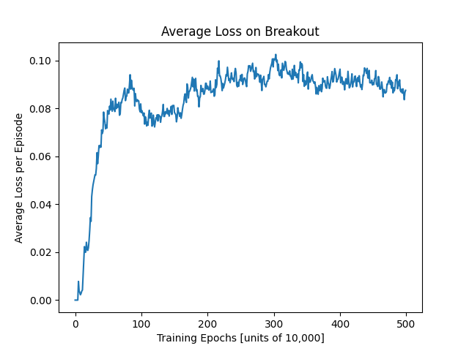
Average Loss 5M

Slide 9
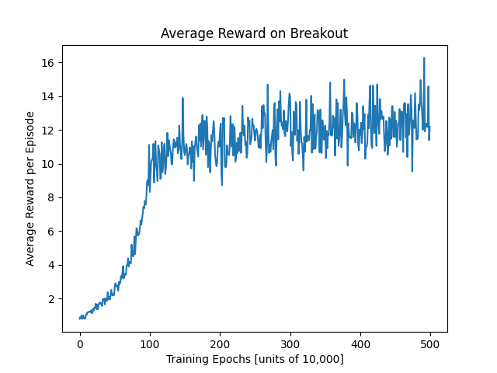
Average reward 5M

Slide 10
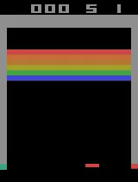
Model running
☺

Slide 11
The end
Thank You

