Slide 1
Lines
Function / Attribute | Description
beginPath() | Starts a new path.
moveTo(x, y) | Moves the pen to the point (x, y).
lineTo(x, y) | Draws a straight line from the current point to (x, y).
stroke() | Renders the outline
strokeStyle | Sets the color of the line
lineWidth | Sets thickness of the line.
lineCap | Specifies shape of line ends: "round", "square"
lineJoin | Corner style where lines meet: "bevel", "round"

Slide 2
<canvas id="lineCanvas" width="300" height="200"></canvas> const lineCtx = document.getElementById('lineCanvas').getContext('2d'); lineCtx.beginPath(); lineCtx.moveTo(50, 50); lineCtx.lineTo(250, 150); lineCtx.strokeStyle = 'red'; lineCtx.lineWidth = 4; lineCtx.stroke();

Slide 3
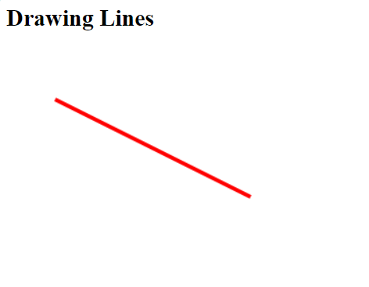

Slide 4
Arcs/Circles
Function / Attribute | Description
arc(x, y, radius, startAngle, endAngle, counterclockwise) | Draws an arc centered at (x, y). Angles in radians.
beginPath() | Start a new shape/path.
closePath() | Connects last point to first.
stroke() | Outline the arc.
fill() | Fill the arc shape.
fillStyle | Set fill color.
strokeStyle | Set border color.

Slide 5
<canvas id="circleCanvas" width="300" height="200"></canvas> const circleCtx = document.getElementById('circleCanvas').getContext('2d'); circleCtx.beginPath(); circleCtx.arc(150, 100, 70, 0, 2 * Math.PI); circleCtx.strokeStyle = 'lime'; circleCtx.lineWidth = 3; circleCtx.stroke();

Slide 6
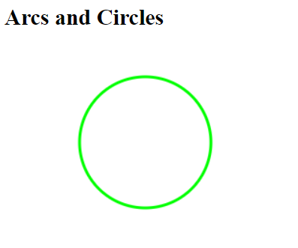

Slide 7
Shadows
Property | Description
shadowColor | Color of the shadow (e.g., "rgba(0,0,0,0.5)").
shadowBlur | How blurry the shadow is (larger = blurrier).
shadowOffsetX | Horizontal shadow offset.
shadowOffsetY | Vertical shadow offset.

Slide 8
<canvas id="shadowCanvas" width="300" height="200"></canvas> const shadowCtx = document.getElementById('shadowCanvas').getContext('2d') shadowCtx.shadowColor = 'blue'; shadowCtx.shadowBlur = 15; shadowCtx.shadowOffsetX = 10; shadowCtx.shadowOffsetY = 10; shadowCtx.fillStyle = 'orange'; shadowCtx.fillRect(50, 50, 150, 100);

Slide 9
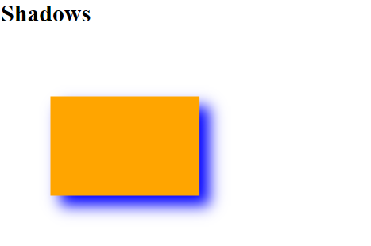

Slide 10
Transformations
Function / Attribute | Description
translate(x, y) | Moves the canvas origin to (x, y).
rotate(angle) | Rotates the canvas (in radians).
scale(x, y) | Scales the canvas along X and Y axes.
save() | Saves current canvas state.
restore() | Restores canvas state to last save().
transform(a, b, c, d, e, f) | Applies a custom matrix transformation.
setTransform(...) | Resets and sets transformation directly.

Slide 11
<canvas id="transformCanvas" width="300" height="200"></canvas> const transCtx = document.getElementById('transformCanvas').getContext('2d'); transCtx.fillStyle = 'gray'; transCtx.fillRect(20, 20, 100, 60); transCtx.translate(50, 100); transCtx.rotate(Math.PI / 3); transCtx.fillStyle = 'purple'; transCtx.fillRect(-50, -30, 100, 60);

Slide 12
