Slide 1
HTML TABLES
Sanjay K N
23BAD115

Slide 2
Why HTML tables?
The Excel of the web
Tables organize data in rows and columns
Used for displaying structured data
Introduced in HTML 3.2
Feature:
You can customize each cell
You have to customize each cell

Slide 3
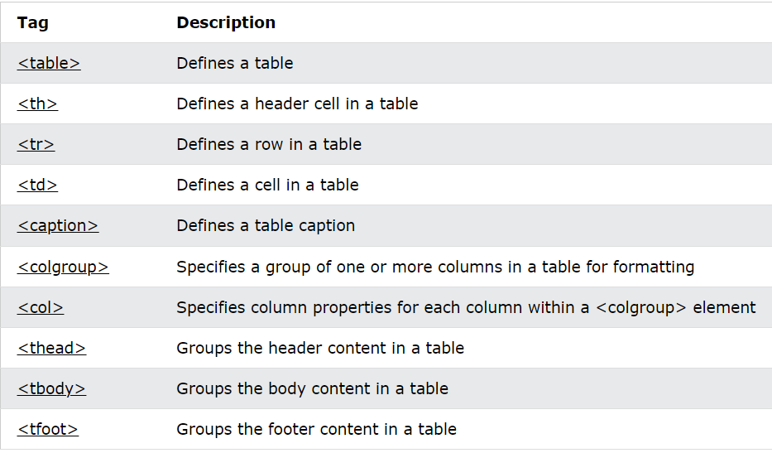
Tags

Slide 4
Table and Borders

Slide 5
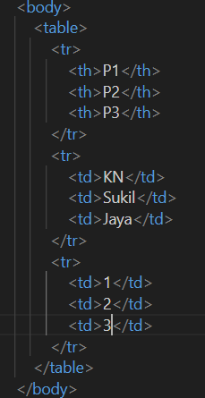
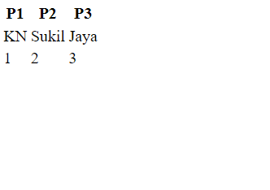
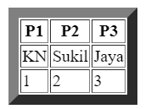

Slide 6
Table’s Size

Slide 7
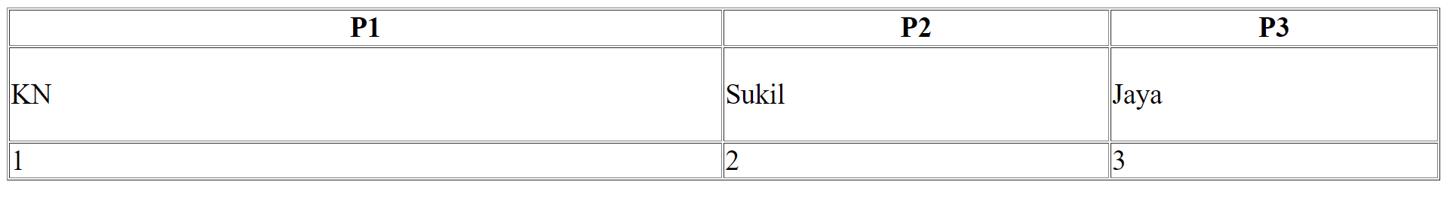
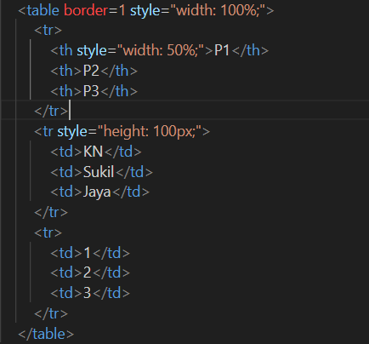

Slide 8
Headers

Slide 9
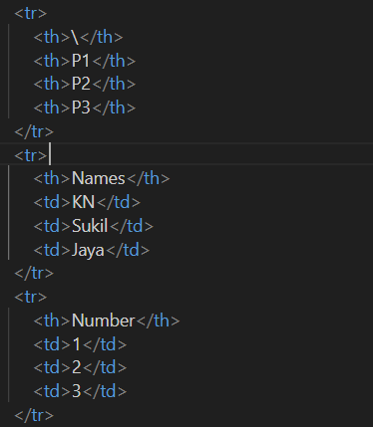
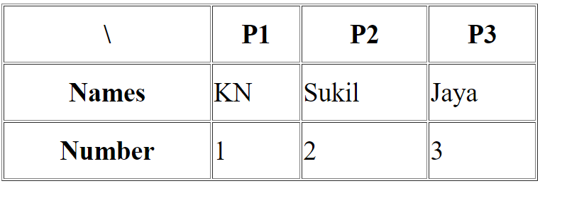

Slide 10
Colspan & Rowspan

Slide 11
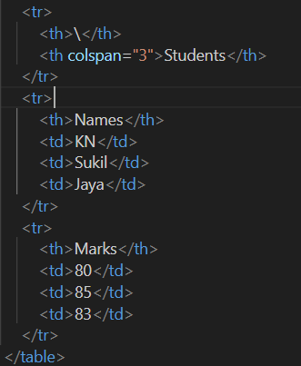
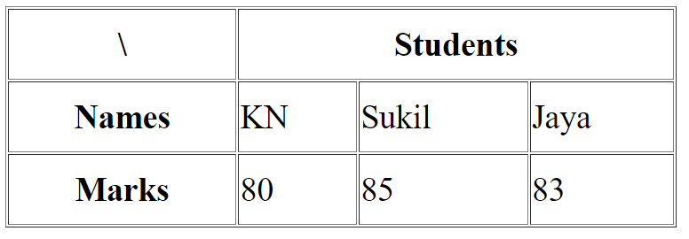

Slide 12
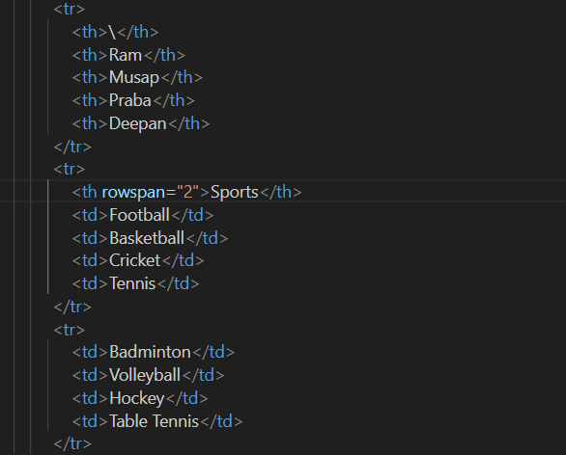

Slide 13
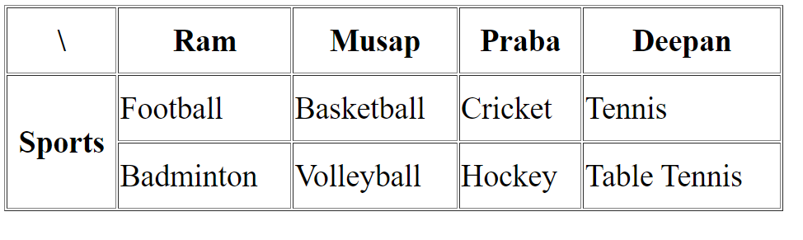

Slide 14
Grouping Columns

Slide 15

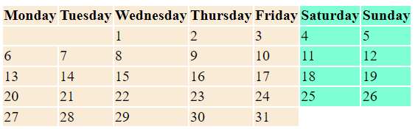

Slide 16


