Slide 1
Smart Traffic Routing
Sanjay K N
Sukil Raj M S
Prabakaran K

Slide 2
Objectives
Build a web-based system for booking road usage slots in advance.
Use Dijkstra’s algorithm to suggest optimal, congestion-free routes.
Predict future traffic load using AI/ML models.
Recommend optimal speed for smooth vehicle movement.
Simulate a mini smart-city road network for demonstration purposes.

Slide 3
Problem Statement
Urban roads often face congestion due to uncoordinated vehicle flow.
Peak-hour traffic leads to delays, increased fuel consumption, and pollution.
Current systems do not offer pre-booking or optimal speed guidance to prevent traffic jams.
There's a lack of smart tools to simulate and plan city traffic using AI techniques.

Slide 4
Google Maps Traffic Navigation
Real-time traffic visualization using GPS data.
Alternative route suggestions during congestion.
Estimated arrival time (ETA) based on current conditions.
Live speed and roadblock alerts via user crowdsourcing.

Slide 5
Google Maps - Limitations
No option for advance road booking or slot reservation.
Works reactively based on current traffic - not proactively.
Doesn’t recommend optimal speed to coordinate flow among vehicles.
Can’t simulate road usage for a planned smart city model.

Slide 6
My System’s Innovation
Booking road usage in advance
Suggesting speed and time slot
Using AI to predict future congestion

Slide 7
Iterative Development Model
Build core modules first (UI + Routing logic)
Test with small datasets
Add features incrementally (ML model, Admin tools, etc.)
Repeat until all requirements are fulfilled

Slide 8
Why iterative?
Easy to adapt changes
Early prototype visualization
Suitable for small team and time-constrained project

Slide 9
Tech Stack
Frontend : ReactJS
Backend : NodeJS
AI/ML : Python
Database : MongoDB

Slide 10
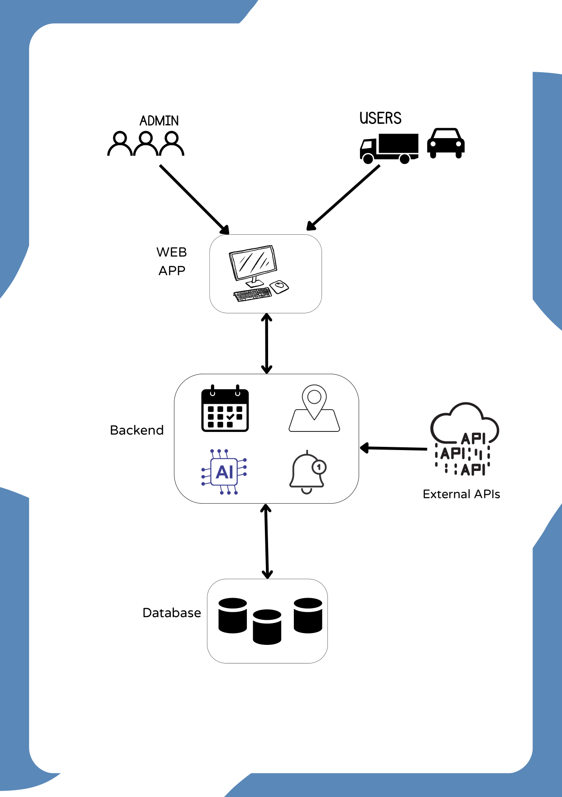

Slide 11
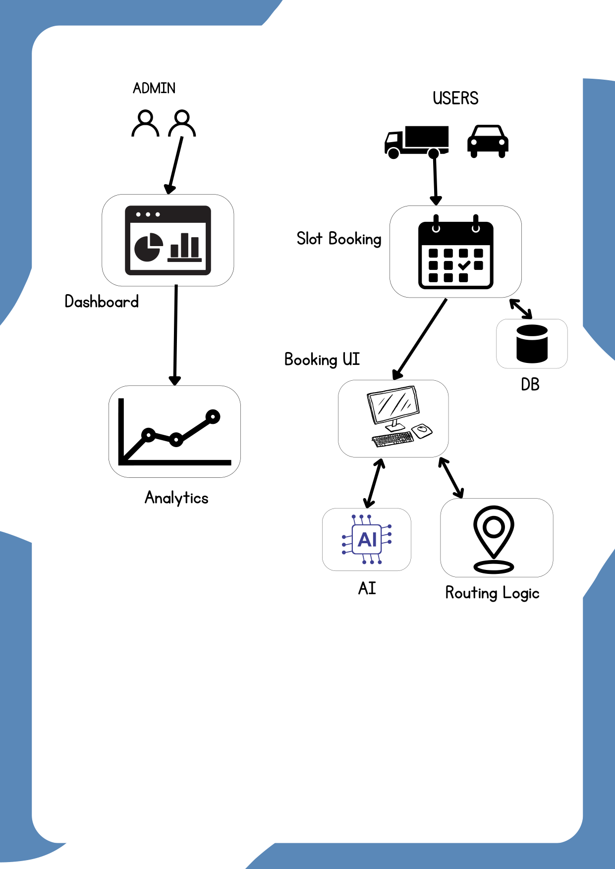

Slide 12
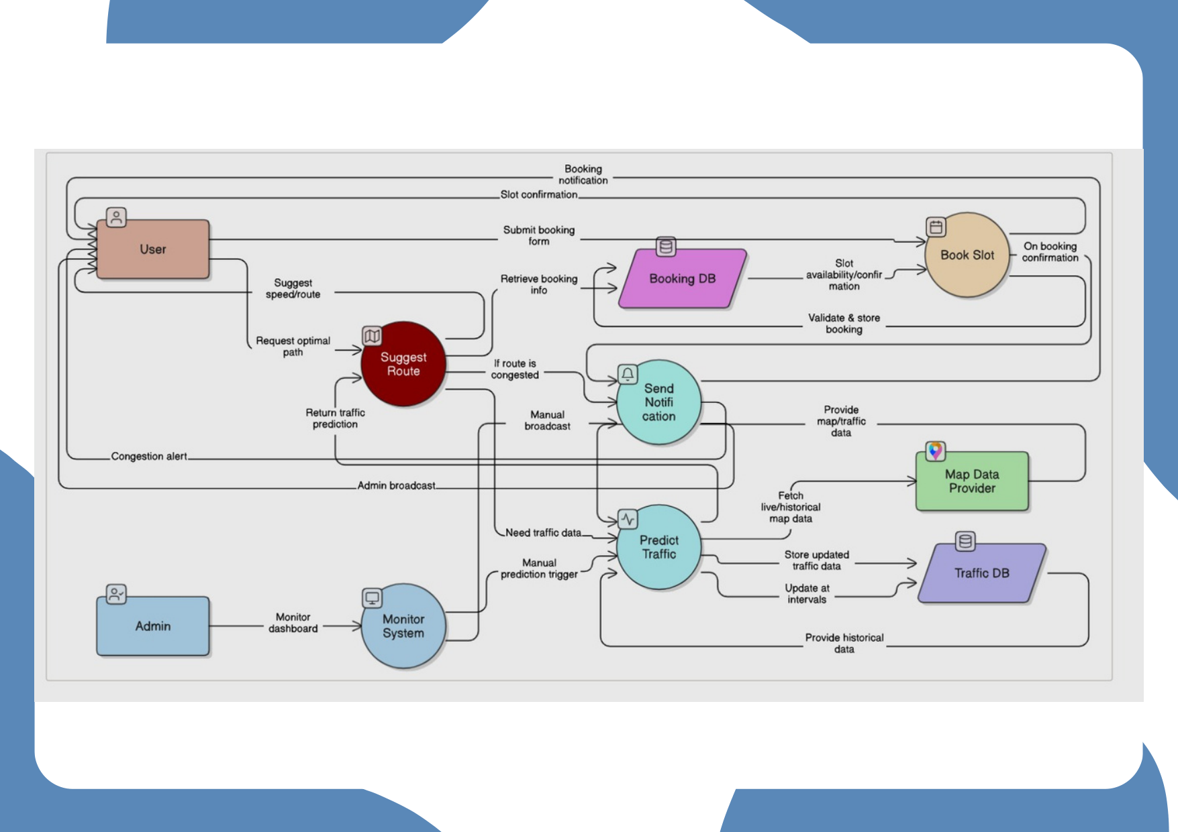

Slide 13
SDLC Model
Iterative Development Model
• Build core modules first (UI + Routing logic)
• Test with small datasets and refine
• Add AI/ML, Admin tools incrementally
Why Iterative?
• Adaptable to change, early prototypes, suits small teams and tight deadlines

Slide 14
AI Ethics
Privacy: Anonymize user data; avoid storing personal trip traces.
Fairness: Ensure model does not bias certain areas or users.
Transparency: Explain booking rejections and speed recommendations.
Safety: Validate recommended speeds against road limits and safety constraints.
Consent & Data Minimization: Collect only necessary data and obtain consent.

Slide 15
Cost Efficiency
Use cloud free tiers: MongoDB Atlas free tier, Vercel/Netlify for frontend.
Lightweight ML models (scikit-learn) and batch predictions to reduce compute.
Cache frequent route calculations and reuse Dijkstra results where possible.
Simulate traffic during development to avoid costly real-world testing.
Complexity awareness: Dijkstra O(E + V log V) — optimize graph representation.

