Slide 1


SMART INDIA HACKATHON 2025
Problem Statement ID – SIH25036
Problem Statement Title- Development of Sensor for Detection of Microplastics – Ministry of Earth Sciences(MoES)
Theme- Miscellaneous
PS Category- Hardware
Team ID-
Team Name- Innov8

Slide 2

IDEA TITLE
Innov8
PROBLEM STATEMENT
Expected Solution:
A portable battery powered sensor system
Detecting & classifying Microplastics
Fast results with minimal sample prep
Water Inlet
Pre-Filtering
Flow Cuvette/ Membrane
Dark Chamber
User Interface
UV Light
AS7265x
Spectrometer
Data Visualization
Mobile App
Wi-Fi
MP Detector
We process water samples through a dark chamber with controlled illumination. A multispectral sensor and camera capture spectral and image data, which are analyzed by an AI model to detect and classify microplastics. If abnormal levels are found, the system logs results and alerts the monitoring team via a mobile app.
TinyML
Model
ESP32-S3
Power Management
Voltage Regulator
Li-ion 18650 cells
Database

Slide 3
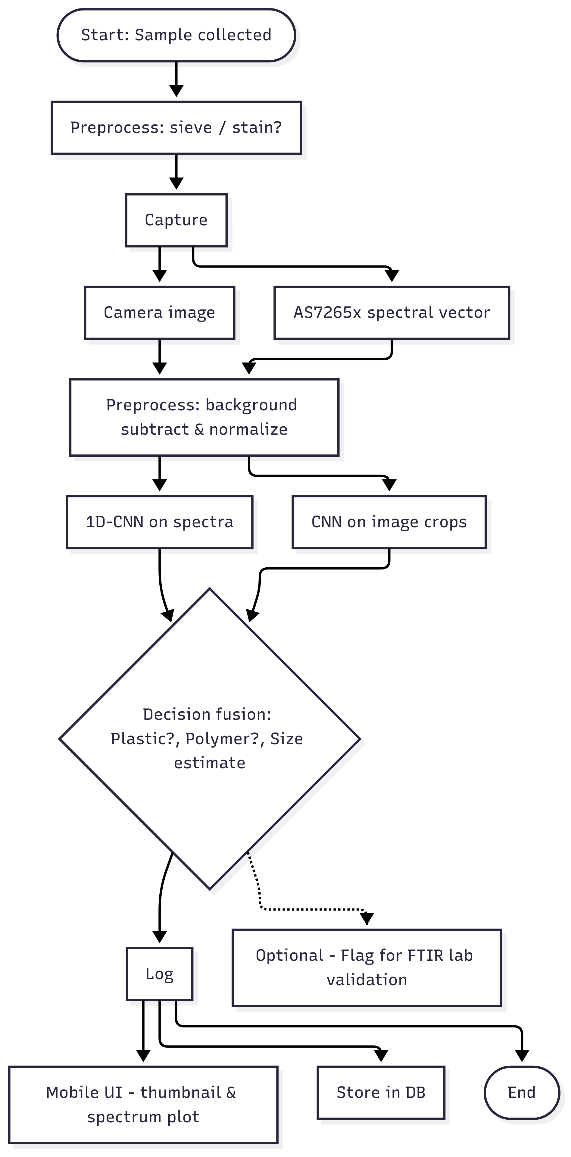
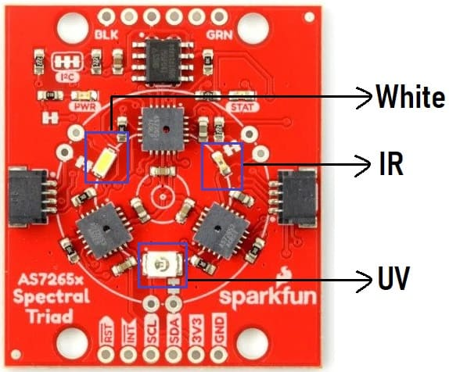
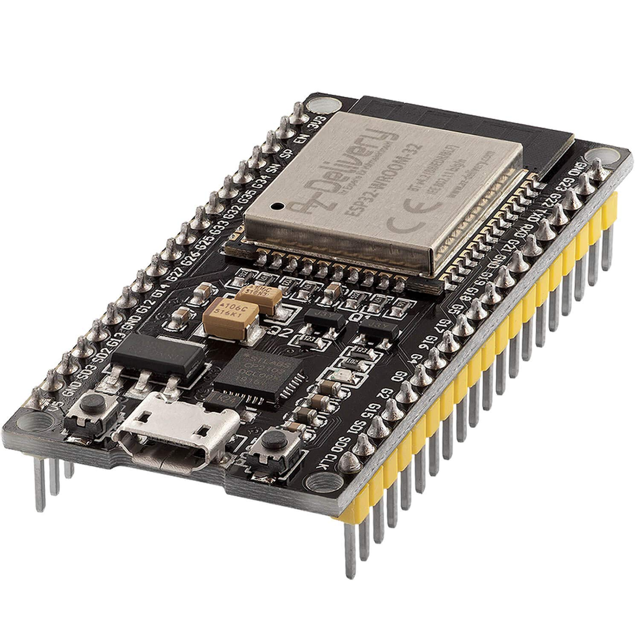
TECHNICAL APPROACH
Innov8
HARDWARE & OPTICS
Optical layout: Dark chamber, 3–5 mm flow cuvette or membrane holder, UV/blue LED (365–405 nm).
Sensors: AS7265x multispectral (18 bands 410–940 nm) for spectral signature; ESP32-S3 camera (5 MP) with optional 10× objective for ≤50 µm resolution.
Electronics: ESP32-S3 devboard, LED driver (PWM), I²C for AS7265x, 12V Li-ion battery + buck regulator (5V/3.3V rails).
SOFTWARE & ML
Firmware: C++ (ESP-IDF)
ML models:
1D-CNN — input 18 channels → Conv(32, kernel=3) → Conv(64) → Dense(64) → Softmax (polymer classes). ~10k params.
Tiny CNN on cropped particle images (quantized to int8).
Backend: Python backend (training), Flutter mobile app
DB: Firebase

Slide 4
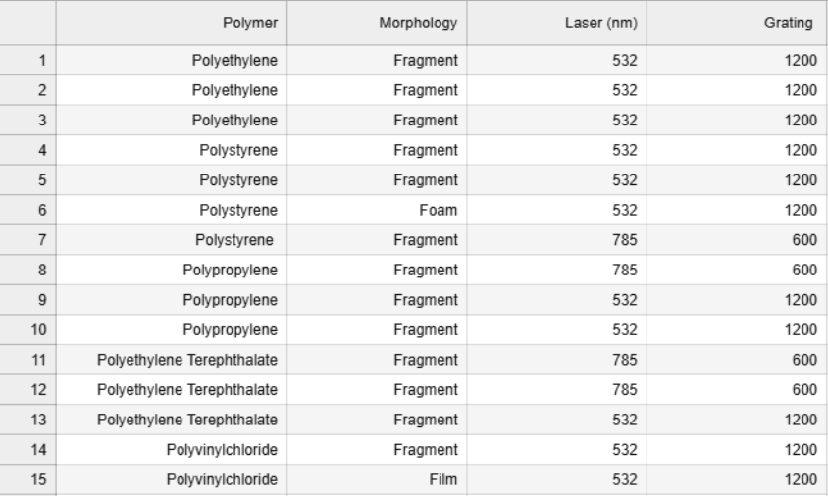
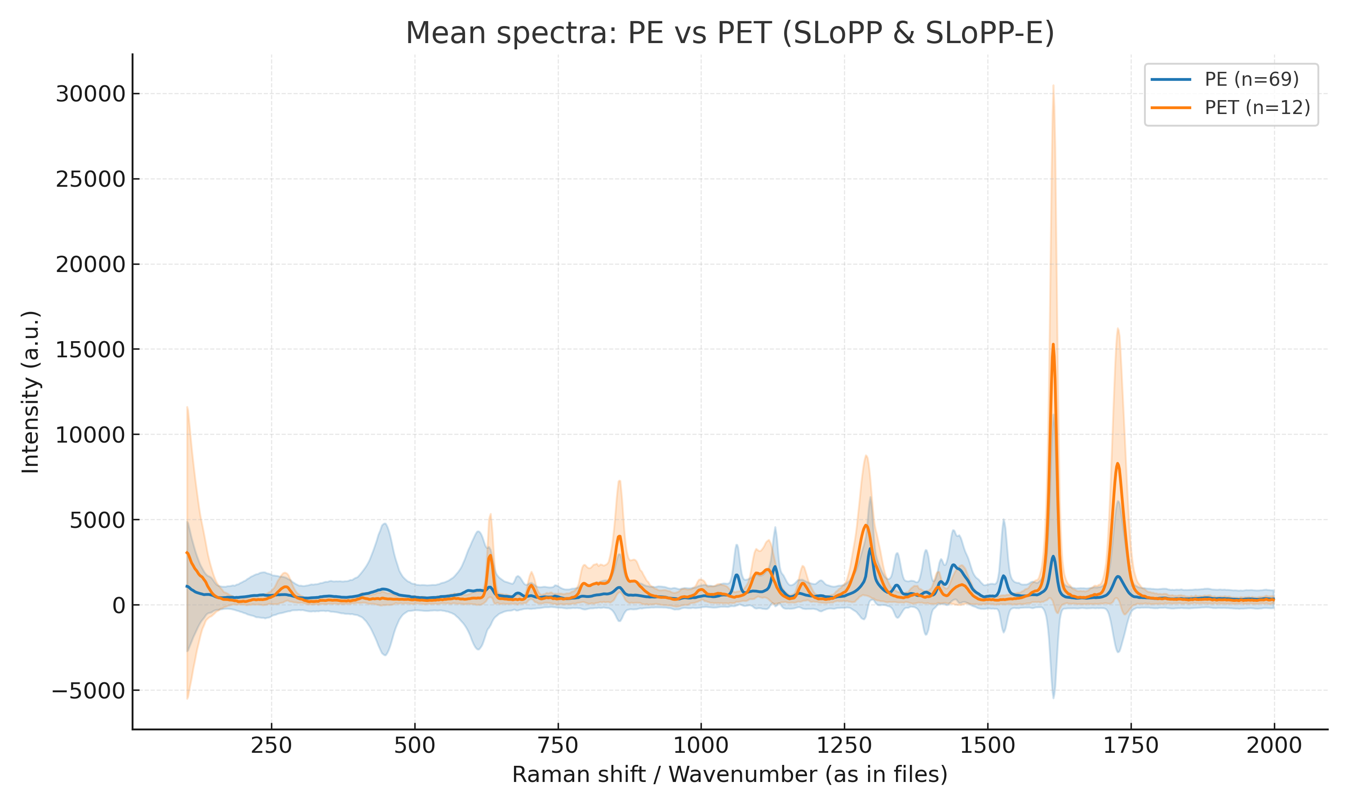
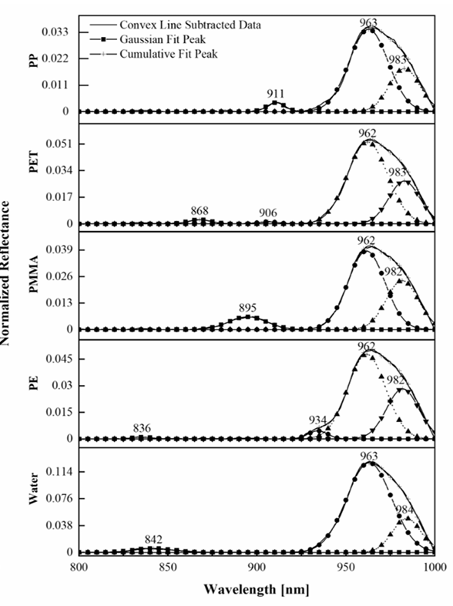
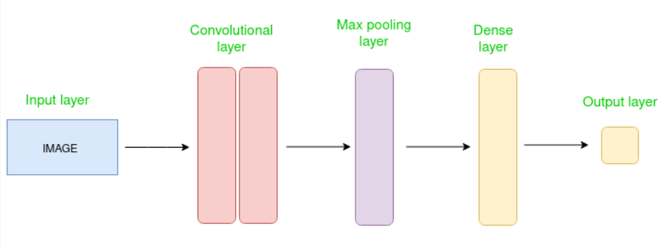
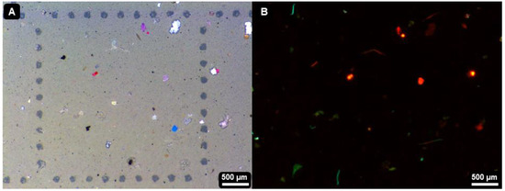
TECHNICAL APPROACH
Innov8

Slide 5
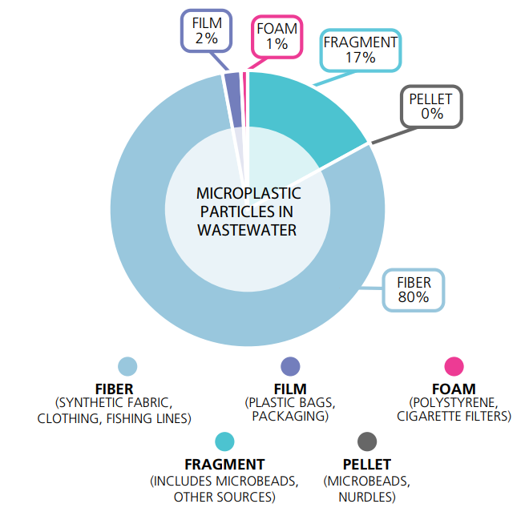
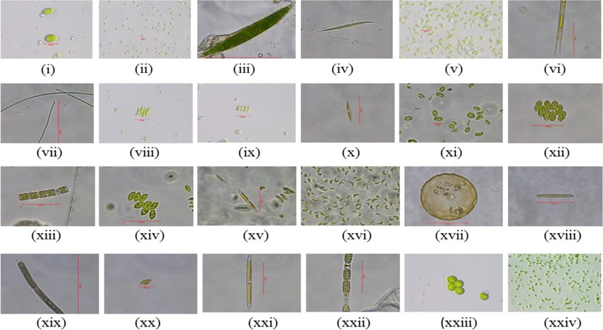
FEASIBILITY AND VIABILITY
Innov8
Feasibility
Low-cost hardware components
Prototype is practical
Performance can be enhanced with a 10× objective
Challenges:
Environmental noise (algae, silt) complicates microplastic detection
Low-cost optics can only resolve particles larger than ~50 µm.
Staining agents like Nile red may produce False positives
Strategies:
Stable energy source
Quality tested components
Continuous data logging & updates

Slide 6
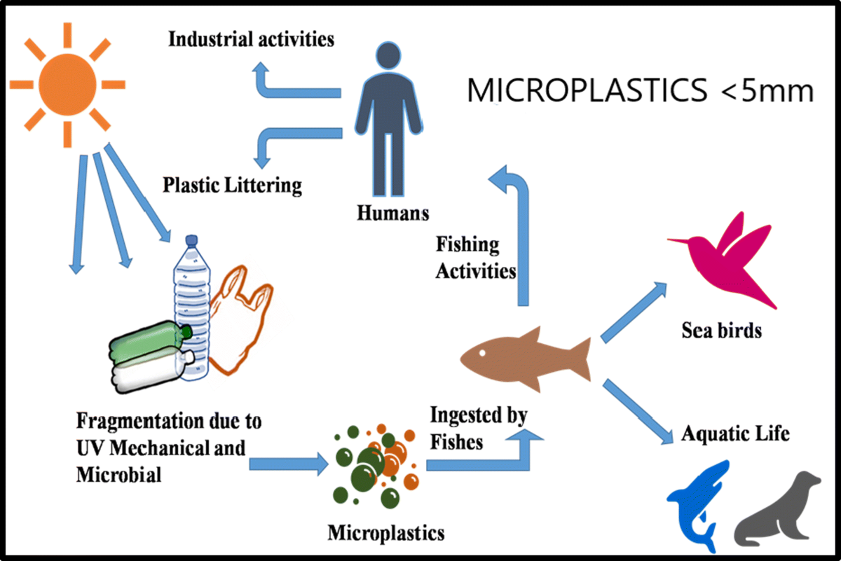
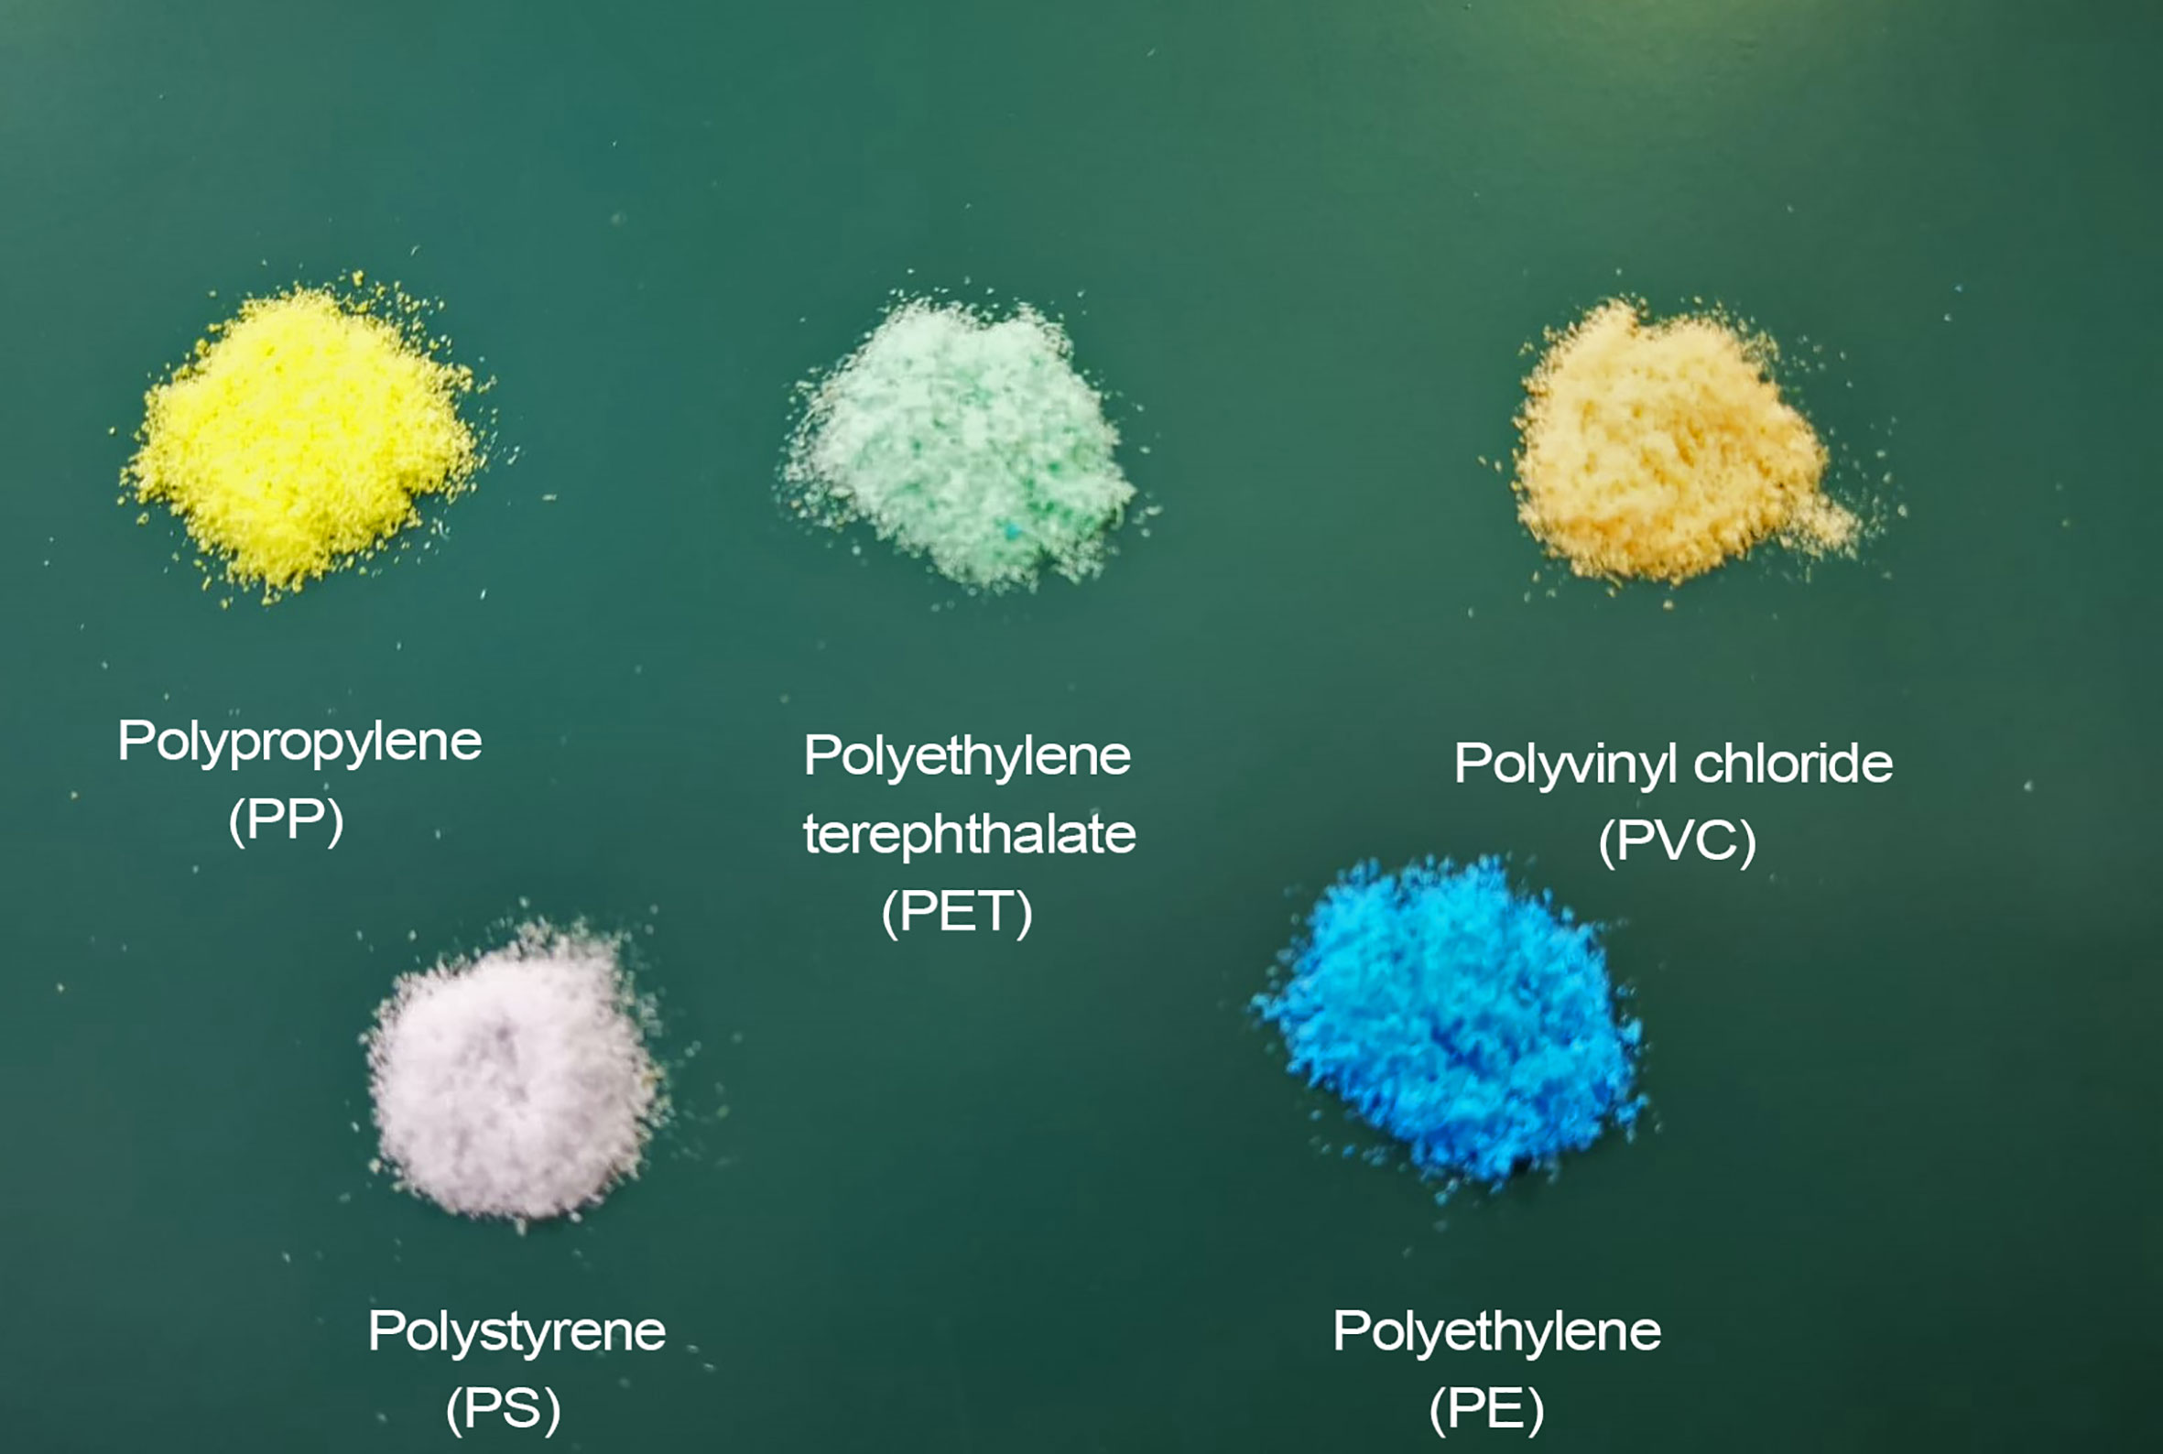
IMPACT AND BENEFITS
Innov8
Benefits:
Fast, low-cost field screening of water bodies
Minimal operational cost
User-friendly Interface
Remote Data logging & Visualization
Highly scalable
Impacts on Environment:
Early detection enables timely intervention and cleanup prioritization
Helps maintain a safe food chain

Slide 7
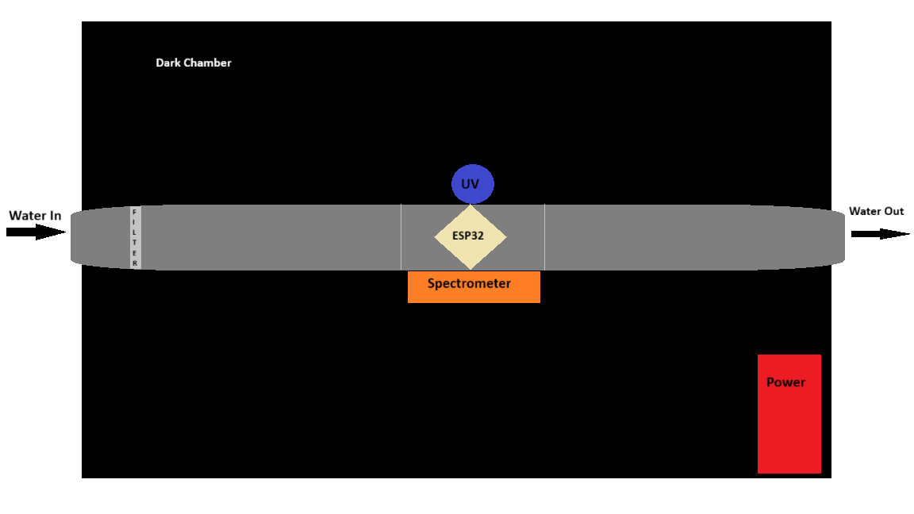
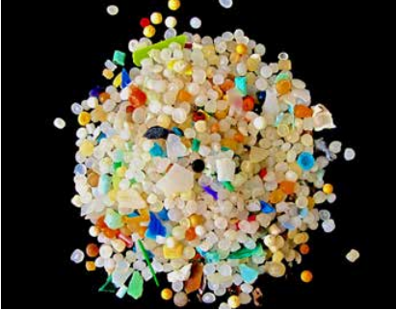


RESEARCH AND REFERENCES
Innov8
Estimated Cost:
ESP32-S3 : ~2000
AS7265x : ~11000
UV LED torch (365–395 nm) : ~1000
Battery Li-ion(12v 5Ah) : ~1500
Total: 17500
References:
Stressor-AOP: https://cb.imsc.res.in/saopadditives/
NOAA NCEI Marine DB: https://pmc.ncbi.nlm.nih.gov/articles/PMC10589325/
Marine Debris Program: https://marinedebris.noaa.gov/
Overview of Analytical methods for the determination of microplastics: https://www.sciencedirect.com/science/article/abs/pii/S0165993623003485
Methods of Microplastic Detection by Bree Foster

