Slide 1


SMART INDIA HACKATHON 2025
Problem Statement ID – SIH25036
Problem Statement Title- Development of Sensor for Detection of Microplastics – Ministry of Earth Sciences(MoES)
Theme- Miscellaneous
PS Category- Hardware
Team ID-
Team Name-

Slide 2

IDEA TITLE
Your Team Name
PROBLEM STATEMENT
Expected Solution:
A portable battery powered sensor system
Detecting & classifying Microplastics
Fast results with minimal sample prep
Water Inlet
Pre-Filtering
Flow Cuvette/ Membrane
Dark Chamber
User Interface
UV Light
AS7265x
Spectrometer
Data Visualization
Mobile App
Wi-Fi
<Detector Name>
We process water samples through a dark chamber with controlled illumination. A multispectral sensor and camera capture spectral and image data, which are analyzed by an AI model to detect and classify microplastics. If abnormal levels are found, the system logs results and alerts the monitoring team via a mobile app.
TinyML
Model
ESP32-S3
Power Management
Voltage Regulator
Li-ion 18650 cells
Database

Slide 3
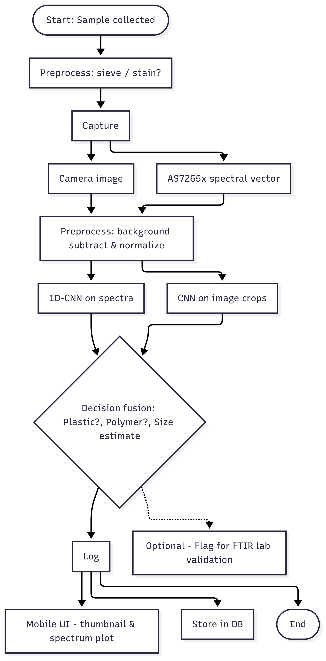
TECHNICAL APPROACH
Your Team Name
Firmware: C++ (ESP-IDF / Arduino)
Sensors: AS7265x (18-band) + ESP32-S3 camera (5MP, optional 10× objective).
Illumination: 365–405 nm UV / blue LED + emission filter (orange longpass).
ML: 1D-CNN on spectral vector + small image classifier → fusion model; converted to TFLite.
Backend / App: Python backend (training), Flutter mobile app
DB: Firebase (proto) → InfluxDB (final TS storage).

Slide 4
FEASIBILITY AND VIABILITY
Your Team Name
Parts are low-cost; prototype achievable in 4–6 weeks (ESP32-S3, AS7265x, optics, 3D printed chamber).
Small-particle resolution (needs magnifier); Nile Red false positives; environmental noise (algae, silt).
Add 10× objective for <100 µm; combine spectral + image fusion; validate subset by FTIR; use prefiltering and sample metadata logging.
Li-ion battery with step-down; Nile Red handled with PPE and proper disposal.

Slide 5
IMPACT AND BENEFITS
Your Team Name
Fast, low-cost field screening of water bodies → helps prioritize samples for lab FTIR.
Environmental benefit: early detection reduces spread and informs cleanup prioritization.
Low operational cost: simple UX for field technicians; remote logging for monitoring programs.
Scalable: multi-device deployments for spatial monitoring and time-series insights.

Slide 6
RESEARCH AND REFERENCES
Your Team Name
Stressor-AOP: https://cb.imsc.res.in/saopadditives/
NOAA NCEI Marine DB: https://pmc.ncbi.nlm.nih.gov/articles/PMC10589325/
Marine Debris Program: https://marinedebris.noaa.gov/
Overview of analytical methods for the determination of microplastics: https://www.sciencedirect.com/science/article/abs/pii/S0165993623003485
Methods of Microplastic Detection by Bree Foster – Dec 13, 2024

