Slide 1


Sign2Notes
K.N.Sanjay
M.S.Sukil Raj

Slide 2
Problem Statement
Many students with hearing impairments can’t take notes properly live classrooms.
Real-time captioning are expensive/unavailable.
Student doubts go unnoticed or interrupt flow.

Slide 3
Objectives
Deliver an/a idea/proposal for a demoable prototype.
Recognize a set of high-impact learning signs.
Produce clear templated notes.

Slide 4
Target Users
Primary: Students with hearing impairment.
Secondary: Learning platforms (accessibility add-on).
Deployment contexts: small classroom, blended online class, recorded lecture review.

Slide 5
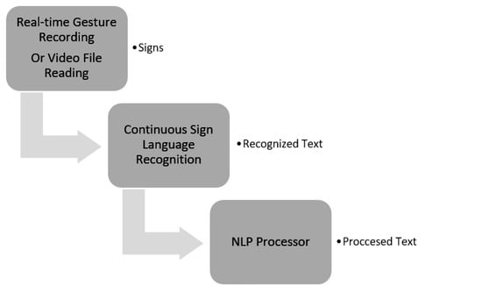
Working:

Slide 6
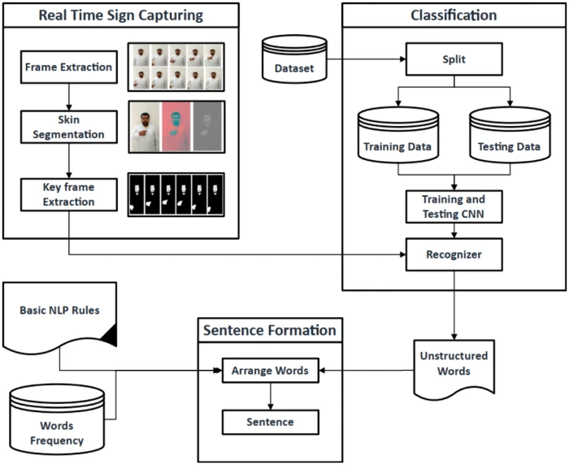
MediaPipe
WLASL
Custom Trained
Model
(PyTorch)
Llama3.2
HMM

Slide 7
Phase 1
Requirements analyzed
Dataset preprocessed
Blueprint of working model theorized

Slide 8
Phase 2
Model trained on 100 classes
Switched from tf to torch due to low accuracy
Modified CNN architecture for testing

Slide 9
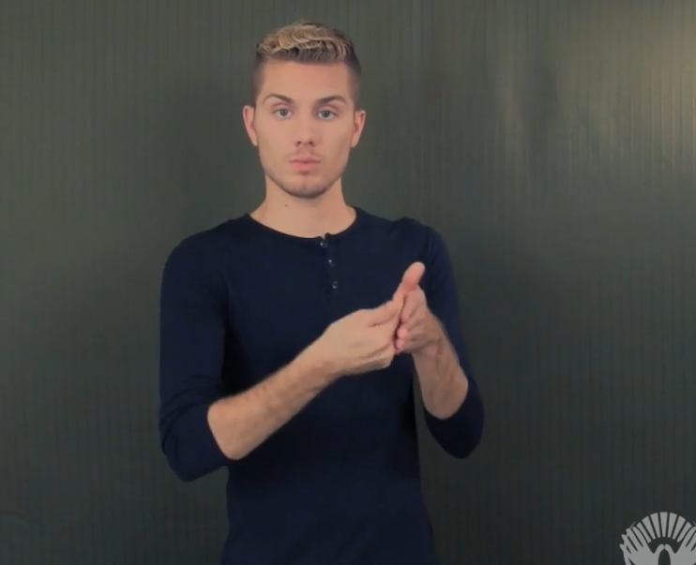
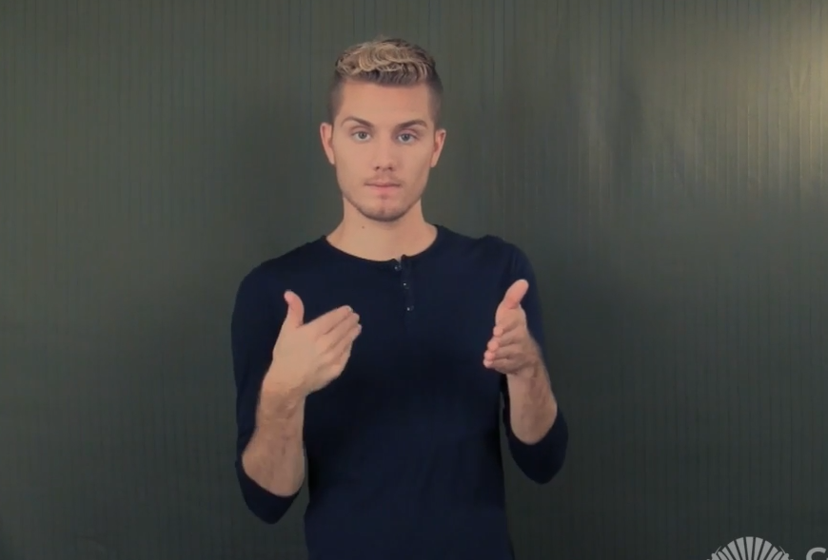
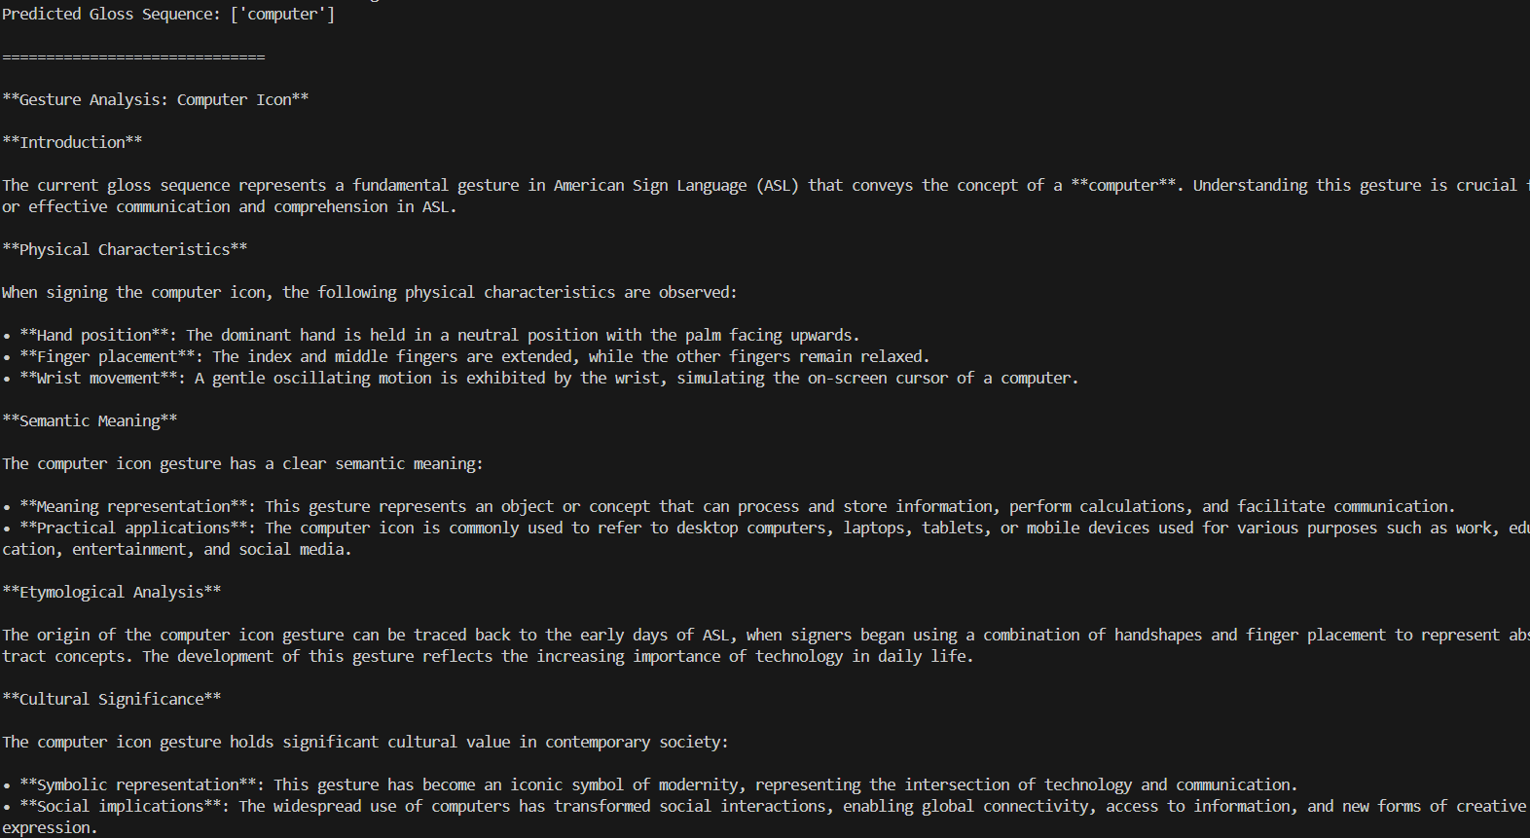

Slide 10
Phase 3
Trained on full dataset
UI MVP developed
Accuracy = 85.4% accuracy

Slide 11
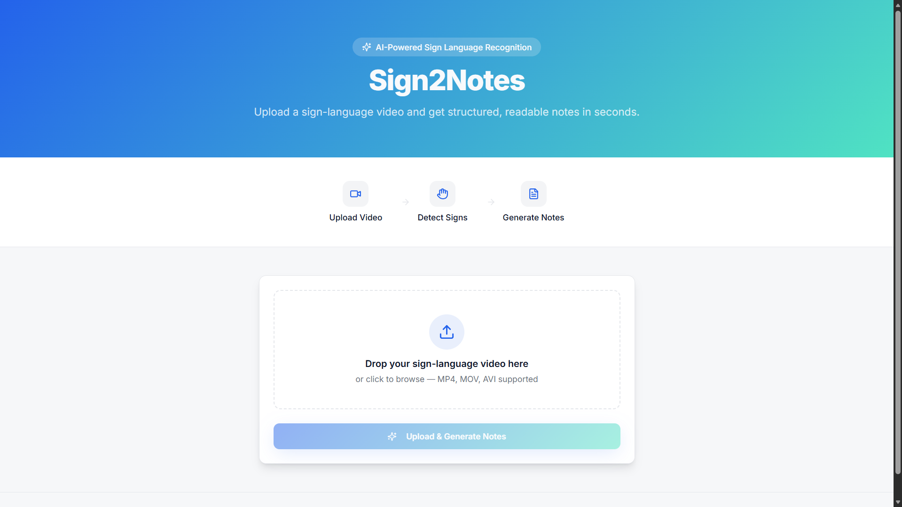

Slide 12
Future works
Make CNN with better architecture
Seamless integration in web app
DB Connection & Auth Verifications

Slide 13
Business Model
B2B licensing to institutions
Subscription model for schools/colleges
EdTech Platform Integration free

Slide 14
Ethical Concerns & Mitigations
Consent: explicit consent for any recordings and dataset use.
Privacy: default to local keypoint extraction; do not store raw video; delete anonymized data after use.
Transparency: clear disclaimer — “prototype, limited-vocab, not clinical/diagnostic.”
Bias: acknowledge signer diversity—collect varied signer samples when possible.

Slide 15
Sign2Note - Empowering Inclusive Education
We aim to bridge communication gaps in classroom and make education accessible to learner.
Thank You

