Slide 1
Monthly Issue Insights — DEC2025
Auto-generated by GenSight-Issue-Insight-Automator

Slide 2
Key Highlights
Status: {'Closed': 77}
Issue Types: {'Endpoint': 29, 'Citrix': 18, 'Other': 15, 'Access/Password': 8, 'MFA': 5, 'Network/VPN': 2}
Top Engineers: [('Sanjay', 77)]

Slide 3
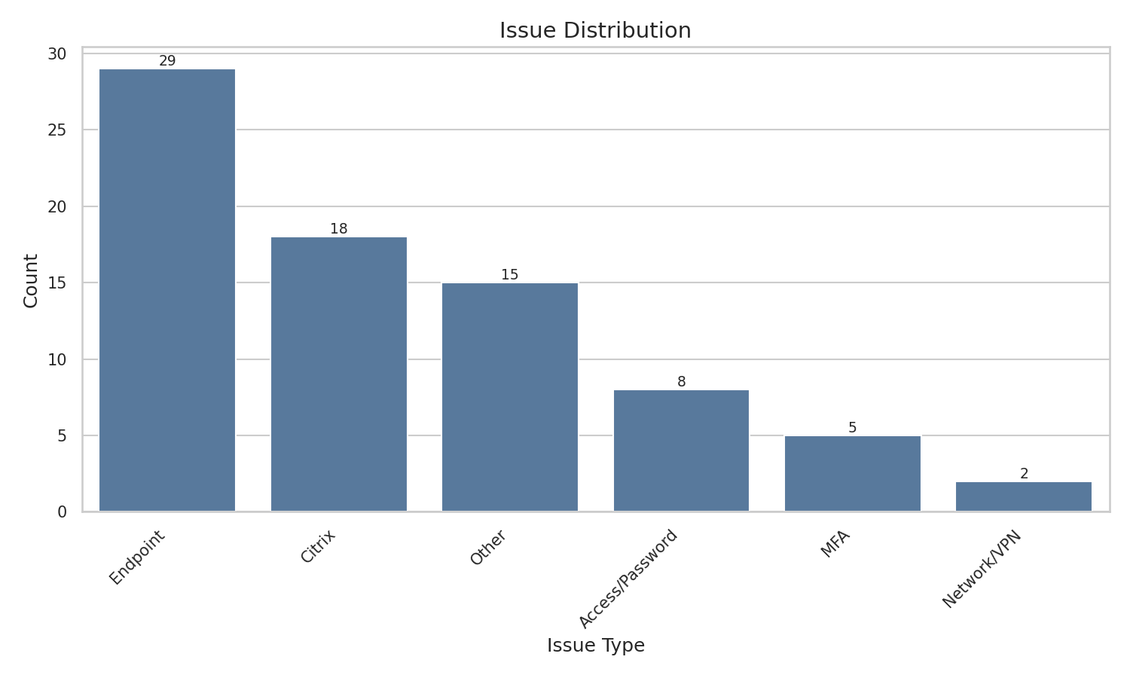
issue distribution DEC2025

Slide 4
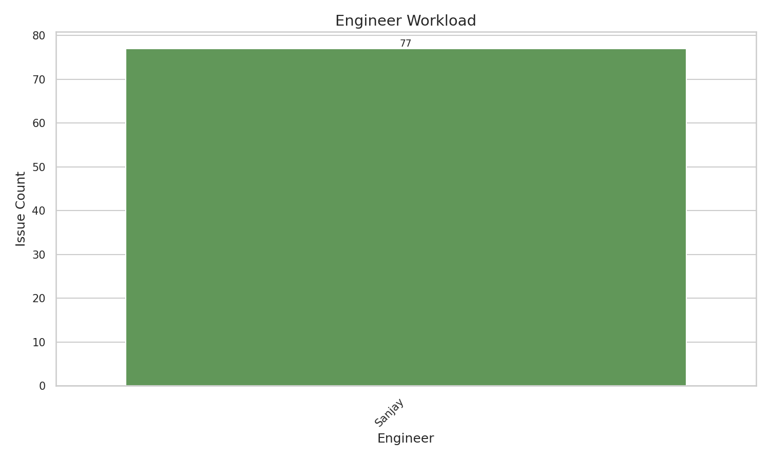
engineer workload DEC2025

Slide 5
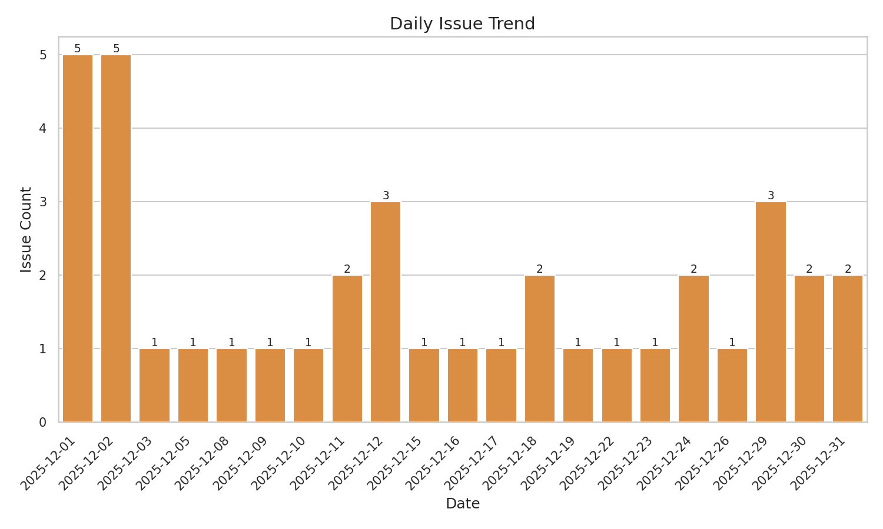
daily trend DEC2025

