Slide 1
Client Issue Summary Report
Generated using GenSight

Slide 2
Summary Insights
Weekly Operational Summary
- Peak Issue Day: August 08, 2025 — 13 issues
- Average Daily Issues: 6.1
- Peak Issue Week: Week of August 18, 2025 — 37 issues
- Average Weekly Issues: 25.6
- Most Frequent Issue: Non-Compliant Prohance software (9 times)
- Top Engineer: Jagadish (66 issues resolved)
*Auto-generated by GenSight for operational transparency.*

Slide 3
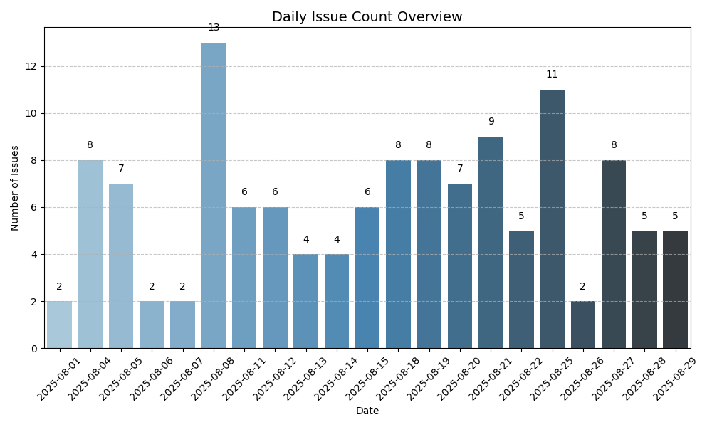
Daily Summary

Slide 4
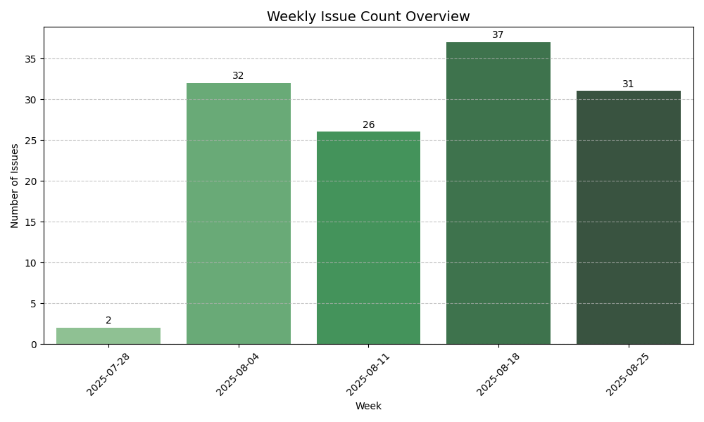
Weekly Summary

Slide 5
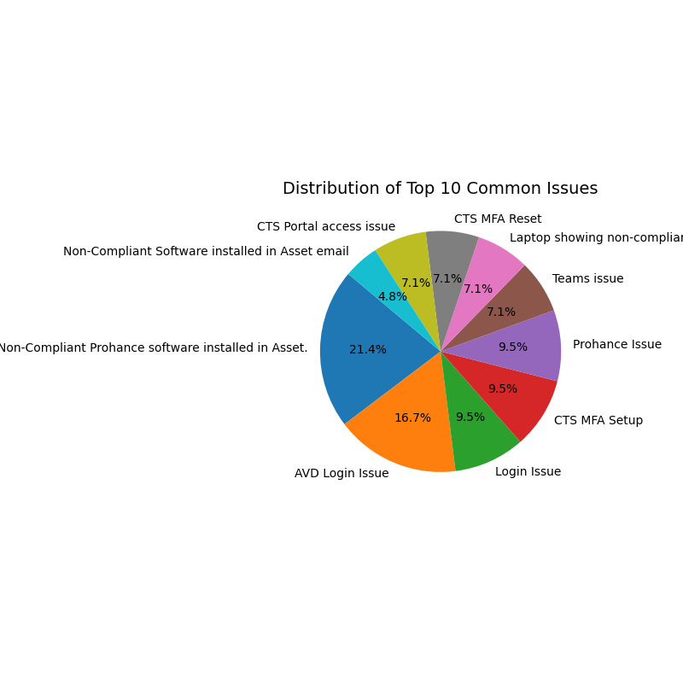
Common Issues

Slide 6
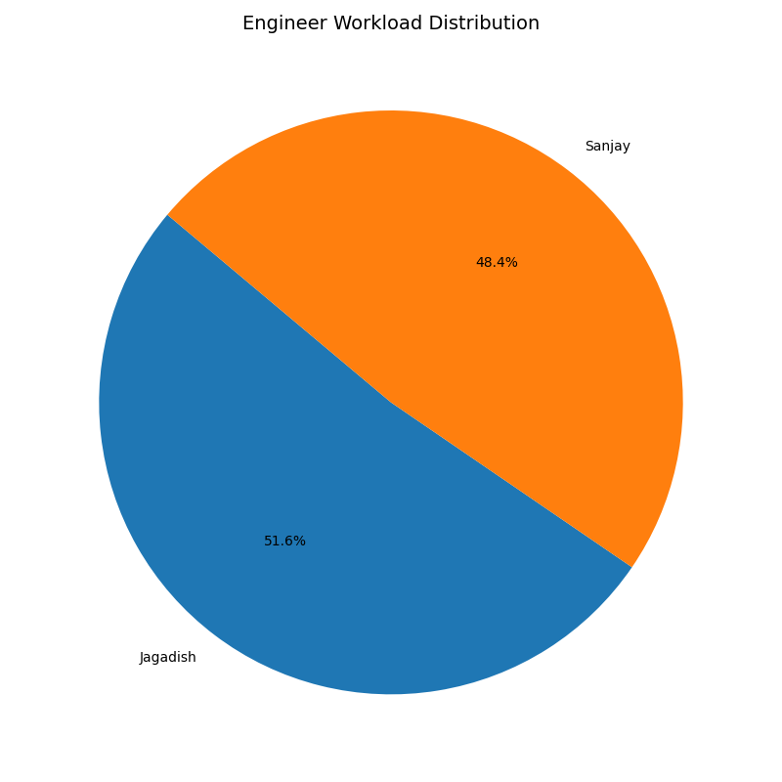
Engineer Workload

