Slide 1
Client Issue Summary Report
Generated using GenSight

Slide 2
Summary Insights
Weekly Operational Summary
- Peak Issue Day: August 08, 2025 — 13 issues
- Average Daily Issues: 6.1
- Peak Issue Week: Week of August 18, 2025 — 37 issues
- Average Weekly Issues: 25.6
- Most Frequent Issue: Non-Compliant Prohance software (9 times)
- Top Engineer: Jagadish (66 issues resolved)
*Auto-generated by GenSight for operational transparency.*

Slide 3
GenAI Insights
GenAI models identified trends in issue types, engineer responsiveness, and resolution efficiency. Recurring issues suggest automation opportunities. Performance metrics highlight top contributors.

Slide 4
Fine-Tuned Model Recommendations
Recommendations:
- Automate high-frequency issues
- Reallocate engineers based on workload
- Predict recurring problems
- Use GenAI summaries in daily standups

Slide 5
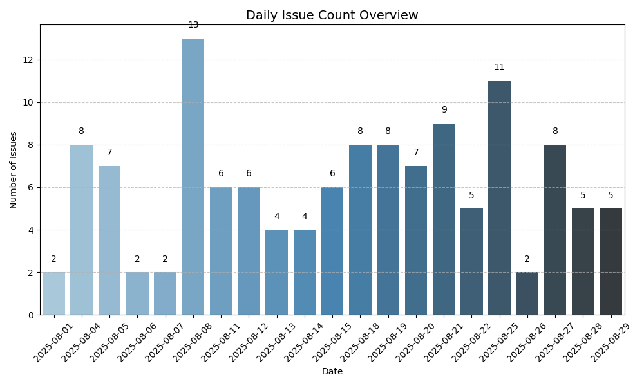
Daily Summary

Slide 6
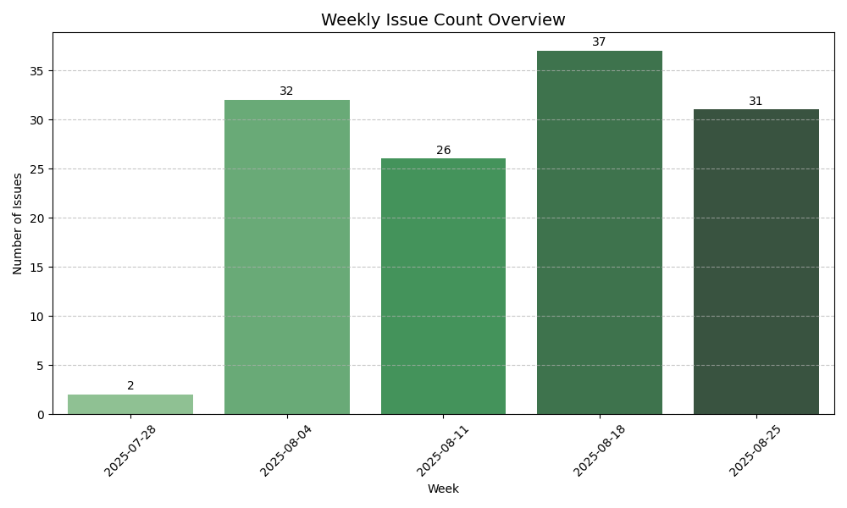
Weekly Summary

Slide 7
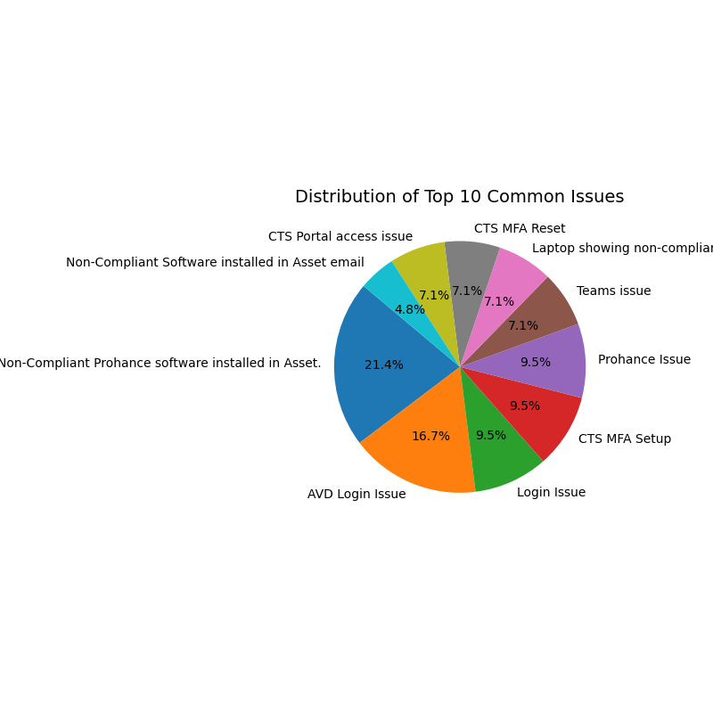
Common Issues

Slide 8
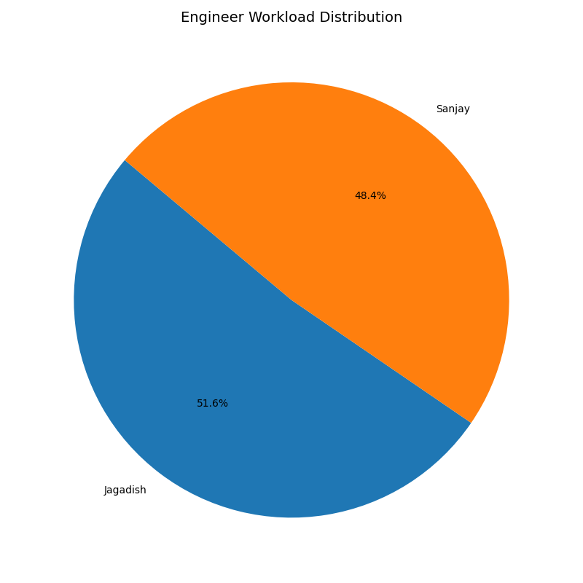
Engineer Workload

