Slide 1
CAD CAM
AND
MARINE DESIGN
ASSIGNMENT
Group - 6

Slide 2
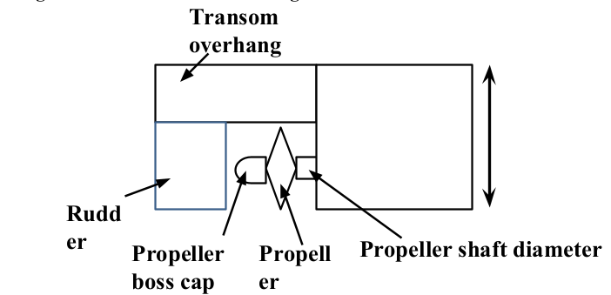

Slide 3
Rudder Length : 6.6m
Rudder Height : 12.4m
Rudder stock diameter: 1.4m
Propeller Boss Cap : 1.6m
Propeller Rudder Gap: 1.8m
Propeller Diameter: 8.5m
Propeller Shaft Diameter : 1.6m
Freeboard: 11.4m
Bulbous bow: 8m
Propeller Clearance:
1.43m; 1.8m

Slide 4
