Slide 1
Mutual Fund Analytics Capstone Project
Bluestock Internship Program
Presented By
M.Sanjay Kumar

Slide 2
Problem Statement
The Indian Mutual Fund industry generates large volumes of financial and investor data. However, raw data alone does not provide meaningful insights for investors.
This project aims to transform raw mutual fund datasets into actionable insights through ETL, analytics, risk modeling, and dashboard visualization.

Slide 3
Objectives
Build ETL pipeline
Clean and validate data
Perform EDA
Analyze fund performance
Calculate risk metrics
Study investor behavior
Build Power BI dashboard
Generate recommendations

Slide 4
Data Sources
Dataset | Description
Fund Master | Scheme Information
NAV History | Daily NAV Data
AUM Data | Assets Under Management
SIP Inflows | Monthly SIP Statistics
Investor Transactions | Investor Activity
Portfolio Holdings | Portfolio Allocation
Benchmark Data | NIFTY Indices

Slide 5
ETL Architecture
The ETL pipeline was designed using Python and Pandas. Raw CSV datasets were ingested, validated, cleaned, transformed, and loaded into a SQLite database for analytics processing.
Data Cleaning Process:
Date standardization
Missing value handling
Duplicate removal
Data type validation
NAV validation
Transaction validation
Expense ratio validation
AMFI code verification
EDA Findings:
SIP inflows increased consistently from 2022–2025.
SBI Mutual Fund maintained market leadership.
Equity categories attracted the highest inflows.
Industry folio count showed strong growth.
Small-cap funds delivered superior returns.

Slide 6
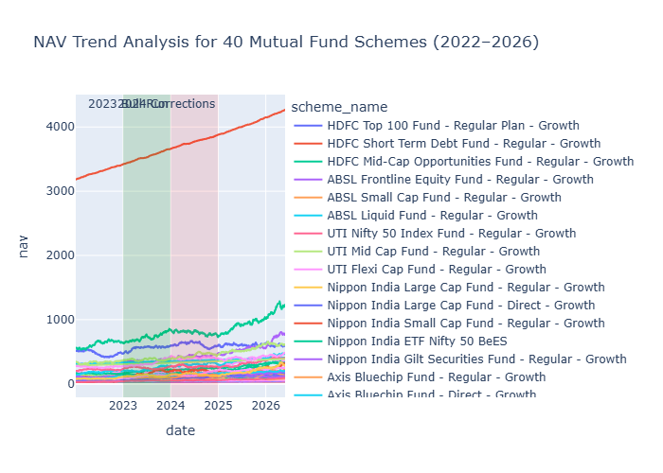
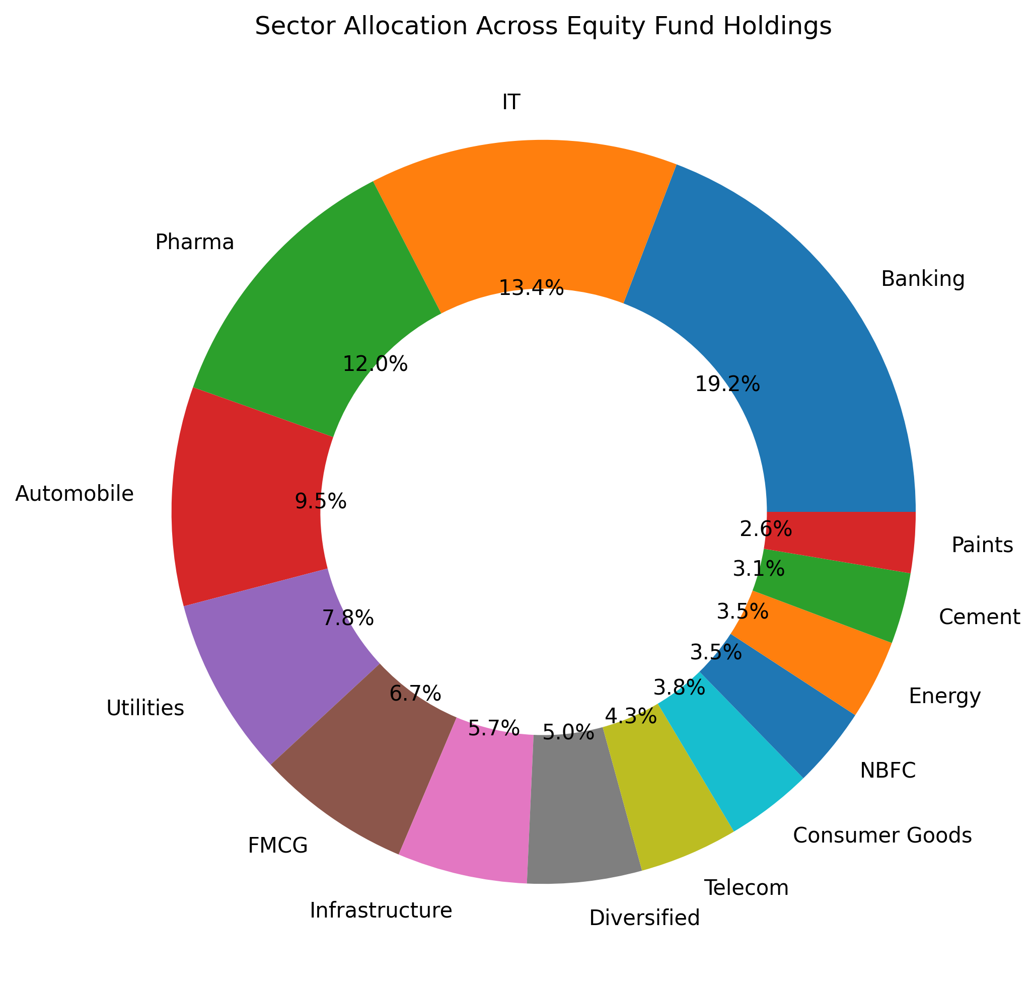
EDA Highlights
SIP inflows increased significantly between 2022–2025.
Mutual fund participation continued to grow.
NAV trends reflected market movements and economic cycles.

Slide 7
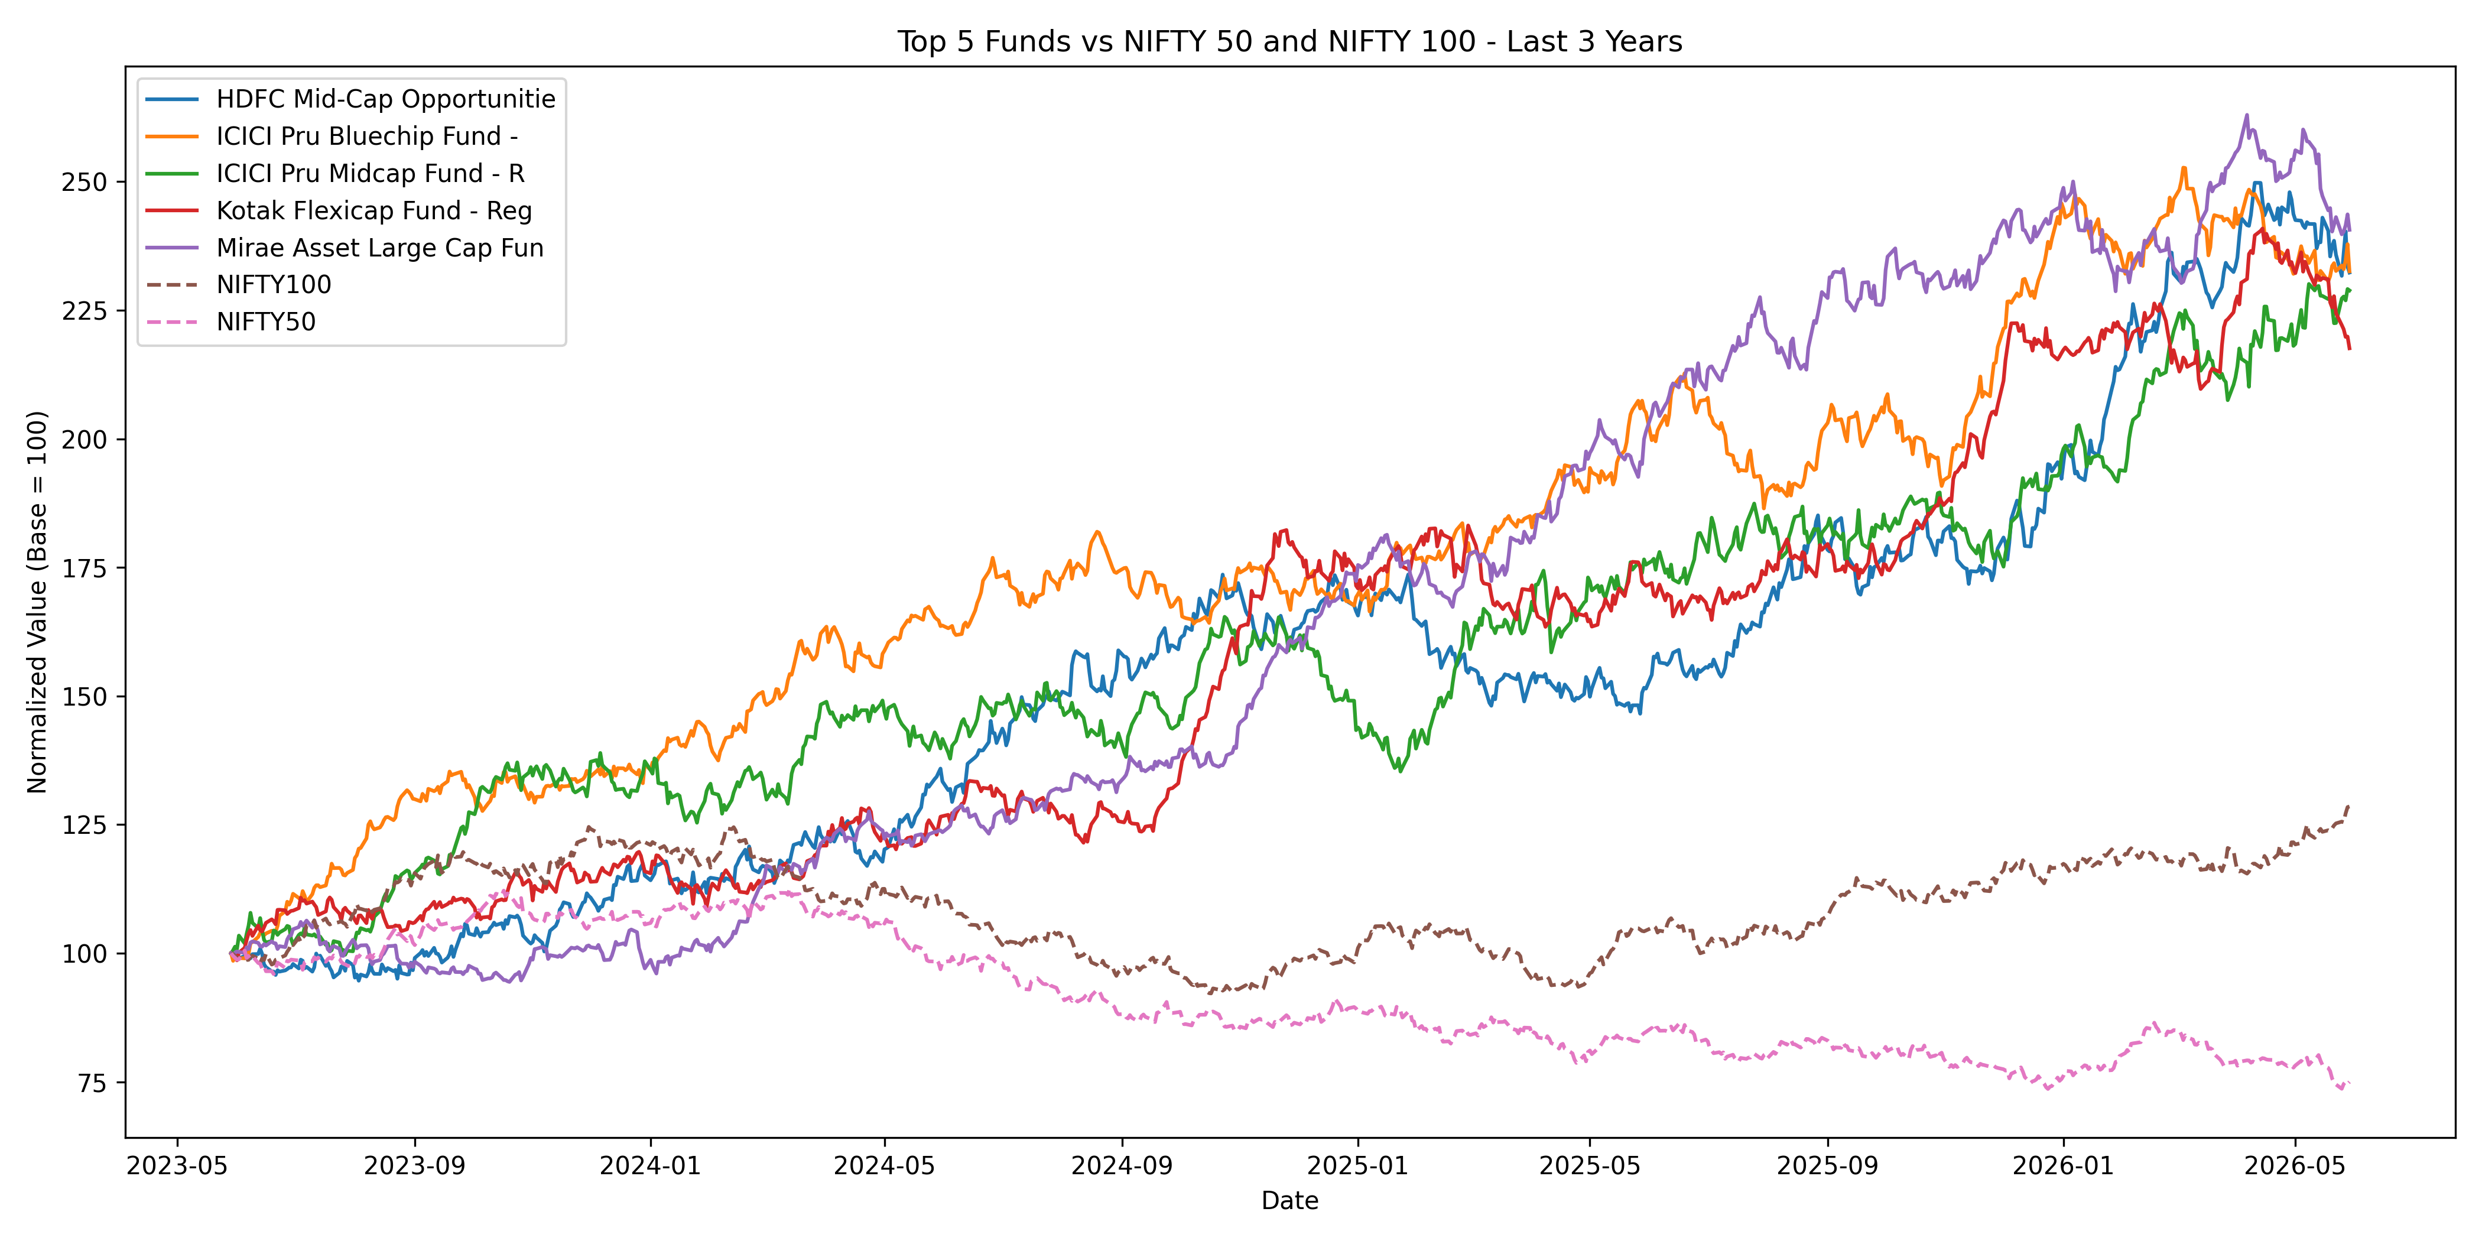
Performance Analytics
Metrics Used:
CAGR
Sharpe Ratio
Sortino Ratio
Alpha
Beta
Maximum Drawdown
Findings:
High Sharpe Ratio funds delivered better risk-adjusted returns.
• Direct plans generally outperformed regular plans.

Slide 8
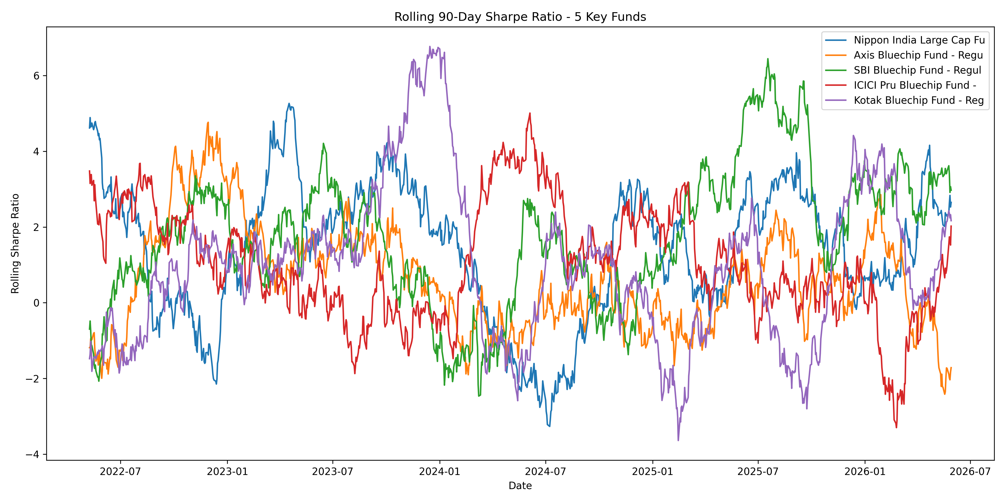
Risk Analytics
Risk Metrics:
VaR (95%)
CVaR
Rolling Sharpe Ratio
Sector HHI
Findings
Small-cap funds exhibited higher downside risk.
Diversified portfolios showed lower concentration risk.

Slide 9
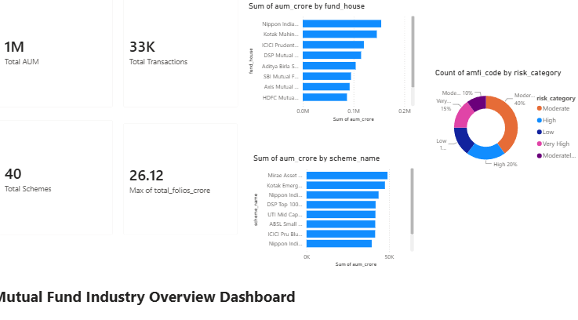
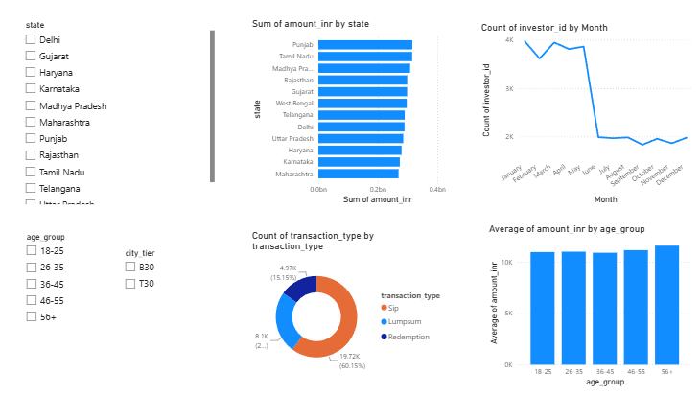
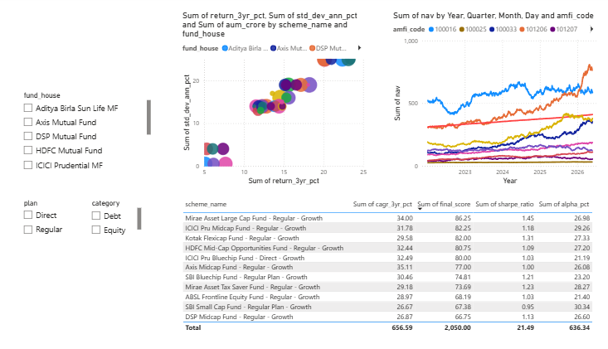
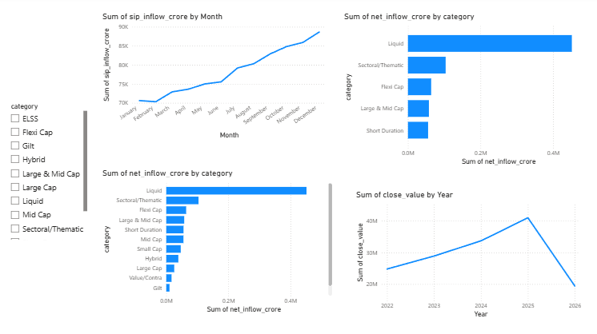
Dashboard Overview

Slide 10
Key Findings
SIP inflows reached record highs.
Investor participation increased steadily.
Risk-adjusted metrics provide better fund evaluation.
Portfolio diversification reduces risk.
Advanced analytics improves investment decision-making.

Slide 11
Thank You

