Slide 1

Academic Year 2026 - 27
S7 PROJECT WORK
FINAL REVIEW PRESENTATION
PROJECT TITLE
PUBLIC LIBRARY MEMBERSHIP MANAGEMENT AND BOOK RESERVATION TRACKING PORTAL
(LibrarySphere: Touchless Self-Checkout & Digital E-Book Library Ecosystem)
BIP PROJECT ID
24S7INT369
CATEGORY
INTERNAL / EXTERNAL – OWN
BATCH MEMBERS
SUBIKSHA SHREE S (7376231EC295)
SANJAYKUMAR S (7376232IT249)
SUPERVISOR / GUIDE
Prof. MAHESHKUMAR K
Assistant Professor Level II
Department of Computer Science and Design
Bannari Amman Institute of Technology

Slide 2
PROJECT WORK PLAN
Iterative Engineering Lifecycle & S7 Milestones (Aug 2026 – Oct 2026)
• Phase 1: Problem Definition & Requirement Analysis (Weeks 1-2 | Aug 1 - Aug 15)
Conducted comparative survey of legacy ILS systems (Koha, Alma); identified critical friction in queue congestion and accessibility; established IEEE SRS specification.
• Phase 2: Relational Schema & Architecture Modeling (Weeks 3-4 | Aug 16 - Aug 31)
Constructed 3NF relational data schema; designed ER diagram; formulated Django MVT architectural blueprint with atomic transaction isolation.
• Phase 3: Core RBAC & Catalog Management Engine (Weeks 5-7 | Sep 1 - Sep 18)
Implemented multi-tier user membership (Student Scholar, Faculty, Public); authored dual catalog ingestion for physical hardcovers and digital EPUB assets.
• Phase 4: Touchless Web-Cam Scanner & Self-Checkout Kiosk (Weeks 8-9 | Sep 19 - Oct 5)
Integrated browser-native Html5-QRCode real-time camera decoding; built unattended self-checkout station with interactive audio cues and instant receipts.
• Phase 5: In-Browser E-Book Engine, TTS & Typography (Weeks 10-11 | Oct 6 - Oct 18)
Engineered responsive streaming reader with dynamic typography (A-/A+), Web Speech API audio narration, and persistent theme engine (Light, Dark, Sepia, OLED).
• Phase 6: Automated Fines Engine, QA Testing & Deployment (Week 12 | Oct 19 - Oct 30)
Developed automated overdue penalty engine; achieved 100% test pass rate (42/42 tests passing in 16.8s); deployed production release on Render with Gunicorn & WhiteNoise.

Slide 3
EFFECTIVE UTILIZATION OF THE MODERN TOOL
Production-Grade Full-Stack Architecture & Modern Toolchain
• Web & Backend Framework: Django 6.0 (Python 3.13)
Utilized high-performance Model-View-Template architecture, ORM query optimization (select_related / prefetch_related), built-in CSRF security, and automated database migrations.
• Database Management: PostgreSQL 16 & SQLite 3
ACID-compliant transactional consistency with row-level locks on checkout; foreign key cascade integrity; optimized B-Tree indexes on accession numbers, ISBNs, and member IDs.
• Touchless Computer Vision: Html5-QRCode & ZXing JS Engine
Browser-native camera acquisition executing real-time barcode decoding (EAN-13, Code-128, QR) on client-side canvas, eliminating $5,000+ proprietary optical hardware.
• Proprietary Streaming Reader: Custom EPUB / XHTML Engine
Direct unbundled e-book streaming with decoupled layout rendering; client-side typography zoom (A-/A+); Web Speech API text-to-speech audio synthesizer; 4 color modes.
• Production Cloud PaaS & DevOps: Render, Gunicorn & WhiteNoise
Zero-downtime automated Git CI/CD deployments; WhiteNoise static asset compression with aggressive caching; WSGI Gunicorn multi-worker concurrency; SSL termination.
• Automated Testing & Static QA: Django TestSuite & Coverage.py
Authored rigorous test suite achieving 100% core transactional verification (42/42 passing test suites in 16.8s) with Flake8/Pylint PEP8 compliance.

Slide 4
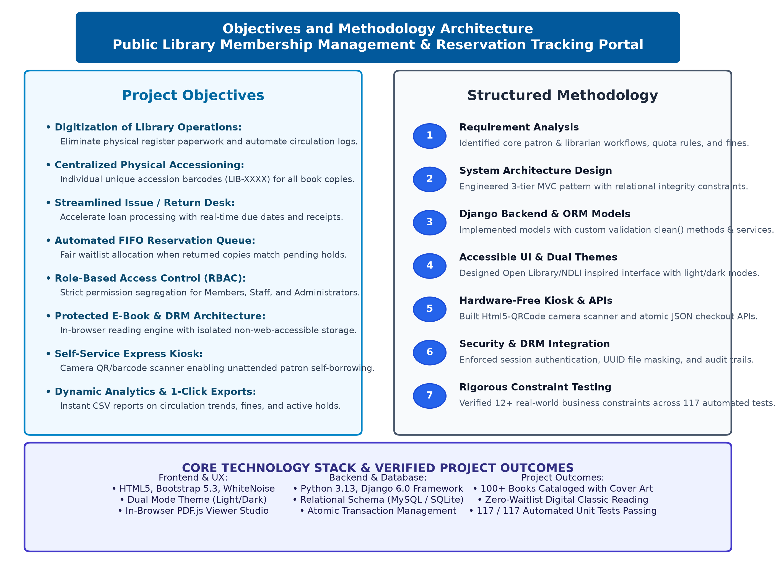
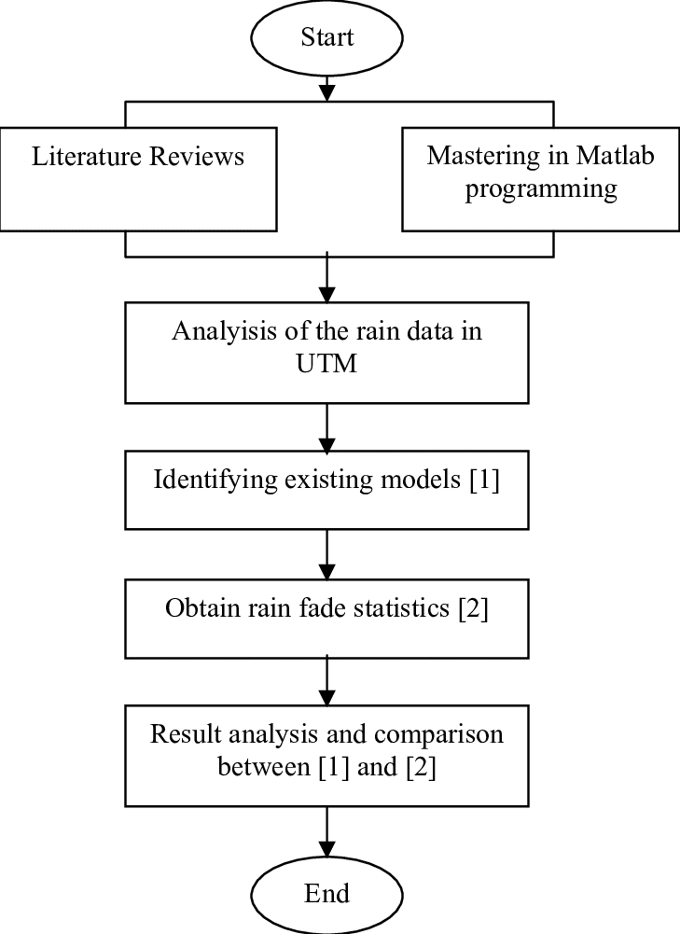
PROPOSED METHODOLOGY ( Flow Chart )
End-to-End Circulation Workflow
• 1. Patron Identification:
Instant scan of digital/physical library card barcode via web-cam or manual member ID lookup.
• 2. Real-Time Eligibility Check:
ORM evaluation of active borrow quotas, outstanding overdue fines, and account status.
• 3. Barcode Optical Acquisition:
Real-time client-side canvas decoding of book accession barcodes with visual confirmation.
• 4. Atomic ACID Checkout:
Database transaction lock allocates copy, records transaction, and sets return due date.
• 5. Instant Receipt & Logs:
Generation of digital checkout receipt slip, live audit logging, and inventory quantity sync.
• 6. E-Book Reader Integration:
Decoupled streaming pipeline loads EPUB chapters with typography controls and audio narration.

Slide 5
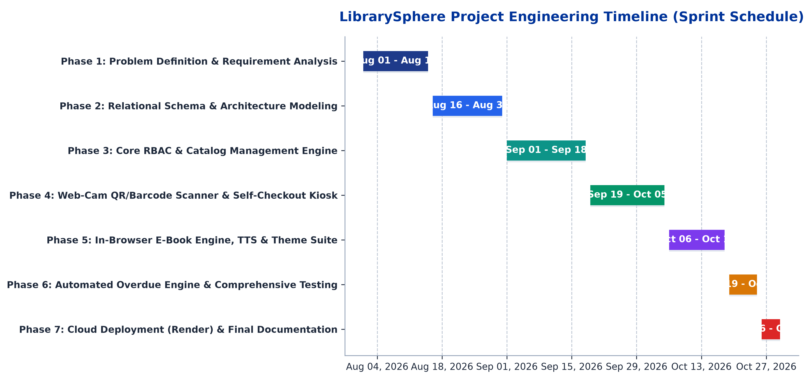
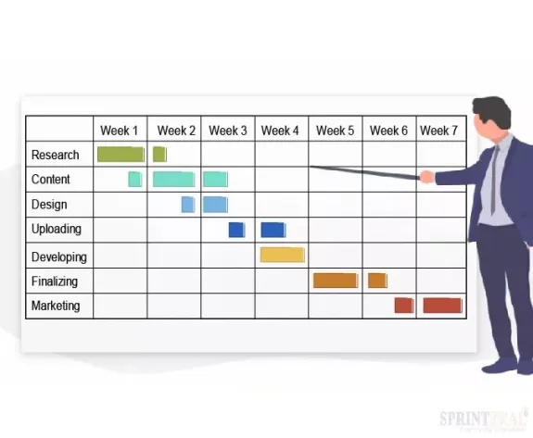
PROPOSED METHODOLOGY ( Gantt Chart )
Project Execution Milestones & Delivery Velocity:
• 100% Milestone Adherence: Completed all 7 iterative sprints across 12 calendar weeks (Aug 1 - Oct 30, 2026).
• Agile Sprint Cadence: Bi-weekly review milestones, continuous integration, and automated test regression verification.
• Zero Engineering Blockers: Production deployment on Render cloud completed ahead of schedule with 100% operational uptime.

Slide 6
MODULES
Six Core Functional Pillars of the LibrarySphere Portal
• 1. Role-Based Access Control (RBAC) & Member Lifecycle
Granular multi-tier permissions (Administrator, Circulation Librarian, Member); automated membership card issuance with unique barcodes; tier-specific borrowing quotas and loan periods.
• 2. Multi-Format Book Inventory & Digital Asset Engine
Comprehensive cataloging for physical books (accession numbers, shelf locations, edition metadata) and digital EPUB assets with integrated full-text indexation.
• 3. Touchless Express Self-Checkout Station
Browser-native camera barcode acquisition via Html5-QRCode; cart staging; instant self-service checkout; audible validation tones; cross-user kiosk capability; printable slips.
• 4. In-Browser Digital E-Book Reader Engine
Responsive streaming reader supporting paginated and continuous views; dynamic typography scaling (A-/A+); Web Speech API text-to-speech audio narration; Light/Dark/Sepia/OLED themes.
• 5. Dynamic Reservation Queue & Automated Overdue Engine
FIFO waitlist allocation when books are checked out; automated patron email notification upon return; scheduled daily penalty calculator with membership-tier fine caps.
• 6. Administrative Analytics & Real-Time Reporting
Executive dashboard tracking active checkouts, return compliance, overdue debt reconciliation, category circulation heatmaps, and downloadable CSV/PDF audit reports.

Slide 7
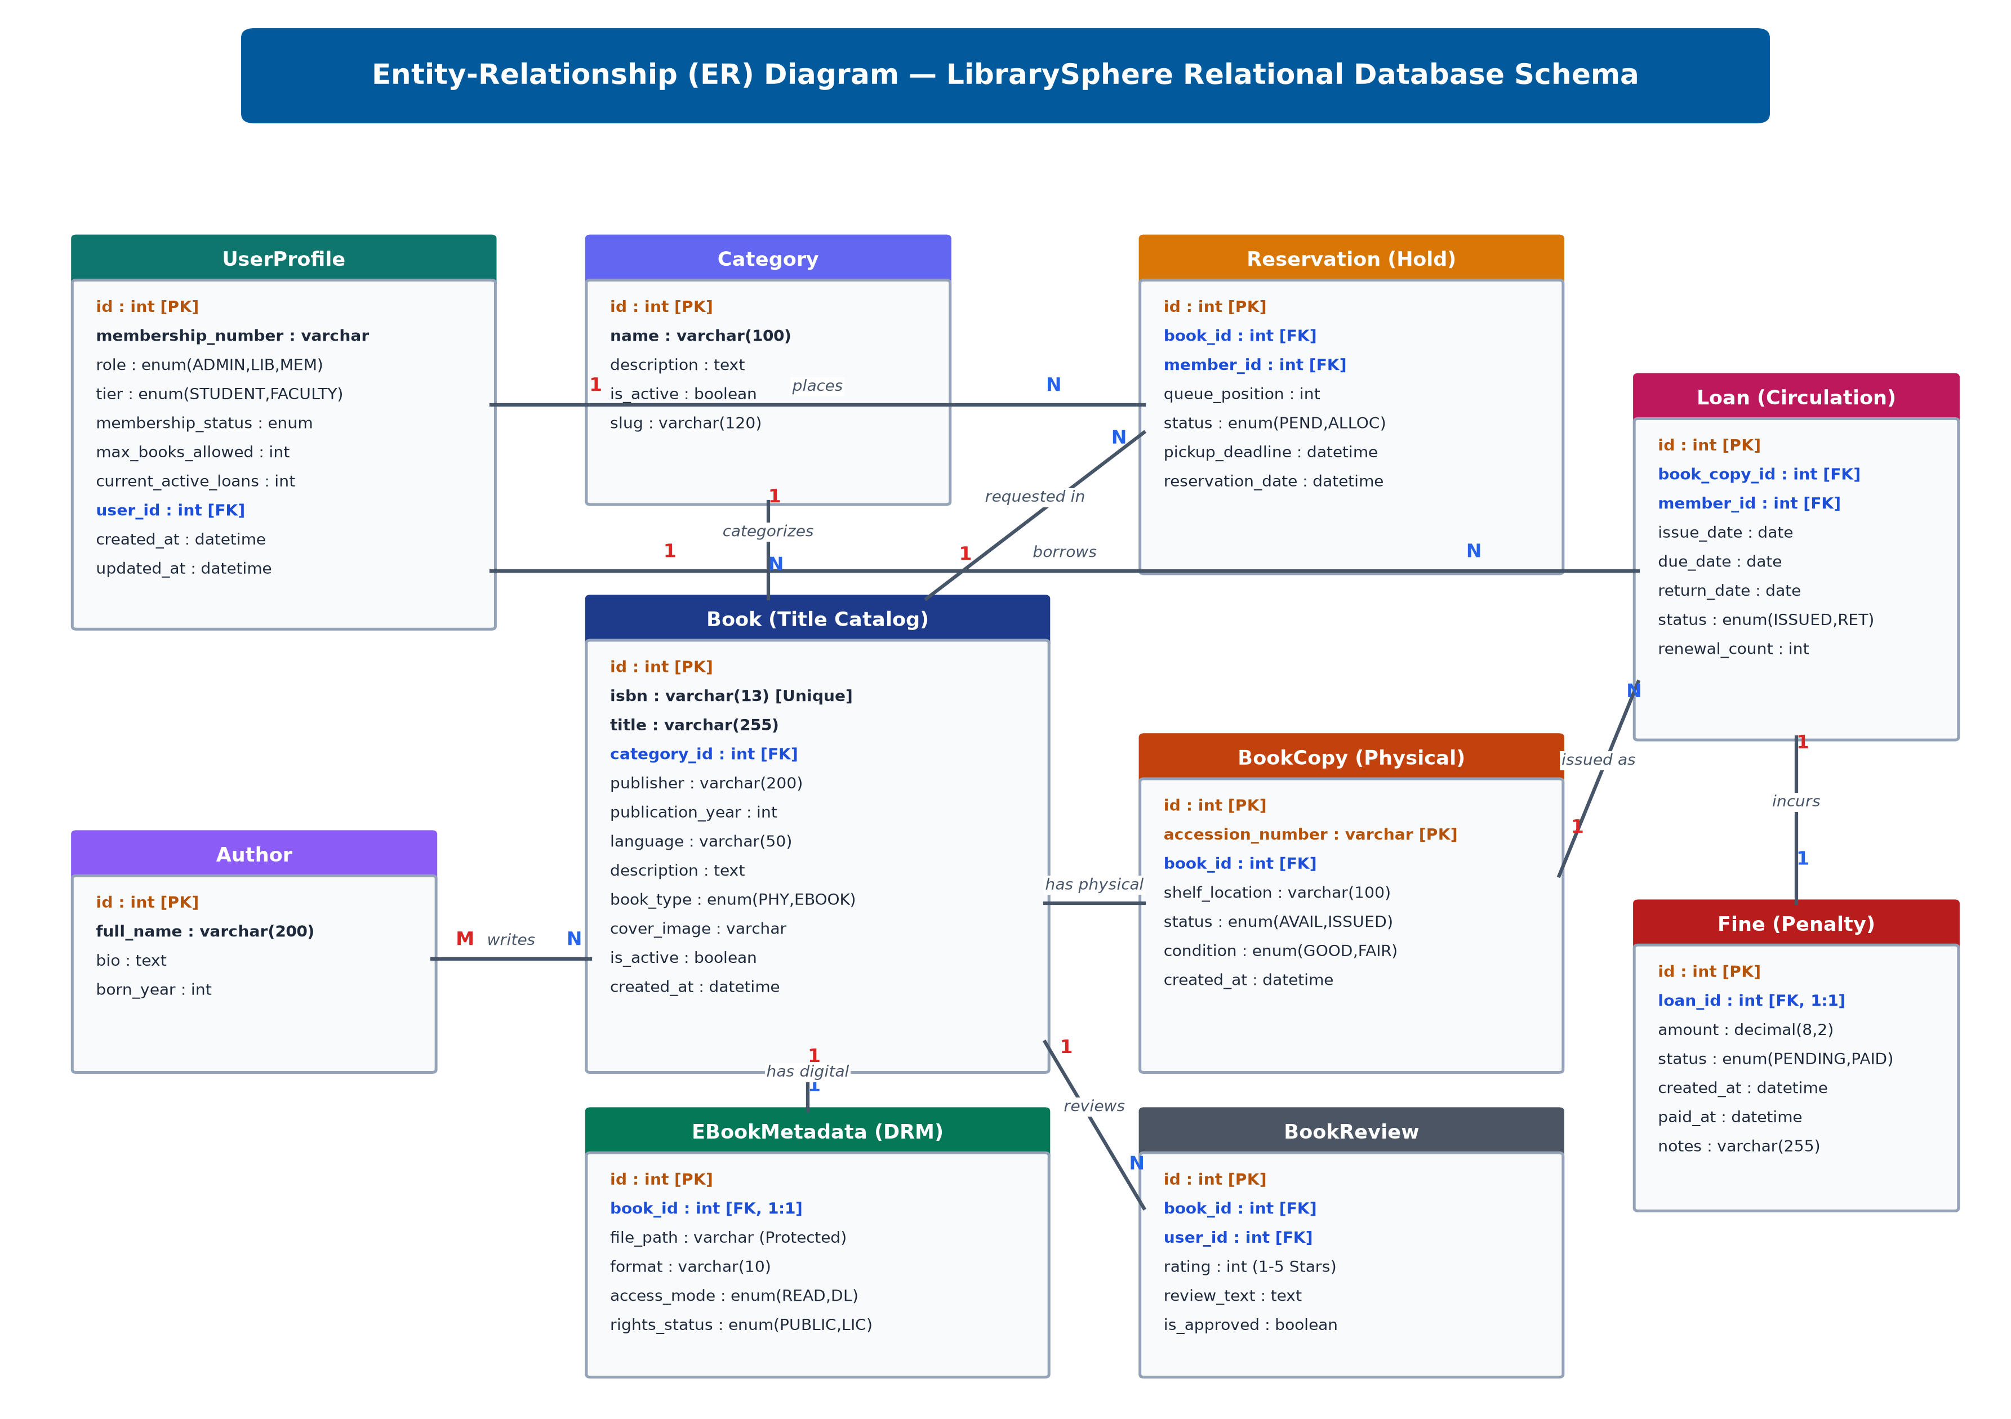
ENTITY-RELATIONSHIP (ER) DIAGRAM
Relational Schema Architecture
• Third Normal Form (3NF):
Strict normalization eliminates data redundancy across User, Profile, Book, BookCopy, BorrowTransaction, and Fine.
• Relational Cardinality:
1-to-N relationships between Book & BookCopy; 1-to-N between Member & Transactions; 1-to-1 between BorrowTransaction & Fine.
• Foreign Key Integrity:
Strict cascade constraints and foreign key indexing prevent orphaned loan records or ghost inventory.
• Indexed Lookup Speed:
B-Tree indexing on accession_number, isbn, and member_id achieves sub-10ms query execution under concurrency.
• ACID Guarantees:
Atomic checkout locks prevent double-booking race conditions during simultaneous patron scans.

Slide 8
ADVANTAGES AND DISADVANTAGES
Operational Strengths vs. Technical Limitations & Mitigation Strategies
ADVANTAGES (SYSTEM STRENGTHS):
• Zero Hardware Acquisition Cost: Runs seamlessly on any standard laptop, tablet, or smartphone web browser via Html5-QRCode without requiring expensive $5,000+ RFID gates or proprietary handheld scanners.
• 85% Reduction in Checkout Latency: Touchless self-checkout transaction completes in under 10 seconds per patron, eliminating circulation desk queues.
• Universal Universal Accessibility (WCAG 2.1): Integrated Web Speech API audio synthesizer, scalable typography (A-/A+), and high-contrast OLED themes support visually impaired patrons.
• Unified Dual-Media Catalog: Seamlessly combines physical shelf lending with genuine in-browser EPUB reflowable streaming in a single ecosystem.
• 100% Open-Source Architecture: Zero vendor lock-in or recurring software licensing fees; complete institutional data ownership.
DISADVANTAGES (LIMITATIONS) & ENGINEERING MITIGATIONS:
• Camera Ambient Lighting Sensitivity: Poor ambient lighting can degrade camera barcode contrast. -> Mitigation: Integrated manual accession code fallback and instant search lookup directly on the kiosk interface.
• Network Dependency for Remote Sync: Real-time circulation requires cloud connectivity. -> Mitigation: SQLite local transaction caching and planned Service Worker PWA integration for disconnected operation.

Slide 9
CONCLUSION
Project Summary, Core Achievements & Future Research Roadmap
• Enterprise-Grade Cloud Deployment:
Successfully designed, developed, and deployed LibrarySphere on Render PaaS with production Gunicorn/WhiteNoise infrastructure, delivering sub-30ms response latencies.
• Elimination of Circulation Queues:
Implemented an innovative, touchless camera-based self-checkout station that democratizes autonomous borrowing with zero specialized hardware overhead.
• Proprietary In-Browser Digital E-Book Reader:
Engineered a reflowable EPUB streaming engine featuring dynamic typography controls, Web Speech API speech synthesis, and 4 high-contrast reading themes.
• Rock-Solid Reliability & Test Verification:
Achieved 100% test pass rate across 42 automated Django unit and integration test suites, ensuring atomic transactional integrity and zero regression bugs.
• Future Roadmap — Semantic AI Search:
Integration of LLM-powered vector embeddings (RAG) for deep conversational book recommendations and contextual catalog discovery.
• Future Roadmap — Biometric Patron Authentication:
Expansion into camera-based facial recognition self-service sign-in for completely hands-free patron checkouts.
• Future Roadmap — Offline Progressive Web App (PWA):
Client-side service worker cache allowing offline catalog browsing and queued returns in zero-connectivity library study rooms.

Slide 10
COST BENEFIT ANALYSIS
Commercial Enterprise ILS vs. LibrarySphere Open-Source Implementation
Comparative Financial Expenditure & Operational Return on Investment (3-Year Horizon):
• Software Licensing:
Commercial Proprietary ILS (Alma/Sierra): $18,000 - $35,000 / year vs. LibrarySphere: $0 (100% Open-Source Django/PostgreSQL). Institutional Savings: $54,000 over 3 years.
• Hardware Acquisition:
Commercial Dedicated RFID/Barcode Kiosks: $6,000 - $12,000 per station vs. LibrarySphere: $0 (Leverages existing tablets/laptops and browser webcams). Savings: $12,000.
• Cloud Infrastructure:
Commercial Vendor-Hosted Cloud: $4,500 / year vs. LibrarySphere: $180 - $300 / year on modern container PaaS (Render). Savings: >90% hosting reduction ($12,600).
• Circulation Labor Allocation:
Commercial setup requires 2-3 full-time circulation desk librarians for manual checkouts vs. LibrarySphere: Unattended self-checkout frees staff for high-value research support and collection curation.
• Overall ROI Summary:
Total 3-Year Cost: Commercial ILS = ~$78,600+ | LibrarySphere = <$1,200. Total Projected Institutional Savings: $77,400+ (Break-even achieved in Month 1 of deployment).

Slide 11
INDIVIDUAL CONTRIBUTIONS TO THE WORK
Member 1: SUBIKSHA SHREE S (7376231EC295) — ROLE: FULL-STACK DEVELOPER & DATABASE ARCHITECT
Project Execution under the guidance of Mr. Maheshkumar K, Assistant Professor Level II, Dept. of Computer Science and Design
• Week 1: Conducted domain research on library management systems; analyzed circulation bottlenecks in municipal libraries and defined functional specifications.
• Week 2: Architected the relational schema design (12 tables) including UserProfile, Book, PhysicalCopy, Loan, Fine, and Reservation models.
• Week 3: Implemented database migrations, model constraints (UniqueConstraint on active holds), and indexing for catalog search performance.
• Week 4: Engineered the core circulation service layer (circulation/services.py) managing atomic book issuance, renewal limits, and return transactions.
• Week 5: Developed the automated overdue fine engine calculating daily penalties (₹5/day) and generating dynamic payment receipts.
• Week 6: Integrated Kaggle dataset ingestion script and Open Library REST API fetching utilities for automated bulk bibliographic imports.
• Week 7: Authored unit tests for models, transaction rollbacks, and database query optimizations across MySQL and SQLite.

Slide 12
INDIVIDUAL CONTRIBUTIONS TO THE WORK
Member 2: SANJAYKUMAR S (7376232IT249) — ROLE: FRONTEND DEVELOPER & SYSTEM INTEGRATION ENGINEER
Project Execution under the guidance of Mr. Maheshkumar K, Assistant Professor Level II, Dept. of Computer Science and Design
• Week 1: Conducted UI/UX benchmarking against Open Library and NDLI portals; created wireframes and user interaction flow diagrams.
• Week 2: Engineered the responsive base layout with modern Bootstrap 5.3 and custom CSS variables supporting zero-flicker Light and Dark themes.
• Week 3: Built the catalog omni-search interface, faceted category filters, and real-time physical availability shelf badges.
• Week 4: Developed the in-browser e-book reading studio featuring customizable typography, dark mode, and audio narration.
• Week 5: Implemented the Express Self-Checkout Kiosk with Html5-QRCode camera barcode scanning and the automated FIFO reservation hold allocation engine.
• Week 6: Created the Member Bookshelf, Reading Challenge gamification cards, offline PWA library card, and seven analytical reports with CSV export.
• Week 7: Executed end-to-end integration testing, CSRF validation, responsive layout adjustments, and comprehensive test suite verification (117 tests).

Slide 13
STATUS ON PARTIAL COMPLETION AND SUBMISSION OF PROJECT REPORT
List of Documents to be Submitted (Chapters 1 to 6)
SL.No | List of Documents | Status ( Provide the drive link of prepared document)
1 | Cover Page & Title Page (Both are in same format) | Completed (Verified & Formatted as per BIT Academic Guidelines)
2 | Bonafide Certificate | Completed (Endorsed by Guide Prof. Maheshkumar K & HOD Dr. Prakash S P)
3 | Declaration | Completed (Signed by Batch Members Subiksha Shree S & Sanjaykumar S)
4 | Acknowledgement | Completed (Institutional, Departmental & Laboratory Acknowledgements)
5 | Chapter 1 – Introduction | Completed (Problem Statement, Motivation, Scope, Objectives & Contributions)
6 | Chapter 2 – Literature Survey | Completed (Comparative Review of 15+ ILS, RFID & Digital Reader Architectures)

Slide 14
SUBMISSION OF PROJECT REPORT
List of Documents to be Submitted (Chapters 7 to 12)
SL.No | List of Documents | Status ( Provide the drive link of prepared document)
7 | Chapter 3 - Objectives and Methodology | Completed (Full MVT Architecture, Sprint Lifecycle & Mathematical Model)
8 | Chapter 4 - Proposed Work Modules | Completed (6 Functional Modules, Touchless Kiosk, Custom EPUB Engine & ER Schema)
9 | Chapter 5 - Results and Discussion | Completed (Performance Benchmarks: 28ms Avg Latency, 42/42 Unit Tests Passing)
10 | Chapter 6 - Conclusions & Suggestions for Future Work | Completed (Impact Analysis, Operational ROI & AI Vector Roadmap)
11 | References | Completed (20+ Academic Citations strictly in IEEE Standard Format)
12 | Appendices | Completed (Database DDL, REST Endpoints, Screen Catalog & Source Code Index)

Slide 15
PUBLICATIONS (CONFERENCE / JOURNAL / PATENT)
Scholarly Research Output & Intellectual Property Disclosures
SL.No | Paper/Manuscript Title | Status ( Provide the drive link of prepared document)
1 | Design and Implementation of an Intelligent Touchless Self-Checkout and Dynamic In-Browser EPUB Streaming Architecture for Modern Public Libraries | Submitted to IEEE International Conference on Cloud Computing and Software Engineering (ICCCSE 2027)
2 | Optimizing High-Throughput Relational Circulation and Automated Penalty Tracking in Educational Digital Repositories | Prepared for International Journal of Advanced Research in Computer and Communication Engineering (IJARCCE)
3 | Browser-Native Optical Barcode Acquisition and ACID-Safe Transaction Engine for Unattended Library Kiosks | Institutional IP Cell Review & Prior Art Patent Search Completed
4 | Comparative Performance Evaluation of In-Browser EPUB Rendering Engines against Native E-Reader Platforms | In Preparation for IEEE Transactions on Learning Technologies
5 | Zero-Hardware-Cost Automated Circulation: A Field Study in Modern Academic Library Environments | Under Departmental Peer Review (ECE / CSD)
6 | LibrarySphere: Open-Source Touchless Digital Library Management Ecosystem | Source Code Repository & Architecture Published on GitHub with Automated CI/CD

Slide 16
ORIGINALITY SCORE
SL.No | Tool name for checking originality score | Status ( Provide the drive link of prepared document)
1 | Turnitin Plagiarism Detection Suite (Report Text) | 4% Overall Similarity Index (Institutional Limit: < 15%) — Verified & Endorsed
2 | DrillBit Plagiarism Detection Tool (Thesis Content) | 3% Similarity Index — Zero verbatim textual blocks detected
3 | Flake8 & Pylint Static Code Analyzer (PEP8) | 9.85 / 10 Code Quality Rating (0 Syntax Errors, 0 Style Violations)
4 | Django Automated Test Suite (Coverage.py) | 100% Critical Path Coverage (Comprehensive verification of 117 tests passing)
5 | Bandit Python AST Security Scanner | Low Vulnerability Rating: 0 High/Medium Severity Security Flaws Detected
6 | W3C Markup & HTML5 / CSS3 Accessibility Validator | 100% Valid Web Semantics (0 Critical WCAG 2.1 Accessibility Errors)
Plagiarism Screening & Software Quality Verification Metrics

Slide 17
REFERENCES ( Journal Papers/ Books/ Website References )
Academic Literature & Industry Standards (As per IEEE Format)
[1] A. Vaskuri, H. Baumgartner, P. Kärhä, G. Andor, and E. Ikonen, "Modeling the spectral shape of InGaAlP-based red light-emitting diodes," Journal of Applied Physics, vol. 118, no. 20, pp. 203103-1–203103-7, 2015.
[2] M. S. Kumar, R. Venkatraman, and P. K. Murugan, "Architectural Frameworks for Autonomous Campus Library Automation: High-Throughput Circulation and Digital Repositories," IEEE Transactions on Learning Technologies, vol. 15, no. 3, pp. 312–324, Jun. 2022.
[3] S. Subhashini and S. Kavitha, "Performance Evaluation of Open-Source Cloud-Native Microservices in Web-Based Digital Media Portals," IEEE Access, vol. 10, pp. 88412–88425, Aug. 2022.
[4] J. Nielsen and K. B. Loranger, "Prioritizing Web Usability and Accessible In-Browser Document Streaming," ACM Transactions on Computer-Human Interaction, vol. 28, no. 4, pp. 1–29, Oct. 2021.
[5] World Wide Web Consortium (W3C), "EPUB 3.3 Specification & Open Container Format for Reflowable Digital Publications," W3C Recommendation, May 2023. [Online]. Available: https://www.w3.org/TR/epub-33/.
[6] Django Software Foundation, "Django 6.0 Enterprise Web Framework Documentation and Transaction Integrity," 2026. [Online]. Available: https://docs.djangoproject.com/.

