Slide 1

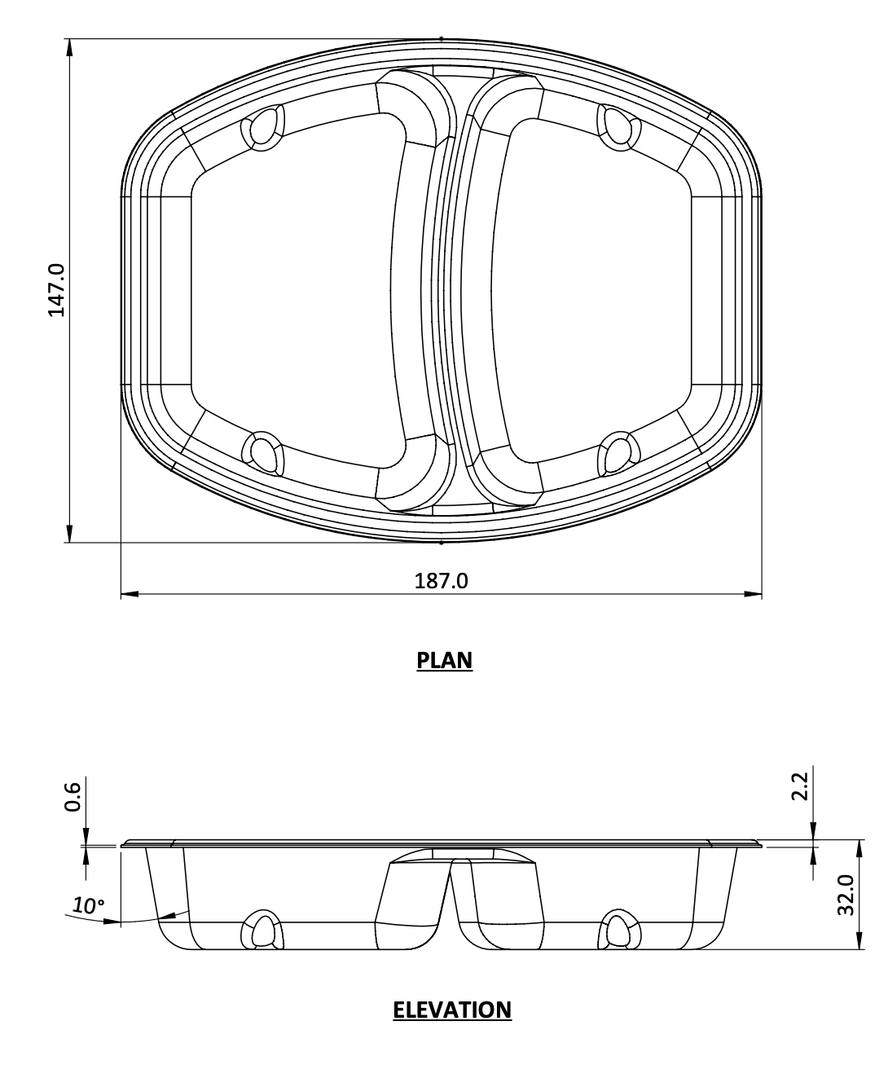
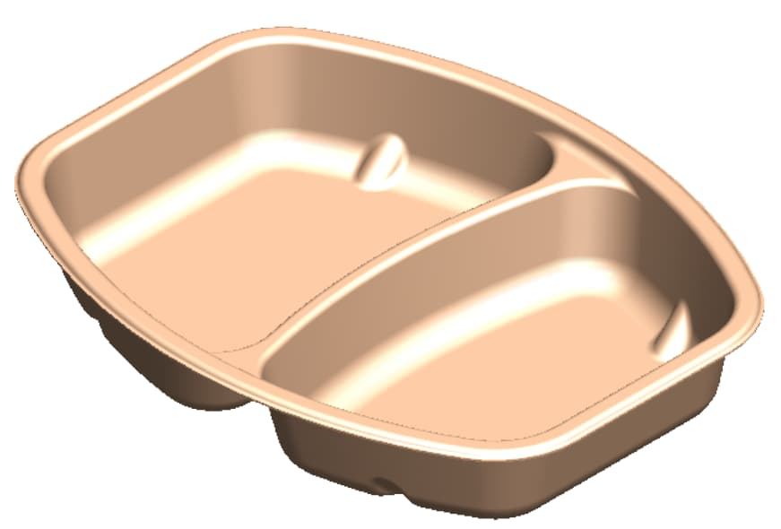
PRODUCT SPECIFICATIONS – Dual Compartment 60:40 Tray
Dual Compartment
Tray – 60:40
187L x 147W x 32H (mm)
No added PFAS
Our Meal Trays are an environmental
alternative to plastic.
Engineered to provide structural integrity and moisture resistance under chilled and refrigerated environment
Designed for packaging of Ready to eat in retail and wholesale
Product Dimensions (mm): 187L x 147W x 32H | Thickness (mm): 0.7 mm | Product Weight (g): 20 grams
Raw Material: 80% Unbleached Bagasse, 20% Soft Wood | Customisation: Yes – See Custom Packaging | Recyclable: Yes
Usage: Hot/Cold & Wet/Dry products | Manufactured: India | MOQ: NA*
Map Compliant: Yes | Freezable: Yes | Microwaveable: Yes Upto 220⁰ C
Carton Quantity: NA* | Peelable Film: Yes | Oven Safe : Yes
*Based on the order placed
Lamination Available- Yes
CPET Lamination
*Appliance Suitability: Our tests on microwave, oven and freezer usage may differ to individual use.
We recommend reheating and freezer applications to individual testing suitable to your purposes and product.
Note that lamination or lidding film may not be suitable for microwave or oven.

