Slide 1
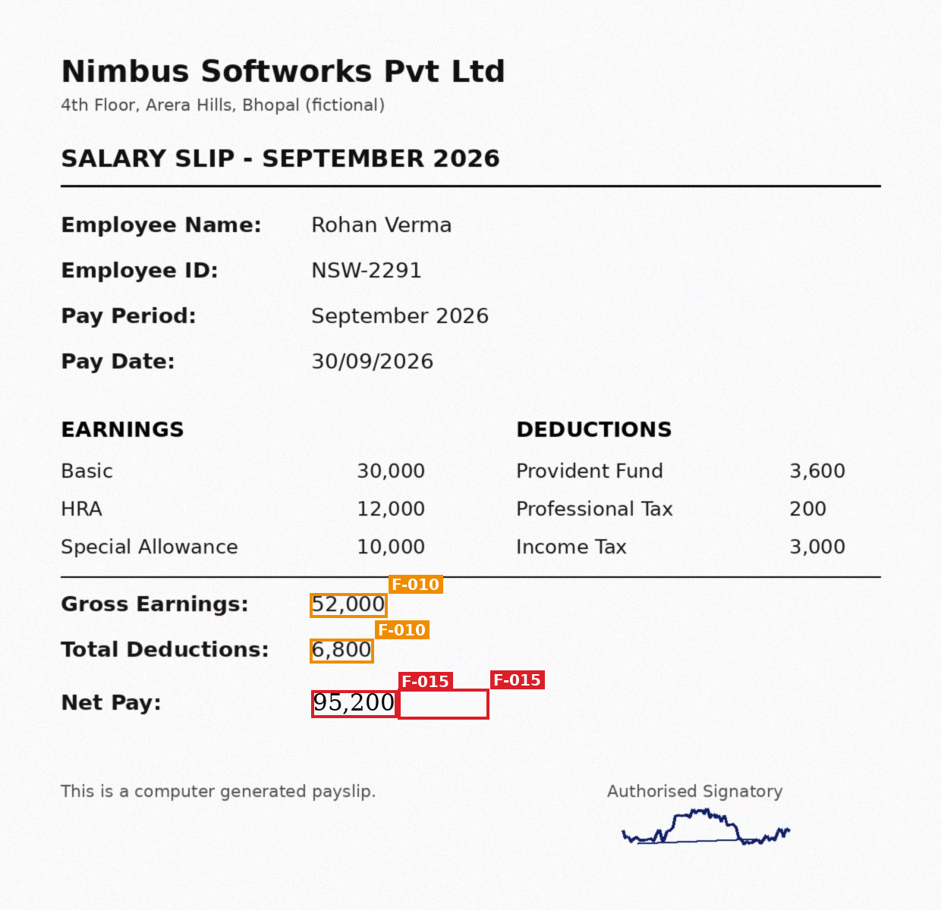

DocSentinel
DataOps Innovation Hackathon 2026 · Hack The Core
AI-powered document forensics and contextual intelligence
Beyond OCR: is the information authentic, consistent and reliable?
Net Pay 95,200 → potential manipulation
4 converging signals · 97% · likely original 45,200
Ayush Kumar
Solo participant · Problem statement: Document Forensics
Notes:
Hi, I'm Ayush Kumar. My project is DocSentinel, built for the Document Forensics problem statement. On the right is a real output: the system flagged that the Net Pay on this payslip was changed from 45,200 to 95,200, and it explains why with four independent pieces of evidence.

Slide 2




OCR reads a document, but cannot tell whether it is true
Banks and lenders process identity proofs, payslips, statements and application forms at scale.
OCR plus field-level rules checks that a value exists and looks valid. It does not check whether the value was altered, or whether it agrees with the rest of the submission.
Manipulation usually shows up between fields and between documents.
Overwritten values
Replaced photographs
Net pay or income retyped on a pasted patch
A different photo pasted into an ID card
Edited digital PDFs
Cross-document conflicts
A balance changed in a PDF editor
DOB, income or employer that do not agree
Notes:
The problem: OCR tells you what a document says, not whether it is true. Fraud shows up as overwritten values, swapped photos, edited PDFs, and above all as contradictions between documents. Checking each field on its own misses these.

Slide 3



DocSentinel investigates the whole submission
Visual & digital forensics
Contextual intelligence
Evidence & traceability
Noise-residual consistency finds pasted patches
Error Level Analysis and glyph-size outliers
Signature placement; PDF fonts and metadata
Payslip arithmetic, bank running balance, dates
Entity matrix across all documents
Reasoning engine weighs converging signals
Every finding → document, page, bounding box
Crops, annotated pages, heat-maps
Dossier PDF and hash-chained audit trail
Three-level status, never a fraud verdict:
Observation
Detected inconsistency
Potential manipulation
A human analyst confirms, dismisses or requests more information, and every decision is logged.
Notes:
DocSentinel has three pillars. Visual and digital forensics show how a value may have been changed. Contextual intelligence shows that it disagrees with everything else. Evidence and traceability tie every claim to a pixel location. Results use three statuses, and a human always makes the final call.

Slide 4
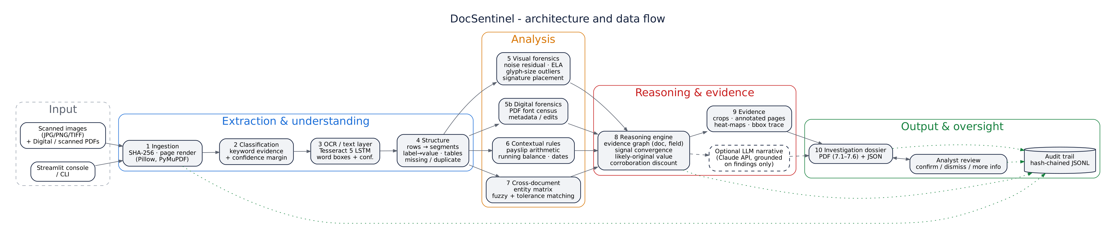
Architecture: modular, explainable, fully offline
Tesseract 5 OCR
OpenCV + NumPy
PyMuPDF
RapidFuzz
ReportLab
Streamlit
Claude API (optional)
10
pipeline stages
0
trained black-box models: every number is reproducible
1
coordinate system: each finding maps to page + box
Notes:
Files are hashed and rendered, OCR'd or read from the PDF text layer, then structured. Four analysers run in parallel: visual, digital, contextual and cross-document. A reasoning engine combines them, evidence is generated, and the dossier is produced. Every step writes to a tamper-evident audit log. Everything runs offline; the LLM narrative is optional.

Slide 5
Ten stages from upload to an evidence-backed dossier
1
2
3
4
5
Submission
Classification
OCR & extraction
Structure
Visual forensics
SHA-256, page render
type + confidence
words, boxes, conf.
label→value, tables
noise, ELA, glyphs
6
7
8
9
10
Contextual checks
Cross-document
Investigation
Evidence
Dossier
arithmetic, dates
entity matrix
signal convergence
crops, bbox trace
PDF 7.1–7.6 + JSON
Blue understand · Amber analyse · Red reason · Green explain. Live progress is shown in the UI; a failed file is logged and skipped.
Notes:
This is exactly the workflow in the problem statement, implemented end to end. The UI shows each stage as it runs, and if a file cannot be read, the system records that and continues with the rest.

Slide 6
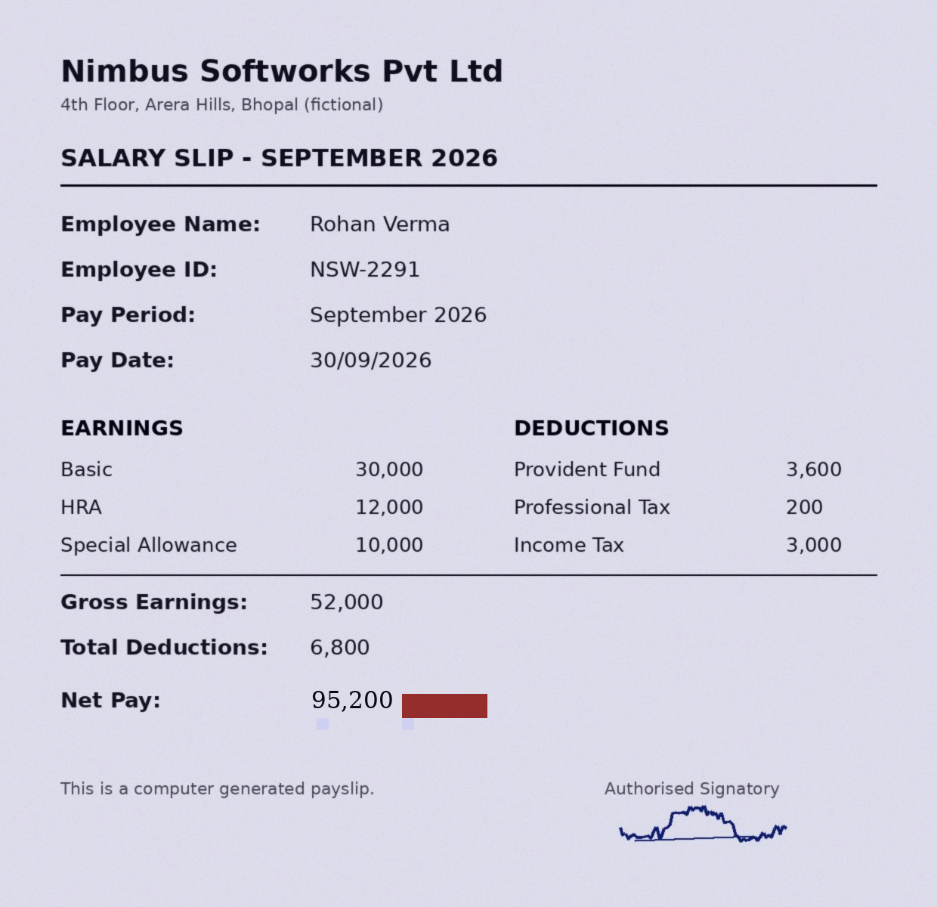
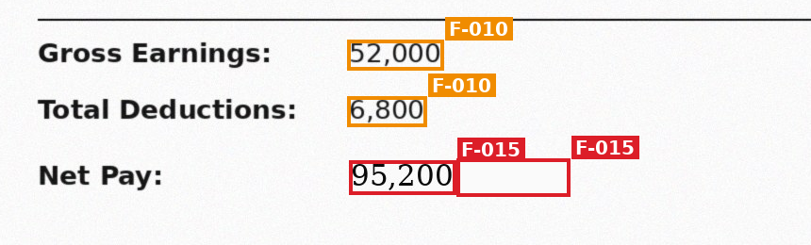
Visual forensics shows how a value was changed
V1 Noise-residual consistency
Scans carry uniform sensor noise; a patch pasted after scanning is abnormally clean
V2 Error Level Analysis
Different compression history responds differently on recompression
V3 Glyph-size outlier
Net Pay digits 15% taller than other values in the same column
V4 Signature analysis
Findings on page
Noise map: only the pasted patch lights up
Detects ink, checks placement in its box, compares shapes across documents
D1 PDF font census
Closing balance in Times-Roman inside a Helvetica statement
D2 PDF metadata
Last written by an editor, modified after creation
Notes:
Visual forensics: the key detector is noise consistency. A scanned page has uniform sensor noise, so a patch pasted on top is unnaturally clean. On the noise map only the patch next to Net Pay lights up. The digits are also 15% taller than the other values. For digital PDFs, the system checks fonts and metadata instead: the closing balance was retyped in a foreign font.

Slide 7
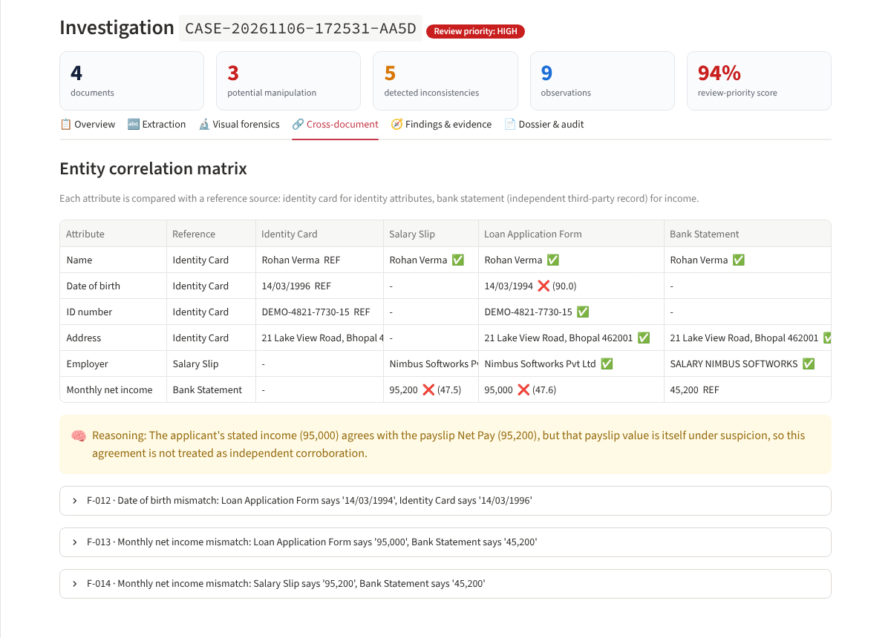
Contextual intelligence shows that a value disagrees
Inside each document
Gross − Deductions = 45,200, but Net Pay says 95,200
Statement table ends at 50,220; Closing Balance says 99,220
Valid dates, plausible age
Across documents
Name, DOB, ID, address vs the identity card
Income vs the bank salary credit, an independent third-party record
Employer vs payslip letterhead and salary narration
Pay date vs credit date
Notes:
Contextual intelligence is worth 20 points, the largest criterion. Inside each document we check the arithmetic. Across documents, an entity matrix compares every attribute with a reference source. Here the application's date of birth and income conflict with the ID card and the bank statement.

Slide 8

Reasoning engine: converging signals, not single alarms
F-002
Visual Noise-free patch beside Net Pay
F-015 · POTENTIAL MANIPULATION
Payslip Net Pay shows converging signs of alteration
F-003
Visual Digits 15% taller than column
97% combined confidence
F-010
Data Gross − Deductions = 45,200 ≠ 95,200
Likely original: 45,200 (recomputation and bank agree). Stated: 95,200.
F-014
Cross-doc Bank salary credit is 45,200
conf = 1 − Π(1 − 0.8·cᵢ) · needs independent visual AND data signals
Corroboration discount: the application's 95,000 agrees with the payslip's 95,200, but that payslip value is itself suspect, so the agreement is not counted as support.
Notes:
This is the AI reasoning part. One signal alone is only an observation. When independent visual and data signals converge on the same field, the engine raises a potential-manipulation hypothesis, combines the confidence, and estimates the original value from sources that agree. It also refuses to count support that comes from a document it already suspects.

Slide 9
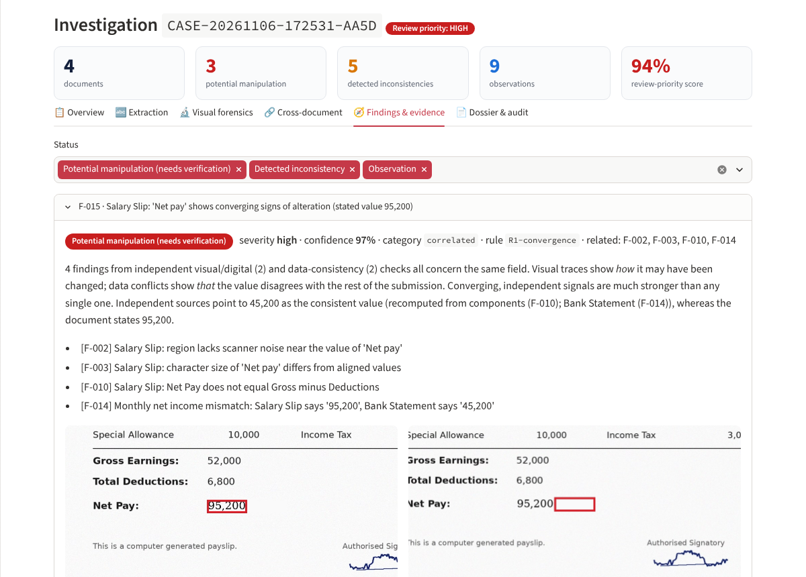
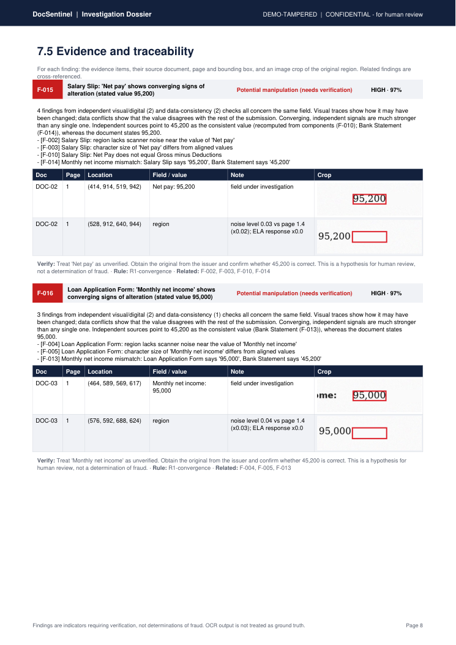
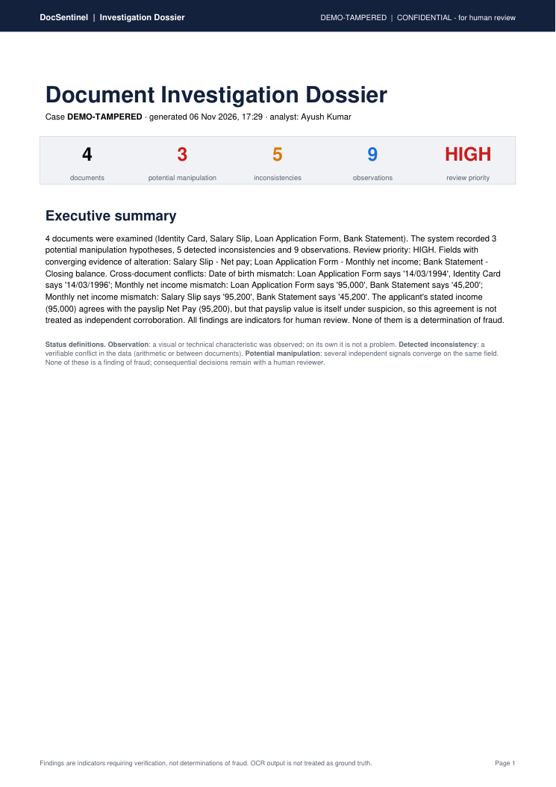
Every finding traces back to a page, a box and a crop
Dossier PDF with sections 7.1–7.6, methodology and audit appendix
Hash-chained audit log: editing any entry breaks the chain
Analyst confirms / dismisses / requests info; decisions logged and added to the dossier
Notes:
Every finding links to its document, page and bounding box, with a crop of the original region. The analyst can record a decision on each finding. The dossier contains every section required by the problem statement, and the audit trail is hash-chained so tampering is detectable.

Slide 10
All six planted manipulations found, zero false alarms
6 / 6
0
3
12 / 12
planted manipulations detected
inconsistencies on the genuine case
potential-manipulation hypotheses, all correct
automated tests passing
# | Planted manipulation | Detected by | Result
T1 | ID photograph replaced | Noise consistency (image region) | Observation
T2 | Payslip Net Pay 45,200 → 95,200 | Noise + glyph size + arithmetic + bank credit | Potential manipulation
T3 | Application income → 95,000 | Noise + glyph size + bank credit | Potential manipulation
T4 | Application DOB 1994 vs ID 1996 | Cross-document DOB | Inconsistency
T5 | Signature outside its box | Signature placement | Observation
T6 | Closing balance edited in PDF editor | Foreign font + metadata + running balance | Potential manipulation
Notes:
On the demo dataset, all six planted manipulations were detected, and the untouched genuine case produced zero inconsistencies. Each detection maps to the ground-truth manifest, and there is a pytest test for each one.

Slide 11
How DocSentinel addresses each judging criterion
Criterion | Pts | What we demonstrate
OCR & information extraction | 15 | Tesseract word boxes + confidence; exact PDF text layer; structured fields and transaction table
Document understanding | 15 | Classification with confidence; label→value pairing; tables; missing / duplicate / low-confidence fields
Visual forensic analysis | 15 | Noise residual, ELA, glyph-size, signature placement; PDF font and metadata forensics
Contextual intelligence | 20 | Arithmetic and date rules; entity matrix; reference sources; corroboration discount
Evidence & traceability | 10 | Page + bbox on every item; crops; annotated pages; click-to-trace in UI
AI reasoning & explainability | 10 | Signal convergence, combined confidence, likely original, plain-language explanations
Technical implementation | 10 | Modular pipeline, CLI + web UI, 12 tests, safe failure, audit chain
Innovation | 5 | Noise-based overwrite detection + reasoning that discounts suspect corroboration
Notes:
This maps every judging criterion to something that runs in the demo.

Slide 12


Responsible by design, honest about limits
Safety and ethics
Known limitations
Synthetic dataset only: fictional person, IDs and accounts
OCR is never ground truth; confidence propagates to findings
Three statuses; nothing is labelled fraud
Human review for every consequential decision
Local processing; optional LLM sees finding text only
Tamper-evident audit trail with file hashes
Black-ink signatures not yet detected
Handwritten fields and multilingual layouts: planned
A forger who adds matching noise can evade V1; data checks remain
New templates need a schema entry
Forensic detectors analyse page 1 of multi-page files
Notes:
We followed the safety requirements: synthetic data, no fraud verdicts, human oversight and an audit trail. We also document what does not work yet, with a full capability matrix in the repository.

Slide 13


From extraction to evidence-driven investigation
Run it in two commands
Source & documentation
pip install -r requirements.txt
streamlit run app.py
github.com/sanjaykumarpathak640-png/docsentinel
README · technical docs · limitations · sample dossiers
Demo case and ground-truth manifest included
Roadmap
Handwriting OCR (TrOCR)
Deep manipulation localisation
Copy-move detection
Multilingual documents
More document types
Thank you · Ayush Kumar
Notes:
To summarise: DocSentinel turns document processing from simple extraction into evidence-driven investigation. Everything is in the repository with setup instructions. Thank you.

