Slide 1
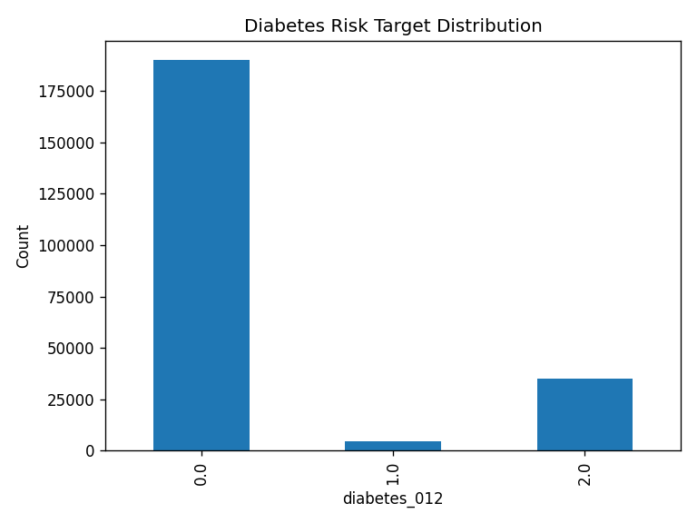
Exploratory
Data Analysis
Diabetes Risk Prediction using Health & Lifestyle Indicators
PERSON 3
229,781 analyzed records • 22 variables • 3 target classes
Notes:
[Sources] - Uploaded target_distribution (1).png - eda_metadata (1).json - target_distribution (1).csv

Slide 2
1. Dataset Overview
Processed analytical dataset after exact-duplicate removal
229,781
22
3
Diabetes_012
ANALYTICAL RECORDS
VARIABLES
TARGET CLASSES
TARGET VARIABLE
Feature landscape
Clinical
Lifestyle
High BP, high cholesterol, stroke, heart disease
Physical activity, smoking, fruit and vegetable intake
Health status
Demographic
BMI, general health, mental health, physical health, mobility
Age band, education, income and sex indicator
Notes:
[Sources] - eda_metadata (1).json - summary_statistics (1).csv - README.md

Slide 3
2. Missing Value Analysis
All 22 analyzed variables are complete after preprocessing
Assignment finding
0
The generated missing-value summary reports zero missing observations for each of the 22 variables.
The analytical dataset is therefore complete for EDA and downstream modeling.
No rows need to be excluded because of missingness at this stage.
missing values
0.0% across every field
Reporting note: this conclusion applies to the processed analytical dataset used for these outputs.
Notes:
[Sources] - missing_value_summary (1).csv - eda_metadata (1).json

Slide 4
3. Target Distribution
The target is strongly imbalanced, especially for the prediabetes class
0
No diabetes
82.71%
190,055
1
Prediabetes
2.01%
4,629
2
Diabetes
15.27%
35,097
Modeling implication
Do not rely on accuracy alone. Report class-level precision, recall and F1-score.
Notes:
[Sources] - Uploaded target_distribution (1).png - target_distribution (1).csv

Slide 5
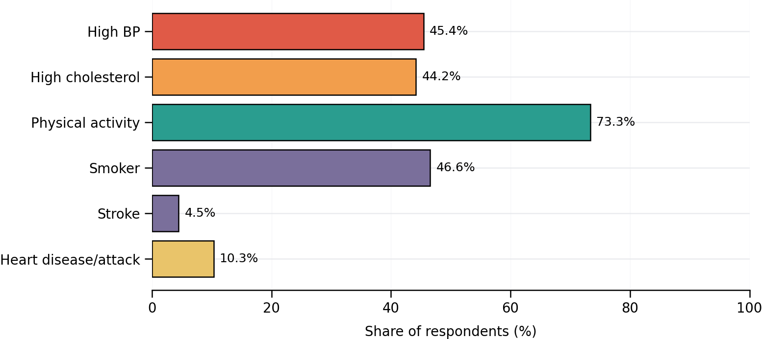
4. Feature Distribution Analysis
The population combines high cardiometabolic exposure with widespread reported activity
Selected distribution insights
BMI
Mean 28.69 | Median 27
Range: 12 to 98
Age band
Mean 8.09 | Median 8
Scale: 1 to 13
General health
Mean 2.60 | Median 3
Scale: 1 to 5
Interpretation
High BP and high cholesterol each affect roughly 4 in 10 respondents, while 73.34% report physical activity.
Notes:
[Sources] - summary_statistics (1).csv - Chart generated from summary_statistics (1).csv

Slide 6
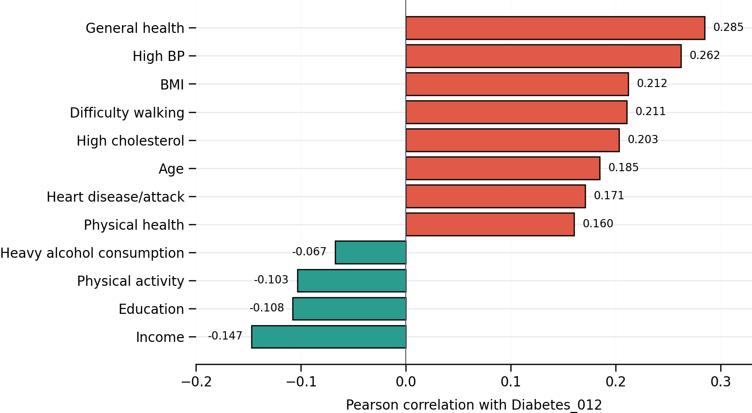
5. Correlation Analysis
Associations with Diabetes_012 are modest; no single feature dominates
Strongest positive
General health +0.285
High BP +0.262
BMI +0.212
Difficulty walking +0.211
High cholesterol +0.203
Strongest negative
Income −0.147
Education −0.108
Physical activity −0.103
Correlation indicates association, not causation.
Notes:
[Sources] - correlation_matrix (1).csv - Chart generated from correlation_matrix (1).csv

Slide 7
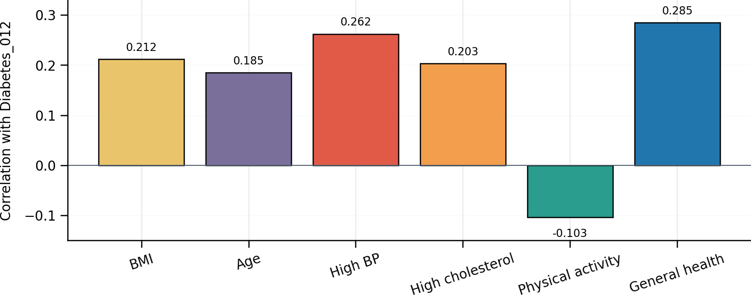
6. Bivariate Analysis
Six priority features compared with the ordered diabetes outcome
Evidence-led interpretation
General health has the strongest of the six associations (+0.285).
High BP (+0.262), BMI (+0.212) and high cholesterol (+0.203) rise with the ordered target.
Age is positively associated (+0.185).
Physical activity is inversely associated (−0.103).
Interpretation boundary: these values summarize linear association; they do not prove a causal effect or substitute for group-level significance tests.
Notes:
[Sources] - correlation_matrix (1).csv - Chart generated from correlation_matrix (1).csv - eda_metadata (1).json

Slide 8
Steps 1–6: Consolidated Findings
A defensible foundation for feature importance and model evaluation
DATA QUALITY
TARGET RISK
229,781 complete records; zero missing values in all 22 analyzed fields.
82.71% are class 0; prediabetes is only 2.01%, creating severe class imbalance.
HEALTH SIGNALS
PROTECTIVE ASSOCIATIONS
General health, high BP, BMI, mobility difficulty and high cholesterol show the largest positive associations.
Income, education and physical activity show the largest negative correlations with the target.
Next analytical stage: quantify feature importance and evaluate models with class-sensitive metrics.
Notes:
[Sources] - eda_metadata (1).json - missing_value_summary (1).csv - target_distribution (1).csv - summary_statistics (1).csv - correlation_matrix (1).csv

