Slide 1
Automatic Sliding Door Operation
By Sanjay Varyani

Slide 2
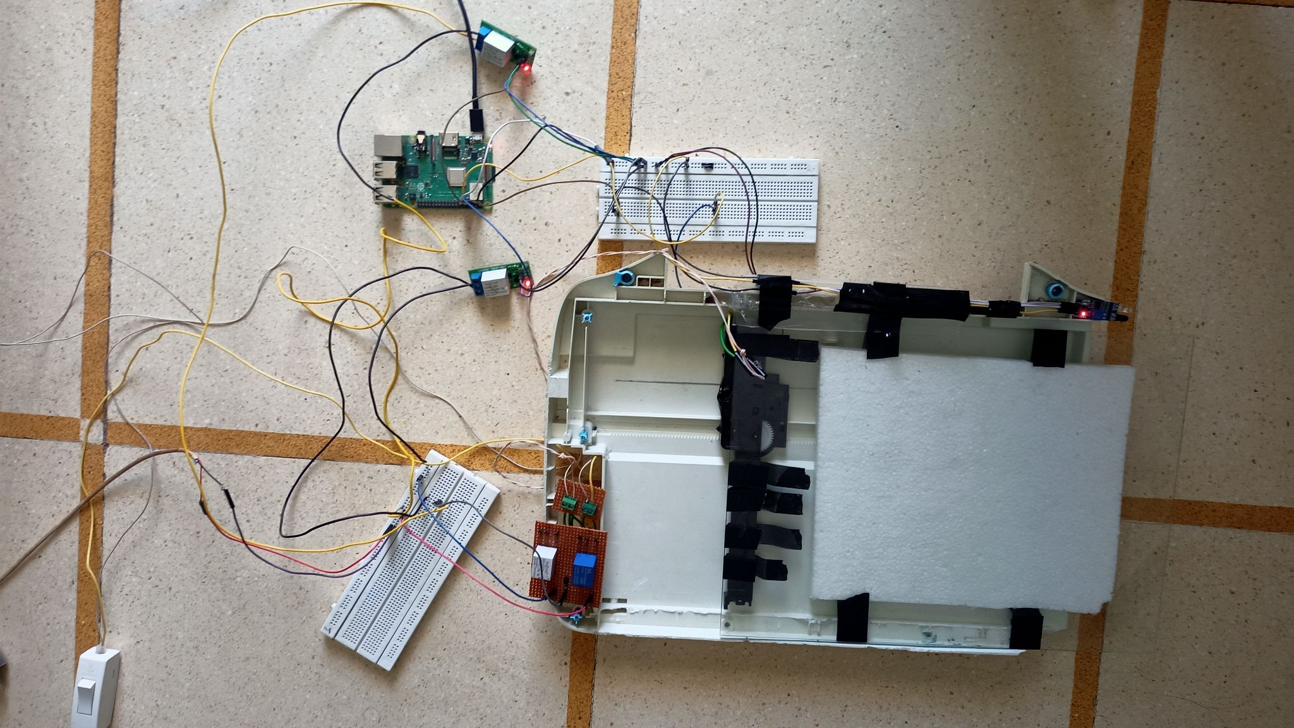
How does the automatic door works ?

Slide 3
Normally the door is closed and it’s open when someone comes in front of the slab and closed again if no-one will there after 5 seconds.

Slide 4
Materials
Controller : - Raspberry Pi
Jumper Wires
Bread Board
Soldering Machine
Flux And Wire
Pin Connectors
Resistors
IR Sensors
3.3v- 5v DC Relays
Diodes
BJT Transistor
DC Supply
DC Motor
Worm Gear
Electric Tape
Cutter
Screw Driver
And Some Switches (Additional)
Can be found in Electronics shop

Slide 5
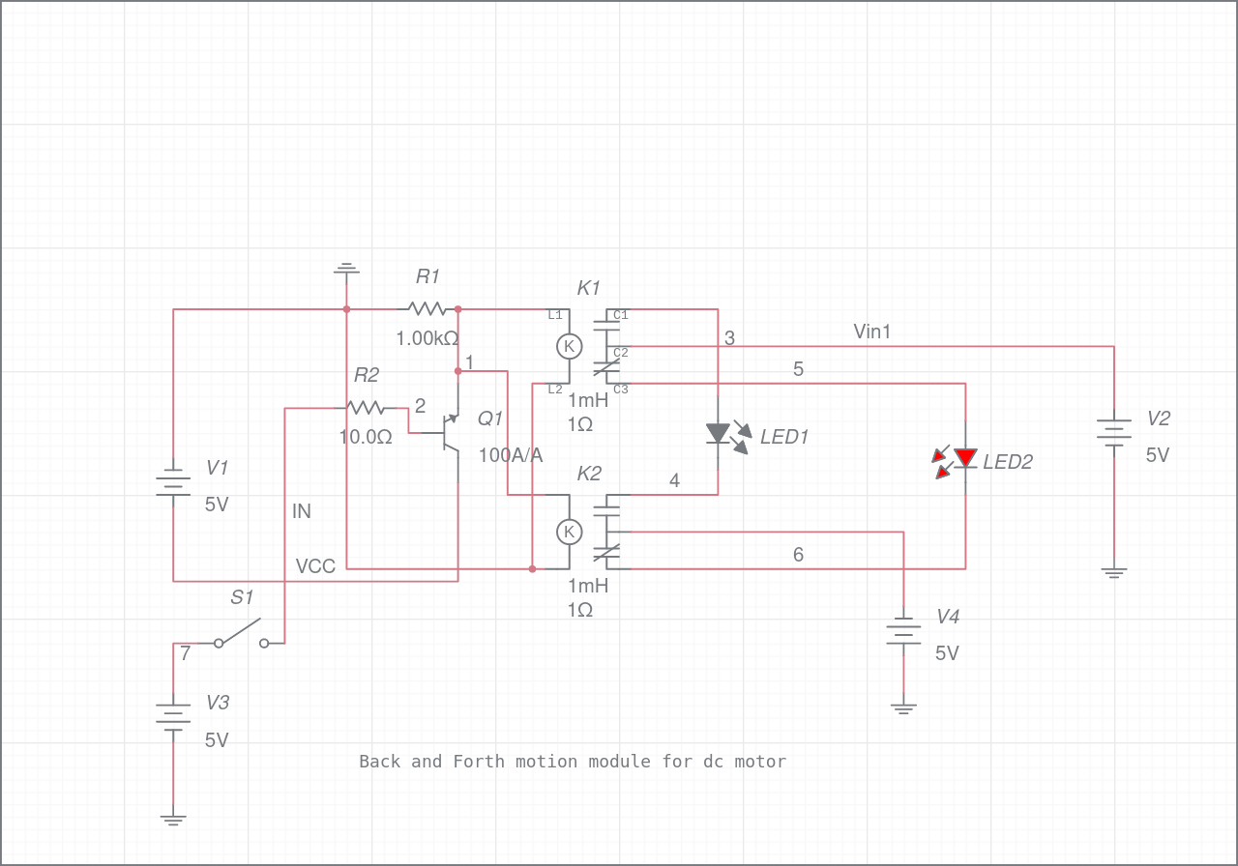
Procedure
Make Motor Driver As Shown In Schematic Figure.
Place Such Components On General Purpose PCB So That Circuitry Will Reduce In Further Case.
Solder That PCB Using Mentioned Equipments.

Slide 6
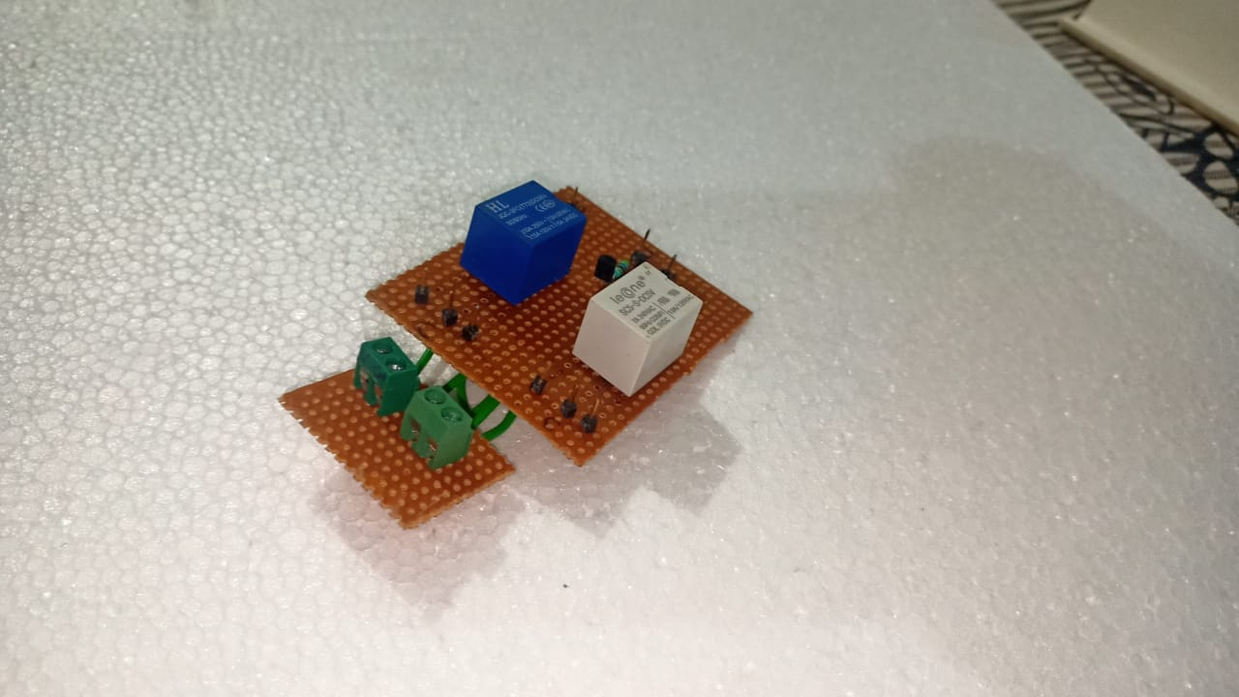
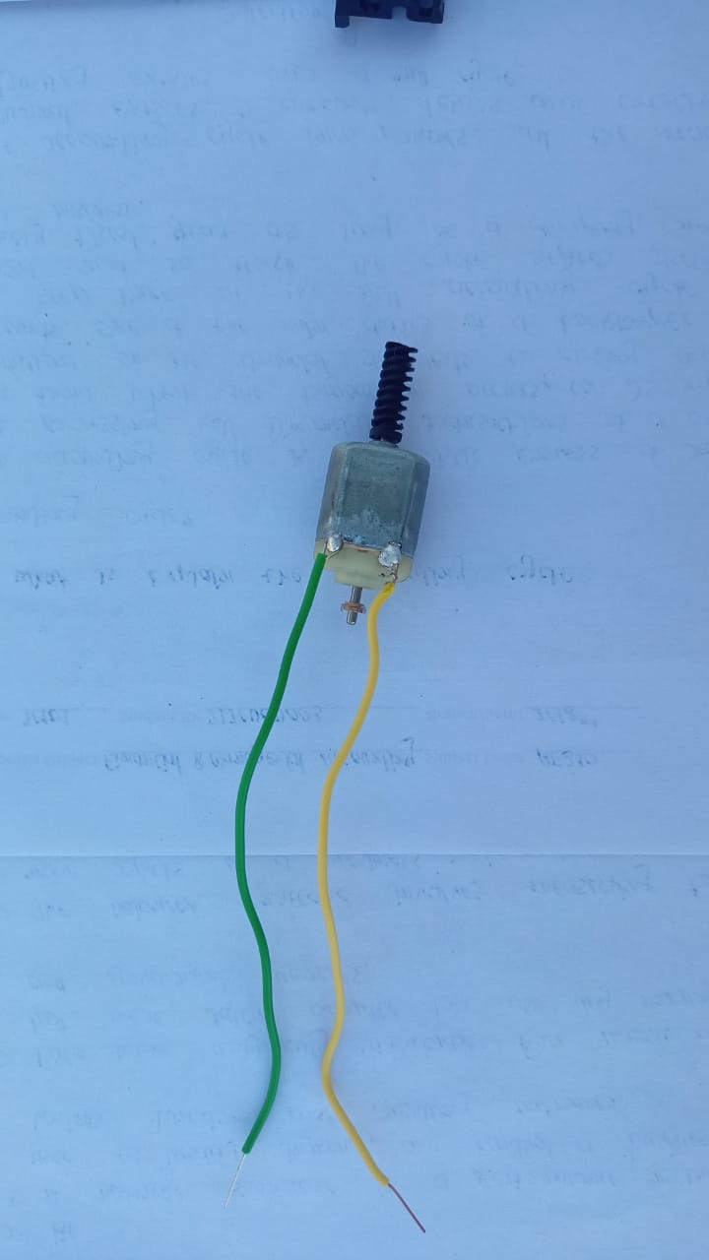
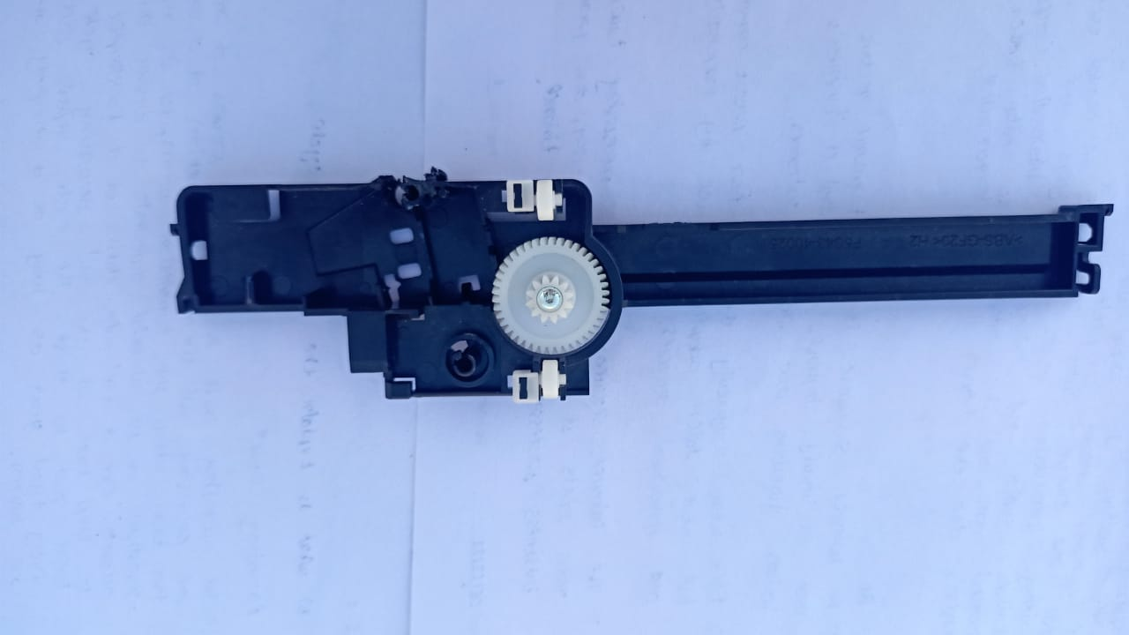
Procedure
Connect Driver Module With Supply And Inputs Of Driving Motor.
Now Insert The Motor Into The Holder Of Worm Gear Assembly, Which Will Be Further Inserted Into The Saw Tooth Geared Assembly.
Place The Slab On Gear System.
Setup IR Sensors On Fruitful Position On Our Particular System For That It Could Take Feedback So that Driver Operate In A Proper Manner.
Take Output Of IR Sensor And Place That Signal In Our Controller.
Based Upon The Signal Operate Switching Of Motor Driver.

Slide 7
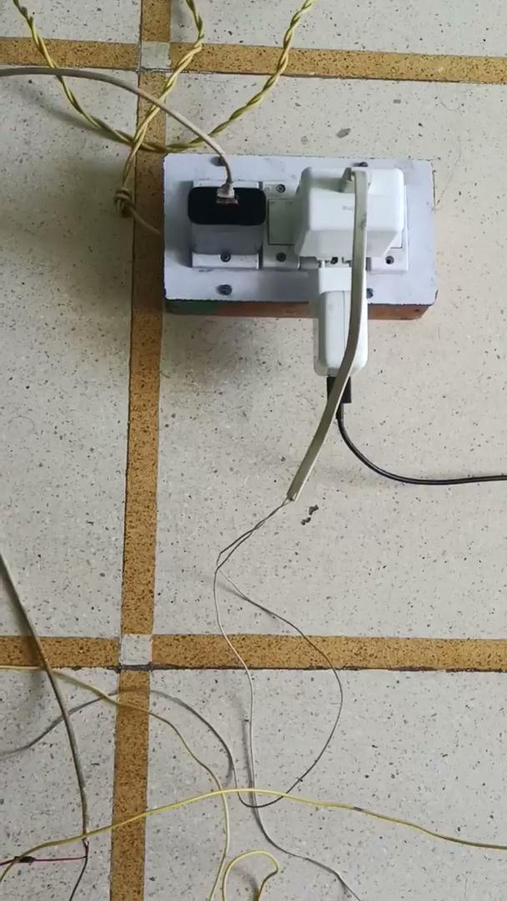
Demonstration Of Experiment

Slide 8
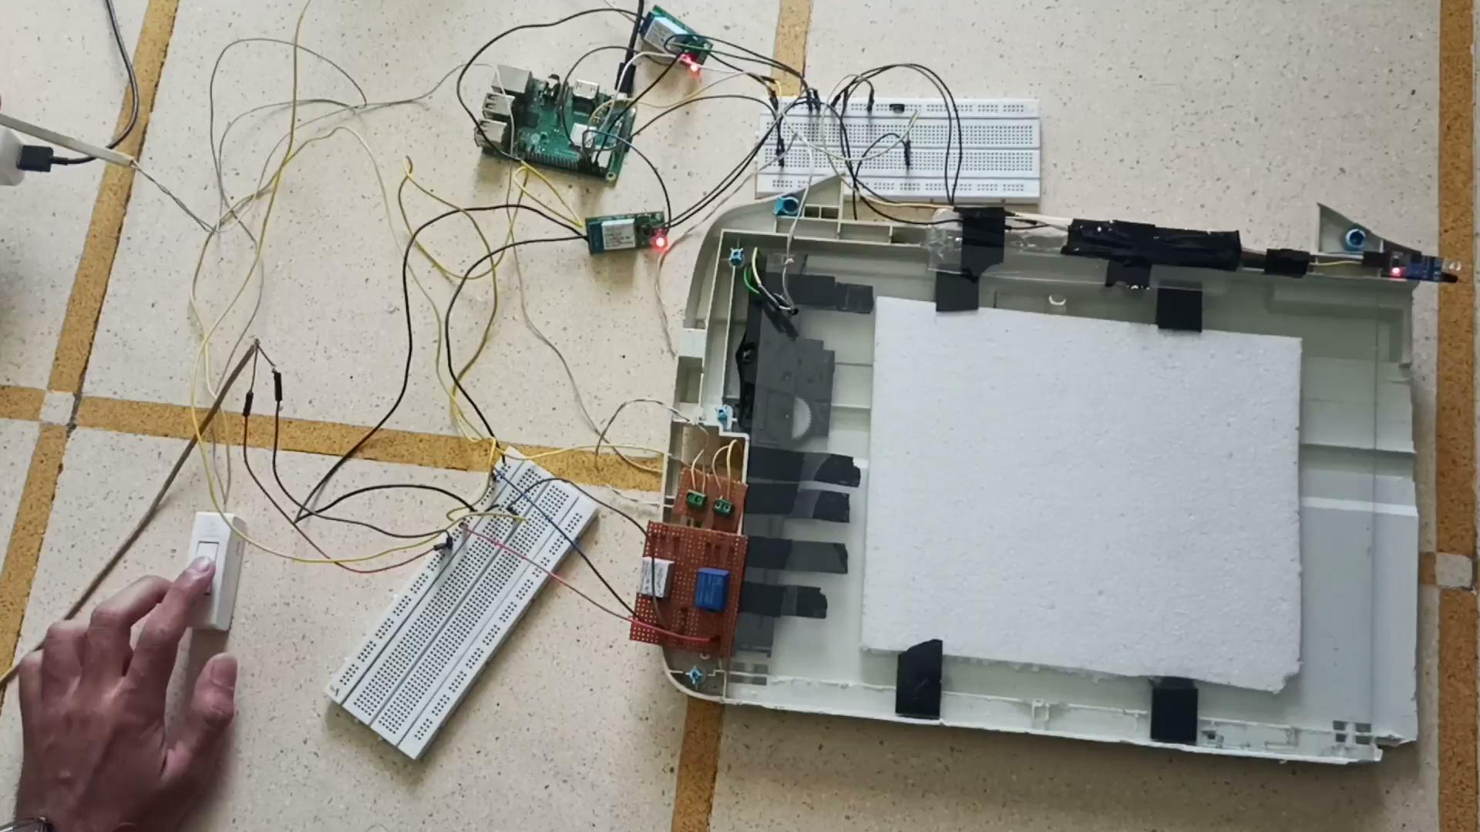
Demonstration Of Experiment

Slide 9

Code Written In Python

Slide 10
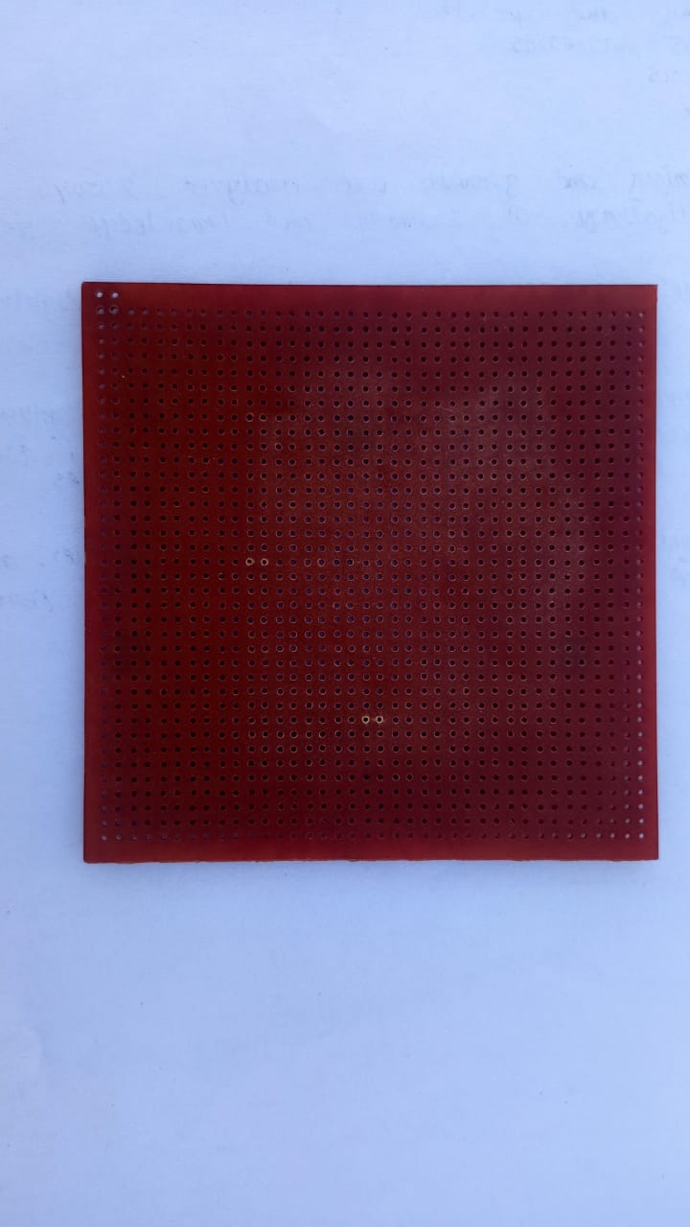
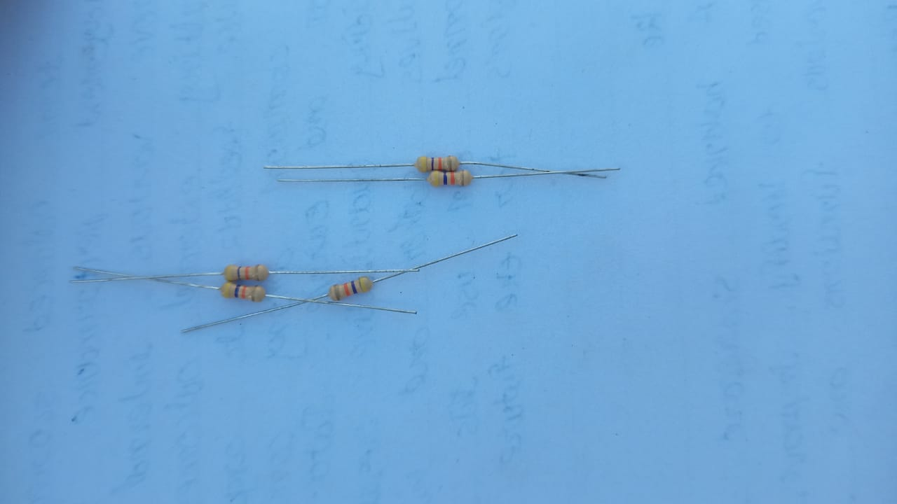
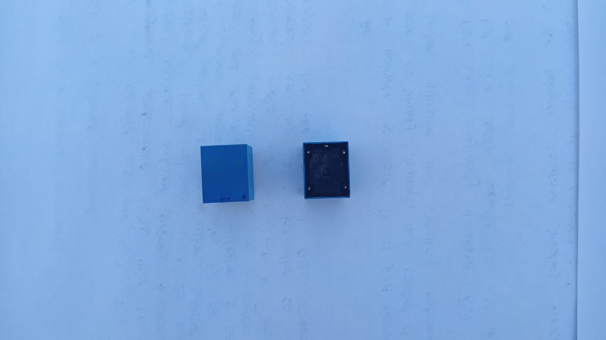
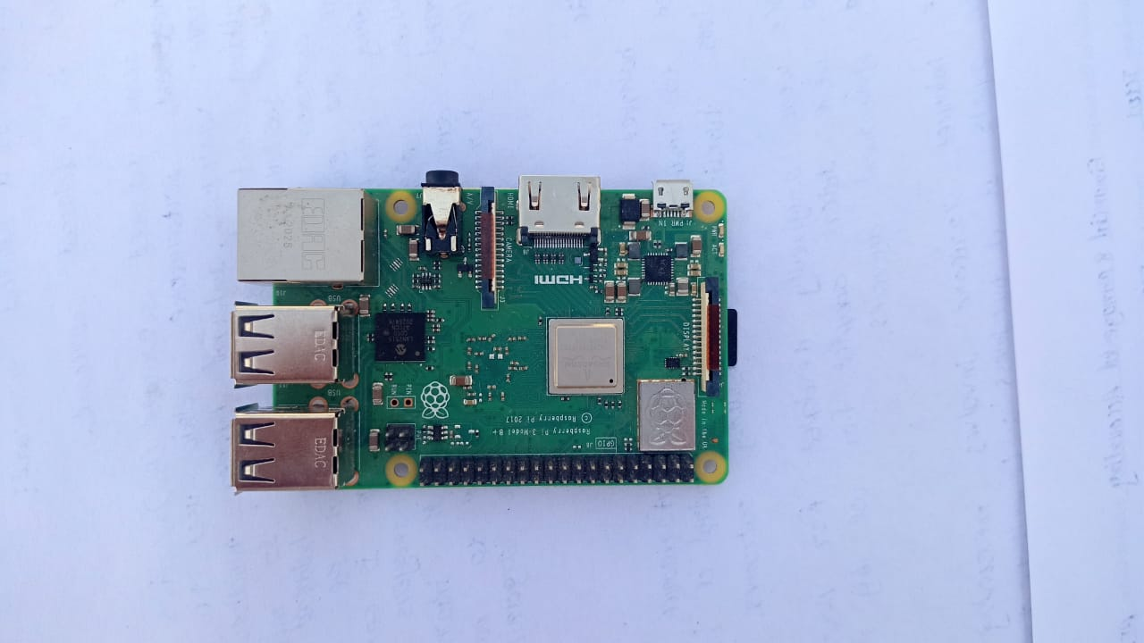
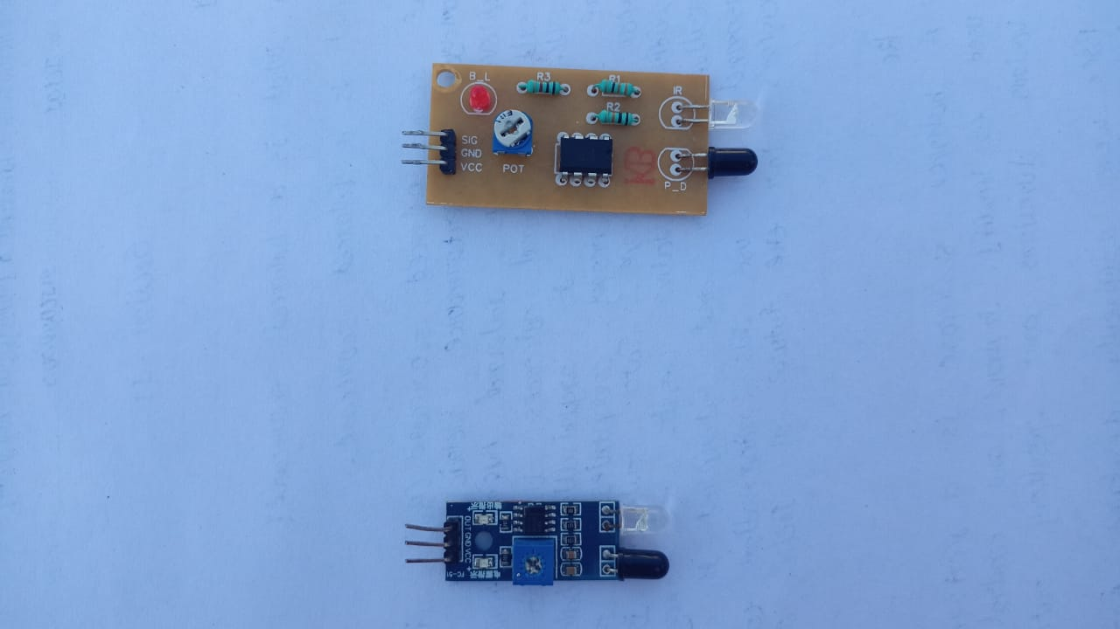
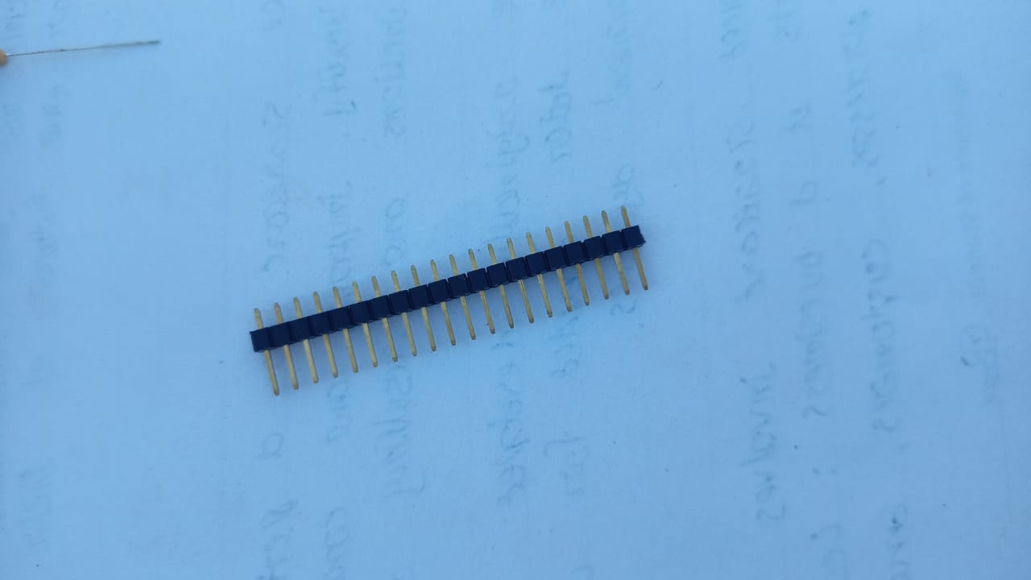
Components Used

Slide 11
Demerits In The Mentioned Project
This Project Is Not Able To Sense Who Will Be In Front Of The Slab, i.e It Doesn’t Justify Whether Standby Object Is A Human Or Animal Or Something Else.
Due To Friction Door Cannot Opened Fully But In Actual Case There Is High Load Motor Placed.

Slide 12
Conclusion
In Modern Life Time Is Very Crucial Thing In Human Life And To Save It We Needed Automation In A Regular Daily Life Things Such As Automatic Door Which Can Opened By Sensing A Human, When They Come Across The Door, From Either Direction.

Slide 13
Thanking You

