Slide 1

NITTE MEENAKSHI INSTITUTE OF TECHNOLOGY
DEPARTMENT OF MASTER OF COMPUTER
APPLICATIONS
INTERNSHIP ON AI & ML
Presented By Under the Guidance
Sanjay M Dr. Dileep M R 1NT22MC091 Associate Professor
Dept of MCA Dept of MCA
IV Semester
Academic Year 2023-2024
Notes:
jvjhvj

Slide 2
Contents
Introduction
Company Profile
Services Offered
Tools and Technologies Used
Project Work
Sample Screenshot
Contributions Made
Conclusion

Slide 3
Introduction
Overview: I completed an internship at Pragyan SmartAI Technology LLP, focusing on artificial intelligence (AI) and machine learning (ML).
Duration: The internship lasted from 10 Nov 2023 to 17 Feb 2024.
Key Areas of Focus: My main areas of focus were developing predictive models, enhancing my coding skills in Python, and working with deep learning frameworks.

Slide 4

Company Profile
About Pragyan SmartAI Technology LLP: A technology company specializing in AI and ML solutions.
Vision and Mission: The company aims to leverage advanced AI techniques to solve real-world problems and drive innovation.
Core Activities: Key activities include AI research, developing ML models, and providing AI solutions to various industries.

Slide 5
Services Offered
Pragyan-ai upskill the working professionals, Career Gap women and Eng/MCA/MBA students in Data Science, Data/Business Analytics and Machine Learning/Artificial learning. Along with Training people, They also empower students to start/launch new startups in Advance Technologies like DS, AI, BigData, Blockchain, IoT, AR/VR. We engage with colleges to fill the gaps in education and industry and make student ready for industry in Data Science and AI roles.

Slide 6
Tools & Technologies Used
Python Programming: Strengthened my coding skills, focusing on writing efficient and scalable code.
Machine Learning Concepts: Learned about various ML algorithms, their applications, and how to implement them.
Deep Learning Frameworks:
TensorFlow: Used for building and training neural networks.
PyTorch: Utilized for its flexibility and dynamic computational graph

Slide 7
Data Preprocessing: Techniques such as data cleaning, normalization, and feature engineering.
Machine Learning Algorithms:
Supervised learning (e.g., Random Forest, LSTM).
Unsupervised learning (e.g., clustering algorithms).
Model Evaluation Techniques: Accuracy, precision, recall, F1-score, and cross-validation.
Data Visualization Tools:
Matplotlib and Seaborn: For creating insightful visualizations.
Streamlit: For developing interactive data applications.

Slide 8
Project Work
Summary of Key Projects:
Bitcoin Price Prediction
Rainfall Prediction System
Main Goals and Outcomes:
Developed predictive models with high accuracy.
Gained practical experience in deploying ML models.
Role in Each Project: Led the development and implementation of models, data preprocessing, and result analysis.

Slide 9
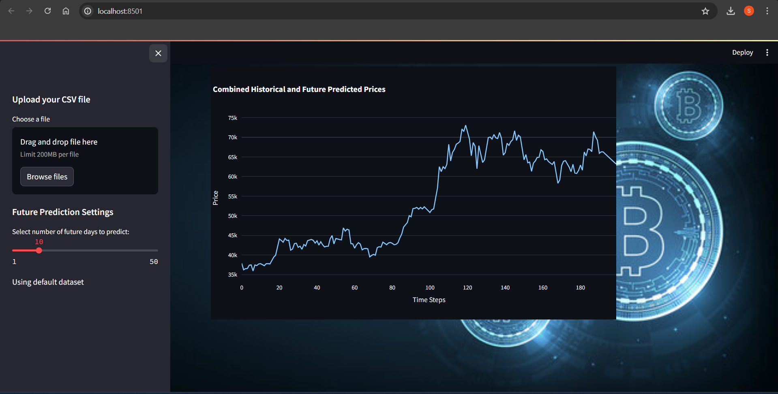
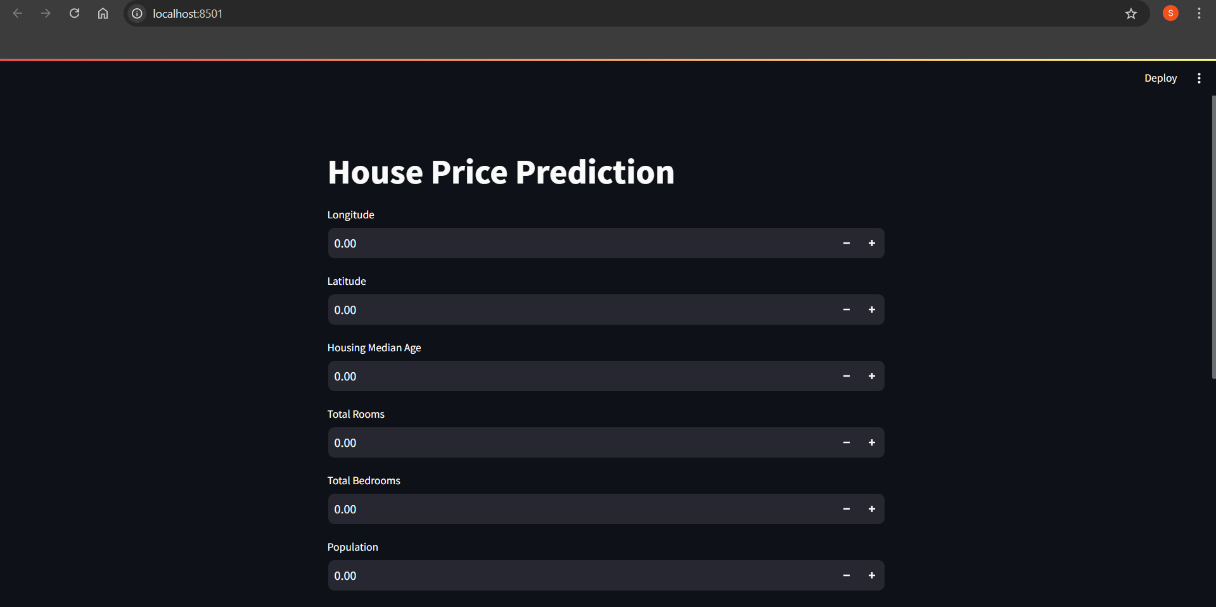
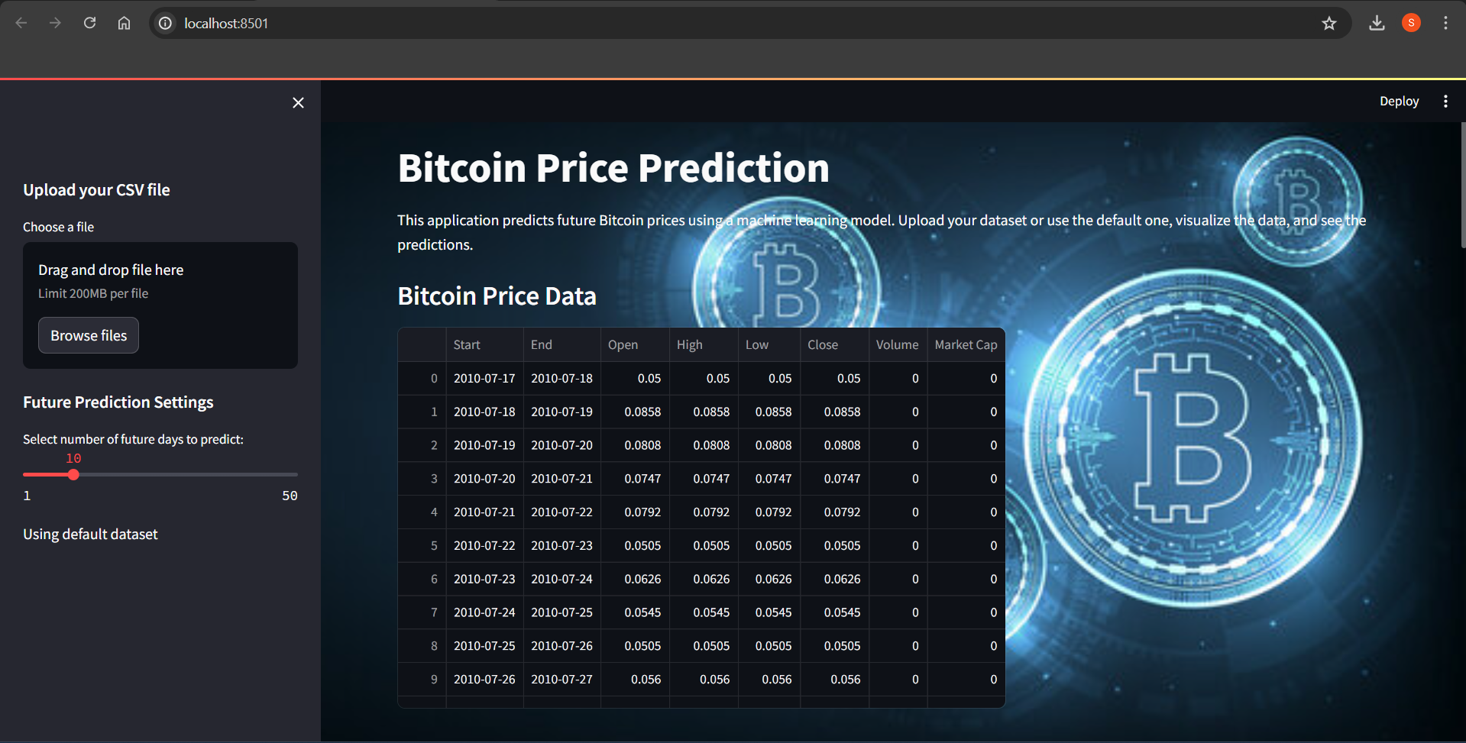
Sample Screenshot

Slide 10
Contributions Made
Individual Contributions:
Developed and implemented ML models for various projects.
Conducted data preprocessing and feature engineering.
Responsibilities Handled:
Managed project timelines and deliverables.
Collaborated with team members and communicated findings.
Key Achievements:
Successfully deployed predictive models.
Improved accuracy and efficiency of models through continuous iteration.

Slide 11
Conclusion
Overall Experience and Learning:
Gained in-depth knowledge and hands-on experience in AI and ML.
Enhanced technical skills and learned to apply theoretical knowledge practically.
Skills and Knowledge Gained:
Strong foundation in Python programming, ML algorithms, and deep learning frameworks.
Future Applications and Career Impact:
Prepared for a career in AI and ML with practical project experience.
Confident in tackling complex AI problems and developing innovative solutions.

Slide 12
Thank You

