Slide 1
Bitcoin Price Prediction Using LSTM Models
AI and ML Project
Name: Sanjay M
USN: 1NT22MC091
Under the Guidance of: Dr. Dileep M R
Associate Professor

Slide 2
Introduction
Overview of the Project
Developing an LSTM model to predict Bitcoin prices using historical data.
Enhancing decision-making in cryptocurrency trading through accurate price forecasting.
Objective
To build a predictive model using LSTM to forecast future Bitcoin prices.
To leverage machine learning techniques for accurate and reliable cryptocurrency market analysis.

Slide 3
Background
Importance of Bitcoin Price Prediction:
Provides valuable insights for investors and traders.
Helps in making informed financial decisions and risk management.
Challenges in Predicting Bitcoin Prices:
High volatility and rapid market fluctuations.
Influence of external factors like regulatory changes and market sentiment.

Slide 4
Problem Statement
Current Methods and Their Limitations:
Traditional statistical models often fail to capture the non-linear patterns in Bitcoin prices.
Existing machine learning models may lack sufficient accuracy due to overfitting or underfitting issues.
Need for Accurate Predictions:
Enhanced accuracy can lead to better investment strategies and risk mitigation.
Accurate predictions support more stable and efficient financial markets.

Slide 5

Data Collection
Source: Yahoo Finance
Dataset Details:
Entries: 5059
Columns: 'Open', 'Close', 'High', 'Low', 'Volume', 'Market Cap', etc.

Slide 6
Data Preprocessing
Steps Involved:
Cleaning
Normalization
Handling Missing Values
Tools Used:
Python
Pandas

Slide 7
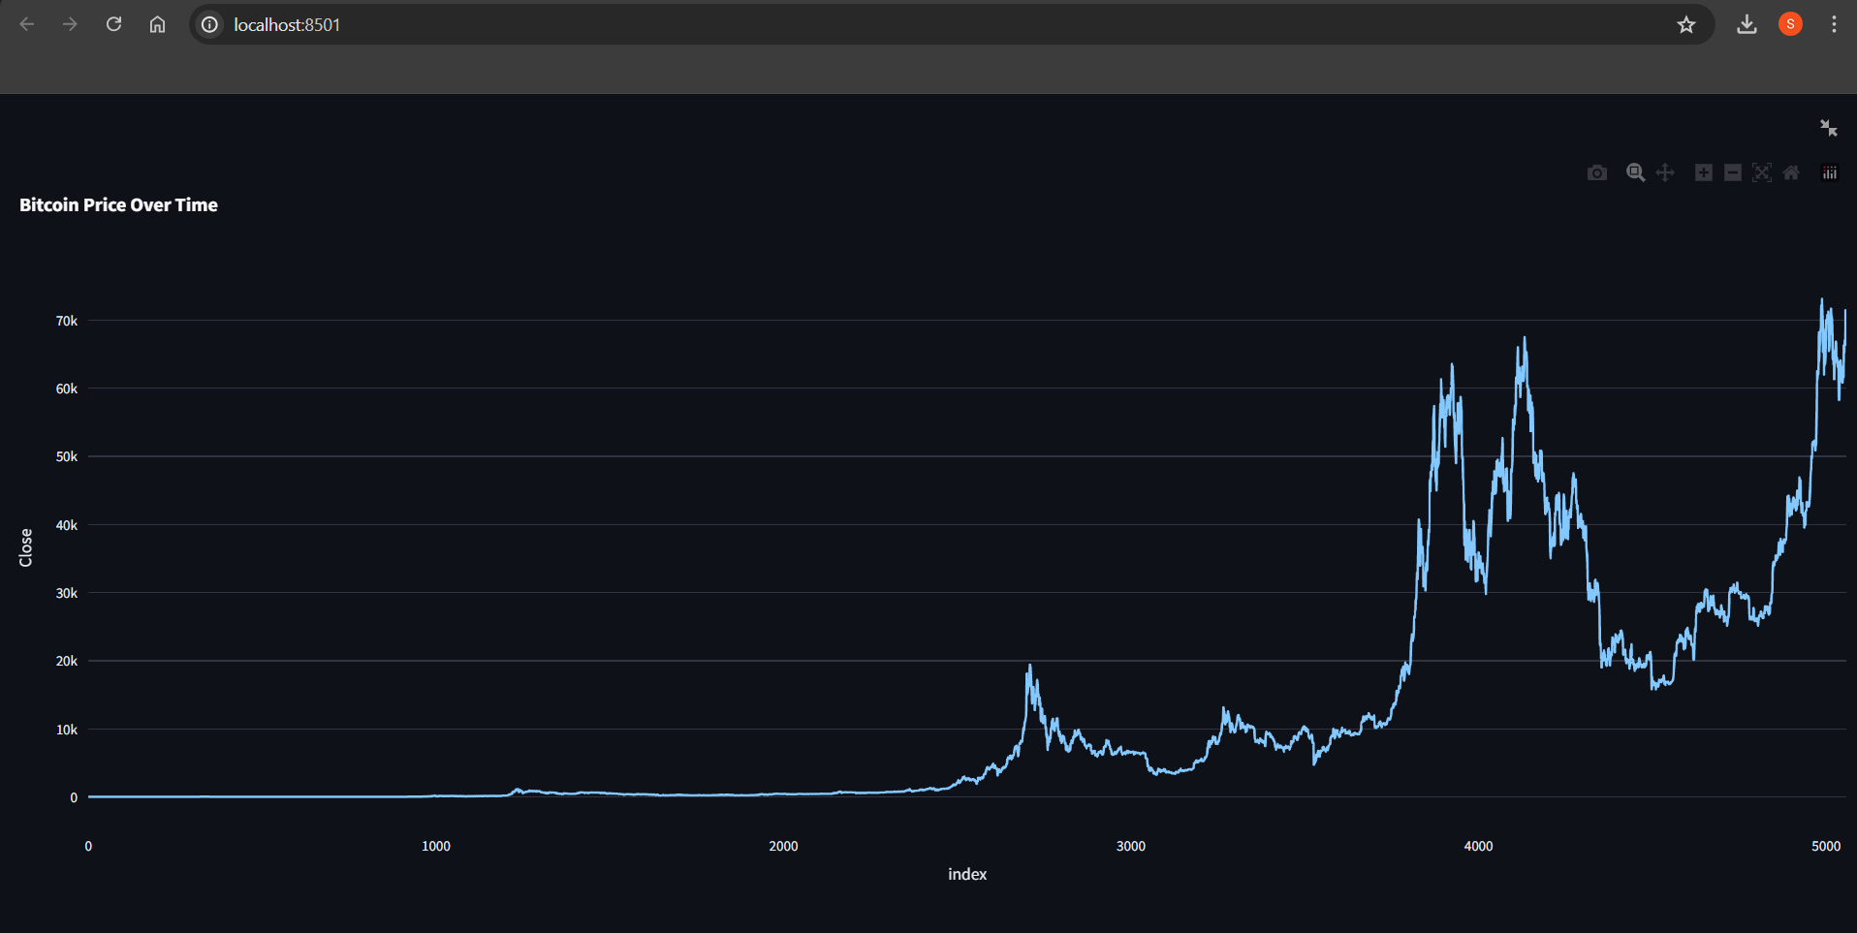
Exploratory Data Analysis (EDA)
Techniques Used:
describe()
info()
head()
Visualizations:
Closing Price Graph

Slide 8
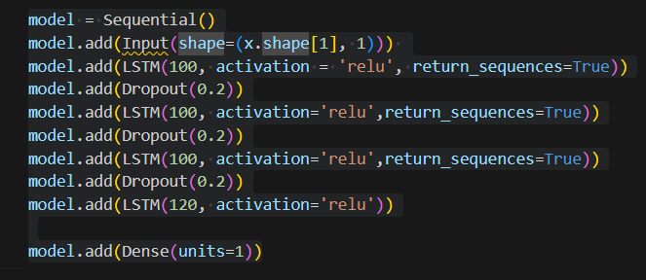
Model Development
Architecture: LSTM Model
Layers:
Input Layer
LSTM Layers
Dropout Layers
Dense Layer
Activation Function: ReLU

Slide 9
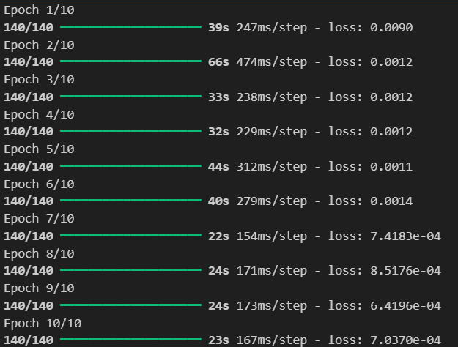
Model Training and Evaluation
Training: Using Adam Optimizer and Mean Squared Error Loss
Evaluation Metrics:
Mean Squared Error (MSE)
Mean Absolute Error (MAE)

Slide 10
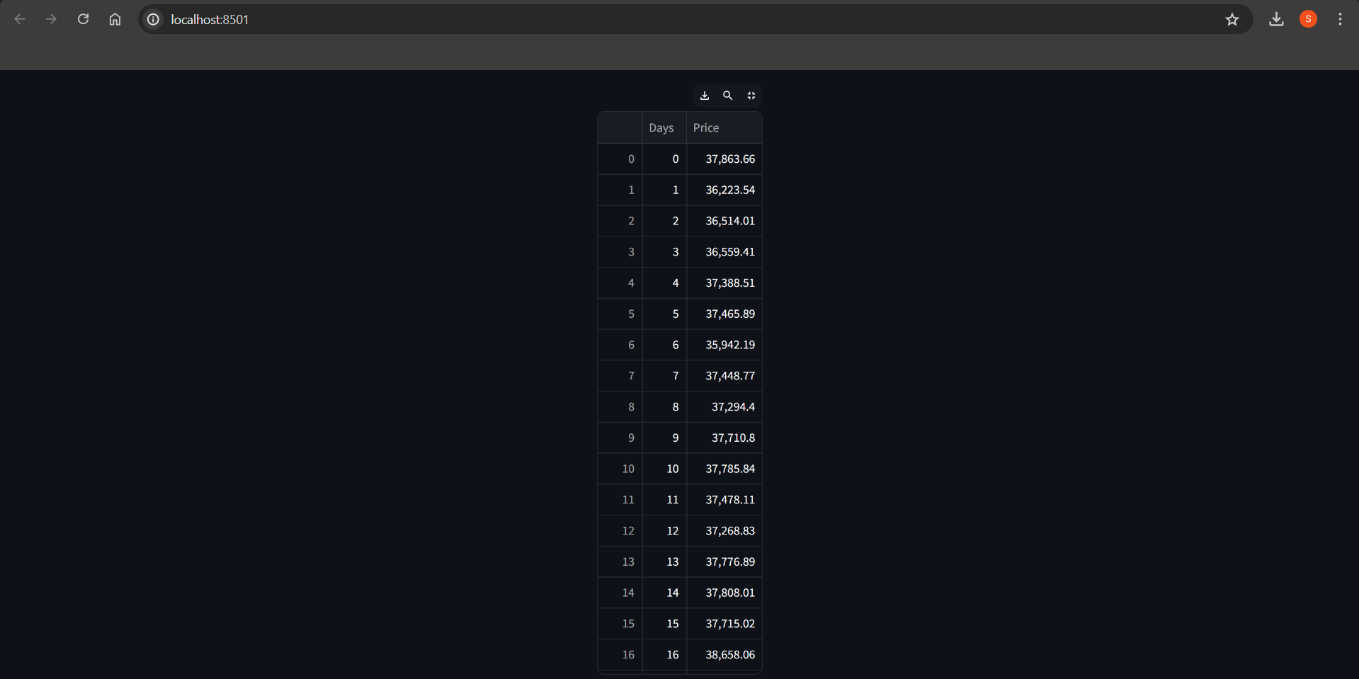
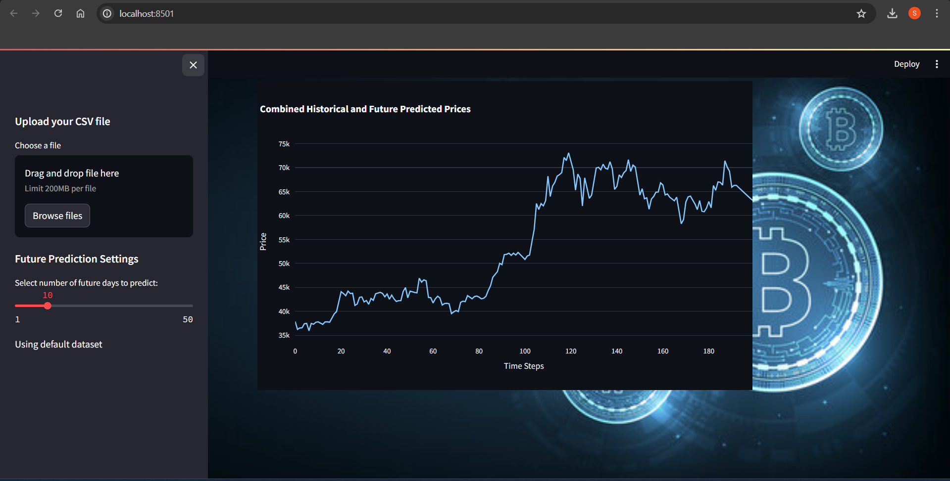
Results and Deployment
Prediction Accuracy
Graphs and Visualizations: Predictions vs Actual Prices
Deployment Platform: Streamlit
Features: Real-time Prediction, User Interface for Data Upload

Slide 11
Future Enhancements
Improving Model Accuracy
Incorporating More Features
Expanding to Other Cryptocurrencies

Slide 12
Conclusion
Summary of Findings:
The LSTM model effectively predicted Bitcoin prices with high accuracy.
Data preprocessing and EDA significantly improved model performance.
Impact of the Project:
Provides a valuable tool for predicting Bitcoin price trends.
Streamlit integration enables real-time predictions and user interaction.
Acknowledgments:
Thanks to mentors and colleagues at Pragyan SmartAI Technology LLP.
Appreciation for the data sources and tools used in the project.

