Slide 1
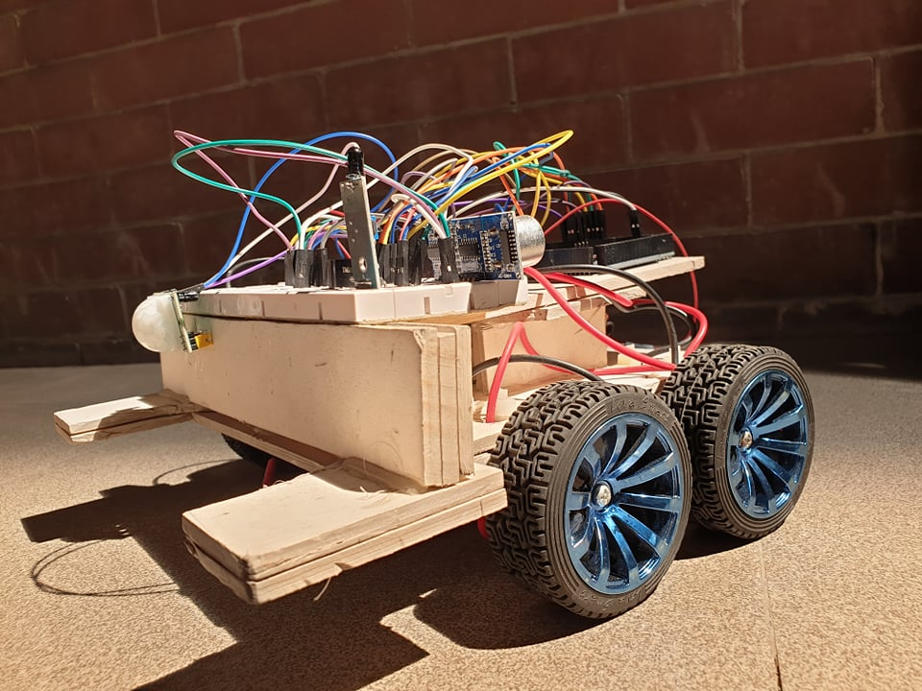
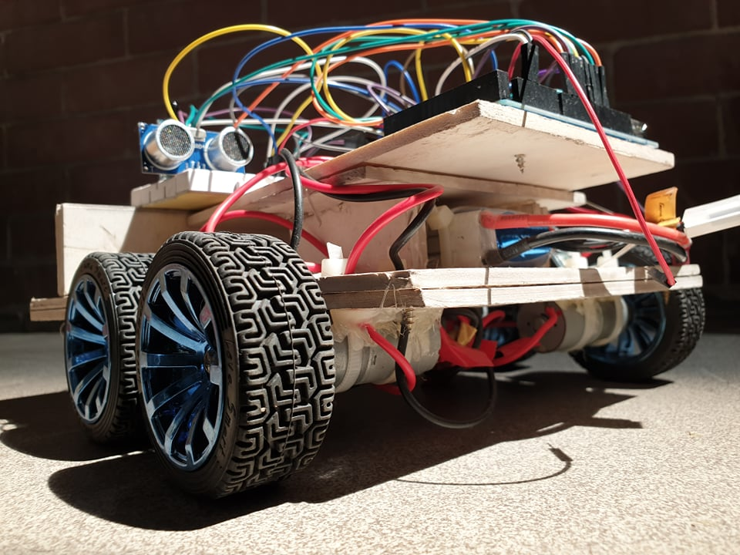
Rescue Assisting Robot
Put Your Logo

Slide 2
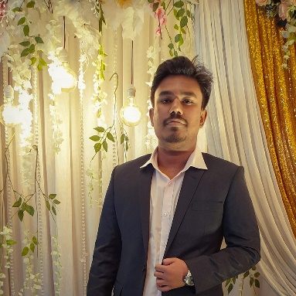
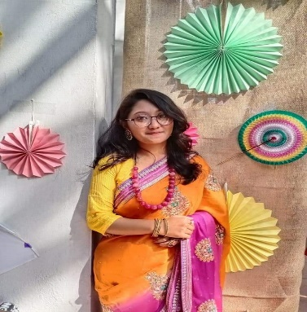
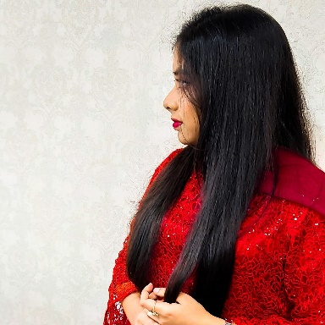
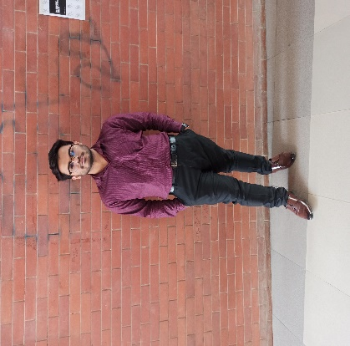
Meet The Team
Sanjay Kumar Mandal
Zamia Mostafiz
Salsabeel Noor Azmi
Neloy Barman
ID: 180204039
ID: 170204041
ID: 180204037
ID: 180204053
2

Slide 3
Objectives
Easily Usable in
Unknown
Environment
Easy controls
Assist Rescuers
Simple Structure
Multifunctional
03

Slide 4
What our Robot Brings to society?
Remote Access
Our bot will be controlled by Bluetooth module so unwanted accidents will less likely occur.
Design
Simple design, easily fixable, less pollution waste.
Human life
Helps to safe human lives in adverse situation
Assisting Firefighters
Would be very helpful to the rescuers.
Economical
Made with affordable hardwares.
04

Slide 5
Required Components
Arduino Mega 2560 R3
Lipo Battery 2000 mAh
Gear Motor
Blue Wheel
Flame Sensor
Ultrasonic Sonar Sensor
PIR Motion Sensor
Buzzer
Jumper Wires, Glue gun etc.
Bluetooth Module
Dual Motor driver
5

Slide 6
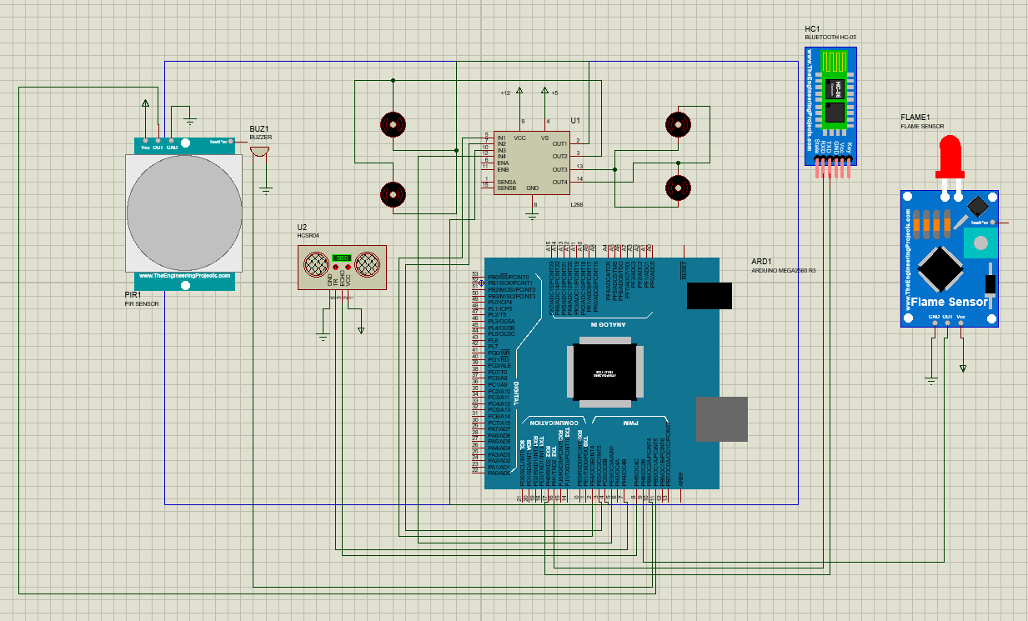
Working Procedure
Fire detection
Detecting motion
Remote controller
Data shown in terminal
Distance Measurement
6

Slide 7
Budget comparison
Equipment | Base Price | Quantity | Initial Budget (Tk) | Final Expenditure (TK)
Arduino Mega 2560 R3 | 1200 | 1 | 1200 | 1300
Lipo Battery 200 mAh | 2100 | 1 | 2100 | 2100
Bluetooth Module | 360 | 1 | 360 | 399
L298N H Bridge Dual Motor Driver | 175 | 2 | 350 | 350
Gear Motor 400 RPM | 480 | 4 | 1920 | 1920
Blue Wheel | 250 | 4 | 1000 | 1000
Mini air pump motor | 590 | 1 | 590 | 0
T plug Male & Female connectors | 38 | 1 | 38 | 38
B3 2s 3s Lip Battery Charger | 380 | 1 | 380 | 380
Flame Sensor | 88 | 3 | 264 | 88
Buzzer | 15 | 1 | 15 | 15
PIR Motion Sensor | 100 | 1 | 0 | 100
ESP32-CAM WIFI + Bluetooth Camera Module | 1200 | 1 | 1200 | 0
HC-SR04 Ultrasonic Sonar Sensor | 75 | 1 | 75 | 100
Zip ties | 230 | As required | 230 | 230
Jumper Wires Male to Male | 90 | As required | 90 | 90
Glue Stick | 10 | 1 | 10 | 30
Glue Gun | 380 | 1 | 380 | 350
Total |  |  | 10,202 | 8,490
7

Slide 8
Contribution of team-members
Sanjay Kumar Mandal : 25%
Salsabeel Noor Azmi : 25%
Neloy Barman : 25%
Zamia Mostafiz : 25%
8

Slide 9
Challenges
Exceeding budget
PIR Sensor as a replacement
No relevancy of pump motor
Calibration of motion sensor
Collaboration of team-members
9

Slide 10
Conclusion
Assistance in rescue efforts
Slight diversion of plan
Implementation of unfinished features
Compaction of size
10

Slide 11
“ THANKS FOR WATCHING
THIS PRESENTATION
ANY QUESTIONS?”
11

