Slide 1













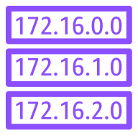


www.example.com
Client
example.com
AWS Cloud
Route53 DNS
AWS WAF
AWS CloudFront
AWS Certificate Manager (ACM)
Availability Zone us-east-1a
Availability Zone us-east-1b
Elastic Load Balancer
Public Subnet
AutoScaling Group (Web tier)
Public Subnet
Security Group
NAT
Gateway
EC2 Instance
Web Server
EC2 Instance
Web Server
NAT
Gateway
Elastic Load Balancer
Private Subnet
AutoScaling Group (App tier)
Private Subnet
Security Group
EC2 Instance
App Server
EC2 Instance
App Server
Private Subnet
Private Subnet
Security Group
Amazon Aurora
(Primary DB)
Amazon Aurora
(Read Replica)

