Slide 1
Capstone Project - 2 NYC Taxi Trip Duration Prediction Team Members Akanksha Agarwal, Saurabh Funde Ganeshkumar Patel, Yaman Saini Sanjay Kumar Data Science Trainee, AlmaBetter, Bangalore

Slide 2
Contents:
1. Introduction 2. Defining Problem Statement 3. Data Preparation 3.1 Data Exploration 3.2 Data Processing 3.3 Feature Engineering 3.4 EDA 4. Preparing Dataset For Modeling 4.1 Feature Selection 4.2 Categorical Feature Encoding 4.3 Applying Model 5. Model Metrics Evaluation 6. Conclusion
7. Challenges

Slide 3
Introduction:
New York City is one of the highly advanced cities of the world with extensive use of taxi services. The city taxi rides constitutes the core of the traffic in the city of New York. The rides taken everyday by many New Yorkers in the lively city can give us a good grasp of traffic times, road blockages, and so on. With ridesharing apps becoming more and more prevalent, it is increasingly significant for taxi companies to provide visibility to their estimated ride duration, since the competing apps bestow these metrics upfront.
Problem Statement The main aim is to build a model that predicts the total ride duration of taxi trips in New York City. The primary dataset is one released by the NYC Taxi and Limousine Commission, which includes pickup time, geo-coordinates, number of passengers, and several other variables.

Slide 4
Dataset Features:
Independent Features : ● id - A unique identifier for each trip. ● vendor_id - A code indicating the provider associated with the trip record. ● pickup_datetime - Date and time when the meter was engaged. ● dropoff_datetime - Date and time when the meter was disengaged. ● passenger_count - The number of passengers in the vehicle. (driver entered value) ● pickup_longitude - The longitude where the meter was engaged. ● pickup_latitude - The latitude where the meter was engaged. ● dropoff_longitude - The longitude where the meter was disengaged. ● dropoff_latitude - The latitude where the meter was disengaged. ● store_and_fwd_flag - This flag indicates whether the trip record was held in vehicle memory before sending to the vendor because the vehicle did not have a connection to the server - Y=store and forward; N=not a store and forward trip Target Feature : ● trip_duration - duration of the trip in seconds

Slide 5
Summary of Dataset:
Summarize the data by identifying key characteristics, such as data volume and total number of variables in the data.
There are 1458644 observations and 11 available features
Understand the problems with the data, such as missing values, inaccuracies, and outliers
There are no null values and duplicate data.

Slide 6
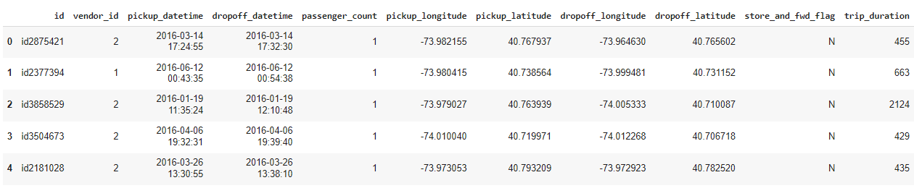
Data Overview

Slide 7
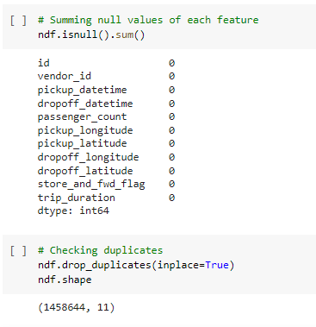
Data Info

Slide 8
Feature Creation:
We have created the following features:
● pickup_day_name which contains the name of the day on which the ride was taken.
● pickup_hour with an hour of the day in the 24 - hour format.
● pickup_month with month number as January = 1 and December = 12.
● Distance from geographical coordinates.
● distance in kms

Slide 9
Feature Engineering:
We have created the following features :
Pickup day & Dropoff day : Contains the name of the weekdays.
Pickup day no & Dropoff day no: Convert weekday into number start at Monday = 0 and end at Sunday = 6.
Pickup hour & Dropoff hour : Extracting hour.
Pickup month & Dropoff month : Extract month in number
Distance : Calculate the distance with the help of latitude and longitude (km).
Speed : Calculated speed distance/trip duration (km/hr).
Day part : Dividing 24 hours into four parts

Slide 10
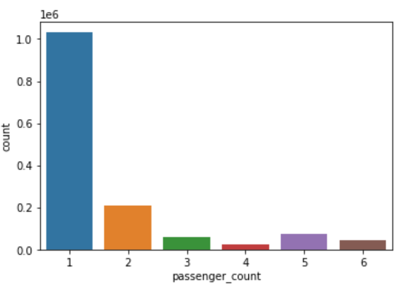
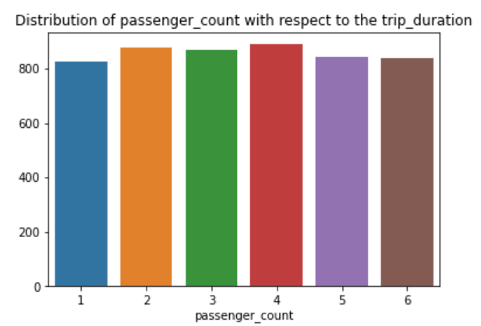
Passenger Count Analysis:
Passenger : It is evident that most of the trips was taken by single passenger and that is inline with our day to day observations.

Slide 11
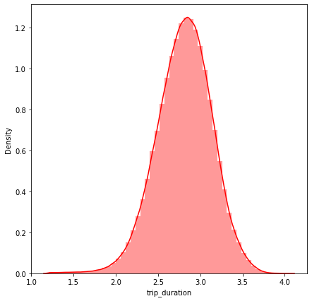
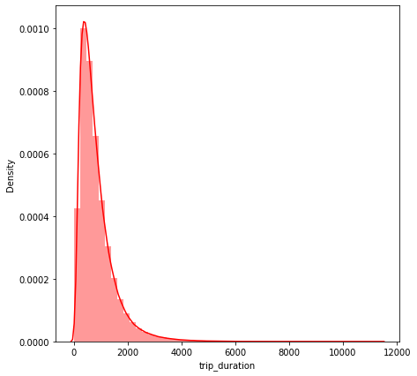
Trip Duration:
There are some durations with as low as 1 second which points towards trips with 0 km distance. Major trip durations took between 10-20 minutes to complete

Slide 12
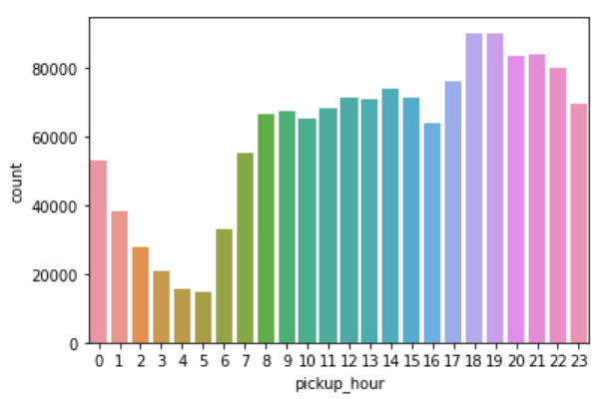
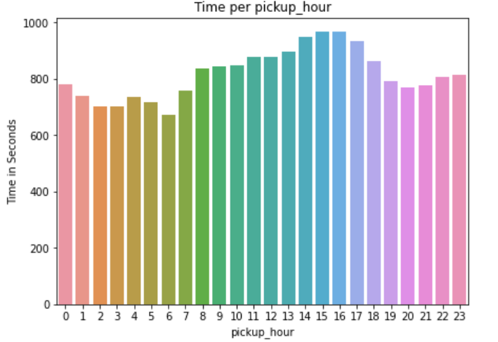
Trips per Hours:
The plot consist of the distribution of the pickups across the 24 hour time scale. It's inline with the general trend of taxi pickups which starts increasing from 6AM in the morning and then declines from late evening i.e. around 8 PM.

Slide 13
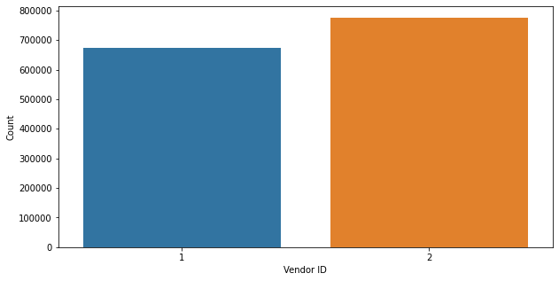
Vendors:
There are 2 vendors serve in this NYC taxi record and not much difference between the trips taken by both vendors.
Vendors 1 - 678342
Vendors 2 - 780302

Slide 14
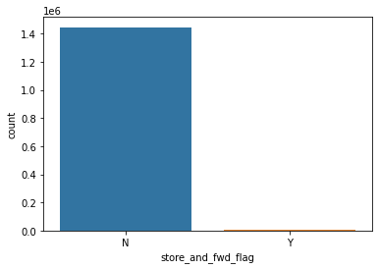
Store and fwd flag distribution:
Trip durations scale is less for the trips where the flag is set i.e. the trip details are stored before sending it to the server. Trip duration is longer for the trips where the flag is not set.

Slide 15
Model Building

Slide 16
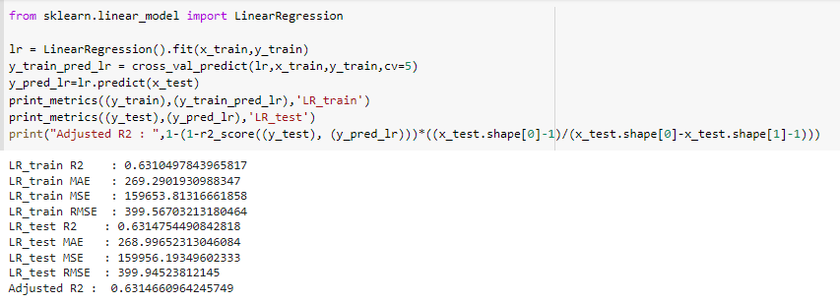
Linear Regression

Slide 17
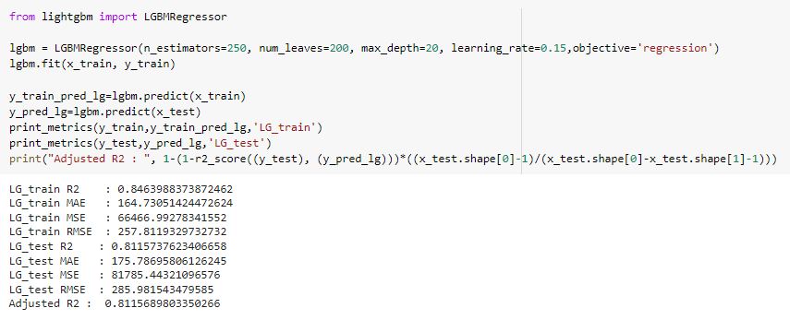
LGBM Regression

Slide 18
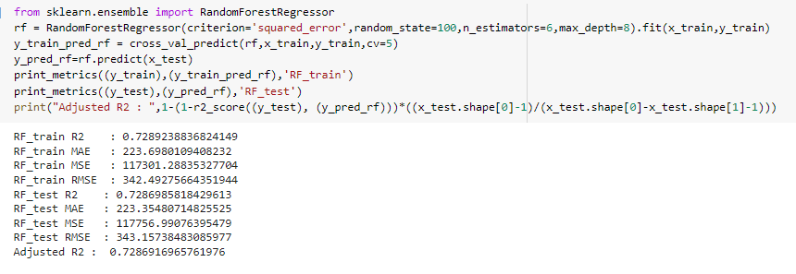
Random Forest

Slide 19
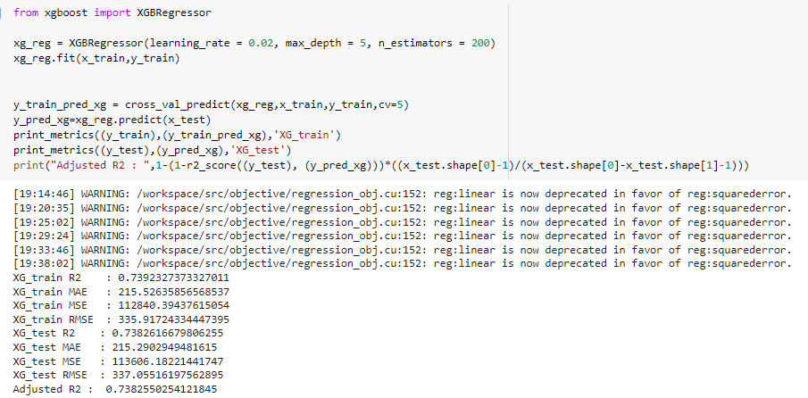
XGBoost Regressor

Slide 20
Model Evaluations:
Training Model | Train MAE | Test MAE | Train MSE | Test MSE | Train RMSE | Test RMSE | Train R2 | Test R2 | Adjusted R2
Linear Regression | 269.2901 | 268.9965 | 159653.8131 | 159956.1934 | 399.5670 | 399.9452 | 0.6310 | 0.6314 | 0.6314
Random Forest Regressor | 223.6980 | 223.3548 | 117301.2883 | 117756.9907 | 342.4927 | 343.1573 | 0.7289 | 0.7286 | 0.7286
LGBM Regressor | 164.7305 | 175.7869 | 66466.9927 | 81785.4432 | 257.8119 | 285.9815 | 0.8463 | 0.8115 | 0.8115
XGB Regressor | 215.5263 | 215.2902 | 112840.3943 | 113606.1822 | 335.9172 | 337.0551 | 0.7392 | 0.7382 | 0.7382

Slide 21
Conclusion:
● For Linear regression model, MSE and RMSE for training and testing are
similar but has very poor R2 for training and testing data.
● Random Forest Regressor R2 increases, but not with significant amount.
● We can see that MSE and RMSE of XGB Regressor model are not
varying much during training and testing time. Also the R2 is almost same for
training and testing time.
● RMSE of LGBM Regressor model are very similar and their R2 is above 81%
for training and test data.
● From above table, we can conclude LGBM Regressor is best model for our
dataset.

Slide 22
Challenges:
● Large dataset to handle.
● Need to Remove outliers
● Carefully handled feature selection part as it affects the R2 score.
● Carefully tuned Hyperparameters as it affects the R2 score.

Slide 23
Thank you

