Slide 1
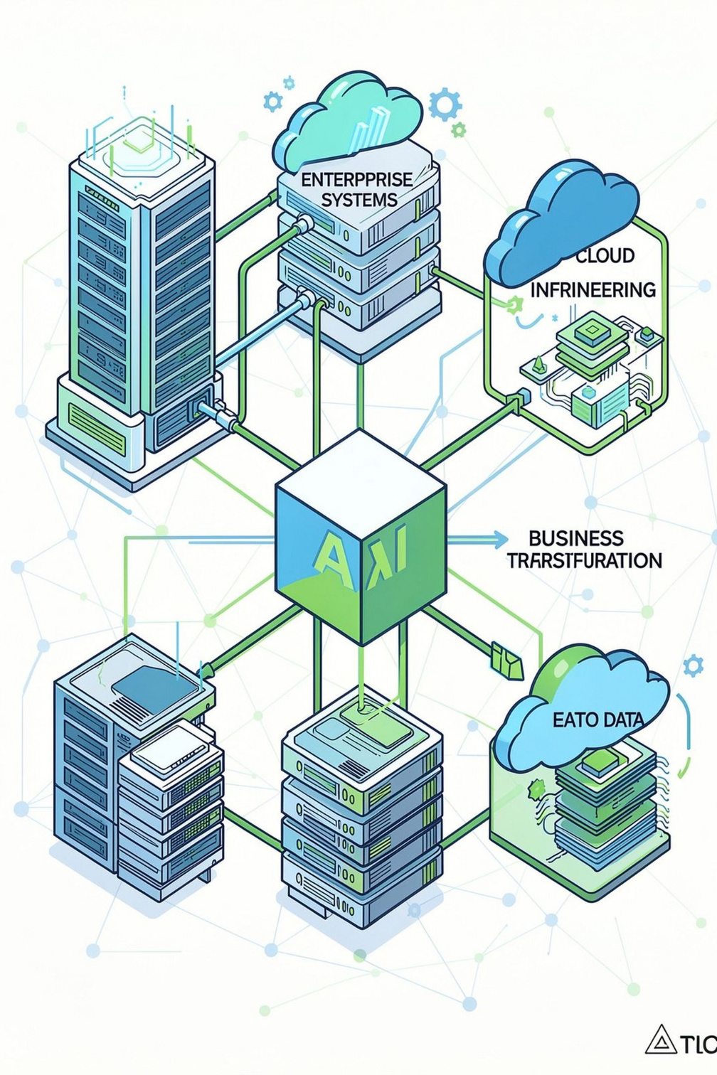
CEI – AI Engineering & Enterprise AI Transformation
CEI designs, builds, and operationalizes production-grade AI to help enterprises move from strategy and experimentation to reliable, measurable business outcomes. We integrate AI into mission-critical platforms, enterprise data and applications, and operational workflows with an emphasis on secure, scalable, governed, cloud-native, and highly reliable AI.
Company Snapshot
Founded: 1992
HQ: Pittsburgh, PA, USA
Industry: IT Services & Consulting
Website: cei.ai
Experience: 30+ years enterprise transformation

Slide 2
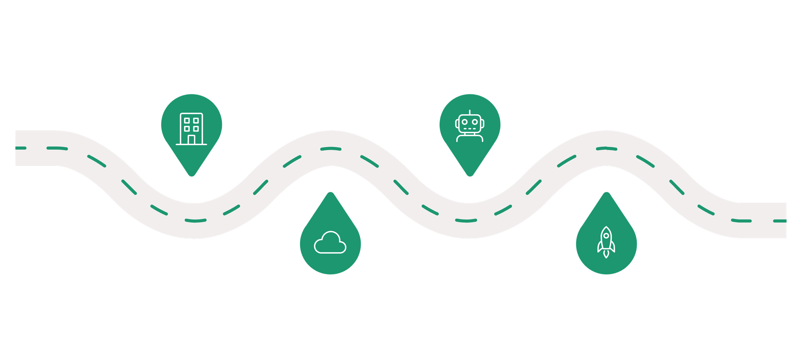
From Enterprise IT to an AI-First Company
CEI evolved from classic enterprise technology and software services into an AI-first engineering organization. The company now embeds AI into operating models — moving beyond pilots into production-grade engineering, operations, and continuous optimization.
AI Transformation
1992 Foundation
Enterprise IT, consulting, software
Generative AI, automation, governance
AI-First Enterprise
Growth & Digital
App dev, modernization, cloud, DevOps
Strategy → engineering → production → ops
Timeline stages highlight how CEI layered modern cloud, data and DevOps capabilities to enable enterprise-scale AI: Strategy → Engineering → Production → Operations → Continuous Optimization.

Slide 3
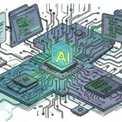
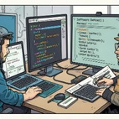
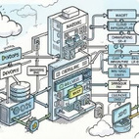
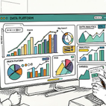
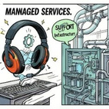
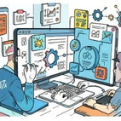
CEI's Core Services
An integrated portfolio to deliver end-to-end enterprise AI transformation — from strategy and engineering to managed operations and continuous improvement.
AI Engineering
Software Engineering
Cloud & DevOps
Data & Analytics
Enterprise AI, generative and agentic AI, automation, AI strategy and production engineering.
Cloud transformation, infrastructure, DevOps, integration and modernization.
Enterprise data management, BI, big data platforms and analytics.
Application development, modernization, maintenance, web & mobile, Java and open-source engineering.
Managed Services
Digital Transformation
IT and application managed services, infrastructure support, operational excellence.
Digital strategy, agile transformation, UX/visual design, enterprise information management.

Slide 4


CEI's Enterprise AI Solutions
Three complementary, integrated solutions that move organizations from validated use cases to autonomous operations.
CLAIRVOYANCE™ — Prove AI Value Before You Scale
DARTS™ — Automate the Engineering Lifecycle
PRISM™ — Transform IT from Reactive to Proactive
Agentic use-case framework that identifies high-value AI opportunities and maps them to measurable business goals. Uses a focused 40-hour Proof of Value workshop to validate ROI before scaling.
Spec-to-code framework that converts business requirements into validated software. Leverages agentic AI for development, automated testing, and governance to accelerate delivery.
AI-native managed services and AI-driven IT operations for predictive detection, remediation, and self-healing operations to support continuous performance and reliability.
CLAIRVOYANCE → DARTS → PRISM
Use Case Validation → Intelligent Engineering → Autonomous Operations

Slide 5

From AI Pilot to Production
CEI’s end-to-end process ensures models become operational capabilities embedded in enterprise systems and workflows.
Business Goal
AI Strategy
Data & Systems
AI Engineering
CEI addresses common enterprise barriers — legacy systems, fragmented data, ERP/CRM integration, security & compliance, governance, monitoring, reliability, and scalability — while preserving human oversight.
Key principles: Secure | Governed | Scalable | Observable | Measurable

Slide 6
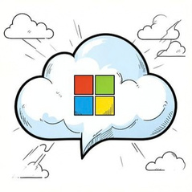


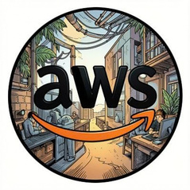
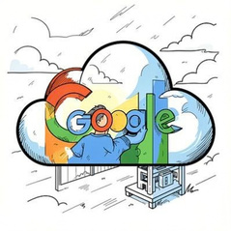


Technology Ecosystem & Enterprise Impact
Technology Ecosystem
Business Impact
CEI integrates AI into existing enterprise platforms and hybrid clouds — partnering across cloud, security, development, and SaaS ecosystems.
30+ Years
30–90%
Enterprise Transformation
Automation Gains
Decades of experience delivering enterprise-scale technology projects.
Range of automation achievable across service lines depending on use case and scope.
30–50%
5–7×
Operational Cost Reduction
Faster Delivery & Decisions
Typical operational efficiency improvements from automation and modernization.
Accelerated time-to-value through AI-enabled engineering and automation.
CEI emphasizes ROI-focused transformation, faster time to value, improved operational efficiency, responsible AI practices, and enterprise-scale deployments.
Integrations: ERP, CRM, ServiceNow, Hybrid Cloud, Enterprise Data platforms.

Slide 7




CEI – Building the AI-Ready Enterprise
CEI combines long-standing enterprise technology experience with modern AI engineering to help organizations shift from experimentation to reliable, scalable, and measurable enterprise AI.
AI Engineering
Agentic AI & Automation
Build production-grade models and pipelines integrated with enterprise systems.
Use agentic and automation frameworks to accelerate engineering and operations.
Cloud & Data
AI Governance
Hybrid cloud and enterprise data integration underpin scalable deployments.
Embed security, compliance, monitoring, and human oversight into every stage.
Key takeaways: AI integrated into workflows; focus on production and measurable outcomes; emphasis on security, governance and observability; combined expertise in technology, engineering and operations to deliver enterprise transformation.
“From AI Potential to Enterprise Performance.”
CEI | cei.ai

