Slide 1
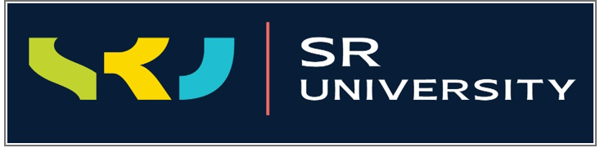

AI & ML PROJECT ON
SIGN LANGUAGE RECOGNITION
UNDER THE GUIDANCE OF
Dr .Arpita Baronia
School of Computer Science & Artificial Intelligence
SR University
LIMITATIONS
MODULES
CONCLUSION
WORKING
MODULES
INTRODUCTION

Slide 2
AGENDA:
INTRODUCTION
MODULES
HARDWARE AND SOFTWARE
LIMITATIONS
MODULES
CONCLUSION
WORKING
MODULES
INTRODUCTION
METHODOLOGY AND FLOW CHART
RESULT SCREEN
CONCLUSION

Slide 3
Speech impaired people use hand signs and gestures to communicate. Sign language is the only tool of communication for the person who is not able to speak and hear anything. Normal people face difficulty in understanding their language. It bridges the gap between physically challenged people and normal people. With the help of computer vision and neural networks we can detect the signs and give the respective text output
LIMITATIONS
MODULES
CONCLUSION
WORKING
MODULES
INTRODUCTION

Slide 4
TENSORFLOW
2.0.0
TensorFlow serves as a core platform and library for machine learning. TensorFlow's APIs use Keras to allow users to make their own machine learning models. In addition to building and training their model, TensorFlow can also help load the data to train the model, and deploy it using TensorFlow Serving. TensorFlow allows you to create dataflow graphs that describe how data moves through a graph. The graph consists of nodes that represent a mathematical operation. A connection or edge between nodes is a multidimensional data array.
INTRODUCTION
CONCLUSION
MODULES
LIMITATIONS
WORKING
MODULES

Slide 5
KERAS
2.1.1
Keras is a high-level, deep learning API developed by Google for implementing neural networks. It is written in Python and is used to make the implementation of neural networks easy. It also supports multiple backend neural network computation. Keras allows you to switch between different back ends. TensorFlow has adopted Keras as its official high-level API. Keras is embedded in TensorFlow and can be used to perform deep learning fast as it provides inbuilt modules for all neural network computations.
MODULES
MODULES
WORKING
CONCLUSION
INTRODUCTION
LIMITATIONS

Slide 6
OpenCV
4.5.6.7
OpenCV is a Python library that allows you to perform image processing and computer vision tasks. It provides a wide range of features, including object detection, face recognition, and tracking. Using OpenCV it becomes easy to do complex tasks such as identify and recognise faces, identify objects, classify human actions in videos, track camera movements, track moving objects, extract 3D object models, generate 3D point clouds from stereo cameras, stitch images together to generate an entire scene with a high resolution image and many more.
MODULES
CONCLUSION
INTRODUCTION
LIMITATIONS
WORKING
MODULES

Slide 7
NUMPY
1.15.0
NumPy is a Python library used for working with arrays.
It also has functions for working in domain of linear algebra, fourier transform, and matrices. NumPy stands for Numerical Python. Pandas depend upon Numpy for implementing many data objects like data frames or series. Pandas make use of Numpy for data analysis.
MODULES
CONCLUSION
MODULES
LIMITATIONS
WORKING
INTRODUCTION

Slide 8
IMAGE AQUISTION : Extracting image from the Source.
01
02
SEGMENTATION: Separating signs from captured Image.
03
PRE-PROCESSING: Each Picture frame is Preprocessed to eliminate noise and apply Filters to Enhance image
into Gaussian before Morphological Transform.
04
RECOGNITION: Using Classifier(CNN), The Data will be classified and recognized.
WORKING
MODULES
LIMITATIONS
INTRODUCTION
CONCLUSION
MODULES
05
TEXT OUTPUT: Understanding human behavior and identifying various postures and body movements, as well as translating them into text.

Slide 9
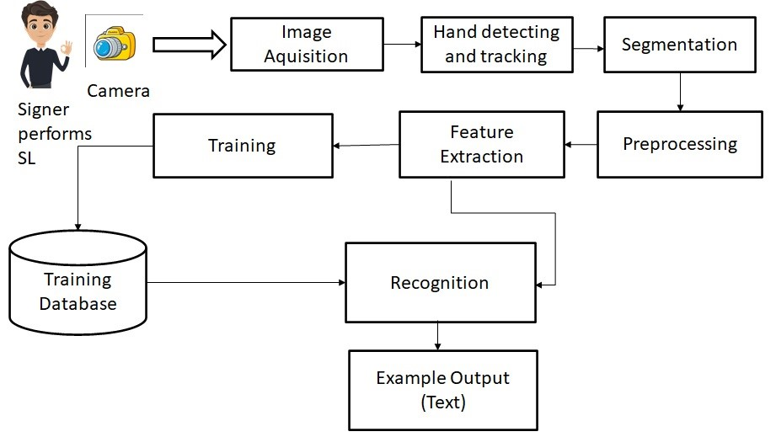
LIMITATIONS
MODULES
CONCLUSION
WORKING
INTRODUCTION
MODULES

Slide 10
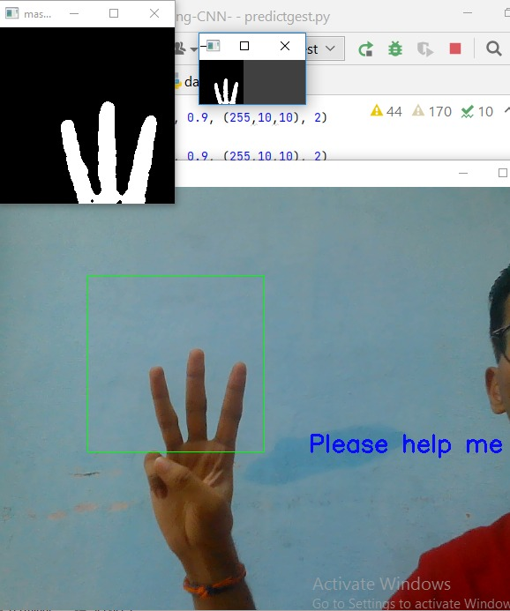
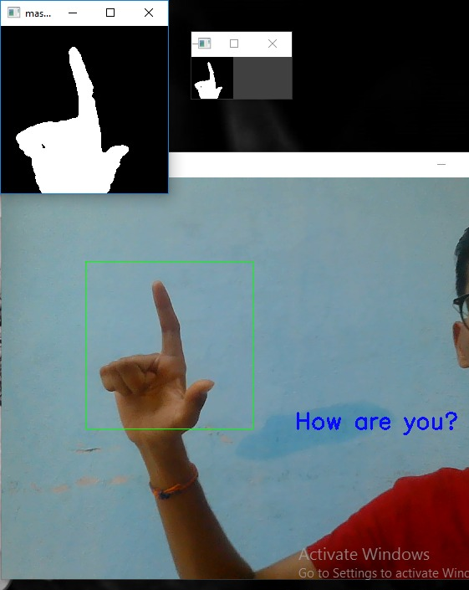
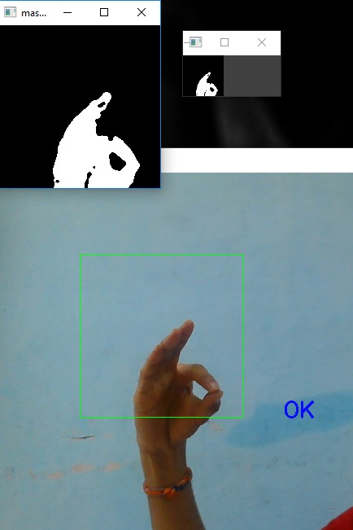
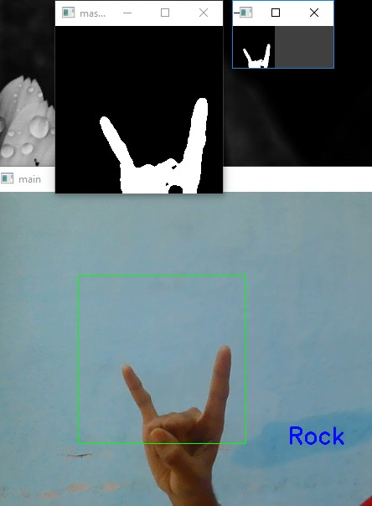
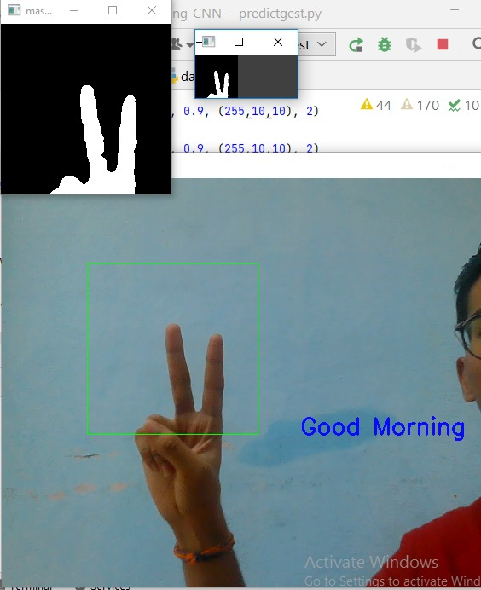
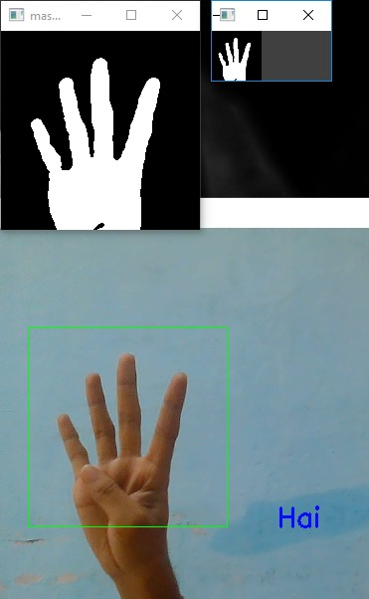
LIMITATIONS
MODULES
CONCLUSION
WORKING
INTRODUCTION
MODULES

Slide 11



The model works well only in good lighting conditions.
Plain background is needed for the input to detect the
Model with good accuracy.
CONCLUSION
LIMITATIONS
MODULES
WORKING
MODULES
INTRODUCTION
Our Project Trained only 9 Gestures. So You cant expect your own Output.

Slide 12
Sign language recognition system is a powerful tool to prepare an expert knowledge and edge detect the combination of inaccurate information from different sources. The intend of convolution neural network is to get the appropriate classification. The proposed sign language recognition system used to recognize sign language gestures can be further extended to recognize facial expressions and can further be extended to convert the signs to speech.
teams
history
LIMITATIONS
timeline
CONCLUSION
INTRODUCTION

Slide 13
REFERENCES:
[1]https://www.itmconferences.org/articles/itmconf/pdf/2021/05/itmconf_icacc2021_03004.pdf
MODULES
CONCLUSION
LIMITATIONS
MODULES
WORKING
INTRODUCTION

Slide 14
PROJECT BY
NIKHIL
SANJAY
NAGANISHITH
VISHNU VARDHAN
ABHIRAM
2303A51LB0
2303A51LA4
2303A51L89
2303A51L87
2303A51L84
teams
history
LIMITATIONS
timeline
CONCLUSION
INTRODUCTION

