Slide 1


Workshop 6. Detecting genes under recent positive selection
Training course in data analysis for genomic surveillance of African malaria vectors
Module 1. AgamPrimer - Designing primers in Anopheles gambiae

Slide 2
Learning objectives
1. Explain what DNA primers are, and describe some of their applications.
2. Explain why it is important to consider SNPs when designing primers.
3. Design genomic DNA primers to target the Ace1-280S mutation.
4. Design RT-qPCR primers to measure gene expression of the cytochrome P450, Cyp9k1.

Slide 3
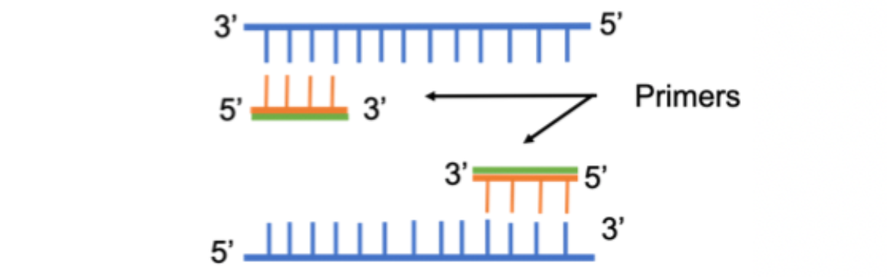
Recap - What are DNA primers?
A primer is a short strand nucleic acid that serves as a starting point for DNA synthesis
DNA polymerase (responsible for DNA replication) enzymes are only capable of adding nucleotides to the 3’-end of an existing nucleic acid, requiring a primer be bound to the template before the process can begin

Slide 4
Molecular biology applications
Endpoint PCR (Detection / Genotyping)
Real-time quantitative PCR (Detection / Genotyping / Gene expression)
      SYBR
      Locked Nucleic Acid (LNA)
      TaqMan
Cloning
Next generation sequencing
      Amplicon sequencing

Slide 5
Primer Design
Suitable primers are crucial to effective PCR reactions and must be designed to be robust, reliable and consistent across experimental conditions.
Size: 17-24 bases long
      This can vary depending on the application. Often, hybridisation probes are shorter. Shorter primers may be less specific, whereas longer primers may have a slower hybridisation rate.
Tm: An ideal melting temperature of 62°C, which is based on typical PCR conditions and the optimum temperature for PCR enzymes.
Ta: Annealing temperature no more than 5°C below the Tm of your primers.
GC content: Design your assay so that the GC content is 35–65%, with an ideal content of ~50%, which allows complexity while still maintaining a unique sequence.

Slide 6
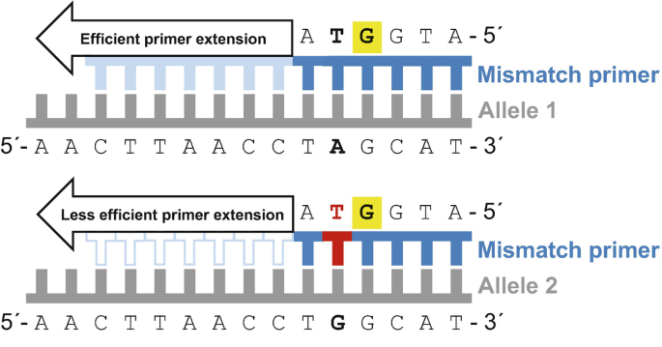
SNPs / Mismatches in primer binding sites
SNPs (mismatches) affect the Tm and stability of the primer-template duplex
And affects efficiency of primer extension
This can cause null alleles – I.e no amplification
Particularly problematic in pooled sample PCR

Slide 7
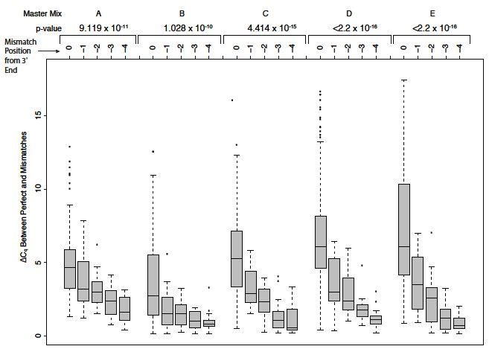
SNPs / Mismatches in primer binding sites
Primers may bind with unequal efficiency against different genetic variants
In quantitative assays (ie. qPCR), could lead to biases in abundance estimation
The effect depends on type of mismatch, and mismatch position (3’ is worse)
Mismatches at the terminal 3’ can affect Cq values as much as 5-7 cycles

Slide 8
Ag1000g
The Ag1000g resource has revealed extreme amounts of genetic variation in Anopheles gambiae s.l
You can find a SNP in less than every 2 bases of the accessible genome - which makes considering SNPs even more important when designing molecular assays
To maximise the accuracy of our data we should try to avoid SNPs

Slide 9
malariagen_data + primer3 = AgamPrimer
malariagen_data has made it easy to access Ag1000g data in the cloud
Primer3 is the most widely cited primer design program, and a python version primer3-py has recently been developed.
With AgamPrimer, we can use both together to design primers in An. gambiae s.l, whilst considering SNP variation in the primer binding sites
  Genomic DNA primers
  Complementary DNA primers (qPCR)
  Hybridisation probes

