Slide 1


Workshop 6. Detecting genes under recent positive selection
Training course in data analysis for genomic surveillance of African malaria vectors
Module 4. AgamPrimer - Designing primers in Anopheles gambiae
Notes:
Welcome to module 4, of workshop 6.
In the previous modules of workshop 6, we learnt how to discover candidate loci for insecticide resistance, using genome-wide selection scans (GWSS). In this module, we introduce a new python package AgamPrimer, which uses the malariagen_data API and a primer design package, primer3-py, to allow us to design primers and probes in Anopheles gambiae s.l.
We can then use these primers and probes to help us validate putative resistance loci. By integrating the malariagen_data API, AgamPrimer allows us to consider and avoid genetic variation in the Ag1000g resource during the design of our primers.

Slide 2
Learning objectives
1. Describe the principles of PCR, qPCR, and the role of primers.
2. Describe some of the applications of PCR in vector control
3. Explain why it is important to consider SNPs when designing primers.
4. Design genomic DNA primers to target the Ace1-280S mutation.
5. Design RT-qPCR primers to measure gene expression of the carboxylesterase, COEAE2F.
Notes:
At the end of this module, you will be able to:

Slide 3
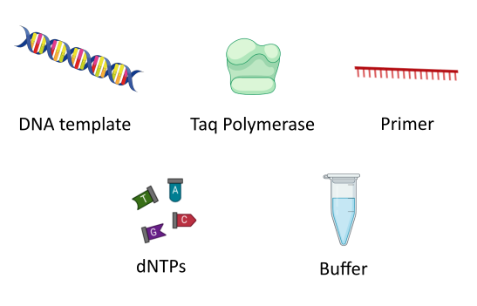
Introduction - What is PCR?
Polymerase chain reaction (PCR) is a technique used to "amplify" small segments of DNA.
Polymerase chain reaction (PCR) is a technique used to "amplify" small segments of DNA.
Ingredients
The DNA template to be copied
DNA nucleotide bases (A, C, G and T) (also known as dNTPs).
Taq polymerase enzyme to add in these new DNA bases and synthesise new DNA strands
Buffer to ensure the right conditions for the reaction
Primers, short stretches of DNA that initiate the PCR reaction, designed to bind to either side of the section of DNA you want to copy. DNA polymerase enzymes which perform DNA replication are only capable of adding nucleotides to the 3’-end of an existing nucleic acid, requiring a primer be bound to the template before the polymerase can begin a complementary strand.
Notes:
Before we jump into primer design, im just going to give a brief recap on PCR, qPCR, and some of their applications.
PCR is a technique used to "amplify" small segments of DNA. Using PCR it is possible to generate thousands to millions of copies of a particular section of DNA from a very small input amount. In the context of vector control, we can use PCR and qPCR to genotype vectors for specific alleles, determine species, identify bloodmeals, measure gene expression, and much more.
For any PCR reaction, we need the following ingredients:

Slide 4
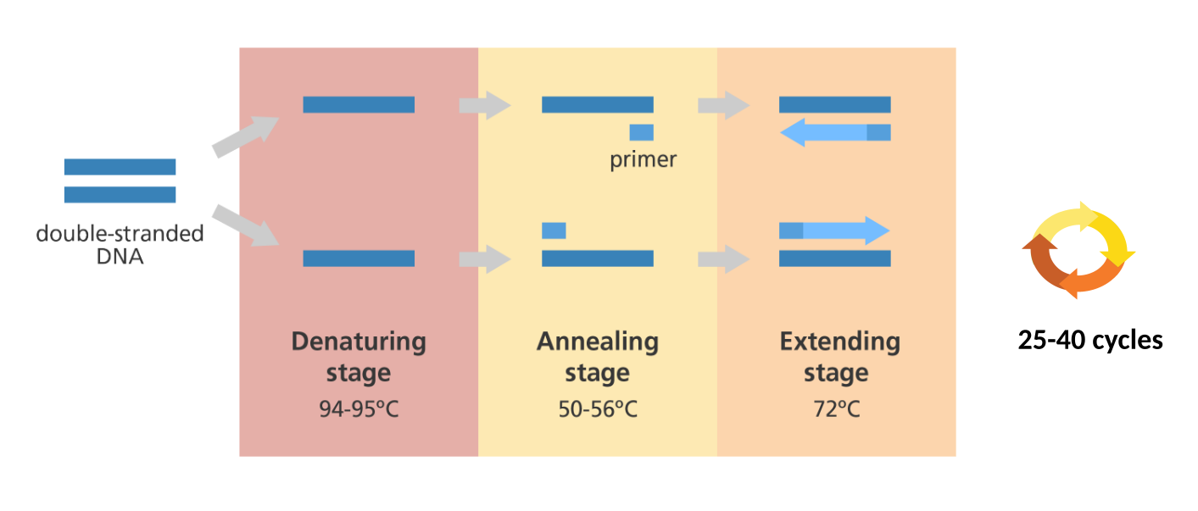

Introduction – The stages of PCR
There are three main stages:
Denaturing – when the double-stranded template DNA is heated to separate it into two single strands.
Annealing – when the temperature is lowered to enable the DNA primers to attach to the template DNA.
Extending – when the temperature is raised and the new strand of DNA is made by the Taq polymerase enzyme.
Polymerase chain reaction (PCR) is a technique used to "amplify" small segments of DNA.
Thermal Cycler
Notes:
A typical PCR reaction will have the following steps, which we will repeat for 25-40 cycles, in order to amplify our region of interest.
For this, we use a thermal cycler.

Slide 5
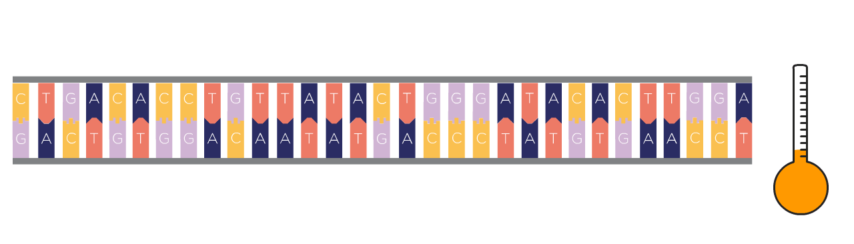
PCR - Denaturation
Heat the reaction to ~95°C to break apart the double stranded DNA template into single strands

Slide 6

PCR - Annealing
Lower the temperature to 50-56°C enable the DNA primers to attach to the single-stranded template DNA.

Slide 7

PCR - Extension
Taq polymerase
dNTPs
Raise the temperature to ~72°C and the new strand of DNA is synthesised by the Taq polymerase enzyme.
Taq polymerase is optimised for this temperature, as it was isolated from a thermophilic bacteria, Thermus aquaticus.
Notes:
We then repeat this process for 25-40 cycles – and after each cycle, the number of DNA molecules should approximately double

Slide 8
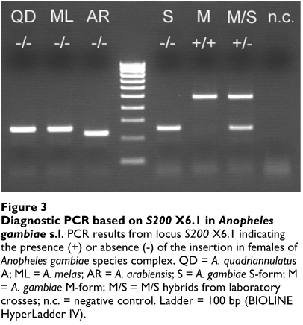
Standard PCR - Vector biology applications
Endpoint PCR (Detection / Genotyping)
e.g The SINE PCR species ID for
    An. gambiae s.l
e.g The 2la molecular assay
Santolamazza, F., Mancini, E., Simard, F. et al. Insertion polymorphisms of SINE200 retrotransposons within speciation islands of Anopheles gambiae molecular forms. Malar J 7, 163 (2008). https://doi.org/10.1186/1475-2875-7-163
Notes:
In standard PCR, we amplify specific regions of the genome and utilise the PCR product at the end of the reaction. This could be an endpoint PCR, where we run the PCR product on an agarose gel to determine the size of the amplicon.
Examples of this include the SINE PCR species ID assay, which can differentiate between members of the gambiae complex, based on a marker on the X chromosome, as seen in this Figure.
Another example is the 2la assay, which can karyotype individuals for the 2la inversion

Slide 9
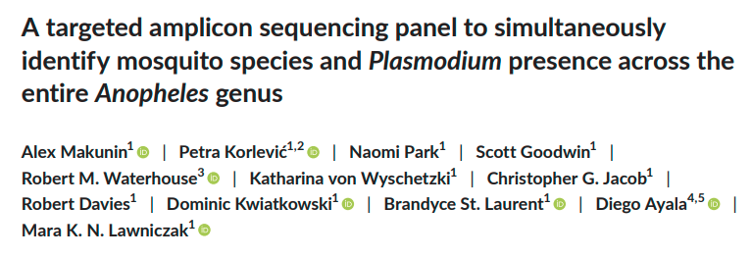
Standard PCR - Vector biology applications
Amplicon sequencing
We can multiplex primers to target multiple loci in the genome, and sequence the resulting amplicons
e.g ANOSPP, a species ID amplicon sequencing panel
Notes:
Alternatively, standard PCR can be used in amplicon sequencing to amplify specific regions of the genome prior to next-generation sequencing
An example of this, is ANOSPP, an amplicon sequencing panel which determines species within the entire *Anopheles* genus

Slide 10
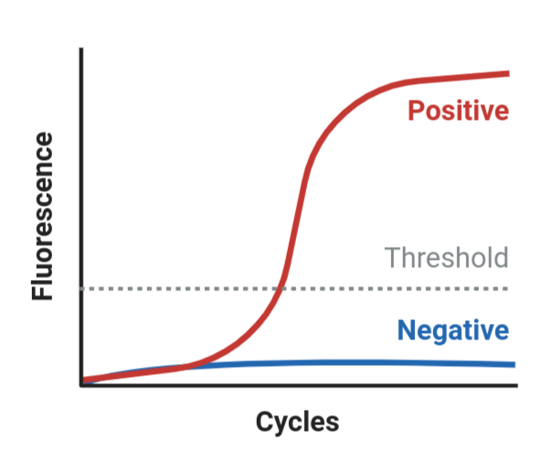
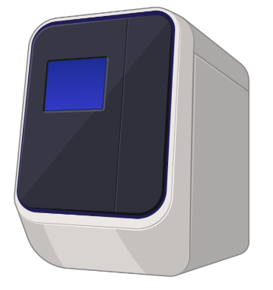
Introduction – quantitative PCR
The same concept as PCR, except we use either fluorescent dye or fluorescent hybridisation probes, and measure fluorescense in at each PCR cycle
Cq value
Real-time PCR machine
By measuring fluorescense and determining Cq values, we can determine the amount of DNA template that was in the original sample
Notes:
In quantitative PCR, the concept is the same as standard PCR, but we measure the amount of DNA in the reaction at each cycle. To do this, we use either a fluorescent dye or fluorescent hybridisation probes, which emit light as the DNA concentration increases. The number of cycles at which each sample passes a given threshold, is called the Cq or Ct value.
By measuring fluorescense and determining Cq values, we can determine the amount of DNA template that was in the original sample.

Slide 11

Introduction – quantitative PCR
Fluorescent dye – SYBR green
primer
Low fluorescence in solution when DNA concentration is low
High fluorescence when bound to double-stranded DNA when DNA concentration is high
Notes:
SYBR green is a fluorescent dye, which emits a fluorescent signal when bound to double stranded DNA.
When DNA concentration is low, few SYBR molecules are bound to the template, and so the fluorescence level is low
However, as the DNA concentration increases with each PCR cycle, more and more SYBR binds to the template, and high levels of fluorescense are emitted

Slide 12
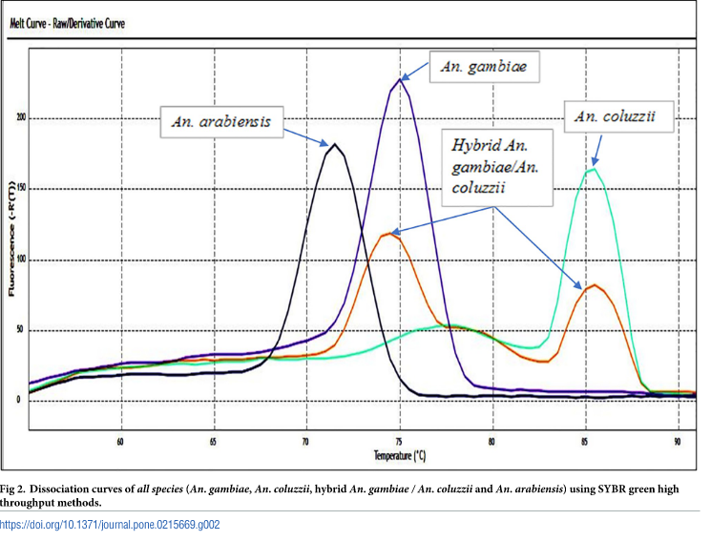
Vector biology applications
Real-time quantitative PCR (Detection / Genotyping / Gene expression)
      SYBR
e.g The SINE melt curve assay species ID for An. gambiae s.l
e.g standard RT-qPCR assays for measuring gene expression
Chabi J, Van’t Hof A, N’dri LK, Datsomor A, Okyere D, Njoroge H, et al. (2019) Rapid high throughput SYBR green assay for identifying the malaria vectors Anopheles arabiensis, Anopheles coluzzii and Anopheles gambiae s.s. Giles. PLoS ONE 14(4)
Notes:
Examples of this include the SINE melt curve assay for species ID, a highthroughput version of the SINE PCR assay
Or any standard qPCR gene expression assay

Slide 13
Introduction – quantitative PCR
Hybridisation probe – TaqMan/LNA
probe
primer
probe
Low fluorescence when probe bound to template
High fluorescence when probe is displaced by strand extension
Notes:
Hybridisation probes are short sequences, like primers, which bind to the DNA template. These can have flourophores attached, which emit fluorescence when the probe is displaced from the DNA template.

Slide 14

Vector biology applications
Real-time quantitative PCR (Detection / Genotyping / Gene expression)
      TaqMan
e.g TaqMan genotyping assays for Ace1, KDR etc
Notes:
Examples of this include TaqMan assays to detect the Ace1 mutation

Slide 15
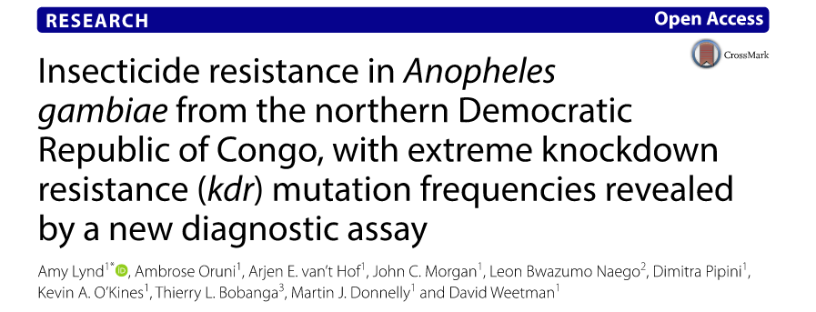
Vector biology applications
Real-time quantitative PCR (Detection / Genotyping / Gene expression)
      Locked Nucleic Acid (LNA)
e.g KDR LNA assay
Notes:
Or the Kdr LNA assay , which simultaneously genotypes the 995F and 995S vgsc mutations.

Slide 16
What is important to consider when designing primers?
Suitable primers are crucial to effective PCR reactions and must be designed to be robust, reliable and consistent across experimental conditions.
Size:
      17-24 bases long
      This can vary depending on the application. Often, TaqMan and LNA probes are shorter, as it helps to discriminate between SNPs.
Tm: the temperature at which the primer duplex dissociates into single strands.
      An ideal melting temperature of ~62°C
GC content: GC content between 35–70%, with an ideal content of ~50%.
Notes:
….
…
Primers should also be free of strong secondary structures and self-complementarity. Primer design algorithms, such as primer3, will take these considerations into account.

Slide 17

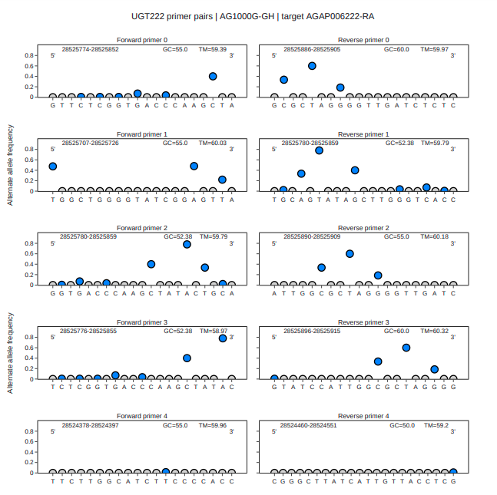
AgamPrimer - Designing primers in Anopheles gambiae
Sanjay C Nagi
Notes:
Welcome to module 4, of workshop 6.
In the previous modules of workshop 6, we learnt how to discover candidate loci for insecticide resistance, using genome-wide selection scans (GWSS). In this module, we introduce a new python package AgamPrimer, which uses the malariagen_data API and a primer design package, primer3-py, to allow us to design primers and probes in Anopheles gambiae s.l.
We can then use these primers and probes to help us validate putative resistance loci. By integrating the malariagen_data API, AgamPrimer allows us to consider and avoid genetic variation in the Ag1000g resource during the design of our primers.

Slide 18
What are primers in PCR?
Primers - short stretches of DNA that initiate the PCR reaction,
designed to bind to either side of the section of DNA you want to copy.
Notes:
Welcome to module 4, of workshop 6.
In the previous modules of workshop 6, we learnt how to discover candidate loci for insecticide resistance, using genome-wide selection scans (GWSS). In this module, we introduce a new python package AgamPrimer, which uses the malariagen_data API and a primer design package, primer3-py, to allow us to design primers and probes in Anopheles gambiae s.l.
We can then use these primers and probes to help us validate putative resistance loci. By integrating the malariagen_data API, AgamPrimer allows us to consider and avoid genetic variation in the Ag1000g resource during the design of our primers.

Slide 19
SNPs / Mismatches in primer binding sites
SNPs (mismatches) affect the Tm and stability of the primer-template duplex
And affects efficiency of primer extension
This can cause null alleles – I.e no amplification
Problematic
    Null heterozygotes appear as homozygotes
    In pooled assays we can never really know
Notes:
Single nucleotide polymorphisms (SNPs) in primer binding sites can affect both the stability and *Tm* of the primer-template duplex, as well as the efficiency with which DNA polymerases can extend the primer (Figure 2). In some cases, this can completely prevent primer binding and amplification of the template DNA, often referred to as null alleles.
Null alleles can become particular troublesome when performing PCR on pooled samples, where we may not observe whether all samples amplified successfully, and so we may not be sampling and observing the full range of alleles.

Slide 20
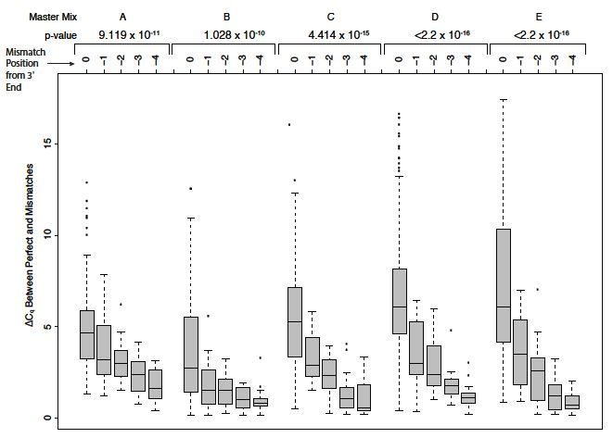
SNPs / Mismatches in primer binding sites
Primers may bind with unequal efficiency against different genetic variants
In quantitative assays (ie. qPCR), could lead to biases in abundance estimation
The effect depends on type of mismatch, and mismatch position (3’ is worse)
Mismatches at the terminal 3’ can affect Cq values as much as 5-7 cycles
Notes:
An equally problematic scenario may occur if primers bind but with unequal efficiency against different genetic variants. In this case, in any quantitative molecular assay such as qPCR for gene expression, SNPs could lead to biases in the estimation of gene expression between genetic variants or strains. Even single SNPs can introduce a variety of effects, ranging from minor to major impacts on Cq values . The effect will depend on the type of SNP (which nucleotides are involved), and on the position of the SNP (3’ or 5’ end), as SNPs within the last 5 nucleotides at the 3’ end can disrupt the nearby polymerase active site, and so these tend to have a much greater impact . SNPs at the terminal 3’ base had the strongest shift of Cq, altering Cq by as much as 5–7 cycles (Figure 2).

Slide 21
Ag1000g
The Ag1000g resource has revealed extreme amounts of genetic variation in Anopheles gambiae s.l
You can find a SNP in less than every 2 bases of the accessible genome - which makes considering SNPs even more important when designing molecular assays
To maximise the accuracy of our data we should try to avoid SNPs
Notes:
As we have seen in earlier workshops, the Ag1000g resource has revealed extreme amounts of [genetic variation in Anopheles gambiae. You can find a SNP in less than every 2 bases of the accessible genome - which makes considering SNPs even more important when designing molecular assays.
However, it was not previously straightforward to consider genetic variation when designing primers, and so the vast majority of primers currently in use did not consider SNP variation during their design.

Slide 22
malariagen_data + primer3 = AgamPrimer
malariagen_data has made it easy to access Ag1000g data in the cloud
Primer3 is the most widely cited primer design program, and a python version primer3-py has recently been developed.
With AgamPrimer, we can use both packages together to design primers in An. gambiae s.l, whilst considering SNP variation in the primer binding sites
  Genomic DNA primers
  Complementary DNA primers (qPCR for gene expression)
  Hybridisation probes
Notes:
Primer3 is the most widely cited program for primer design, and has been used extensively over the past two decades. It is also the primer design engine behind Primer-BLAST, a web-server which designs primers and then blasts the primers to check for specificity.
Thanks to the primer3-py python package and the malariagen_data API, it is now possible to design primers in the cloud with google colab, considering SNP variation.

