Slide 1

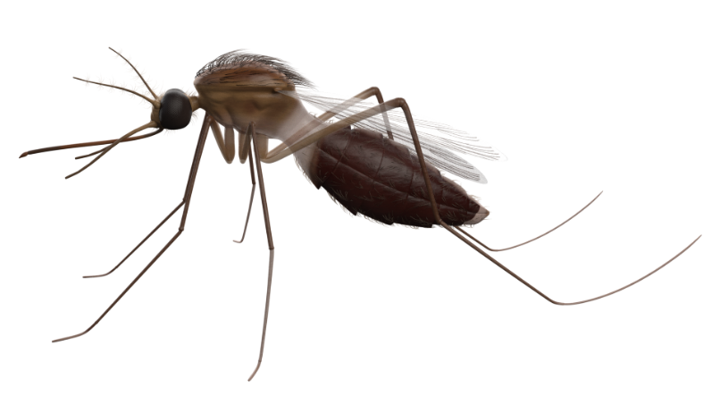

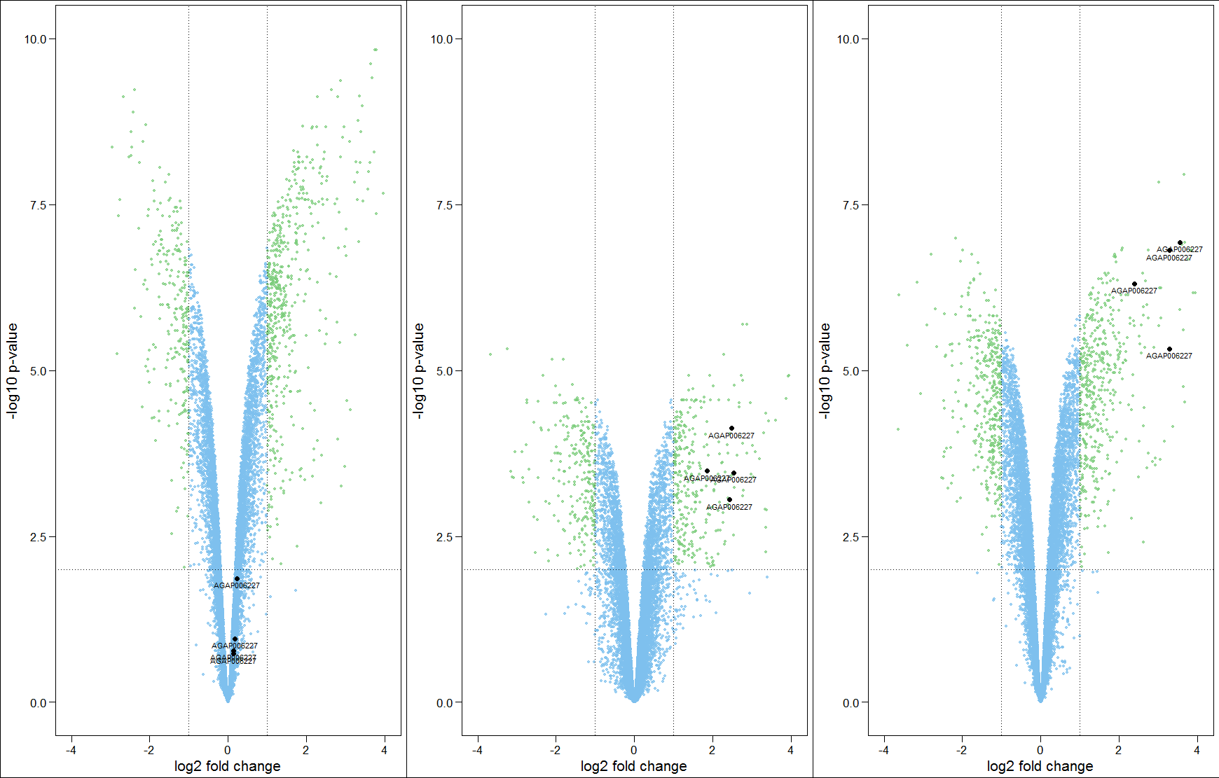
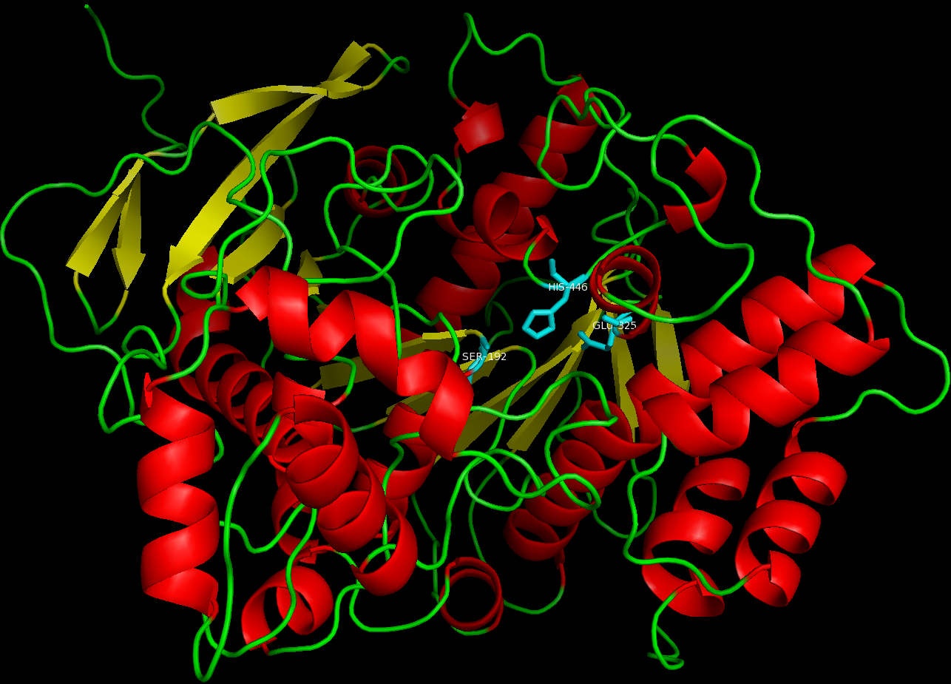
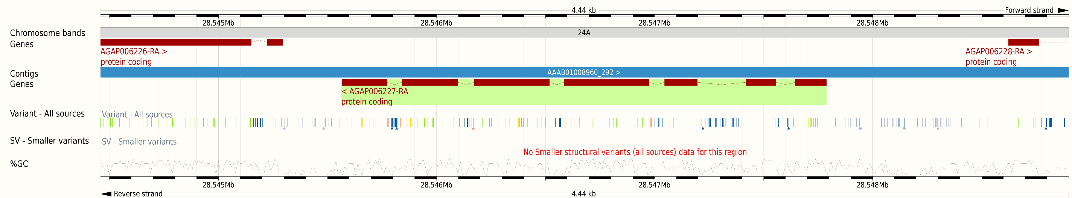
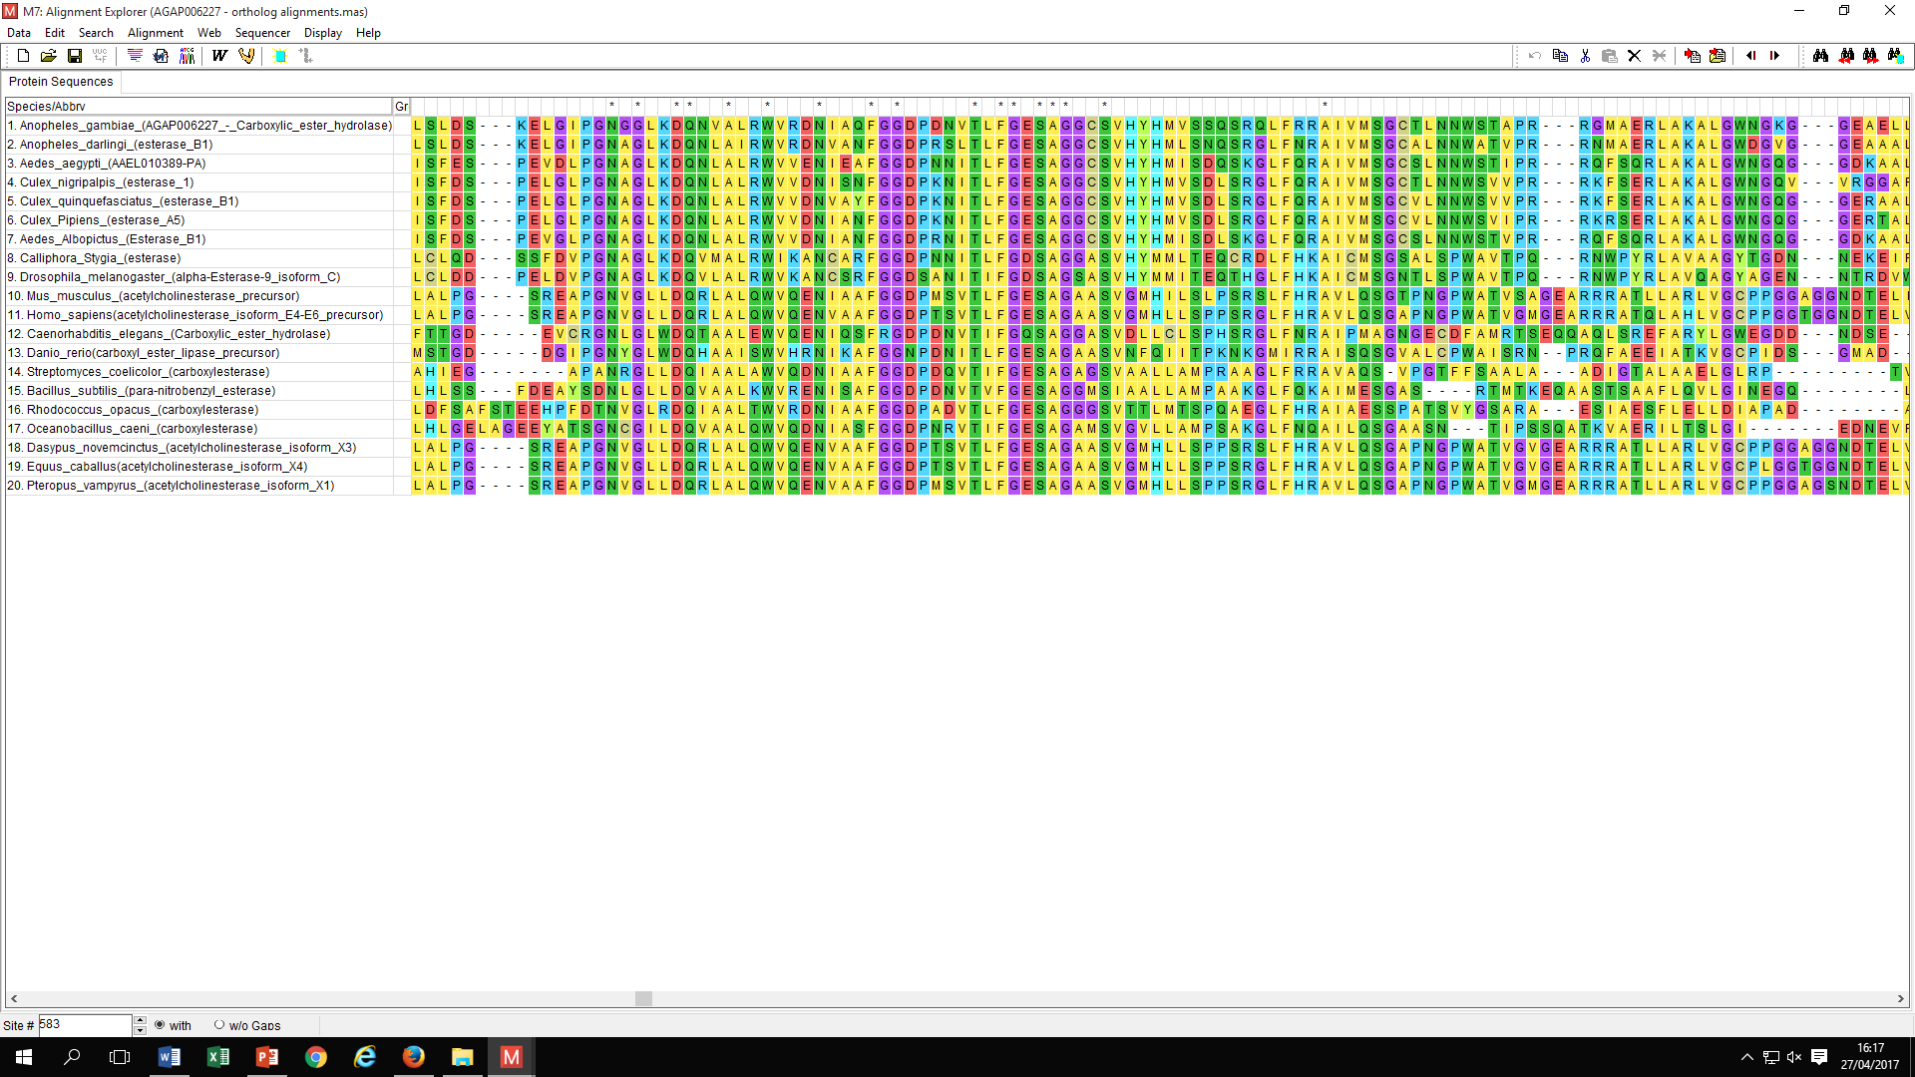
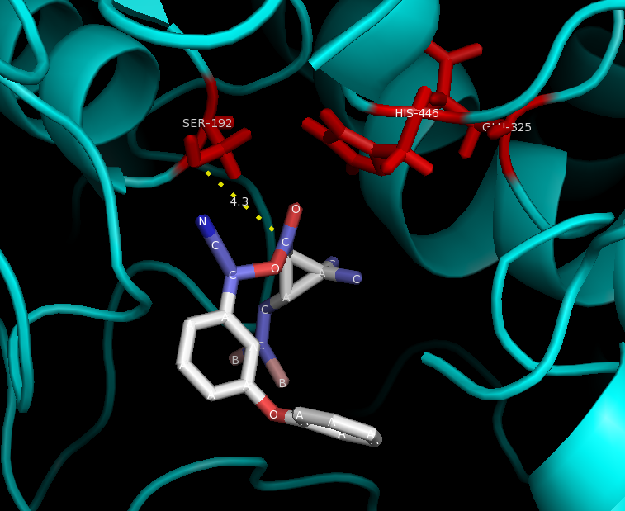
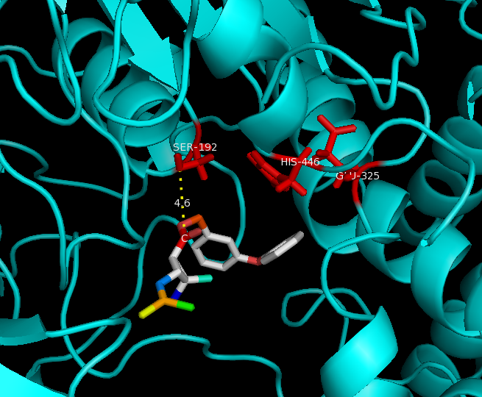
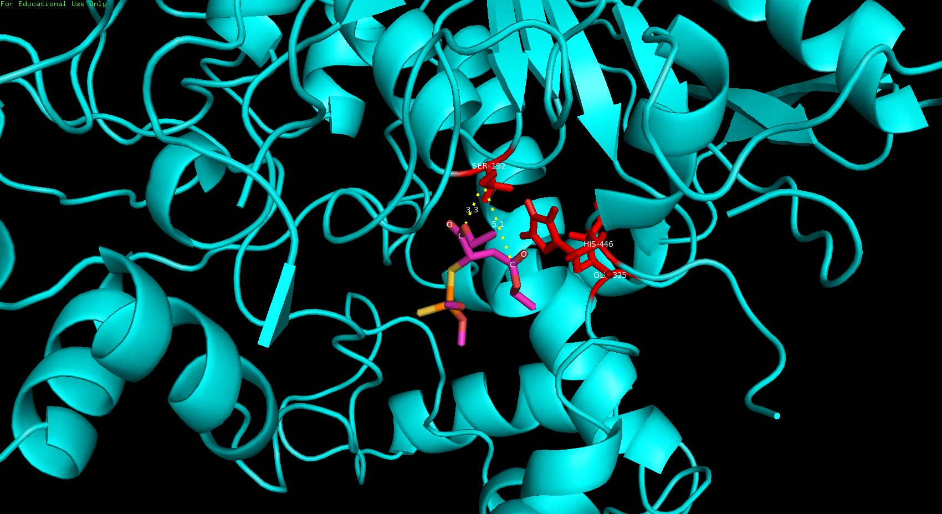
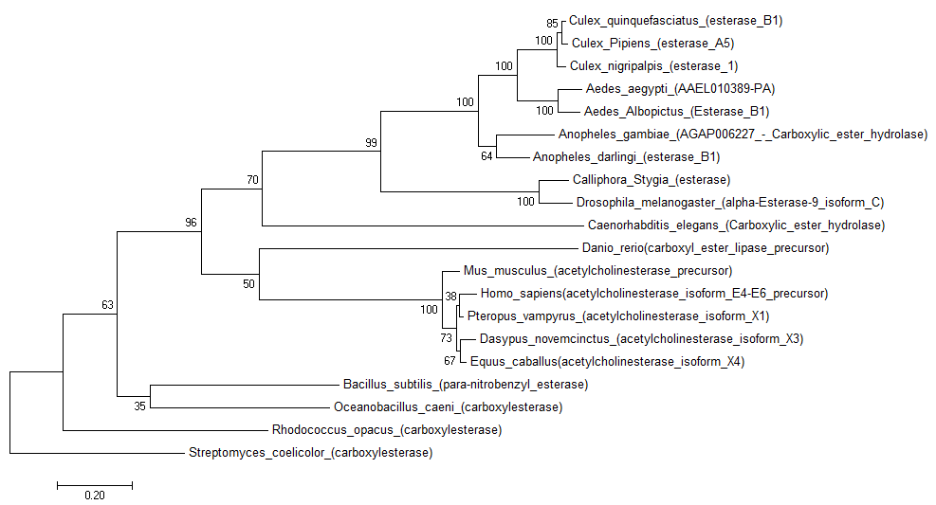
Anopheles gambiae AGAP006227 – A Carboxylesterase involved in insecticide resistance? By Sanjay Nagi 11842
The Experiment
Three resistant strains were isolated from 3 locations in Côte d’Ivoire, and relative gene expression was measured against a susceptible strain from Cameroon via microarrays.
No IRS in Côte d’Ivoire, but widespread LLINs use. So Deltamethrin/Permethrin resistance will be selected for primarily.
How could AGAP006227 be involved in Permethrin/Deltamethrin resistance?
A = ~1.1 fold change
B = ~5 fold change
C = ~9 fold change
The Protein
542 Amino acids
Type B Serine Carboxylesterase
Part of the Alpha/Beta hydrolase Superfamily
Variants (Panoptes Ag1000)
Leucine – 530 → Glutamine (85%)
Glutamate – 477 → Valine (49.4%)
Valine – 105 → Leucine (34.4%)
Glutamate – 28 → Valine (11.1%)
Glutamine – 129 → Glutamate (9.9%)
Aspartate – 463 → Asparagine (7.4%)
No Data from the Ivory Coast exists in Panoptes, so data is taken from Burkina Faso, a neighbouring country. (Allele Frequency). Comparison is to the reference Anopheles genome
Conserved Domains
F-[GR]-G-x(4)-[LIVM]-x-[LIV]-x-G-x-S-[STAG]-G
Serine Active site
The Catalytic Triad
S -192 – nucleophilic Serine
E - 325 – acidic Glutamate
H - 446 – Histidine base
Background
Esterases typically implicated in resistance to organophosphates, carbamates, and to a lesser extent pyrethroids.
Esterases hydrolyse a carboxylic ester → alcohol + a carboxylate.
Generally, resistance conferred by esterases is due to increased binding and sequestration of insecticides before reaching the target site, and not rapid hydrolysis. However, in some cases, amino acid mutations can lead to increased hydrolysis of insecticides [1].
AGAP006227 was upregulated in an area of intense agriculture, suggesting agricultural selection may contribute [2].
The Aedes aegypti ortholog (AAEL010389) was upregulated in pyrethroid resistant strains [3].
Homology modelling & Molecular docking
Structure was modelled primarily from the crystal structure of αlpha-esterase-7 of Lucilia cuprina, the Australian sheep blowfly (40% identity) [4]
Alpha/Beta Hydrolase fold
In silico molecular docking was performed in Autodock vina to estimate whether AGAP006227 could bind deltamethrin, permethrin, and the organophosphate malathion.
The Gene
4,620 Base Pairs long
7 Exons
51 Esterase genes in Anopheles gambiae
Location
Chromosome 2L
Reverse Strand
Within the aridity tolerance conferring 2LA inversion polymorphism
A paralog AGAP006228 (51% identity) is upstream, the result of a cis-duplication
Alignment
Conserved active site at residues 179-194 identified
Highly conserved even in bacterial phyla
Phylogenetic Tree
Displays evolutionary relationship between other mosquitoes, dipterans, model organisms, mammals, and bacteria.
Esterases are conserved throughout eukaryote taxa and prokaryotes
F-[GR]-G-x(4)-[LIVM]-x-[LIV]-x-G-x-S-[STAG]-G
Productive pose of Deltamethrin
Binding affinity = -8.8 kcal/mol
Distance from OH of Serine to Carbonyl of ester bond = 4.3 Ångströms
(Distances displayed above)
Productive pose of 1R-Cis-Permethrin
Binding affinity = -7.4 kcal/mol
Distance from OH of Serine to Carbonyl of ester bond = 4.6 Å
1R-Cis-Permethrin is the toxic isomer
Productive pose of Malathion
Binding affinity = -5.1 kcal/mol
Distance from OH of Serine to Carbonyl of ester bond = 3.3 Å, 5.1Å
Note 2 ester bonds in Malathion, so 2 possible sites of metabolism
References – 1) Hemingway, J., N. J. Hawkes, L. McCarroll, and H. Ranson. (2004). The molecular basis of insecticide resistance in mosquitoes. Insect Biochem. Mol. Biol. 34:653–665. 2) Theresia E Nkya, Idir Akhouayri, Rodolphe Poupardin, Bernard Batengana, Franklin Mosha, Stephen Magesa, William Kisinza and Jean-Philippe David. Insecticide resistance mechanisms associated with different environments in the malaria vector Anopheles gambiae: a case study in Tanzania (2014) Malaria Journal 3) Strode C, Wondji CS, David JP, Hawkes NJ, Lumjuan N, Nelson DR, Drane DR, Karunaratne SHPP, Hemingway J, Black WC, Ranson H: Genomic analysis of detoxification genes in the mosquito Aedes aegypti. Insect Biochem Mol Biol. 2008, 38: 113-123. 10.1016/j.ibmb.2007.09.007 4) C.J. Jackson, J.-W. Liu, P.D. Carr, F. Younus, C. Coppin, T. Meirelles, et al. Structure and function of an insect α-carboxylesterase (αEsterase7) associated with insecticide resistance. Proc. Natl. Acad. Sci. U.S.A., 110 (2013), pp. 10177–10182

