Slide 1
WaPOR HACKATHON 2026 · FROM TOOLS TO DECISIONS
Same Budget. More Water.
Ranking Egypt’s irrigation budget by the water that evaporated without growing a crop.
DECISION-MAKER
MANDATE
TOOL
WHERE
MWRI budget committee
Egypt’s Nile allocation
IPAT, already at MWRI
Nile Delta & Valley
FAO WaPOR v3 Level 2 · 100 m · 18 dekads · 1 May – 31 Oct 2024 · 3.56 Mha observed irrigated land
Notes:
Do not name the subtheme, the team, or any next steps in the recorded pitch, all three are explicitly prohibited. Anchor on IPAT, the tool MWRI already runs.

Slide 2
The tool works. The decision still does not get made.
FAO lists more than twenty working WaPOR applications. Egypt has its own, running inside the ministry.
IPAT
The decision it does not make
Irrigation assessment tool for Egypt. Operational pilot, hosted by the Ministry of Water Resources and Irrigation. WaPOR v3 Level 3 at 20 m, across ~1.5 million hectares of the Middle and West Delta.
A planning officer with a fixed annual modernisation budget still has to decide where to spend it. Today that split is made by cultivated area or political balance across governorates.
It shows, accurately, where water productivity is high and where it is low.
Nothing in the toolchain says which hectare of subsidy buys the most water back.
It does not say where to spend.
The gap is not data, and it is not accuracy.
The output arrives in the wrong units for the decision: millimetres per dekad, when the decision is denominated in pounds, hectares and cubic metres.
Notes:
Do not say "nobody uses the E/T split", you are talking to the people who built WaPOR. Say nobody converts it into money.

Slide 3
WaPOR knows which water grew something
It reports evaporation, transpiration and interception as separate layers. Nobody converts that into money.
TRANSPIRATION
77%
EVAPORATION
23%
passed through a stoma and grew a crop
delivered, paid for, grew nothing
Study-area average share of all water consumed, measured over 18 dekads. The orange share runs from 0.16 to 0.29 across governorates; the volume behind it varies far more.
4,844
Recoverable
Everywhere
Mm³ evaporating each season across the study area, water already delivered and already paid for
with measures that already exist in Egypt: laser levelling, mulching, better rice water management
no new instruments, no new field campaign, the data exists today for every WaPOR country
So the question of where the money should go has a measured answer: wherever a pound of spending recovers the most evaporated water.
Recoverable evaporation is an upper bound: some avoided evaporation becomes transpiration and yield rather than saved water.
Notes:
The palette is the argument: blue is water that worked, orange is water that did not.

Slide 4
The mandate, the gap in it, and why this tool fills it
Who makes the decision, what they are deciding, and where this tool already sits.
THE MANDATE
THE CHALLENGE
THE ALIGNMENT
Ministry of Water Resources and Irrigation
A mandate to save water, no evidence on where
IPAT already sits inside the mandate
Allocates and manages Egypt’s Nile share under the National Water Resources Plan, and is accountable to the Ministry of Finance for what the on-farm modernisation budget delivers. Its remit is explicitly to raise water-use efficiency. Egypt has roughly 55 BCM a year and around 110 million people.
The committee must decide which governorates receive this season’s budget, and in what proportion. Today that split can only be defended by cultivated area or by political balance, because nothing tells it where a pound of subsidy recovers the most water.
IPAT is operational at MWRI on WaPOR v3 Level 3 across roughly 1.5 Mha of the Middle and West Delta. It shows, accurately, where water productivity is high and low, and stops there.
The decision-maker is the annual budget committee, working on an annual cycle, under pressure to spread allocations evenly across governorates.
The gap is not data, and it is not accuracy. The output arrives in millimetres per dekad; the decision is denominated in pounds, feddans and cubic metres.
We add the one step that converts its output into the committee’s decision: rank by recoverable evaporation, price it per cubic metre, and spend down the list. No new tool, no new institution, no new meeting.
In practice: the planning officer works down a ranked list instead of dividing the budget by cultivated area.

Slide 5
The method is three lines
Deliberately so. Everything it depends on is visible and editable.
V
recoverable water
m³ per year
Then sort by c and spend down the list.
E_mm × irrigated ha × 10 × reduction × seasons
Cheapest water first. A district can be part-treated, so the greedy solution is optimal.
C
annualised cost
USD per year
(USD per ha ÷ life years) × irrigated ha
Compared against an area-proportional split, a neutral prior, not a claim about ministry practice.
c
cost of water
USD per m³
C ÷ V
The cropland mask is free
Outside the irrigated Nile there is no water and effectively no rain, so seasonal evapotranspiration collapses to near zero. A seasonal AETI threshold separates cropland from desert almost perfectly, using data we already have, with no extra product, licence or cost. Open water is removed separately, by beneficial fraction and by JRC surface water.

Slide 6
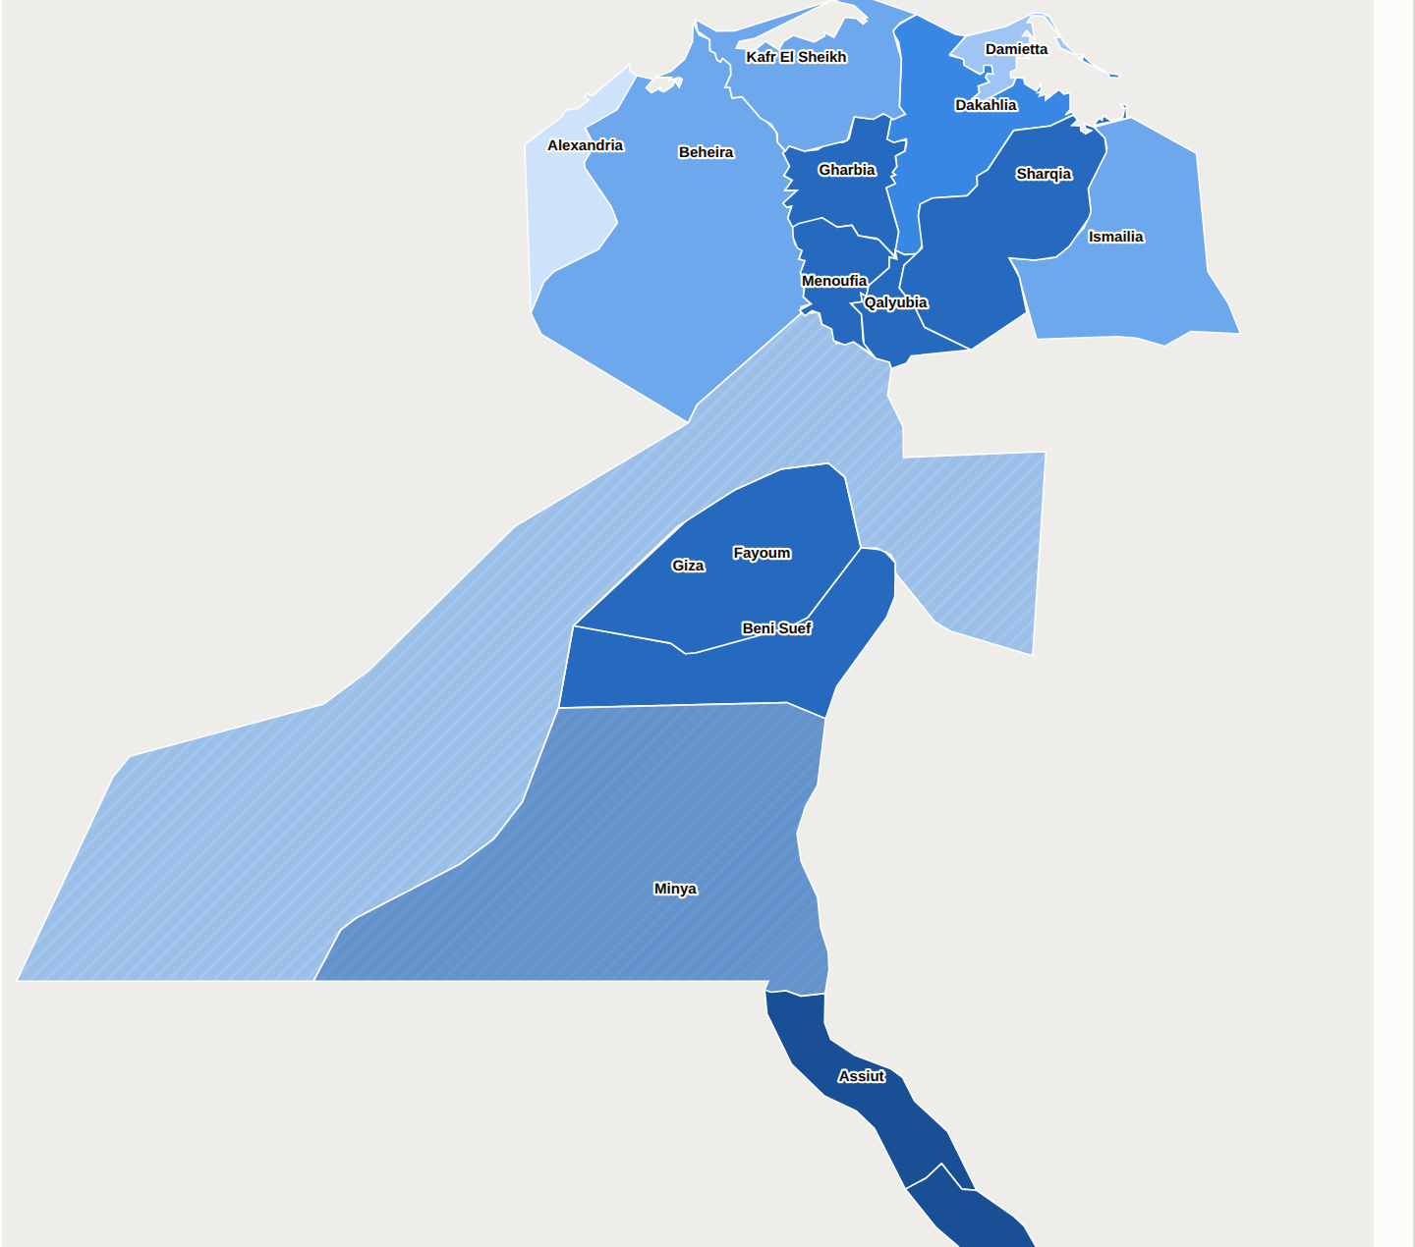
Same budget, same measures, different order
At a $12M modernisation budget
+25%
more water recovered than an area-proportional split, and the same figure on unit cost, so it is not an artefact of spending more
Targeted
273 Mm³
Area-proportional
218 Mm³
$0.044/m³ targeted vs $0.055/m³ baseline
Evaporation share runs 0.16 to 0.34 across the study area, a twofold spread, and the reason targeting works at all. The ranking is driven by that measurement; the size of the prize still moves with every cost coefficient.
FAO WaPOR v3 Level 2, 100 m, 18 dekads, 1 May – 31 Oct 2024. Observed irrigated area 3.56 Mha against 3.21 Mha reported cultivated, an independent check the method passes.

Slide 7
What the data told us we had wrong
We expected the northern Delta rice belt to come out worst. Ponded paddy, evaporating all season. The measurement says otherwise.
share of consumed water that evaporated without growing anything · E / AETI · area-weighted
Delta, rice belt
0.210
what we predicted would be WORST
Nile Valley (Upper Egypt)
0.241
684 mm through the field
Delta, other
0.243
500 mm through the field
A closed rice canopy shades the water. Ponding does not imply evaporation, Damietta reaches 0.157 and Kafr El Sheikh 0.191, the most efficient irrigated land we measured anywhere in Egypt. And the second surprise: the wasted fraction is similar everywhere, around 0.24. What differs is throughput, Upper Egypt is hotter, pushing 660–775 mm through a field against the Delta’s 510–640, so the same inefficiency costs more water. Targeting follows the heat, not the bad practice.
Notes:
Pause after "the measurement disagreed." If asked how much is the satellite: flat evaporation gives 0%, a per-system average +21.5%, real per-district +25.2%.

Slide 8
A recommendation a committee can sign
Pure cheapest-first funds seven governorates out of eighteen. No ministry with an equity mandate signs that.
No floor
25% floor
50% floor
100% floor
7
18
18
18
governorates funded
governorates funded
governorates funded
governorates funded
273 Mm³
264 Mm³
253 Mm³
218 Mm³
maximum water
−3.2% vs pure targeting
−7.2% vs pure targeting
−20.1% vs pure targeting
Reserve a quarter of the budget for equity and you fund every governorate for 3.2% of the water. Stakeholder engagement happens outside the dataset interface, so we priced the political constraint instead of optimising around it. The floor is a slider: the committee argues with the model in the room and leaves owning the result.

Slide 9
And next season, we check
Most tools stop at the recommendation. This one can be checked against what actually happened.
1
2
3
4
Allocate
→
Spend
→
Observe
→
Attribute
WaPOR evaporation ranks the districts and sets the spending list
Some districts are funded. Some are not, through budget limits, not by design
Next season WaPOR measures evaporation in both groups, at the same cost, with the same instrument
Funded vs unfunded is a control group. Difference-in-differences, with the confidence interval shown
Why this matters
The same measurement that justified the spending also measures the result, so progress is observed rather than reported. We will publish the confidence interval with it, including the cases where the change is too small for WaPOR to see.
Notes:
Answers "you cannot verify this" before it is asked. End on the word worked, then cut.

Slide 10
What we are not claiming
The limits of the method, set out plainly.
Field scale is not basin scale
Feasibility rests on one swap
Some water an intervention frees was already returning to a drain and being reused downstream, and suppressing evaporation can convert it to transpiration and yield rather than to saved water. Recoverable E is an upper bound. These figures rank places; they are not a water account.
Governorates are not how this budget is delivered, irrigation directorates and command areas are. The method is boundary-agnostic: the same three lines run on any polygon set, including IPAT’s own 20 m command areas. That swap is the whole distance between this and something MWRI could run.
The magnitude is soft, the order is not
We caught ourselves contaminating our own result
Most of the value is the pattern, not the pixel
The ranking is driven by observed evaporation. The size of the prize moves with every cost coefficient, so every one is an editable input, not a hidden constant. An earlier version of our own robustness claim did not survive testing, and we withdrew it.
Lake Nasser, the Toshka lakes, canals and fish ponds survived both the JRC water mask and the beneficial-fraction test, evaporating 1,300–1,800 mm. In Aswan that was 5,392 pixels and it had put Aswan top of the national ranking on contamination alone. A physical ceiling on cropland evaporation removed it; Aswan’s lead largely went with it.
Real per-district evaporation gives +25.2% over the baseline. A per-system average alone gives +21.5%. So satellite detail is worth about 3.7 points, the rest is the system-level pattern. But that pattern is precisely what the satellite told us we had backwards.
Each of these is documented in full, with the corrections we made, in the accompanying technical note.

Slide 11
WHY IT WOULD ACTUALLY GET USED
An ordered spending list,
not another map.
→
No new tool
it runs on IPAT, already operating inside the ministry
→
No new meeting
the output is the brief the budget committee already writes
→
No new data purchase
WaPOR is free and global, so this is not Egypt-specific
→
No new mandate
raising water-use efficiency is already what MWRI answers for
An existing tool, an existing budget committee, an existing annual cycle.

