Slide 1
EOPS: A Multi-Agent AI Engineering Operations Platform for Automated Incident Investigation and Root Cause Analysis
Sanjay P C
Sam Benadick J
Praveenkumar S
Nibuna A
B.Tech AI & Data Science
Ms D. Hemamalini
Assistant Professor
Dept. of AI & Data Science
Sri Eshwar College of Engineering

Slide 2
INTRODUCTION
• Cloud-native systems ship daily; production incidents are unavoidable.
• One investigation spans six disconnected systems: source code, deployments, database, logs, runbooks and team chat.
• Engineers correlate this evidence manually. Context switching raises cognitive load, prolongs Mean Time to Resolution and makes diagnosis depend on individual expertise.
• Existing LLM assistants target code generation or conversation, not coordinated investigation across engineering tools.
52.5 h
median time to mitigate a production incident (Microsoft, one year of incidents)
Objective: a supervisor-driven multi-agent platform where specialised agents investigate a team's own tools in parallel and return an evidence-cited root cause, with human approval before any action.

Slide 3
LITERATURE REVIEW
Work | Contribution | Limitation for incident investigation
Lewis et al., NeurIPS 2020 — RAG | Grounds generation in retrieved documents | Retrieval only; no tools, no investigation
Yao et al., ICLR 2023 — ReAct | Interleaves reasoning with tool actions | Single agent on a single task
Wu et al., COLM 2024 — AutoGen | Multi-agent conversation framework | Unbounded chat; no evidence contract
Ahmed et al., ICSE 2023 | Fine-tuned LLM proposes root cause from incident text | One-shot; no multi-source evidence
Chen et al., EuroSys 2024 — RCACopilot | Handlers collect diagnostics; LLM predicts category (Micro-F1 0.766) | Provider-side; one handler per alert type
Roy et al., FSE 2024 | ReAct agent for RCA; hallucination 6% vs 49% for retrieval | Single agent; diagnosis only
Yang et al., NeurIPS 2024 — SWE-agent | Agent-computer interface resolves repository issues | Repository only; no live system signals
Research gap: no system coordinates several specialised agents over a customer's own heterogeneous tools, sharing one investigation state in which every finding must cite the tool call that produced it.

Slide 4
METHODOLOGY / MATERIALS AND METHODS
Incident in chat
Supervisor plans
may assign only desks that have a connected tool
Code
Frontend
& Hosting
Backend
& Services
Database
Observability
Knowledge
six desks run concurrently · each holds read-only tools · a desk may ask one colleague a precise question
Shared investigation state — every finding carries its tool-call id
RCA agent — cause, failure point, confidence
Engineer approves before any write
1
Initialise
2
Plan
3
Parallel evidence
4
Collaborative reasoning
5
Human validation
Five phases of the proposed methodology; each desk runs a budgeted reason-act loop (8 tool calls, 300 s) and is forced to report its findings when a budget is reached.

Slide 5
EXPERIMENTAL ANALYSIS
Experiment 1 — Orchestration
Experiment 2 — Knowledge retrieval
Does the supervisor coordinate desks and keep one consistent state?
How well does the Engineering Memory Layer retrieve runbooks and postmortems?
Orchestration latency · state consistency · agent completion rate
MRR · Recall@K · Precision@K · response latency
Experiment 3 — Root-cause reasoning
Experiment 4 — End-to-end workflow
Do generated reports match expert analyses of the same incident?
Injected faults: API latency, slow query, failed deploy, broken content.
Evidence use · completeness · explanation quality · confidence calibration
Time to root cause · evidence completeness · unsupported-claim rate · usability
Baselines: single ReAct agent with the same tools · one-shot prompt with all context · the same architecture without compaction
Datasets: OpenRCA (ICLR 2025, 335 real failures) · AIOpsLab fault scenarios (MLSys 2025) · 20–30 faults injected into a live stack
Ablations: multi-agent vs single agent · with and without retrieval · with and without enforced citation

Slide 6
RESULTS & DISCUSSION
39%
less input resent per desk — older tool output collapses to its opening while keeping its citation id
Bounded
context per step: each desk sees only its own tools; the RCA agent reads one-line evidence, never raw logs
Parallel
wall-clock follows the slowest desk rather than the sum of all desks
Implemented: 9 agent roles · 3 live connectors (GitHub, Supabase, knowledge vault) · 229 automated tests · pilot investigation ≈ 7.7 min end to end
Discussion: the architecture behaves as designed — desks work concurrently, every finding carries a verifiable citation, and compaction cuts resent context measurably.
Threat to validity: this is a position paper with a working prototype; the pilot timing is an engineering observation, not an evaluation result. Large-scale measurement is future work.

Slide 7
CONCLUSION
1
A coordination protocol, not a bigger model
A supervisor plans, specialised desks investigate the team's own tools in parallel, and one shared state carries every finding with its tool-call citation.
2
Trust comes from the harness
Uncited findings are rejected, investigating desks are read-only, budgets bound every loop, and confidence is capped by code — not by the model's own claim.
3
Decision support is the right target today
Published agents resolve only 11–15% of real scenarios autonomously, so EOPS keeps the engineer in the approval seat.
4
Future work
Measurement on OpenRCA and injected faults, graph-augmented retrieval over code–service–document relations, and learning from accepted versus rejected recommendations.

Slide 8
REFERENCES
[1] A. Vaswani et al., "Attention is all you need," in Proc. NeurIPS, 2017.
[2] P. Lewis et al., "Retrieval-augmented generation for knowledge-intensive NLP tasks," in Proc. NeurIPS, 2020.
[3] S. Yao et al., "ReAct: Synergizing reasoning and acting in language models," in Proc. ICLR, 2023.
[4] Q. Wu et al., "AutoGen: Enabling next-gen LLM applications via multi-agent conversation," in Proc. COLM, 2024.
[5] J. Yang et al., "SWE-agent: Agent-computer interfaces enable automated software engineering," in Proc. NeurIPS, 2024.
[6] C. E. Jimenez et al., "SWE-bench: Can language models resolve real-world GitHub issues?," in Proc. ICLR, 2024.
[7] T. Ahmed et al., "Recommending root-cause and mitigation steps for cloud incidents using large language models," in Proc. ICSE, 2023.
[8] Y. Chen et al., "Automatic root cause analysis via large language models for cloud incidents," in Proc. EuroSys, 2024.
[9] D. Roy et al., "Exploring LLM-based agents for root cause analysis," in Proc. FSE (Industry), 2024.
[10] "OpenRCA: Can large language models locate the root cause of software failures?," in Proc. ICLR, 2025.
[11] "AIOpsLab: A holistic framework to evaluate AI agents for enabling autonomous clouds," in Proc. MLSys, 2025.
[12] "ITBench: Evaluating AI agents across diverse real-world IT automation tasks," in Proc. ICML, 2025.
[13] Y. Gao et al., "Retrieval-augmented generation for large language models: A survey," arXiv:2312.10997, 2023.
[14] LangChain AI, "LangGraph," 2024; Chroma, "Chroma embedding database," 2024.
References [8]–[12] situate EOPS against the current state of the art in LLM-based root cause analysis.

Slide 9
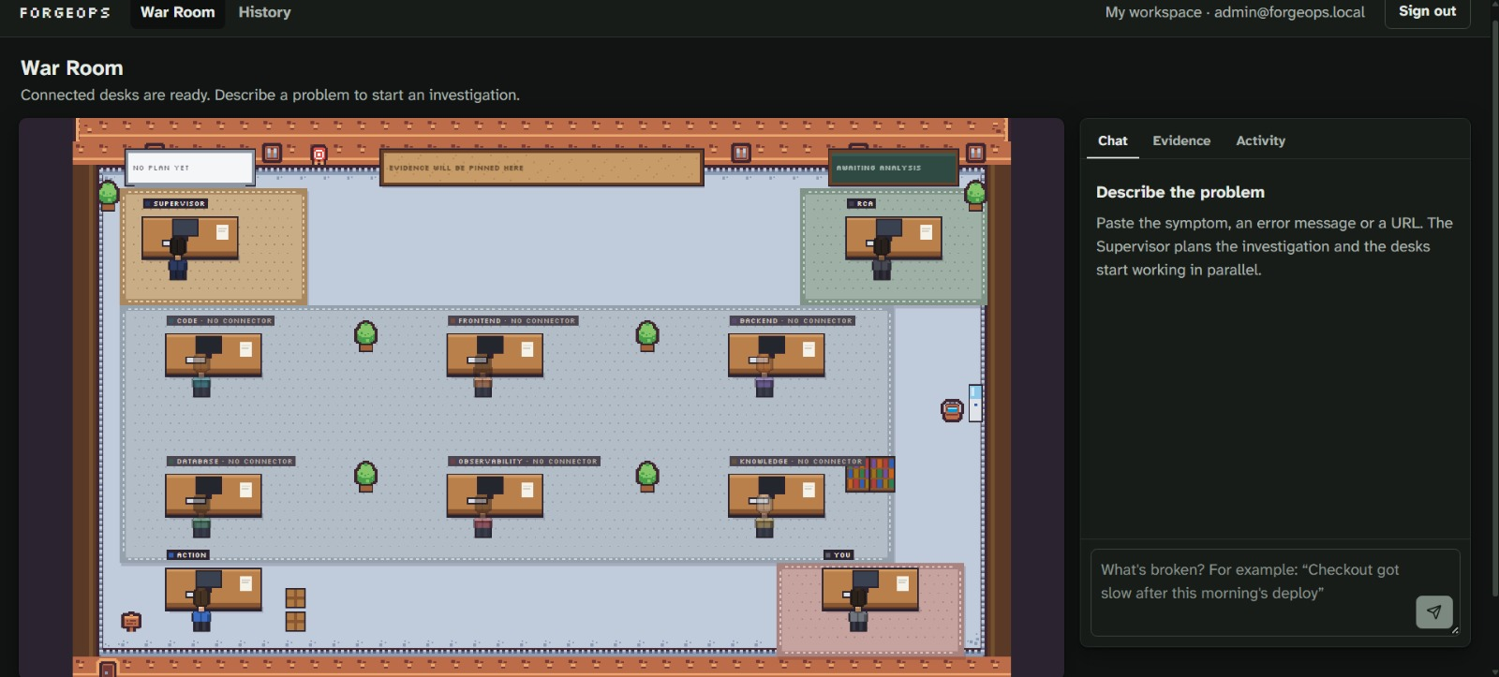
Results and output

