Slide 1

Shree Shambhubhai V. Patel College of Computer Science and Business Management
AFFILIATED TO
VEER NARMAD SOUTH GUJARAT UNIVERSITY
PROJECT REPORT
ON
CAFE MANAGEMENT SYSTEM
BACHELOR OF COMPUTER APPLICATION
(B.C.A.)
SUBMITTED BY: GUIDED BY:
Gujrati Jeel (89) Dr. Radhika Amlani
Katrodiya Prince (131) Kumhar Sanjay (154)

Slide 2
OUR PROJECT IS
HOSPITAL MANAGEMENT SYSTEM

Slide 3
INDEX
NO. | TOPIC | PAGE NO.
1 | Title page
2 | Index | 3
3 | Introduction | 4
4 | Aim/Objective | 5
5 | Features of our project | 6
6 | Technology used | 7
7 | Limitations of existing technology | 8
8 | Advantages of current technology | 9
9 | E-R diagram | 10
10 | DFD | 11
11 | Database design | 16
12 | Screen shots | 20
13 | System testing | 39
14 | limitations of current system | 40
15 | Future enhancement | 41

Slide 4
INTRODUCTION
PROJECT DESCRIPTION
The Hospital Management System (HMS) is a software application designed to simplify and manage hospital operations.
It integrates key hospital functions like Administration, Doctors, Patients, and Appointments into a single platform.
HMS ensures efficient workflow, reduced paperwork, and improved patient care.
The system provides a digital and user-friendly approach to hospital management.
The HMS project focuses on computerizing hospital processes such as patient registration, doctor management, and appointment scheduling.
The system improves efficiency, transparency, and faster hospital operations.

Slide 5
AIM/OBJECTIVES
AIM
The aim of the Hospital Management System (HMS) is to digitize and automate hospital operations for better efficiency, accuracy, and patient care .
To provide a centralized platform that connects administrators, doctors, and patients .
To reduce manual work, minimize errors, and save time in hospital management.
OBJECTIVES
Patient Management – Enable easy registration and appointment booking for patients.
Doctor Management – Maintain details of doctors, their specialization, and availability.
Appointment Scheduling – Provide a streamlined process for booking and managing appointments.
Administration Control – Allow admins to manage doctors, patients, and appointments effectively.
Efficiency & Transparency – Improve hospital workflow by reducing paperwork and delays.
User-Friendly System – Ensure the software is simple, secure, and easy to use for all users.

Slide 6
FEATURES OF OUR PROJECT
Patient Registration – Simple and quick process for adding new patients.
Doctor Management – Store and manage doctor details such as name, specialization, and availability.
Appointment Scheduling – Patients can easily book, reschedule, or cancel appointments.
Admin Module – Administrator can manage patients, doctors, and appointment data.
Authentication & Security – Login system for secure access to admin, doctors, and patients.
Search & Filter Options – Easy retrieval of doctor or patient details.
User-Friendly Interface – Simple design that is easy to navigate for all users.
Scalability – System can be enhanced in the future to add more modules like billing, reports, or notifications.

Slide 7
TECHNOLOGY USED
FRONT-END | PHP , HTML , CSS ,BOOTSTRAP , JQUERY
BACK-END : | PHP
DATA-BASE : | MYSQL SERVER
BROWSERS : | GOOGLE CHROME
PLATFORM : | WINDOWS 10
DOCUMENTATION TOOL : | MICROSOFT OFFICE 2013
GUIDE : | DR. RADHIKA AMLANI
SUBMITTED TO : | Shri Shambhu bhai v. Patel College Of Computer Science and Business management

Slide 8
Limitations of Existing System
Manual Workload – Patient registration, appointment booking, and doctor scheduling are done manually, leading to delays.
Paper-Based Records – Information is stored on paper, which is prone to damage, loss, and difficult to manage.
Time-Consuming – Managing patients, doctors, and appointments takes extra time and effort.
Lack of Accuracy – Chances of human errors in data entry, patient details, and scheduling.
No Centralized Access – Patients and doctors cannot access hospital information easily.
Poor Communication – Limited interaction between patients, doctors, and administrators.
Data Security Issues – Paper records are not secure and can be accessed or misplaced by unauthorized persons.

Slide 9
Advantages of current technology
Easy Record Keeping
Stores patient, doctor, and hospital data in digital form, reducing paperwork.
· Quick Access
Patient details, appointments, and reports can be accessed easily when needed.
· Time Saving
Automates tasks like registration, appointment scheduling, and billing.
· Improved Accuracy
Reduces chances of human errors in records and calculations.
· Better Patient Care
Doctors can view medical history quickly, leading to better treatment.
· Cost Effective
Saves resources by reducing manual work and paperwork.
· Data Security
Records are protected with login credentials, reducing chances of data loss.
· Scalable
New features (like pharmacy, lab reports, or online payments) can be added in the future.

Slide 10
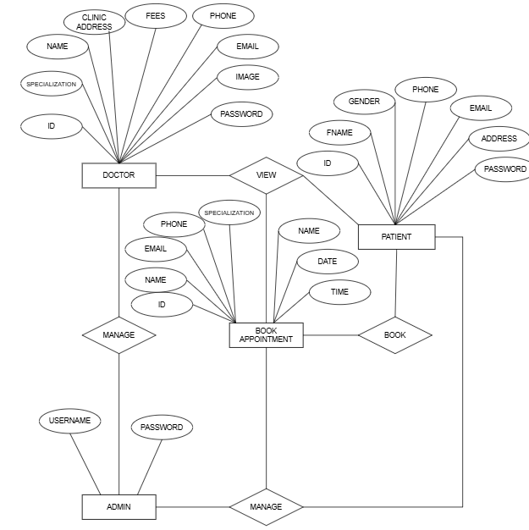
ER DIAGRAM

Slide 11
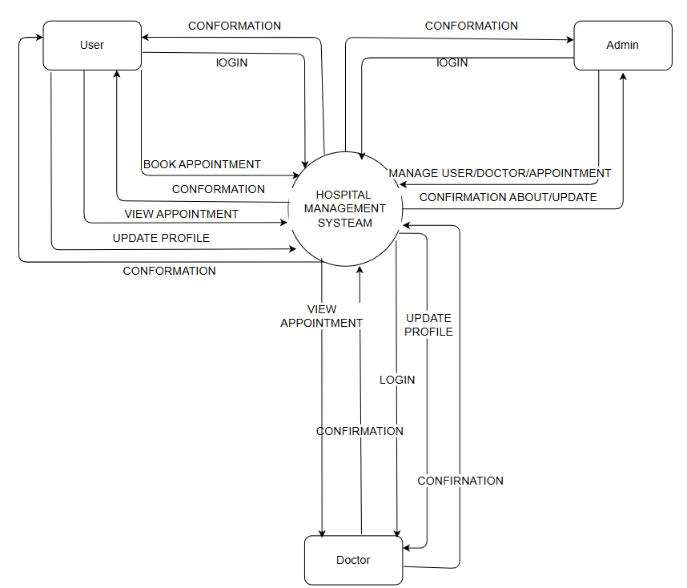
DFD OR UML
Dataflow diagram:
Context level dataflow diagram:

Slide 12
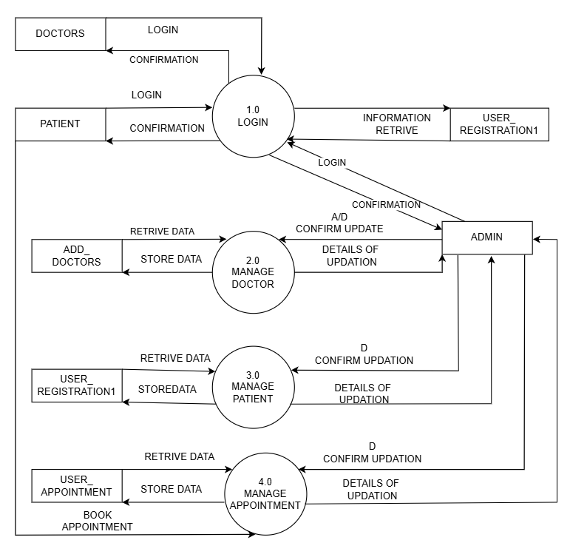
Zero level dataflow diagram:

Slide 13
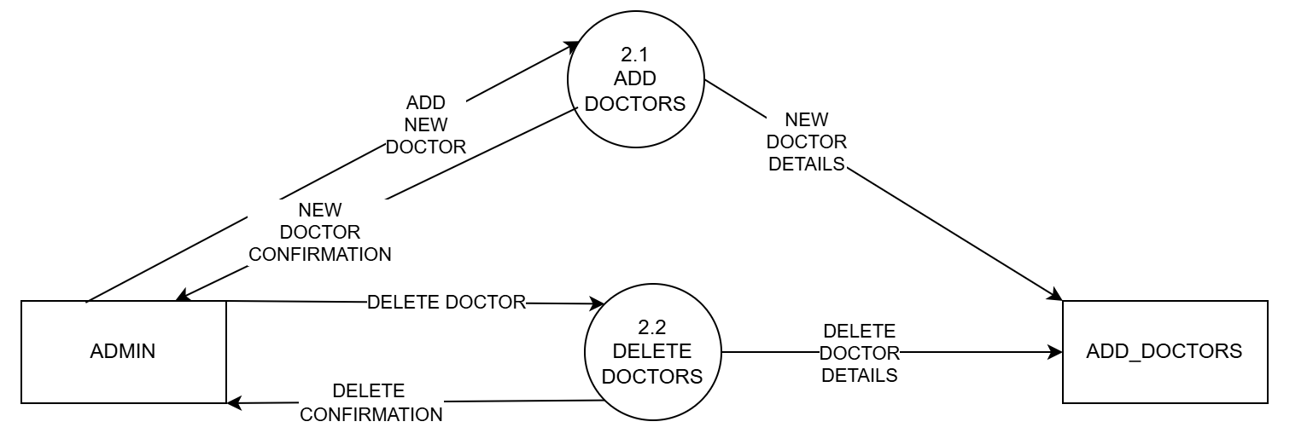
First level data flow diagram of manage doctors:

Slide 14
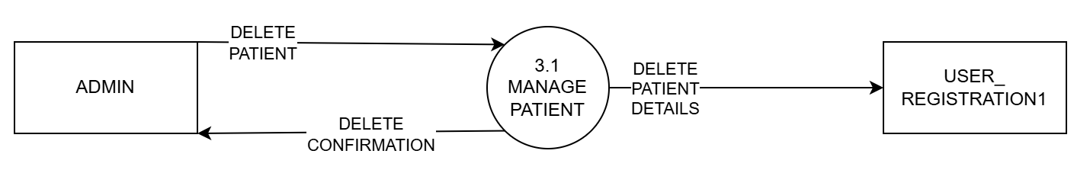
First level data flow diagram of manage patient:

Slide 15
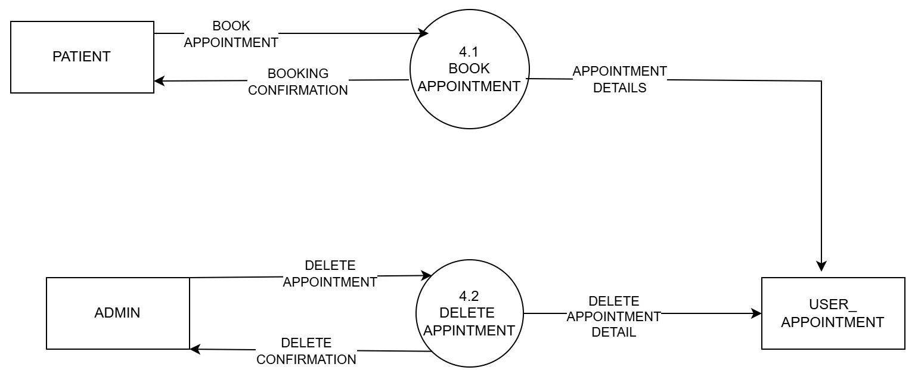
First level data flow diagram of manage appointment:

Slide 16
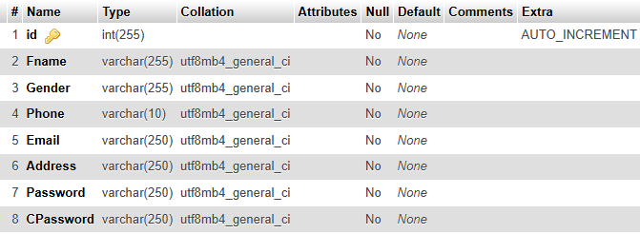
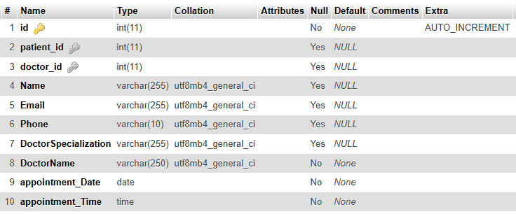
Database design
USER
APPOINTMENT BOOKING

Slide 17
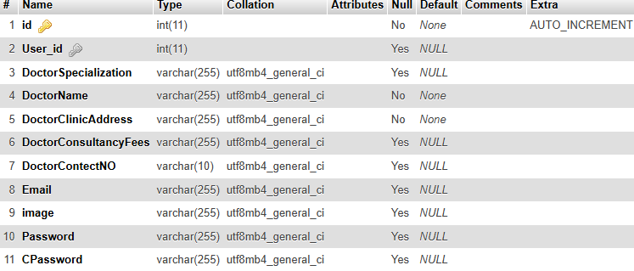
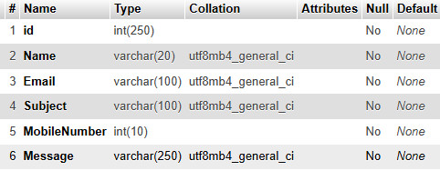
DOCTORS
CONTACT

Slide 18
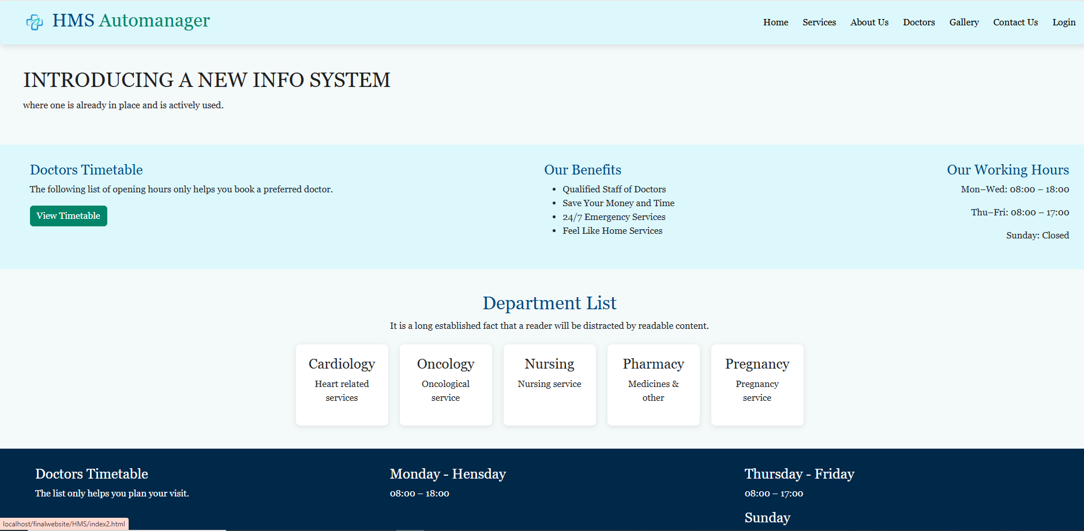
Screen shots
User interface
HOME

Slide 19
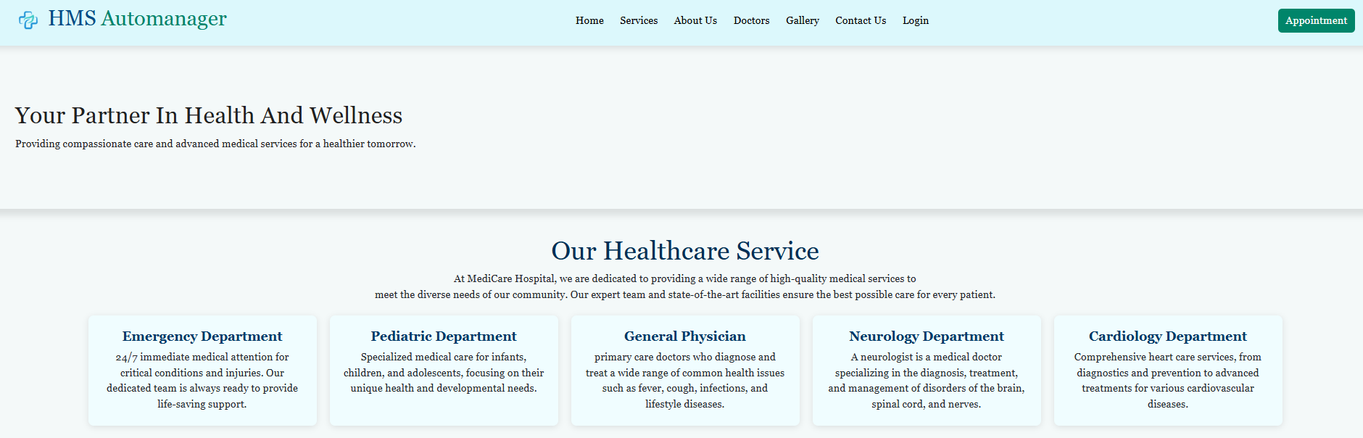
Services

Slide 20
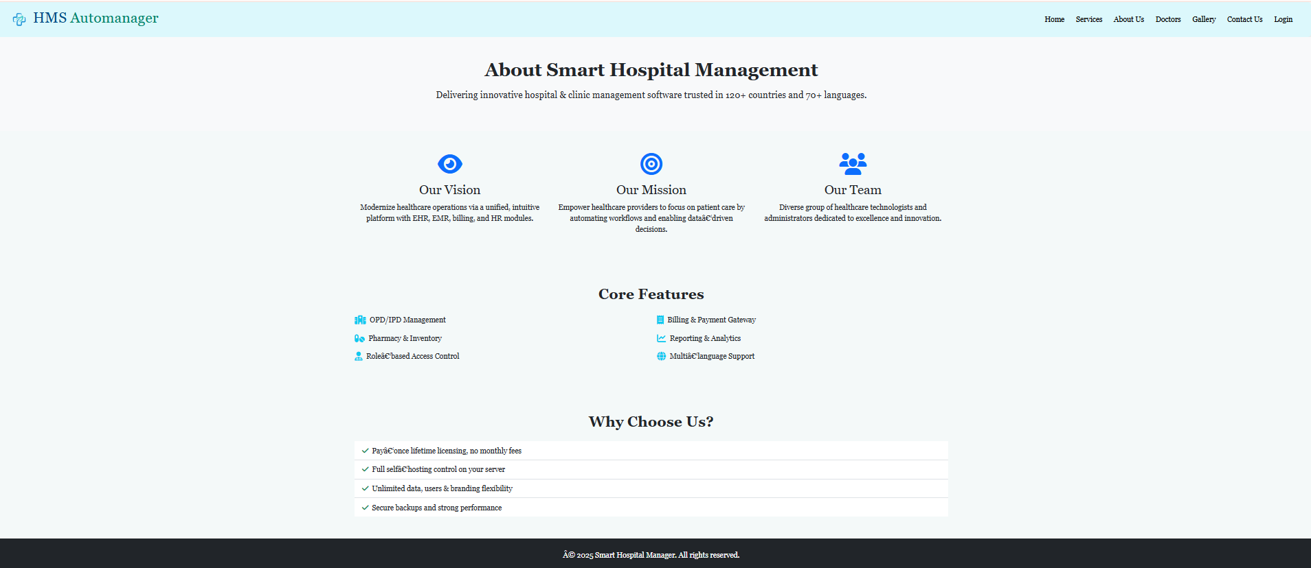
About us

Slide 21
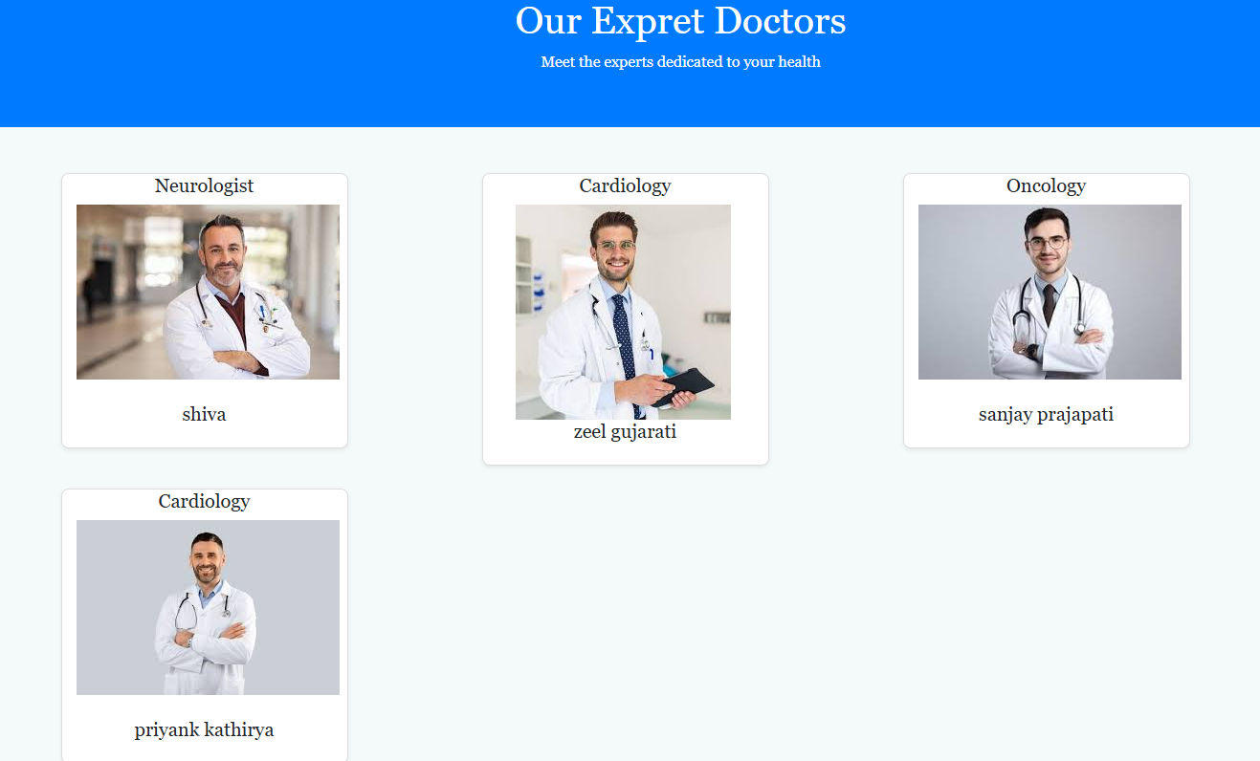
Doctor

Slide 22
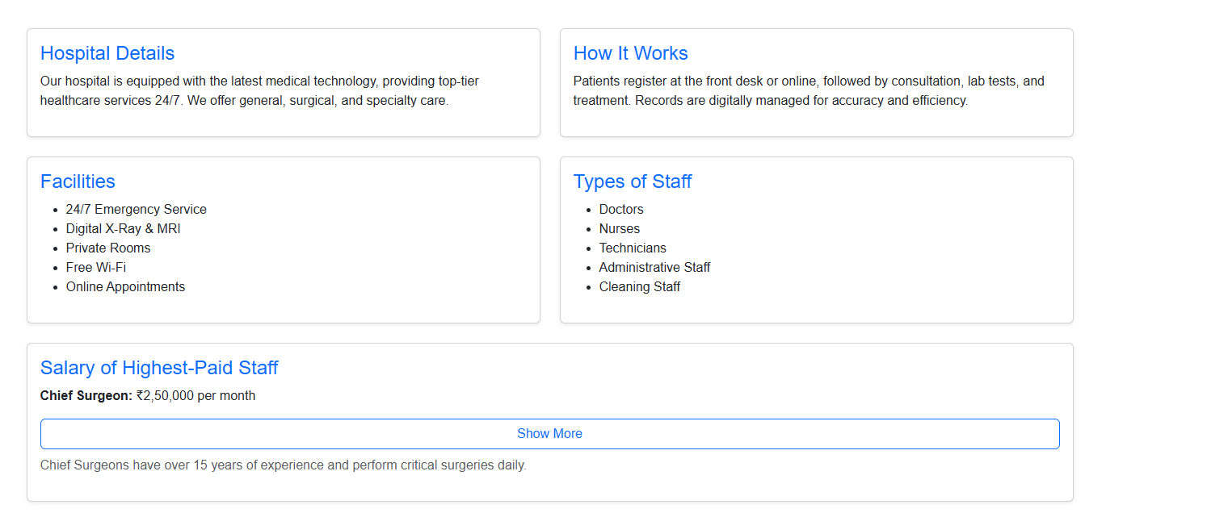
Gallery

Slide 23
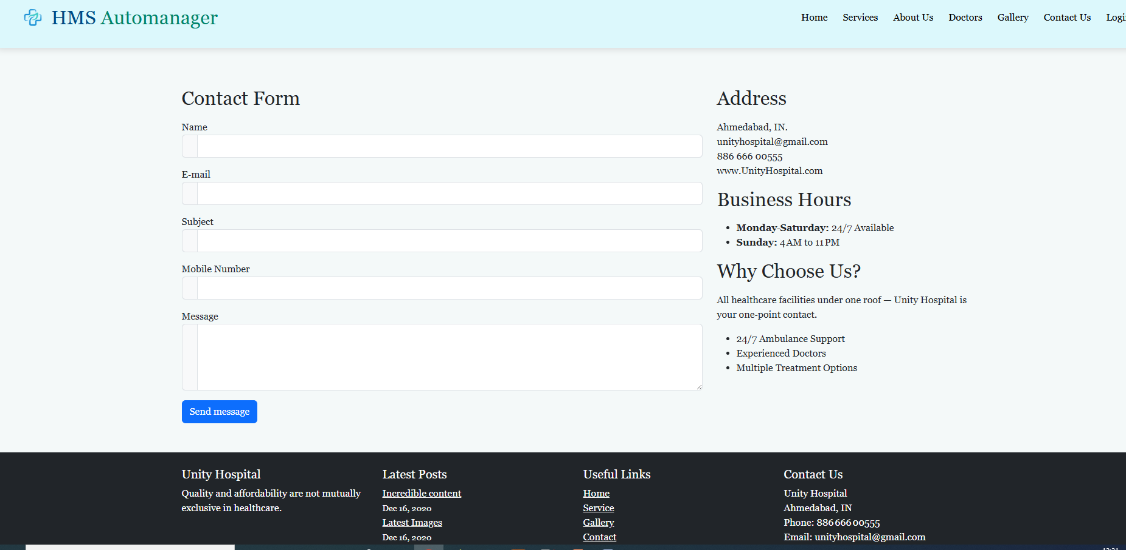
Contact

Slide 24
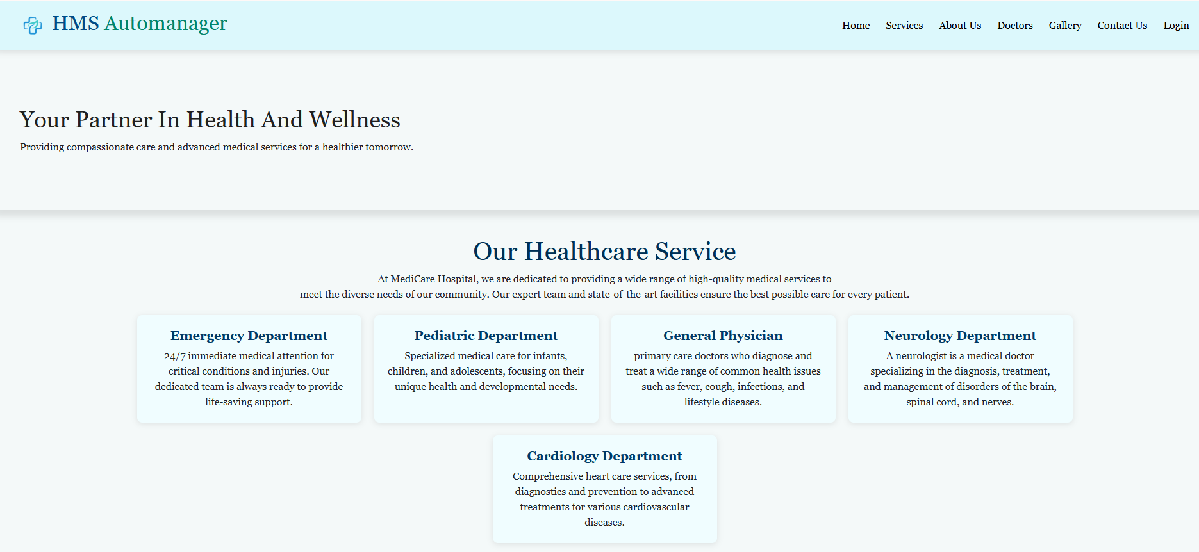
services

Slide 25
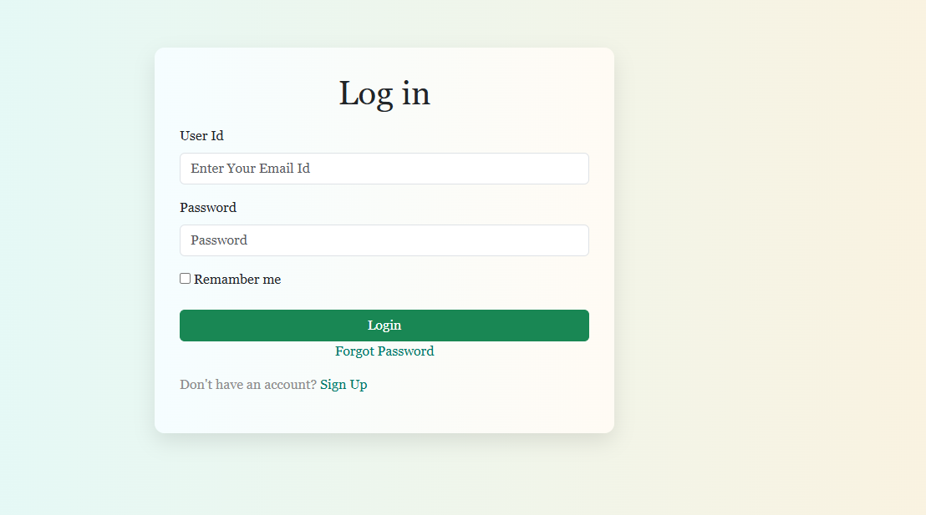
Login

Slide 26
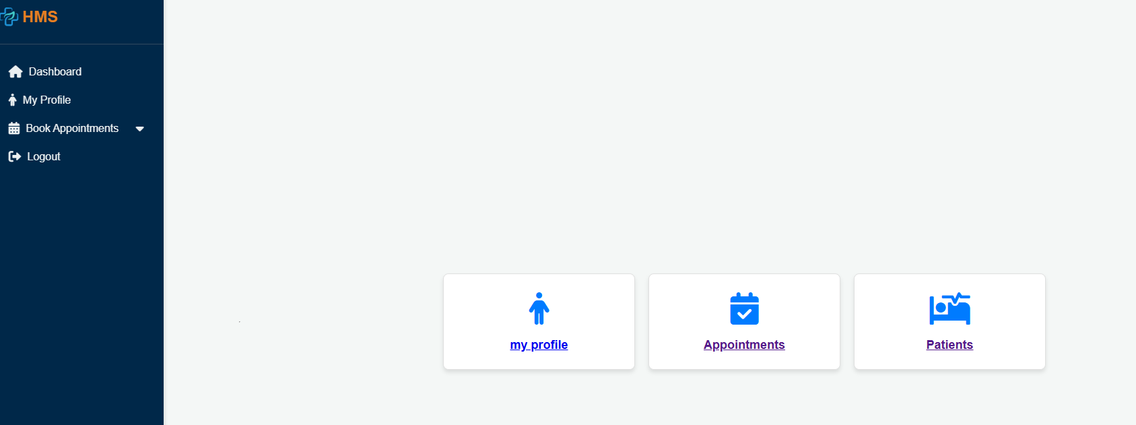
Patient Interface

Slide 27
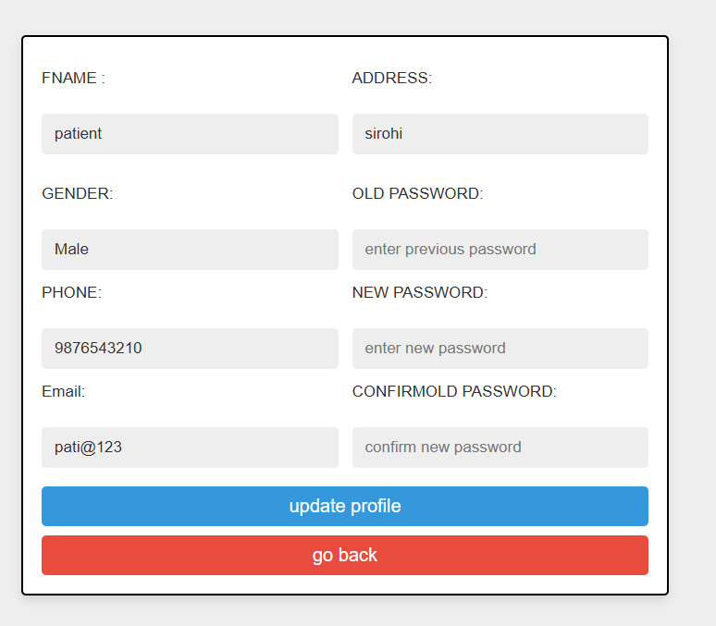
My profile

Slide 28
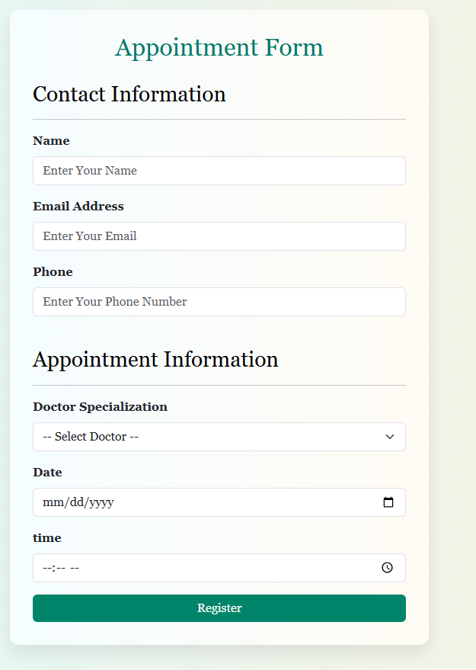
Appointment form

Slide 29
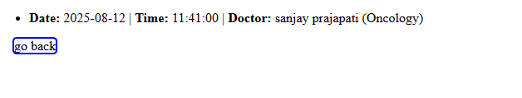
View appointment

Slide 30
Doctor interface
Login

Slide 31
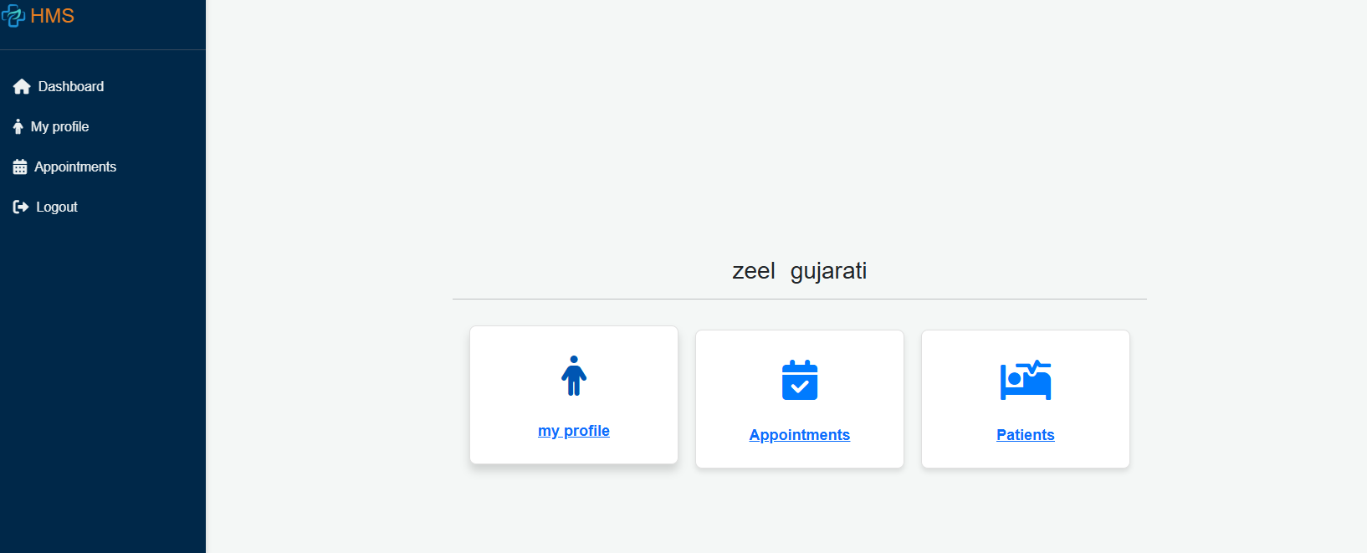
Doctor dashboard

Slide 32
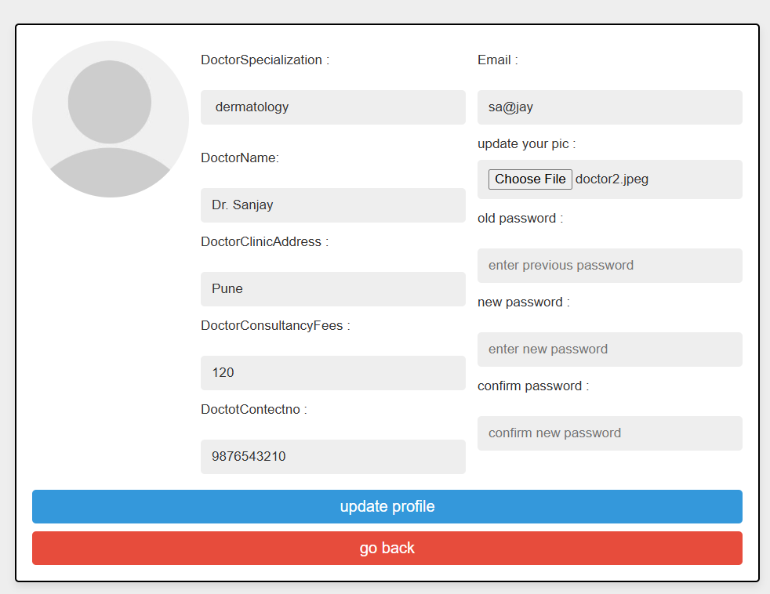
My Profile

Slide 33

Appointments

Slide 34
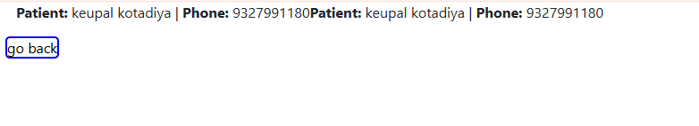
Patient

Slide 35
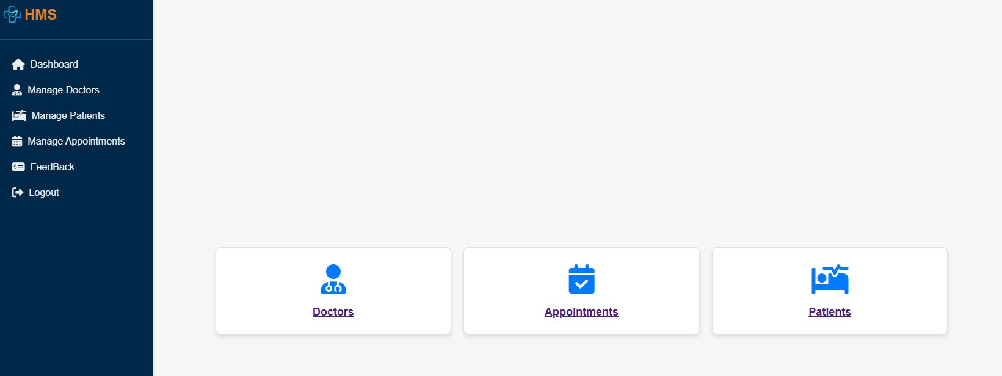
Admin interface

Slide 36
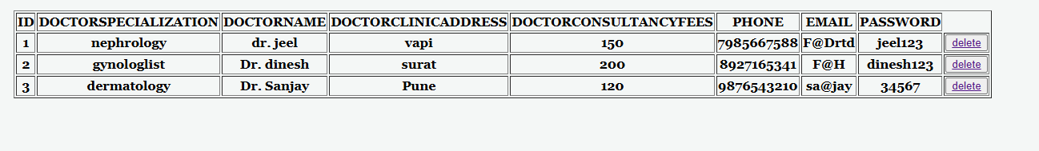
Doctor

Slide 37
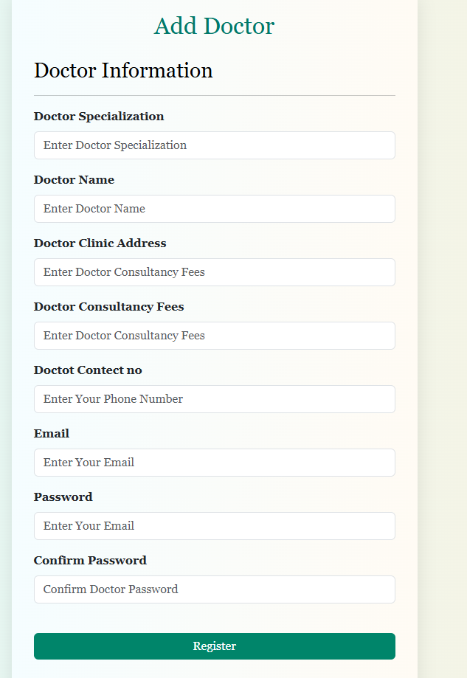
Add new doctor

Slide 38
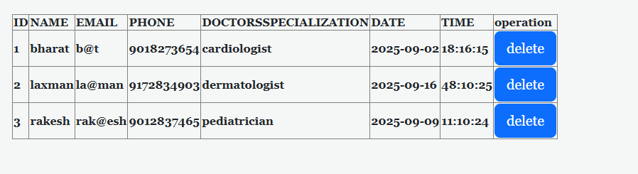
Manage appointment

Slide 39
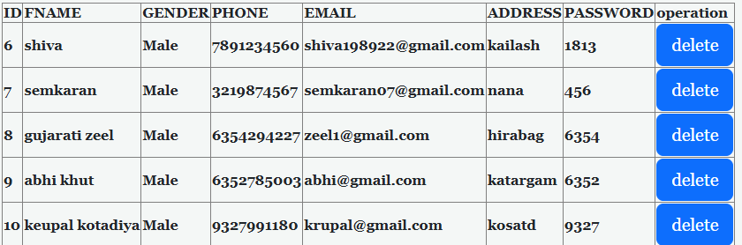
Manage patient

Slide 40
System Testing
System Testing is performed to check whether the Hospital Management System (HMS) works as expected and meets all requirements.
Types of Testing Performed:
Unit Testing
Tests each module (Admin, Doctor, Patient, Appointment) individually.
Ensures all modules function correctly.
Integration Testing
Tests how different modules (e.g., Patient + Appointment, Doctor + Admin) work together.
Verifies smooth data flow between modules.
System Testing
Tests the complete HMS as a whole.
Ensures all features work correctly in the live environment.
User Acceptance Testing (UAT)
Tests the system from the perspective of doctors, patients, and administrators.
Confirms that the HMS meets user needs and is ready for deployment.

Slide 41
Limitations of Current System
Manual Operations – Most tasks like patient registration and appointment booking are done manually.
Time-Consuming –
Managing patient details and doctor schedules takes extra time.
Error-Prone –
High chances of mistakes in maintaining patient and doctor records.
No Centralized Access –
Patients and doctors cannot easily access information.
Poor Data Security –
Records are stored on paper or basic files, which are not secure.
Difficult to Manage Growth
As the number of patients increases, managing records becomes harder.
Limited Communication –
No direct system for patients and doctors to interact efficiently.

Slide 42
Future Enhancements
Online Payment Integration – Allow patients to pay consultation/registration fees online.
SMS/Email Notifications – Automatic reminders for appointments and updates.
Mobile Application – A dedicated HMS mobile app for patients and doctors.
Cloud Database Support – Secure cloud storage for easy access and backup.
Telemedicine Support – Video consultation between doctors and patients.
Health Reports Module – Digital medical reports and prescriptions.
Multi-Language Support – Interface available in multiple regional languages.
AI Integration – Predictive analytics for patient care and appointment optimization.

Slide 43
THANK YOU

