Slide 1
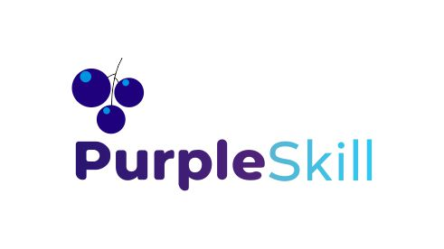
The Model Context
Protocol (MCP):
Build Smarter Autonomous AI Systems
Starting Date : December 4,2025
Time : 8:00 PM IST to 10:00 PM IST
Powered by PurpleSkill & SpanLabs

Slide 2

MCP introduction
Use cases

Slide 3
The Problem MCP Solves 🧩
The Mismatch: Before MCP, connecting an LLM to a tool required writing complex, custom integration code (wrappers/adapters) for every single service.

Slide 4
The Problem MCP Solves 🧩
LLMs communicate via natural language or simple JSON.
External Services communicate via specific binary, HTTP, or gRPC protocols.
The Tool Sprawl Problem: This custom adapter approach creates massive overhead. As the number of tools grows, the complexity of maintaining all these unique integration layers quickly becomes unmanageable, hindering the scalability of Agentic systems.

Slide 5
Introducing the Model Context Protocol (MCP)
Definition: MCP is a language-agnostic, standardized protocol designed specifically for machine-to-machine communication between an Agent/LLM and external services (Tools).
Analogy: The "USB Port" for AI Tools: MCP provides a universal interface. Any Agent (Client) can plug into any MCP-compliant Tool (Server), regardless of the programming language they were built in.
Core Functionality: MCP standardizes the communication lifecycle:
Tool Discovery (Schema Retrieval): The Agent asks, "What tools do you expose (e.g., calculator, fetch_weather) and what are their required inputs and outputs?"
Tool Invocation (Execution): The Agent sends a structured command to the server (call_tool("calculator", {"a": 5, "b": 10})).
Result Delivery: The Server executes the task and sends the structured result back to the Agent.

Slide 6
MCP Architecture: Client & Server
MCP Server (The Tool's Wrapper):
Role: Exposes the functionality of an external service (e.g., a proprietary database connection) as an MCP-compliant API.
Functionality: Handles requests from the Agent, manages the execution of the actual tool logic, and formats the result into a standard MCP response.
Implementation: Often implemented using libraries like FastMCP in Python.
MCP Client (The Agent's Connector):
Role: Sits within the Agent's framework (e.g., LangChain, PraisonAI) and is the component the LLM directly addresses.
Functionality: Translates the Agent's internal intent (structured JSON) into an MCP message and sends it across the network/local pipe.
Transport Layer: The standardized protocol (MCP) is carried over various transports:
Standard I/O (stdio): Used for fast, local communication where the client launches the server as a subprocess.
WebSockets/TCP: Used for communication across networks.

Slide 7
MCP's Impact on Agentic AI
True Modularity: Agents are decoupled from their environment. You can swap out a slow Python calculator tool for a fast Rust calculator tool (both MCP-compliant) without changing the Agent's core code.
Multi-Lingual Tooling: A Python Agent can seamlessly use tools implemented in any language (Go, Node.js, etc.), promoting code reuse and leveraging specialized libraries.
Scalability and Resilience: By isolating the tools in separate servers, failures in one tool don't crash the entire Agent application. Tool execution can also be distributed.
Security & Sandboxing: The MCP server acts as a security barrier. The Agent (potentially vulnerable to prompt injection) never directly accesses the file system or sensitive APIs. It communicates only with the trusted MCP wrapper.

