Slide 1

Tools , Memory and React
Build Smarter Autonomous AI Systems
Starting Date : November 27,2025
Time : 8:00 PM IST to 10:00 PM IST
Powered by PurpleSkill & SpanLabs

Slide 2

Agenda
LangChain recap
Agents work
Tools
ReAct agents
Memory storage
Patterns

Slide 3
LangChain Architecture Overview
LLM Layer → Chains → Agents → Tools → Memory → Retrieval
Ollama provides local LLM runtime
ReAct orchestrates reasoning + tool actions

Slide 4
How Agents Work (Diagram)
User Query → Agent → Reason (Thought)
Reason → Select Tool → Execute → Observe
Observe → New Thought → Final Answer
This loop is the core of ReAct

Slide 5
Why Tools Matter?
LLMs alone cannot perform actions
Tools let LLMs: access APIs, run Python, search data, read files
Agents call tools strategically using ReAct

Slide 6
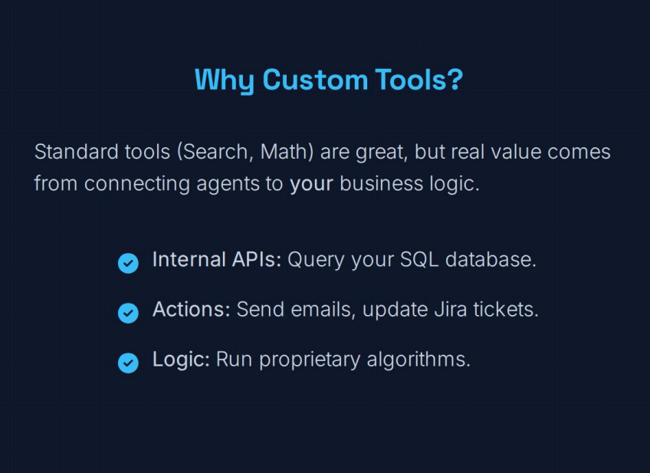

Slide 7
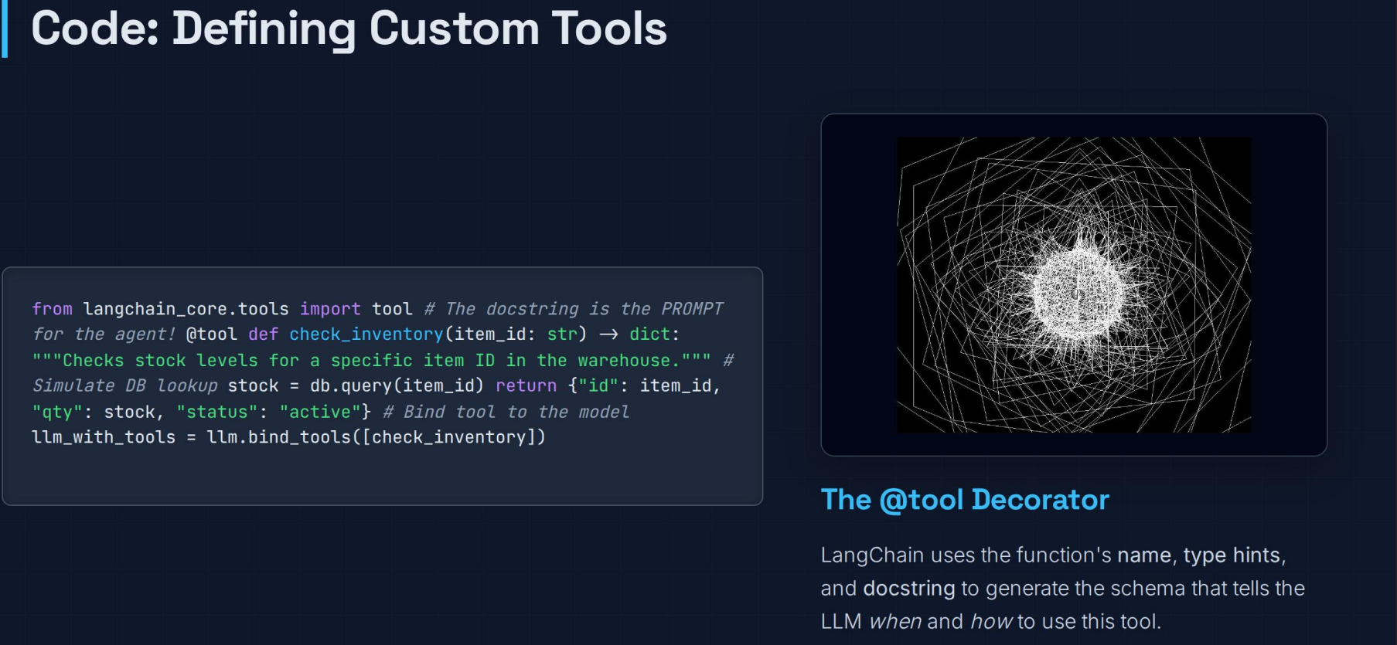

Slide 8
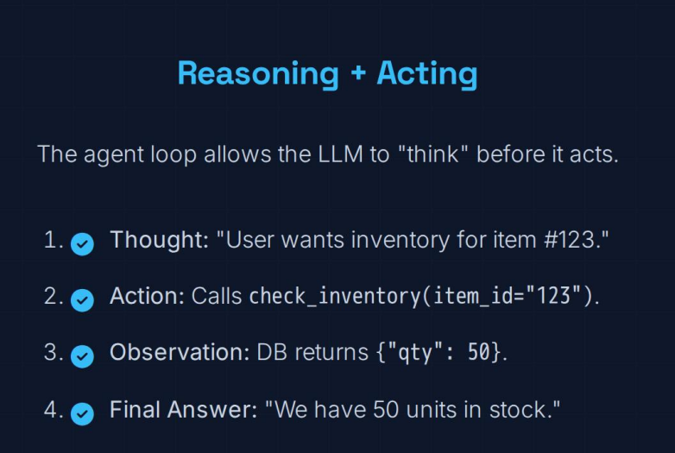
ReAct Agent

Slide 9
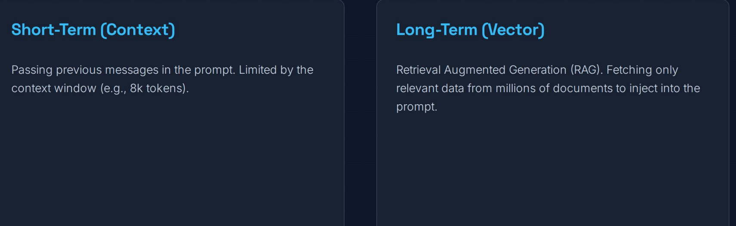
Memory and Retrieval

Slide 10
Memory Pattern 1: In-Memory Buffer
Mechanism: Stores all messages in a Python dictionary (store) during the program's runtime.
Use Case: Quick testing, simple chat interfaces, or sessions that don't need to persist after the server shuts down.
Key Component: RunnableWithMessageHistory automatically manages injecting the message list into the MessagesPlaceholder in the prompt.
Class: ChatMessageHistory (The modern, correct class name for in-memory history).

Slide 11
Memory Pattern 2: File-Based Persistence
Mechanism: Stores the entire conversation as a JSON file (e.g., session-id.json) on the local disk.
Use Case: Single-user chatbots, restarting a demo, or when a full database is overkill.
Persistence: The history survives program restarts.
Key Setup: The factory function must manage the file path (os.path.join(HISTORY_DIR, f"{session_id}.json")).

Slide 12
Memory Pattern 3: Database Persistence (MySQL Example)
Mechanism: Uses SQLAlchemy via SQLChatMessageHistory to store messages in a database table (e.g., MySQL, Postgres).
Use Case: Multi-user applications, scaling to many simultaneous conversations, data integrity required.
Setup: Requires a connection string (DB_URL) and an indexed session_id column for fast retrieval.
DDL: LangChain creates the table, typically with id, session_id, and message (TEXT).

Slide 13
Advanced Pattern: Tool-Calling Agents
Goal: Allow the LLM (like Llama 3) to execute custom Python functions (tools) to fetch live data (e.g., crypto prices) or run complex logic.
Process: The LLM's prompt includes the tool schemas (bind_tools). The LLM decides to call the tool and generates a structured JSON output.
Tool Definition: Uses the @tool decorator and Pydantic schemas to strictly define the tool's input.

Slide 14
Advanced Pattern: Metafiltering
Definition: Metadata filtering involves applying structured constraints (like dates, tags, IDs, user permissions) to the documents stored in a vector database before the vector similarity search is performed or after an initial search.
Purpose: To limit the search space and improve retrieval accuracy by excluding irrelevant documents that might otherwise be semantically similar. This prevents the LLM from hallucinating based on outdated, unauthorized, or contextually inappropriate information.

Slide 15
Advanced Pattern: Metafiltering
How it works?
Ingestion: When documents are converted into vectors (embeddings) and stored in the vector database, they are accompanied by a metadata dictionary containing structured information (e.g., {"author": "John Doe", "year": 2023}).
Query: A user's query is processed, and the system extracts two parts:
The vector query (for semantic search).
The metadata filter (for structured search), often derived from the query or predefined by the application logic (e.g., "only documents written in 2024").
Filtering: The vector database first applies the metadata filter, restricting the search to a subset of documents.
Vector Search: The semantic search (KNN/cosine similarity) is then run only on the filtered subset.
Retrieval: The top k most relevant documents from the filtered subset are returned to the RAG pipeline

Slide 16
Advanced Pattern: Metafiltering
Common use case
Temporal Filtering (Time):
Constraint: date > '2024-01-01'
Purpose: Ensure the LLM only uses up-to-date policies, pricing, or news articles.
Security and Access Control (User Permissions):
Constraint: user_role == 'admin' OR department IN ['Finance', 'HR']
Purpose: Guarantee that a user only retrieves documents they are authorized to see.
Source/Source Type Control:
Constraint: source_type == 'Internal Memo' AND project_id == 'P-42'
Purpose: Restrict answers to specific file types, projects, or domains, avoiding mixing technical manuals with marketing copy.
State Management:
Constraint: status != 'draft'
Purpose: Retrieve only documents that are finalized or published.

Slide 17
Feature | Metadata Filtering (Structured) | Semantic Search (Vector)
Goal | Exact match on structured criteria. | Conceptual similarity on meaning.
Logic | Boolean (AND, OR, NOT, equality, range). | Distance metric (Cosine, Euclidean).
Data | Strings, numbers, booleans, dates, lists. | High-dimensional vectors (embeddings).
Result | Guaranteed precision on attributes. | Returns relevant documents, but may miss constraints.

Slide 18
Describe the trade-offs between using ChatMessageHistory (in-memory) versus FileChatMessageHistory for a production chatbot.
In memory Fastest, non-persistent, non-scalable across multiple processes.
File-Based: Persistent, slower I/O, not suitable for high-concurrency (race conditions).

Slide 19
If you were designing a large-scale, multi-tenant chat application, which LangChain history class would you choose and why? (e.g., SQLChatMessageHistory or RedisChatMessageHistory).
SQL: Data integrity, reliable persistence
. Redis: Low-latency, high-concurrency, caching layer.

Slide 20
In a Retrieval-Augmented Generation (RAG) system, explain the difference between semantic search and metadata filtering. Why do we need both?
Semantic: Meaning, vector similarity. Metadata:
Structured, boolean logic, exact match on attributes
. Need for both: Ensures retrieved documents are both relevant (semantic) and correct/authorized (structured).

