Slide 1
eGFR Regression with Gradient Boosted Trees
Roberts – Coady - Haddad

Slide 2
Predicting Patient’s Next Month eGFR Score
Given 17 months of 100,000 patients’ eGFR scores and demographic data we will leverage gradient boosted trees regression and expanded grid search to predict with a high degree of accuracy, by the metric R-squared, those patients’ 18th-month eGFR scores.

Slide 3
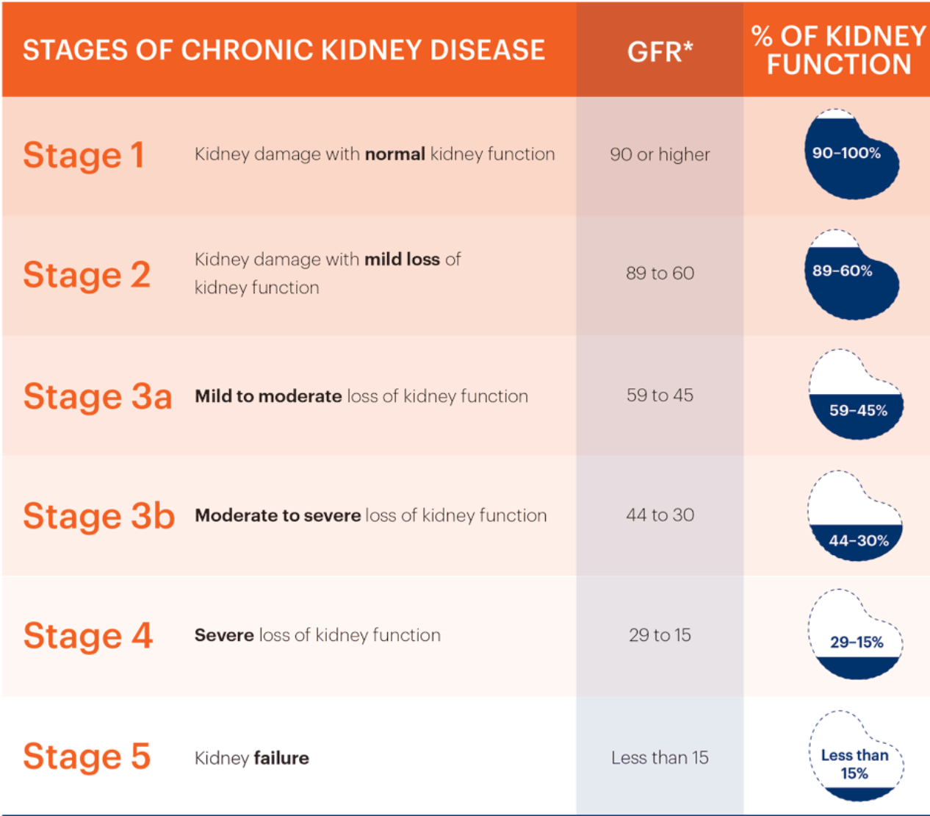
Estimated Glomerular Filtration Rate (eGFR)
eGFR estimates patients’ kidney function by measuring blood creatinine levels
Used to determine a patient’s level of kidney disease
A low eGFR indicates kidneys are not working as well as they should
Kidney Disease is the 9th leading cause of death in the U.S.
1 in 10 adults (31 million) have Kidney Disease
https://www.kidney.org/atoz/content/gfr

Slide 4







Data source and method
SQL, Python, & R
R Programming Language
Clinicians & Frontline Staff
EDA
Modeling & Testing
EHR Allscripts TouchWorks® EHR, Allscripts Professional EHR™
Train/Val/Test Split & Feature Selection
xGboost & Grid Search
Regression
Interpolate, Scale, & One-Hot-Encode
Visualize Results
EHR Database
Join Vitals & Patient Demographics
Test on Unseen Data
Clinical Data Warehouse
(CDW)

Slide 5
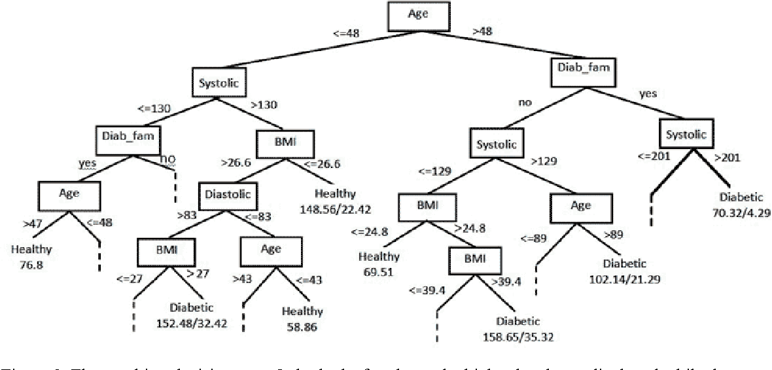
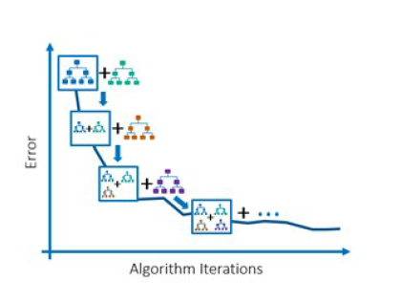
Gradient boosted trees
Machine Learning Algorithm for classification and regression
Ensemble method where a number of weak prediction models (decision trees) are gradually incremented iteratively (gradient descent)
Starting state—predict group mean for all cases, calculate residuals, update model with Loss Function and Regularization
L(y_{obsv}, y_{pred}), or MSE * learning rate (α, η, ν)
Now generate decision trees, predict residuals
Final result is group mean + sum of all iterations’ residuals weighted by learning rate
Parameters to control: depth of decision trees, learning rate, number of iterations

Slide 6





Application of primary method explained
eGFR Training Data
CART
Classify Members
Ensemble Model
Boosting
Post Explanatory Data Analysis
The tree ensemble model consists of a set of classification and regression trees (CART).
Classify the members of a family into different leaves and assign score on the leaf.
A single tree is not strong enough and an ensemble model, which sums the prediction of multiple trees, is used.
Define an objective function and optimize it: training loss and regularization.
https://xgboost.readthedocs.io/en/latest/tutorials/model.html

Slide 7

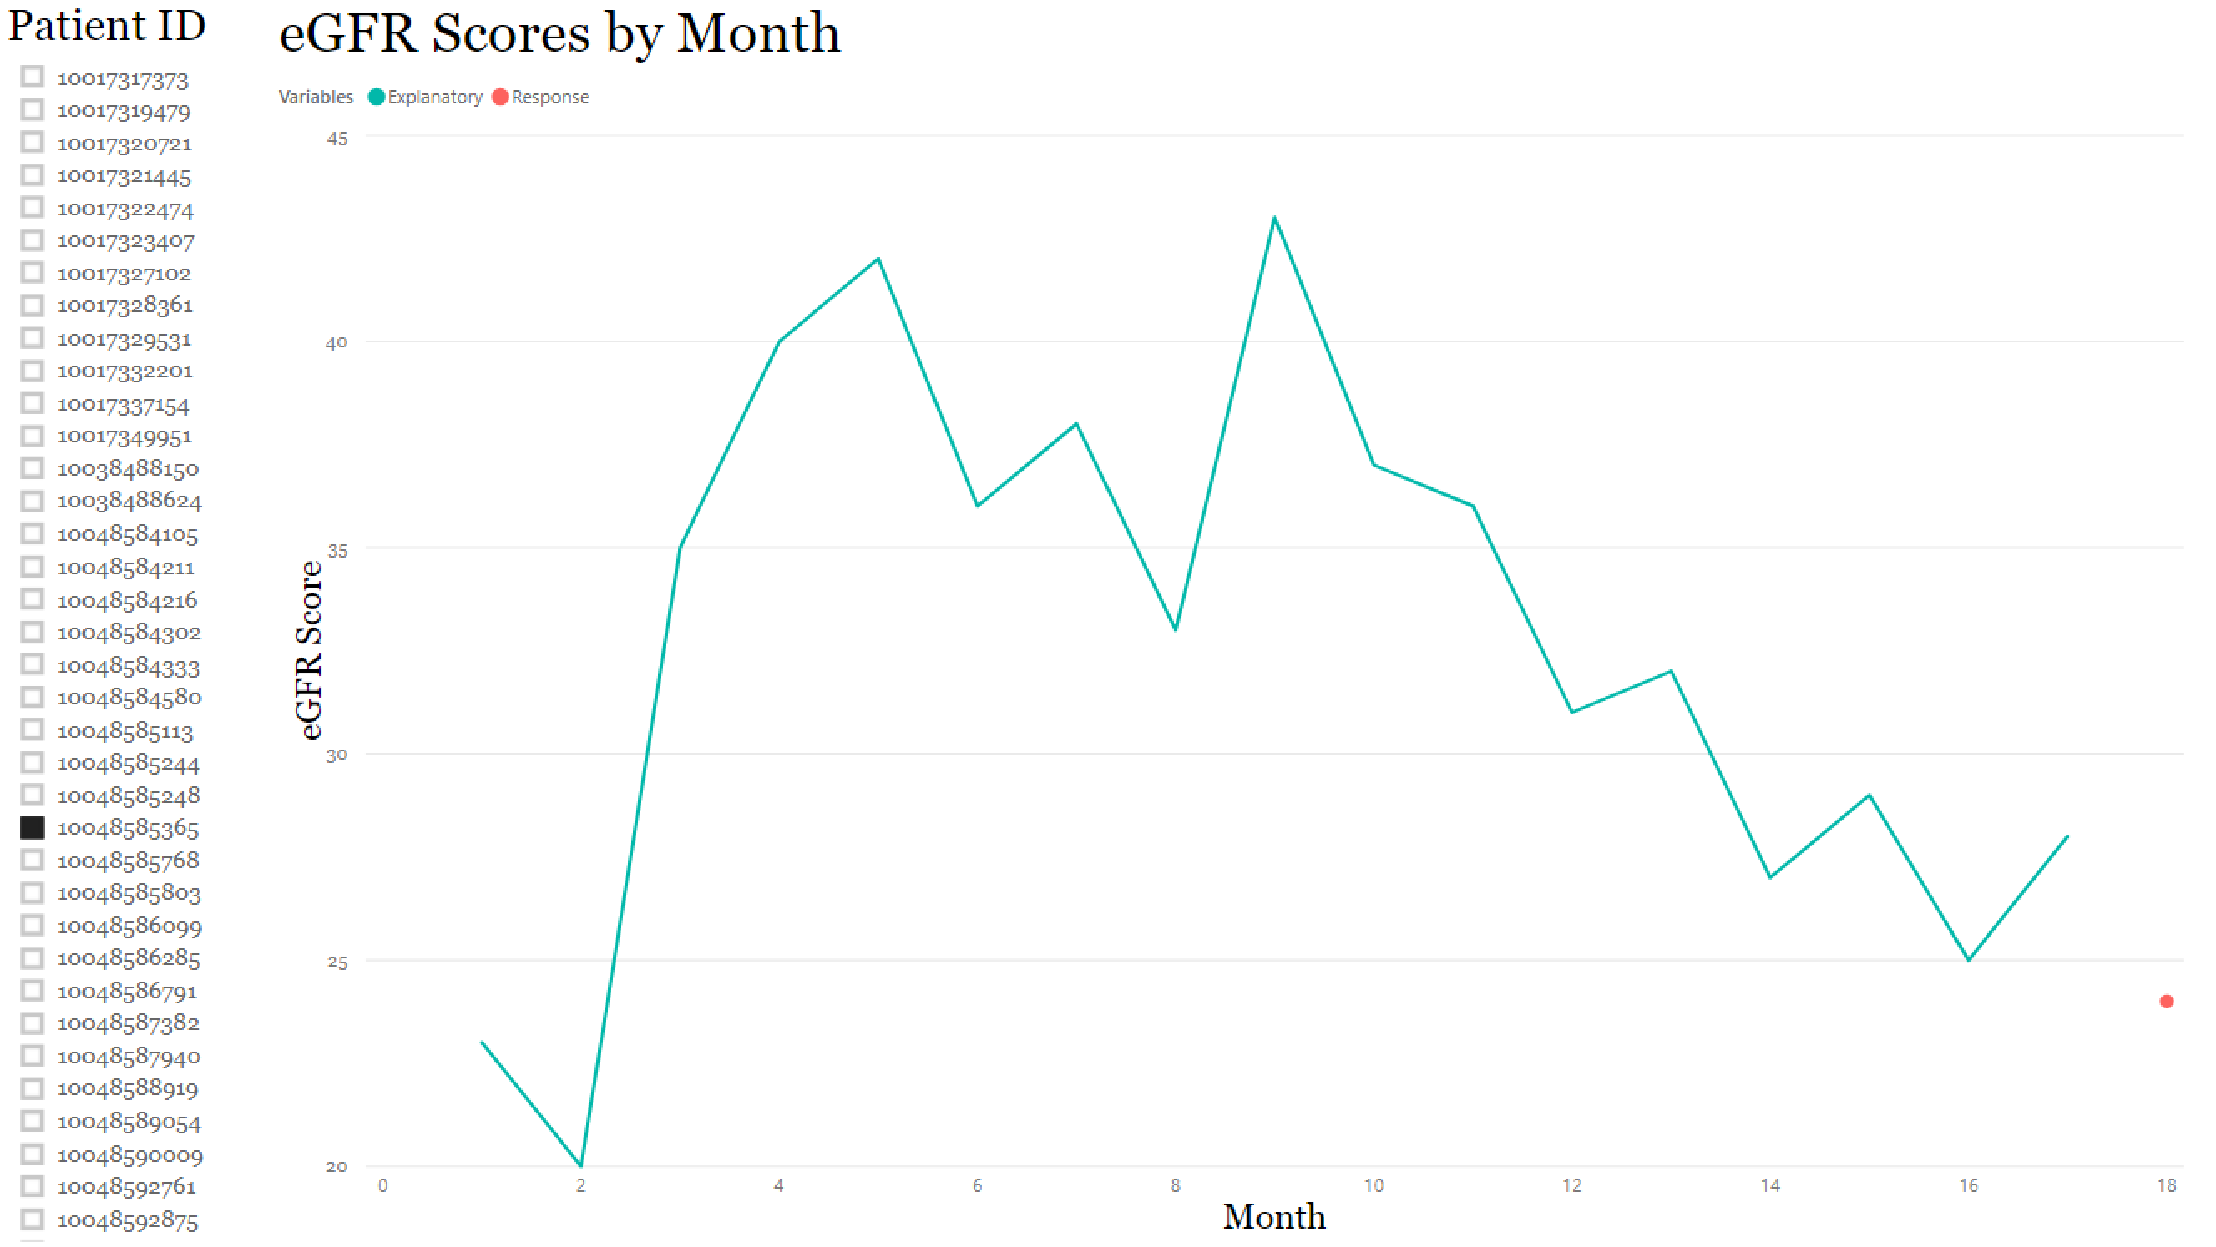

Slide 8
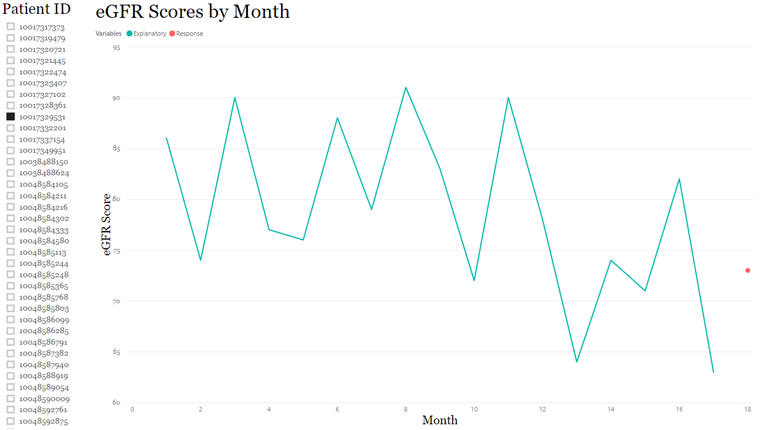

Slide 9
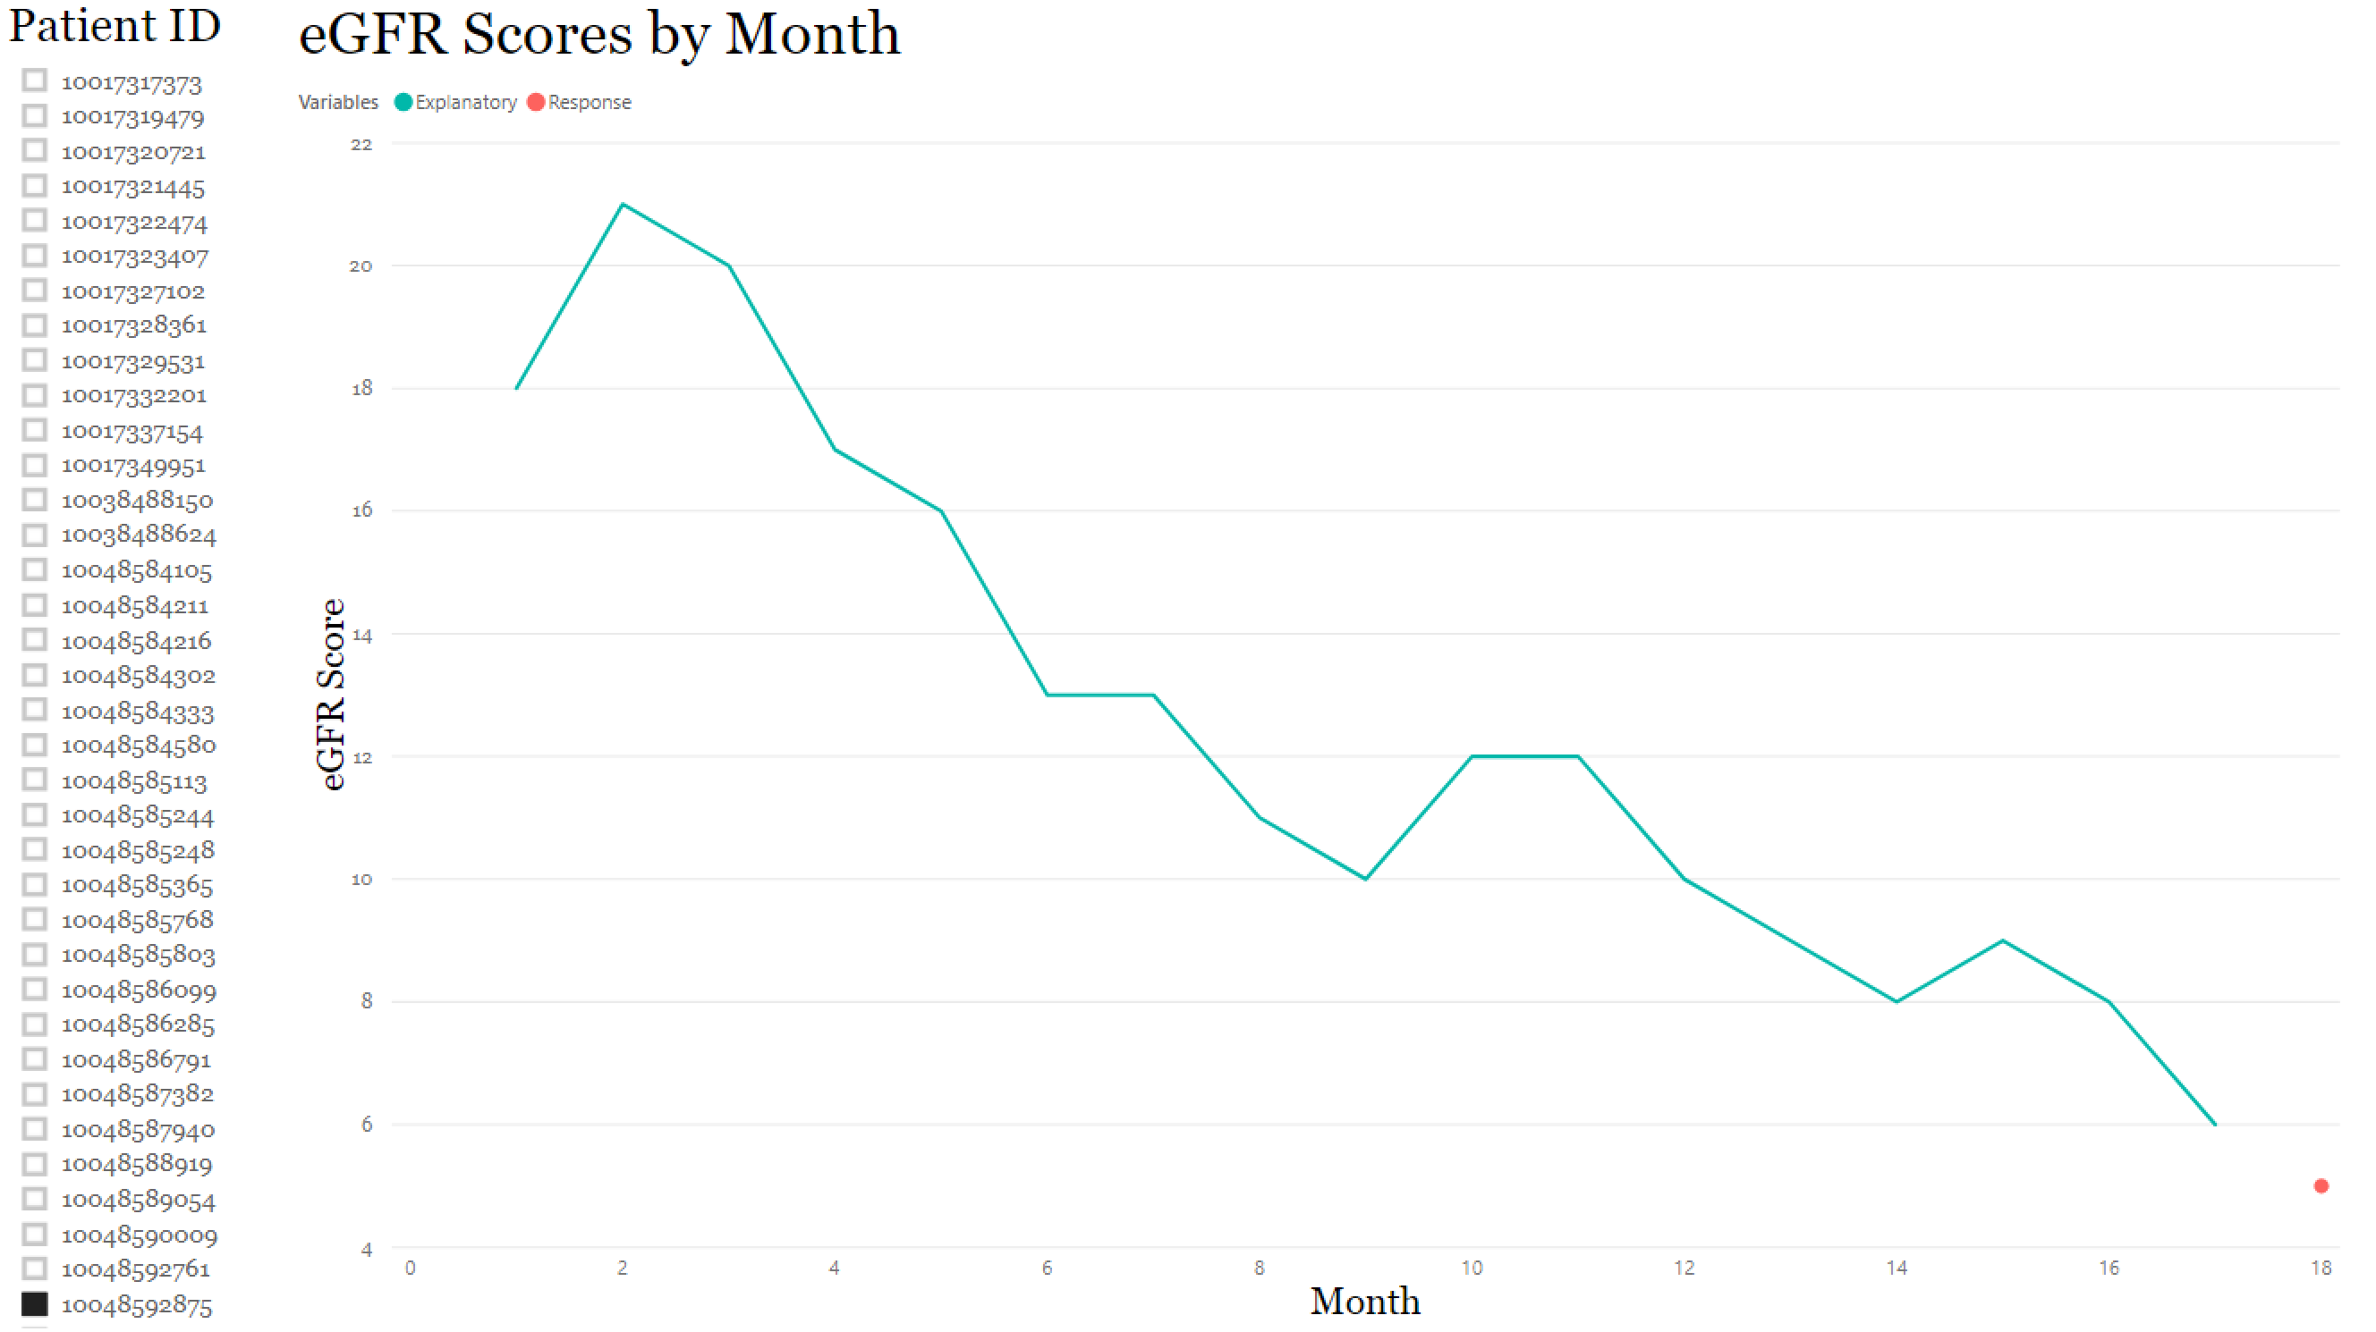

Slide 10
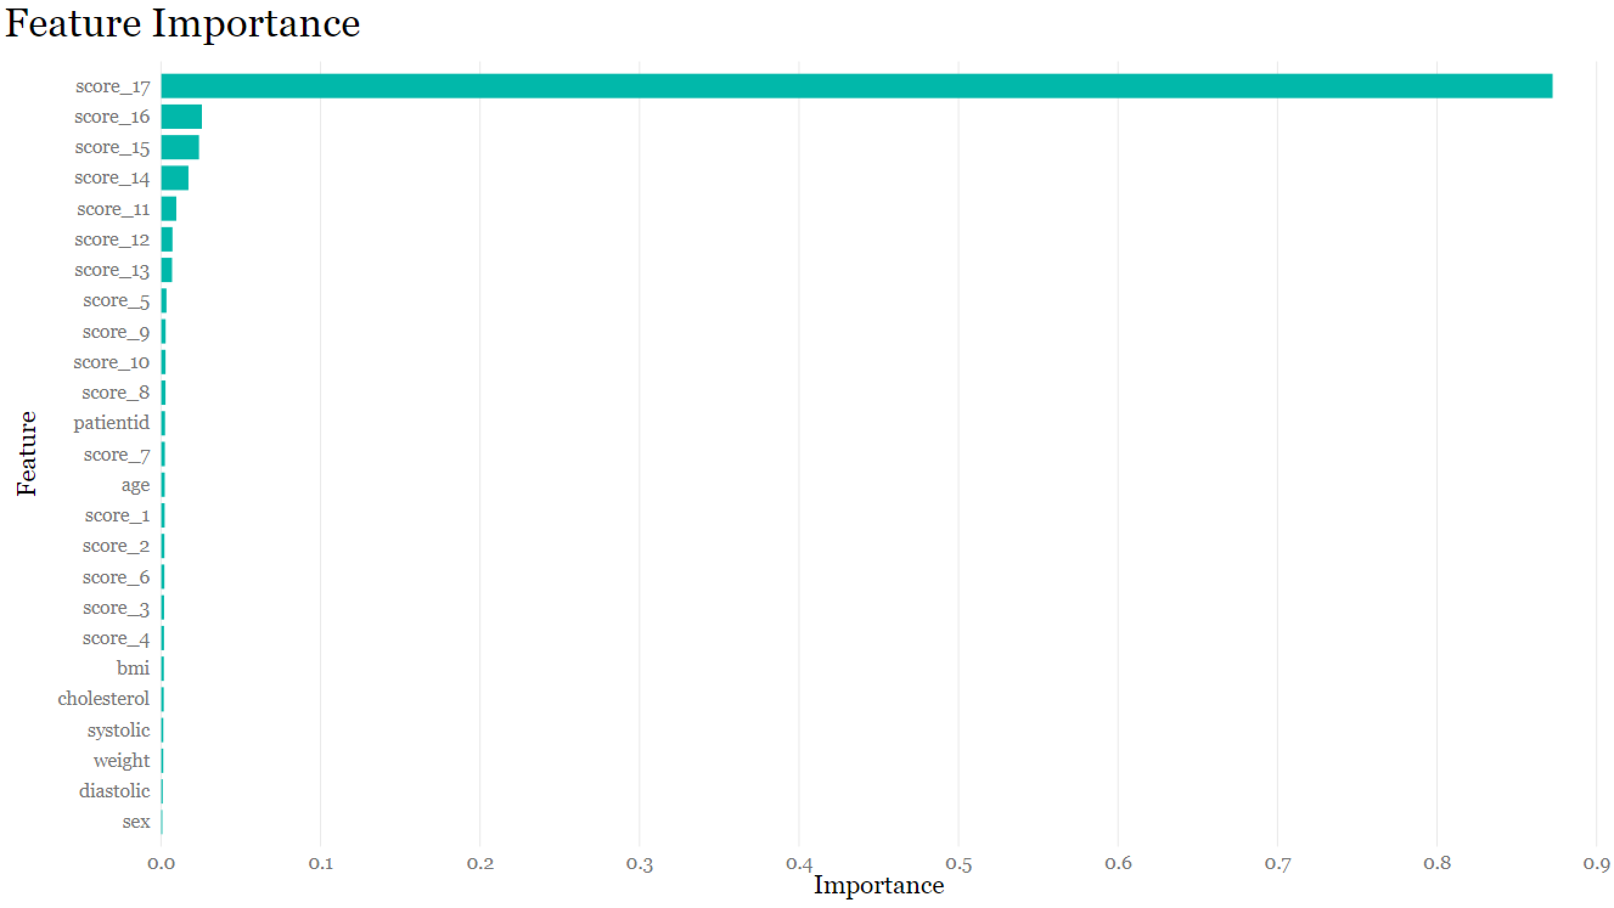

Slide 11
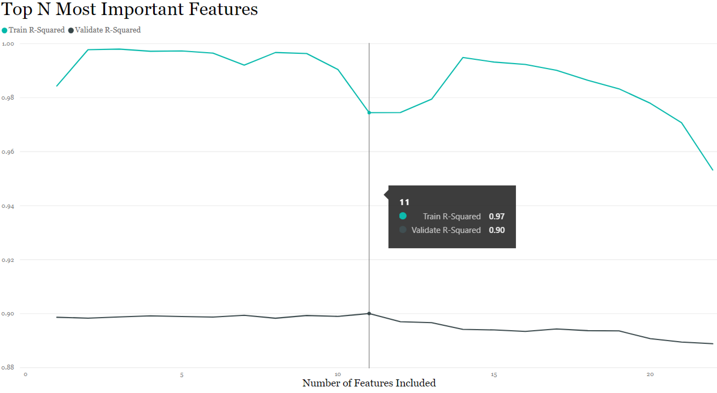

Slide 12
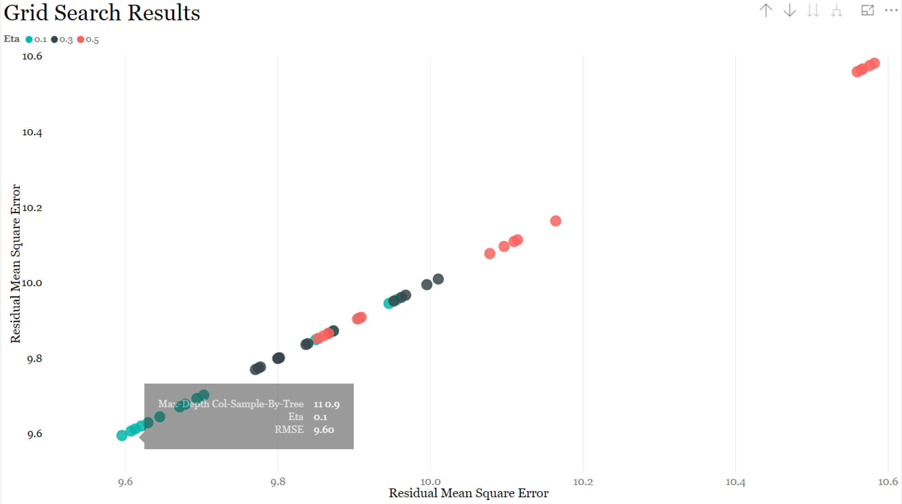

Slide 13
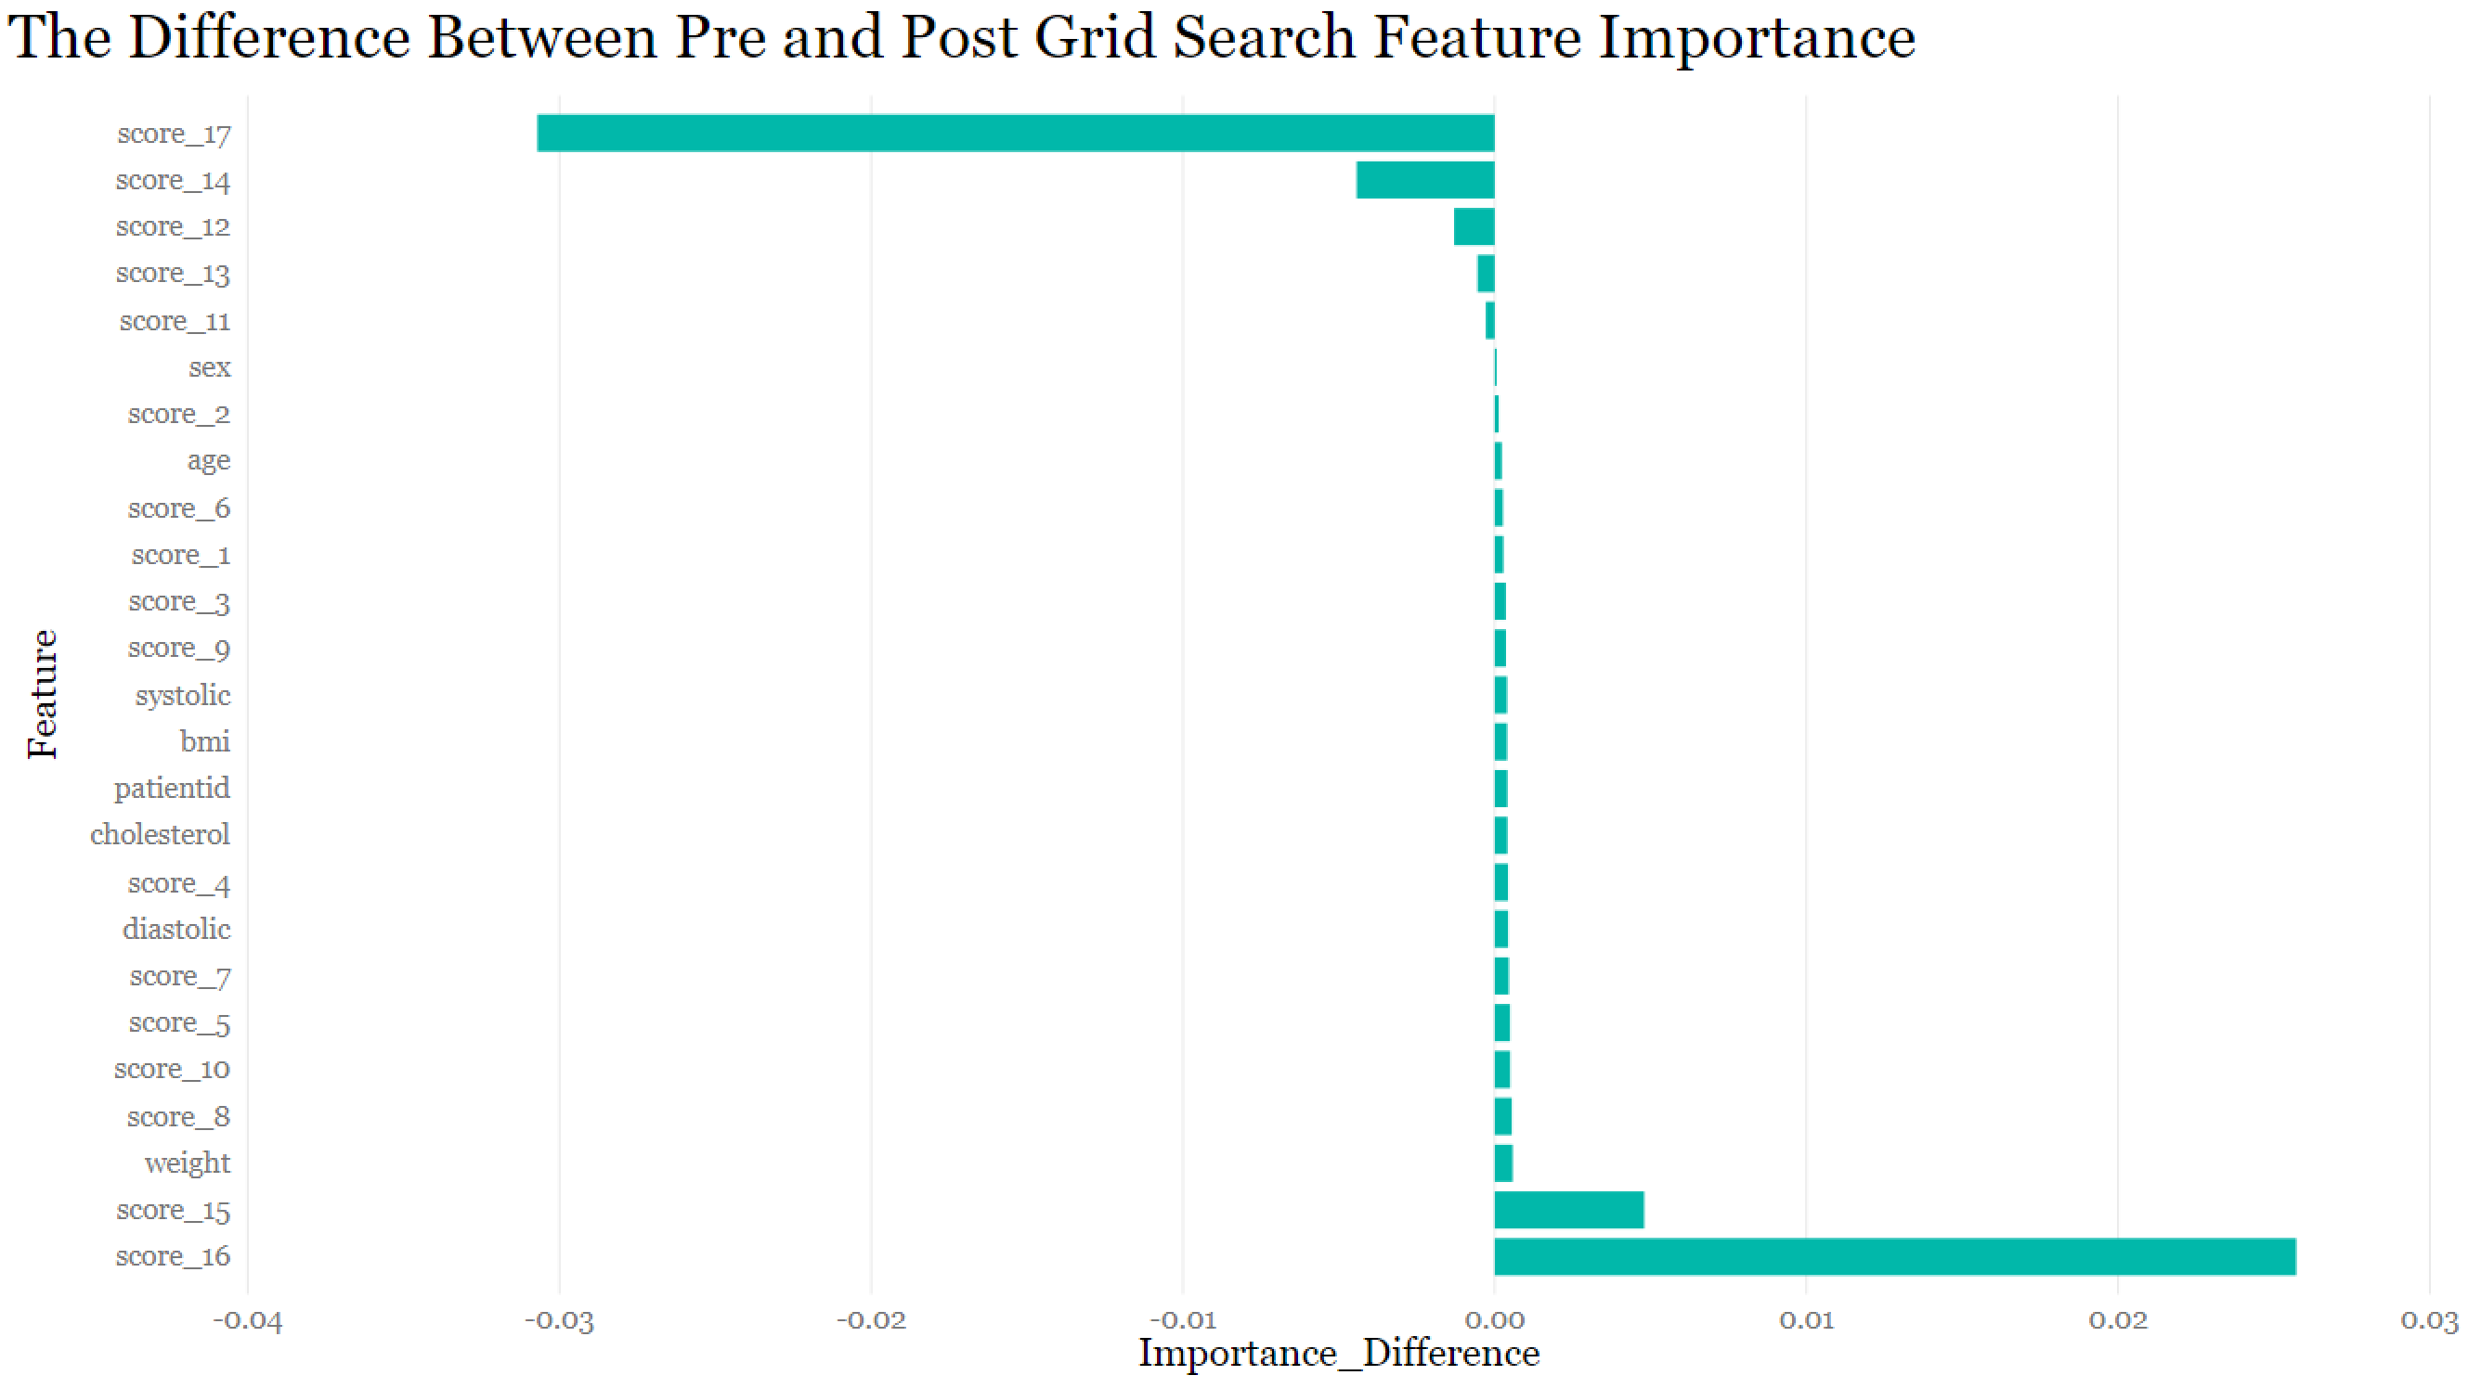

Slide 14
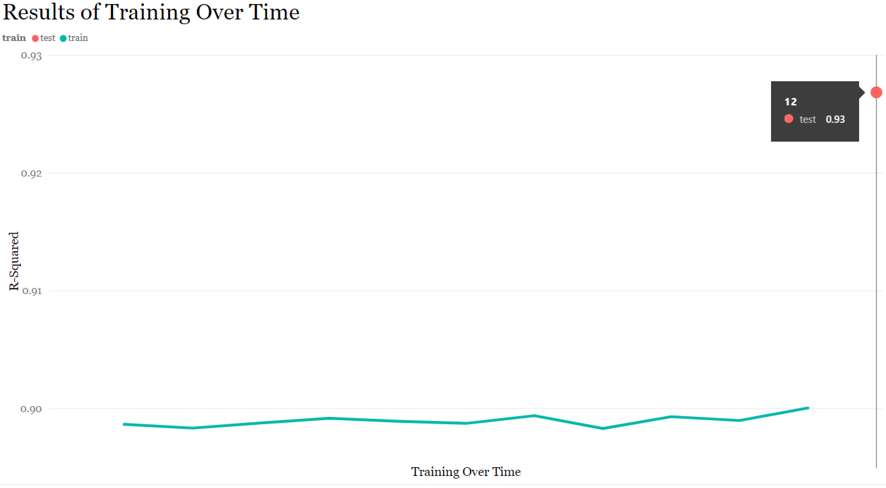

Slide 15
Interpretation and Summary
Age and previous eGFR measures were the best predictors of month 18 eGFR score
Other demographic measures (sex, blood pressure, weight, BMI, cholesterol) did not effectively predict eGFR scores
Autocorrelation needs to be addressed
Successfully increased accuracy from 89% when using an xGboosted model with default parameters to 93% with a grid-search-tuned model using R-squared
Reduced Importance on most recent score using parameter-tuned xGboost

Slide 16
Questions?

