Slide 1


PANIMALAR ENGINEERING COLLEGE
DEPARTMENT OF COMPUTER SCIENCE AND ENGINEERING
CS8811 PROJECT WORK
Commentator(YouTube Comment Analysis using NLP)
Guide Name: Mr. M. Krishnamoorthy
KUMARESH P(211418104134)
PRABHU M(211418104192)
SANJAY KUMAR R(211418104227)
BATCH NO: D7

Slide 2
ABSTRACT
YOUTUBE IS A VIDEO VIEWING SERVICE WHERE USERS CAN WATCH, LIKE, SHARE, COMMENT AND UPLOAD THEIR OWN VIDEOS. THE VIDEO SERVICE CAN BE ACCESSED ON PCS, LAPTOPS, TABLETS AND VIA MOBILE PHONES. NOW-A-DAYS, THE NUMBER OF PEOPLE WITH SMARTPHONE AND INTERNET FACILITIES HAVE INCREASED TREMENDOUSLY AND HENCE THE NUMBER OF YOUTUBE CHANNELS HAVE ALSO INCREASED ACCORDINGLY.
EACH VIDEO HAS A COMMENT SECTION WHERE PEOPLE EXPRESS THEIR THOUGHTS OR OPINIONS ABOUT THE PRODUCT REVIEWED OR OPINIONS ABOUT THE VIDEO POSTED AND HENCE THIS COMMENT SECTION CAN BE ANALYSED USING NATURAL LANGUAGE PROCESSING TECHNOLOGY TO GAIN A BETTER IDEA ABOUT THE EMOTIONS OF THE COMMENT SECTION OF A YOUTUBE VIDEO.
EVEN THOUGH THERE IS A LIKE/DISLIKE BUTTON TO EXPRESS THE EMOTIONS OF A VIDEO, SOMETIMES THEY CAN BE MANIPULATED BY THE USE OF BOTS AND IT IS ALSO IMPOSSIBLE FOR A YOUTUBER OR USERS TO GO THROUGH ALL THE COMMENTS OF A VIDEO AND COMPLETELY ANALYSE THE EMOTIONS EXPRESSED IN IT.

Slide 3



OBJECTIVES
TO HELP BOTH VIEWERS AND CONTENT CREATORS SAVE TIME BY GIVING AN OVERALL ANALYSIS OF THE VIDEO
TO HELP VIEWERS UNDERSTAND THE TRUE NATURE OF EMOTIONS EXPRESSED IN VIDEO
TO HELP VIEWERS IN IDENTIFYING PAID PROMOTION VIDEOS AND ALSO TO PROVIDE AN ALTERNATIVE FOR DISAPPEARANCE OF DISLIKE BUTTON

Slide 4




TECHNOLOGY STACK
PROGRAMMING LANGUAGE : PYTHON
DEVELOPMENT ENVIRONMENT : GOOGLE COLABORATORY
OPERATING SYSTEM : WINDOWS 10
LIBRARIES/API’S USED : SCIKIT-LEARN, NLTK(NATURAL LANGUAGE TOOLKIT), PANDAS, YOUTUBE API

Slide 5
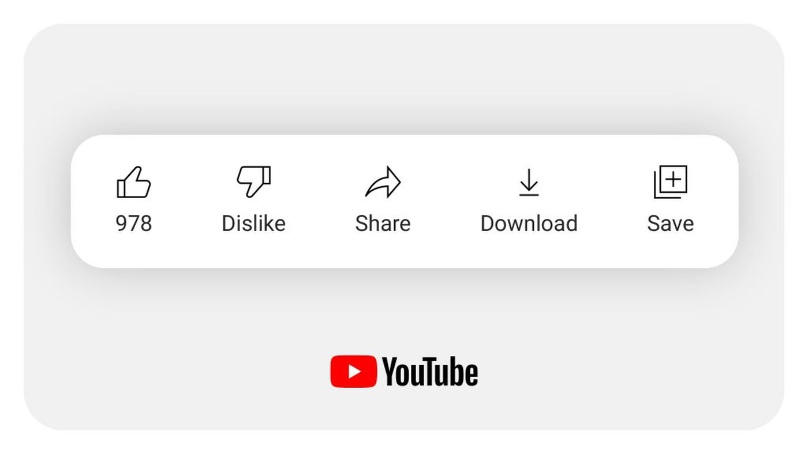


EXISTING SYSTEM
NO WAY OF KNOWING THE INSIGHTS OF THE VIDEO WITHOUT WATCHING IT
COMMENTS ARE SORTED BASED ON LIKES RECEIVED AND CONTENT CREATORS HAVE THE OPTION TO DELETE UNFAVOURABLE COMMENTS
TAKES A LONG TIME TO READ ALL THE COMMENTS BOTH FOR THE CONTENT CREATORS AS WELL AS VIEWERS

Slide 6



PROPOSED SYSTEM
CATEGORIZATION OF COMMENTS BASED ON USER’S OPINIONS
MODEL IS TRAINED USING REALTIME YOUTUBE COMMENTS AND ACCURATE SENTIMENTS THEREBY INCREASING THE OVERALL PREDICTION ACCURACY
HELPS IN DECISION MAKING FOR THE VIEWERS WHETHER TO WATCH THE VIDEO OR NOT

Slide 7
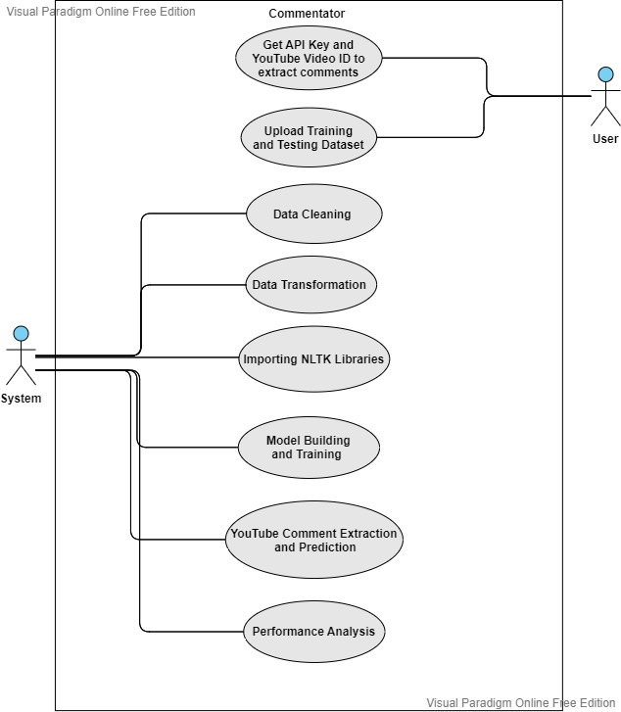
USE CASE DIAGRAM

Slide 8
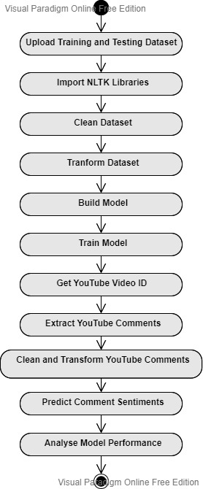
ACTIVITY DIAGRAM

Slide 9
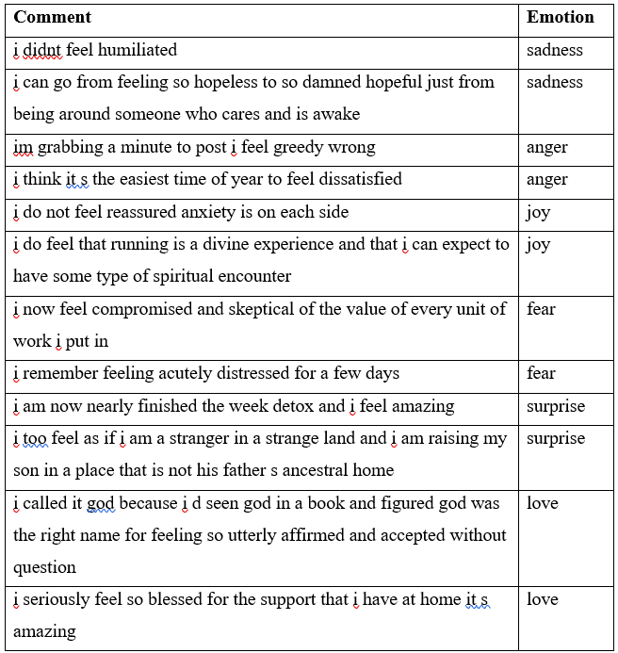
SAMPLE TRAINING /TESTING DATASET

Slide 10
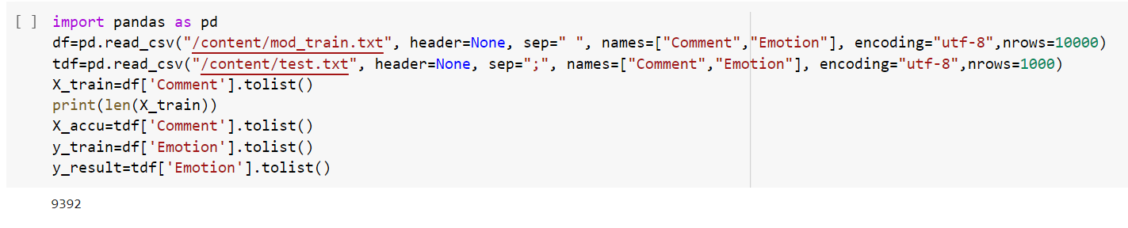
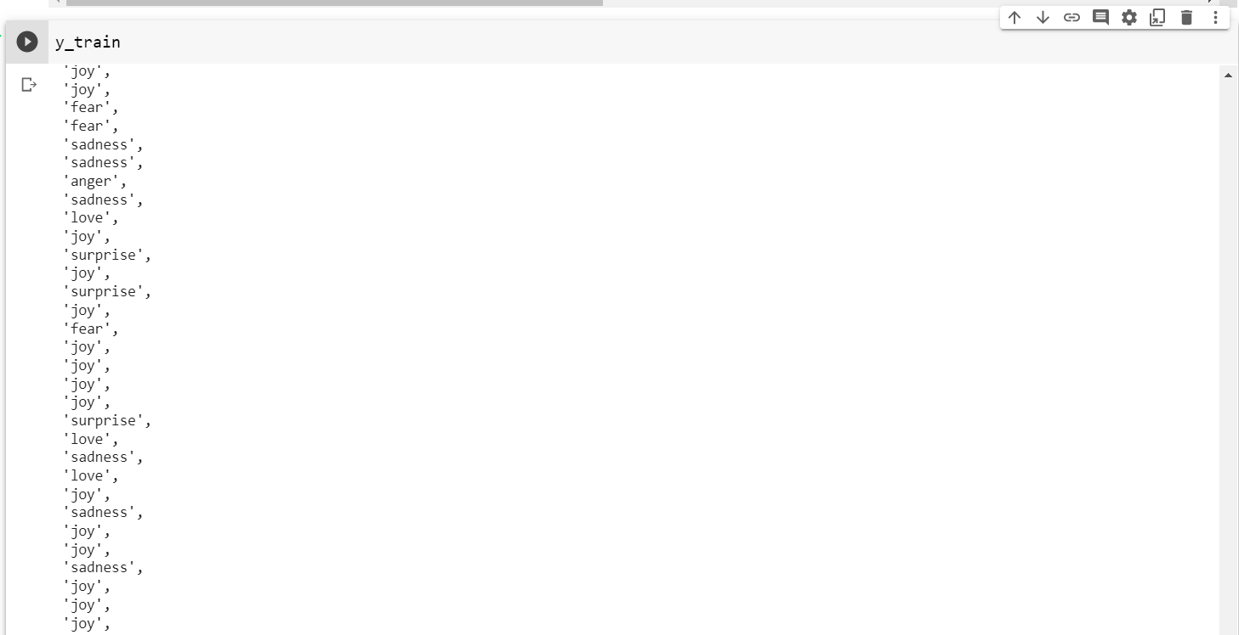
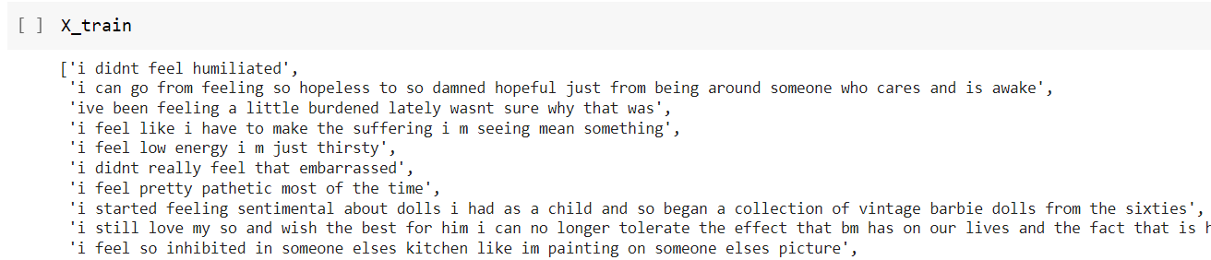
DATASET IMPORTING MODULE

Slide 11
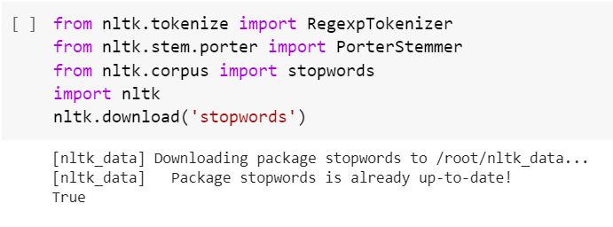
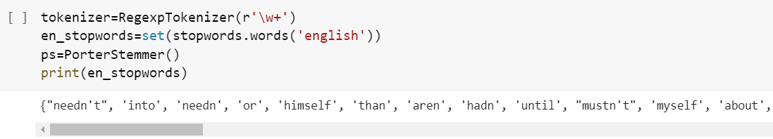
NLTK LIBRARIES IMPORTING MODULE

Slide 12
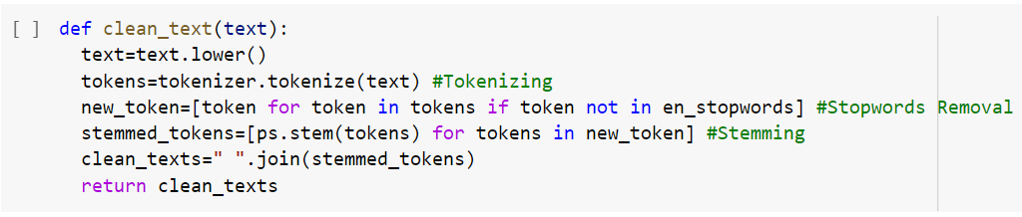

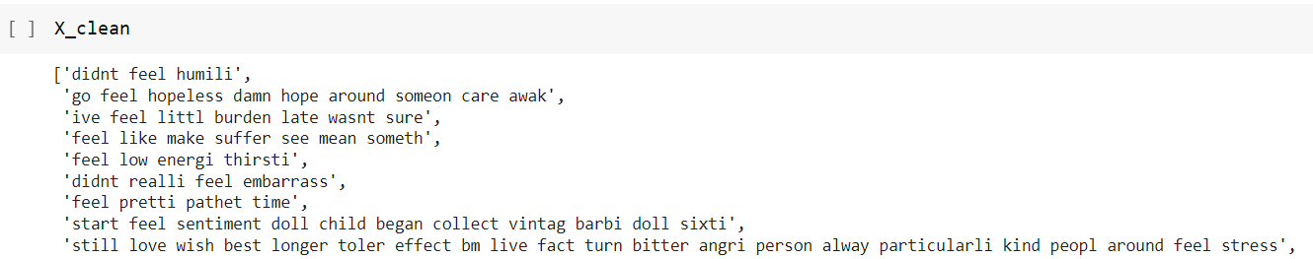
DATASET CLEANING MODULE

Slide 13

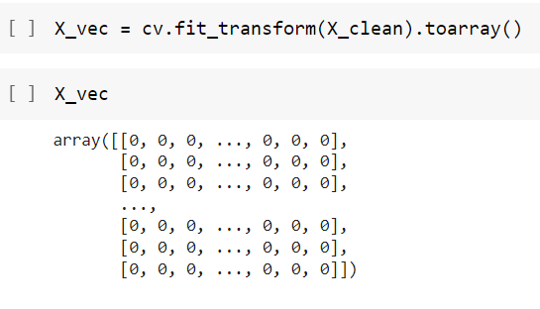
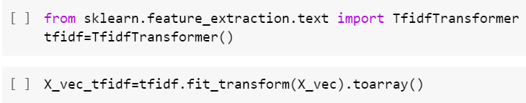
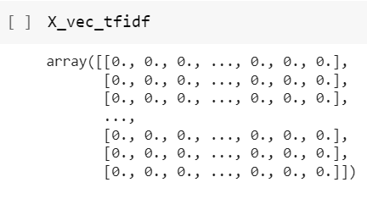
DATASET TRANSFORMATION MODULE

Slide 14


MODEL BUILDING AND TRAINING MODULE

Slide 15
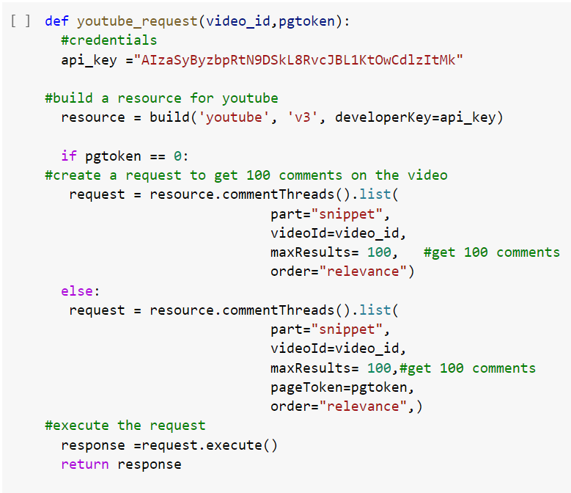
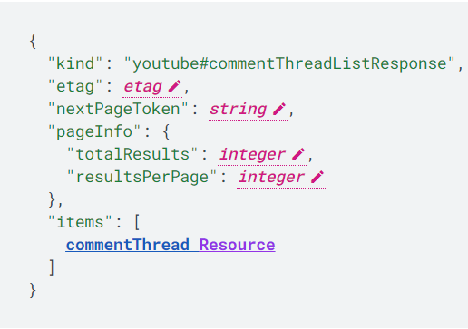
YOUTUBE COMMENT EXTRACTION MODULE

Slide 16
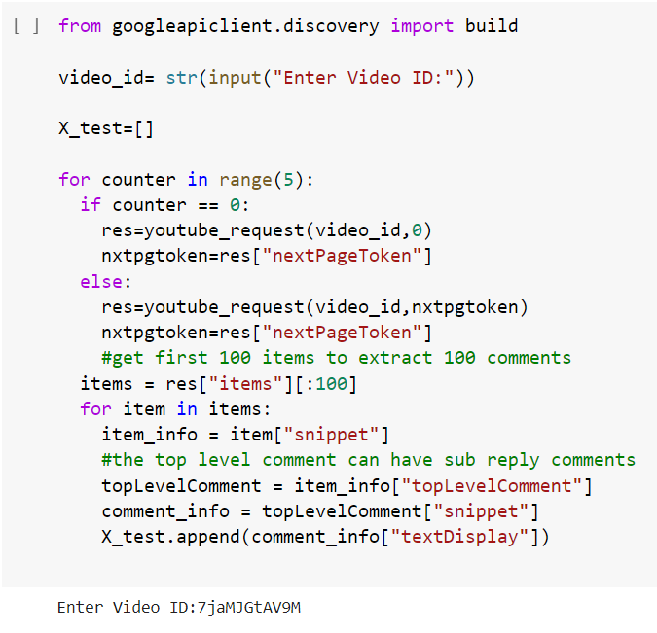
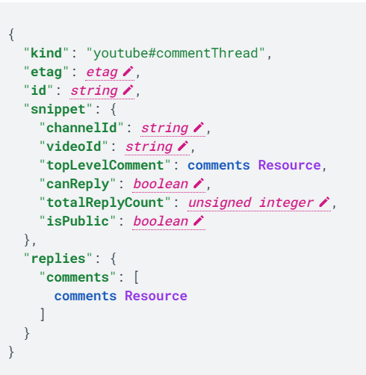
YOUTUBE COMMENT EXTRACTION MODULE CONTD

Slide 17
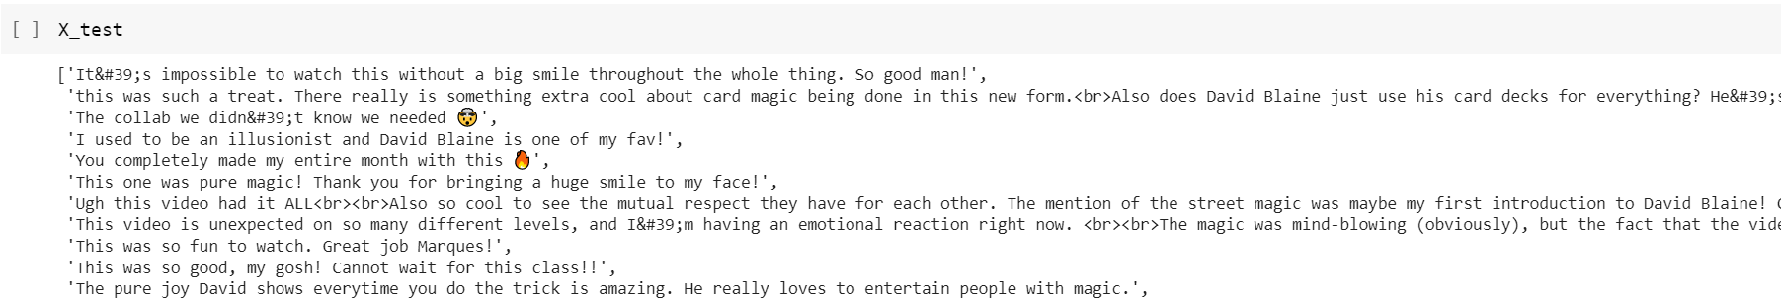
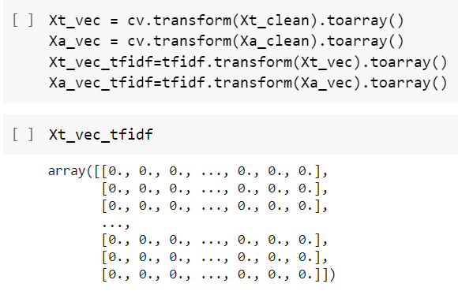

YOUTUBE COMMENT EXTRACTION MODULE CONTD

Slide 18
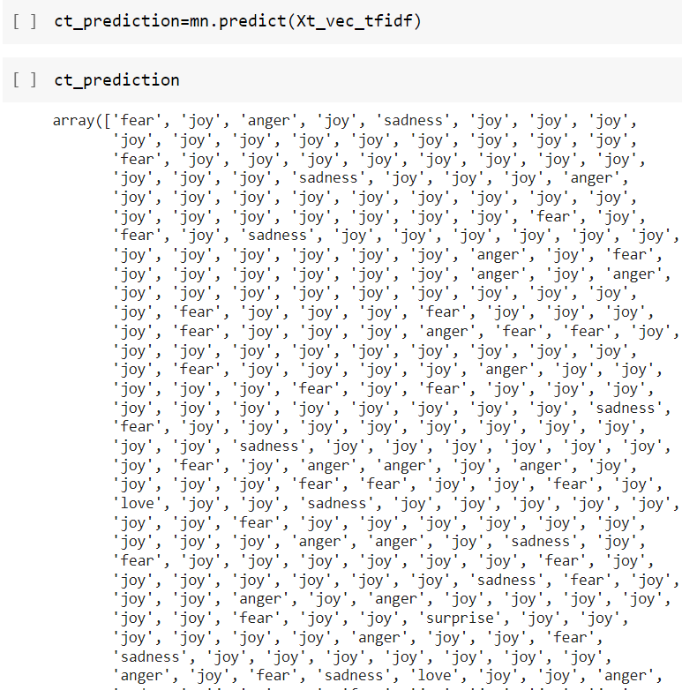
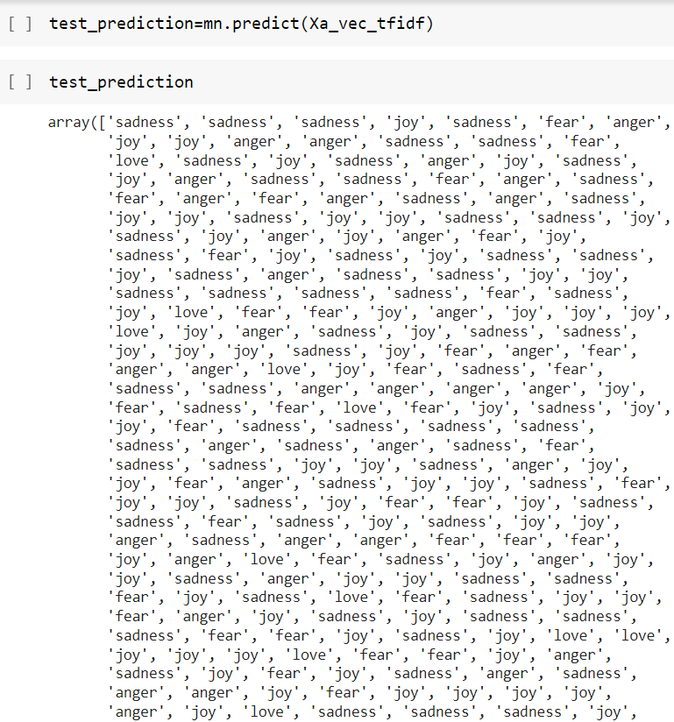
SENTIMENT PREDICTION MODULE

Slide 19
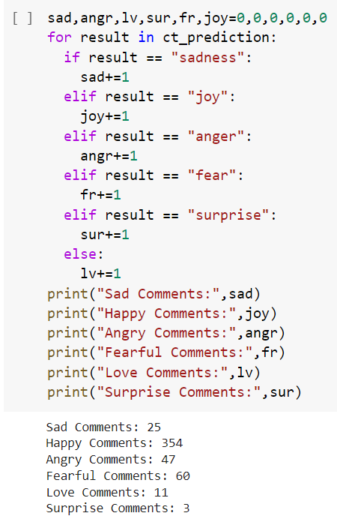
SENTIMENT PREDICTION MODULE CONTD

Slide 20
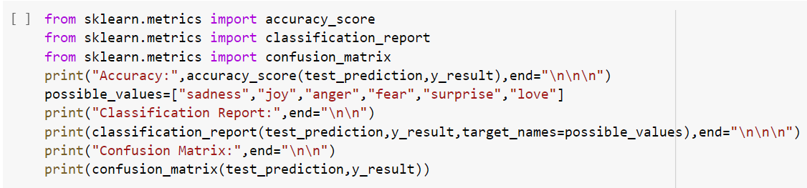
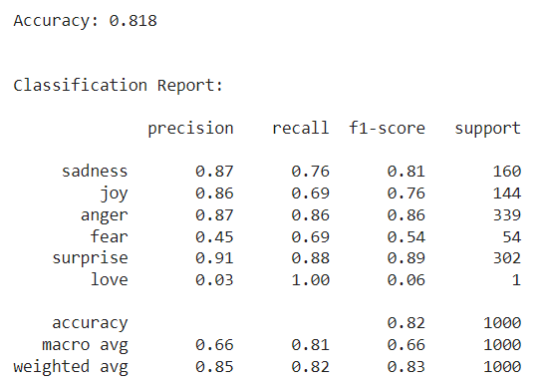
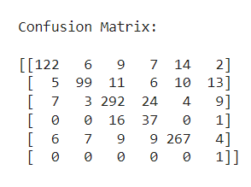
PERFORMANCE ANALYSIS MODULE

Slide 21
CONCLUSION AND FUTURE ENHANCEMENTS
IN THIS PROJECT, THE AIM WAS TO CONSTRUCT A YOUTUBE COMMENT DATASET AND BUILD A MULTINOMIAL NAIVE BAYES MODEL TO CLASSIFY YOUTUBE COMMENTS AS ONE OF THE FOLLOWING CATEGORIES: SAD, HAPPY, ANGRY, FEAR, LOVE, SURPRISE.
A TOTAL OF 11,000 COMMENTS WERE MANUALLY LABELLED BASED ON THEIR SENTIMENT WHICH ARE EQUALLY DIVIDED BASED ON ONE OF THE ABOVE CATEGORIES. FOLLOWING THAT, THE PERFORMANCE OF MULTINOMIAL NAIVE BAYES MODEL ON THE YOUTUBE COMMENT DATASET WAS EVALUATED AND THE ACCURACY WAS FOUND TO BE 81.8%.
THE FUTURE ENHANCEMENTS COULD INCREASING THE NUMBER OF TRAINING AND TESTING DATASETS, CREATING MORE COMPLEX DATASETS WITH LARGE SENTENCES AND CREATING A USER FRIENDLY GUI INTERFACE WITH THE MODEL PREDICTION OPERATION IN BACKEND.

