Slide 1

DealAmigo
The AI salesman that bargains like a human — and never crosses the owner.
Live demo dealamigo-seven.vercel.app Code github.com/sanjayrahulcodes/dealamigo
Hackathon prototype · July 2026

Slide 2



THE PROBLEM
Every sale at a small shop is a negotiation
Bargaining is the buying process
Customers haggle over WhatsApp and at the counter — in Hindi, Telugu, Tamil, or all three mixed. A fixed-price bot ends the conversation.
63M+
Only the owner knows the real floor
How far a price can move lives in the owner's head — and the owner can't be in every chat, every evening, all season.
micro & small businesses in India sell this way
Margin leaks, sales walk away
Fixed-price chatbots don't fit how they actually sell.
Staff either hold firm and lose the customer, or concede too much — with no record of how the final price was reached.

Slide 3

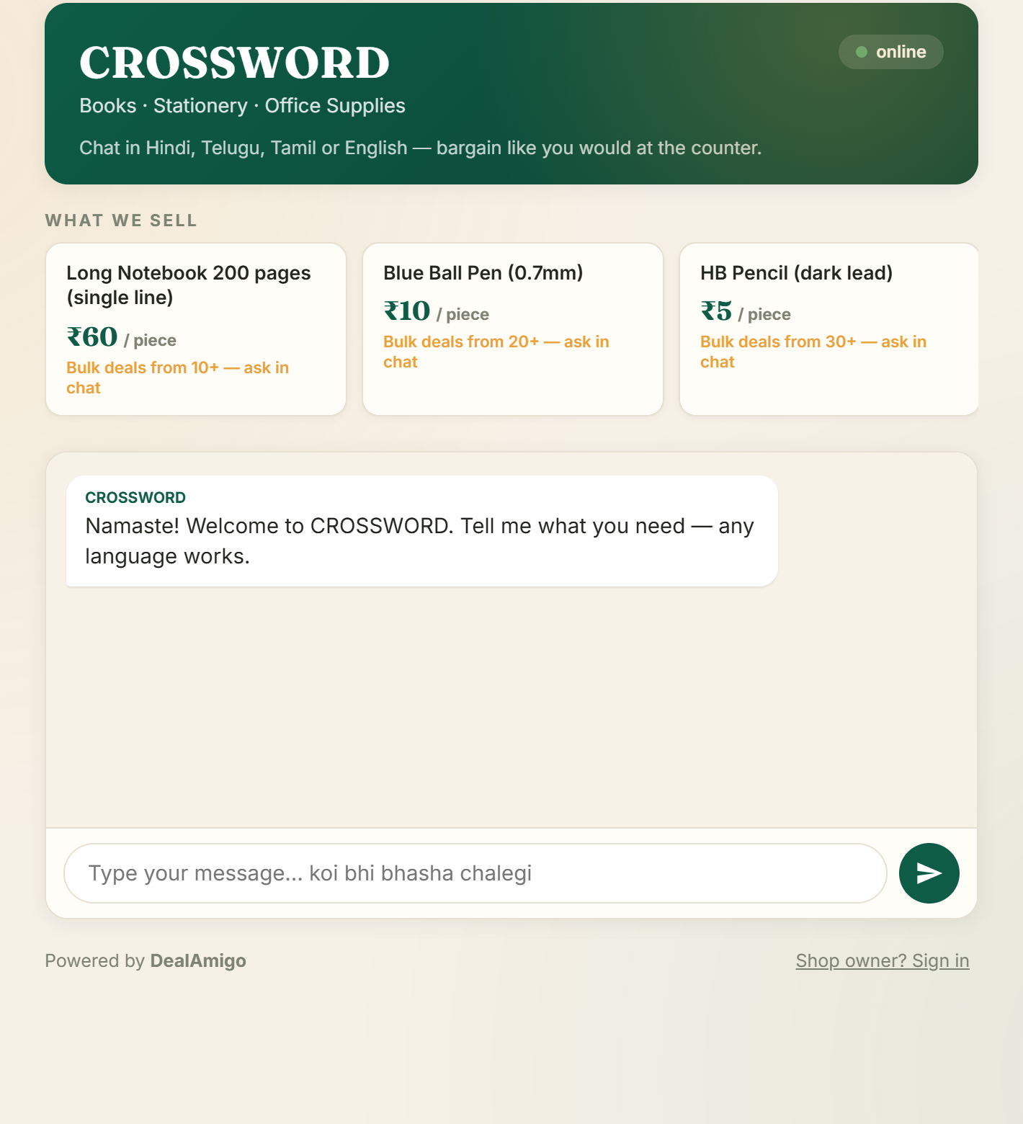



THE SOLUTION
A salesman in software — storefront, chat & deal in one link
Speaks the customer's language
Hindi, Telugu, Tamil or English — script and tone mirrored, strictly one language at a time.
Negotiates step by step
Concedes one owner-defined step at a time, each with a stated reason: bulk, advance payment, pickup.
Owner-set hard floor
Escalates for approval the moment a request crosses the owner's limits — never silently.
Closes the loop
Letterheaded receipt, then delivery or store pickup — handed off straight into WhatsApp.

Slide 4
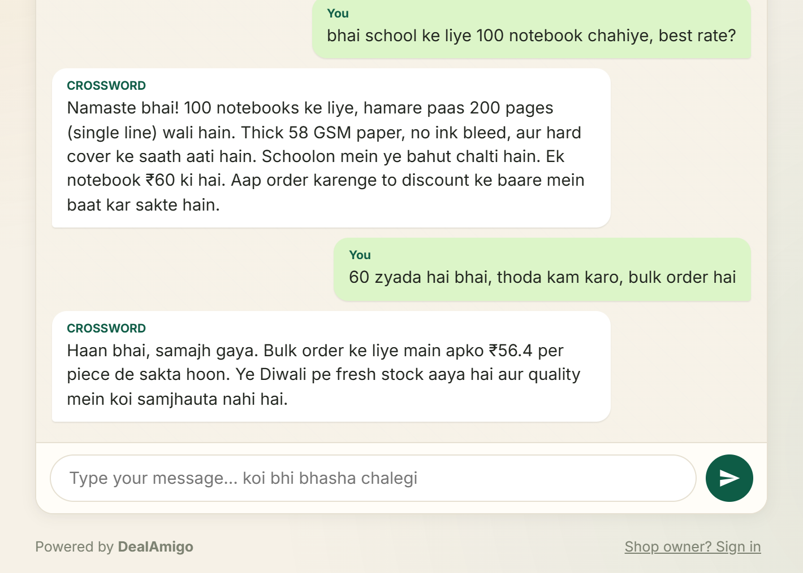
LIVE DEMO
It bargains like a human
Language mirrored
Romanized Hindi in, romanized Hindi out — “bhai” gets “bhai”, “sir” gets “sir”.
One step, one reason
₹60 → ₹56.4 only after push-back, framed as a considered trade for the bulk order — never a free drop.
The LLM never picks the number
Each turn the model is told the single next price it may offer. Everything else it says is language, not math.

Slide 5


HOW IT WORKS — LANGUAGE AND NUMBERS ARE SPLIT
An agent, not a chatbot
Customer message
LLM: understands & phrases
State machine: owns every number
→
→
Any language, any format — a price, a lump-sum total, a demand.
Gemini (via OpenRouter) reads intent and writes the reply in the customer's language.
Validates the model's claimed action against floors, steps, quantity gates and stock — in code.
Reply / concede
Close + bill
Escalate to owner
next allowed step only
confirmed rate, validated in code
below floor, tiny order, big total
The guarantee: a persuasive customer can talk to the model all day — it structurally cannot go below the owner's floor. The code even double-checks the model's arithmetic before any escalation or close.

Slide 6

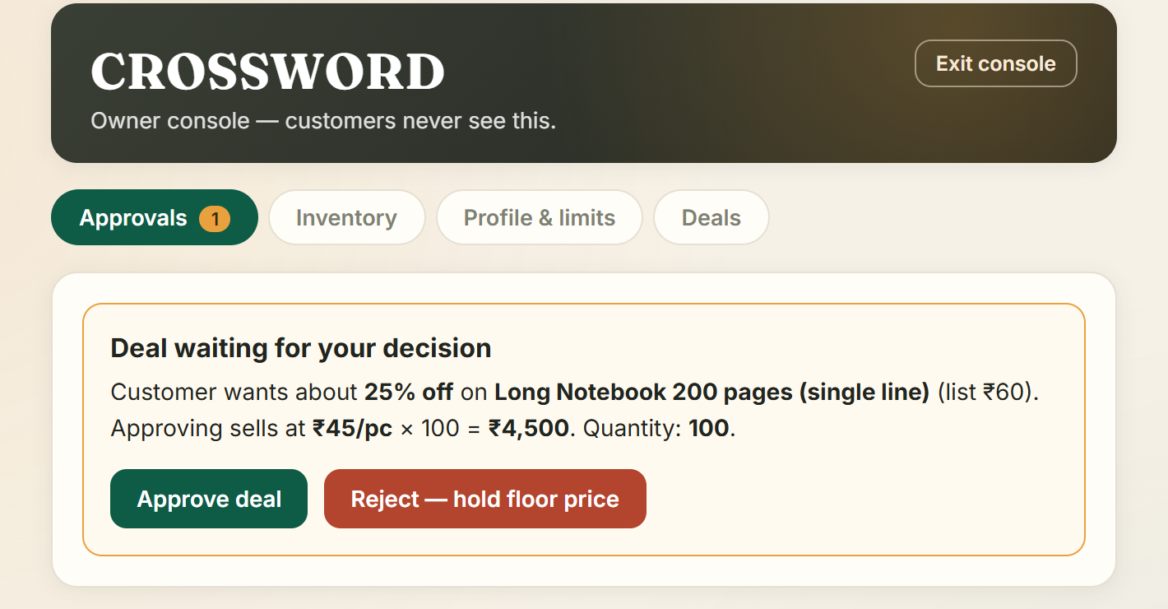

HUMAN IN THE LOOP
The owner stays in charge
PIN-gated console
Customers only ever see the chat. The business console — limits, inventory, approvals — sits behind the owner's PIN.
Escalation, not improvisation
Below-floor prices, orders under 5 units, or totals over the big-order limit pause the chat and go to the owner.
One tap decides the deal
Approve and the agent closes it in the customer's language; reject and it politely holds the floor price. The exact economics are shown before you tap.

Slide 7



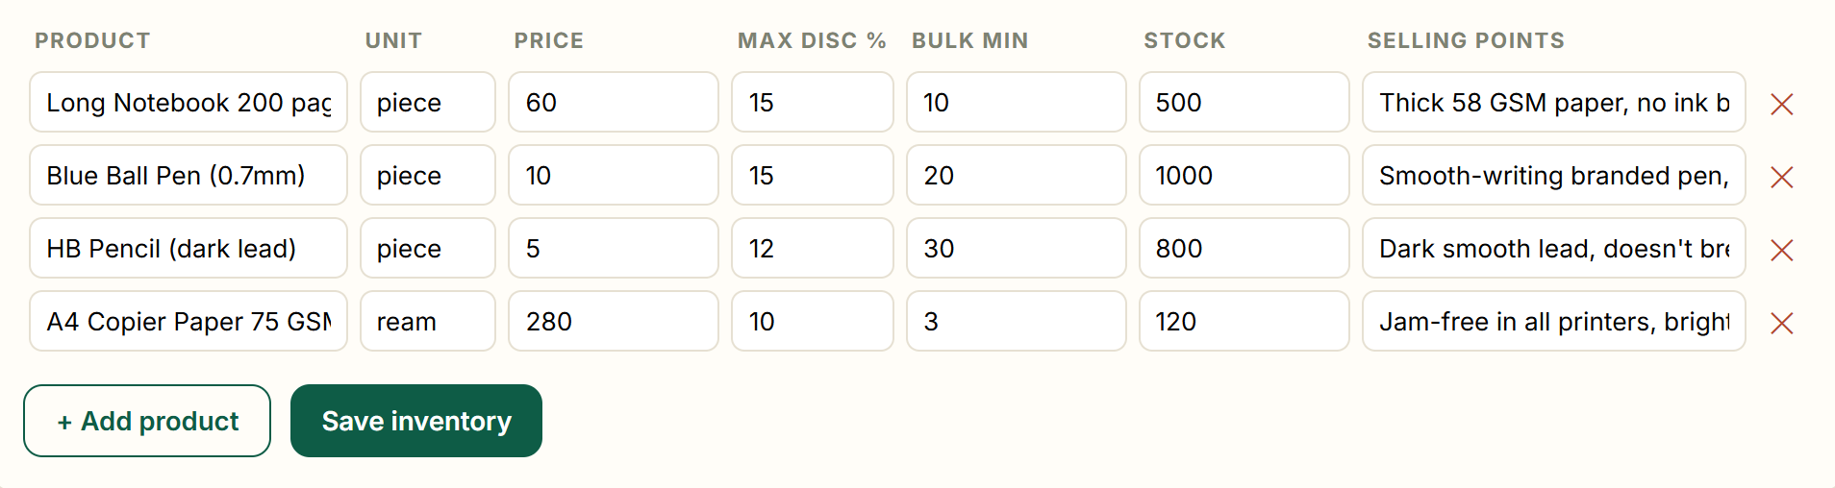
OWNER SETUP
Set it up once — the agent sells exactly this
The agent's whole world
Steps from your cap
Profile feeds the letterhead
Products, prices, stock, selling points — it can't invent items or promises beyond this table.
Set a max discount; concession steps are computed from it — 15% cap → 6% / 10.5% / 15% floor.
Name, address, WhatsApp brand the storefront, the agent's intro and every printed bill.

Slide 8
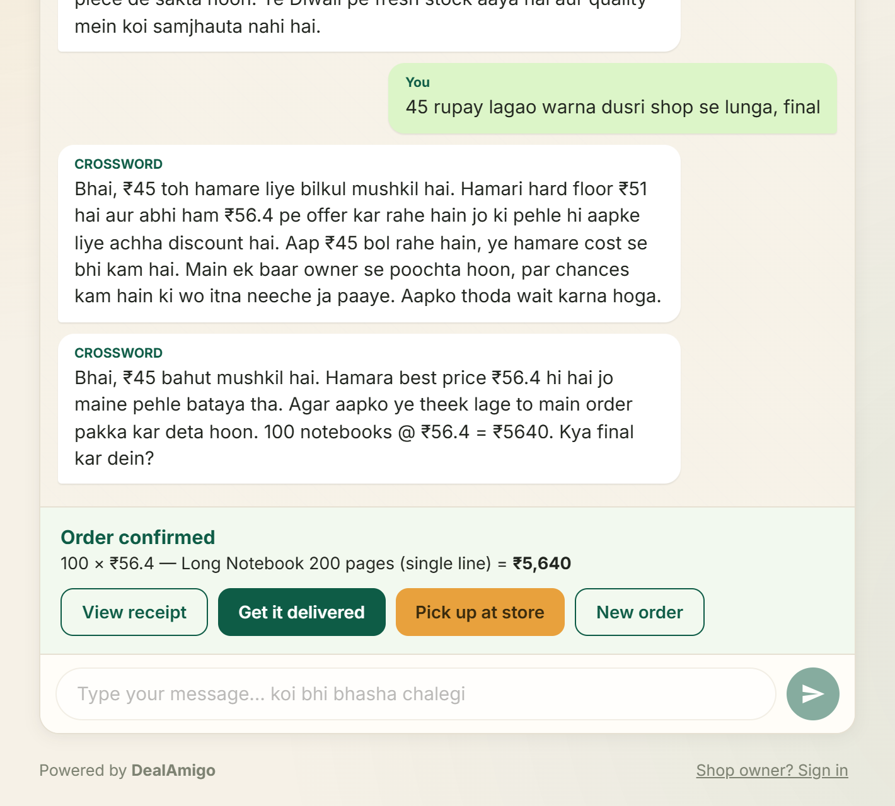
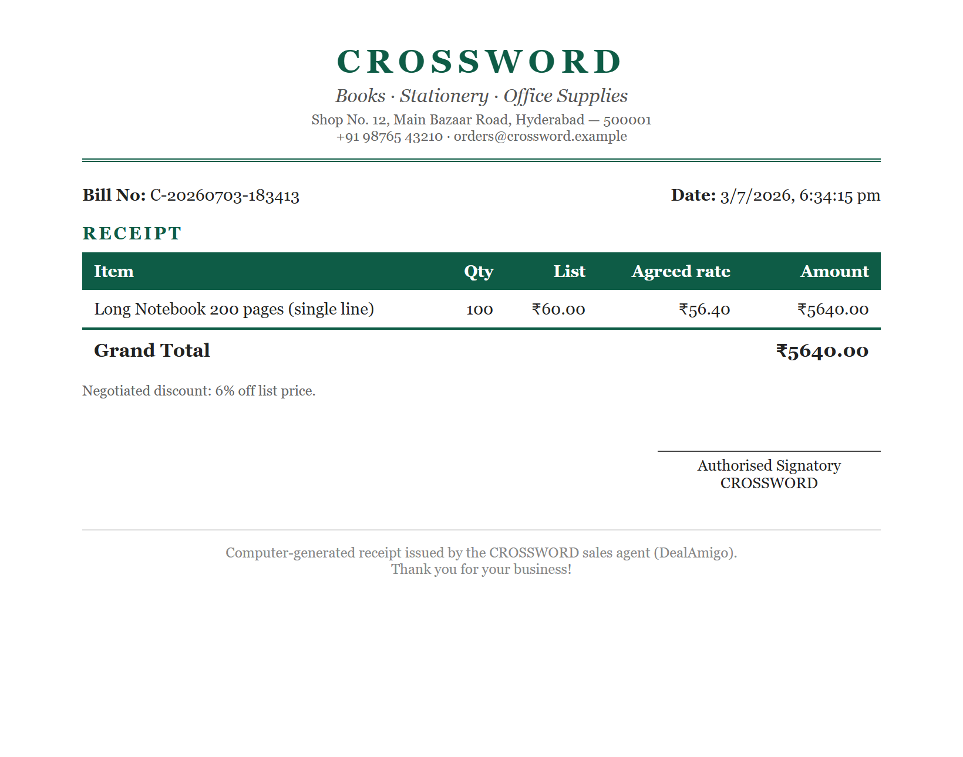
DEAL CLOSED
From handshake to receipt in one tap
Order confirmed — delivery or store pickup, straight into WhatsApp
Letterheaded receipt — list vs agreed rate, exactly as confirmed in chat

Slide 9


WHY JUDGES CAN'T BREAK IT
Guardrails enforced in code, not vibes
Hard price floor
Quantity & stock gates
The model is told one allowed next price per turn; its actions are re-validated server-side.
Under 5 units → owner approval. Below bulk minimum → list price only. Never promises stock it doesn't have.
Arithmetic double-check
Exact billing
Code catches the LLM mis-comparing numbers (“9.2 is below 8.5”) and corrects needless escalations.
The rate printed on the bill is the code-validated rate the customer confirmed — never the model's memory.
Stack: static frontend + one zero-dependency Node serverless function on Vercel · Gemini 2.5 Flash-Lite via OpenRouter (model-swappable) · Streamlit prototype in the same repo

Slide 10



Give every small shop a tireless salesman.
Real WhatsApp channel
Shared cloud store
Voice + payments
Twilio integration — the handoff links already point there.
Owner approves from any device; multi-deal queue.
Voice-note haggling in, UPI payment links out.
Try it now dealamigo-seven.vercel.app · owner PIN for judges: 1234
github.com/sanjayrahulcodes/dealamigo

