Slide 1
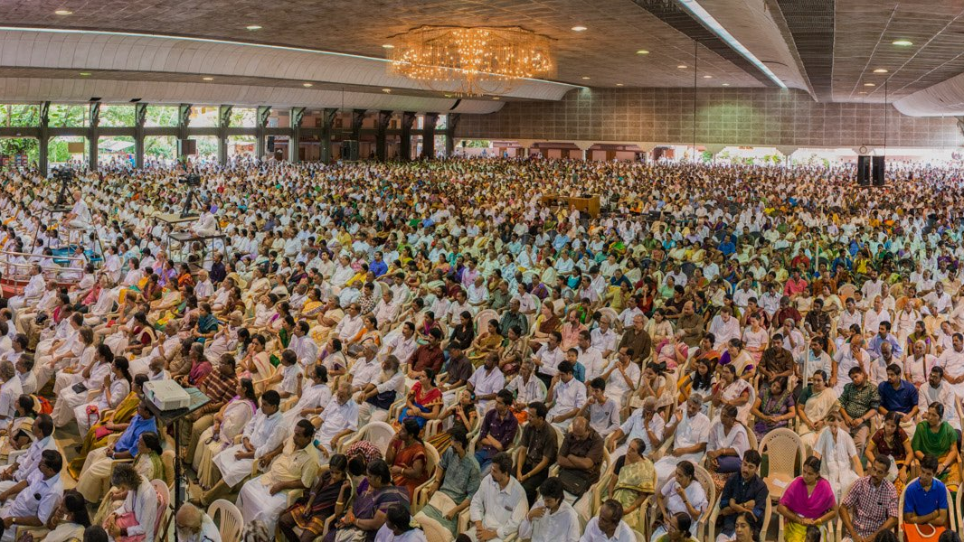
Festivity Management System
Thejas Menon , Sanjay Rajesh, Anil SP Nair, Akshai S

Slide 2
2 parts to FMS
FMS for guests
FMS for staff and students

Slide 3
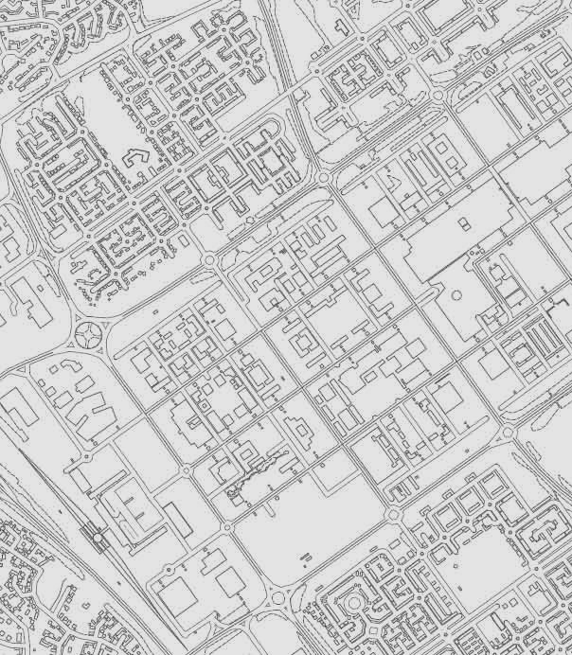
FMS for guests
A web application used for navigation and getting information
A 2D map of Amritapuri with current GPS location, as well as the ability to view events and venues by clicking on the appropriate place in the map
Uses a database to display time, schedule, location, etc. information to guests.

Slide 4

FMS for staff and students
Login as staff or students
Contains a database detailing when and where each staff and student should be
News bulletin and important notifications
Contact information of festivity administrators

Slide 5
Thanks

