Slide 1
Can Today’s and Tomorrow’s World Uniformly Gain from Carbon Taxation? Kotlikoff, Kubler, Polbin, & Scheidegger
Discussion at “Climate and the Business Cycle” Workshop
Sanjay R. Singh, FRBSF

Slide 2
Questions
Q: Can we design a system of intergenerational transfers along with carbon taxation to uniformly increase welfare of all generations?
Build on “MAKING CARBON TAXATION A GENERATIONAL WIN WIN” (2021)
X 18 regions in an open economy

Slide 3
Climate Macro General Equilibrium Model
OLG model (begin at age 20 and max age of 100)
Feed in UN population projections (fertility, mortality, migration)
Fair annuity market hedges mortality risk
Final consumption good with capital, labor, and energy
Energy: clean (produced with land, K, L) or dirty (produced with fossils)
Baseline: perfect substitutes (allow for gradual increase in substitutability)
Dirty energy: coal, oil, natural gas (Golosov Hassler Krusell Smith, 2014)
Increasing resource extraction costs on finite world resources
Carbon taxes per unit of dirty energy
Perfectly competitive energy producers

Slide 4
Macro Structure
Single consumption good in the world (no home bias/trade costs)
Perfect capital mobility – unique world real interest rate
Labor market region specific.
Countries differ in their energy share, and TFP
Labor immobile
Energy intensity region-specific
Clean energy non-tradeable. But oil, gas, coal freely tradeable.
homogenous ownership of all assets (fossils, land, capital, debt)

Slide 5
Climate meets Macro block
Dirty energy Emissions Temperature Damage
(Nordhaus + advances in climate science Follini, Kubler, Malova & Scheidegger 2021)
Production of fossils feed into carbon (Atmospheric & Oceanic)
Carbon concentration radiative forcing temperature
Translate the global temperature into GDP weighted local temperature
Local temperature affects local TFP (good for cold countries)

Slide 6
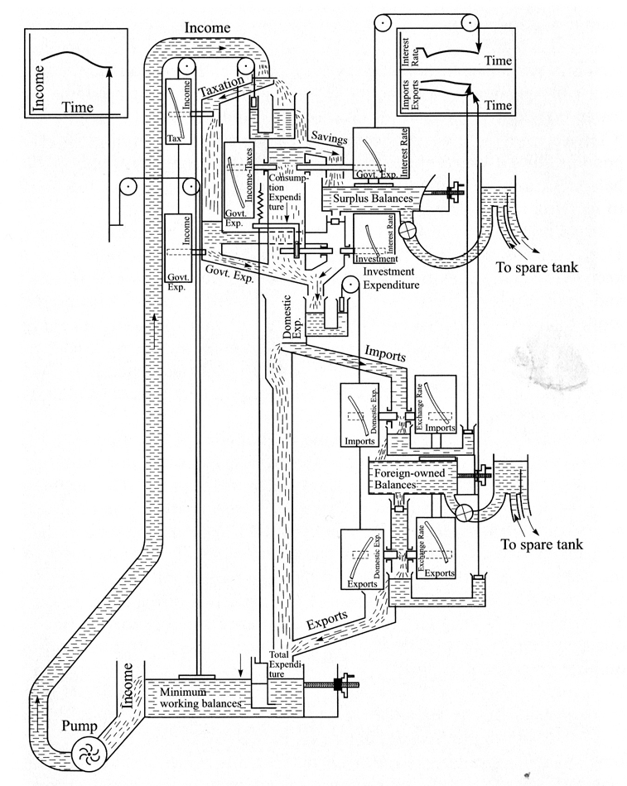
Schematic for Bill Phillips’ MONIAC: Monetary National Income Analogue Computer
Source NY Times 2009

Slide 7
Carbon Policy Instruments
Sequence of carbon taxes
Initial carbon tax
Growth rate of carbon taxes
Transfers to current generations at date 0
Transfers to unborn generations in their first year
Debt issued by IMF to finance carbon policy

Slide 8
Uniform Welfare Improvement (UWI)
OLG framework to think about carbon taxation
Intergenerational externality from carbon emissions
Single infinitely lived agents: how do you choose a discount factor? Ethics? Intergenerational altruism?
Their solution: UWI. With caveat that we get to leave debt burden on unborn generations.
Optimal Carbon Policy
An initial carbon tax, a carbon tax growth rate, and generation-specific net transfers
To uniformly maximize the welfare-gain of all generations (UWI)
the largest uniform (across all current and future generations) welfare increasing (UWI) carbon tax
Welfare changes = compensating consumption differentials relative to business-as-usual (BAU) scenario

Slide 9
How it is being computed?
1. Find optimal carbon tax path based on social cost of carbon in business as usual
2. For this tax path, compute the solution to UWI redistribution policy
Calculate new equilibrium social cost of carbon. Update the carbon tax.
Iterate until convergence

Slide 10
What is being computed
Time paths of
aggregate capital stock,
oil, coal, gas reserves
global emissions,
TFP, and,
carbon tax
over a millennium to determine yearly
Prices: coal, oil, gas, land, labor, capital,..
Quantities: consumption, temperature, damages…

Slide 11
(some of the) Quantitative Results
Business as Usual
Avg temperature increase is 3.7℃ by 2200
“Good” for Canada and Russia, “Bad” for India, Africa, the Middle East
Optimal UWI policy
Dirty energy usage ends in 2103, limits rise in temperature to 2.1℃
Good news: carbon taxation works! Consumption increase of 4.3% for all under business as usual to be indifferent to UWI scenario.
Bad news: we may be too late! Optimal policy limits absolute economic damages by 44% relative to business as usual.

Slide 12
What do the UWI transfers look like?
The Redistribution Authority (IMF) makes transfers
Positive (near-term) to Russia, Eastern Europe and Former Soviet
to offset their rising costs as they use fossils heavily in production
About 15% of lifetime consumption
Negative (after 2200) to India
Most exposed to climate change under business-as-usual
About 40 percent of lifetime consumption

Slide 13
Time-consistent policy
UWI is not time-consistent. Future generations once climate change is resolved may decline to honor the taxation burden
Alternate policy: UWIF.
Restrict current generation utility to business as usual
Impose a flat 10% tax on future generations
Future generations are better off than UWI (not paying as high taxes)
India still faces highest carbon taxes in the future
They restrict future net tax cap to 10 percent in another UWIL policy
Like the exercises they do, but somewhat unconvinced that UWIL is politically feasible.

Slide 14
Coalitions: convergence and compliance
If China does not agree to the optimal carbon policy,
Can achieve only 60% of the Consensus gains
Gains from coordination with China are very large
I think it relies on an assumption of convergence in income between EU and China
Nordhaus (2015): Climate Clubs with import sanctions on non-participants? Can import sanctions on non-compliant countries work?
Trade wars to deal with climate compliance? Nordhaus (2021)

Slide 15
Climate Clubs: political feasibility
Coalition consensus is hard to build for many reasons
Winners and Losers are separate entities.
Consume different goods, different political appetite for sanctions
What if only the losers built a coalition?
Interaction of Demographics with climate coalition/clubs
Climate coalitions with heterogenous ownership of fossils

Slide 16
Somewhat surprising answers
Distribution of global GDP unaffected under UWI
Despite nonlinear climate damage functions
US and China have similar temperatures today. Damage proportional to temperature. So, climate change does not affect distribution of income materially
allow for spillovers in climate damages (input-output networks)?

Slide 17
I would like to understand a little better
The projection on real interest rate
Current calibration is 4% per year.
Under BAU, projected to fall to 2.9%. Under UWI, between 3.4% – 4.2%
Would be useful to see how carbon taxation interacts with aging
Interaction with growth assumptions (Benzel et al. 2023)
Could make a connection to misallocation of capital (Hsieh and Klenow) to interact with carbon policy?
Productivity damages should push down r*
How would MPK heterogeneity interact with carbon policy?

Slide 18
I liked this paper a lot
Structural approach
Obviously comes with a lot of assumptions but most of these are very transparent
Non-trivial computational artillery
There is a lot of admiration for the work in this paper
I learnt a great deal!
Recommend reading it!
Thank you!

Slide 19
Carbon tax path under UWI
Initial tax: $ 22.4 to $ 87.5 per ton of CO2 (1x – 6x damage)
Growth in tax rate: 1.8 to 1.4 %
Temperature Rise is limited between 2.8 and 2.1 percent
Which of these scenarios would align with the Paris Accord commitments?

Slide 20
Model validation: Business as usual
Projections from business-as-usual scenario align with those estimated by other climate studies
Global GDP peak loss is close to 20 percent
Carbon emissions in 6X damage similar to some DICE projections

