Slide 1
Project: Energy Consumption Analysis
Analyzation of energy usage and greenhouse gas (GHG) emissions of Ontario's Broader Public Sector (BPS) organizations

Slide 2
Tableau
Tableau is a powerful data visualization and business intelligence software that enables users to create interactive and insightful visualizations from various datasets, facilitating data-driven decision-making.
It simplifies complex data analysis and presentation, making it accessible to users with varying levels of technical expertise.

Slide 3
Approaches
The approach involved a comprehensive analysis of energy usage and GHG emissions, evaluating conservation effectiveness through key criteria.
I have employed a combination of quantitative and qualitative methods to identify trends, allowing for a holistic understanding of the BPS organizations' environmental impact through the Interactive Visualizations which have been created.

Slide 4
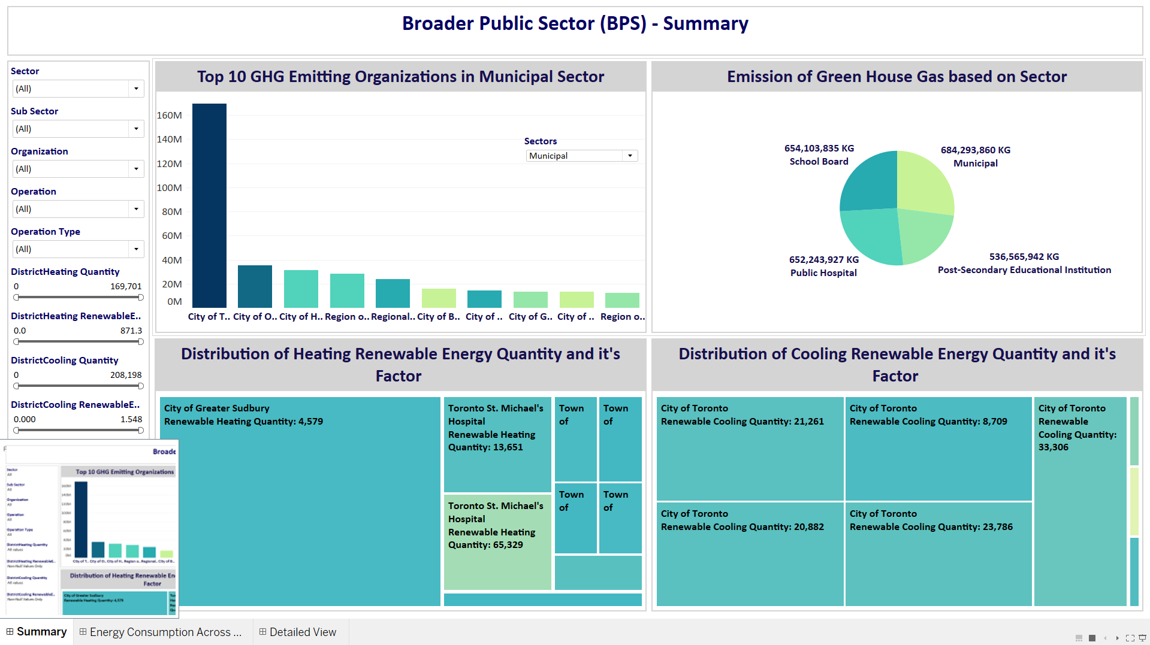
Exploratory Data Analysis The below mentioned dashboard tells about the how Green house gas affecting across all the sectors and also the distribution of Renewable resources which has been deployed in organizations and it’s quantity and factor value.

Slide 5
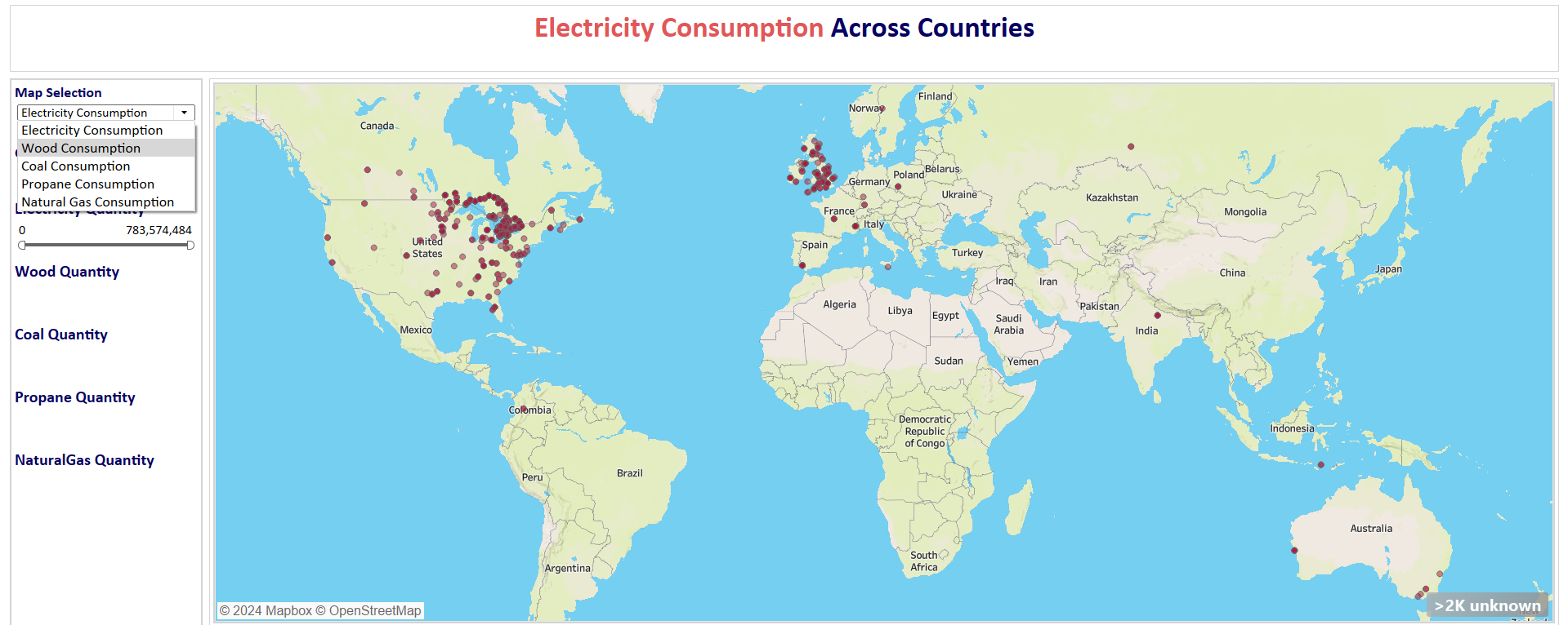
Exploratory Data Analysis The below mentioned dashboard tells about the consumption of different kind of materials used across the organizations along by showing the Operation, Operation type and in which city.

Slide 6
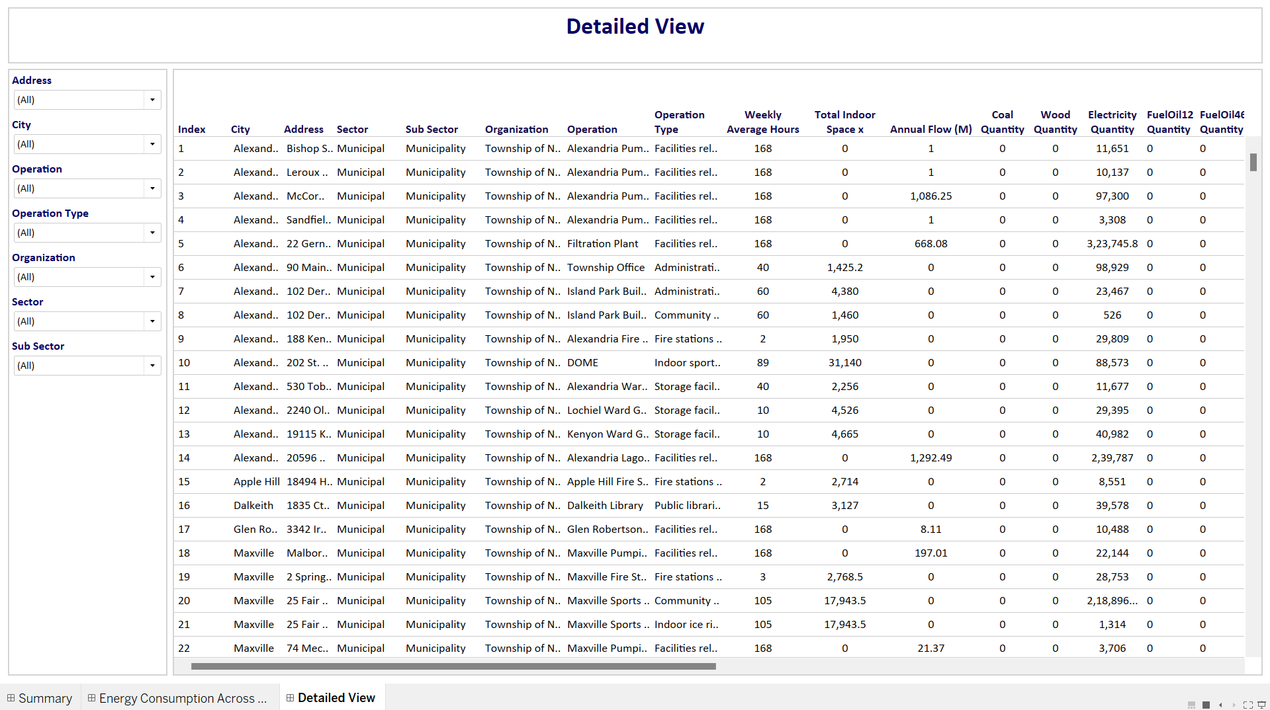
Exploratory Data Analysis The below mentioned dashboard tells about the Detailed View that contains all the necessary information about the Project along with the interactive filters.

Slide 7
Conclusion
Through the Analysis, It identified successful conservation measures in certain BPS organizations while pinpointing areas for improvement. The data-driven suggestions include implementing targeted energy efficiency initiatives, investing in renewable energy sources, and fostering sustainable practices to achieve ambitious climate change mitigation goals within the Broader Public Sector."

