Slide 1
Project: IMDB Movie Analysis
The impact of this problem is significant for movie producers, directors, and investors who want to understand what makes a movie successful to make informed decisions in their future projects.

Slide 2
Tableau
Tableau is a powerful data visualization and business intelligence software that enables users to create interactive and insightful visualizations from various datasets, facilitating data-driven decision-making.
It simplifies complex data analysis and presentation, making it accessible to users with varying levels of technical expertise.

Slide 3
Approaches
Utilizing Tableau, I conducted comprehensive analysis of IMDb data, uncovering trends in movie ratings, genres, and audience preferences through interactive visualizations, providing valuable insights for the film Industry..
Employing Tableau, I scrutinized IMDb datasets to discern patterns in movie demographics, enabling stakeholders to make data-driven decisions for marketing strategies and content creation in the film industry.

Slide 4
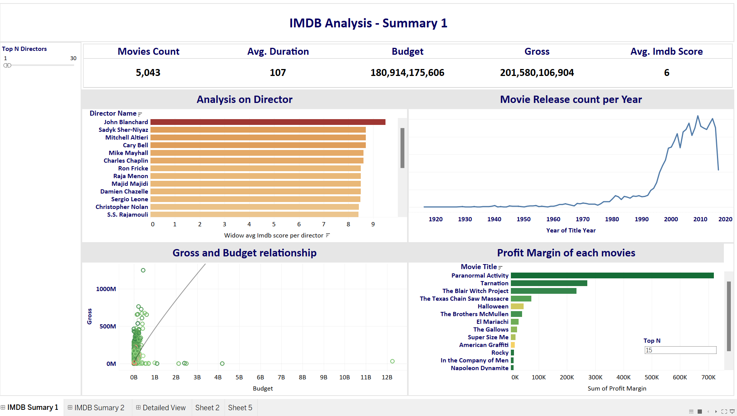
Exploratory Data Analysis The below mentioned dashboard tells about the overall summary of Director Analysis and Profit Margins and Gross and Relationships of the movies and how those analysis impacting on IMDB Rating.

Slide 5
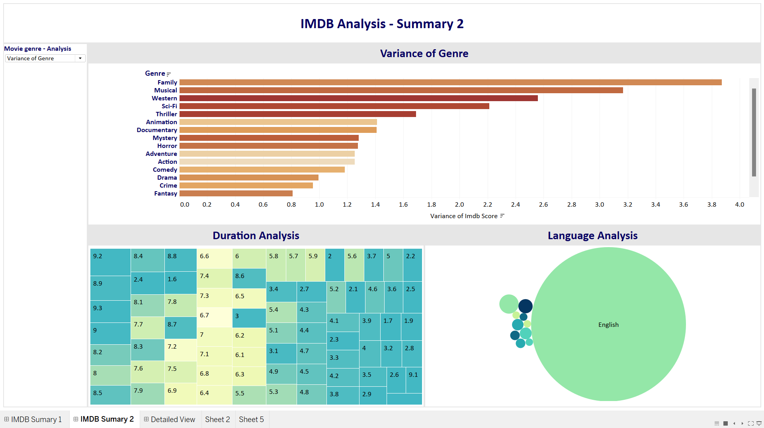
Exploratory Data Analysis The below mentioned dashboard tells about the overall analysis on Duration and Language affects IMDB and also showcases the Mean ,Variance and Standard Deviation of Genre and how it’s affecting the IMDB Rating.

Slide 6
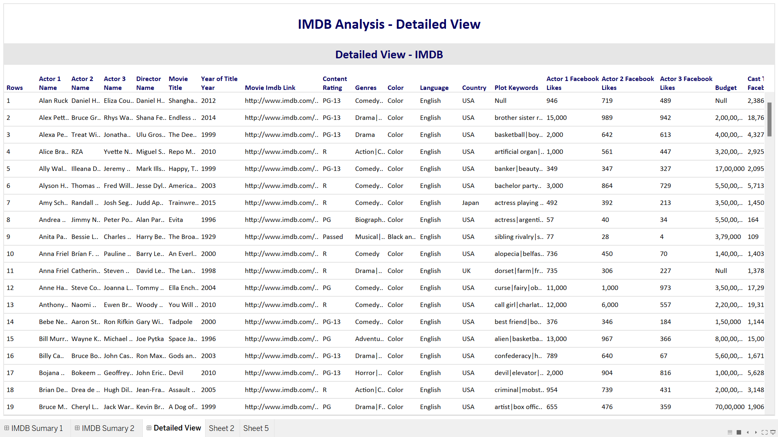
Exploratory Data Analysis The below mentioned dashboard tells about the Detailed View that contains all the necessary information about the Project.

Slide 7
Conclusion
Overall, our analysis underscores the multifaceted nature of the film industry and the wealth of insights that can be gleaned from IMDB data. Through this Analysis we can find that most of the IMDB rating falls under History and Film-Noir and also most of the movies are captured from English Language which has 6.3 avg IMDB score of overall other language movies.

