Slide 1
Docker

Slide 2
Containerization
Containers provide the following advantages
Flexible: Even the most complex applications can be containerized.
Lightweight: Containers leverage and share the host kernel.
Interchangeable: You can deploy updates and upgrades on-the-fly.
Portable: You can build locally, deploy to the cloud, and run anywhere.
Scalable: You can increase and automatically distribute container replicas.
Stackable: You can stack services vertically and on-the-fly

Slide 3
Docker
Platform for building applications using containers providing a lightweight solution for virtualizing applications.
Docker containers are lightweight runtime environments that consist of an application and its dependencies
Containers are lightweight because they don’t need the extra load of a hypervisor, but run directly within the host machine’s kernel allowing them to avoid the 1-5% of CPU overhead and 5-10% of memory overhead associated with traditional virtualization technologies.
They can also be created from a read-only template called a Docker image

Slide 4
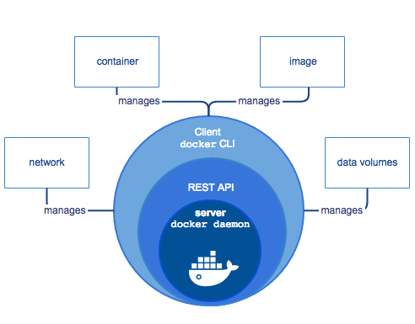
Docker Engine
Docker Engine is a client-server application with these major components:
A server which is a type of long-running program called a daemon process (the dockerd command).
A REST API which specifies interfaces that programs can use to talk to the daemon and instruct it what to do.
A command line interface (CLI) client (the docker command).
The CLI uses the Docker REST API to control or interact with the Docker daemon through scripting or direct CLI commands.
The daemon creates and manages Docker objects, such as images, containers, networks, and volumes.

Slide 5
Docker objects
IMAGES
An image is a read-only template with instructions for creating a Docker container.
To build an image one creates a Dockerfile with a simple syntax for defining the steps needed to create the image and run it.
Each instruction in a Dockerfile creates a layer in the image
CONTAINERS
A container is a runnable instance of an image
By default, a container is relatively well isolated from other containers and its host machine.

Slide 6
Docker Images
Docker images can be created from an environment definition called a Dockerfile
A Docker image can be pushed to a registry like Docker Hub and a container can be created from that image
Containers too can be committed to images which are then committed to Docker Hub.

Slide 7
Containers
Containers are a way of packaging software
All the application’s code, libraries, and dependencies are packed together in the container
It is like running a virtual machine, without the overhead of an entire operating system
Application gets deployed into production environment (local data center or a cloud provider or a mix) as a container or an orchestrated service
https://blog.containership.io/k8svsdocker

Slide 8
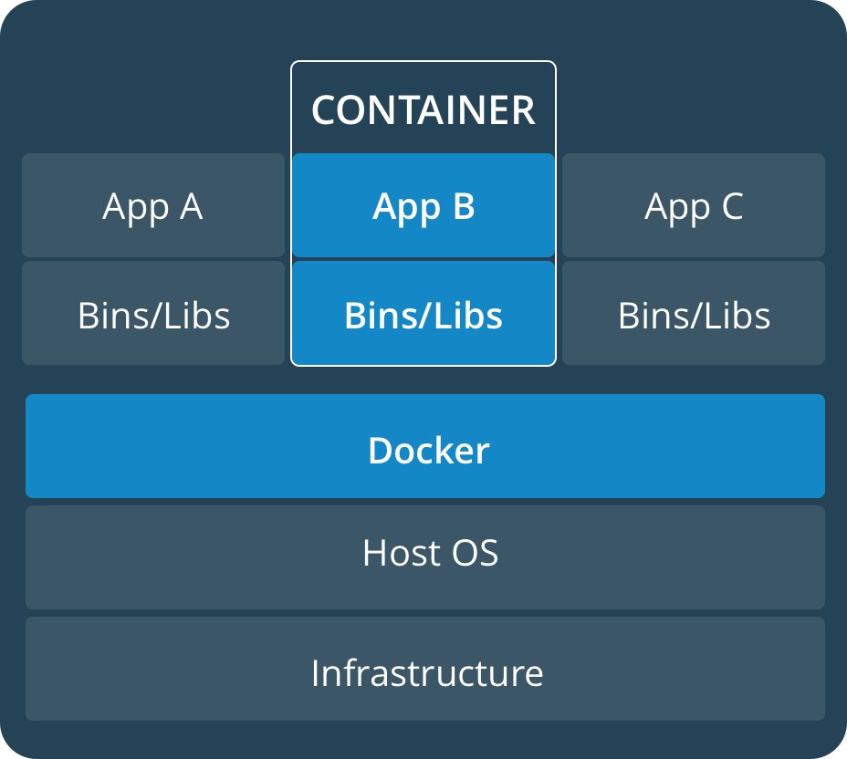
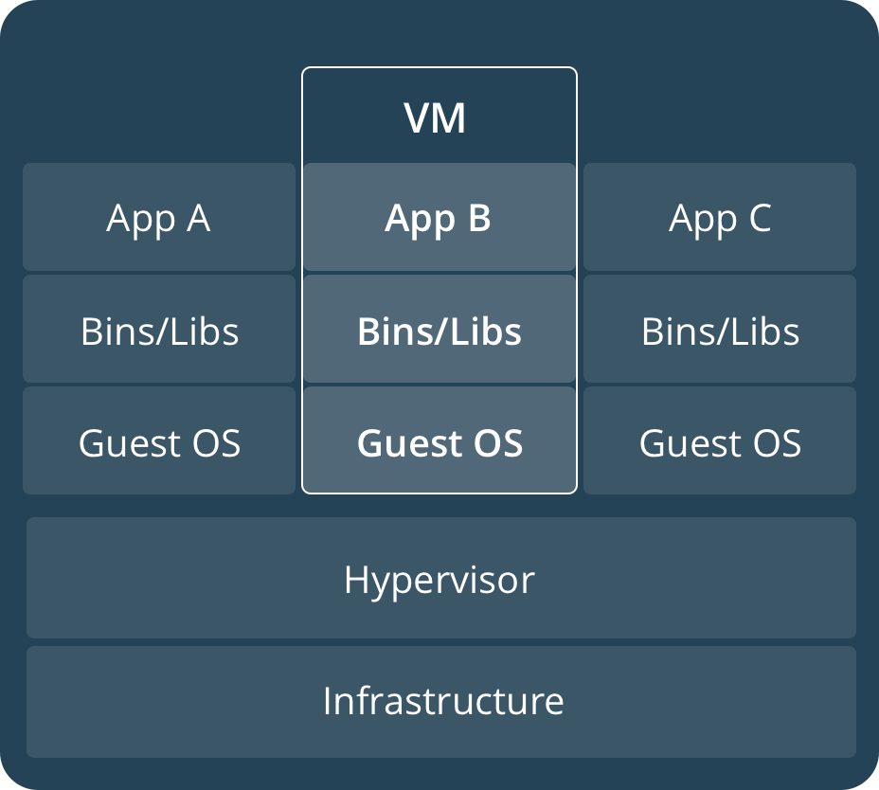
Container vs VM
A container runs natively on Linux and shares the kernel of the host machine with other containers. It runs a discrete process, taking no more memory than any other executable, making it lightweight.
By contrast, a virtual machine (VM) runs a full-blown “guest” operating system with virtual access to host resources through a hypervisor. In general, VMs provide an environment with more resources than most applications need

Slide 9
Let us run some commands
The following command runs an ubuntu container, attaches interactively to your local command-line session, and runs /bin/bash.
$ docker run -i -t ubuntu /bin/bash
When you run this command, the following happens (assuming you are using the default registry configuration):
If you do not have the ubuntu image locally, Docker pulls it from your configured registry, as though you had run docker pull ubuntumanually.
Docker creates a new container, as though you had run a docker container create command manually.
Docker allocates a read-write filesystem to the container, as its final layer.
Docker creates a network interface to connect the container to the default network, since you did not specify any networking options
Docker starts the container and executes /bin/bash. Because the container is running interactively and attached to your terminal (due to the -i and -t flags), you can provide input using your keyboard while the output is logged to your terminal.
When you type exit to terminate the /bin/bash command, the container stops but is not removed. You can start it again or remove it.

Slide 10
Run Some Commands
docker --version Docker version 17.12.0-ce, build c97c6d6
docker info Containers: 0 Running: 0 Paused: 0 Stopped: 0 Images: 0 ...
docker image ls
docker container ls --all

Slide 11
Task
In next few slides we will create a docker image starting from a base image containing python, get the required packages and run a python program and check its output using a browser from the host machine
We will then upload the image to a registry
Finally we will try to scale the app by running multiple containers

Slide 12
Developing an Environment
Create an empty directory and cd into the new directory
Create a file called Dockerfile
Copy-and-paste the following content into that file, and save it
# Use an official Python runtime as a parent image FROM python:2.7-slim # Set the working directory to /app WORKDIR /app # Copy the current directory contents into the container at /app ADD . /app # Install any needed packages specified in requirements.txt RUN pip install --trusted-host pypi.python.org -r requirements.txt
# Make port 80 available to the world outside this container EXPOSE 80 # Define environment variable ENV NAME World # Run app.py when the container launches CMD ["python", "app.py"]

Slide 13
Create requirements.txt containing the two lines mentioned below-
Flask
Redis
Create app.py with the code written below (Or copy it from appropriate directory shared with you)
from flask import Flask from redis import Redis, RedisError import os import socket # Connect to Redis redis = Redis(host="redis", db=0, socket_connect_timeout=2, socket_timeout=2) app = Flask(__name__) @app.route("/") def hello(): try: visits = redis.incr("counter") except RedisError: visits = "<i>cannot connect to Redis, counter disabled</i>" html = "<h3>Hello {name}!</h3>" \ "<b>Hostname:</b> {hostname}<br/>" \ "<b>Visits:</b> {visits}" return html.format(name=os.getenv("NAME", "world"), hostname=socket.gethostname(), visits=visits) if __name__ == "__main__": app.run(host='0.0.0.0', port=80)

Slide 14
Build The Image
Run the following commands
docker build -t friendlyhello .
docker image ls
docker run -p 4000:80 friendlyhello
See the output in a browser at http://localhost:4000
Notes:
RUN pip install -r requirements.txt

Slide 15
Sharing The Image
Create an id at hub.docker.com
Run the following commands
docker login
docker tag friendlyhello <your id>/tutorial:firstversion
docker image ls <You should be able to see your tagged image there>
docker push <Your id>/Tutorial:firstversion
Please note Tag command syntax is <docker tag image username/repository:tag>

Slide 16
Stopping the Container
CTRL+C to quit
On Windows to explicitly stop the container run the commands
docker container ls
docker container stop <Container NAME or ID>
See example below
docker container ls CONTAINER ID IMAGE COMMAND CREATED 1fa4ab2cf395 friendlyhello "python app.py" 28 seconds ago
Notice that CONTAINER ID matches what’s on http://localhost:4000
docker container stop 1fa4ab2cf395

Slide 17
Running Multiple Load balanced containers

Slide 18
Running the Service
We want to run containers and their multiple instances to provide the required horsepower to the service.
Read the docker-compose.yml which does the following
Pull the image that we uploaded to registry
Run 5 instances of that image as a service called web, limiting each one to use, at most, 10% of the CPU and 50MB of RAM
Immediately restart containers if one fails
Map port 4000 on the host to web’s port 80
Instruct web’s containers to share port 80 via a load-balanced network called webnet
Define the webnet network with the default settings (which is a load-balanced overlay network)

Slide 19
Starting/Stopping The Service
Run the following commands
docker swarm init
docker stack deploy -c docker-compose.yml getstartedlab
docker service ls (Look for output for the web service, prepended with your app name)
docker service ps getstartedlab_web
docker container ls -q
http://localhost:4000 (every time you refresh you should see a different ID showing load balancing)
Shutdown the app and the swarm
docker stack rm getstartedlab
docker swarm leave --force

Slide 20
Docker Cheat Sheet
docker create [image]: Create a new container from a particular image.
docker login: Log into the Docker Hub repository.
docker pull [image]: Pull an image from the Docker Hub repository.
docker push [username/image]: Push an image to the Docker Hub repository
Running Docker Containers
docker start [container]: Start a particular container.
docker stop [container]: Stop a particular container.
docker run -ti — rm — image [image] [container] [command]: Create and start a container at the same time, run a command inside it, and then remove the container after executing the command.
docker pause [container]: Pause all processes running within a particular container.
Using Docker Utilities
docker images: List all of the images that are currently stored on the system.
docker ps: List all of the containers that are currently running.
docker version: Display the version of Docker that is currently installed on the system.
Cleaning Up Your Docker Environment
docker kill [container]: Kill a particular container.
docker kill $(docker ps -q): Kill all containers that are currently running.
docker rm [container]: Delete a particular container that is not currently running.
docker rm $(docker ps -a -q): Delete all containers that are not currently running

